Slide 1
SECOND WIPO INTER-REGIONAL MEETING ON SOUTH-SOUTH COOPERATION ON PATENTS, TRADEMARKS, GEOGRAPHICAL INDICATIONS, INDUSTRIAL DESIGNS AND ENFORCEMENT Cairo, Egypt May 6 to 8, 2013
Geographical Indications (GIs) in the implementation of Public Policies: Best Practices and the Socio-Economic Dimensions of GIs
Emmanuel Sackey
Chief Examiner. ARIPO

Slide 2
Defining GIs for Public Policy Development
Geographical Indications
TRIPs Agreement Article 22.1 defines GI as “indications which identify a good as originating in the territory of a member, or a region or locality in that territory, where a given quality, reputation or other characteristics of the good is essentially attributable to its origin
Most GIs provide protection for agricultural products such as food and beverages, fish products and handicrafts. But for a continent that is so rich in TK/TCEs as well as abundant biodiversity, the benefits to be derived are immense
Indication
Refers to a Country or to a place situated therein as being the country or place of origin of a product, A geographical origin with no special characteristics implied
Appellation of Origin
Used on products that have specific quality that is exclusively or esstentially due to the geographical environment in whi h the products are produced

Slide 3
SUBJECT MATTER OF PROTECTION
TRIPS vrs TRIPS PLUS Protected Subject Matter of GI
Goods and services
Natural products
Agricultural products
Industrial products
Handcraft
FEATURES OF GIs
- Collective/Community Rights
- Exclusive
- No right to assign
- Right in Perpetuity
- Functions like trademarks
- Knowledge in Public domain?

Slide 4
International Legal Instruments on GIs
Paris Convention – False Indications
Madrid Agreement/Protocol – False and Deceptive Indications
Lisbon Agreement – Appellation of Origin
TRIPS – GI products and enforcement of its application
Legal Tools for protecting Gis
Unfair competition/Passing off
Appellation of origin
Registration of Geographical indications
Collective and certification of marks
Administrative schemes

Slide 5
EXAMPLES OF PROTECTED GI
Bulgaria Bulgaria Yoghurt
Canada Canadian Rye Whisky
Czech Republic Pilsen and Budiweis (Beer)
European Communities Champagne
Hungary Eger (Wine) Szatrader
Liechtenstein Blazer
Slovak Republic Korytnick mineralna voda mineral water
USA Pride of New York (Agricultural Products)

Slide 6
Examples of GIs in Africa
Guinea Pineapple - Guinea
Argon oil – Morocco
Elephant Kijia and spices – Tanzania and Zanzibar
Kente/Cocoa/Miracle sweet berries – Ghana
Mazoe Oranges/Shona stone sculpture –Zimbabwe
Marula oil from Namibia

Slide 7
VARIETIES
Generally the Sheanut tree is small, with short trunk
Its leaves are very dark and green when in season

Slide 8
The Case study of Shea butter production in Ghana
The Sheanut is a fruit obtained from the sheatree, which grows wild in semi-arid areas of Ghana. About 50-60 trees grow/hectare. The climatic conditions are ideal for cultivation of the plant
Several varieties exist and are characterize by variations in its size, shape and fruit yield as it grows in the wild. The main fruit season is from May to August.Its fruit sizes are between 12g and 17; 18g and 30g; and 20g and 28g.
Currently there are no scientifically developed varieties, the plant continues to be wildly propagated by seed and It takes about 10 years to grow and bear fruit. The Cocoa Research Institute of Ghana (CRIG) has undertaken studies which show that vegetative propagation is possible

Slide 9
PREPARATION AND PROCESSING:
The fruits are not harvested by plucking
They are allowed to drop then picked and collected mainly by women
The fruits must be picked or collected regularly
At least two times in a week
This is to prevent its germination or deterioration
It is also to ensure that the fruit is not attacked by insects
The immature, unripe and rotten/decayed nuts are not be collected.

Slide 10
SHEA BUTTER EXTRACTION METHOD
Washing and pulp removal
Nut boiling, drying and winnowing
Extraction of the butter involving crushing, milling and kneading
Crude butter

Slide 11
APPLICATION AND USAGE
The indigenous people see the sheatree as a gift from nature.
The tree serves also as source of timber.
The pulp around the seed is edible.
The shea-butter is used as cooking oil which is considered to be very healthy.
The shea-butter is very nourishing to the body, and the skin. It is very soft and smooth.
It also has medicinal uses.

Slide 12
ECONOMIC USE
The sheanut and the sheabutter are traded in, both locally, and internationally.
The nuts are purchased and transported to countries in Asia, Europe and in America.
It is used as shea-butter, shea-cake, etc
It is also used as substitute for cocoa butter in the confectionery and chocolate industries.
Another use is in the cosmetic industry

Slide 13
SOCIO-ECONOMIC BENEFITS OF GIs FOR AFRICA
The protection of GIs will give African countries a natural competitive advantage for agro-cultural products
MSMEs will be able to increase their market share
GIs will assist in the prevention of bio-piracy of TK/TCEs and enhance the status of traditional production methods
Because GIs do not require very high levels of innovation, their protection will benefit a lot of African farmers
Due to their collective nature, small scale producers are able to access funds for the branding and marketing of their products
The protection could potentially enhance tourism

Slide 14
ARIPO’s INITIATIVES ON THE PROTECTION OF GIs
The organization has in recent past participated in several international meetings within the framework of WIPO/WTO and EU-ACP programs
ARIPO has signed an MOU with EU to generate empirical evidence, based on country, sub-regional and product case studies regarding the benefits that ARIPO Member States can derive from enhanced multilateral GI protection
At the 13th Session of the Council of Ministers of ARIPO that took place in Accra, Ghana on December 1 and 2, 2011, the Council adopted proposals for ARIPO to;
- take initiatives on GIs and link its initiatives with that of WIPO, WTO and EU
- create awareness on the importance of GI protection for economic development
- develop a regional policy and legal framework for the benefit of the member states as well as assist the states to enact national legislations
ARIPO and WIPO have jointly developed projects to brand selected African products

Slide 15
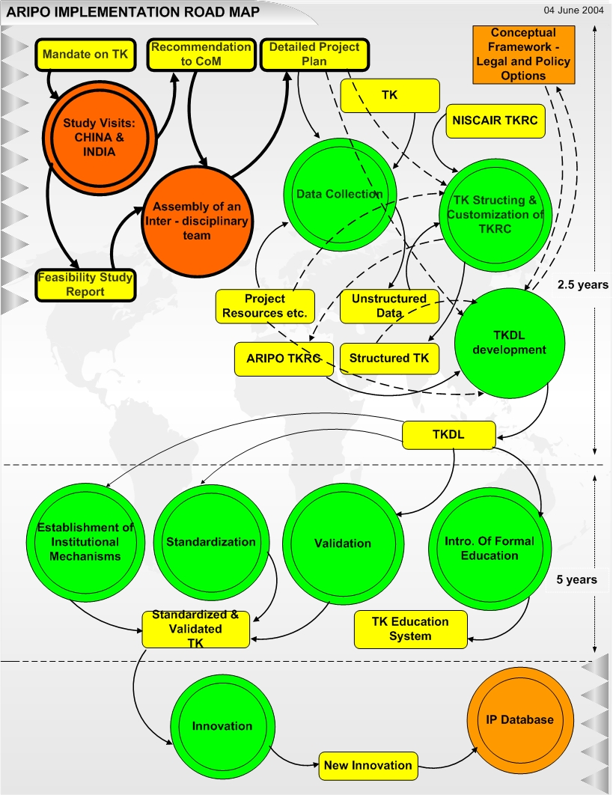

Slide 16
CHALLENGES
Quality standard requirements
Lack of multilateral/Pluri-lateral system and incoherence ( Art 23 and 24 of TRIPS)
Obstacles associated with bi-laterism
Lack of enabling domestic legislation
Another approach towards exportation of primary commodities?
How to innovate based on existing Gis?

Slide 17
Thank You For Listening!

