Slide 1
Geographical Indications (GIs) in the Implementation of Public Policies: Best Practices and the Socio-Economic Dimension of GIs
6 – 8 May 2013
Cairo, Egypt
Ms. Nisachol Sasanon
Head of Encouraging Utilization Group
Intellectual Property Management Office
Department of Intellectual Property
Thailand
Notes:
Good afternoon ladies and gentle men. First of all, I would like to thank WIPO for inviting Thailand to join this meeting. It is an honor and a pleasure to share with you our experience on the theme of “Geographical Indications in the Implementation of public policies: best practices and the socio-economic dimension of GIs

Slide 2
Market Tools
TRADEMARKS
INDIVIDUAL RIGHTS
USED BY ONE ENTERPRISE
RENEWAL
TRANSFERABLE
IDENTIFY PRODUCTS
OF ENTERPRISES
GEOGRAPHICAL INDICATIONS
COMMUNITY RIGHTS
USED BY THE PRODUCERS
IN THE PLACE OF ORIGIN
UNLIMITED DURATION
INCAPABLE OF BEING
TRANSFERRED
INDICATE QUALITY OF PRODUCTS
LINKED TO THE GEOGRAPHICAL
AREAS
Notes:
Before we start, I would like to compare the differences between trademarks and gi which are used as market tools.
Trademarks is individual rights used by one enterprise to identify its products. It must be renewal and it can be transferred.
On the other hand, GI is community rights used by the producers in the place of origin to indicate quality of products linked to the geographical areas. It has unlimited duration but it’s cannot be transferred.

Slide 3
Legal System; Sui Generis Law
Geographical Indications Protection Act 2003
To prevent the public from being confused or misled as to geographical origins of the goods.
Ministerial Regulation 2004
Ministerial Notification 2004
DIP Notification 2004
Notes:
When we talk about geographical indications in Thailand, we have to bear in mind that Thailand has implemented our GI law for 10 years. The GI protection act was promulgated in 2003. we also implement the obligations under Article 22 to 24 of the TRIPS Agreement.

Slide 4
Qualification for GI Registration Geographical Indication Act 2003
Name symbol or any other thing which is used for calling or representing a geographical origin
The goods originating from such geographical origin
Details of the particular quality, reputation or other characteristic of the goods is attribute to the geographical origin
Notes:
The meaning of GI in Thailand includes name, symbol, or any other things which is used for calling or representing a geographical origin and the goods originating from such geographical origins and details of the particular quality, reputation or other characteristics of the goods that is attributed to their geographical origin.

Slide 5
Geographical Indication
A product called by
its geographical origin with specific quality,
reputation ,and characteristic.
Geography
Know-how
Quality
Notes:
It means that geographical indications in Thailand combine three key elements of geography, know-how and quality. In other words, GIs represent products from specific geographical origin with specific quality, reputation and characteristics.

Slide 6
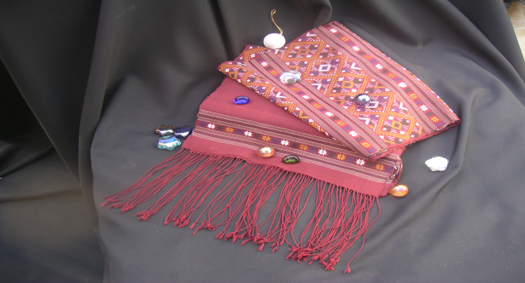
Thai GI Protection
Goods
Agricultural products
Industrial products
Handicrafts
Notes:
We provide protection for goods, and not yet for services. We protect agricultural products, industrial products and handicrafts.

Slide 7
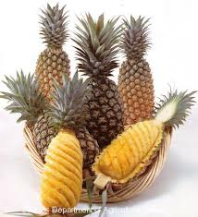
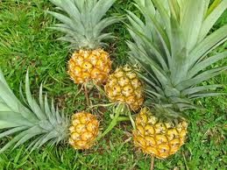
Goods for GI Registration
Eligible Goods
Ineligible Goods
Agricultural products
Industrial products
Handicrafts
generic name
contrary to public order, morality or public policy
Phulae
Chiang Rai
Nanglae
Phuket
Phurua Plateau
Loei
Celadon
Chiang Mai
Notes:
Example of Agricultural products is Chiang Rai Phulae Pineapple.
A small pineapple with aromatic smell, sweet and crispy taste, produce in Nanglae district of Chiang Rai province. It is a Phuket variety pineapple plant in Nanglae district. To change the planting area of pineapple from South to North, makes pineapple smaller in size and has a distinctive taste.
Example of Industrial products is Phurua Plateau Wine.
Wine obtain from fermentation of grape planted in Phurua Plateau, Loei Province.
Handicrafts, for example: Chiang Mai Celadon (Pottery)
Pottery with glazed, greenish color and unique crack pattern all over from Chiang Mai Province.
Generic name and the name that contrary to public order, morality or public policy cannot be registered as GI in Thailand.

Slide 8
Who Can Apply?
Government Agency whose area of responsibility embraces the geographical origin of the goods;
Producers or traders domiciled in the geographical origin of the goods;
Consumers (groups or organization) using GI
Notes:
Who can apply for GI in Thailand?
First: Government Agency whose area of responsibility embraces the geographical origin of the goods;
Second: Producers or traders domiciled in the geographical origin of the goods;
Third: Consumers (groups or organization) using GI

Slide 9
Foreign GI Registration
Must be explicit evidence that such geographical indication is protected under the law of such country
Has been used continuously until the date of filing an application for registration in Thailand
Notes:
In the case of foreign GI registration,
There must be explicit evidence that such geographical indication is protected under the law of such country and
The GI has been used continuously until the date of filing an application for registration in Thailand

Slide 10
1
2
3
4
5
Notes:
Next, I would like to touch on the necessary steps taken in Thailand prior to registration procedures.
First, we conduct a factual study on history, linkages and special characteristics and engage producers of potential GI products.
Second, we draft the specifications, including the production standards, specification, geographical boundaries and verification.
After that the application will be sent to my office (Department of Intellectual Property: DIP) for registration.
Then we have GI control mechanisms which is a very important aspect of GI. They include self-control, internal control and external control.
Another important aspect is marketing and promotion.
These are issues that we discuss with our local GI producers. If the application meets all the requirements, we will give them a certificate. After they have registered, they are allowed to use the GI logo. The logo certifies that the products comply with the working manual, internal control plan and other established criteria.

Slide 11
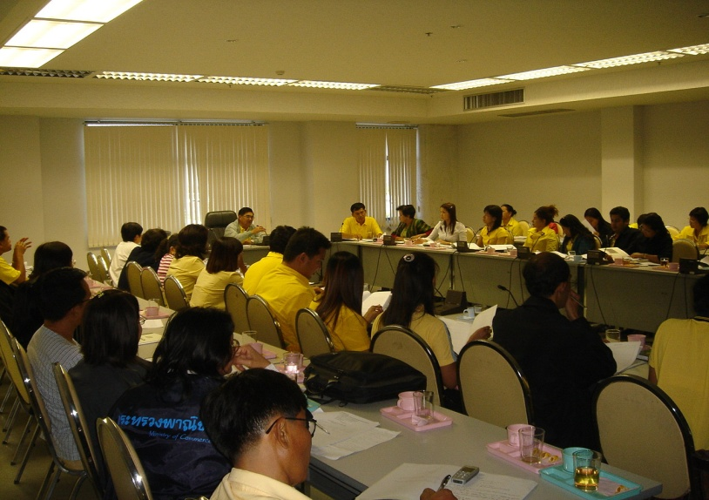
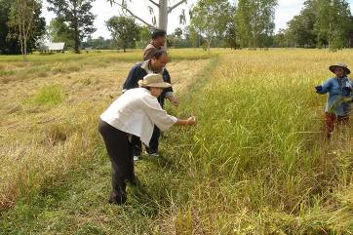
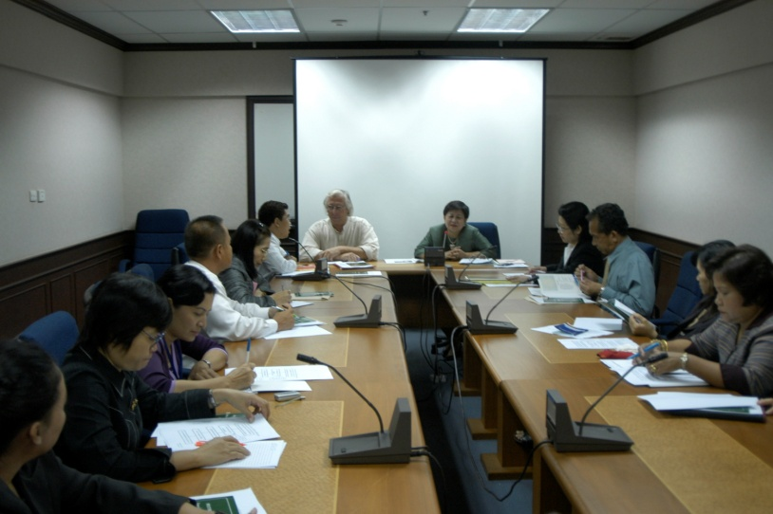
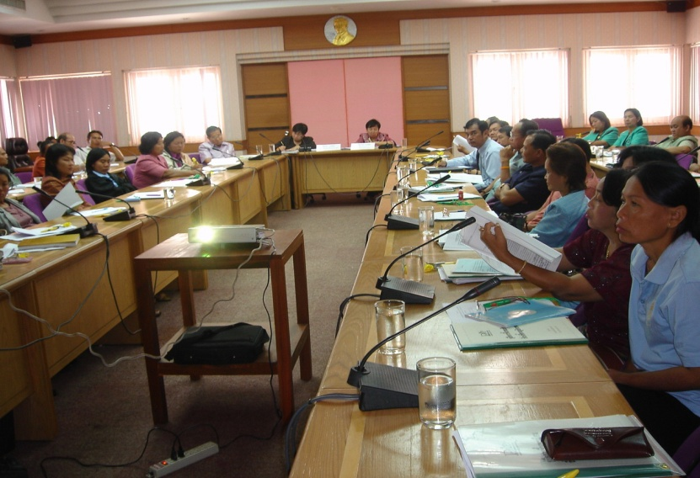
Pre-registration Activities
Workshop
Field studies
Follow up Registration
Brainstorm for Manual
Notes:
Since GI is a new concept in Thailand, we provide the community with Pre-registration Activities to make people in the community understand “What is GI.” including the GI law, GI registration process, Quality control, and marketability of GI products.
Our activity are, such as,
Organize some workshop on GI
Have a field studies to observe the possibility to register such product as a GI
Follow up on Applications for GI registrations
Organize a meeting to brainstorm the production manual with GI product operators.

Slide 12
Notes:
Application Process for GI registration.
1. Submit Application Form to DIP.
2. Examiner will examine the application.
3. If the examiner needs expert opinion, he or she can consult with the expert
4. Then the examiner will decide whether to accept or reject the application.
5. If the application is accepted. It will be publish for 90 days.
6. If there is no objection the application will be registered as a GI. If someone disagree to the publication they can make an objection.
7. But if the examiner reject the application. Applicant can appeal. And could have a litigation if necessary.

Slide 13
Thai GI Symbol DIP Notification 2004
Qualification GI producer must possess ;
Working Manual
Internal Control Plan to ensure compliance with the establish criteria
Who can use GI symbol?
Producers of the goods in the geographical origin of the goods
Traders related to the goods
Notes:
This is Thai GI Symbol for Thai GI products.
To obtain Thai GI Symbol, the GI producers must have
- Working Manual and
- Internal Control Plan to ensure that the production procedure complies with the specific criteria of GI
Who can use GI Symbol?
- Producers of the goods in the geographical origin of the goods
- Traders related to the goods

Slide 14
GI Registration in Thailand
Registered GI
Thai Registered GI | Foreign Registered GI | Total Registered GI
42 products | 8 products | 50 products
GI Applications
Thai GI Applications | Foreign GI Applications | Total GI Applications
80 products | 14 products | 94 products
Numbers from year 2003 to April 2013
Notes:
Now Thailand had registered about 50 products, 42 are Thai and 8 are foreign. The total number of applications in the pipeline is 94 which are 80 Thai products and 14 foreign products.
The latest foreign application we received is Buon Ma Thuot (บวนมาถวด) Coffee from Vietnam.

Slide 15
GI Registration in Thailand
Year | Thai | Foreign | Total
2003 | - | - | -
2004 | - | - | -
2005 | 2 | 1 | 3
2006 | 10 | 1 | 11
2007 | 6 | 2 | 8
2008 | 1 | - | 1
2009 | 7 | 2 | 9
2010 | 3 | - | 3
2011 | 2 | 1 | 3
2012 | 7 | 1 | 8
2013 | 4 | - | 4
Total | 42 | 8 | 50
Numbers from year 2003 to April 2013
Notes:
This is annual registration number of GI start from year 2003 until april 2013

Slide 16
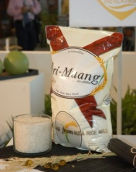
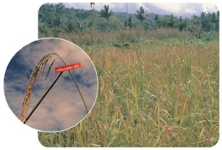
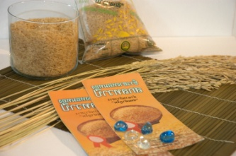
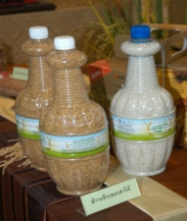
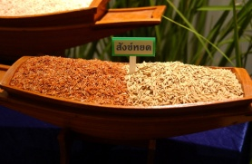
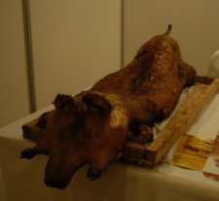
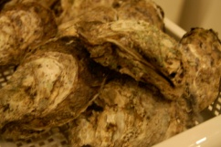
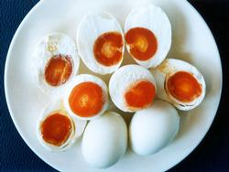
Thai GIs Agricultural and food products
Khao Leuang Patew
Chumphon (Rice)
Khao Hom Mali Thung Kula
Rong Hai (Rice)
Sakon Dhavapi Haang Golden Aromatic Rice
Khao Hom Mali Surin (Rice)
Khao Jek Chuey
Sao Hai (Rice)
Sangyod Maung Phatthalung Rice
Trang Roast Pork
Surat Thani Oyster
Chaiya Salted Eggs
Notes:
Here are example of Thai GI products for agricultural and food products.
Khao Hom Mali Thung Kula Rong Hai (Rice)
Khao Hom Mali Surin (Rice)
Trang Roast Pork
Sakon Dhavapi Haang Golden Aromatic Rice
Sangyod Maung Phatthalung Rice
Chaiya Salted Eggs
Khao Leuang Patew Chumphon (Rice)
Khao Jek Chuey Sao Hai (Rice)
Surat Thani Oyster

Slide 17
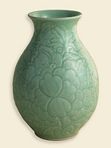
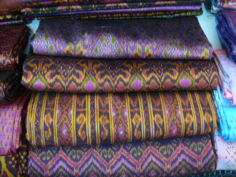
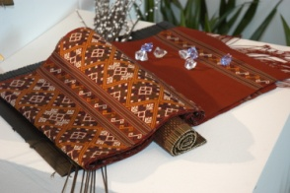
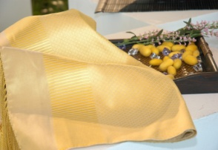
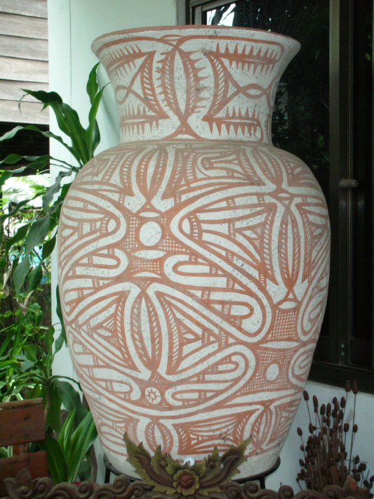
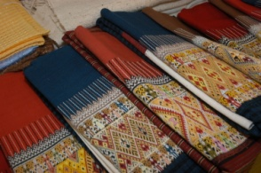
Thai Gis Handicrafts
Chiang mai Celadon (Pottery)
Chonnabot Mudmee Thai Silk
Praewa Kalasin Thai Silk
Lamphun Brocade Thai Silk
Mae Jaem Teen Jok Fabric
Yok Mlabri Nan
Ban Chiang Pottery
Notes:
Here are example of Thai GI products for Handicrafts.
Chiang mai Celadon (Pottery)
Lamphun Brocade Thai Silk
Mae Jaem Teen Jok Fabric
Praewa Kalasin Thai Silk
Yok Mlabri Nan
Chonnabot Mudmee Thai Silk
Ban Chiang Pottery

Slide 18
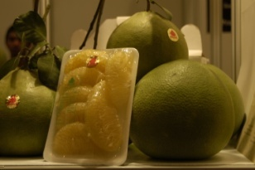
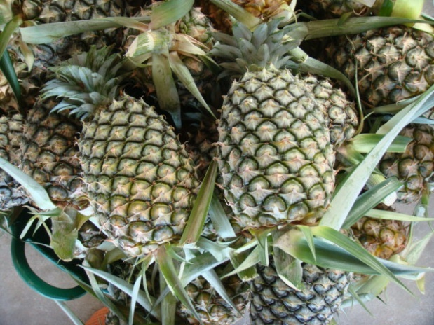
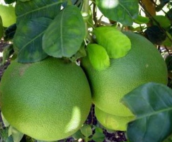
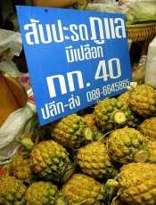
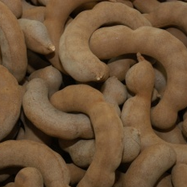
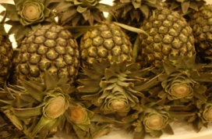
Thai Gis fruit and industrial products
Nakonchaisri Pomelo
Phurua Plateau Wine
Sriracha Pineapple
Kafae Doi Chaang (coffee)
Chainat Khaotangkwa
Pomelo
Chiangrai Phulae Pineapple
Phetchabun Sweet Tamarind
Phuket Pineapple
Kafae Doi Tung (coffee)
NangLae Pineapple
Notes:
Here are example of Thai GI products for fruit and industrial products.
Nakonchaisri Pomelo
Chainat Khaotangkwa Pomelo
Phetchabun Sweet Tamarind
Sriracha Pineapple
Phuket Pineapple
Kafae Doi Chaang (coffee)
Kafae Doi Tung (coffee)
Phurua Plateau Wine
Chiangrai Phulae Pineapple
NangLae Pineapple

Slide 19
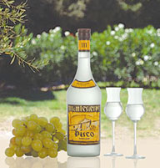
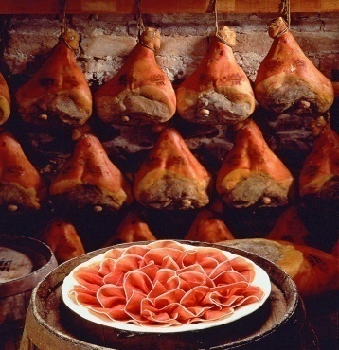
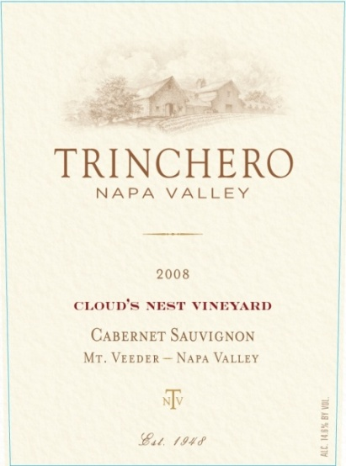
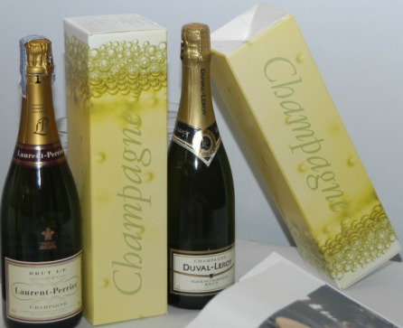
Foreign GI Products (Registered in Thailand)
1. Pisco
(Peru)
5. Prosciuto di Parma (Italy)
3. Brunello di Montalcino (Italy)
4. Cognac
(France)
6. Scotch Whisky (Scotland)
7. Napa Valley
(America)
2. Champagne (France)
8. Tequila (Mexico)
Notes:
Here are 8 foreign GI products registered in thailand.
Pisco (Peru)
Champagne (France)
Cognac (France)
Prosciuto di Parma (Italy)
Scotch Whisky (Scotland)
Brunello di Montalcino (Italy)
Napa Valley (America)
Tequila (Mexico)

Slide 20
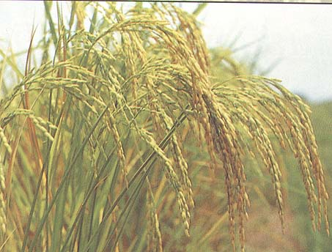
Khao Hom Mali Thung Kula Rong Hai
Variety
Khao Dok Mali 105
Kor Khor 15
Production Process
Planting →Processing →Packaging
in the production area of Thung Kula Rong Hai
Geographical Area
5 provinces ; Roi Et, Yasothon, Surin, Mahasarakham, Srisaket
Notes:
Now I would like to introduce you a couple of Thai GI products.
Khao Hom Mali Thung Kula Rong Hai is a special Jasmine Rice produced in 5 Provinces from the Northeastern of Thailand. The 5 Provinces are Roi Et, Yasothon, Surin, Mahasarakham, Srisaket.
The variety are Khao Dok mali 105 and Kor Khor 15.
The characteristic of this rice is slim and long grain, soft when cooked with very good aroma.
This area of production is very dry land. Without enough water the rice is stressed and produce an extra aroma. This becomes a special characteristic of Khao Hom Mali Thung Kula Rong Hai.
We applied for a GI protection in EU for this product, as well as Doi Tung Coffee and Doi Chaang Coffee.
Khao Hom mali Thung Kula Rong-Hai applied in EU on 20 nov 2008 registered on 4 Mar 2013
Doi Tung coffee and Doi Chang Coffee applied in EU in May 2010

Slide 21
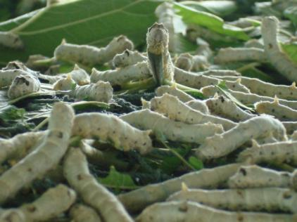
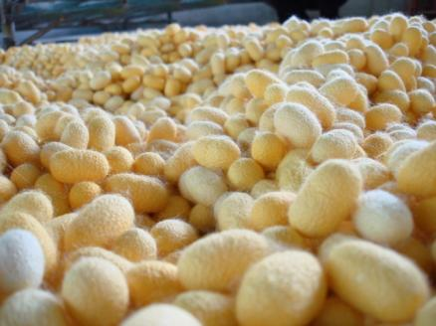
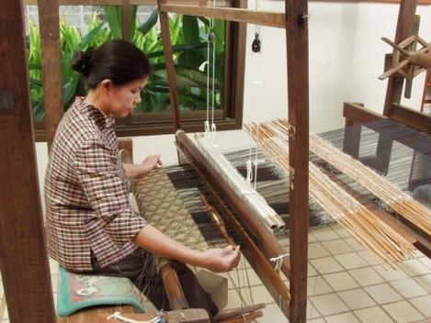
Silk Cycle : Lamphun Brocade Thai Silk
Notes:
This is an example of Thai GI Silk called “ Lamphun Brocade Thai Silk.”
It is produced in Lamphun province with a traditional weaving pattern that’s unique to this area.
The cycle of production are….
First, growing the mulberry trees, then farm the silkworm until you can obtain the cocoon. The harvested cocoon will be soak in the boiling water to obtain the silk fiber. lastly the silk thread is being hand weaved by the local method that passed on for generation to generation.

Slide 22
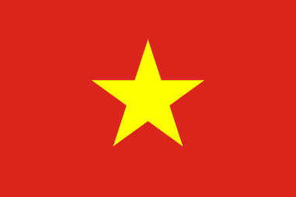
Various Initiative
in the field of GI
Notes:
Various Initiative in the field of GI

Slide 23
International Level
GI multilateral system for wines and spirits
GI extension
- to extend higher level of protection (Article 23) to other products beyond wines and spirits
Lisbon System
- review of Lisbon System to explore possible improvements for the Lisbon System
Notes:
When we talk about various initiatives of GI in Thailand, I would like to say that Thailand have tried to do many things in the last 10 years.
We have engaged in many cooperation activities with many countries and organisations. We have worked under WTO, more specifically the TRIPS Council, and the Doha mandate. Thailand is one of GI Friends. We are supportive of 2 issues. The first one is GI multilateral system for wines and spirits. The second is GI extension, giving higher level of protection to other products beyond wines and spirits. We feel that Thailand and other ASEAN have many kinds of products and it is possible to provide the same level of protection as wines and spirits.
Under WIPO, we have participated in the working group of the review of Lisbon. We aim to develop and improve works which will cover both GI and Appellation of Origins. Another issue of interest is when we talk about a future possible international registration, Lisbon system will have a system similar to Madrid Protocol. For example, you can file one application through WIPO for protection in multiple countries.

Slide 24
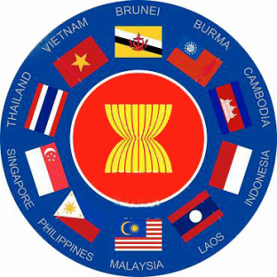
ASEAN Level
ASEAN Working Group on Intellectual Property Co-operation (AWGIPC)
Thailand is the champion country in Geographical Indication
ASEAN adopted the Action Plan on GI for 2012-2015
The ASEAN Project on Intellectual Property Rights (ECAPIII)
- approved by the European Union and ASEAN in 2009, has entered Phase II in December 2012
- “to further integrate ASEAN countries into the global economy and world trading system to promote economic growth and reduce poverty in the region” through intellectual property
Regional Cooperation Project on Geographical Indications
Supported by French Development Agency (AFD) and Food and Agricultural Organization of the United Nations
Thai, Laos, Vietnam, and Cambodia
Notes:
At the ASEAN level, with its goal to become the AEC within 2015, we have an action plan to guide our works for the years 2011 to 2015.
We have ASEAN Working Group on the Intellectual Property Cooperation namely AWGIPC. Under the Action Plan we have 28 initiatives. One of the initiatives is GI. It means that ASEAN is keen on GI protection too. Thailand and Vietnam are champion countries in this area.
The other project that supports GI in ASEAN is ECAP III phase II, which became operational last year. GI protection in ASEAN is supported by the EU.
The third is a regional cooperation project on geographical indications. This project is supported by the French Development Agency (AFD) and Food and Agricultural Organisation (FAO) of the United Nations. The participating countries of this programme are Thai and Laos, Vietnam and Cambodia.

Slide 25
Bilateral Cooperation
Thailand has bilateral cooperation regarding GI with
- Vietnam
MOU 2005, implementation plan from 2010
- Laos
MOU 2013, implementation plan from 2013
FTA negotiation with various countries has involved issues of GI, such as, EU , Peru , Chile
Notes:
For bilateral cooperation, Thailand has bilateral cooperation on GI with Vietnam. We concluded an MOU together. We have exchanged information and study visits with Laos. We plan to sign an MOU with them in 2013. This MOU will cover implementation of GI protection too.
For FTA negotiations as they relate to intellectual property, GI is an important issue subject to focused discussion. Of late, Thailand has engaged in FTA negotiations with Chile and Peru. Our negotiations with the EU will start in May this year.

Slide 26
WIPO Product Branding Project
Thailand is selected as a pilot country to join WIPO Product Branding Project.
3 products is selected to join the project.
Mae Jaem Teen Jok Fabric (GI)
Lamphun Brocade Thai Silk (GI)
Bang Chao Cha Wicker
Notes:
For WIPO, Thailand is selected as a pilot country to join WIPO product branding project. The duration of this project is from 2010 to 2013. Thailand, Uganda and Panama were chosen to be pilot countries. Thailand has chosen 3 products: Mae Jaem Teen Jok fabric, Lamphun Brocade Thai silk and Bang Chao Cha wicker, 2 of them are GI products.

Slide 27
National Level Thailand’s Initiative
1. Promote registration of Thai GIs
2. Promote recognition of GIs in Thailand
3. Promote mechanisms for control and traceability system
4. Support Thai GIs for overseas market
5. Registration of Thai GI in foreign country
Notes:
Now, I want to say a few words about initiative at the national level.

Slide 28
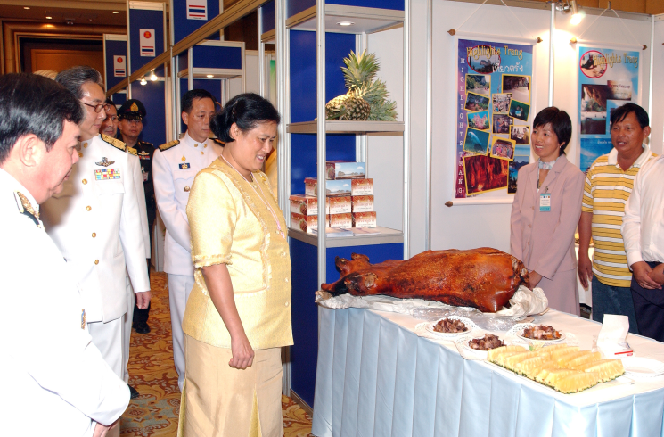
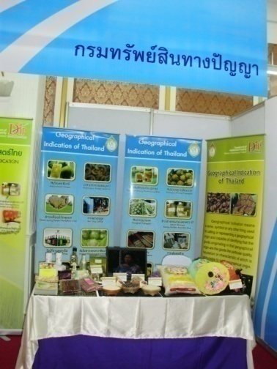
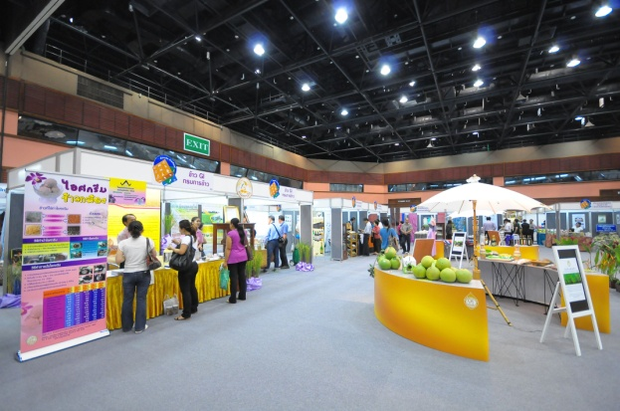
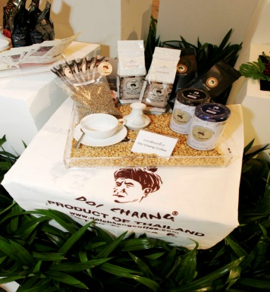
Thailand’s Initiative
1. Promote registration of Thai GIs
Disseminate information on GI law and registration system to local community in every province (76 provinces)
Promote potential GI products of each province
2. Promote recognition of GIs in Thailand
Holding exhibition in Thailand
Distributing booklets on GI of each province
Promote GI products on TV, radio, newspaper and magazine
Notes:
I would like to start from the promotion of GI registration in Thailand.
When we talk about promoting registration in Thailand, the first thing you have to be aware of is that there are altogether 76 provinces, excluding Bangkok. We would want to know first which products are potential GIs. We have disseminated information on GI law and registration system to the local communities in every province.
Second, we promote potential GI products of each province. We have promoted the recognition of GI in Thailand, for example, we organise exhibitions. Another promotion method is publishing a booklet of GI in each province. We try to promote not only through printed media or exhibitions. We use as many channels as possible. For example, television, radio, newspapers, magazines and social networks.

Slide 29
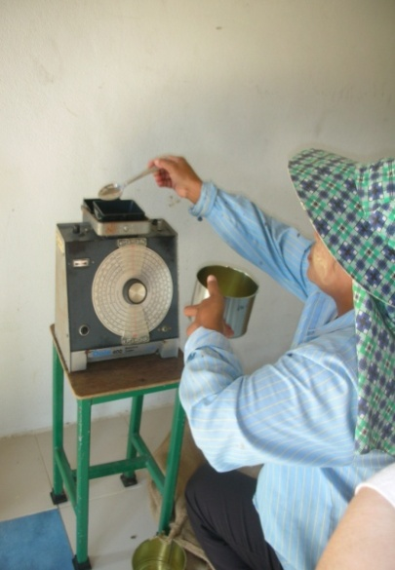
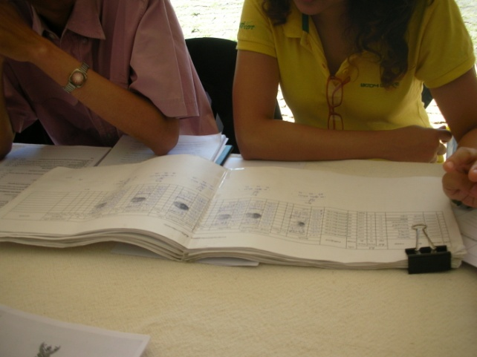
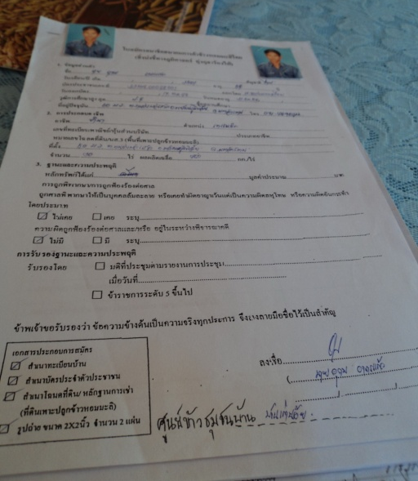
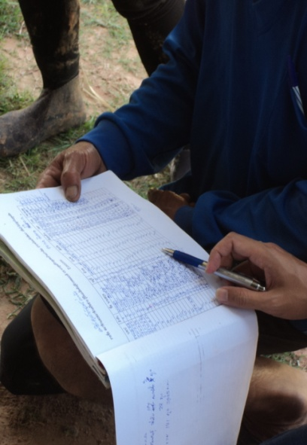
Thailand’s Initiative
3. Promote mechanisms for control and traceability system
Developing the manual for producing GI products.
Developing methods for tracing the origin of the GI products
Developing “GI Control System of Thailand ” with responsible national authorities ; MOU between DIP and TISI + ACFS
Notes:
Furthermore, Thailand has promoted control mechanisms and traceability system. I would like to say that control systems are very important. We try to develop a manual for the production of a GI product and then we promote the method for tracing the origins of GI products and then we have developed GI control system in Thailand.
We have an MOU between my Department, the Department of Thai Industrial Standard Institute (TISI) and National Bureau of Agriculture Commodity and Food Standard (ACFS) which was signed last year. It means that we will work together for the development and improvement of control systems in Thailand.

Slide 30
Geographical Indication Control System of Thailand
AB
(Accreditation Body)
Thai Industrial Standards Institute
(TISI)
National Bureau of Agricultural
Commodity and Food Standard
(ACFS)
(example: Cofrac in France)
DUTY : Accredits CB
According to ISO Guide 65
and Specific requirements
define by DIP
Scheme Owner
CA
(Competent Authorities)
Department of
Intellectual Property (DIP)
(example: INAO in France)
DUTY :
1. Validation of Specifications and
Inspection method (manual)
2. Approve & Supervise CB
GI
Board
CB
External Control
(Control Body /
Certification Body)
DUTY : to perform GI control
on behalf of the CA
- on the producers to verify compliance
with specifications laid down and check
the running of autocontrols
on the group to check the running of the internal controls.
accreditation
approval
certification
certification
Internal Control
( GI Committee at Provincial Level )
DUTY : to check the running of autocontrol on the producers
processors farmers industries.
Self Control / Autocontrol
(Producers Processors Farmers Industries)
DUTY : to control their product according to specification (manual) which can be modified by group members
Consumer
Retailer
Distributor
Exporter
Notes:
When we look at this slide I would to say that DIP is the scheme owner. The scheme owner acts as the competent authority. We are responsible for the validation of specifications and inspection methods. The second is to approve and supervise CB.
We have worked together with AB, as I said before we signed the MOU with TISI and ACFS. Their duties are accrediting CB according to ISO guide 65 and specific requirements defined by DIP. For the producers, they will start from the bottom to the top. This means that they must have a self-control/auto control system in place.
The second step is to implement an internal control. The internal control can be undertaken by a committee established at the provincial level to inspect if the producer follows the specifications or not. Then we will have CB or external control and on the top is the GI Board.
This is the control systems in Thailand. It means that the producers will follow the specification that had been registered already.

Slide 31
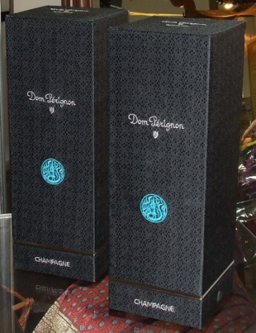
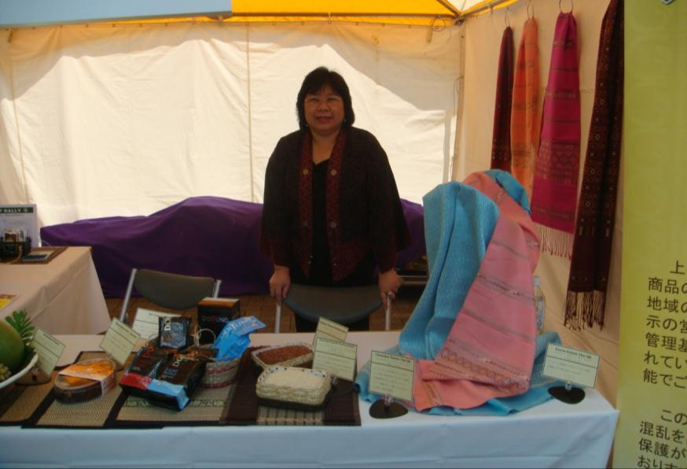
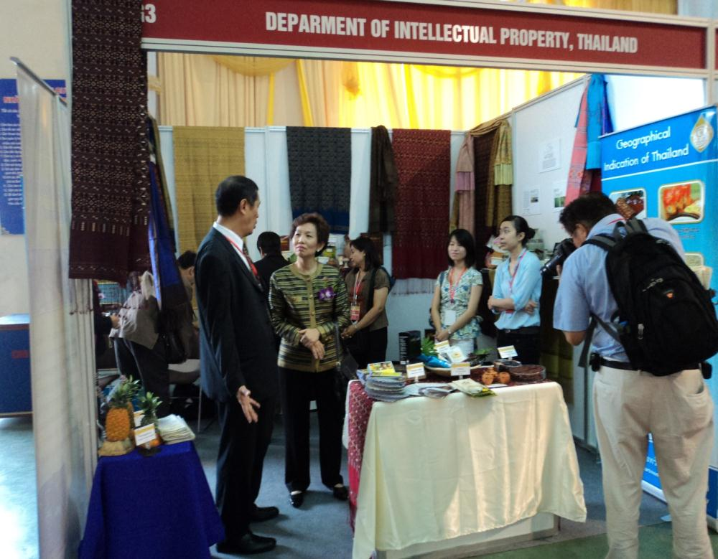
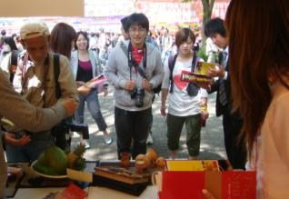
Thailand’s Initiative
4. Support Thai GIs for overseas market
Twinning products project; Champagne + Lamphun Brocade Thai Silk
Overseas Exhibition; Japan, Vietnam, Hong Kong etc.
Notes:
We have other initiatives. Thailand supports greater access of Thai GI in overseas markets, for example, we have the twinning project between Thailand and France for Champagne and Lamphun silk brocade. It means that for special occasions, Champagne will use Lamphun silk brocade for silk ties given to their valued customers.
We organise overseas exhibition for example, in Japan, Vietnam and Hong Kong. We plan to go to Singapore and France.

Slide 32
Thai Festival in Japan
Thailand Trade Exhibition in Vietnam
Notes:
Here are some picture from participating in Thai Festival in Japan, year 2010. And Thailand Trade Exhibition in Vietnam, year 2011.

Slide 33
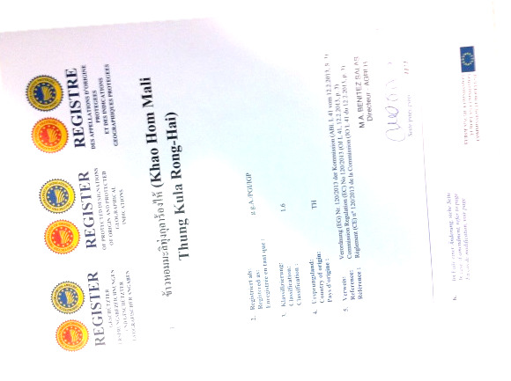
Thailand’s Initiative
5. Registration of Thai GI in foreign country
European Union PGI Registration
Khao Hom Mali Thung Kula Rong-Hai (rice) :
applied on 20th November 2008
registered on 4th March 2013
Notes:
I am very proud of the project that I am going to talk about. My Department is filing applications for registration in foreign countries. We begin with the EU for PGI registration. The reason that Thailand decided to file its first overseas application in the EU is because Thailand’s system is modeled after the EU’s, especially France’s.
The President of European Commission presented GI certificate to Thai Prime Minister when she visited Brussels on 6 March 2013. He gave her the certificate of GI registration for “Thai Khao Hom Mali Thung Kula Rong-Hai”. On that occasion, we organised an exhibition to showcase Thai GI products as well.

Slide 34
Thailand’s Initiative
5. Registration of Thai GI in foreign country (Cont.)
European Union PGI Registration
Kafae Doi Chaang (Coffee) : applied in May 2010
Kafae Doi Tung (Coffee) : applied in May 2010
Khao Sungyod Muang Phattalung (Rice) : drafting application
Vietnam GI Registration
Thai- Isan Indigenous Silk Yarn : drafting application
Notes:
Other Thai applications are Kafae Doi Chang and Kafae Doi Tung. These two applications are now being processed in the EU. I hope that it will be registered in the near future. We are interested in the systems and we are thinking that this year we will file two more applications to register in the EU our rice called “Khao Sungyod Muang Phattalung” and in Vietnam -- our handicraft named “Thai-Isan Silk Yarn”.

Slide 35
Why Thailand has these initiatives?
There are a lots of opportunities created when we use GI
Add value to existing products; create niche market; moving toward blue ocean strategy
Enhance food quality
Create job opportunities and increase employment rate
Maintain traditional knowledge, culture and know-how of the locality
Environment-friendly
Support other industries such as tourist industry
Enhance networking among producers and suppliers in the supply chain
Turning areas prone to drug manufacturing to commercially viable land of GI products
Notes:
One of the objectives of use is adding value to the existing products. Products that carry GI name in fact carry a community brand, not an individual one. We add value to the products and they will sell in niche market. When we have GI system we have specifications and we have control systems. It means that the producers or the processes will follow the specifications that have been registered already.
GIs can help create job opportunities, preserve traditional knowledge and conserve environment. The local producers or the local people over there can take pride of their local culture and try to preserve the distinct qualities of their products. GI also support other industries such as tourism industry. Enhance networking among producers and suppliers along the supply chain is important. I think this is a chance for the producers to meet other producers and exchange ideas and contacts or make market together in the future.

Slide 36
Doi Tung Coffee: Turning areas prone to drug manufacturing to commercially viable land of GI products
Notes:
Last but not least, GI can turn areas prone to drug manufacturing to commercially viable land of GI products as you can see in Doi Tung Coffee case.

Slide 37
Doi Chaang Coffee
Notes:
Now I would like to go into more details on Doi Chaang Coffee case.

Slide 38
Economical Differences for Doi Chaang
Coffee Cherry Price
4.50 baht/kg → 15 baht/kg → 28-32 baht/kg
Before → Doi Chaang Start → Now
Green Bean Price
12 USD/kg → 65 USD/kg
Contract Farming
Coffee Contract of 5 year + 5 year + 5 year from all over the world
Applied for GI protection in EU
* 1 US$ = 29 – 30 THB
Notes:
When we mention price premium, 20 years ago, the price of coffee cherries used to be 4.50 baht/kg. 10 years later when doi chang group was formed the price was 15 baht/kg. Today it is 28-32 baht/kg.
- Green Bean Price went from 12 USD/kg to 65 USD/kg
- Contract Farming
Now, Doi Chaang got a Coffee Contract of 5 year plus 5 year plus 5 year from all around the world and still doesn’t have enough coffee for the demands that rise so high. But Doi Chaang is a GI Specialty coffee, therefore people needs to know that they only produce limited number of coffee, and that is how it added value to the product.
- Doi Chaang Coffee applied for GI protection in EU in 2010 and will be the first ASEAN GI Coffee to be registered in EU.

Slide 39
Chiang Rai Phulae Pineapple
Price Comparison Between year 2004 (before registered as a GI) → year 2012 (now)
Price at Farm
8 baht/kg → 23 baht/kg
Retail Price
35 baht/kg → 50 baht/kg
Going to be 60 baht/kg soon
* 1 US$ = 29 – 30 THB
Notes:
Now I will show you the case of Chiang Rai Phulae Pineapple.
Chiang Rai Phulae Pineapple is a small pineapple, weight about 4 pineapple per kilo. It has an aromatic smell, sweet and crispy taste that you can bite throgh the core of pineapple. It produces in Nanglae district. It is a Phuket variety pineapple plant in Nanglae district. To change the planting area of pineapple from South to North, makes pineapple smaller in size and has a distinctive taste.
Price comparison between the year 2004 (before registered as a GI) and year 2012 (now) is as followed.
Price at farm goes from 8 baht per kilo to 23 baht per kilo
Retail Price goes from 35 baht per kilo to 50 baht per kilo. And going to be 60 baht per kilo soon.

Slide 40
Thank you
Department of Intellectual Property
www.ipthailand.go.th
Tel. (66)2-5474700
Fax. (66)2-5474681
Notes:
40
Thank you for your kind attention.

