Slide 1
SOUTH-SOUTH AND TRIANGULAR COOPERATION PARTNERSHIPS AND FOR ACCESS TO INFORMATION AND KNOWLEDGE:
ARIPO AS AN EXAMPLE OF REGIONAL COOPERATION IN THE FIELD OF INTELLECTUAL PROPERTY
Emmanuel Sackey
Chief Examiner
Lima, Peru
May 5 and 6, 2015

Slide 2
REGIONAL COOPERATION ON IP IN AFRICA
ARIPO
OAPI
⇨ ARIPO: African Regional Intellectual Property Organization
⇨ Established: December 9, 1976 (as ESARIPO)
⇨ Instrument of creation: Lusaka Agreement (in Zambia)
⇨ Headquarters: Harare, Zimbabwe
⇨ Member States (19): Botswana, Ghana, Kenya, Lesotho, Liberia, Malawi, Mozambique, Namibia, Rwanda, Sao Tome & Principe, Sierra Leone, Somalia, Sudan, Swaziland, The Gambia, Uganda, United Republic of Tanzania, Zambia and Zimbabwe
⇨ OAPI: African Intellectual Property Organization
⇨ Established: 22 September 1962
⇨ Instrument of creation: Libreville Agreement (in Gabon)
⇨ Headquarters: Yaounde, Cameroun
⇨ Member States (17): Benin, Burkina Faso, Cameroon, The Central African Republic, Chad, Comoro Islands, Congo, Equatorial Guinea, Gabon, Guinea, Guinea-Bissau, Ivory Coast, Mali, Mauritania, Niger, Senegal and Togo

Slide 3
MEMBERSHIP
Botswana
Gambia
Ghana
Kenya
Liberia
Lesotho
Malawi
Mozambique
Namibia
Rwanda
Sao Tome & Principe
Sierra Leone
Somalia
Sudan
Swaziland
Tanzania
Uganda
Zambia
Zimbabwe
= 19

Slide 4
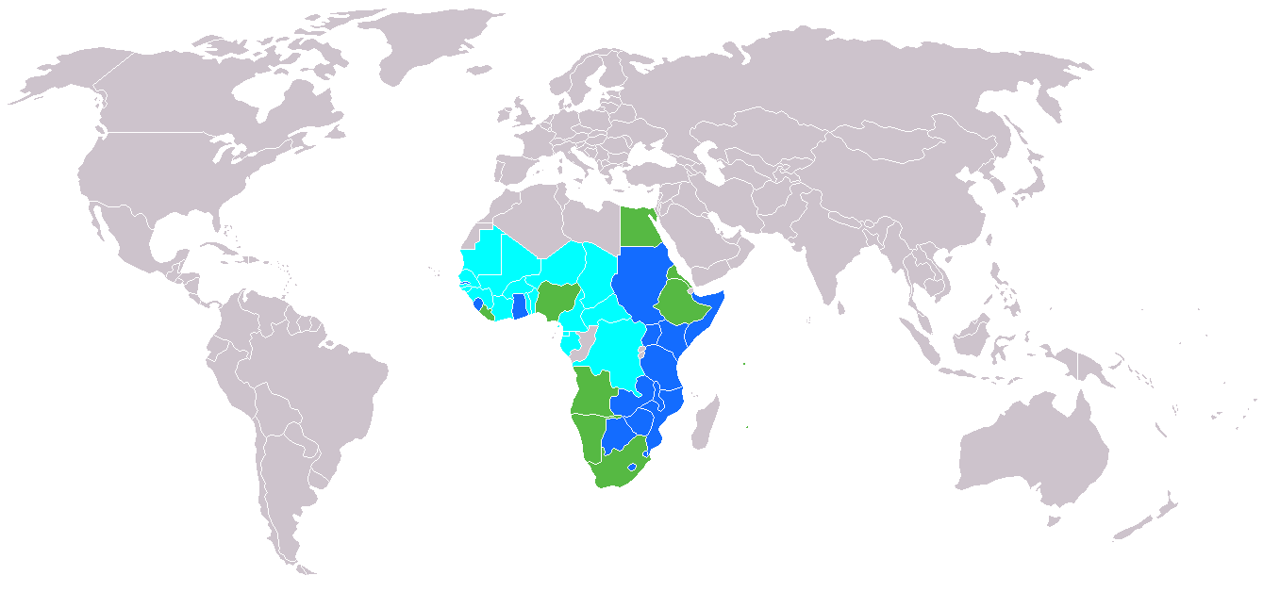
Territory Covered by Regional IP Offices in Africa – Including Observers
ARIPO + OAPI – 67% of African Countries
ARIPO + Potential Member States (9)+OAPI – 83%

Slide 5
Need for Cooperation at Regional Level on IP
⇨ IP is regional and multilateral in nature
IP deals with tradable goods that cross boundaries
Violation of IPRs is global
Some IP issues are trans-boundary: TK, biopiracy, transfer of technology
⇨ Response to IP challenges must be regional
Common policies and harmonization of IP
Common systems of protection of trans-boundary TK, fight against bio-piracy
Common mechanisms of enforcement of IPRs
Common infrastructures, skills development and administration systems

Slide 6
ARIPO Role in the Promotion of IP in its Member States
⇨ Pooling of resources together for promotion, development and harmonization of IP laws and policies.
⇨ Integrating IP in the national & regional economic development programmes & policies
⇨ Facilitating & encouraging IP awareness Programs
⇨ Facilitating harmonized national & regional protection, exploitation & enforcement of IP
⇨ Promoting capacity building & development of human resources in IP (ARIPO Academy)
⇨ Promoting dissemination of technological information
⇨ Promoting transfer of technology

Slide 7
Technological Information
80% of technological information is in the form of patents
There are 70 million patents in the World
1 million new patents each year
All this information is stored in databases (some freely accessible)

Slide 8
Relationship between Development and IP

Slide 9
ARIPO’s activities and initiatives in the promotion of access to knowledge and information
ARIPO SEARCHES, PATENT ANALYSIS AND SELECTIVE DISSEMINATION OF INFORMTION (Patent landscape)
Encourages innovation and consequently economic growth by rewarding investments made in developing a new invention(protection) and publishing and making known technical information of a new invention (disclosure)
Patent protection is territorial in nature but Patent information is global
Patent protection is limited by claims in scope but Patent information includes all information contained in patent documents
Patent protection is time-limited but Patent information remains permanently available
Patent protection gives patent owners a right to prevent others from carrying out the invention (manufacturing or marketing) but Patents do not prevent others from learning from the invention

Slide 10
Users, Uses and Levels of Use
Users
Analysis
Uses
Increasing level of detail
Increasing level of metrics
60%
Government
National Policy
Strategic Planning
Companies / SMEs
20%
Project orientation
Commercialization
IP Agents and Attorneys
10%
Validity and Legal status
Researchers
10%
Technical

Slide 11
ARIPO ROVING SEMINARS ON MAKING BETTER USE OF IP FOR BUSINESS COMPETITIVENESS AND DEVELOPMENT – LAUNCHED IN JAN. 2013
Focuses on Parliamentarians, Policy Makers, Business Community and Users of the ARIPO system
Held Roving Seminars in 6 African Countries in 2014 and visited 3 Users. Targeted 8 Countries and 4 users in 2015
Within 1 year – ARIPO’s patent filings have increased by 20%
Have also seen increased accession/ratification of ARIPO Legal Instruments

Slide 12
ARIPO’s RECENT COOPERATION WITH KOREA – ARIPO-WIPO-KOICA-KIPO Launched on March 24, 2015
POLITE + (ARIPO Secretariat and Member States Information sharing system)
e-SERVICE (Public online system)
Data Exchange Services

Slide 13
ARIPO –WIPO COOPERATION
Establishment of TISCs in Selected Institutions in the ARIPO Member States and Africa
Establishment of Technology Transfer Offices TTOs and IP Units/Offices in the Universities and R&D Institutions
Joint Regional and Sub-regional Sensitization and awareness raising programmes on IP and use of Technological Information for R&D
WIPO IP development matchmaking database and WIPO Re:Search

Slide 14
SOUTH-SOUTH COOPERATION ON CAPACITY BUILDING
Joint WIPO-ARIIPO-African University Masters in Intellectual Property Programme hosted at the Africa University in Mutare, Zimbabwe – Over 170 graduates produced between 2008-2014
Joint WIPO-ARIPO –KIPO training on ICT Tools (IPAS and Polite+) for business processes at ARIPO and the IPOs of its Member States
WIPO-ARIPO-IP Australia Regional Patent Examination Training for ARIPO Office Examiners and those of its Member States
ARIPO-OHIM training on Trademarks and Designs
ARIPO-USPTO training of Examiners (Trademarks and Patents) in the ARIPO Member States
ARIPO-UPOV-USPTO workshops on Plant Variety Protection

Slide 15
SOUTH-SOUTH COOPERATION: CHALLENGES AND WAY FORWARD
Need to provide effective platform in a WIN-WIN context to facilitate sharing of ideas, strengthening of cooperation and using of information tools and systems to build on individual and collective accomplishments and also address country-specific needs and expectations
To provide evidence-based analysis to support the need for developing Countries and LDCs to utilize IP as a tool for wealth creation and nation building
To develop effective matchmaking mechanisms for enhancing value addition of resources where the southern providers have comparative advantage
To build synergies to shape the global IP architecture and normative processes for the levelling of the IP playing field
To mainstream SSC in WIPO Program of Activities with the requisite budget for the next biennium to enable WIPO to develop concrete activities for the achievement of the WIPO Development Agenda

Slide 16
esackey@aripo.org

