Slide 1
Innovation support in the Philippines
INTERREGIONAL EXPERT meeting
South-South and Triangular Cooperation for Access to Information and Knowledge, Innovation Support, and Technology Transfer
Harris M. Fulo R.Ch, M.Sc.
Technology Transfer Division
Documentation, Information & Technology Transfer Bureau
Intellectual Property Office of the Philippines (IPOPHL)
Republic of the Philippines
Notes:
1. the needs for the IP office to have its own expert team of patent searchers who can mentor and lead the other stakeholders;
2. the non-training aspects of building ITSOs into a network that works together as one for the country rather than rival / fragmented camps of institutions;
3. the need to rally all other development partners beside WIPO to fill in the training needs so there is monthly training for the stakeholdrs; 4. the need to create demand, and not just the supply. Without continuing work, the skills are not practiced and will be lost; and 5. the need for apprenticeship with international firms so trainees get the longer period of on-the-job exposure.

Slide 2
OUTLINE OF THE PRESENTATION
Overview of the Initiative
Results achieved
Next steps/outlook
Lessons learned: main challenges, achievements and opportunities for adaptation/replication
Notes:
Overview of the initiative/partnership
(rationale, main partners, objective/expected results, deliverables, implementation modalities, activities, timeframe)
Results achieved
Next steps/outlook
Lessons learned: main challenges, achievements and opportunities for adaptation/replication

Slide 3
Overview of the initiative
INNOVATION & TECHNOLOGY SUPPORT OFFICE (ITSO)
The Innovation & Technology Support Office (ITSO)
Notes:
The Philippines came up with the Filipino version of the WIPO TISC – Technology and Innovation Support Centers (TISC)

Slide 4
IIPI Study on Philippine Researches
Results (2011):
Agricultural | 39%
Chemical | 13%
Electrical | 1%
Mechanical | 1%
Medical | 36%
Physics | 9%
Notes:
International Intellectual Property Institute

Slide 5
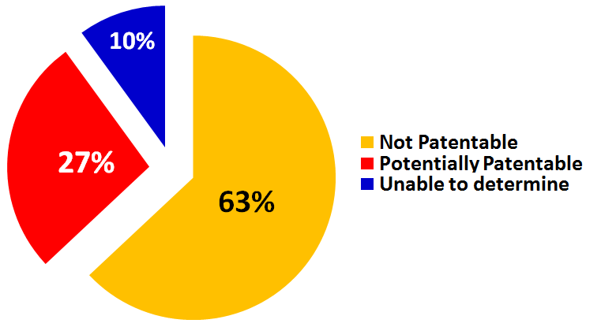
IIPI Study on Philippine Researches
Results:
Notes:
Almost 6000 research studies 1,500 publications

Slide 6
Factors
How universities/RDIs view their role in society
Prevailing culture in the academe of
“Publish or Perish”
Lack of knowledge & understanding of the IP system
Absence of a sound IP Policy
No institutionalized mechanism equipped to assist innovators in protecting & promoting the technological innovations
Weak link between RDIs/universities & industry

Slide 7
INNOVATION & TECHNOLOGY SUPPORT OFFICE
(ITSO)
Notes:
Hence, the creation of the INNOVATION & TECHNOLOGY SUPPORT OFFICE patterned after the TISC

Slide 8
FUNCTIONS OF ITSOs
IP CREATION
IP PROTECTION
IP UTILIZATION

Slide 9
FUNCTIONS OF ITSOs
In support of IP Creation by facilitating access to global science & technology information:
Serve as a patent search facility and library for patent information;
Provide skills training in patent searching;
Render patent search services; and
Organize a community of patent information users
IP CREATION

Slide 10
FUNCTIONS OF ITSOs
In support of IP Protection by promoting domestic & globally-recognized innovations:
Provide general information on patents & patenting;
Provide skills training in patent drafting & prosecution;
Render patent drafting & prosecution services;
Organize a community of experts to participate in patent examination.
IP PROTECTION

Slide 11
FUNCTIONS OF ITSOs
In support of IP Utilization by assisting the commercialization of globally-competitive innovations:
Render IP audit and evaluation services;
Provide licensing support;
Provide advice on IP management & commercialization strategies; &
Be a depositary of patent-related documents, papers and statistics
IP UTILIZATION

Slide 12
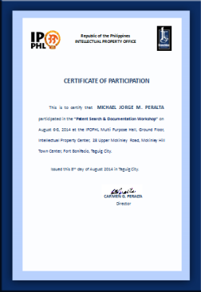
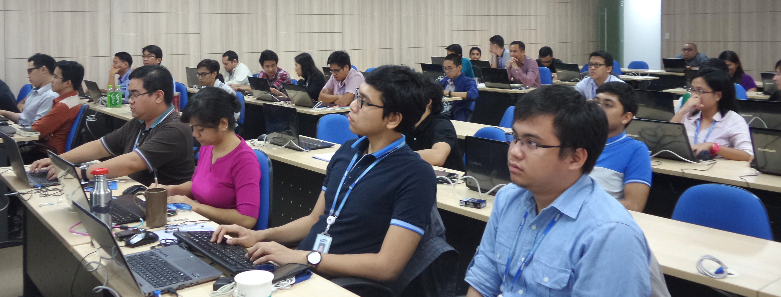
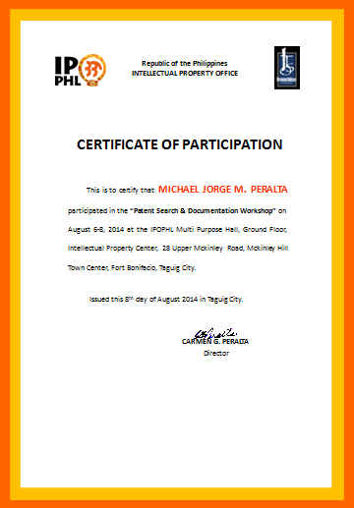
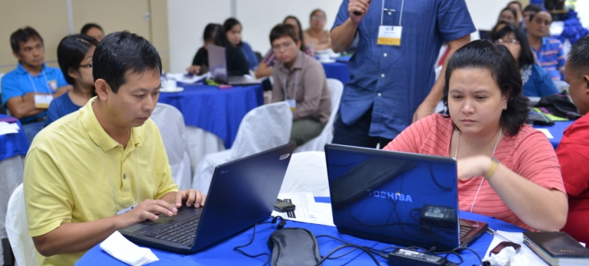
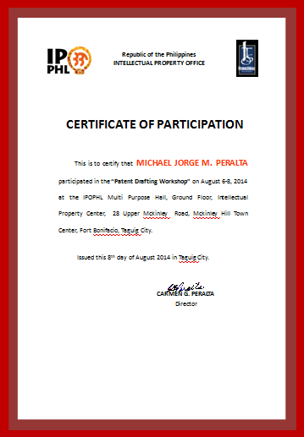
TRAINING COURSES
Foundation Course on IP
Overview of the IP System
Patent Search Workshop
Patent Drafting
Patent Drafting 1
Basic Patent Search
Advanced Patent Search
Patent Drafting 2
Pre-PAQE Review
PAQE
Patent, Copyright & Trademark
Patent Information

Slide 13
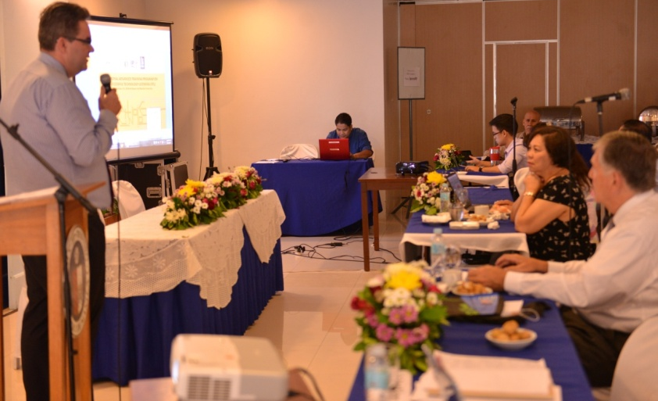
Additional TRAINING COURSES
Workshop on IP Commercialization (STL)
Technology Pitching Workshop

Slide 14
Additional TRAINING COURSES
WIPO Distance Learning (DL) Courses
Patent Search tool database workshops
DL101
DL320*
DL450* *requirement for ITSO manager

Slide 15
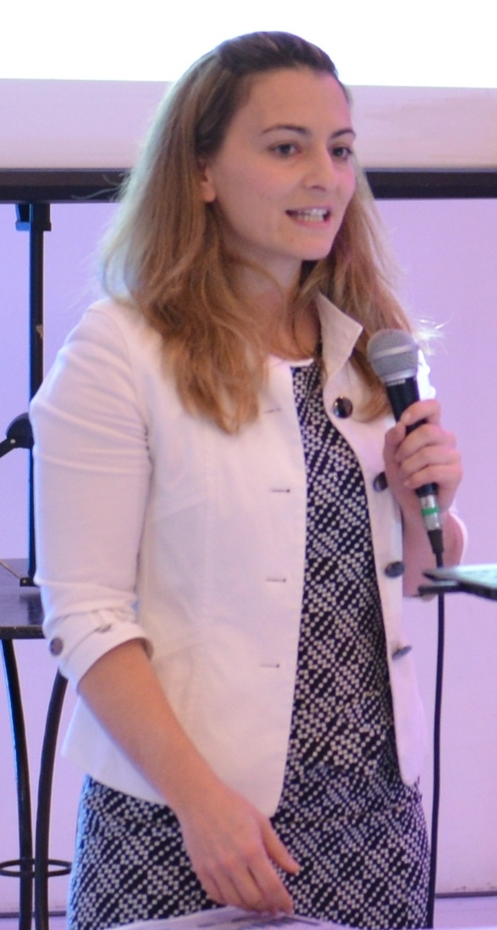
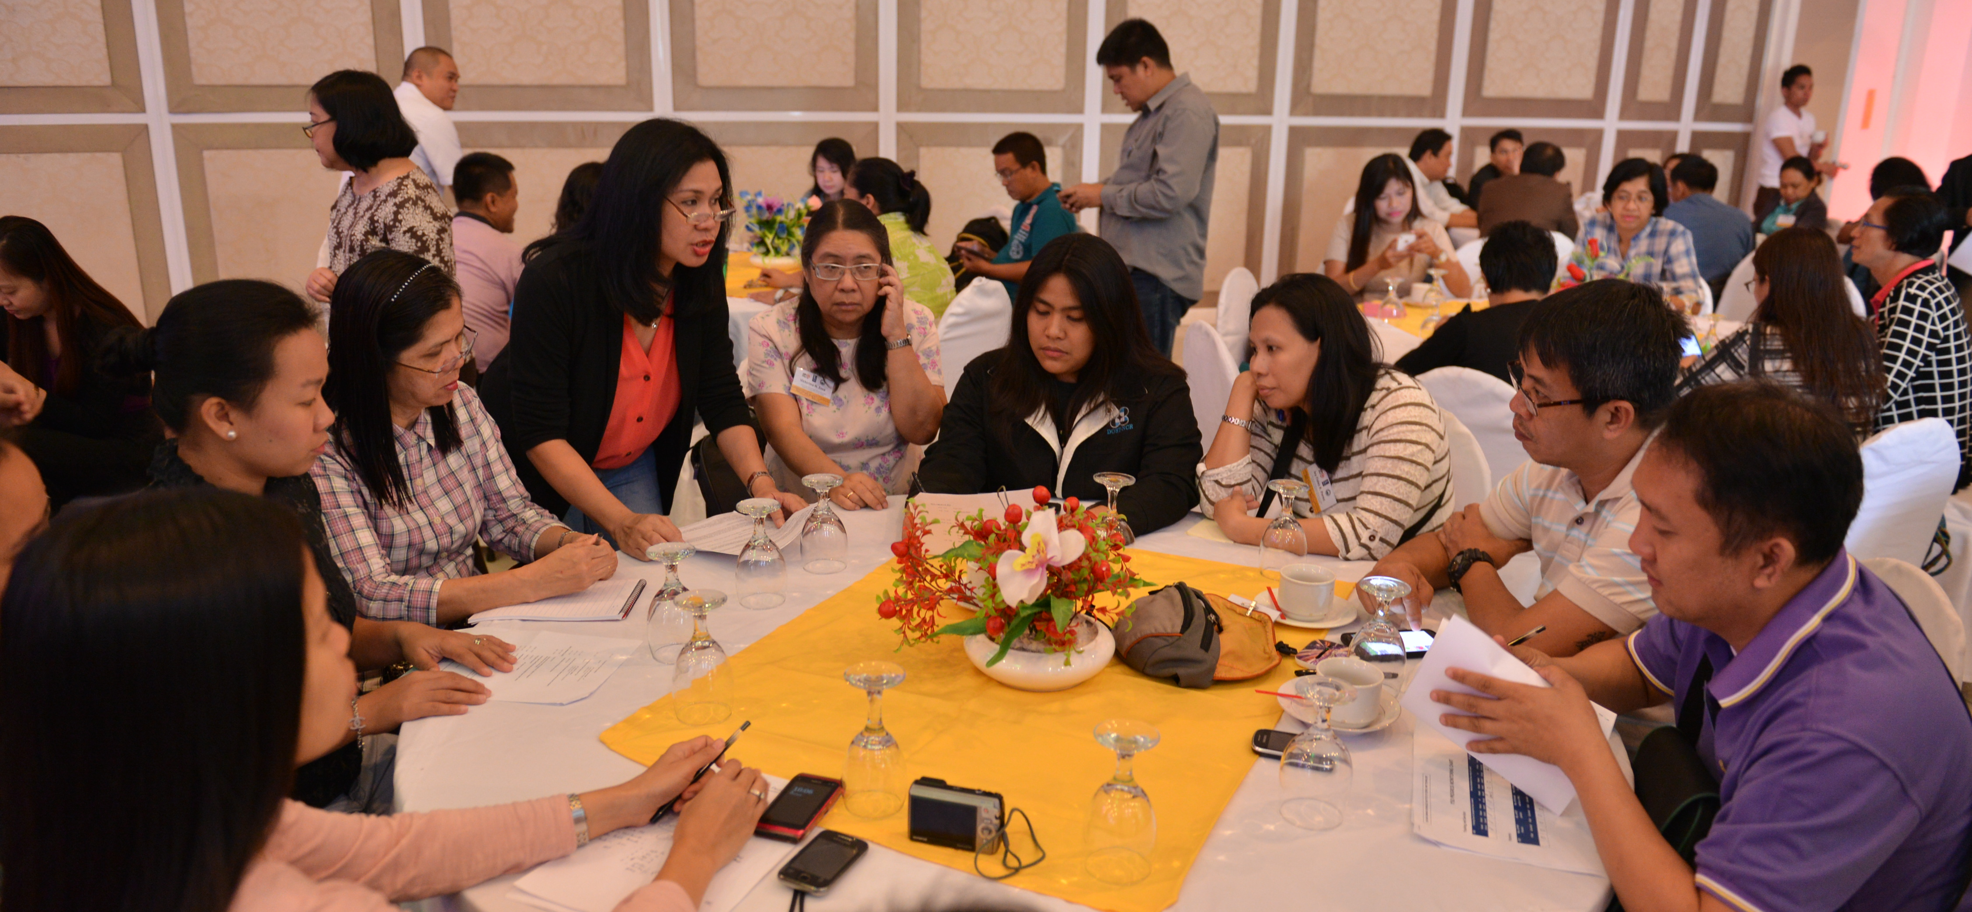
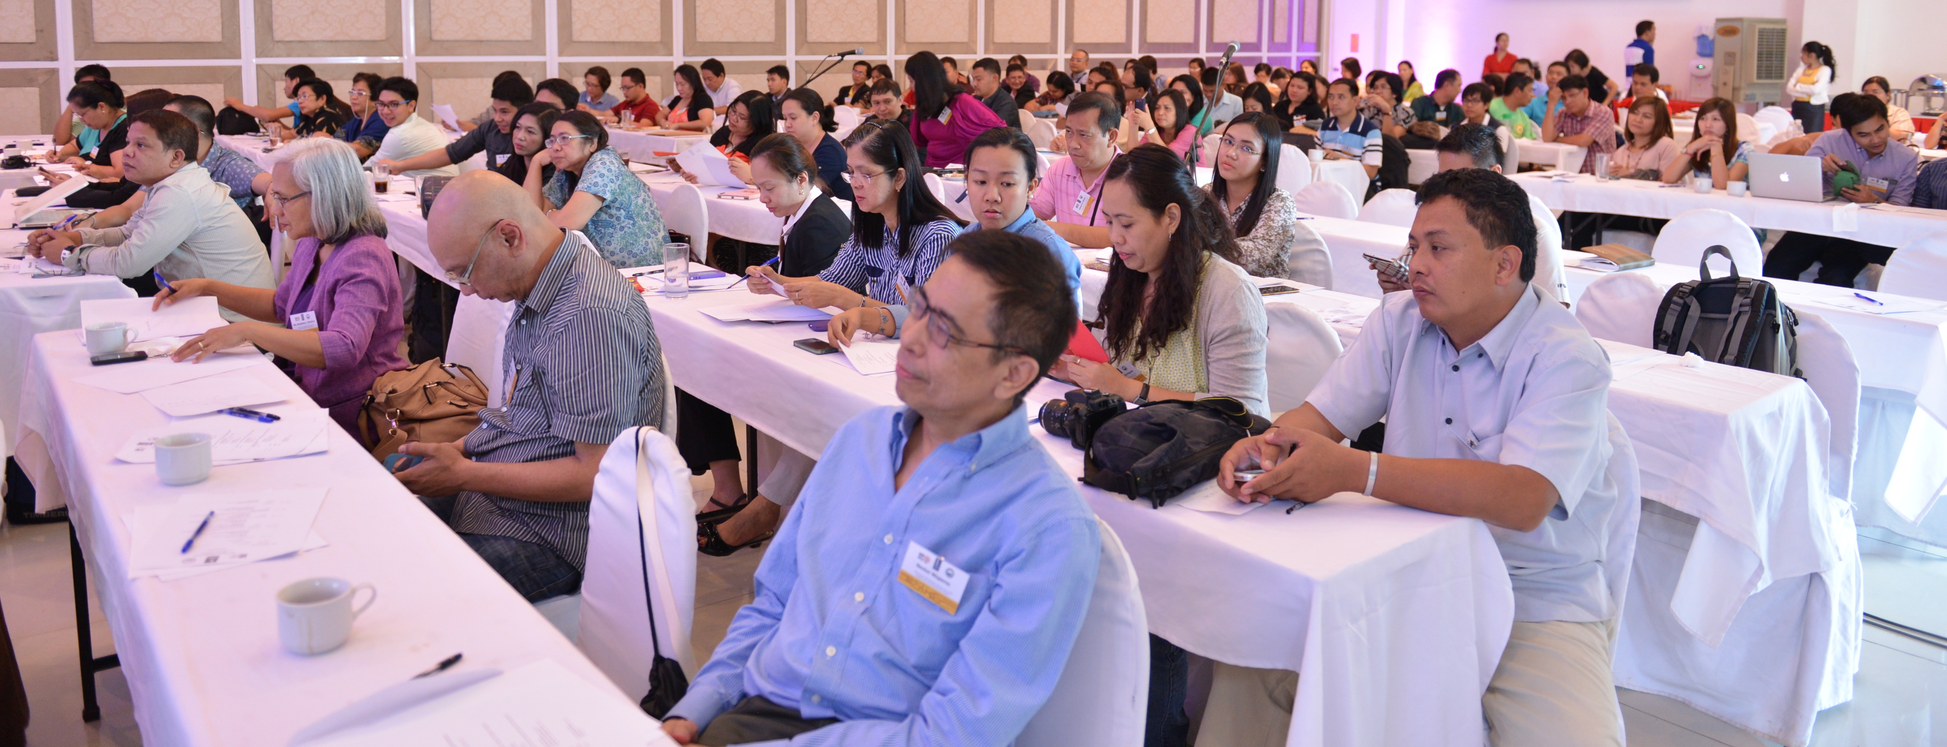
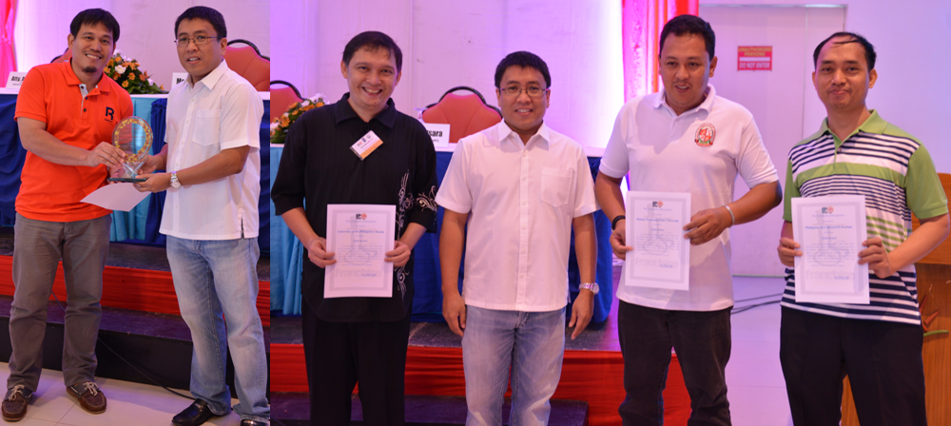
Other Activities
Annual ITSO planning
Echo of experience or participation in various international forums or conferences
Assessment
Committee formation
Sharing of best practices
Awarding of top performing ITSOs
Open forum
Oath-taking of PAQE passers

Slide 16
IPOPHL’s initiatives
JUAN’S THOUSAND INVENTIONS
PATENT PROTECTION INVENTIVE PACKAGE (PPIP)
launched in March 2012
IPOPHL waives 100% of fees up to the 15th year of annuity
currently has 116 patent filings under this program

Slide 17
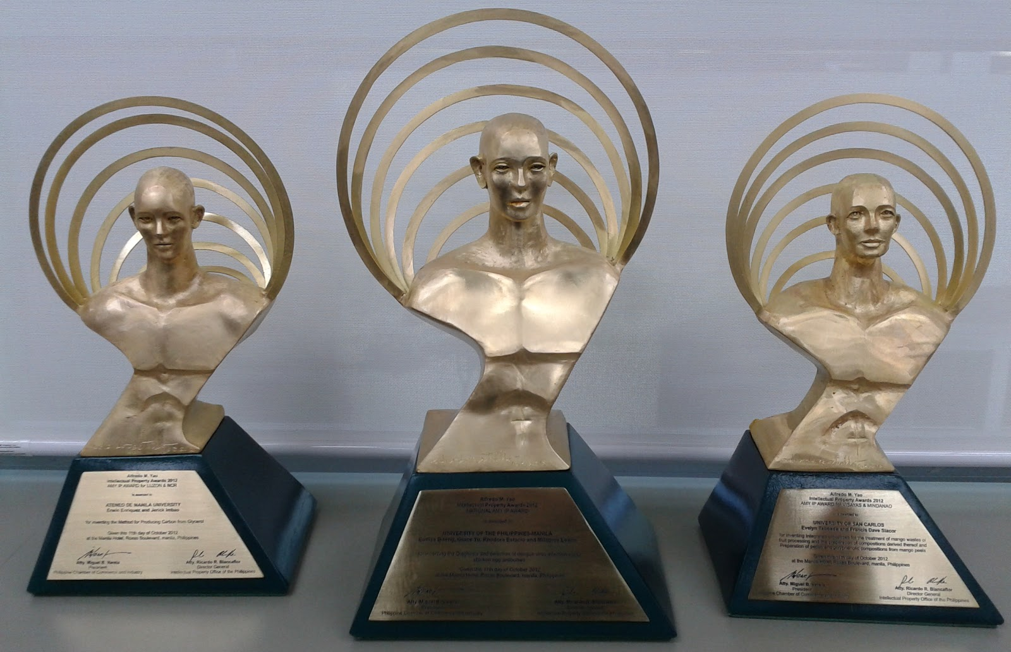
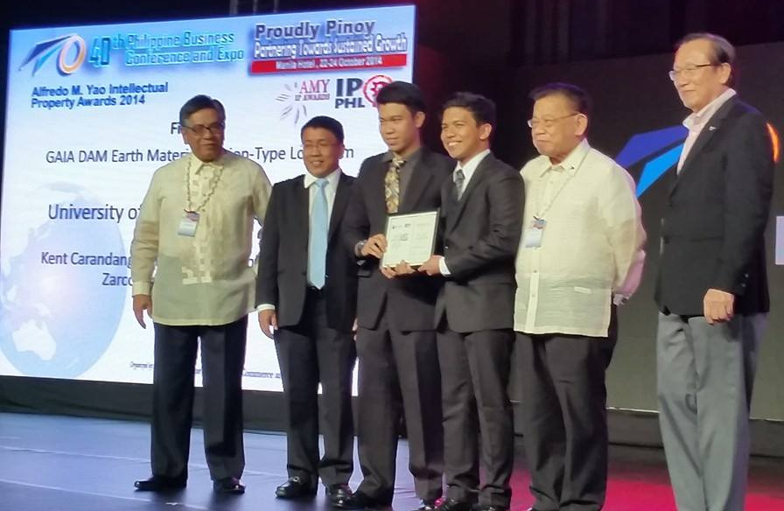
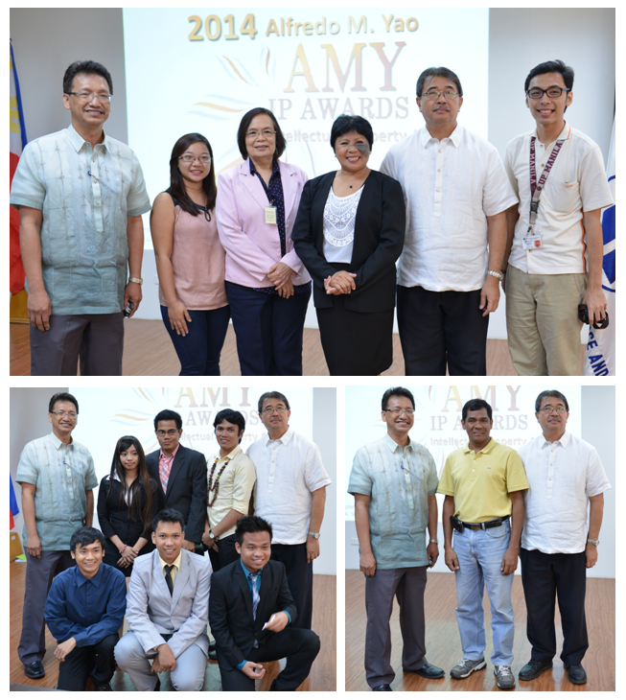
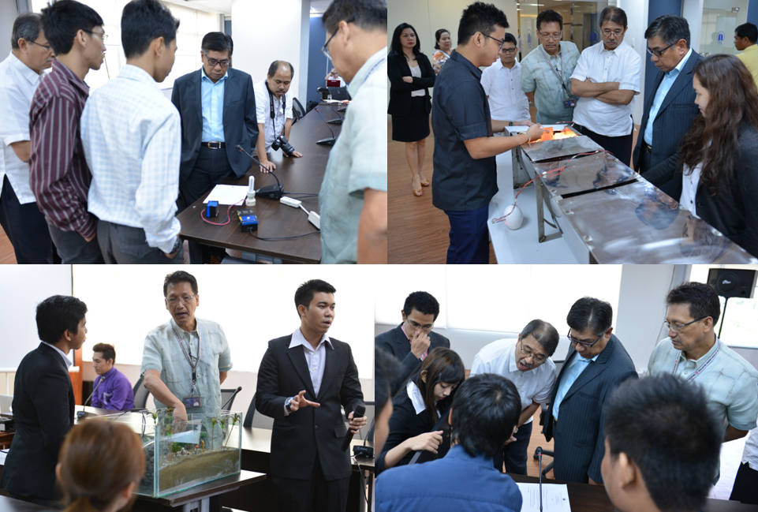
Partnered initiatives
Annual
A.M.Y. National IP Awards
Notes:
For innovations that at least has had a patent application already

Slide 18
Partnerships
WIPO – World Intellectual Property Organization
EPO – European Patent Organization
IIPI - International Intellectual Property Institute
Thomson Reuters – for Thomson Innovation
PCCI – Philippine Chamber of Commerce & Industries
USPTO– US Patent & Trademark Office

Slide 19
Results Achieved
Based on the several initiatives offered by IPOPHL

Slide 20
NOTABLE MILESTONES
1st ITSO MOA ceremonial signing (2 ITSOs) at IPOPHL, Makati
23 new ITSOs
sign-up
PCT Applications from ITSO
ITSO grows to 80
Nov. 15, 2010
2011
March 2013
Dec 2014
Nov. 17, 2010
Mar. 22, 2012
June 2013
5 more ITSOs in Cebu
ITSO
Official Launch
to the public
Technology commercialization from ITSO
PPIP Launched
Notes:
The following slides show several examples of timelines using SmartArt graphics.
Include a timeline for the project, clearly marking milestones, important dates, and highlight where the project is now.

Slide 21
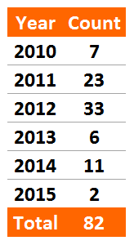
ITSOs ALL OVER the Philippines
as of May 5, 2015, there are already 82 ITSOs throughout the Philippines.
Composed of
Academic Institutions
(universities, colleges, SUCs)
Research & Development Institutions
Partner Government Agencies
Business chambers

Slide 23
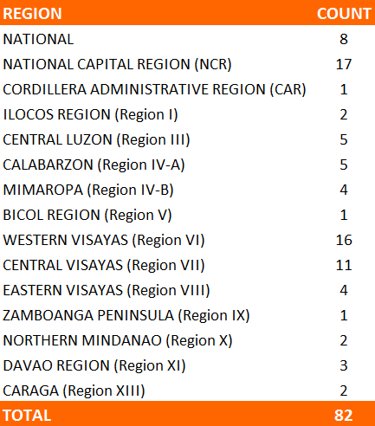
ITSO LOCATIONS
Academic Institutions
Government
Agencies
Cooperating
Institutions
- 70
- 8
- 4

Slide 24
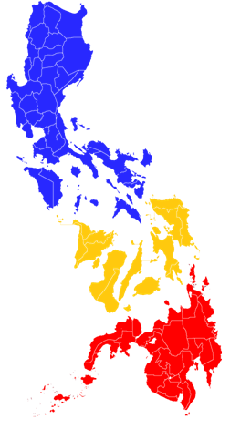
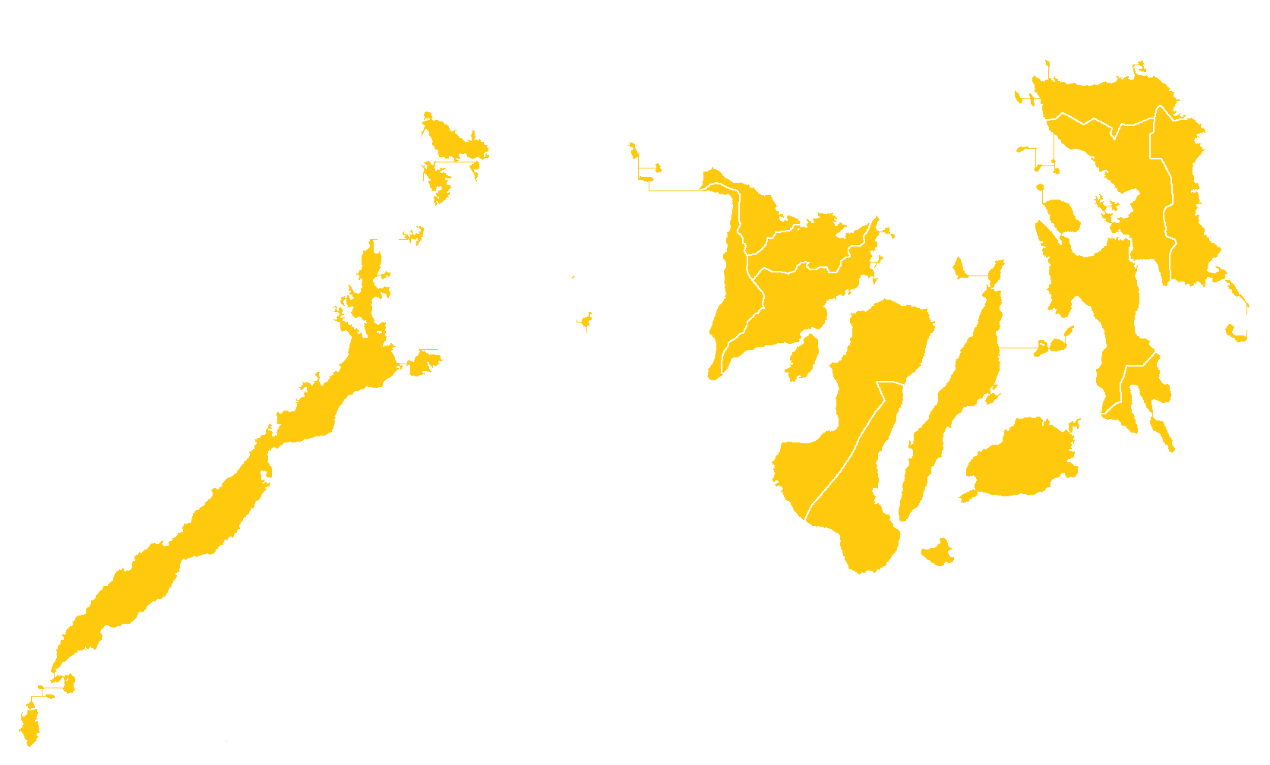
ITSO LOCATIONS
LUZON - 35
NATIONAL - 8
VISAYAS - 31
MINDANAO - 6

Slide 25
PATENT AGENTS
Patent Drafting Training Courses:
WIPO Distance Learning
EPO Patent Drafting Workshop
Number of ITSO personnel who passed
the Patent Agent Qualifying Exam (PAQE)
Year | Chemical | Non-Chemical | TOTAL
2012 | 17 | 23 | 40
2013 | 3 | 19 | 22
TOTAL | 20 | 42 | 62

Slide 26
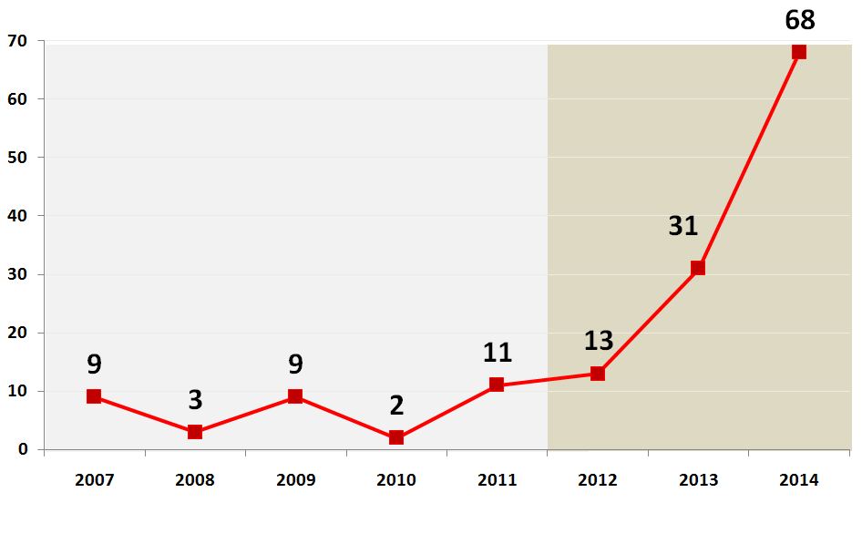
PPIP’s effect on local Patent Filings
ITSO members’ Patent filings comparison from Pre-PPIP and during PPIP
Filings for 5 years prior to PPIP (2007-2011) increased to more than 3x in only 3 years (2012-2014)
PRE-PPIP PPIP

Slide 27
ITSO outcome
Mainstreaming IP in universities
Creation of pool of IP experts
Patent drafting experts
Patent search experts
Increase IP filings
Utilization of patent information in research & technology creations

Slide 28
Next Steps

Slide 29
Build on what the ITSOs have
Introduction of new courses to further enhance capabilities of ITSO members
IP Commercialization
IP Valuation
PAQE
Roadmap generation for each region’s industry needs for ITSOs to capitalise on
Have ITSOs focus on the needs of their region for increasing the marketability of their technologies

Slide 30
ITSO as model network
WIPO and IPOPHL are in partnership with other members of ASEAN to set-up the “ASEAN WIPO Regional Technology and Innovation Support”
APEC proposal for a network training for IP valuation

Slide 31
Lessons learned
Main challenges, achievements and opportunities for adaptation/replication

Slide 32
Lessons Learned
Government leading the way to introduce changes and other initiatives encourages institutions to follow suit
Needs of the country may be addressed by government agencies even beyond their own mandate
Good relationship with international authorities such as WIPO, EPO and others make all initiatives doable
Alignment of innovation initiatives of universities with that of the government

Slide 33
Primary needs
IP office with expert team of patent searchers who can mentor and lead other members of the network
Multiple partnerships to fill in the training needs
(if not WIPO, IIPI or EPO and more…)
Creating demand not only supply
the need for apprenticeship with international firms so trainees get the longer period of on-the-job exposure and expertise
(e.g patent analytics training in multinational companies, AUTM internship, etc.)
Notes:
AUTM – Association of University Tech Managers

Slide 34
THANK YOU!

