Slide 1

Fostering sustainable development through technology transfer among developing countries
U
United Nations Office for South-South Cooperation
Notes:
Why South-South Cooperation?
It offers development solutions
that are:
Appropriate
Adaptable
Affordable

Slide 2

Outline
UN Office for South-South Cooperation
SS-GATE: Assets and Technology
Sustainable Partnerships

Slide 3
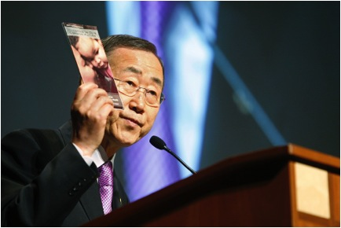
UN Office for South-South Cooperation
Established in 1978 by
UN General Assembly
Facilitates South-South
Cooperation
    Convener
    Knowledge Broker
    Capacity Builder
    Communicator

Slide 4
SS-GATE: Overview
In support of UN Secretary General’s Special Initiatives
Zero-Hunger
Agriculture Exchange
Global Health
Global Health Exchange
Energy for All
Energy & Environment Exchange

Slide 5

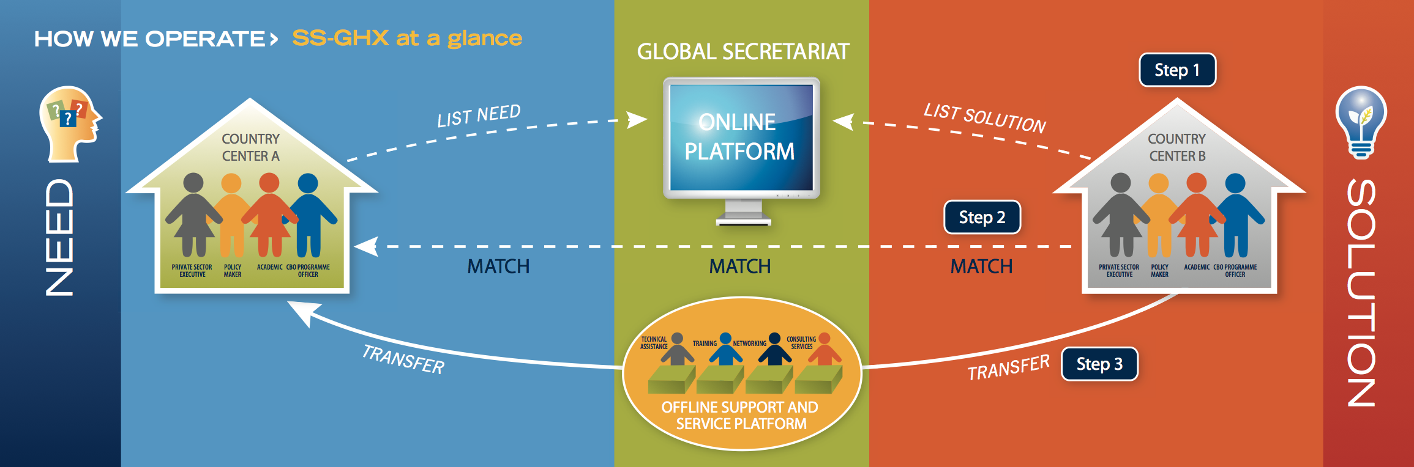
SS-GATE: Model
Market Driven Mechanism
Online and Offline Transaction Platform
Notes:
Facilitates market-driven and transparent exchanges.
Supports capacity building efforts.
Engages private sector, public sector and civil society.

Slide 6

Global Health Exchange (SS-GHX)
Created 2011 in collaboration with PAHO and WHO.
Builds upon successful SS-GATE business model.
Endorsed as a Sustainable Business Model by the General Assembly.

Slide 7
SS-GHX: Focus Areas
South-South Global Health Exchange
Maternal & Child Health
NCDs
HIV/AIDS

Slide 8
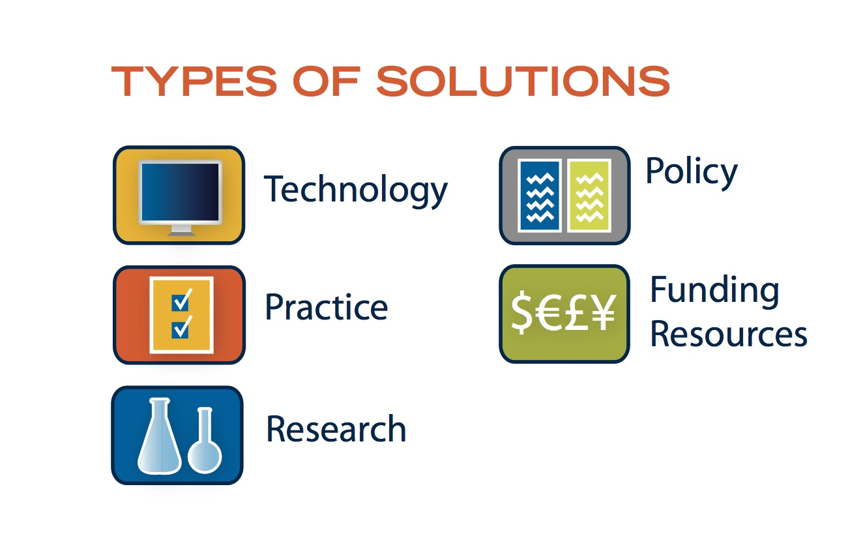
SS-GATE: Matchmaking

Slide 9
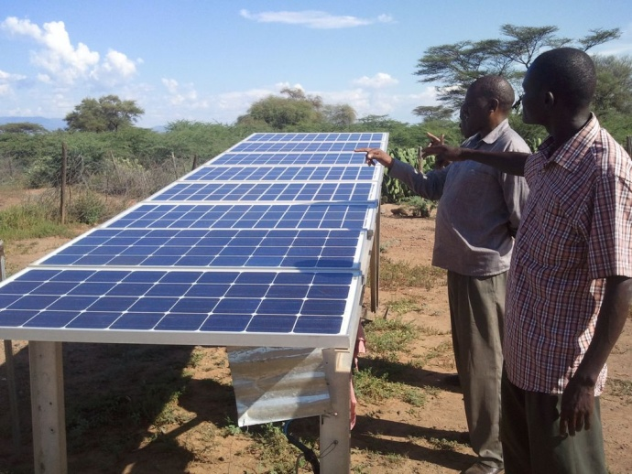
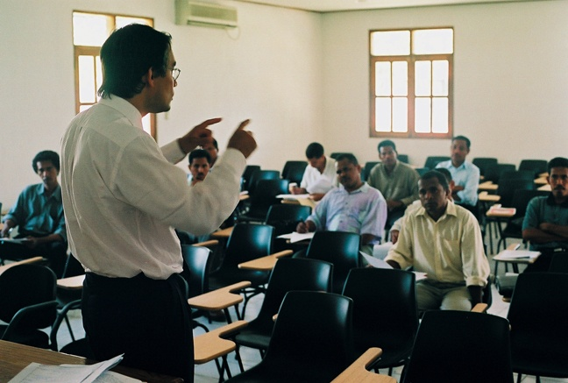
SS-GATE by the numbers
Listed Projects | 7,087
Matched Projects | 2304
Transacted Projects | 957

Slide 10
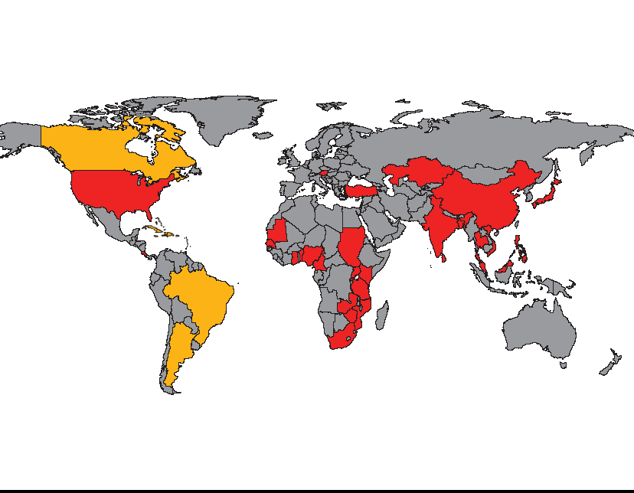
SS-GATE: Global Scope
SS-GATE on the ground Partnerships
50 centers in 37 Countries
1000+ beneficiary organizations

Slide 11
























SS-GATE: Partnerships
Government of Tanzania
Government of Mali
Government of Norway
Government of Kenya
Notes:
Global Network:
UN agencies
Public & private sector
International orgs
Civil society

Slide 12
Partnership Highlights
Aquaculture
Vietnam-Benin
Tilapia (8,000)
Carp (6000) fingering initially
Results:
10 big farms in Nigeria and 6 big farm in Benin.
More than 100 young Tilapia farmers now using Songhai fingerling with growing demand
Housing project
Zambia
US$30 million
First phase 400 houses
Results:
Expanded to other countries
More than 8 countries benefited
One million houses per country
in 10 years
- Skills transfer and training

Slide 13

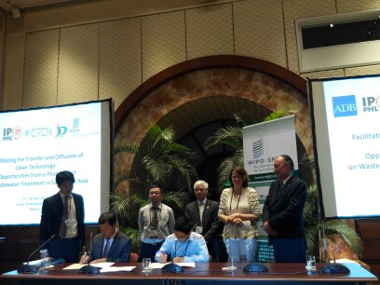
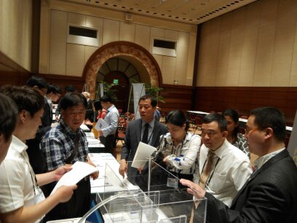
WIPO Green Partnership
Matchmaking event,16 letters of intent signed
Conducted joint workshops on IP and tech-transfer
Shared and showcased southern solutions

Slide 14
Conclusion
Strong partnership
Effective collaboration
Better cooperation

Slide 15


Thank You
United Nations Office for South-South Cooperation

