Slide 1
How policy makers can facilitate the establishment of an IP Ecosystem for the growth of youth entrepreneurship and start-up
By Tom Ogada
Representing Office of Special Advisor on Africa (OSAA)
April 25-26, Kigali, Rwanda

Slide 2
I am a member of the IPR Working Group under the Africa Knowledge Network of UN Office of the Special Adviser on Africa (OSAA), which is located in UNHQ.
The Africa Knowledge Network was launched in June 2021 to advance Africa’s priorities, amplify Africa’s voice, in particular those of academics and practitioners, and promote a new narrative on Africa from Africa at the global arena.
Science, Technology and Innovation (STI) is one of six priorities of OSAA’s strategic agenda and the IPR working group strives to promote better understanding of African policy makers of the role of IP in sustainable development as well as challenges and opportunities of intellectual property rights (IPR), including through producing knowledge products.

Slide 3
My interventions
01
02
03
04
05
Revisit the IP Ecosystem
Need for evidence for policy makers
Need for startups policies and legislations
IP challenges: Perspectives of innovators and startups
Possible policy/strategy intervention areas

Slide 4
1: Revisiting IP Ecosystem
IP Creation
Academia
Innovators
SMEs and start-ups
06
01
Structures, Policies, Legislations and Actors
Financial Capital for IP Exploitation
National Finance support
Venture fundings
Policy incentives for existing banks to support access to finance
Skills for proposal development and pitching
02
IP Protection
National IP Offices
Institutional IP Offices
IP service providers
IP laws
05
03
04
Human resources for IP protection and exploitation
IP Attorneys
Patent Drafters
IP commercialization experts
IP Commercialization
Commercialization Structures
Business and other IP commercial users
Startups
Innovation hubs, accelerators and incubation services
IP enforcement
Robust IP protection and enforcement institutional and legal regime

Slide 5
2: Need for evidence for policy making
Use of evidence for policy making processes (2020-2023)
African Centre for Technology Studies is an STI policy think tank established in 1988 and mandated to support African countries to harness STI for sustainable development. This we do through policy research, policy dialogue and technology brokerage.
Since 2020, we are implementing a three-year project on use of evidence for policy making, funded by Canadian IDRC and we are working with 15 African Science Granting Councils. All these councils are mandated to review and develop STI policies. Key lessons learned are:
STI policy makers appreciate the use of evidence for policy and decision making
However, policy makers do not have time to generate the required data and they need support on this
Recommendations
Policy makers can facilitate/support undertaking a comprehensive analysis of the status of the IP ecosystem and prepare an IP strategy with a focus on the growth of youth entrepreneurship and startups

Slide 6
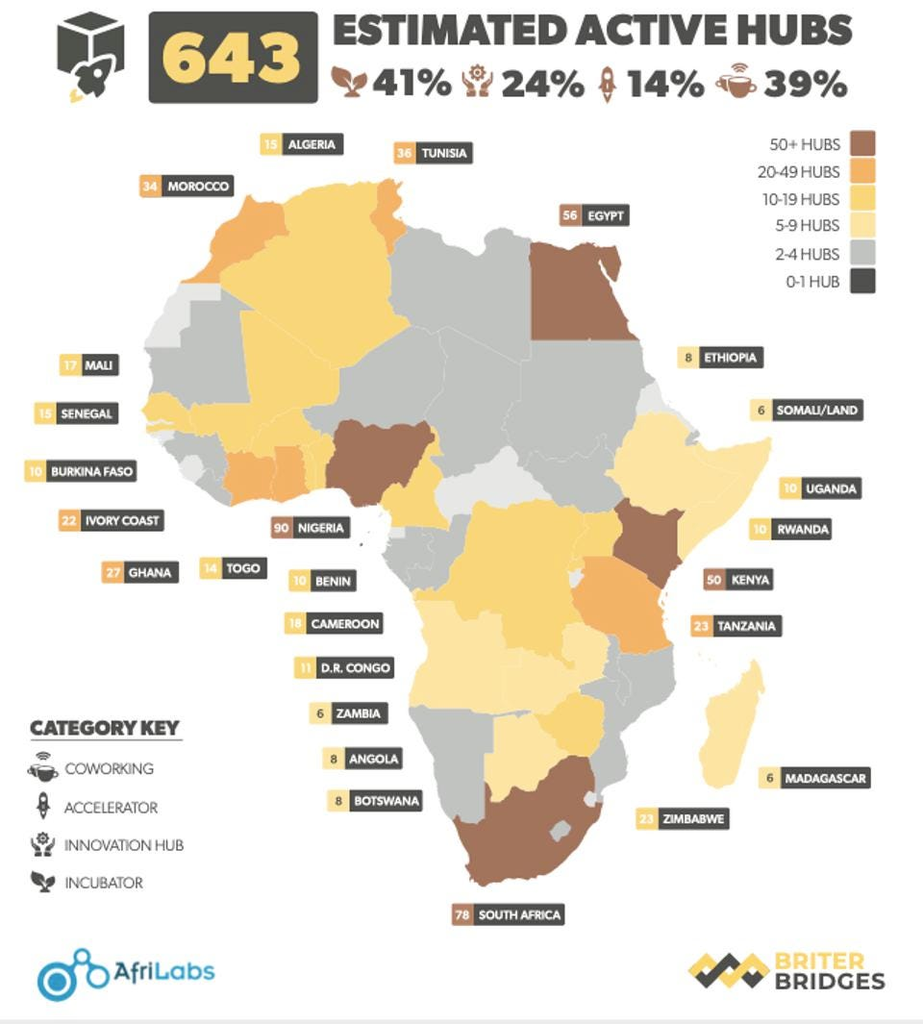
3: Africa is behind in startups policies and legislations
Rapid growth rate of startups and hubs in Africa, but limited policies
Startups and hubs are growing at alarming rate
Kenya has over 200 hubs and the number, 80% established during the last 5 years
Currently there only two countries with Startup Acts : Tunisia (2018), and Senegal (2021). Kenya has a startup bill pending in parliament.
Formulating policies, strategies and legislations on startups, with a focus on youth entrepreneurship is therefore urgent and justified. Such document should provide for IP related incentives

Slide 7
4: IP related Challenges of innovators and startups
Mapping of the innovation ecosystem in Kenya – UNDP
Objective: review characteristics of the key actors, challenges and opportunities to generate evidence to that can be used to accelerate the growth of the ecosystem
Methodology: We have interviewed
120 innovators and startups
92 hubs (innovation hubs, accelerators, innovation incubations)
33 academic innovation labs
21 networks and marketing organizations
47 Skills trainers
24 Financing institutions
Innovators/Start-ups
Only 44% had tried to protect their innovations and less than 5 % succeeded.
Access to IP information
Patent process is complicated, lengthy and time consuming
High cost of patent in terms of application and maintenance
Weak IP enforcement
Hubs, accelerators and incubators
Prioritised IP as one of the skills they require in order to service innovators and start-ups better.
Academia Innovation labs
Most of the existing legal personnel do not have experience in IP
Inadequate institutional support towards IP development, and
lack of resources to support innovation development and commercialization

Slide 8
5: possible policy intervention areas
1: IP Creation
Support for development of IP assets to innovators
04
01
6: Financial Capital for IP Exploitation
Policy incentives for existing banks to support access to finance
Capacity building on proposal development, fundraising and pitching
03
2: IP Protection
Support for drafting, and protection of IP rights from youth and start-ups
Awareness creation programs
Training of hubs managers on IP
02
02
03
5: Human resources for IP exploitation
Capacity building on
patent drafting, valuation, and licensing and Incentives for the youth to access these services
4: IP enforcement
Faster ruling on IP disputes
3: IP Commercialization
Programs to support commercialization of innovative projects of graduates from TVET and universities

Slide 9
Thank you
Contact: t.ogada@acts-net.org

