Slide 1
Global Brand Database
An Introduction
Cyberworld
October
2017
Sandrine Ammann
Marketing & Communications Officer

Slide 3
Agenda
Interface:
Search features
Filter features
Results
Menus
Examples
Q&A

Slide 4
Why is the GBD useful?
Find details about a specific brand
Explore mark landscape to find out if the brand you have in mind already exists.

Slide 5
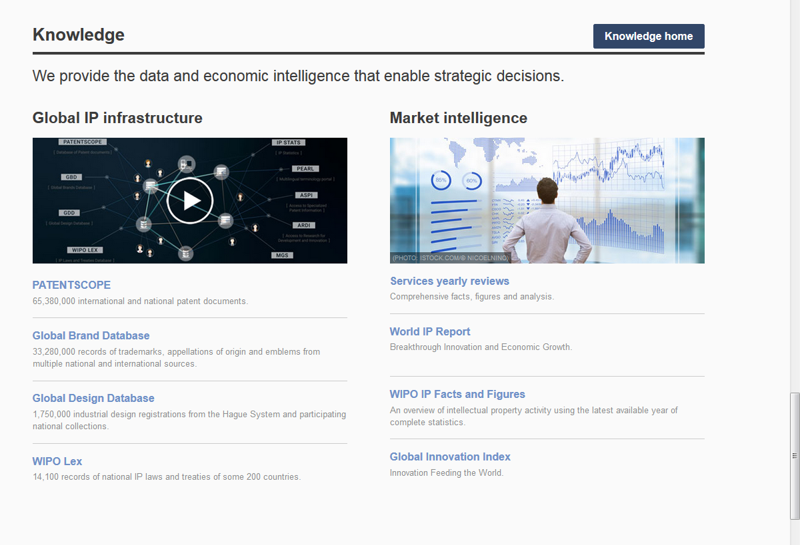
Access
www.wipo.int/branddb
www.wipo.int

Slide 6
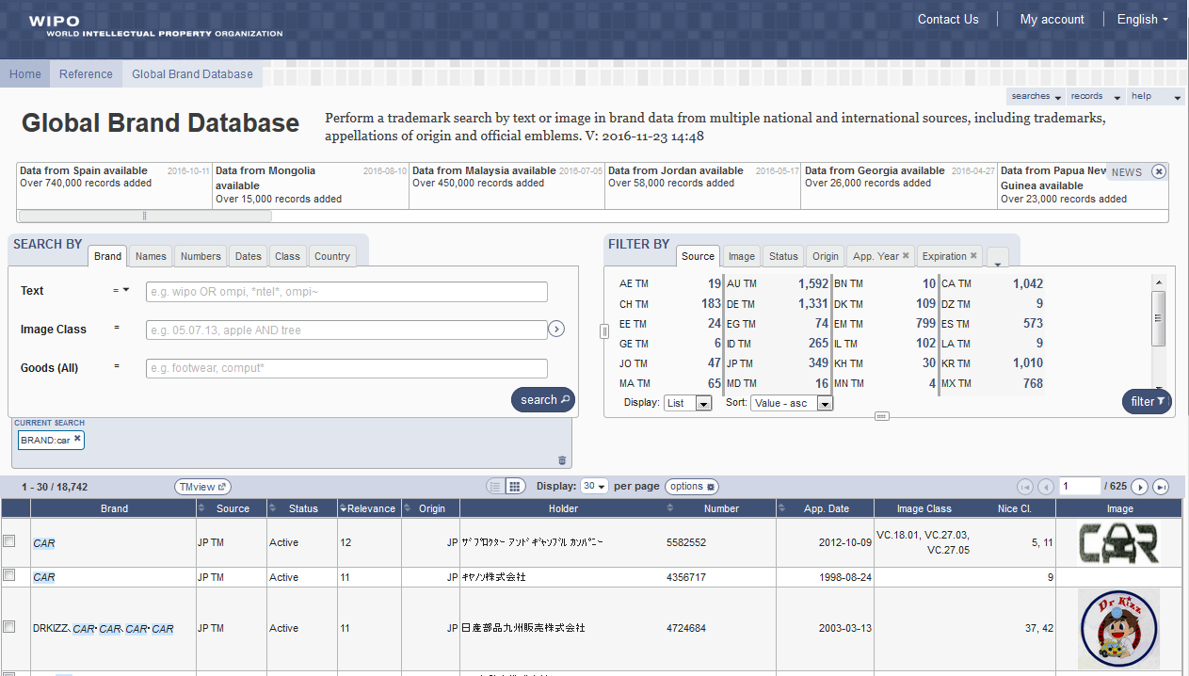
5
6
1
2
3
4

Slide 7
Search by: 1
1

Slide 8
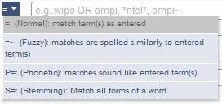
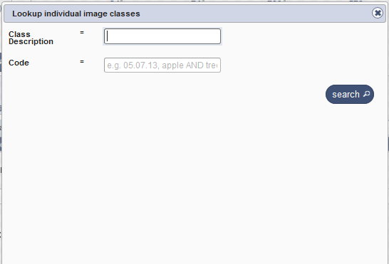
Search by

Slide 9
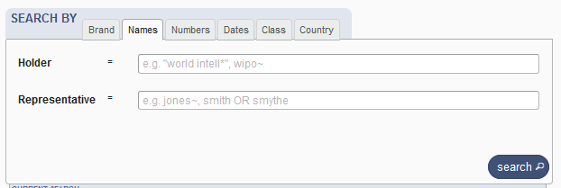
Search by Names

Slide 10
Search by Numbers

Slide 11
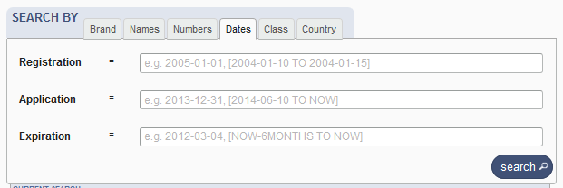
Search by Dates

Slide 12
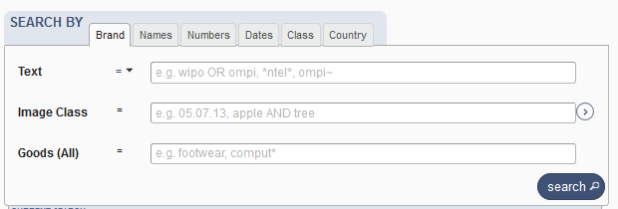
Search by Class

Slide 13
Search by Country

Slide 14
Terms, Operators, Wildcards, Auto-suggest
Each field supports:
Terms: single or «multiple words»
Boolean operators: AND, OR, NOT
Grouping: (…)
Wilcards: * = 0 or multipple letter; ? = 1 letter
Proximity operators: «…» ~10
Fuzzy: ~+ value between 0 and 1
Range: [..]/{…}
Suggestions of potential matching terms

Slide 15
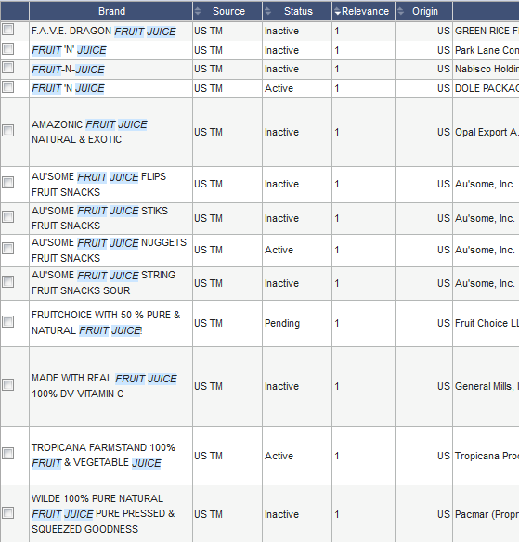
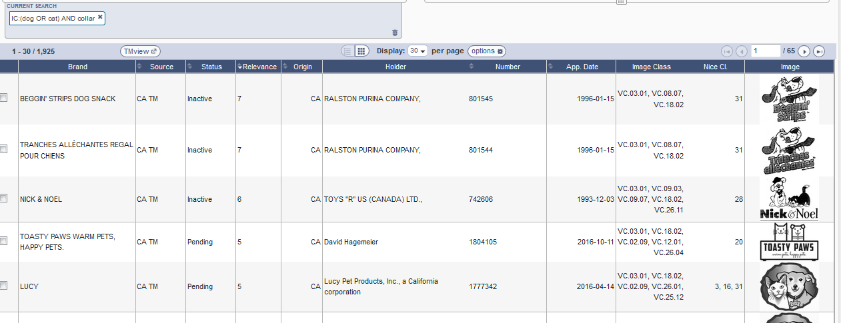
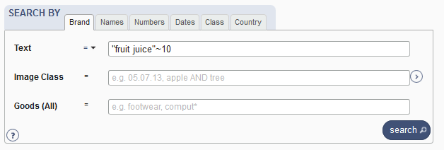
Examples

Slide 16
Filter by: 2
2

Slide 17
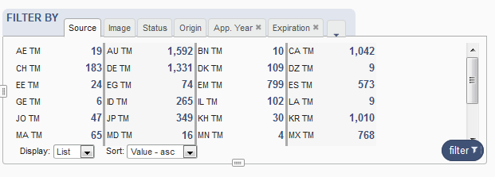
Filter by

Slide 18
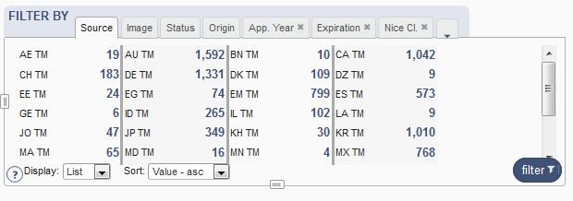
Filter by: Source

Slide 19
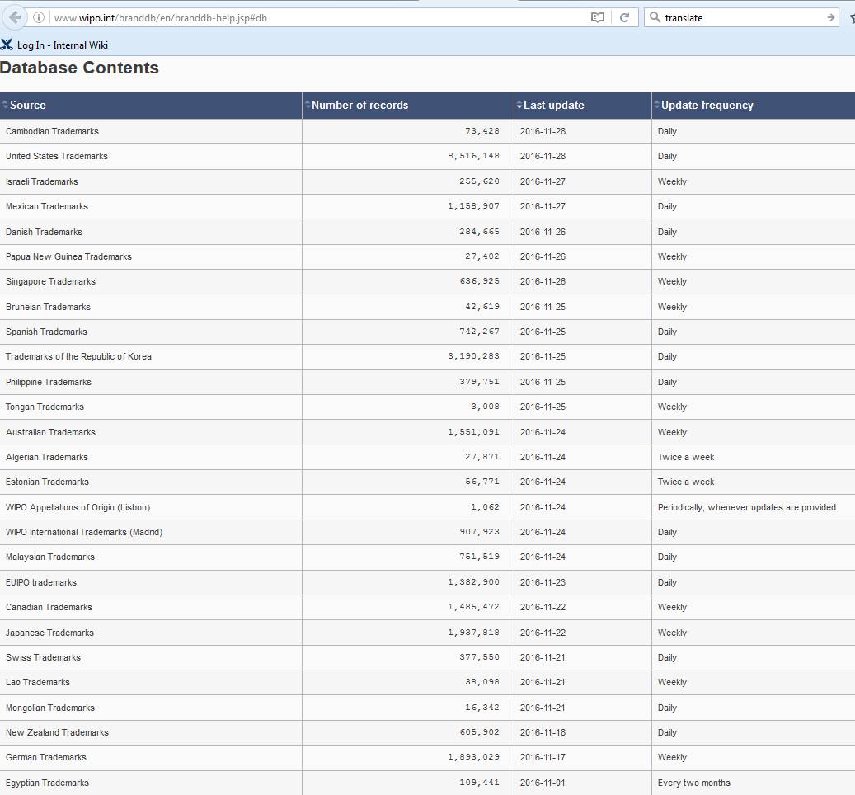
Coverage
http://www.wipo.int/branddb/en/branddb-help.jsp#db

Slide 20
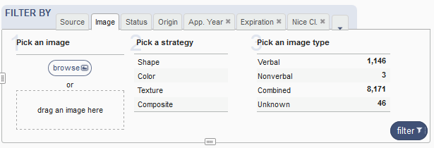
Filter by: Image

Slide 21
Image search
Your search
The results

Slide 22
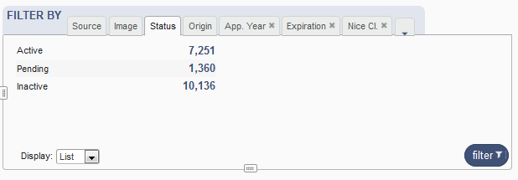
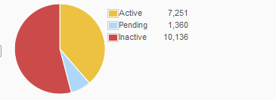
Filter by: Status

Slide 23
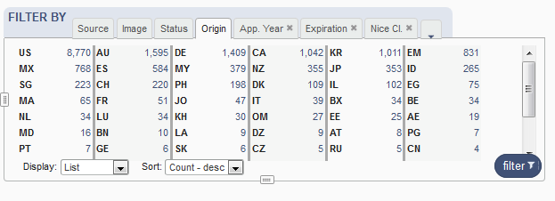
Filter by: Origin

Slide 24
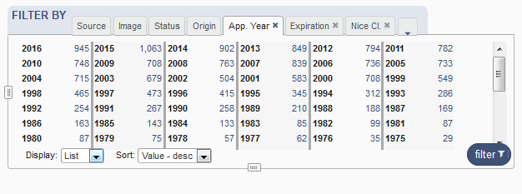
Filter by: Application Year

Slide 25
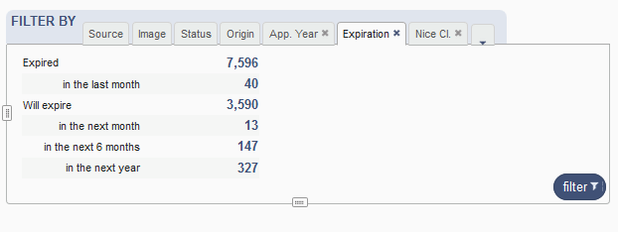
Filter by: Expiration

Slide 26
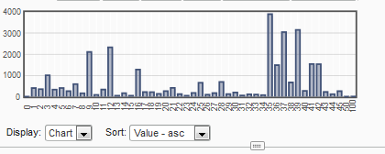
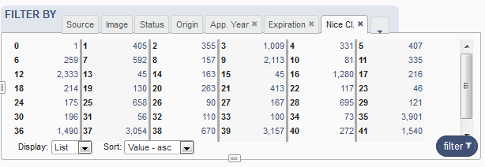
Filter by: Nice Classification

Slide 27
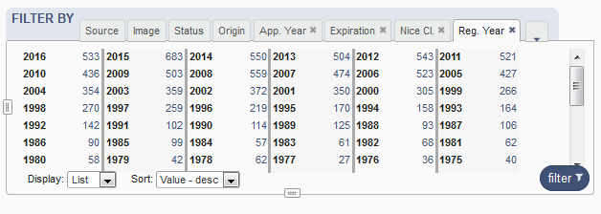
Filter by: Registration year

Slide 28
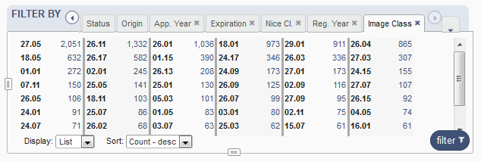
Filter by: Image classification

Slide 29
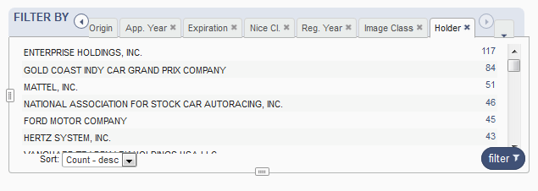
Filter by: Holder

Slide 30
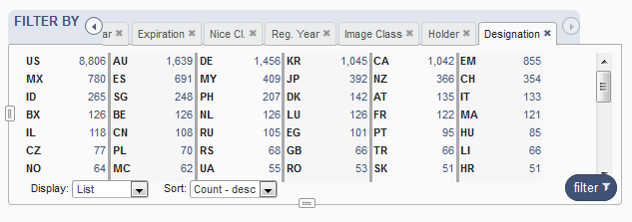
Filter by: Designation

Slide 31
Current search: 3
3

Slide 33
Search results: 4
4

Slide 34
Result area: pager & list

Slide 35
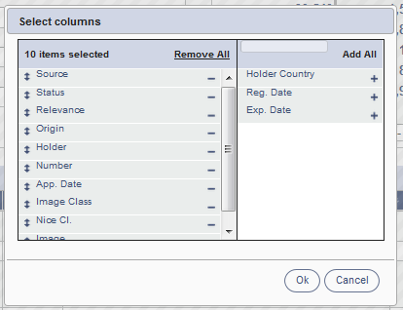
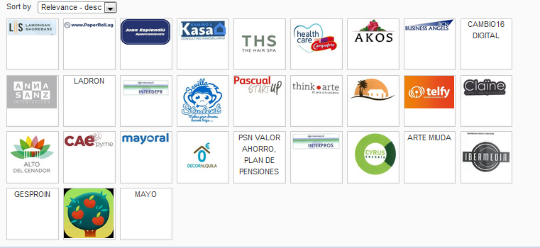
Pager

Slide 36
Record list – list format

Slide 37
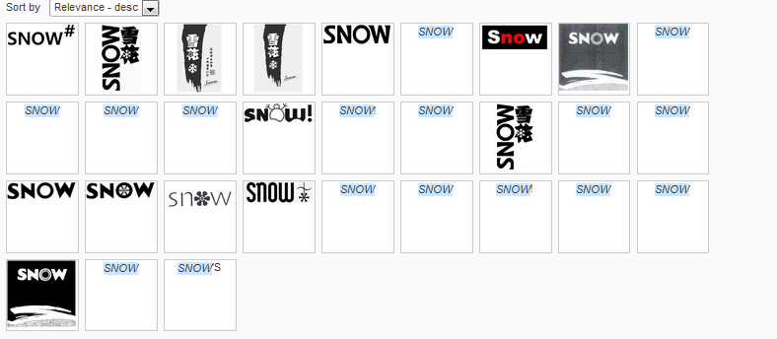
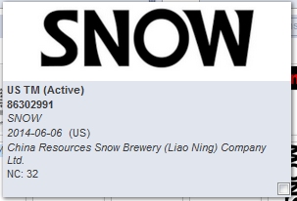
Record list – grid format

Slide 38
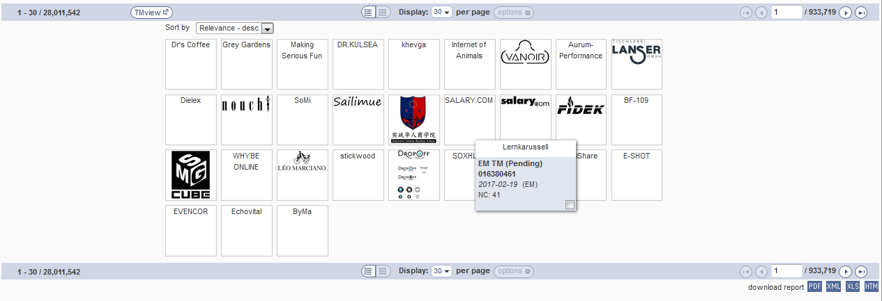
Download reports

Slide 39
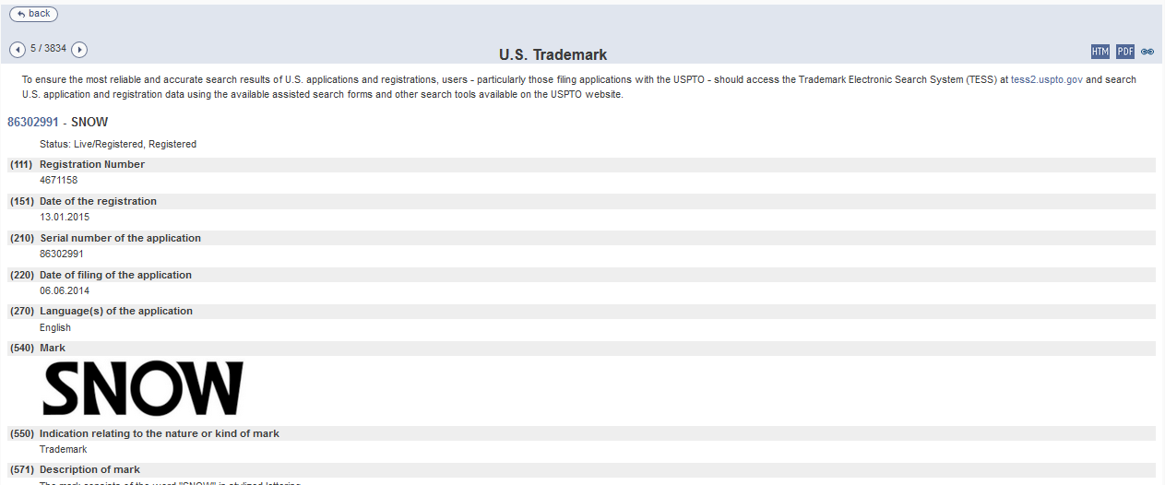
Record view

Slide 40
Menu: 5
5

Slide 41
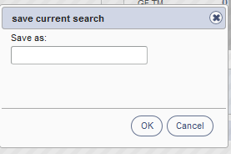
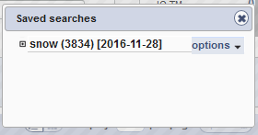
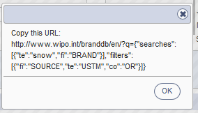

Slide 42
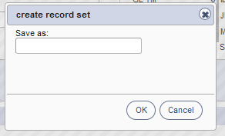
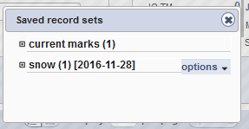

Slide 44
News: 6
6

Slide 45
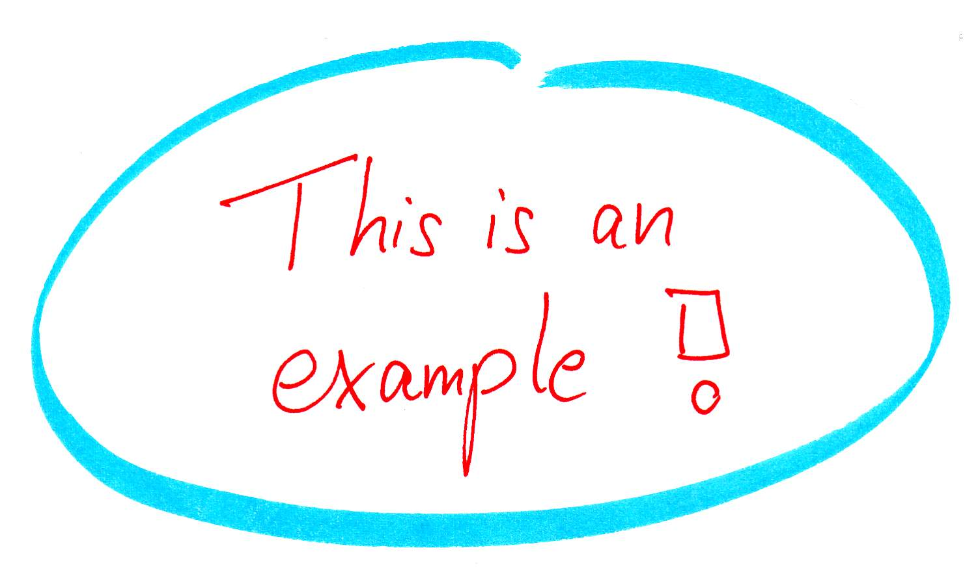

Slide 46
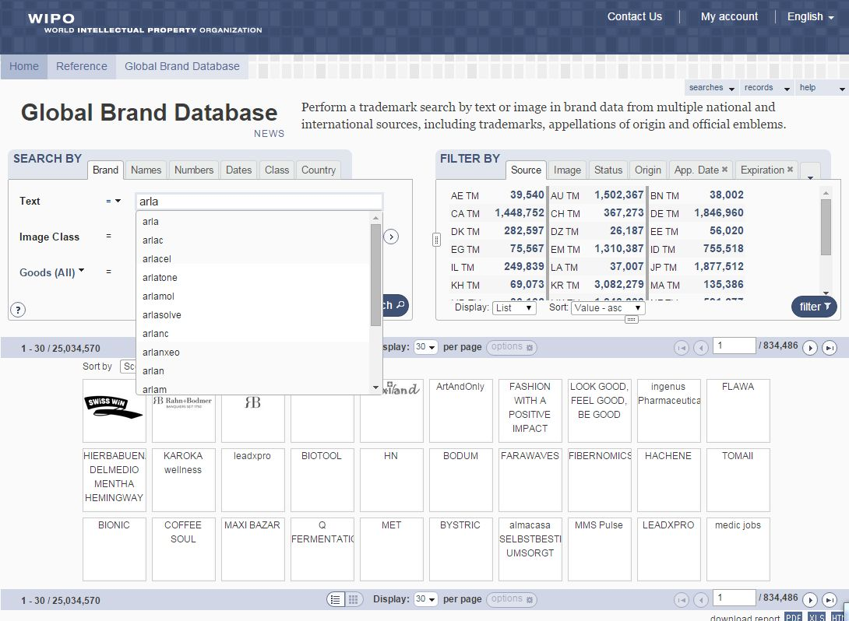

Slide 47
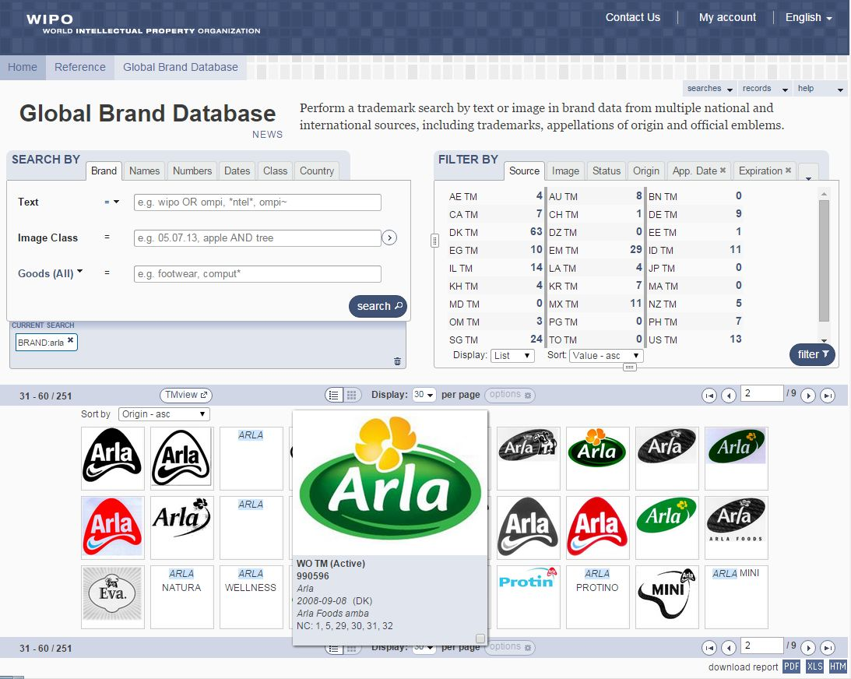

Slide 48
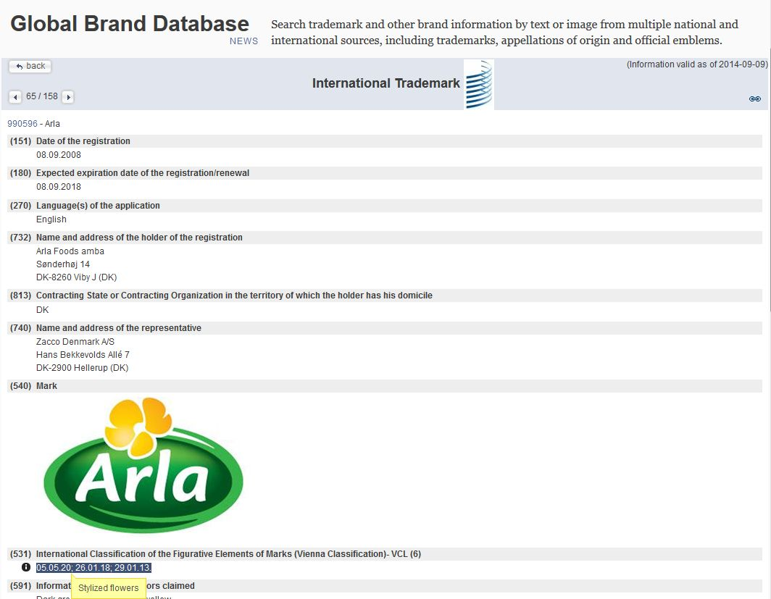

Slide 49
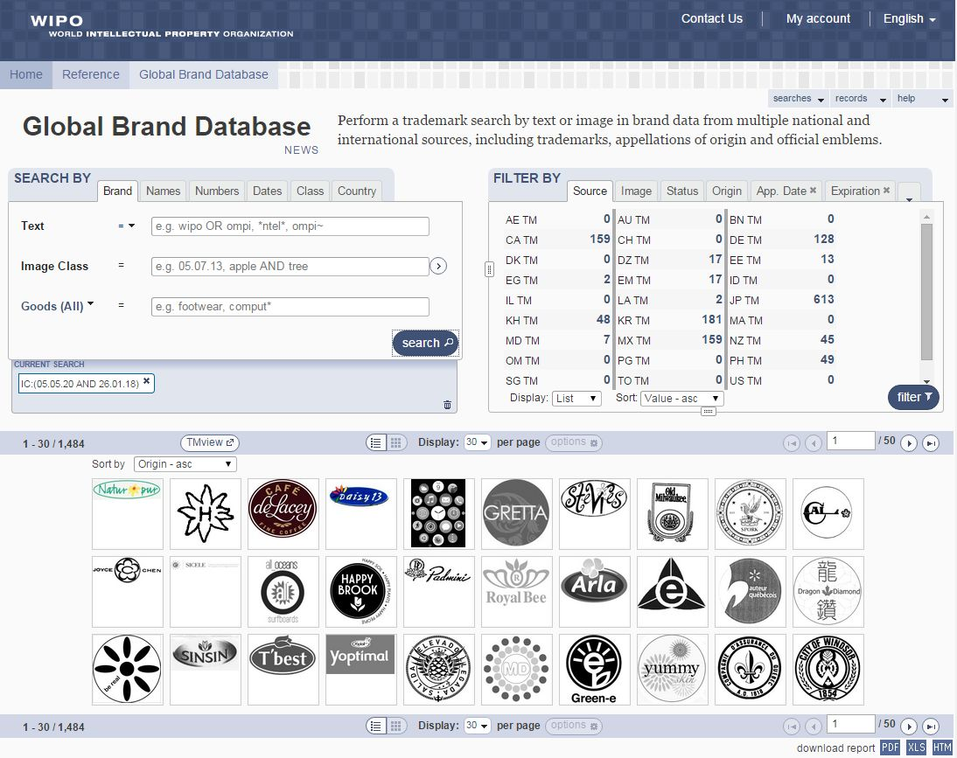

Slide 50
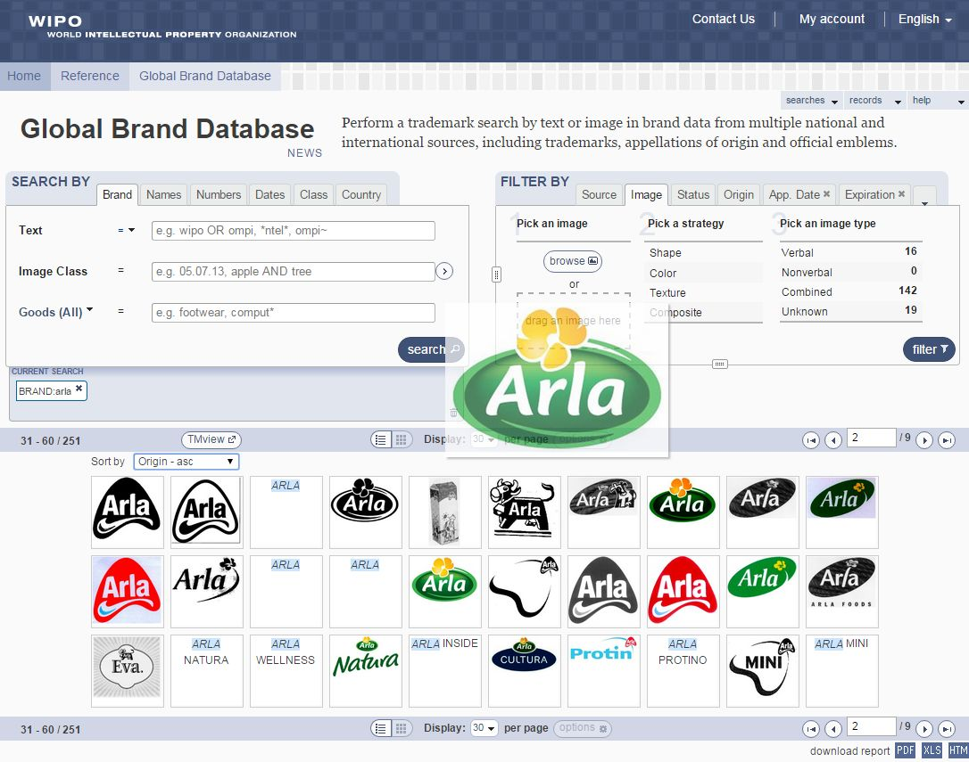

Slide 51
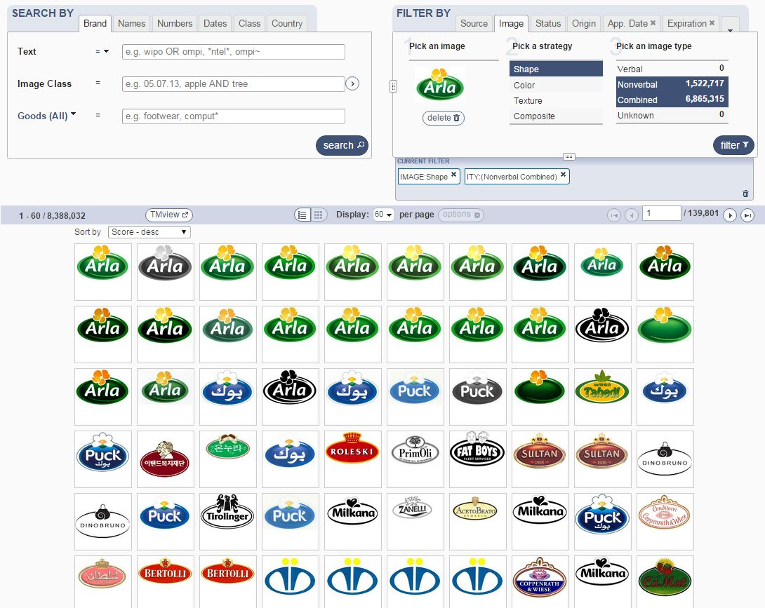

Slide 52
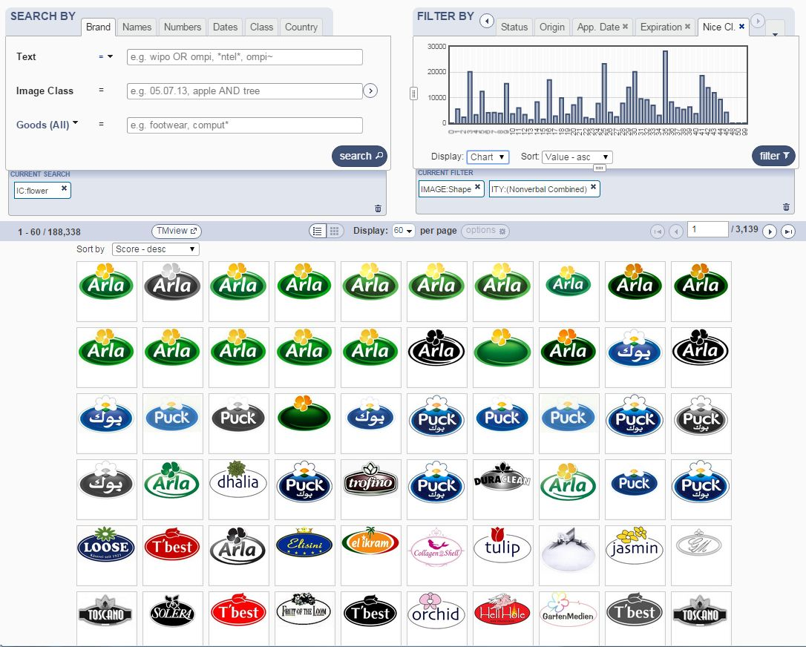

Slide 53
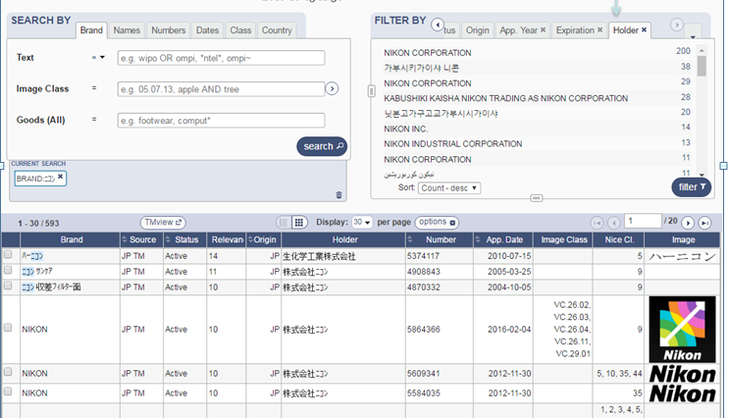

Slide 54
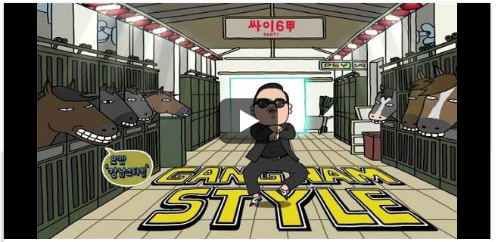

Slide 55
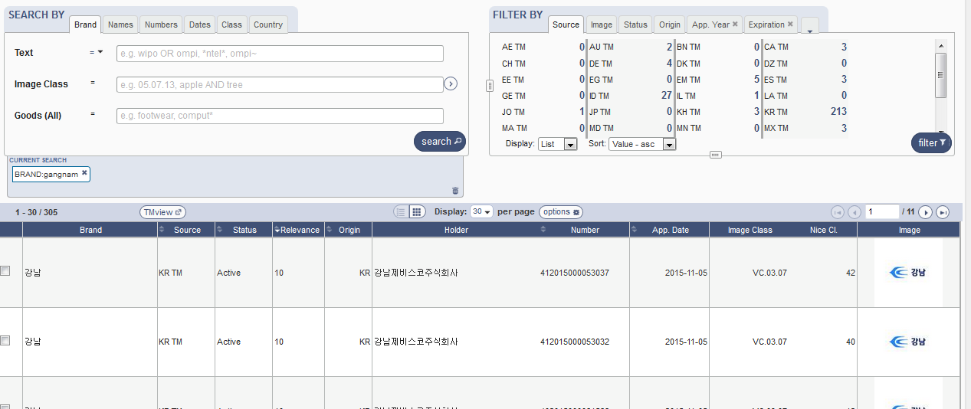
Gangnam

Slide 56
Next Webinar
Performing effective searches in the GBD
November 28 at 5:30pm CET
https://attendee.gotowebinar.com/rt/8193445586516212994
November 30 at 8:30 am CET https://attendee.gotowebinar.com/rt/8193445586516212994

Slide 57
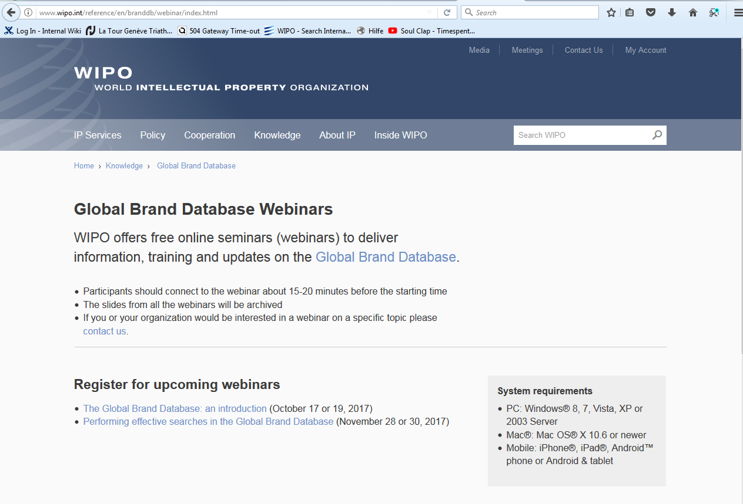

Slide 58
Global Design Database: webinar
The Global Design Database: an introduction
October 24 at 5:30pm CET
https://attendee.gotowebinar.com/rt/2647760724176844290
October 26 at 8:30 am CET
https://attendee.gotowebinar.com/rt/2647760724176844290

Slide 59
Patent database webinar
PATENTSCOPE for experts
November 14 at 5:30 pm
https://attendee.gotowebinar.com/rt/7639402775417310466
November 16 at 8:30 am
https://attendee.gotowebinar.com/rt/7639402775417310466

Slide 60
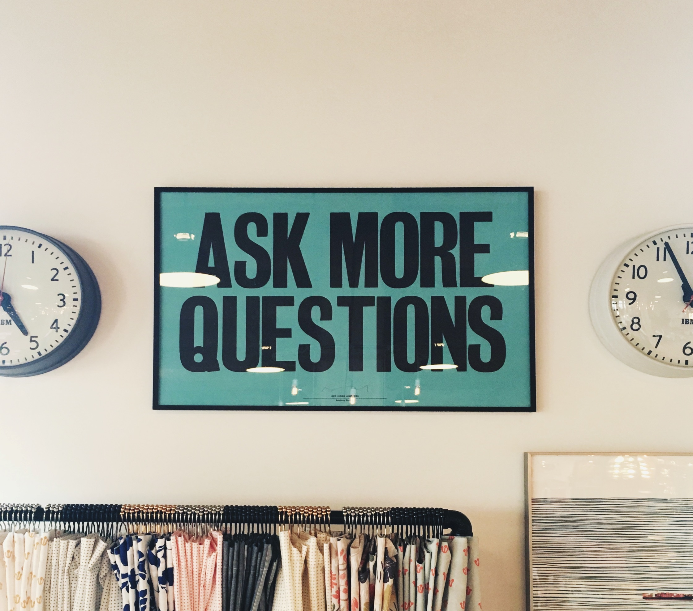

Slide 61
mulțumesc
mulțumesc
gbd@wipo.int

