Slide 1
How to perform effective searches in the Global Brand Database
Cyberworld
November
2017
Sandrine Ammann
Marketing & Communications Officer

Slide 2
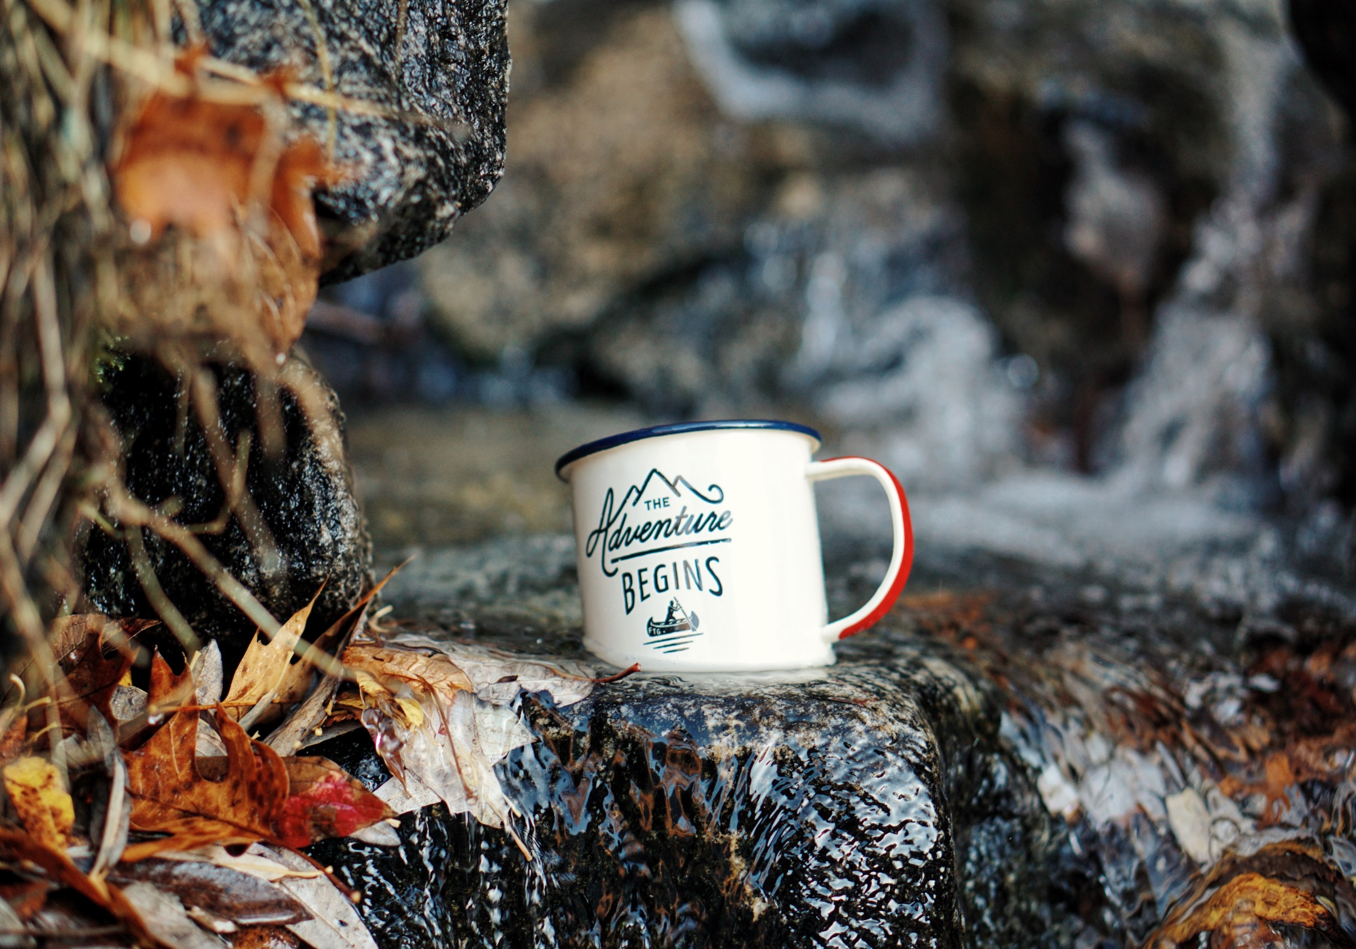

Slide 3
Agenda
Interface:
Search features
Filter features
Results
Menus
Examples
Q&A

Slide 4
Why is the GBD useful?
Brand landscape
Details about brands

Slide 5
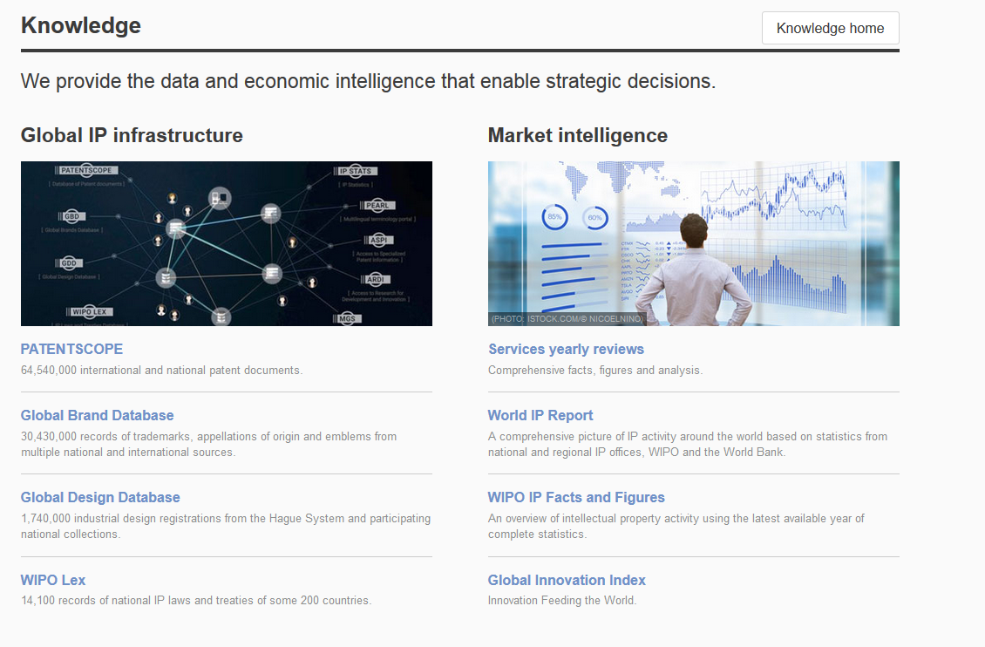
Access
www.wipo.int/branddb
www.wipo.int

Slide 6
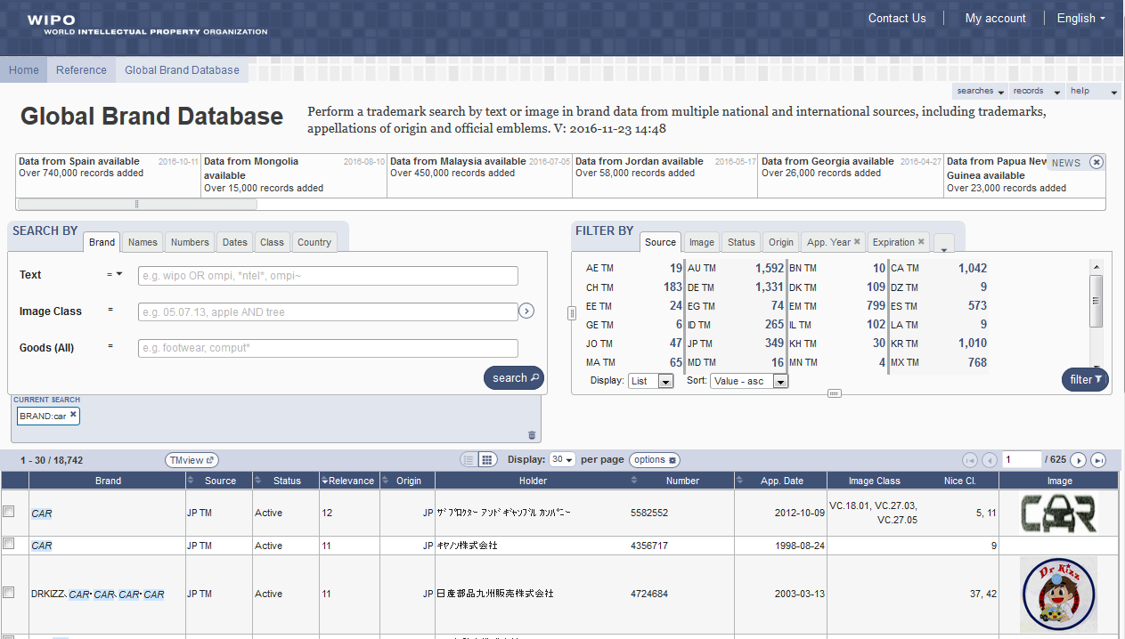
Interface - Account

Slide 7
5
6
1
2
3
4

Slide 8
Search by: 1
1

Slide 9
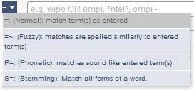
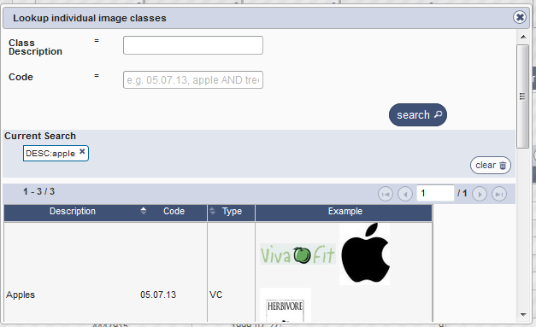
Search by

Slide 10
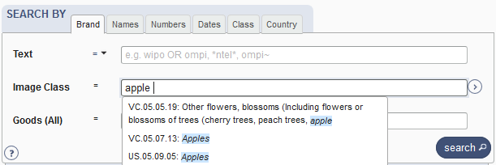

Slide 11
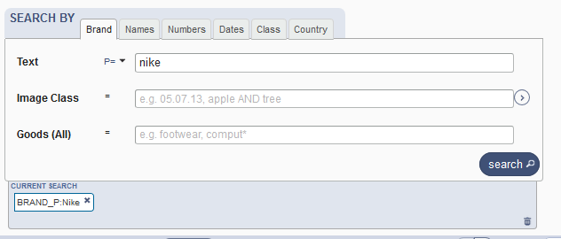
Example: phonetic search

Slide 12
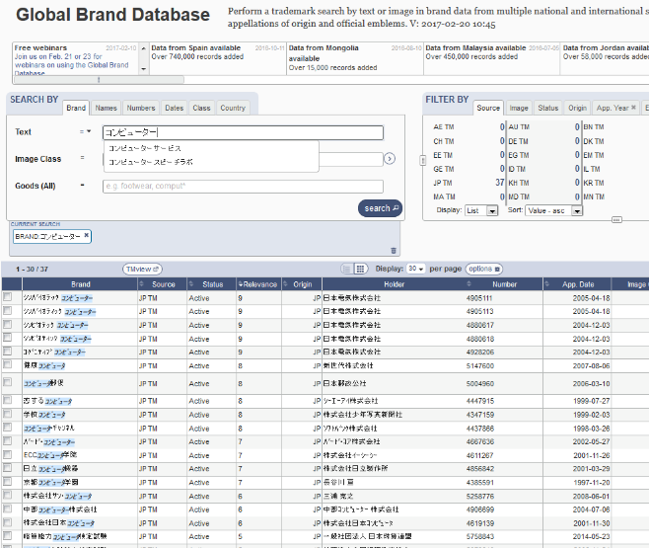
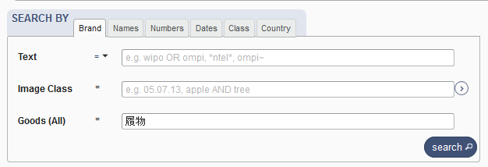
Languages - autosuggestion

Slide 13
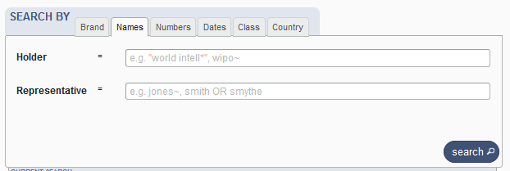
Search by Names

Slide 14
Search by Numbers

Slide 15
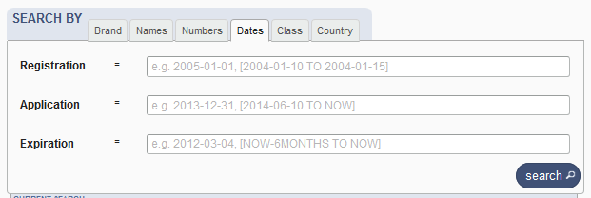
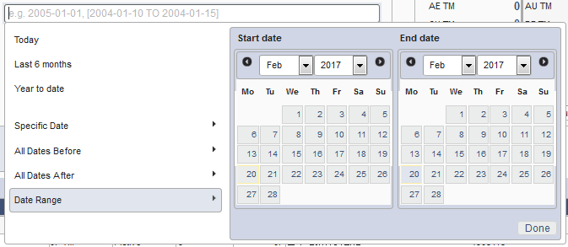
Search by Dates

Slide 16
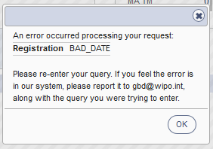
Tips
Range: […]{…} + TO
Error message

Slide 17
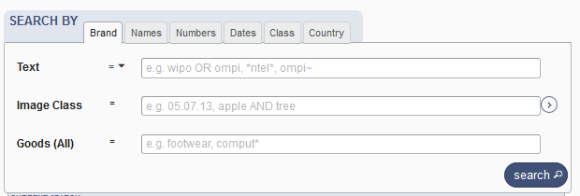
Search by Class

Slide 18
Search by Country

Slide 19
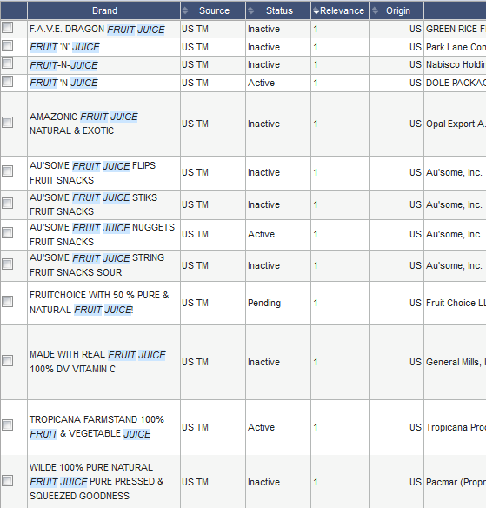
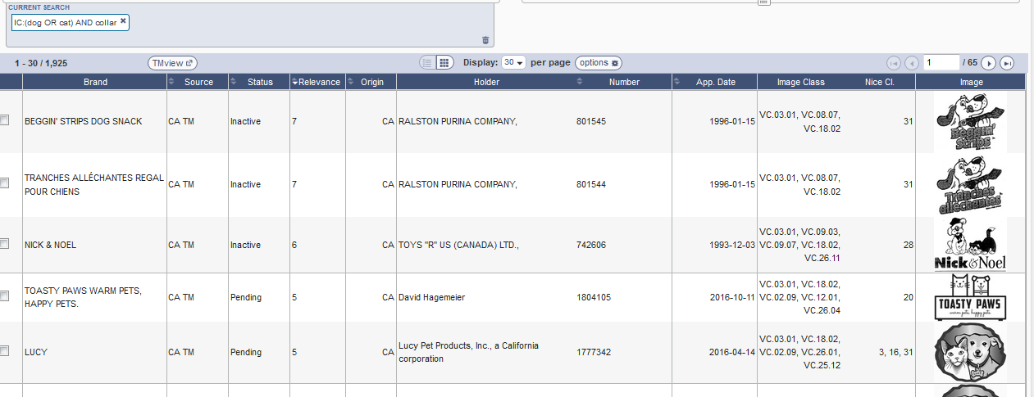
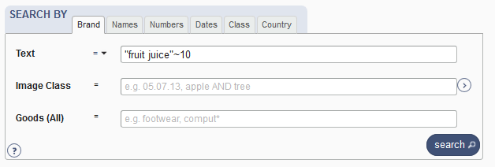
Examples

Slide 20
Tips
OR
Not limit
Needle or "hypodermic needle"
Transliteration:
Korean + Japanese : automatic
Arabic: not supported
Punctuation/ accent: ignored

Slide 21
Wildcards, fuzzy, proximity
Wilcards: * = 0/multiple letter; ? = 1 letter
te?t 'test' and 'text‘
text* 'text', 'texts', 'texting‘
*text or te*t.
Proximity operators: «…» ~10
Fuzzy: ~+ value between 0 and 1
alco~ 'also', 'alcoh', 'asco'

Slide 22
Filter by: 2
2

Slide 23
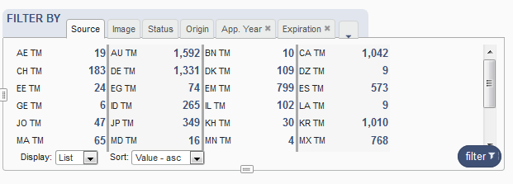
Filter by

Slide 24
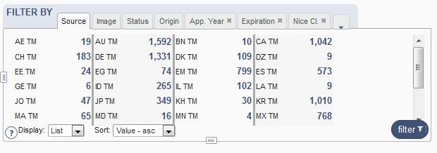
Filter by: Source

Slide 25
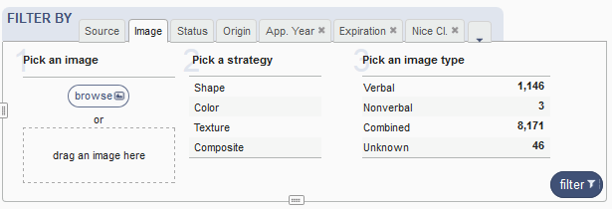
Filter by: Image

Slide 26
Image search
Your search
The results

Slide 27
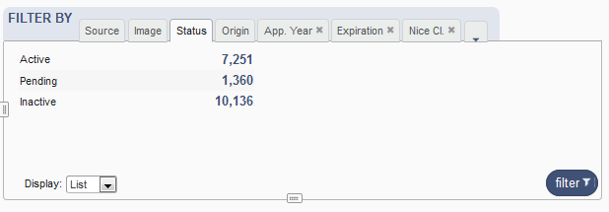
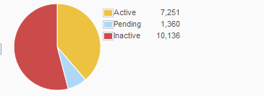
Filter by: Status

Slide 28
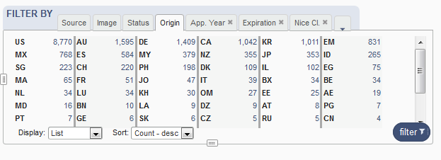
Filter by: Origin

Slide 29
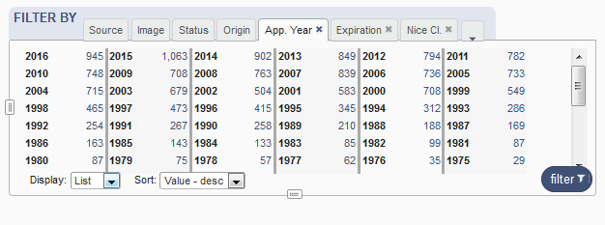
Filter by: Application Year

Slide 30
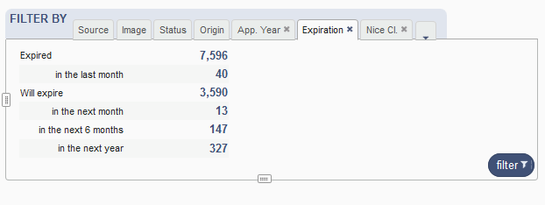
Filter by: Expiration

Slide 31
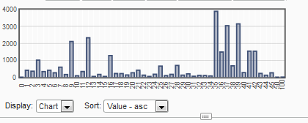
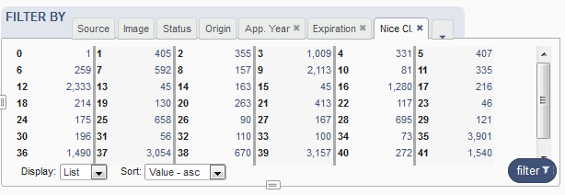
Filter by: Nice Classification

Slide 32
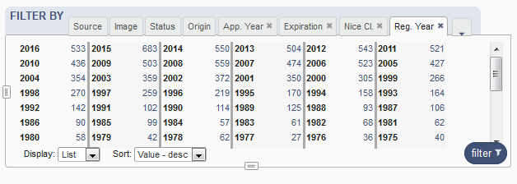
Filter by: Registration year

Slide 33
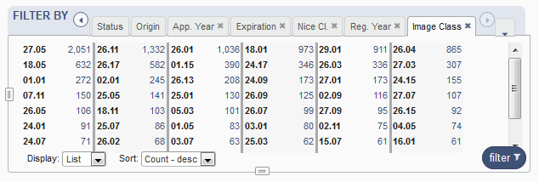
Filter by: Image classification

Slide 34
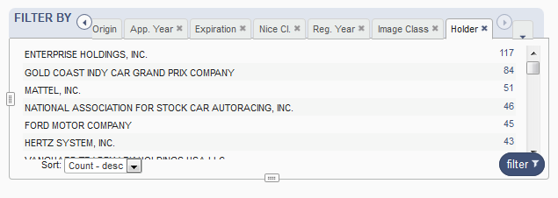
Filter by: Holder

Slide 35
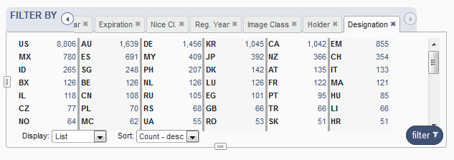
Filter by: Designation

Slide 36
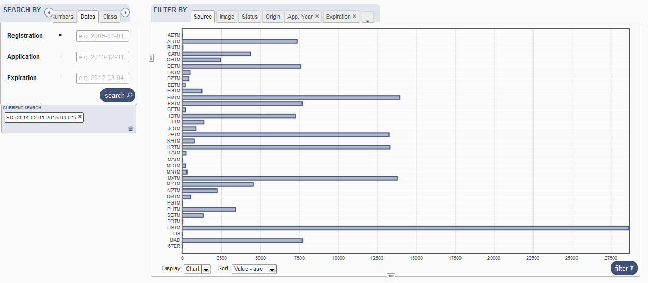
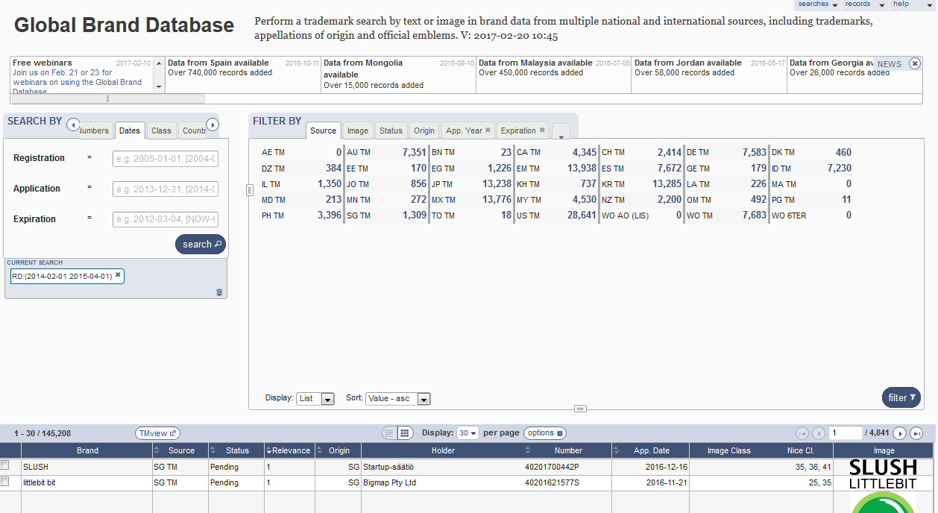
Resize

Slide 37
Current search: 3
3

Slide 39
Search results: 4
4

Slide 40
Result area: pager & list

Slide 41
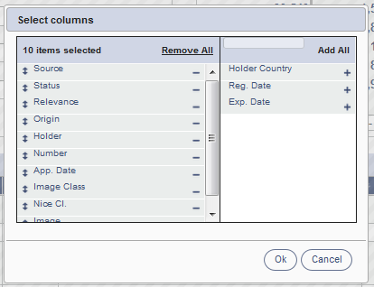
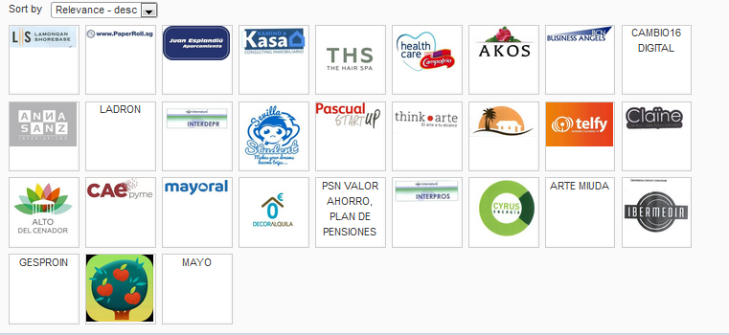
Pager

Slide 42
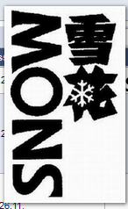
Record list – list format

Slide 43
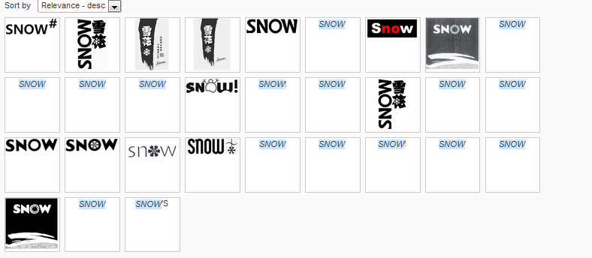
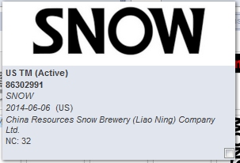
Record list – grid format

Slide 44
Download reports

Slide 45
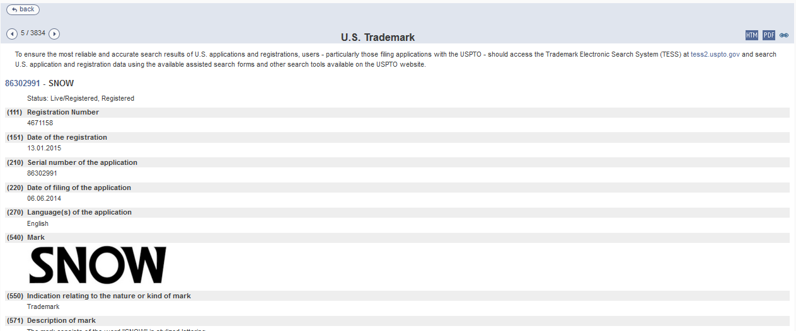
Record view

Slide 46
Menu: 5
5

Slide 47
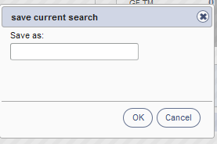
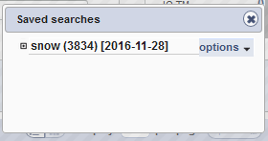
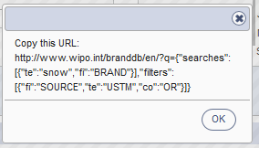

Slide 48
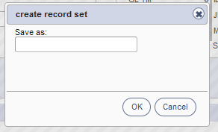
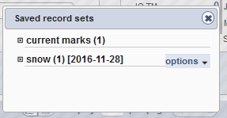

Slide 50
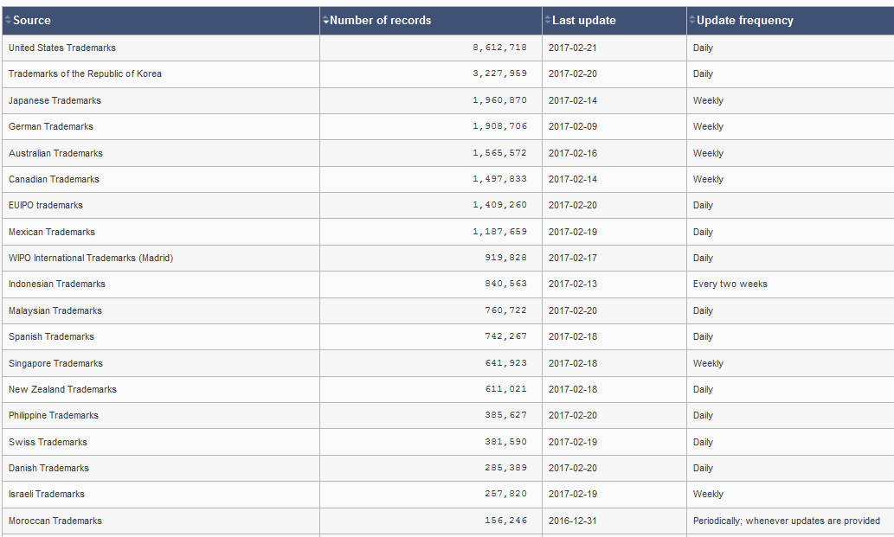
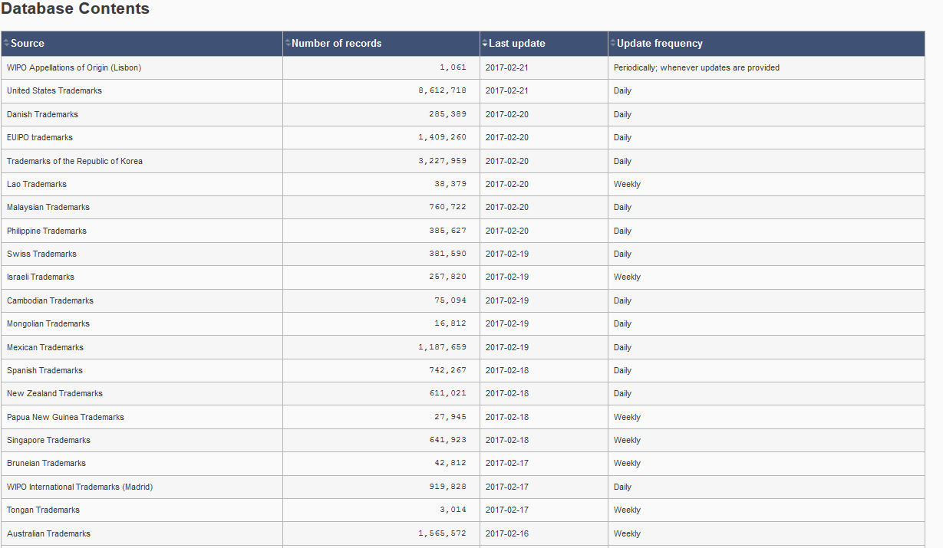

Slide 51
News: 6
6

Slide 53
Combining many search criterias
Brand Arla
2 Nice classifications: 20 & 43
2 designating countries: Japan & Denmark

Slide 54
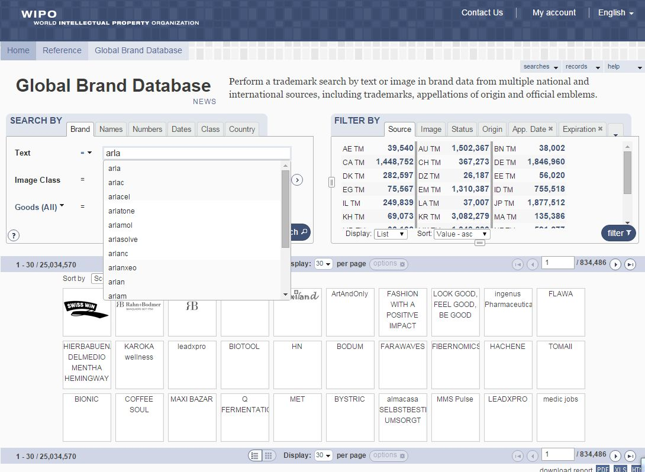

Slide 55
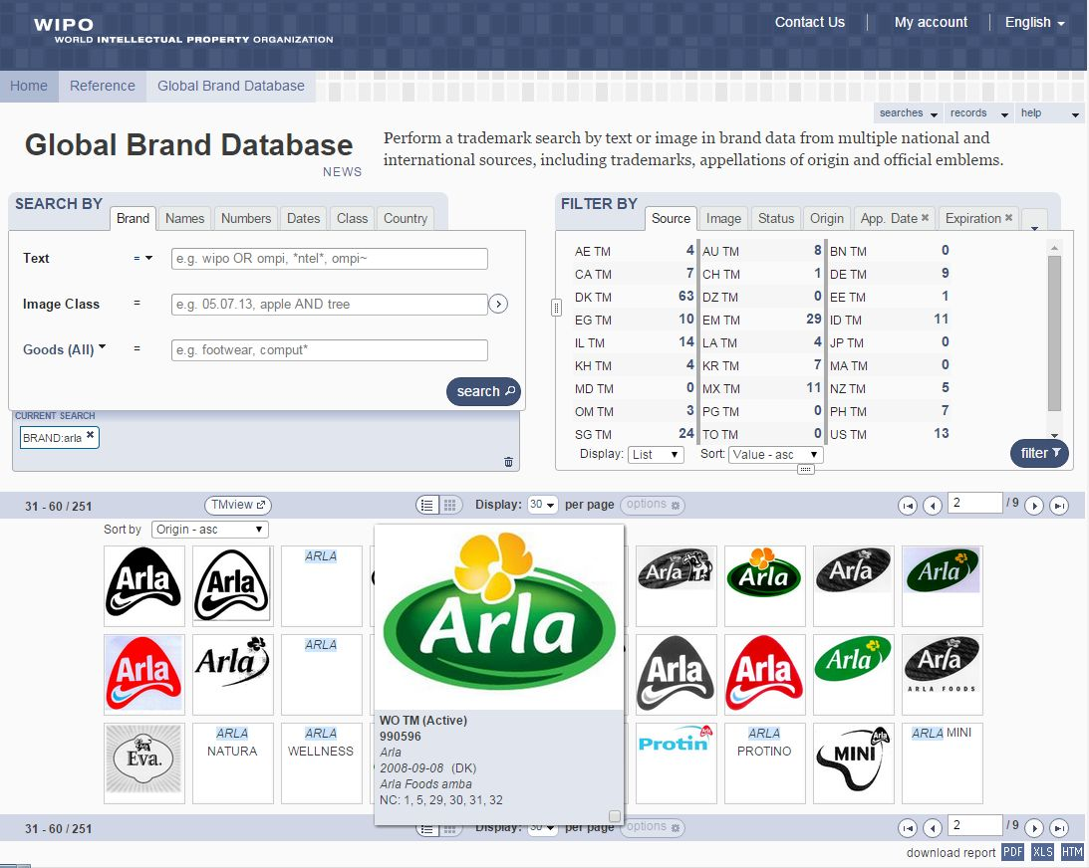

Slide 56
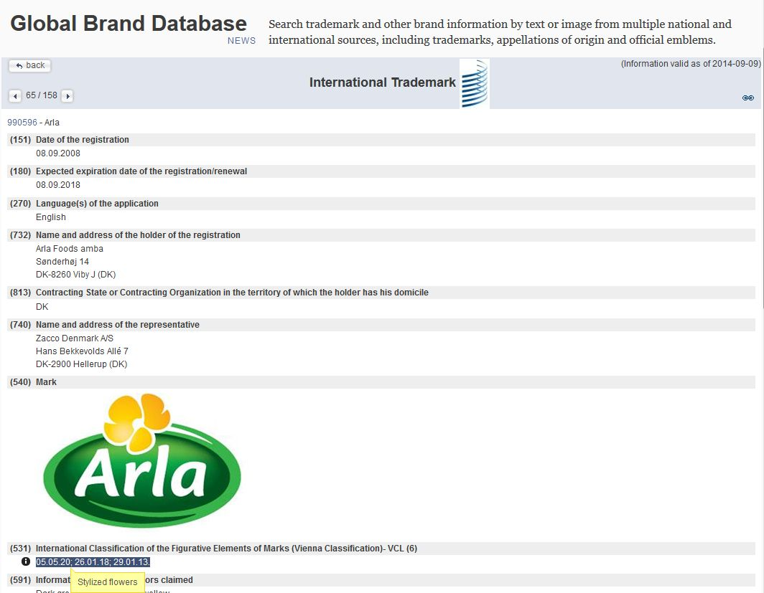

Slide 57
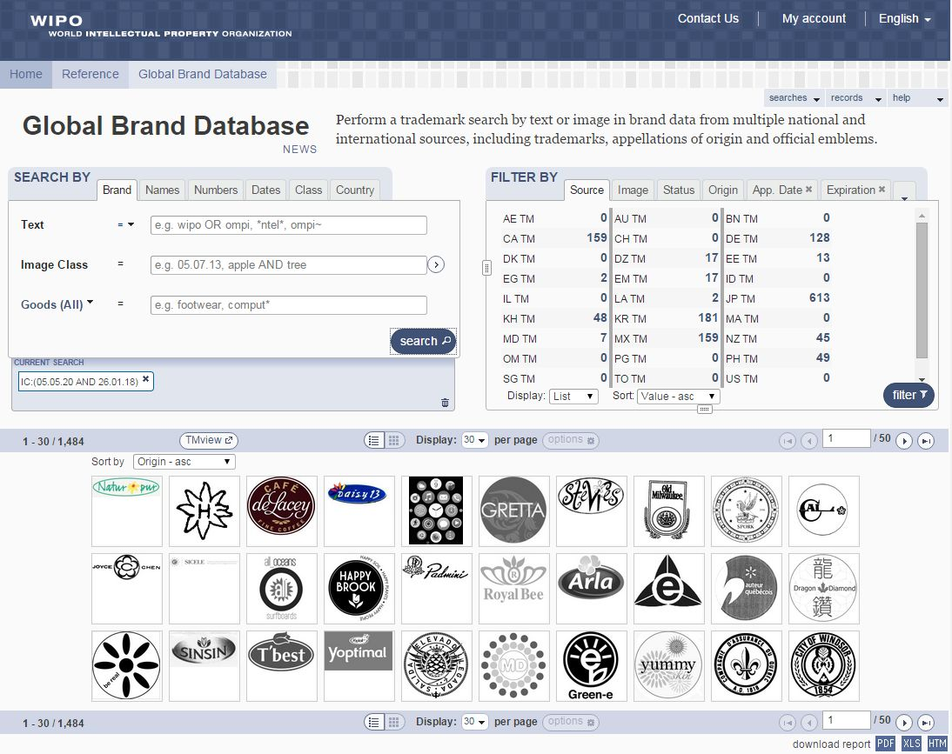

Slide 63
Gangnam

Slide 65
mulțumesc
mulțumesc
gbd@wipo.int

