Slide 1
How to perform effective searches in the Global Brand Database
Cyberworld
April
2018
Sandrine Ammann
Marketing & Communications Officer

Slide 2
Agenda
Survey results & clarification
Interface:
Search features
Filter features
Results
Menus
Examples
Q&A

Slide 3
Survey results
Madrid Monitor (Romarin)

Slide 4
Why is the GBD useful?
Brand landscape
Details about brands

Slide 5
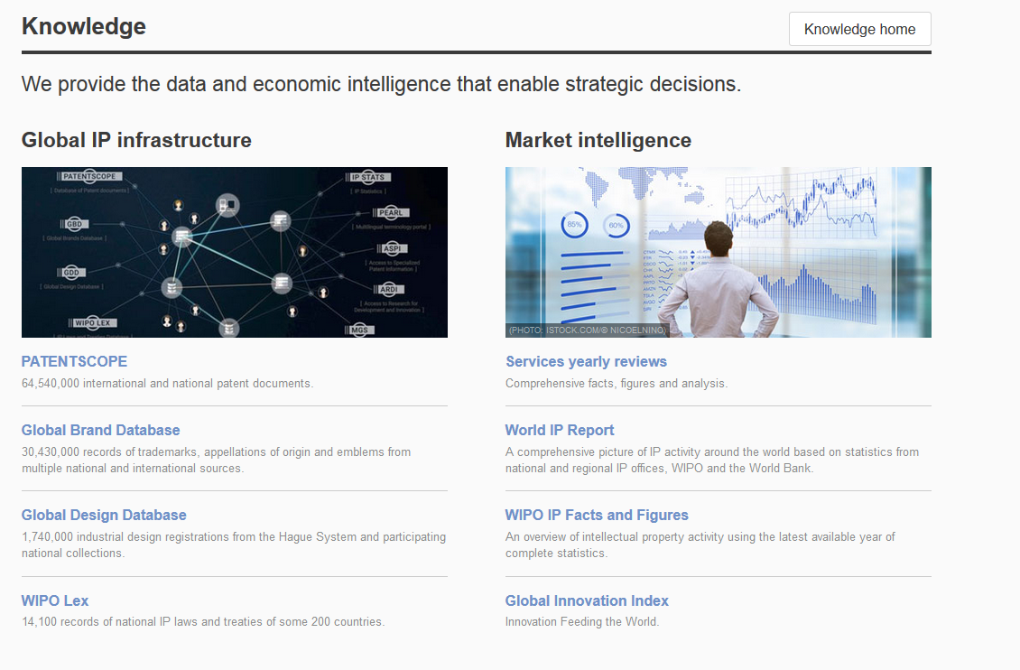
Access
www.wipo.int/branddb
www.wipo.int

Slide 6
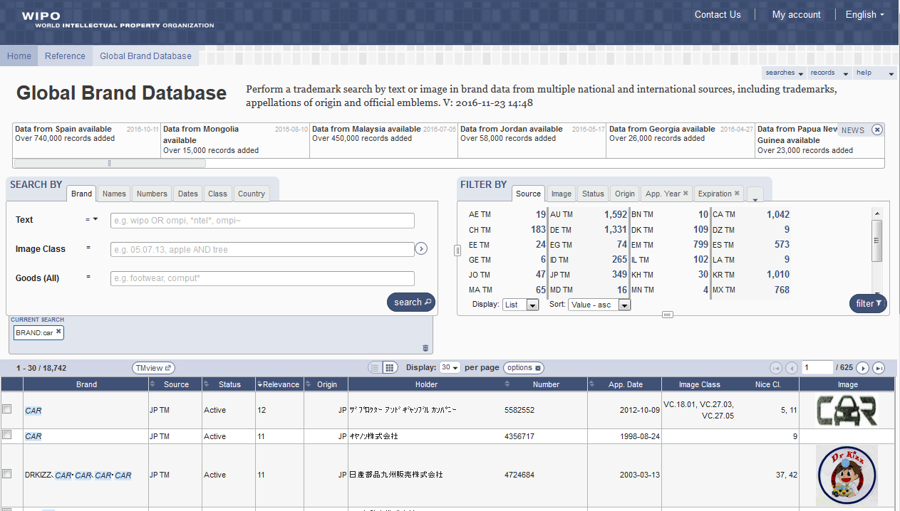
Interface - Account

Slide 7
The principle

Slide 8
Combining many search criterias
Brand Arla
2 Nice classifications: 20 & 43
2 designating countries: Japan & Denmark

Slide 9
5
6
1
2
3
4

Slide 10
Search by: 1
1

Slide 11
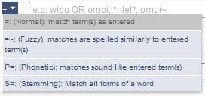
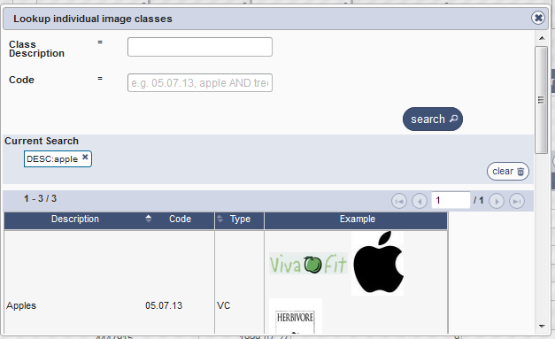
Search by

Slide 12
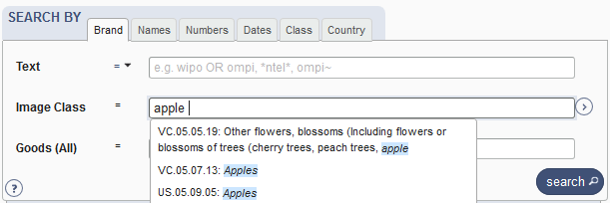

Slide 13
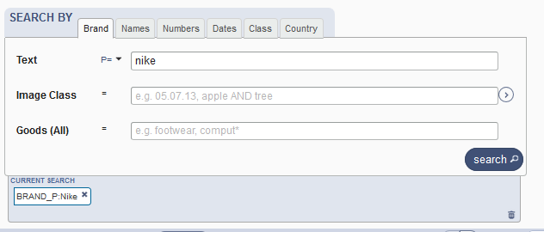
Example: phonetic search

Slide 14
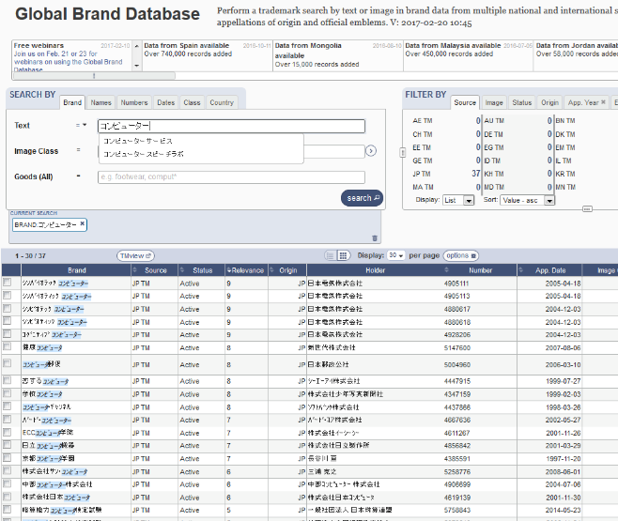
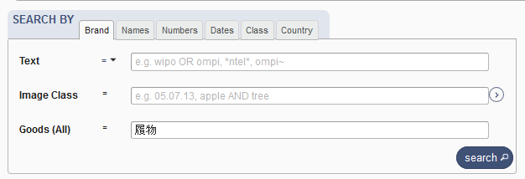
Languages - autosuggestion

Slide 15
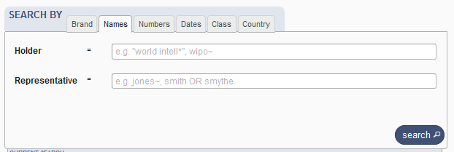
Search by Names

Slide 16
Search by Numbers

Slide 17
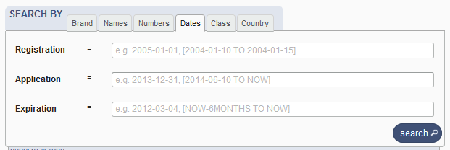
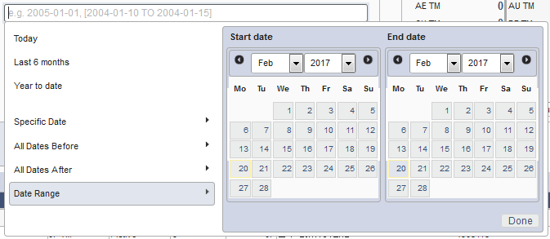
Search by Dates

Slide 18
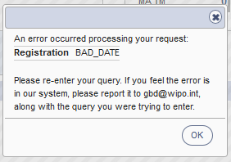
Tips
Range: […]{…} + TO
Error message

Slide 19
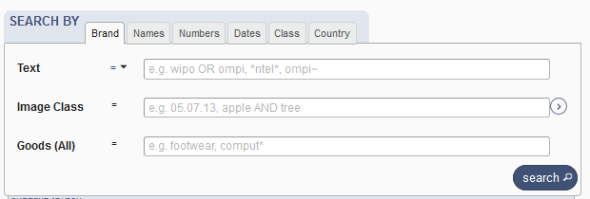
Search by Class

Slide 20
Search by Country

Slide 21
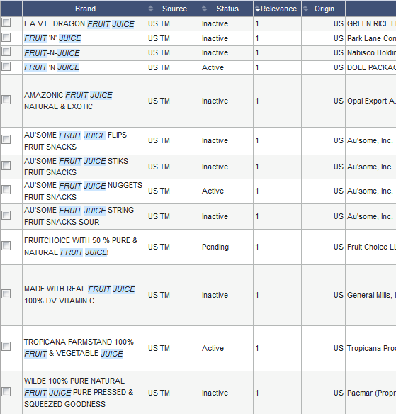
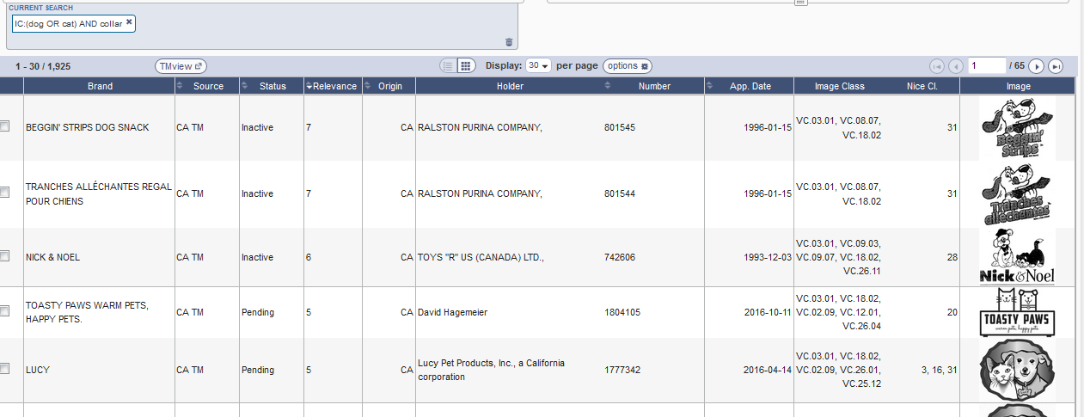
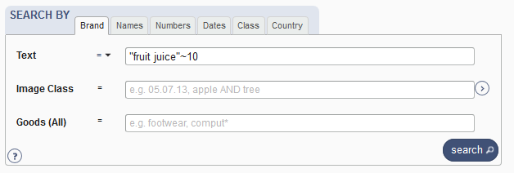
Examples

Slide 22
Tips
OR
Not limit
Needle or "hypodermic needle"
Transliteration:
Korean + Japanese : automatic
Arabic: not supported
Punctuation/ accent: ignored

Slide 23
Wildcards, fuzzy, proximity
Wilcards: * = 0/multiple letter; ? = 1 letter
te?t 'test' and 'text‘
text* 'text', 'texts', 'texting‘
*text or te*t.
Proximity operators: «…» ~10
Fuzzy: ~+ value between 0 and 1
alco~ 'also', 'alcoh', 'asco'

Slide 24
Filter by: 2
2

Slide 25
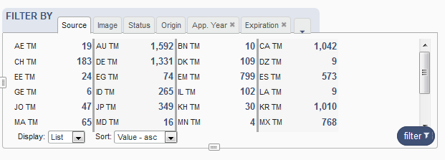
Filter by

Slide 26
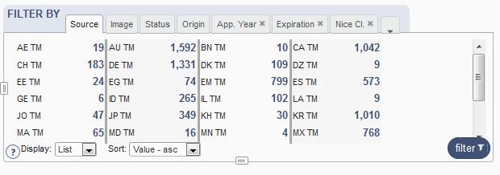
Filter by: Source

Slide 27
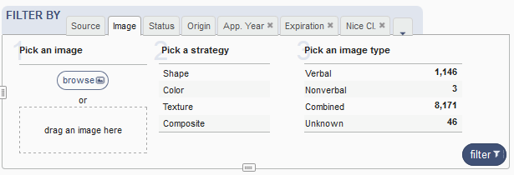
Filter by: Image

Slide 28
Image search
Your search
The results

Slide 29
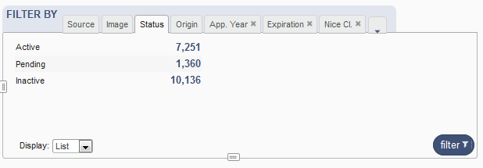
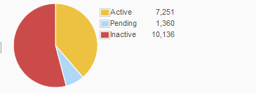
Filter by: Status

Slide 30
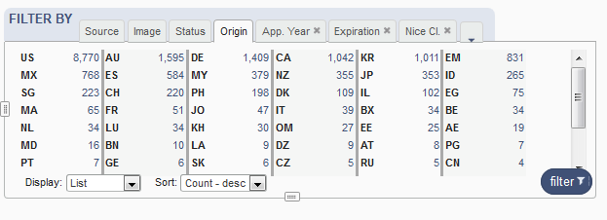
Filter by: Origin

Slide 31
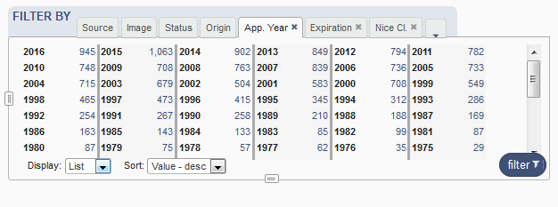
Filter by: Application Year

Slide 32
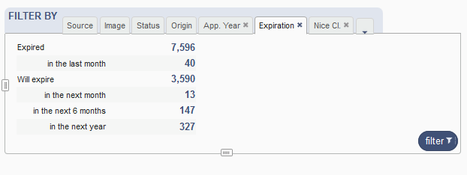
Filter by: Expiration

Slide 33
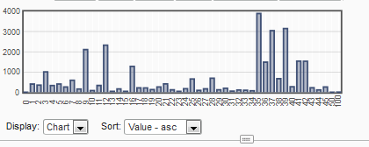
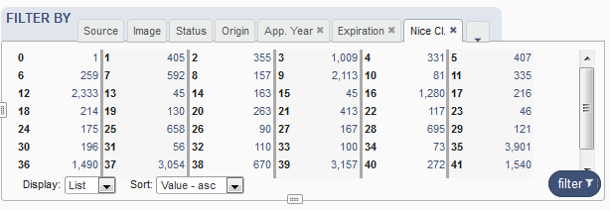
Filter by: Nice Classification

Slide 34
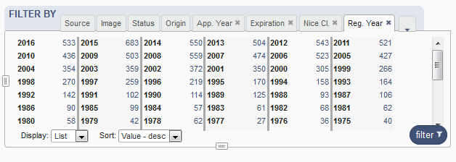
Filter by: Registration year

Slide 35
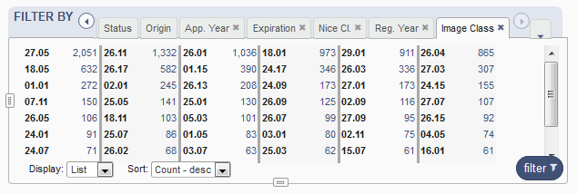
Filter by: Image classification

Slide 36
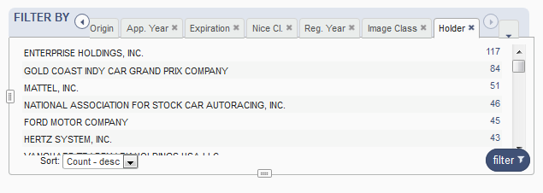
Filter by: Holder

Slide 37
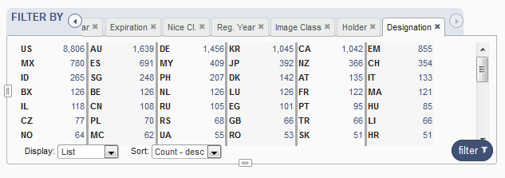
Filter by: Designation

Slide 38
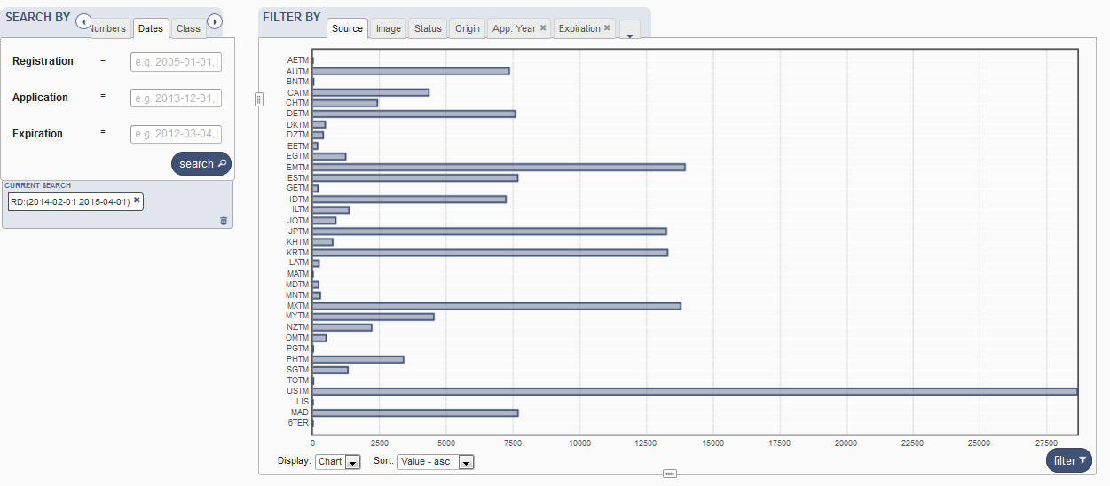
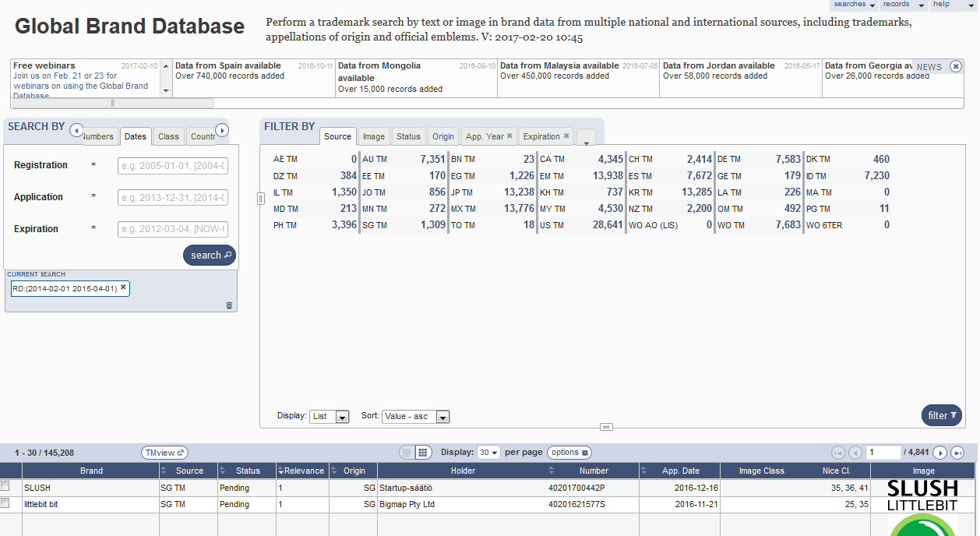
Resize

Slide 39
Current search: 3
3

Slide 41
Search results: 4
4

Slide 42
Result area: pager & list

Slide 43
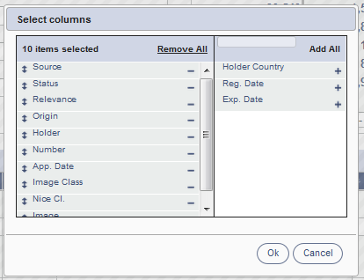
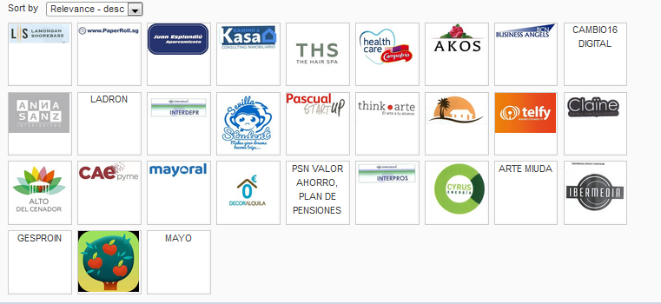
Pager

Slide 44
Record list – list format

Slide 45
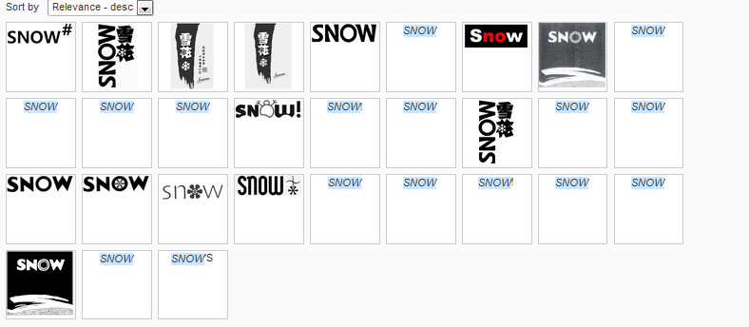
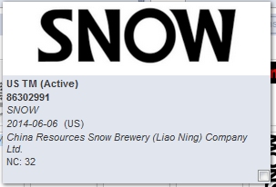
Record list – grid format

Slide 46
Download reports

Slide 47
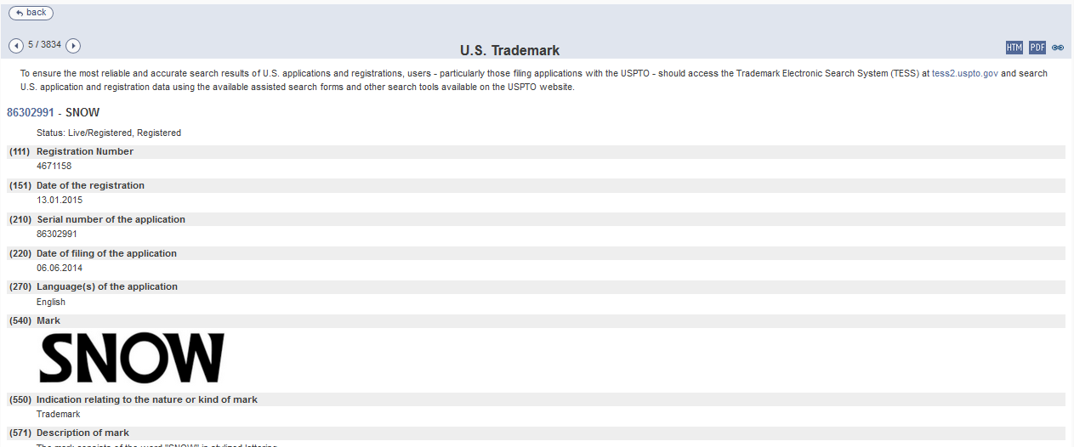
Record view

Slide 48
Menu: 5
5

Slide 49
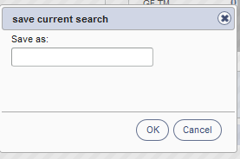
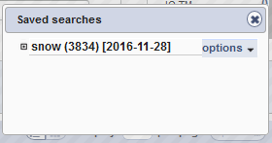
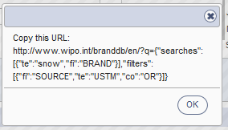

Slide 50
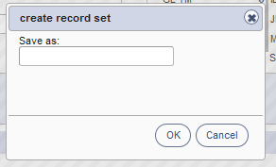
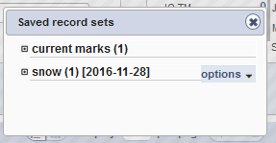

Slide 52
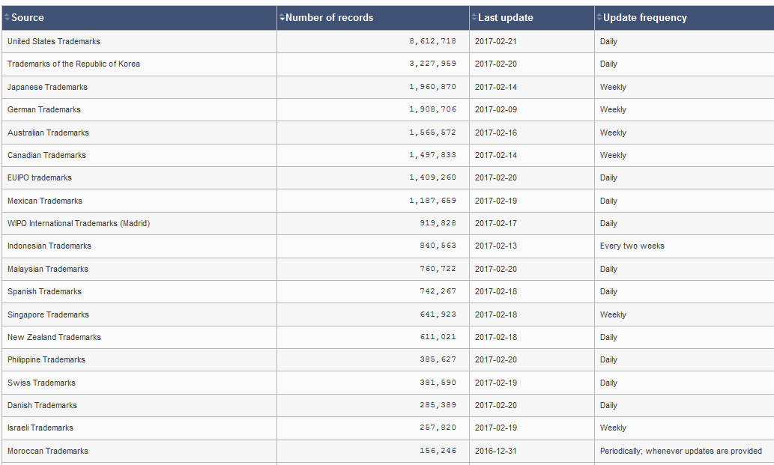
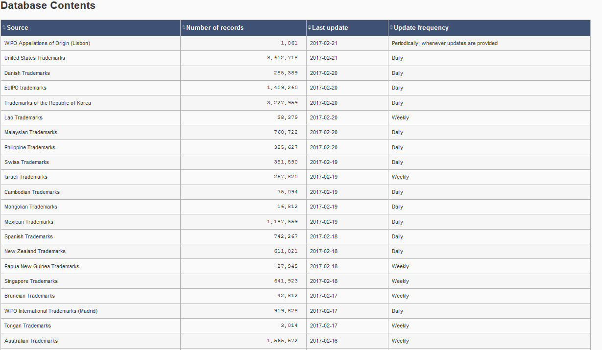

Slide 53
News: 6
6

Slide 55
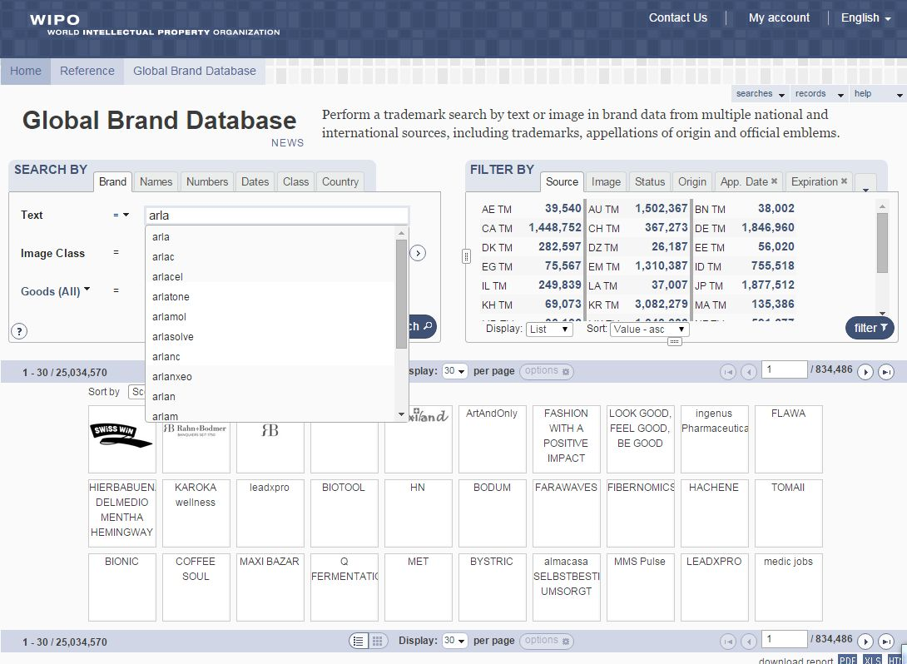

Slide 56
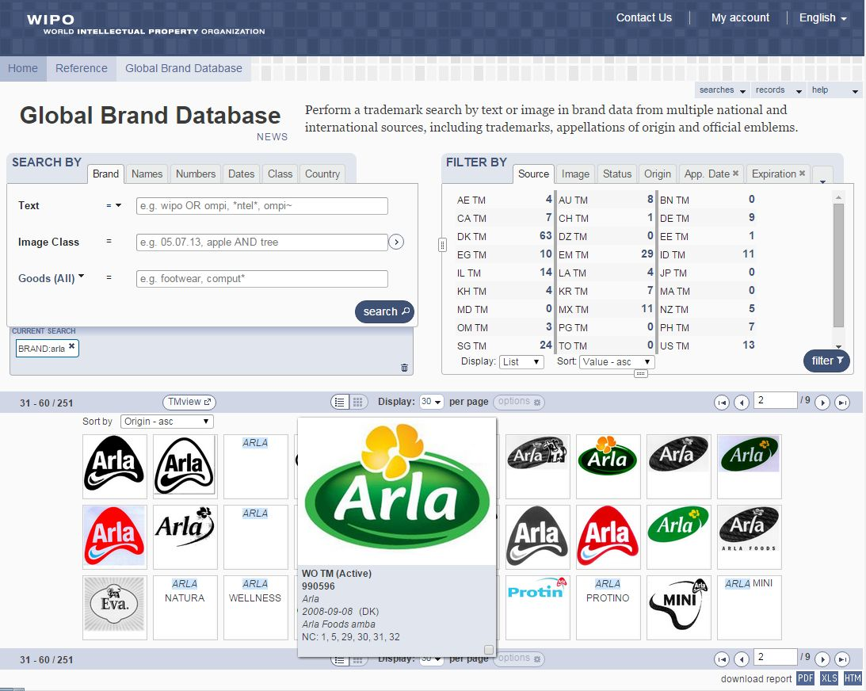

Slide 57
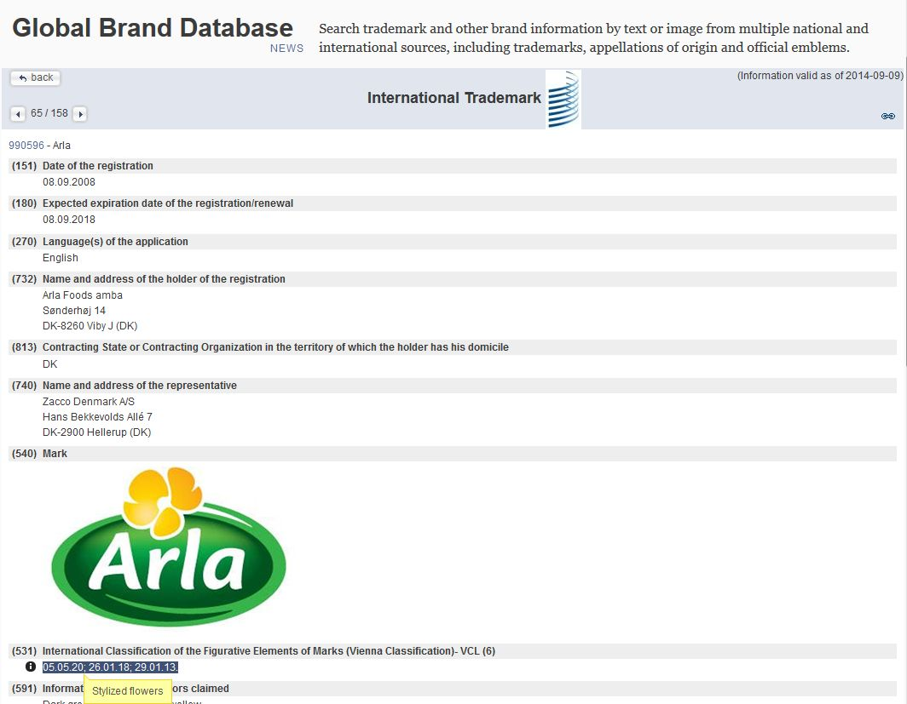

Slide 58
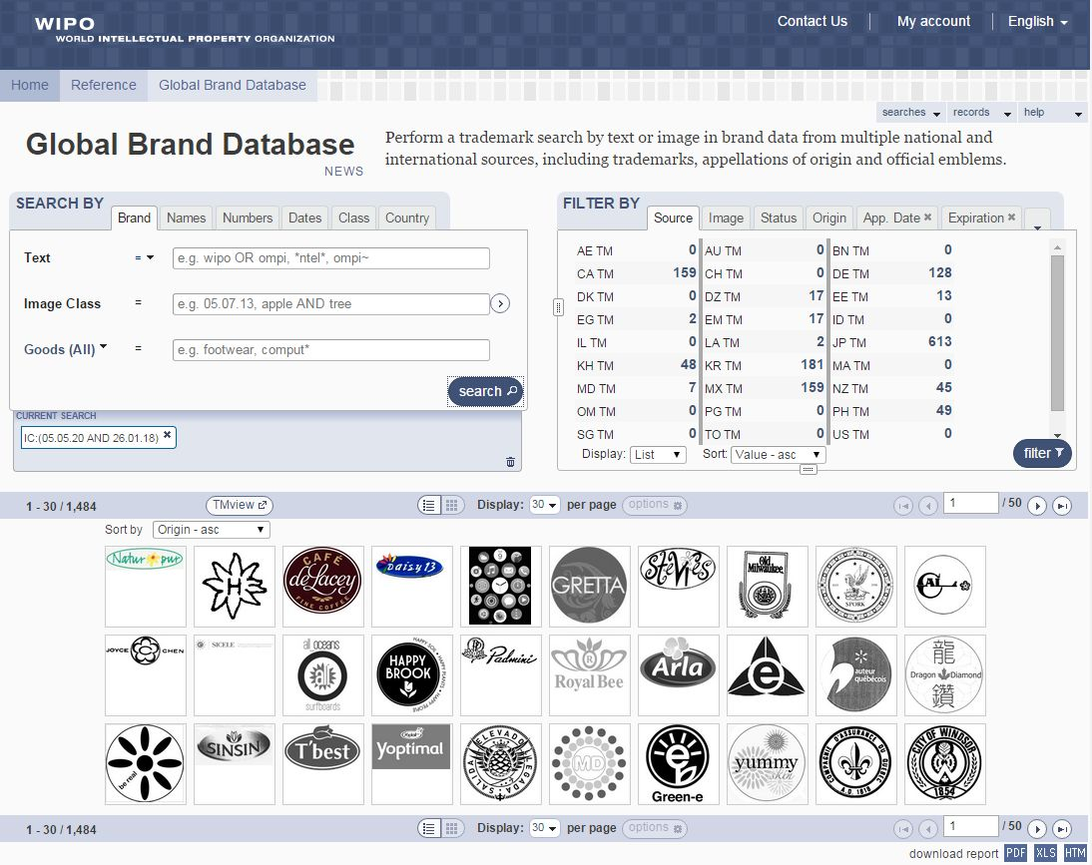

Slide 59
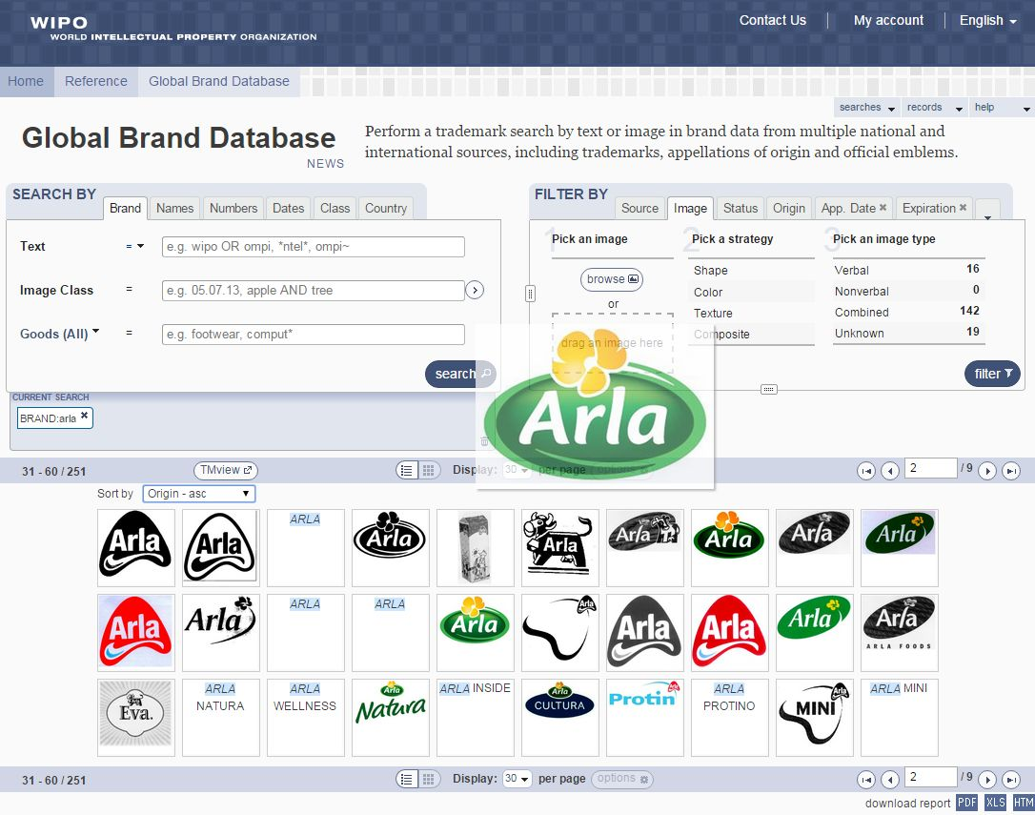

Slide 60
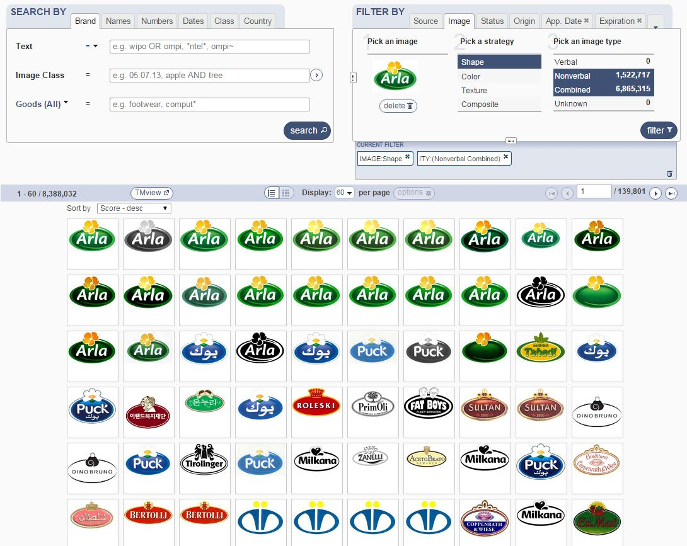

Slide 64
Gangnam

Slide 65
mulțumesc
mulțumesc
gbd@wipo.int

