Slide 1
Global Design Database:
An introduction
March 2018
Sandrine Ammann
Marketing & Communications Officer

Slide 3
Agenda
Access
Interface:
Coverage
Search features
Filter features
Results
Menus
Q&A

Slide 4
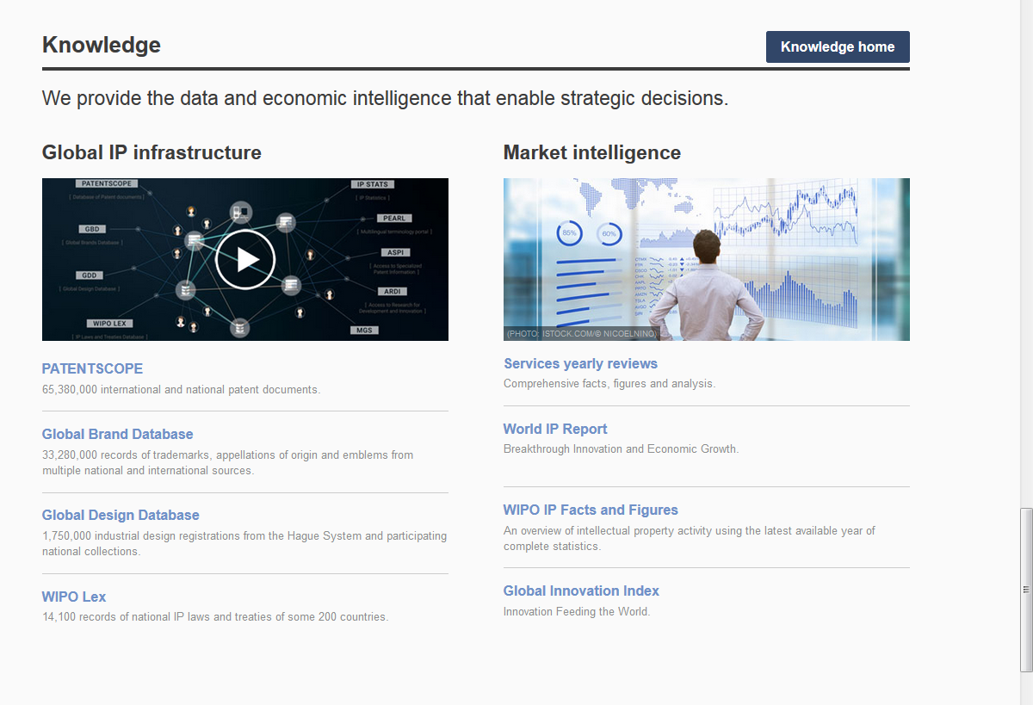
Access: www.wipo.int/designdb www.wipo.int

Slide 5
Why is the GDD useful?
Find details about a specific design
Explore design landscape to find out if the design you have in mind already exists.

Slide 7
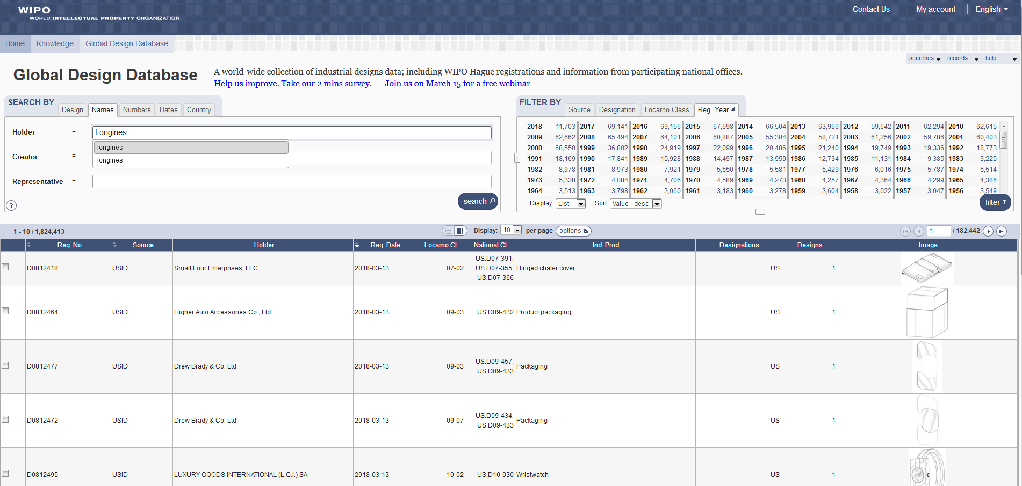

Slide 8
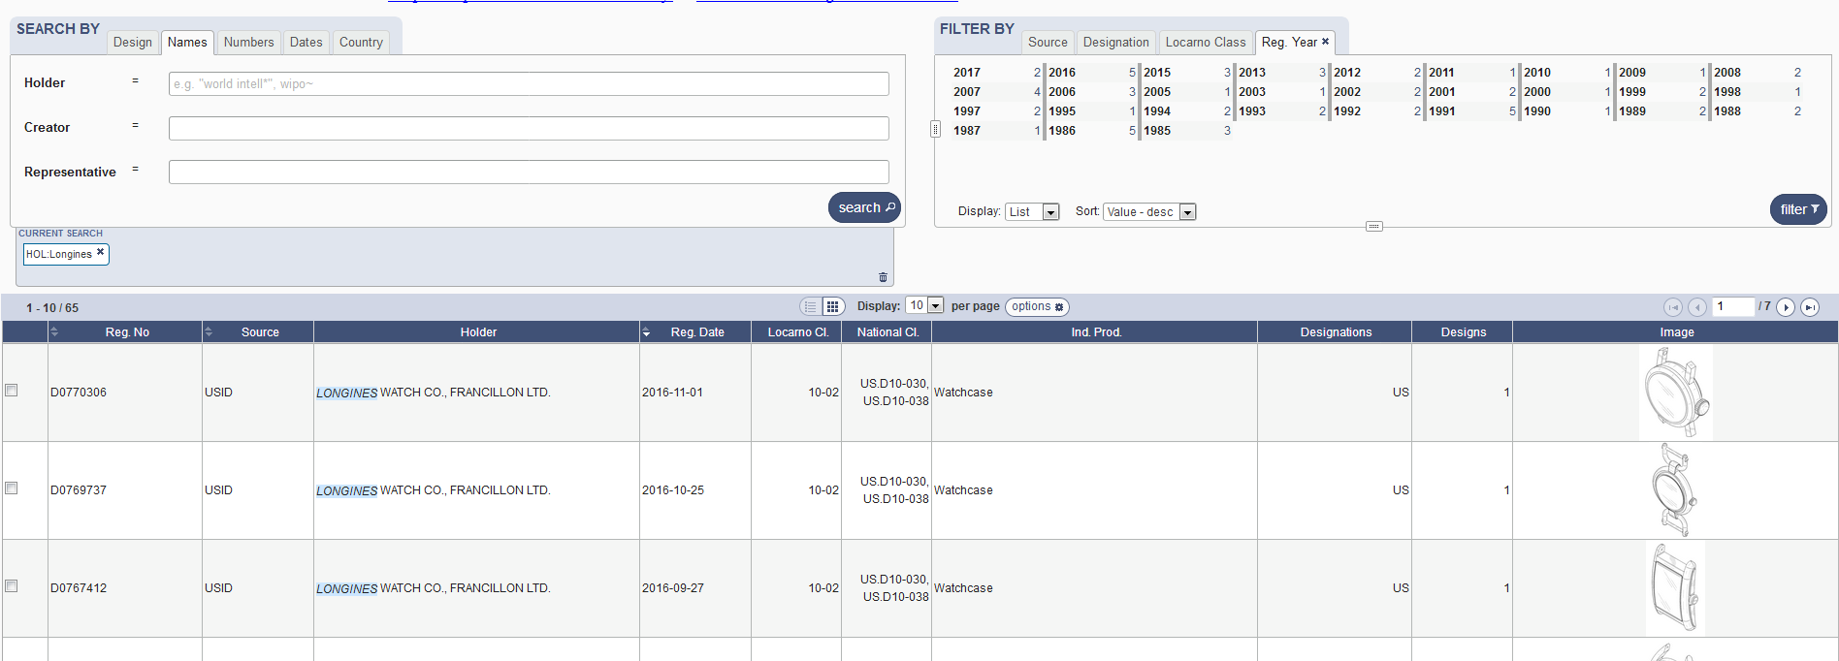

Slide 10
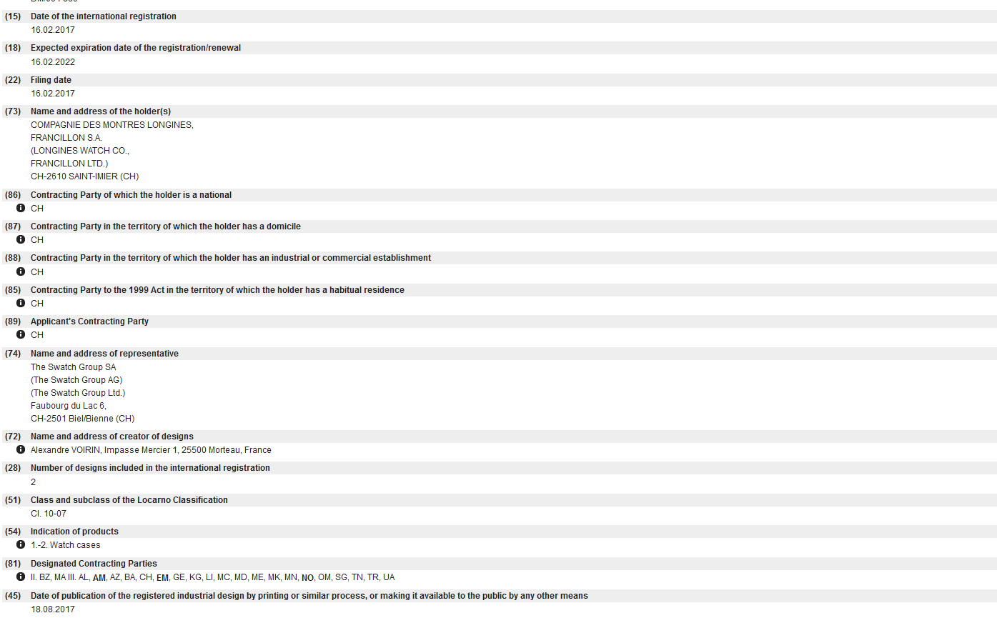

Slide 12
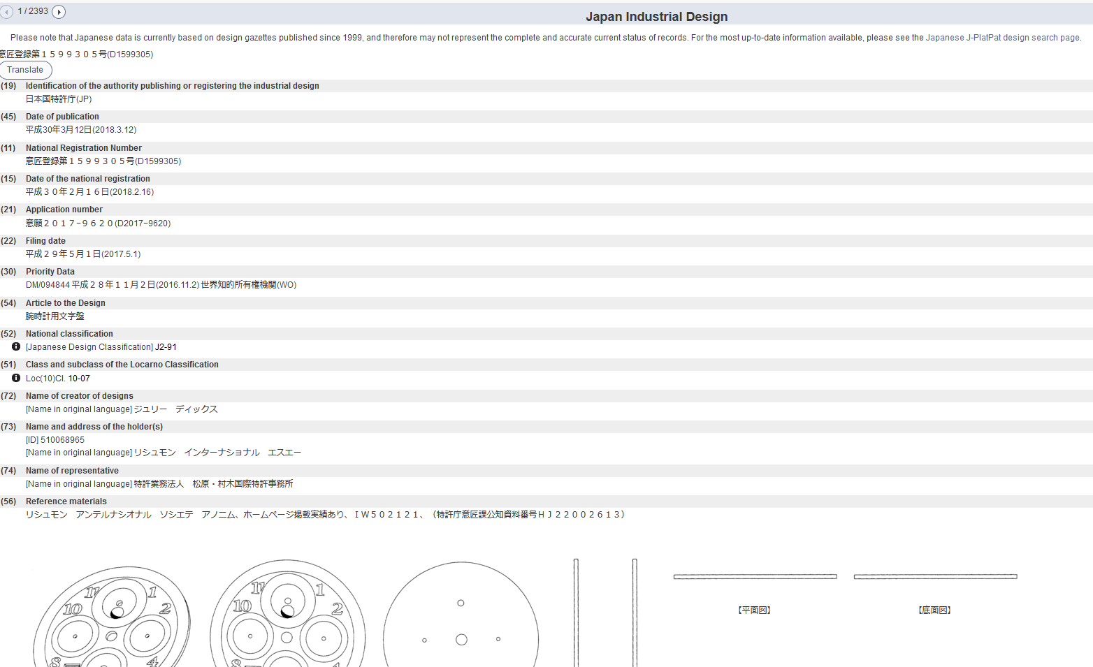

Slide 13
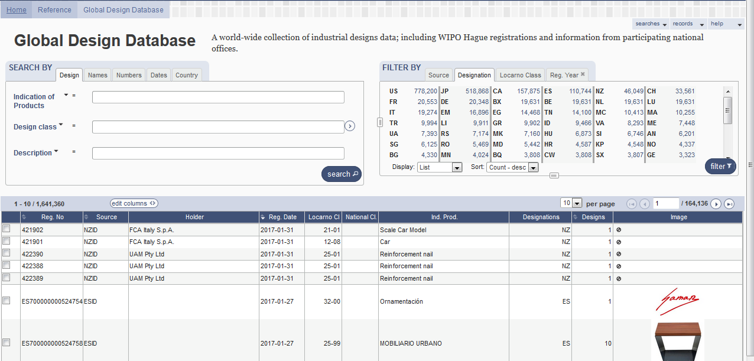

Slide 14
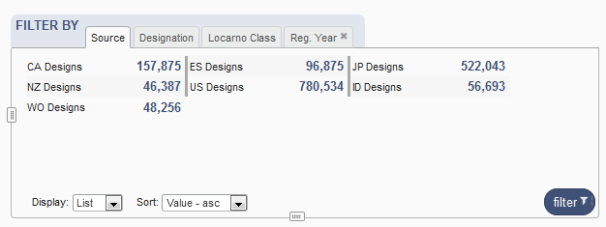
Coverage

Slide 15
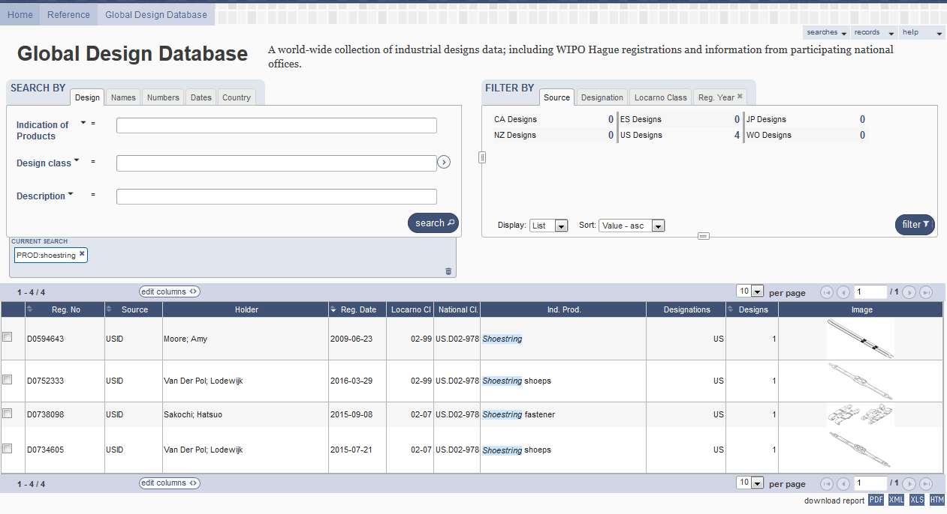
5
1
2
3
4

Slide 16
1

Slide 17
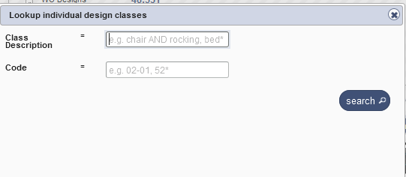
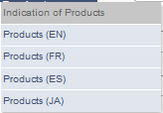
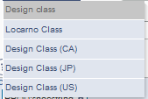
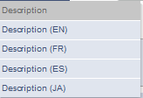
Search by design

Slide 18
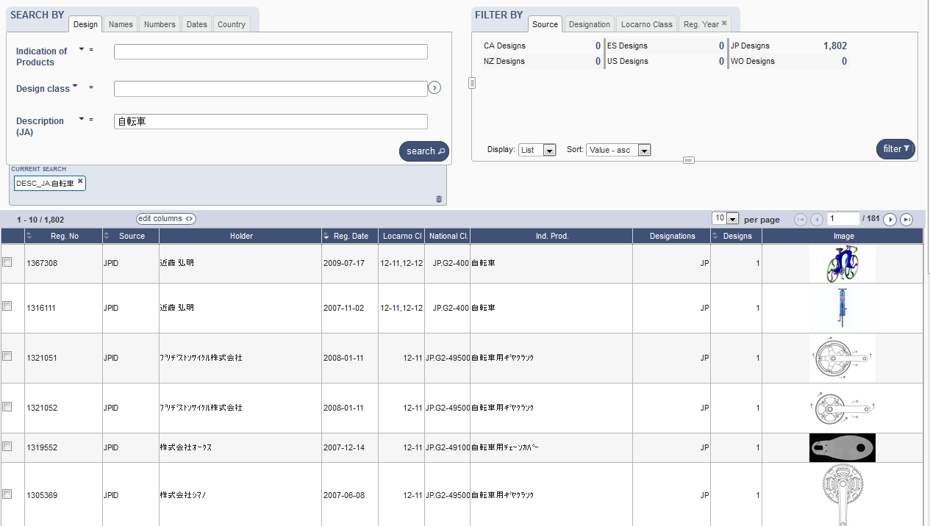
Search by Description JA

Slide 19
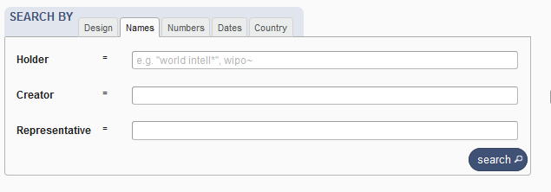
Search by name

Slide 20
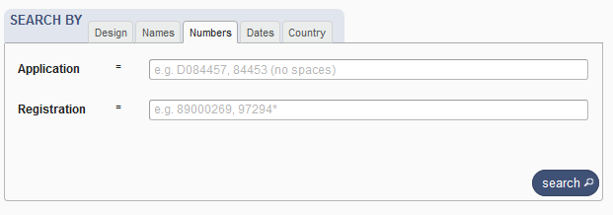
Search by numbers

Slide 21
Search by dates

Slide 22
Search by country

Slide 23
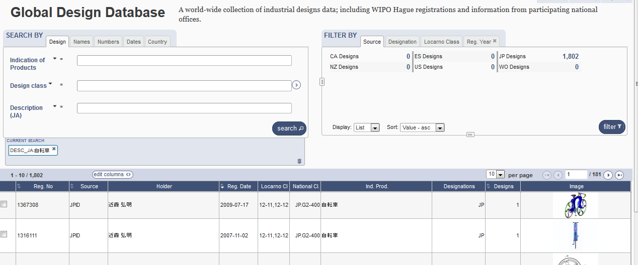

Slide 24
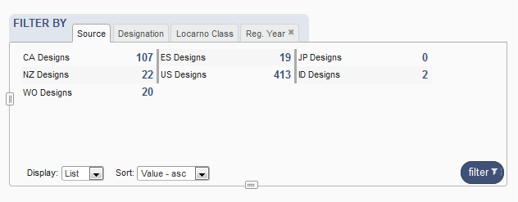
Filter by

Slide 25
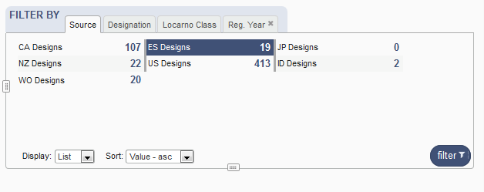
Filter by Source

Slide 26
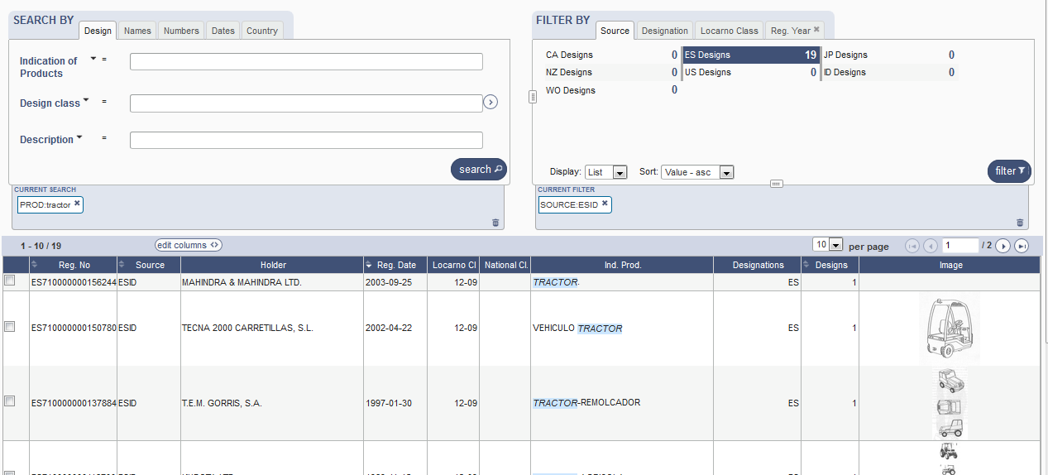

Slide 27
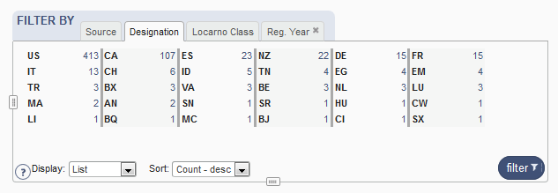
Filter by Designation

Slide 28
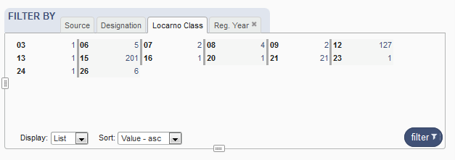
Filter by Locarno Class

Slide 29
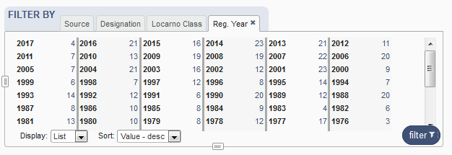
Filter by Registration Year

Slide 30
Options

Slide 31
3

Slide 32
4

Slide 33
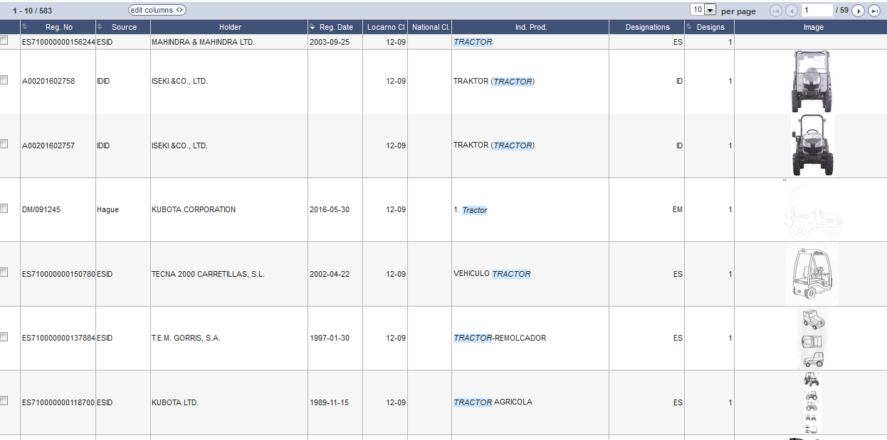
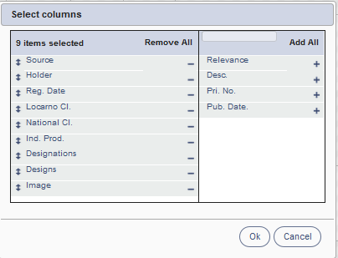
Results

Slide 34
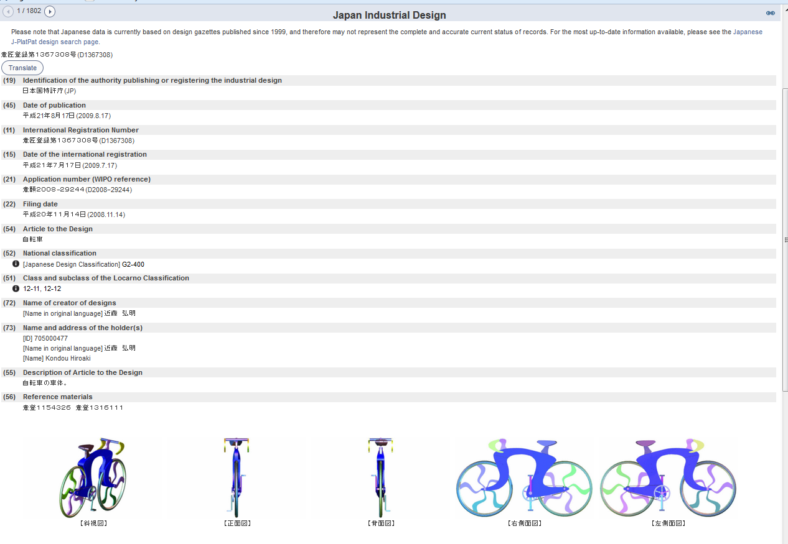
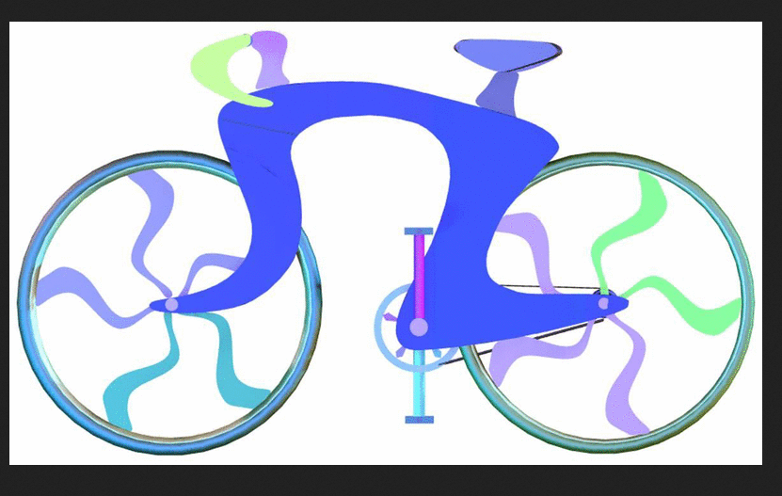
Individual record

Slide 35
5

Slide 37
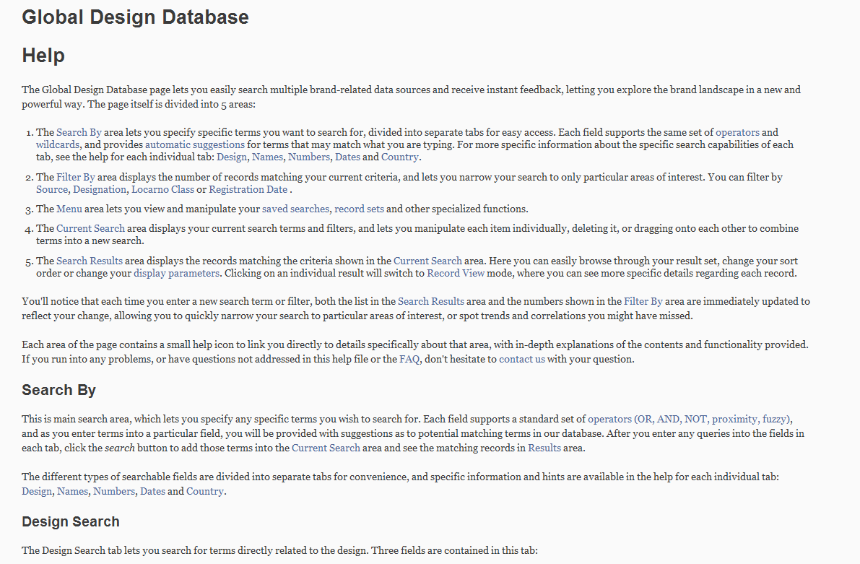
Help

Slide 39
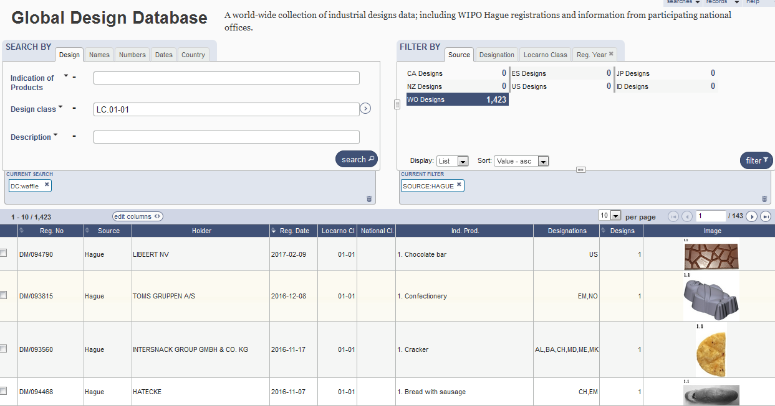
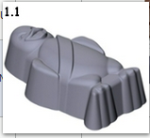

Slide 40
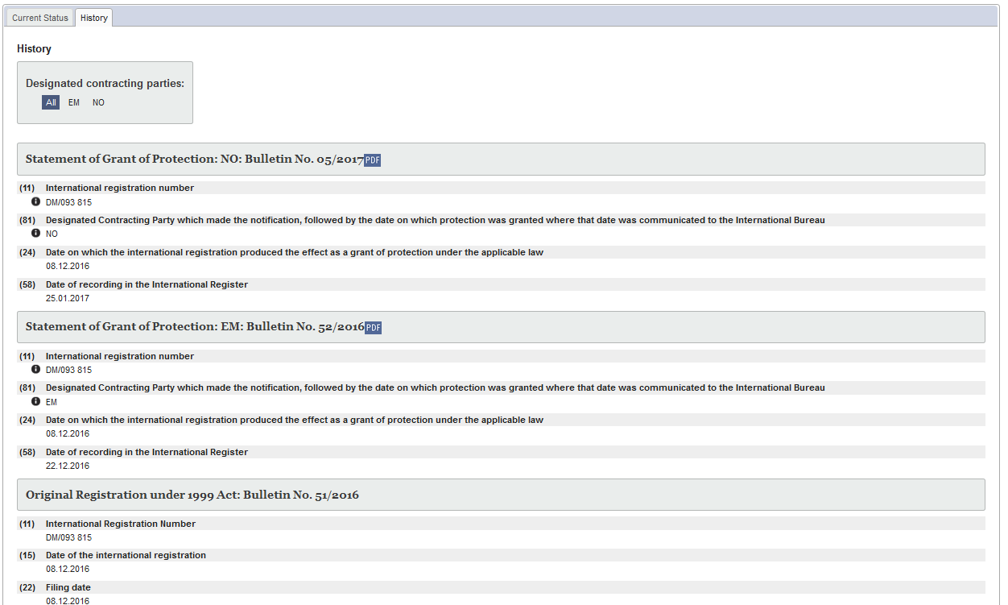
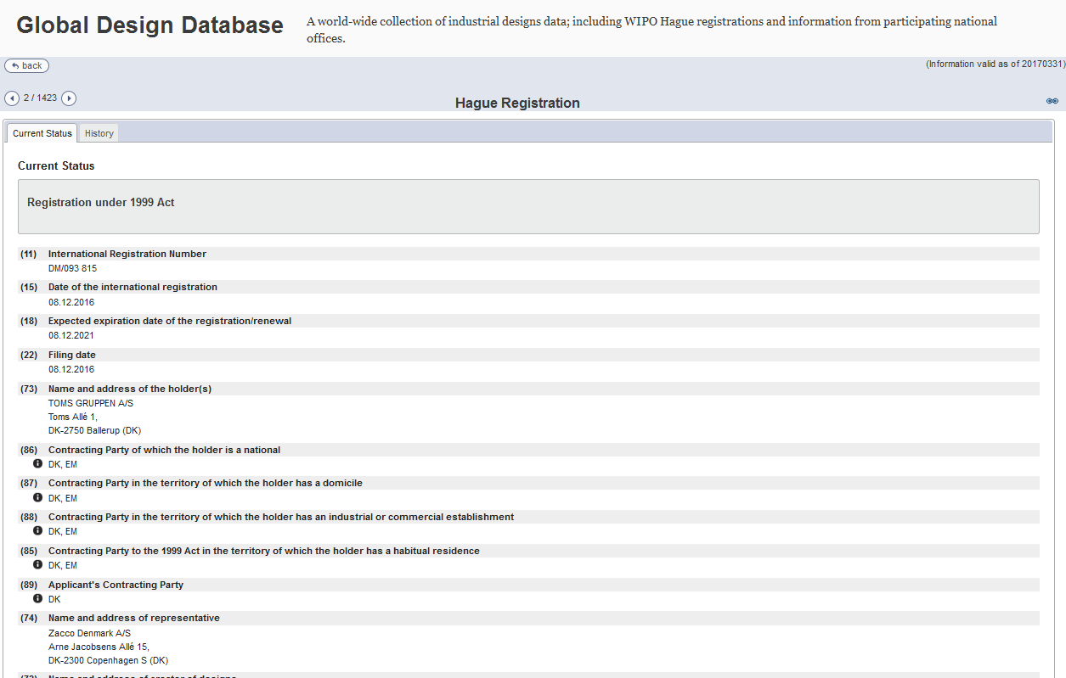

Slide 41
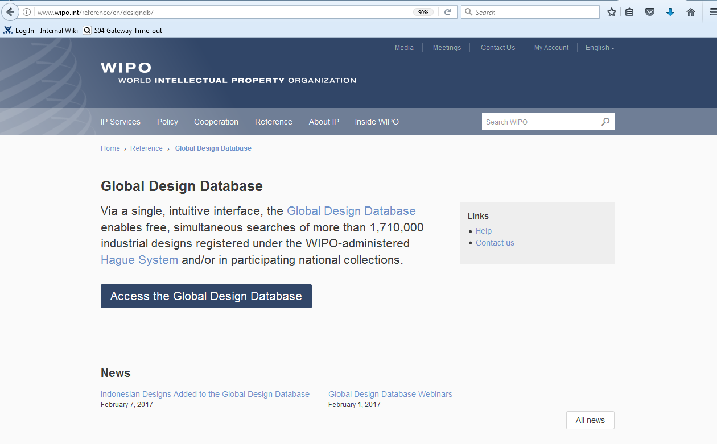

Slide 42
Patent database webinar
Translation tools in PATENTSCOPE
March 20 at 8:30 am https://attendee.gotowebinar.com/rt/683439223517620481
March 22 at 5:30 pm
https://attendee.gotowebinar.com/rt/683439223517620481

Slide 43
Global Brand Database webinar
Performing effective searches in the GBD
April 11 at 9:30 am CET https://attendee.gotowebinar.com/rt/8931489472329613057

Slide 44
mulțumesc
mulțumesc
gbd@wipo.int

