Slide 1
How to find designs using GDD
Internet
May
2018
Sandrine Ammann
Marketing & Communications Officer

Slide 2
Agenda
Interface:
Coverage
Search features
Filter features
Results
Menus
Example
Q&A

Slide 3
Why is the GDD useful?
Find details about a specific design
Explore design landscape to find out if the design you have in mind already exists.
Notes:
A service on top of global industrial designs that aims to improve search quality and examination quality of designs data

Slide 4
Access: www.wipo.int/designdb www.wipo.int

Slide 5
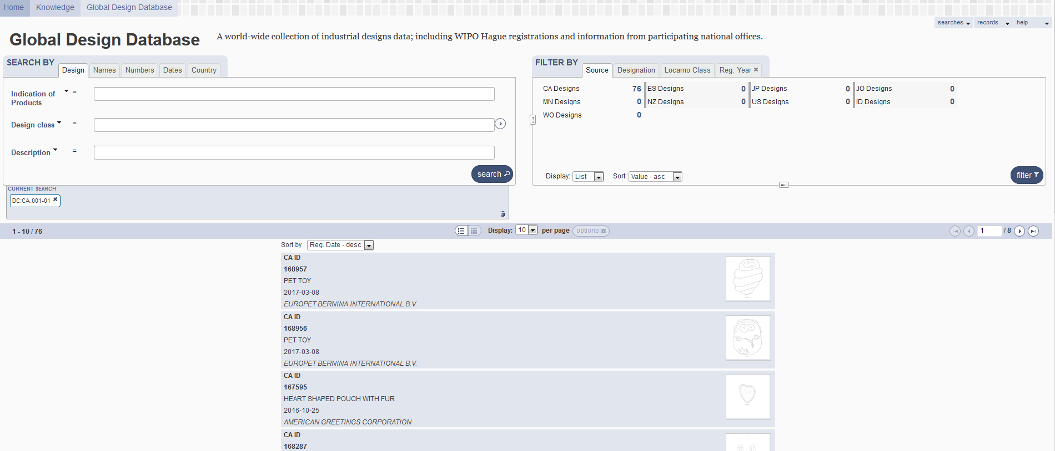

Slide 6
Coverage

Slide 7
Coverage: new
Notes:
Industrial Designs data (1.7+ million records)
Hague System
National Collections – CA, ES, JP, NZ, US, ID
Pending Collections – DE, KR, EM … coming soon

Slide 8
Coverage: new
41,000 international registrations from 1985-1998

Slide 9
5
1
2
3
4

Slide 10
1

Slide 11
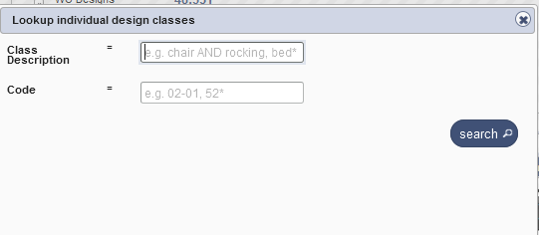
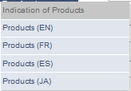
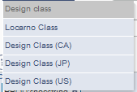
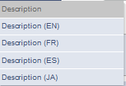
Search by design

Slide 12
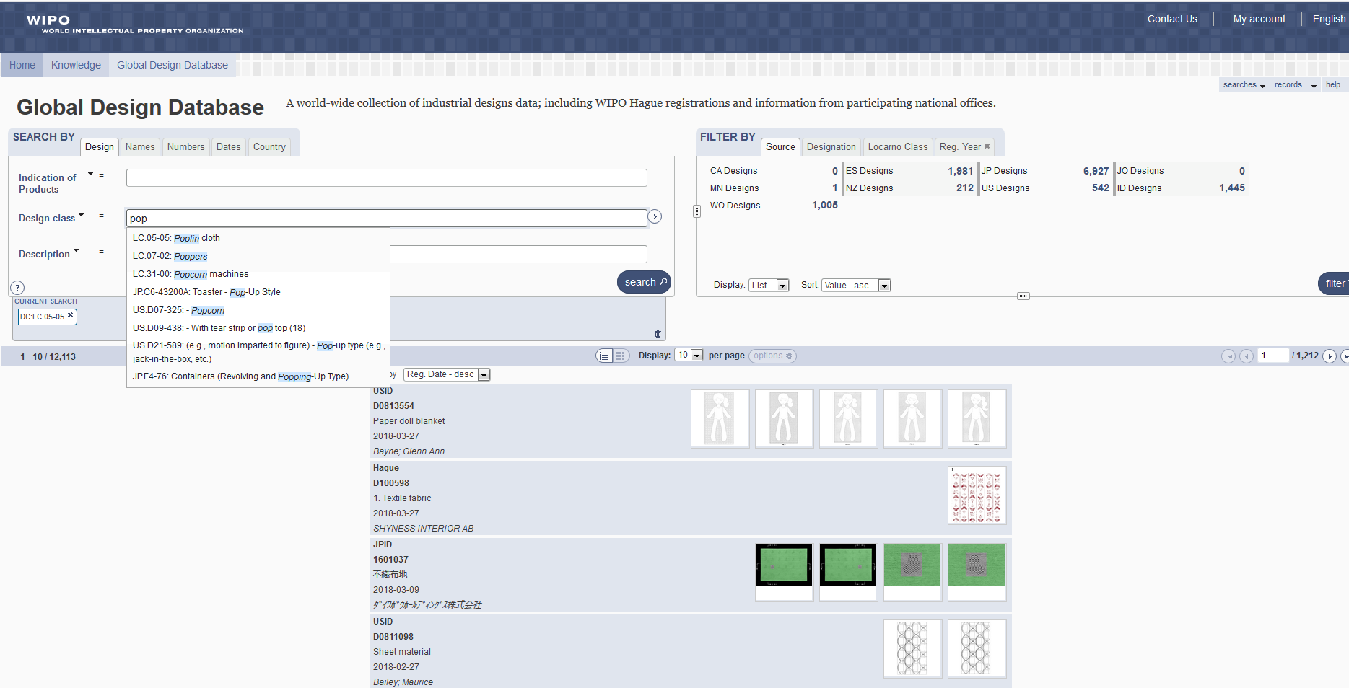

Slide 13
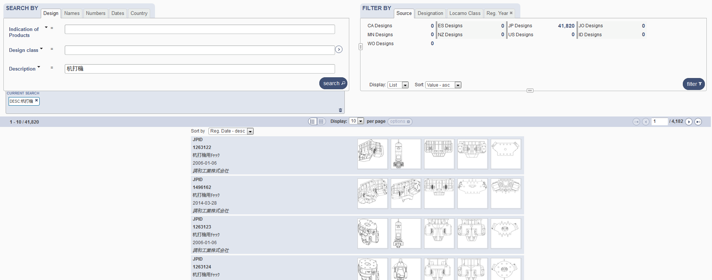
Search by Description JA

Slide 14
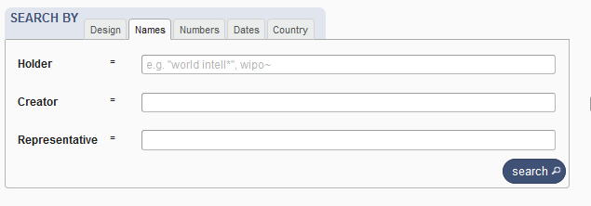
Search by name

Slide 15
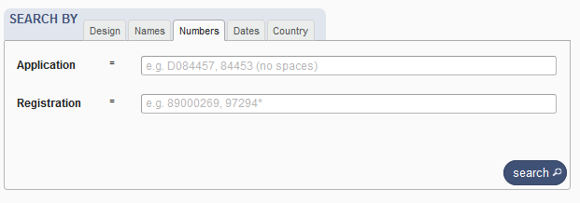
Search by numbers

Slide 16
Search by dates

Slide 17
Search by country

Slide 19
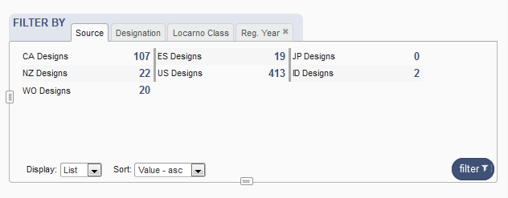
Filter by

Slide 20
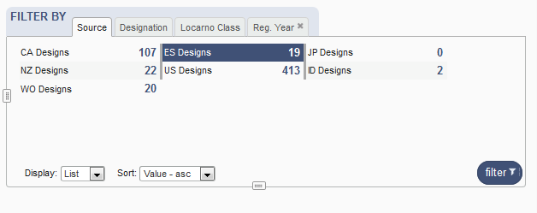
Filter by Source

Slide 21
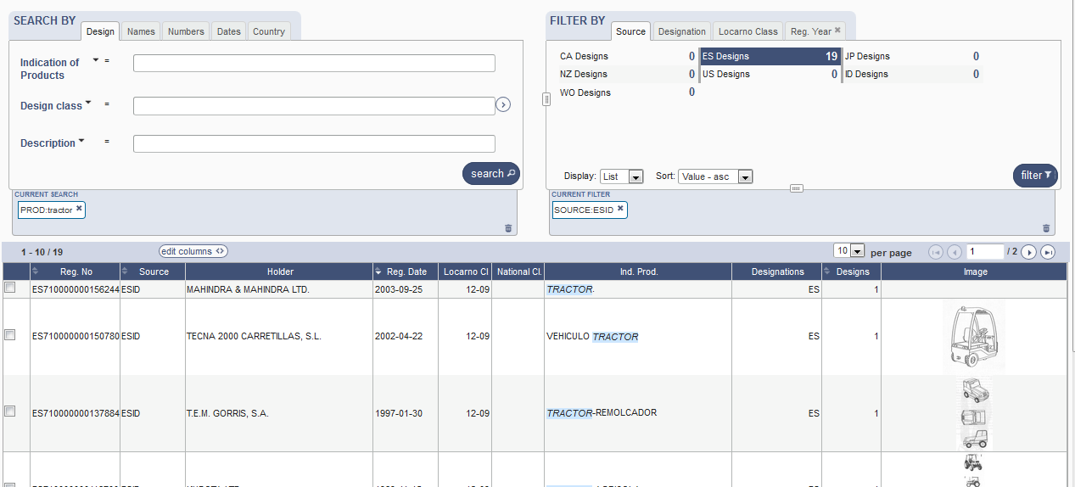

Slide 22
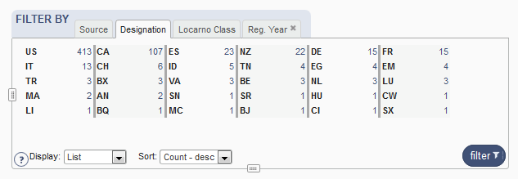
Filter by Designation

Slide 23
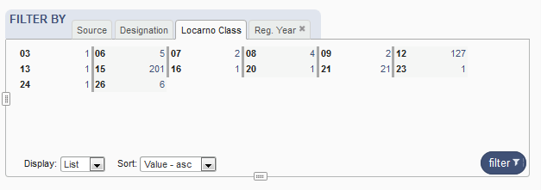
Filter by Locarno Class

Slide 24
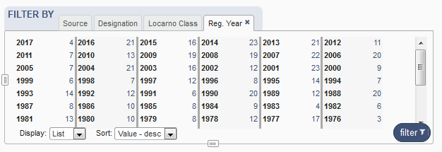
Filter by Registration Year

Slide 25
Options

Slide 26
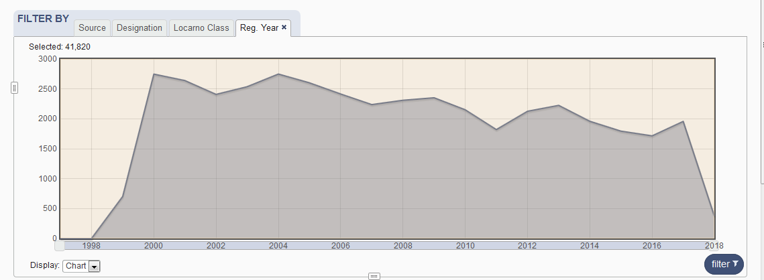

Slide 27
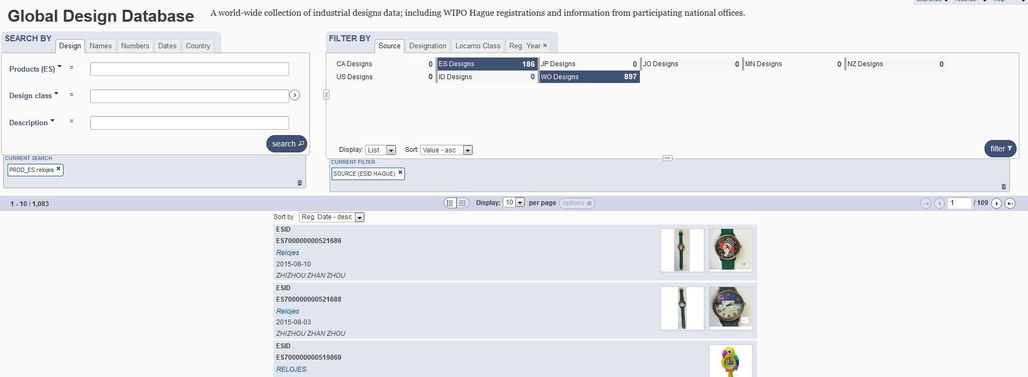

Slide 29
4

Slide 30
Results

Slide 31
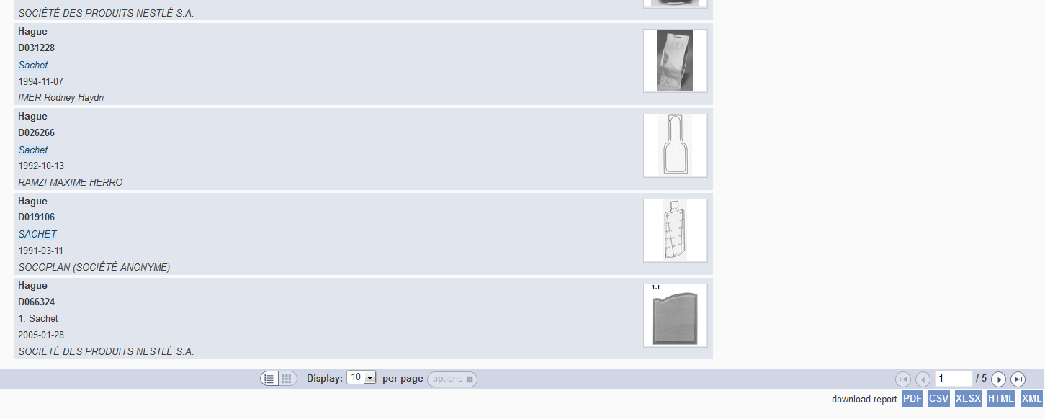
Download reports

Slide 32
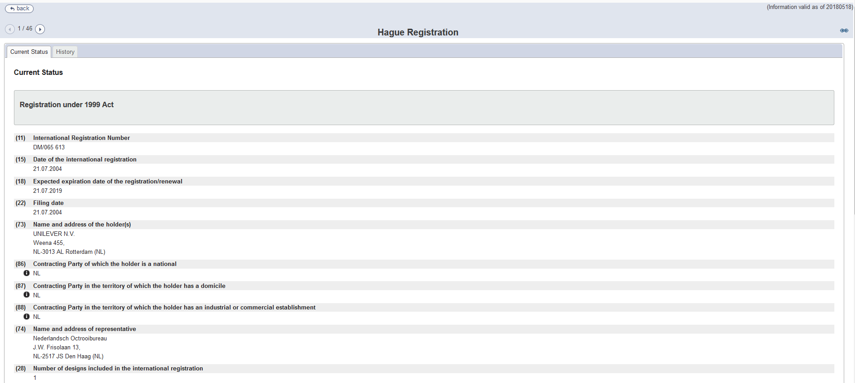
Individual record

Slide 33
5

Slide 35
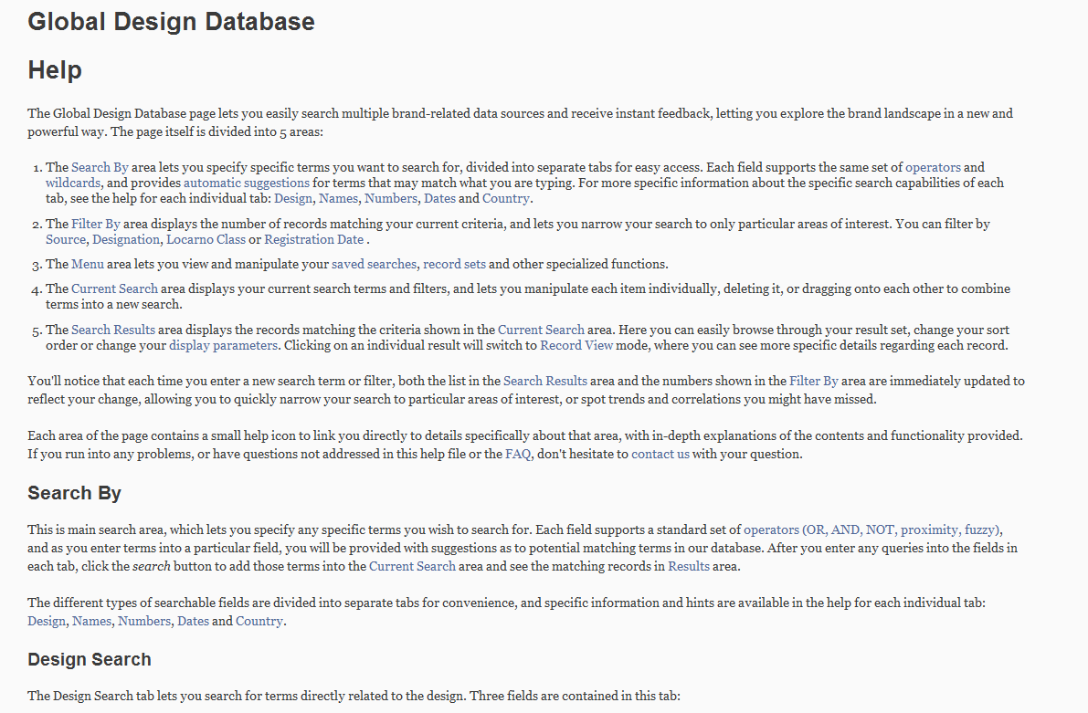
Help

Slide 36
Plans for the future
Add more collections: France, Germany, Georgia, …

Slide 38
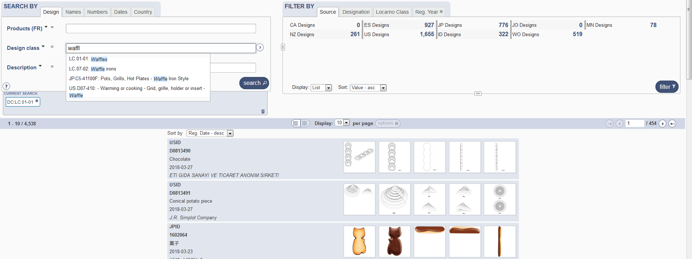
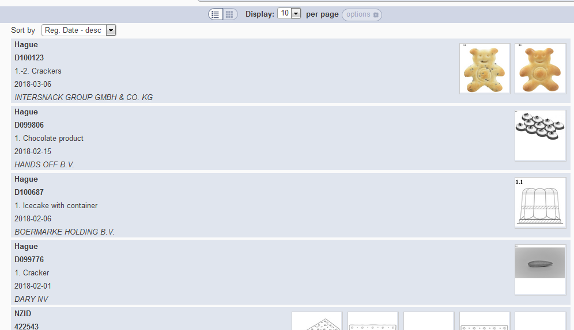

Slide 39
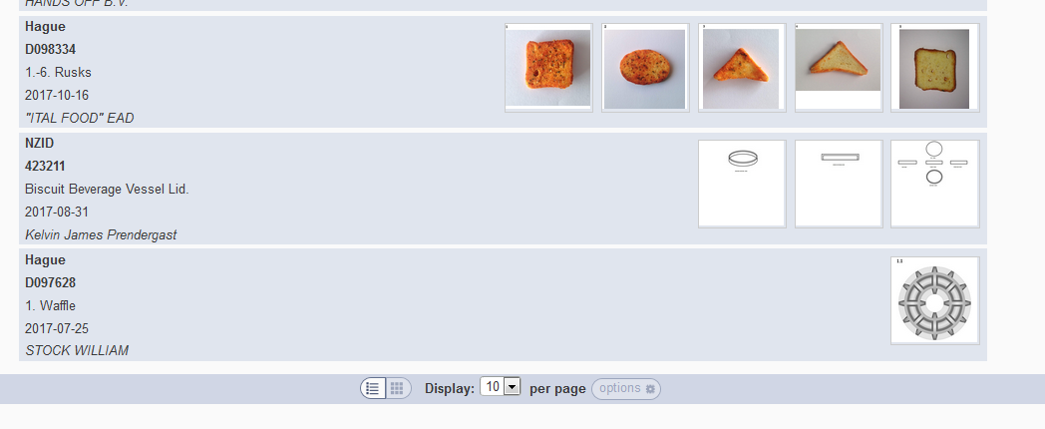
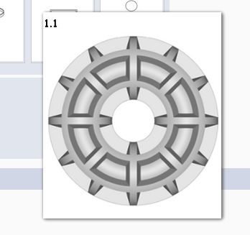

Slide 40
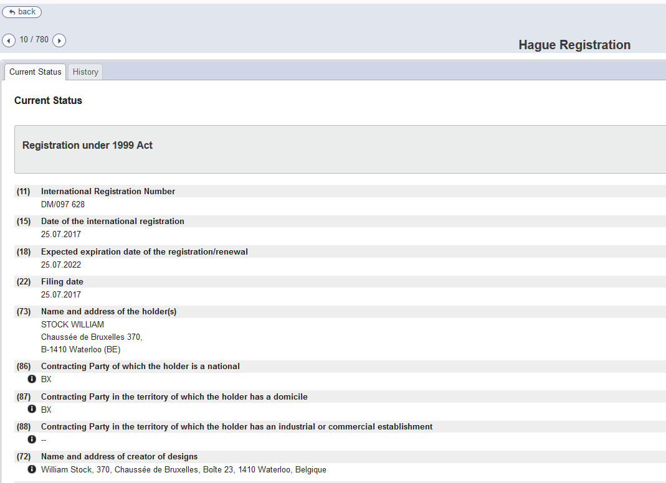

Slide 41
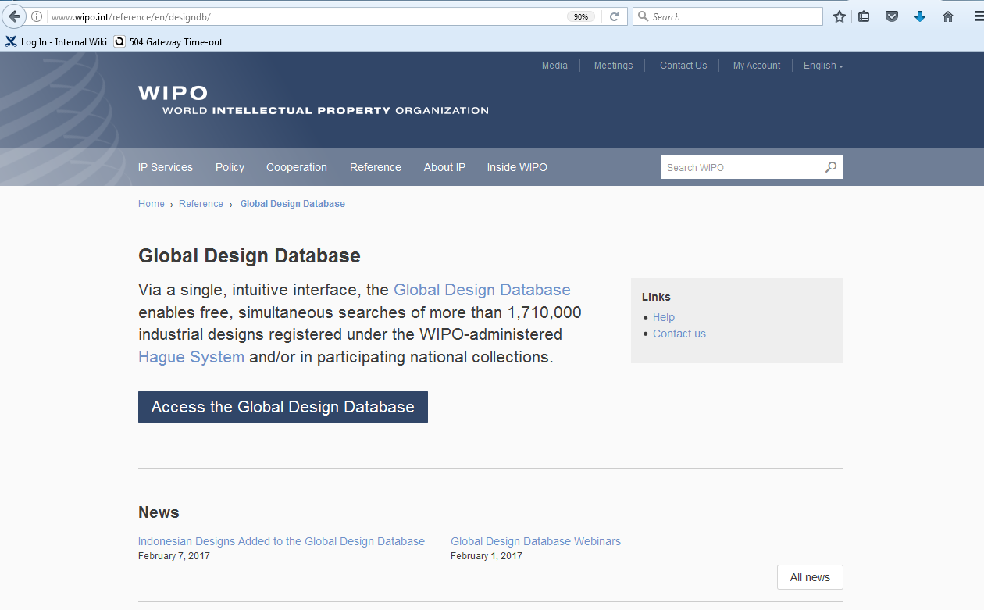
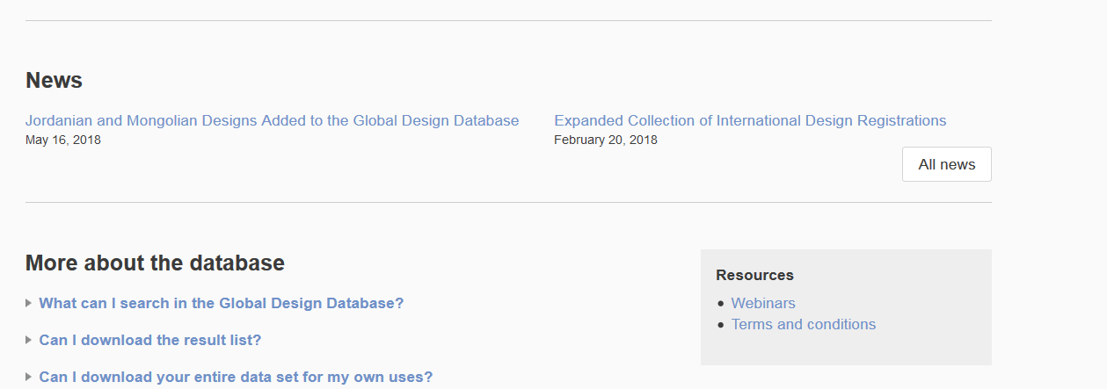

Slide 42
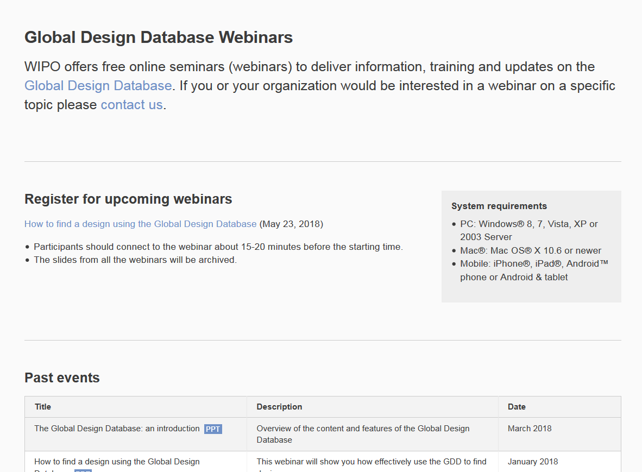

Slide 43
mulțumesc
mulțumesc
gbd@wipo.int

