Slide 1
How to perform a search in the Global Design Database
Internet
July
2018
Sandrine Ammann
Marketing & Communications Officer

Slide 2
Agenda
Interface:
Coverage
Search features
Filter features
Results
Menus
Webinars
Q&A

Slide 3
Why is the GDD useful?
Find details about a specific design
Explore design landscape to find out if the design you have in mind already exists.
Notes:
A service on top of global industrial designs that aims to improve search quality and examination quality of designs data

Slide 4
Access: www.wipo.int/designdb www.wipo.int

Slide 5
The Global Design Database

Slide 6
Combining many search criterias
Design Apple
2 Locarno classifications: 20 & 25
2 registration years: 2017 & 2016
No need to build complex queries

Slide 7
2 steps
1
2
- Design Apple
- 2 Locarno classifications: 20 & 25
-2 registration years: 2017 & 2016

Slide 8
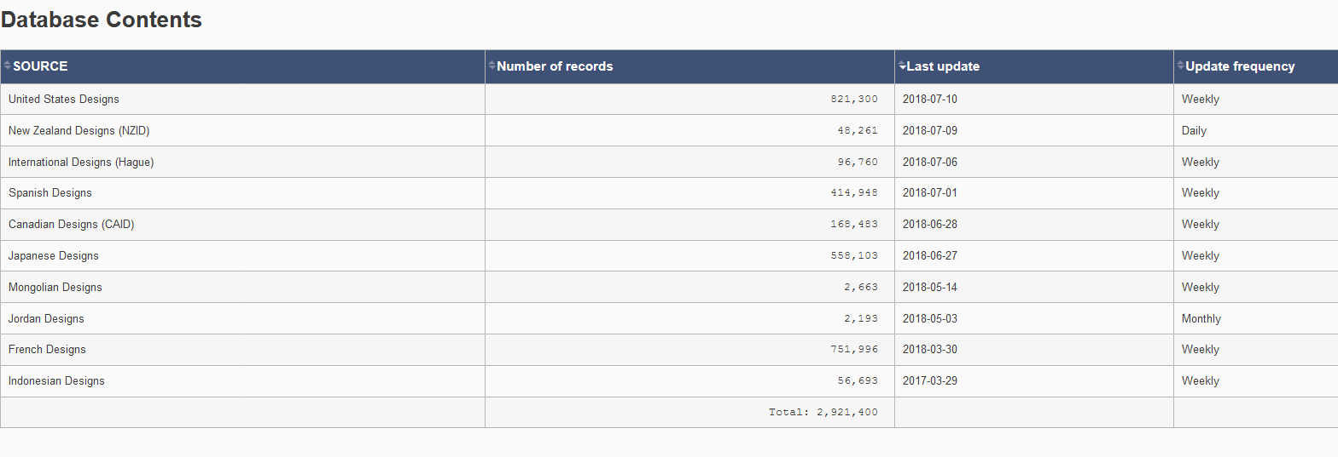
Coverage
http://www.wipo.int/designdb/en/designdb-help.jsp#db

Slide 9
Coverage

Slide 10
Coverage: new

Slide 11
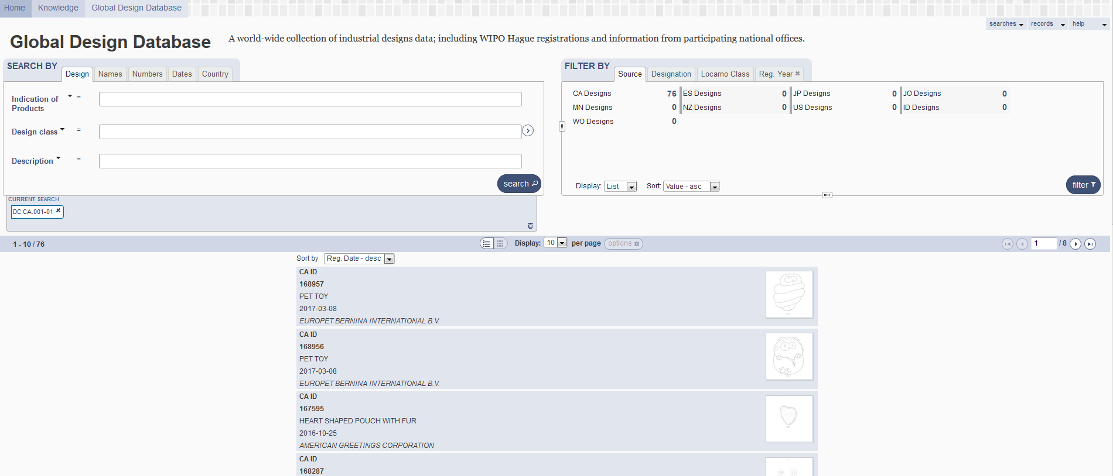
5
1
2
3
4

Slide 12
1

Slide 13
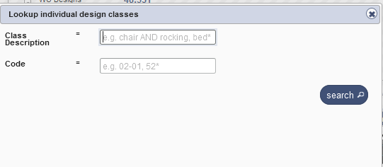
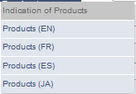
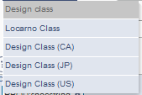
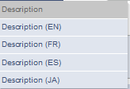
Search by design

Slide 14
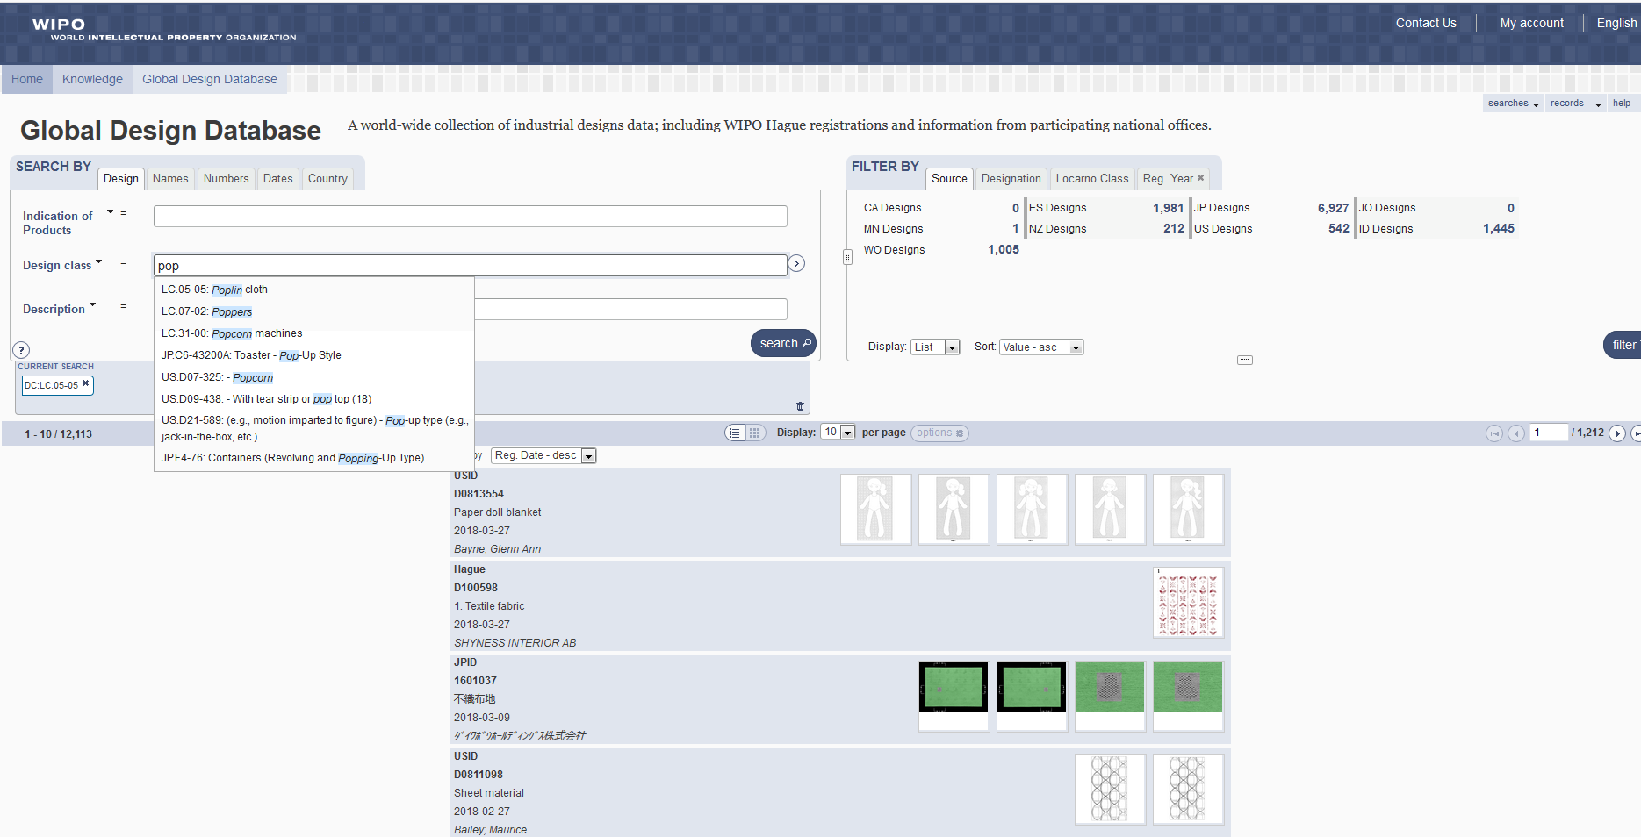

Slide 15
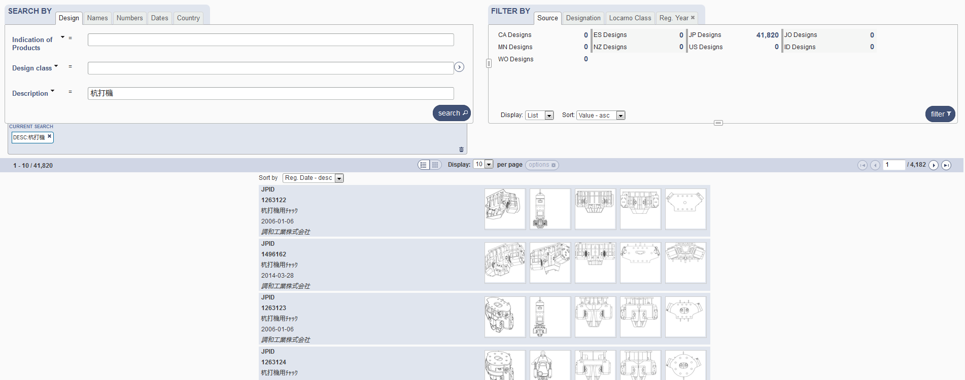
Search by Description JA

Slide 16
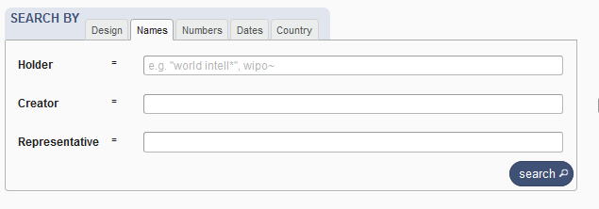
Search by name

Slide 17
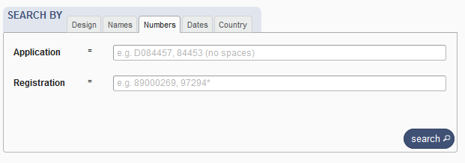
Search by numbers

Slide 18
Search by dates

Slide 19
Search by country

Slide 21
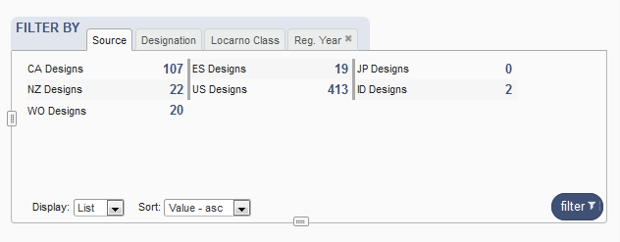
Filter by

Slide 22
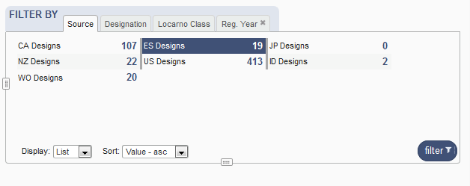
Filter by Source

Slide 23
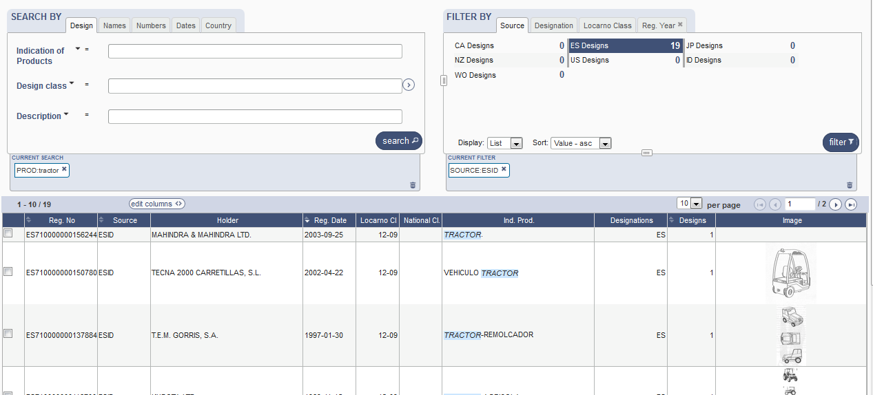

Slide 24
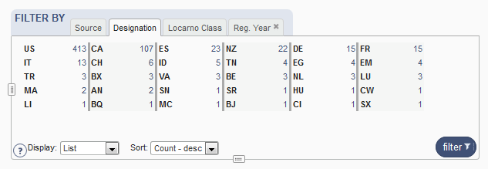
Filter by Designation

Slide 25
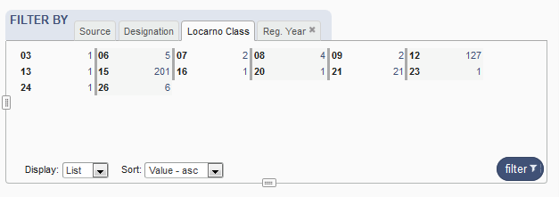
Filter by Locarno Class

Slide 26
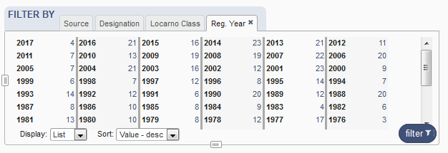
Filter by Registration Year

Slide 27
Options

Slide 28
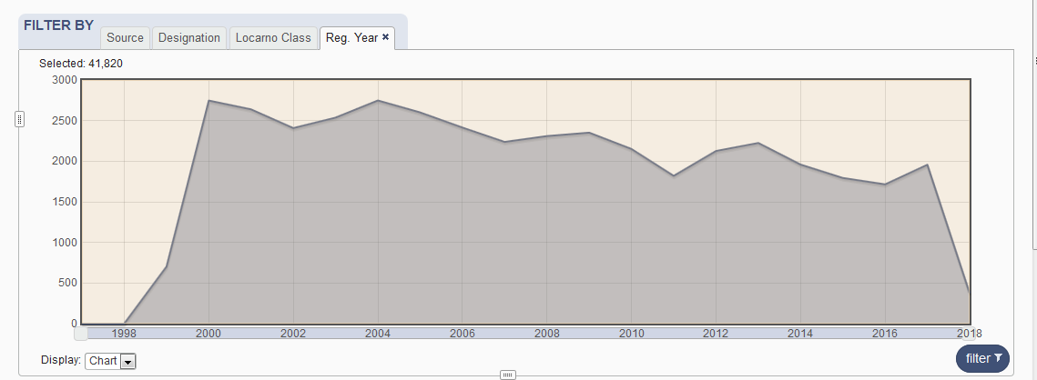

Slide 29
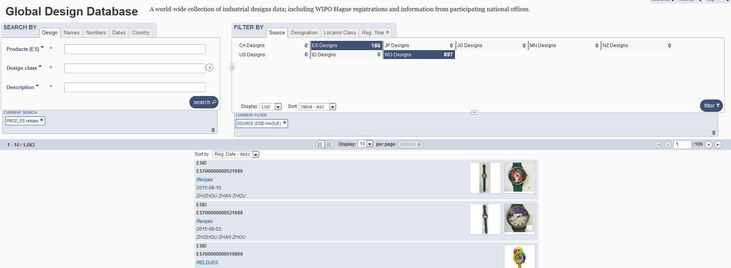

Slide 31
4

Slide 32
2 parts

Slide 33
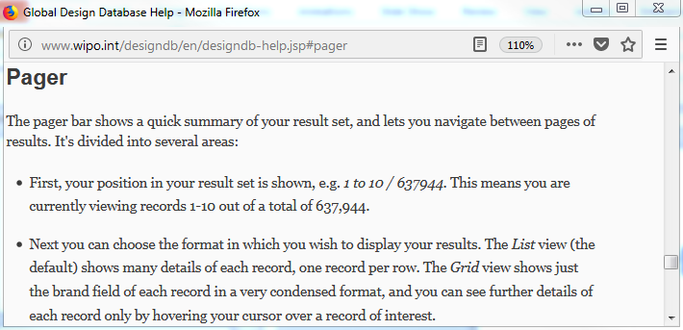
Pager bar

Slide 34
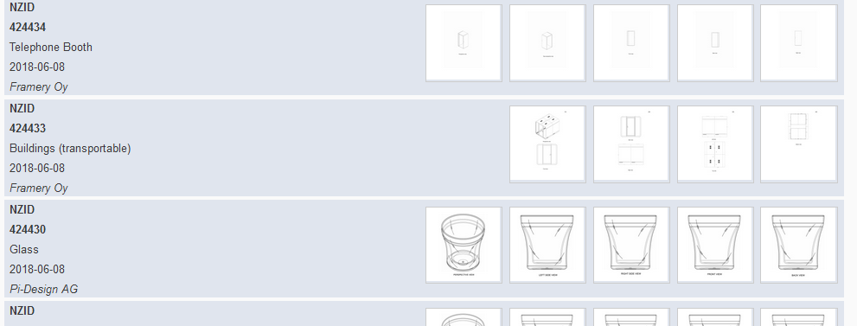
Display

Slide 35
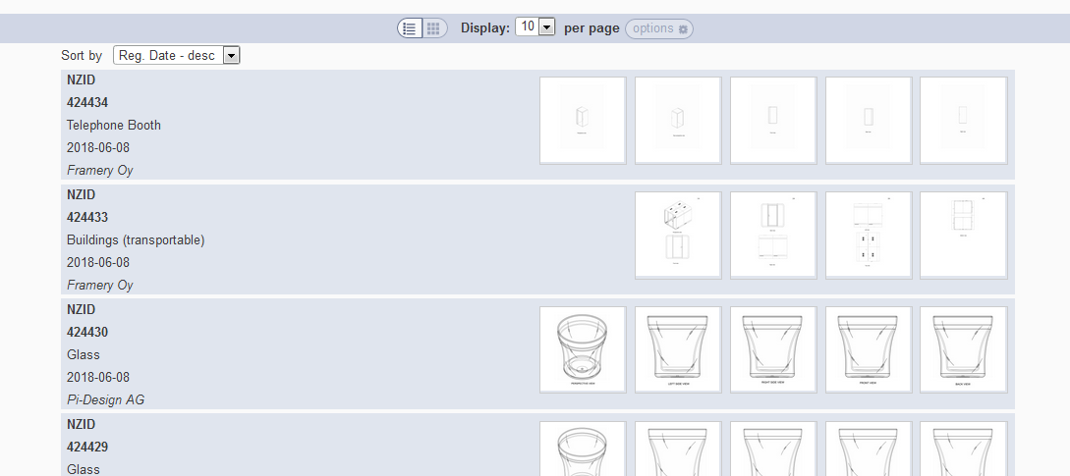
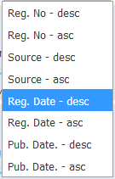
Grid view
Notes:
In case the design has multi models (hauge, new Zealand…), we show the images of every model
In case the design has one model (france, spain…), we should the first 5 images of the model

Slide 36
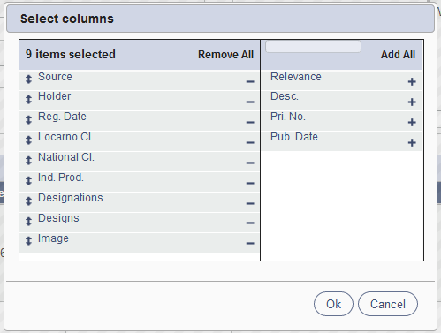
List view

Slide 37
Customized number of columns

Slide 38
2 parts

Slide 39
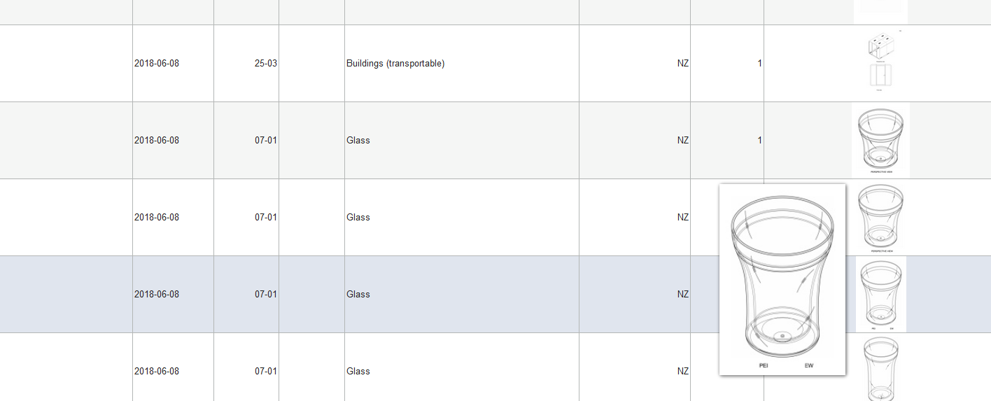

Slide 40
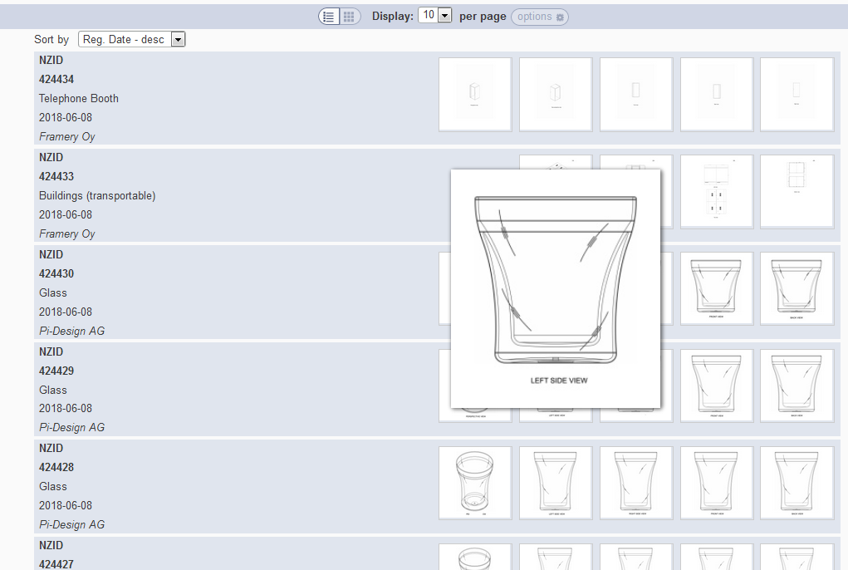

Slide 41
Back button/link

Slide 42
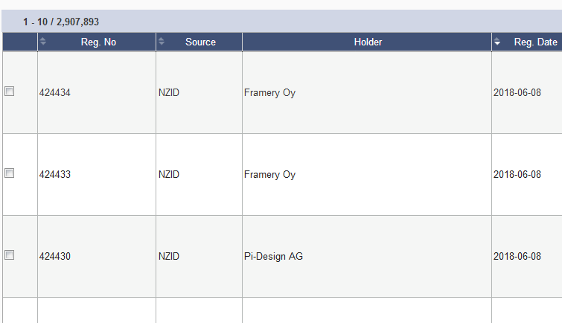
Options: checkbox

Slide 43
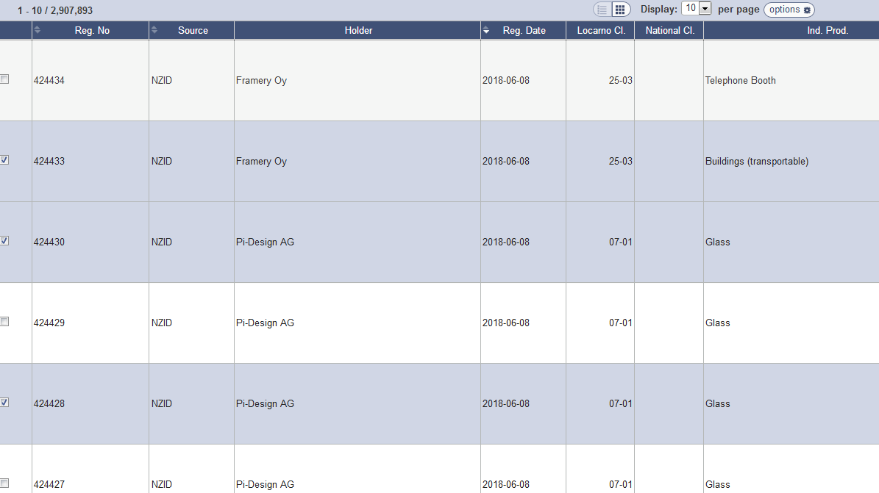

Slide 44
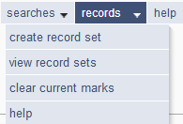

Slide 45
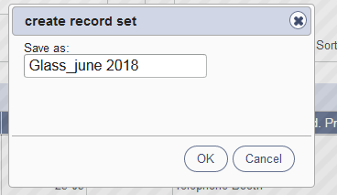
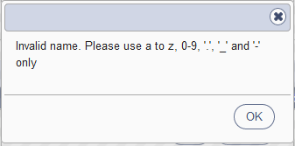
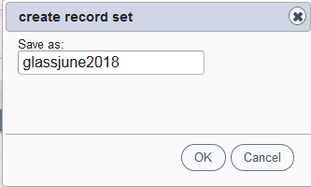
Save a record set

Slide 46
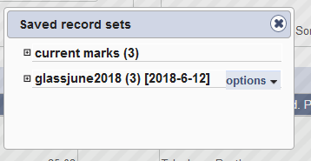
View record sets/Clear current marks

Slide 47
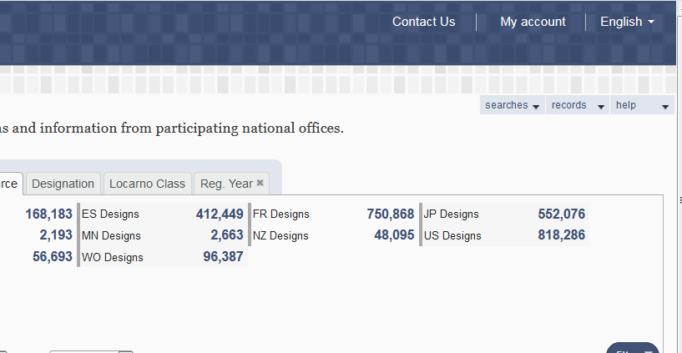
My account

Slide 48
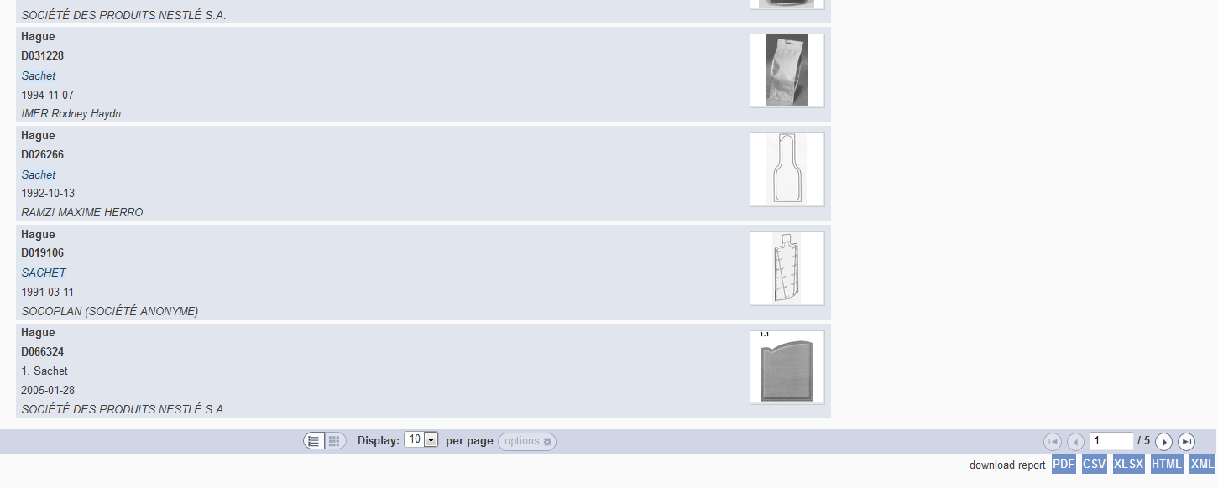
Download reports

Slide 49
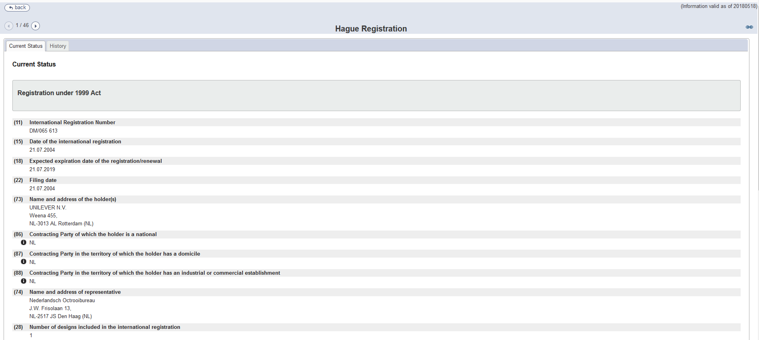
Individual record

Slide 50
5

Slide 52
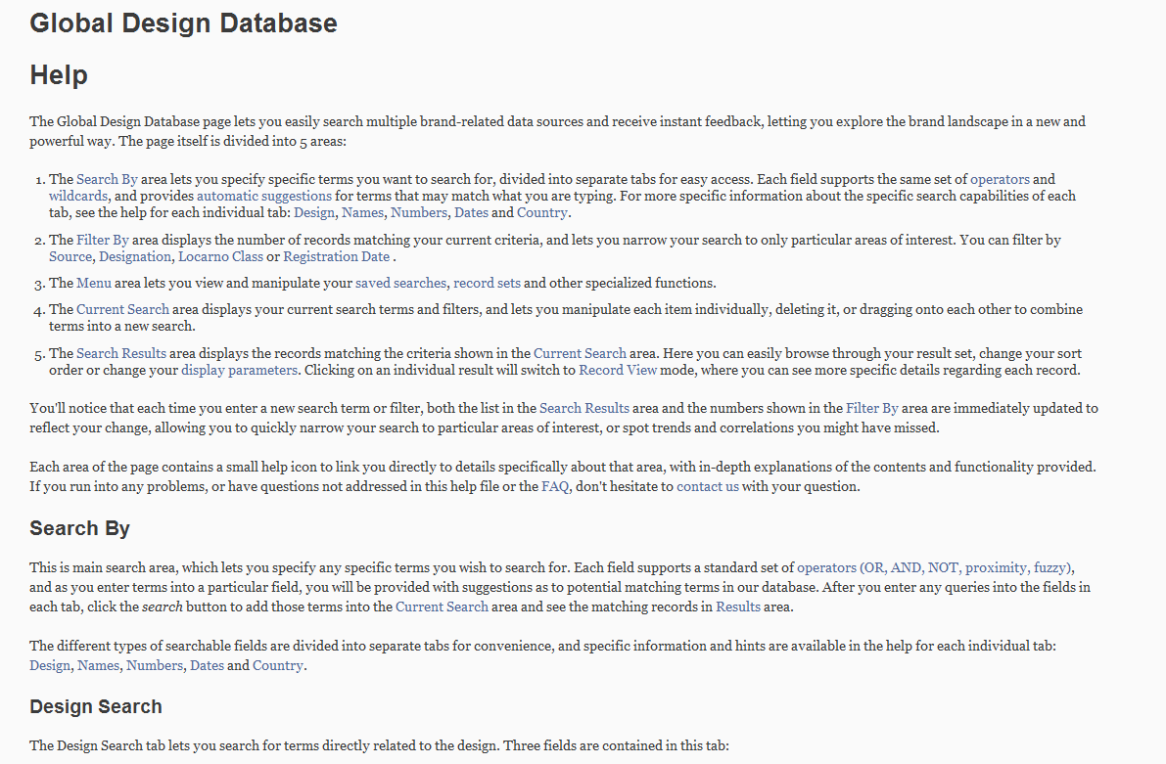
Help

Slide 53
Plans for the future
Add more collections: Germany, Georgia, …

Slide 54
Webinars

Slide 55
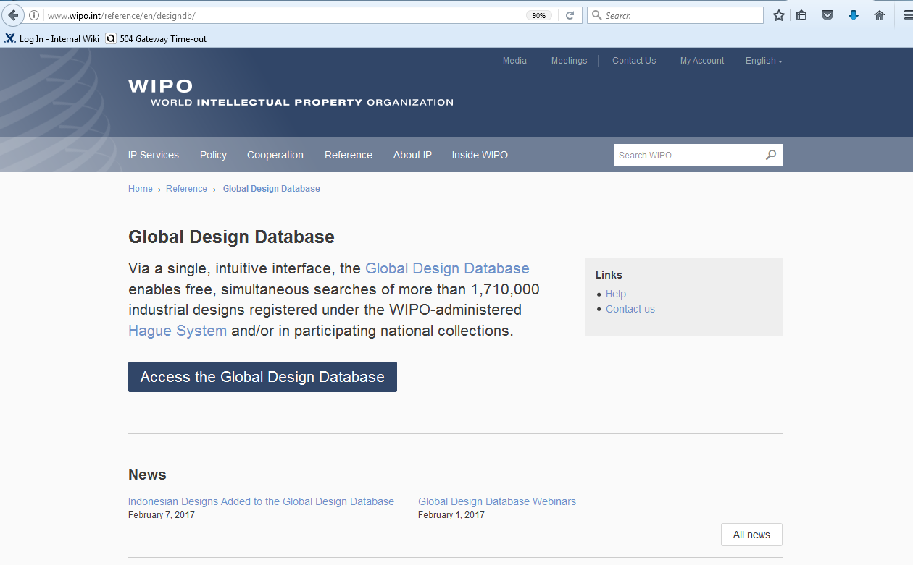
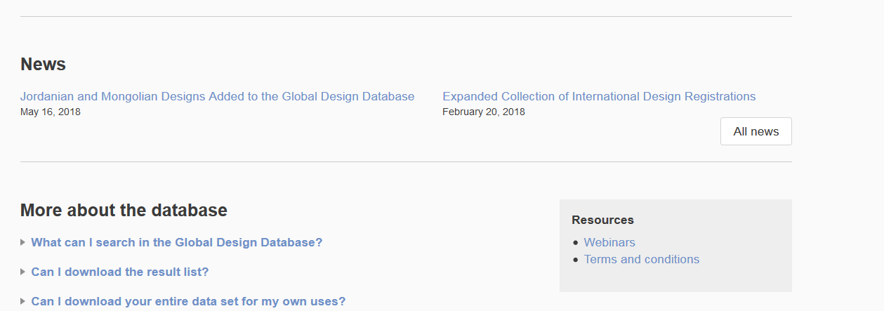

Slide 56
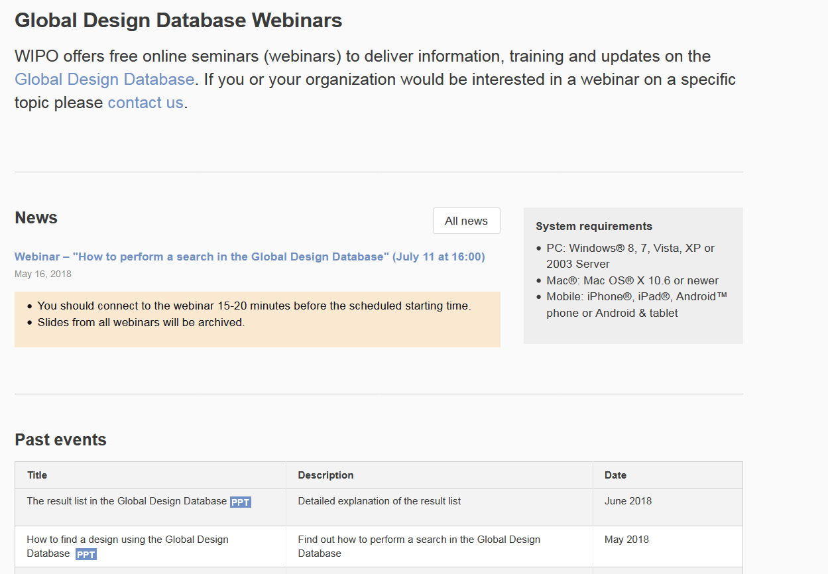

Slide 57
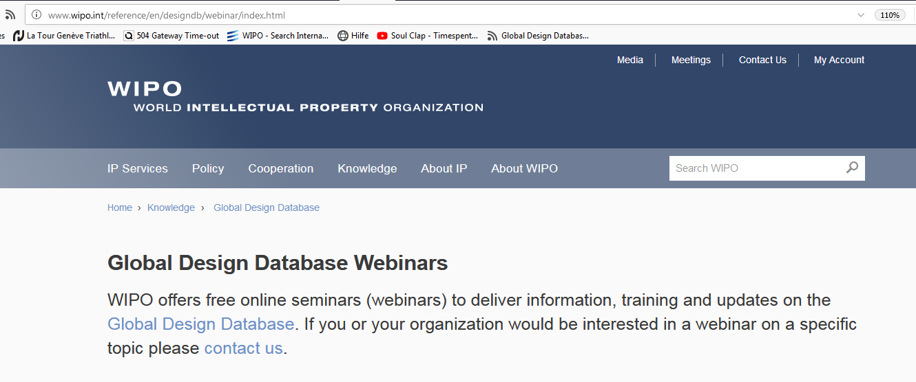
Updates
Click on open menu icon
Select ‘Customize’
Drag the ‘Subscribe’ icon to the navigation toolbar
Click on the icon in the navigation toolbar to view the page-specific feed

Slide 58
PATENTSCOPE webinar
Chemical Structure Search
July 17 or 19
https://attendee.gotowebinar.com/rt/3241594862538409217

Slide 59
Global Brand Database: webinar
Performing effective searches in the Global Brand Database
July 18 at 4:30pm CET
https://attendee.gotowebinar.com/rt/2978426757944878081

Slide 61
mulțumesc
mulțumesc
gbd@wipo.int

