Slide 1
How to read, save & share your results
Global Design Database
Cyberworld
September 19
2018
Sandrine Ammann
Marketing & Communications Officer

Slide 2
Click only if you can hear me…

Slide 5
Questions/concerns
gbd@wipo.int

Slide 6
Agenda
What’s new?
Result list
Grid view
List view
Options
Reports
Quiz
Q&A

Slide 7
What’s new?
New collections: Republic of Moldova

Slide 8
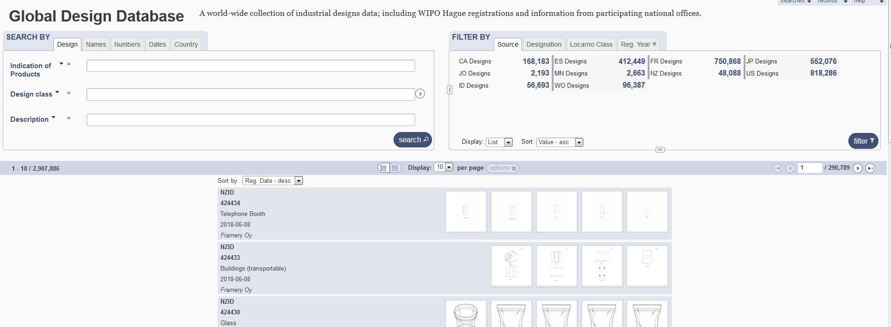
Result list

Slide 9
2 parts

Slide 10
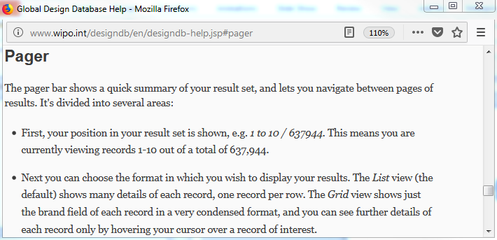
Pager bar

Slide 11
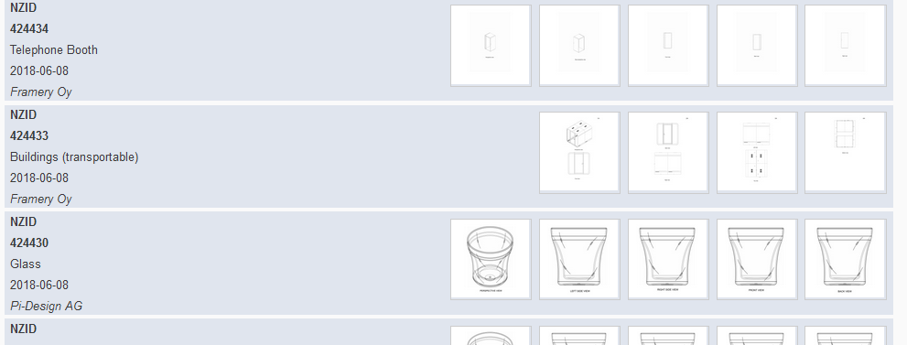
Display

Slide 12
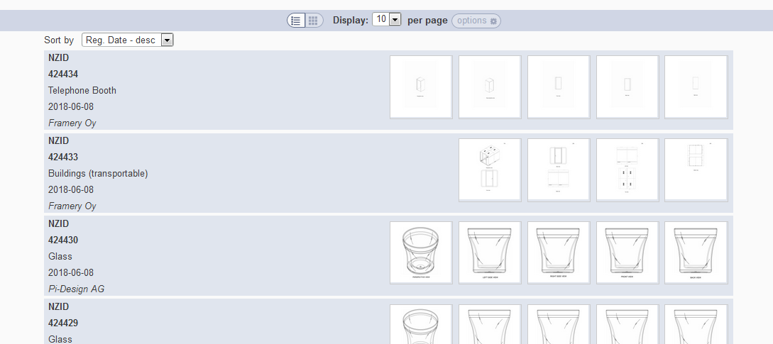
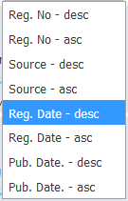
Grid view
Notes:
In case the design has multi models (hauge, new Zealand…), we show the images of every model
In case the design has one model (france, spain…), we should the first 5 images of the model

Slide 13
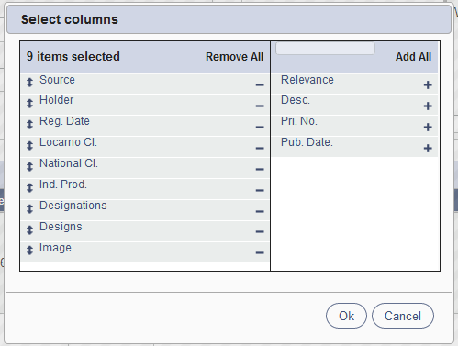
List view

Slide 14
Customized number of columns

Slide 15
2 parts

Slide 16
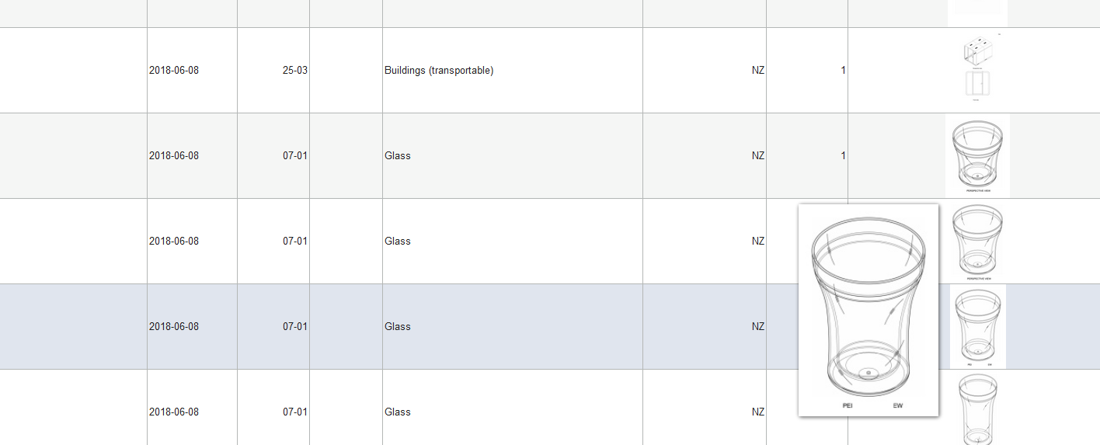

Slide 17
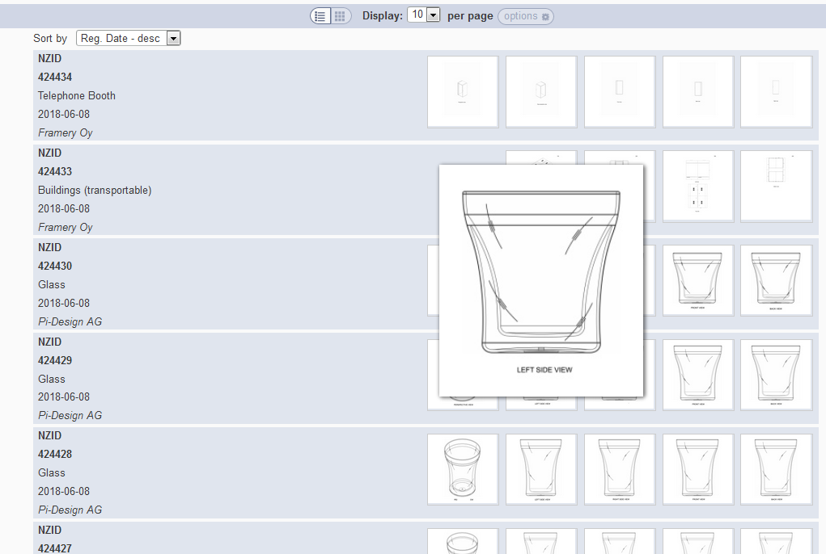

Slide 18
Back button/link

Slide 19
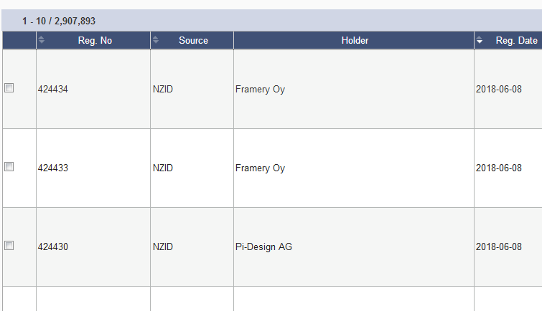
Options: checkbox

Slide 20
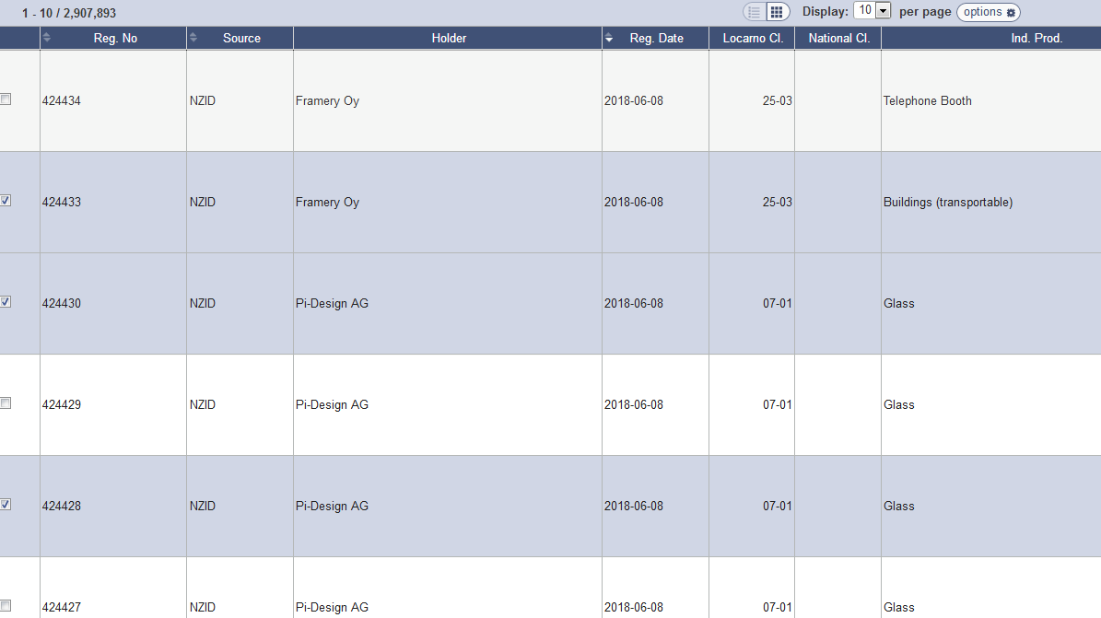

Slide 21
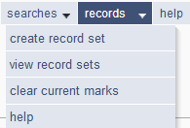

Slide 22
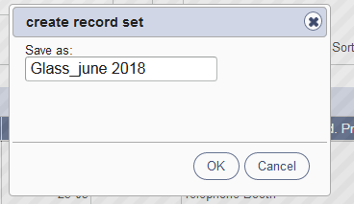
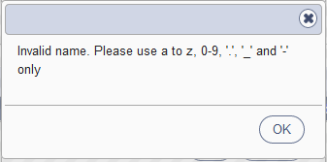
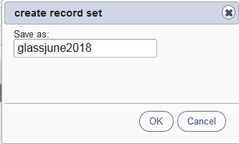
Save a record set

Slide 23
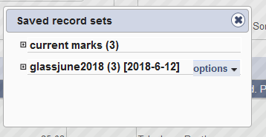
View record sets/Clear current designs

Slide 24
Share

Slide 25
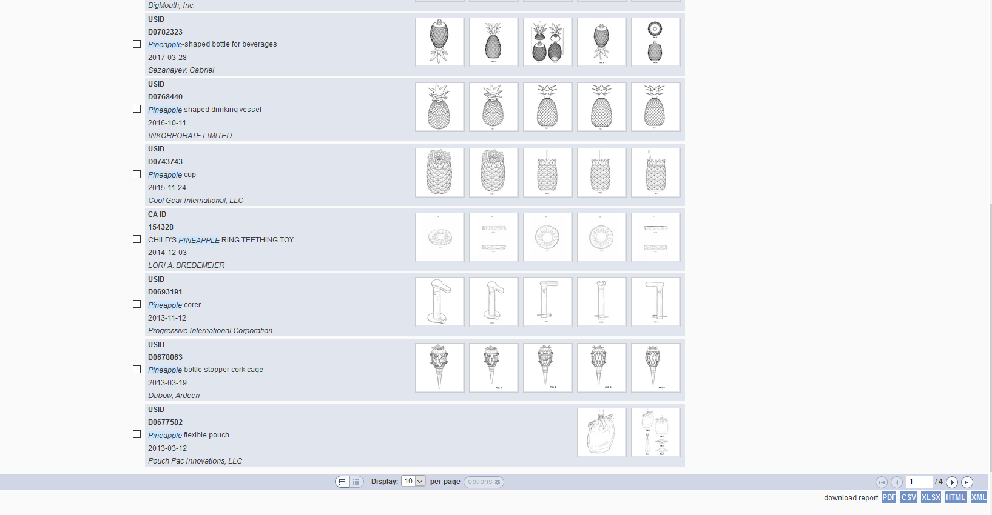
Reports

Slide 26
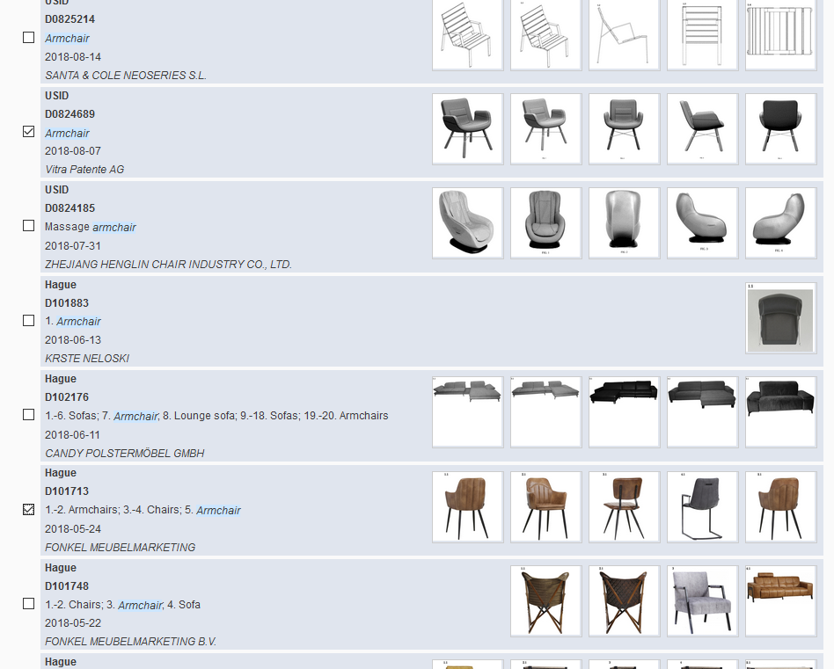
Select records of interest

Slide 27
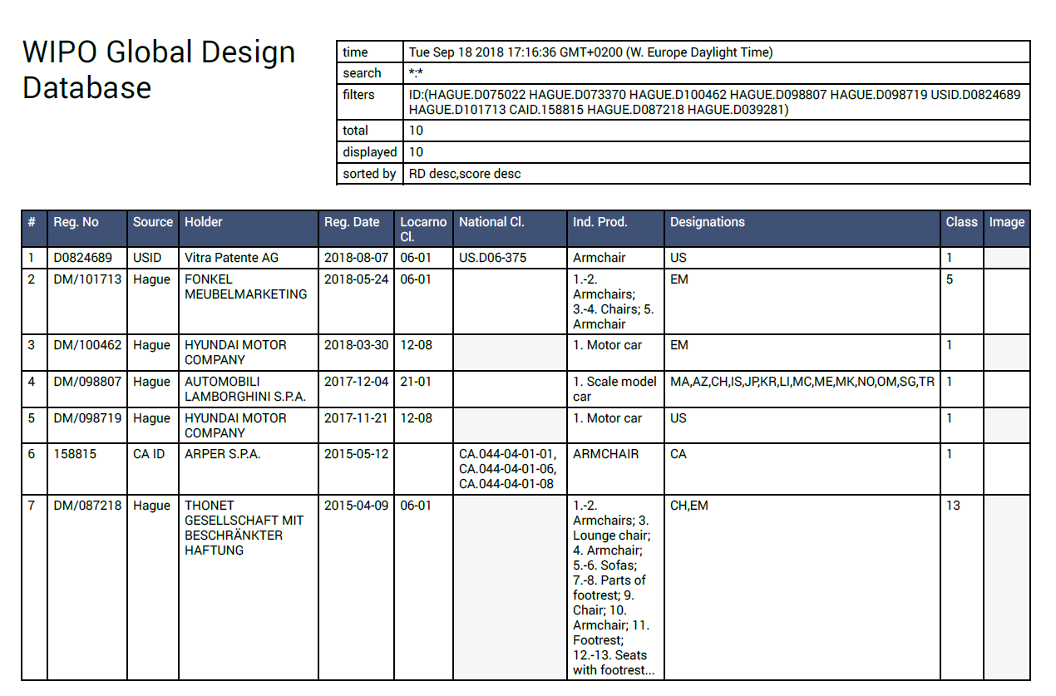
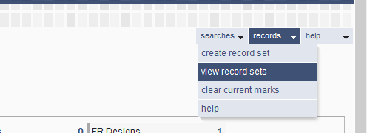
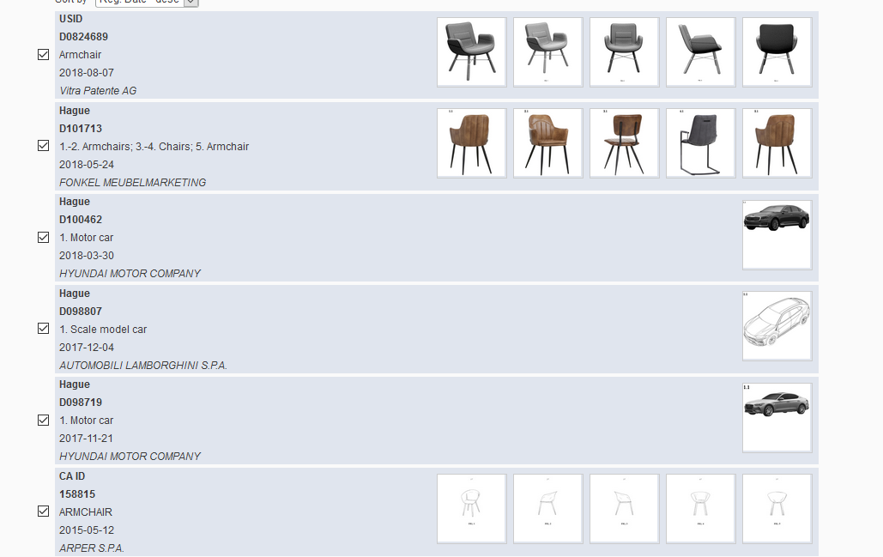
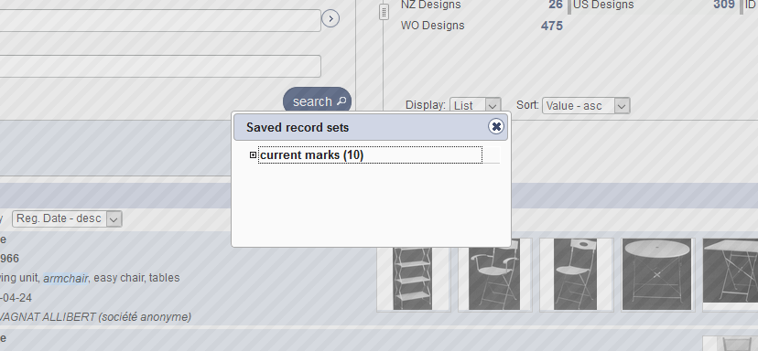

Slide 28
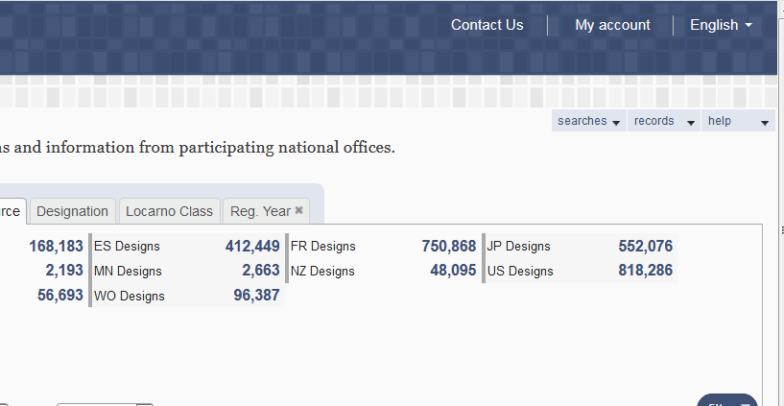
My account

Slide 30
Q.1: If you would like to access your saved records, what should you do?
A
Login
B
Nothing

Slide 31
Q.1: If you would like to access your saved records, what should you do?
A
Login
B
Nothing

Slide 32
Q.2: To customize the search result view, which view should you select?
A
Grid
B
List

Slide 33
Q 2: To customize the search result view, which view should you select?
A
Grid
B
List

Slide 34
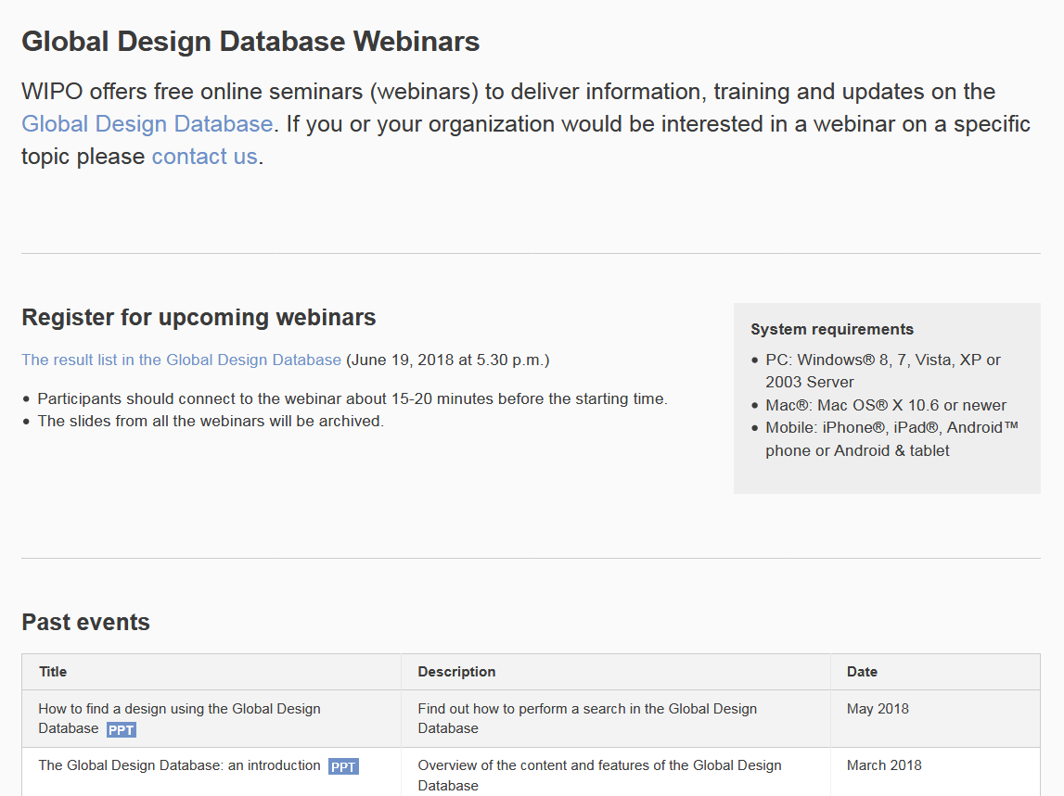
Future/past webinars:
http://www.wipo.int/reference/en/designdb/webinar/index.html

Slide 35
Global Design Database: webinar
How to perform a search in the Global Design Database
October 16 at 5:30pm or October 18 at 8:30am CET
https://attendee.gotowebinar.com/rt/2787233782654701825

Slide 36
Global Brand Database: webinar
Image searching in The Global Brand Database
September 26 at 4:30pm CET
https://attendee.gotowebinar.com/register/1256669614973868035

Slide 37
PATENTSCOPE webinar
How to find information in languages you don’t know in PATENTSCOE
September 25 at 5:30 pm
https://attendee.gotowebinar.com/rt/1978876131026604803
September 27 at 8:30 am
https://attendee.gotowebinar.com/rt/1978876131026604803

Slide 39
gbd@wipo.int

