Slide 1
Presentation Title
Presentation Subtitle and/or Conference Name
Place
Day Month
Year
First Name Last Name
Job Title

Slide 2
Global Design Database:
An introduction
January 2019
Sandrine Ammann
Marketing & Communications Officer

Slide 3
Agenda
Access
Interface:
Coverage
Search features
Filter features
Results
Menus
Q&A

Slide 4
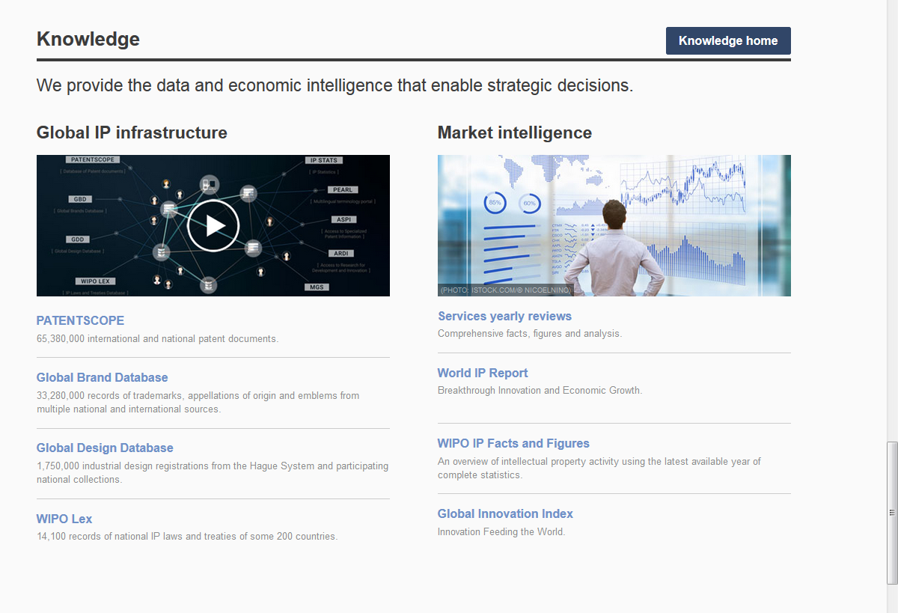
Access: www.wipo.int/designdb www.wipo.int

Slide 5
Why is the GDD useful?
Find details about a specific design
Explore design landscape to find out if the design you have in mind already exists.

Slide 7
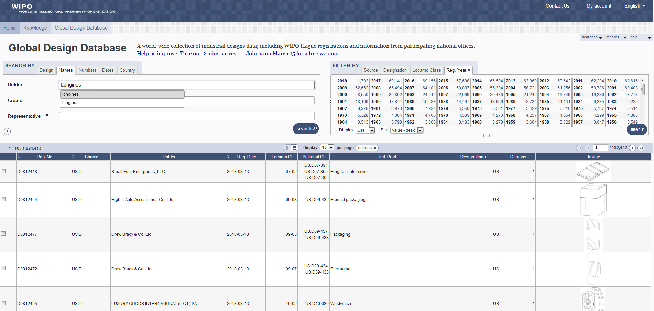

Slide 8
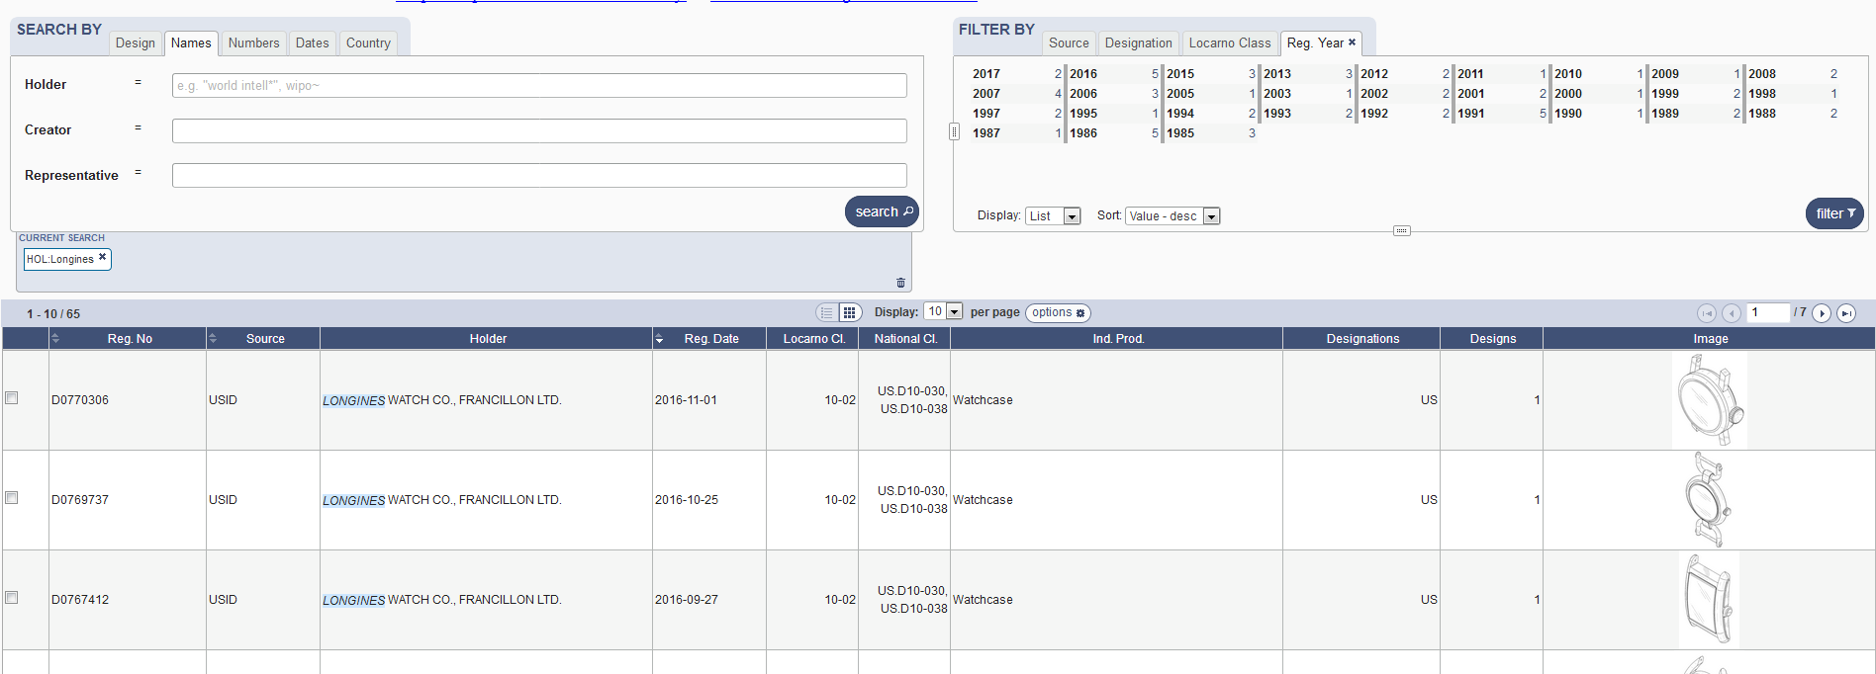

Slide 10
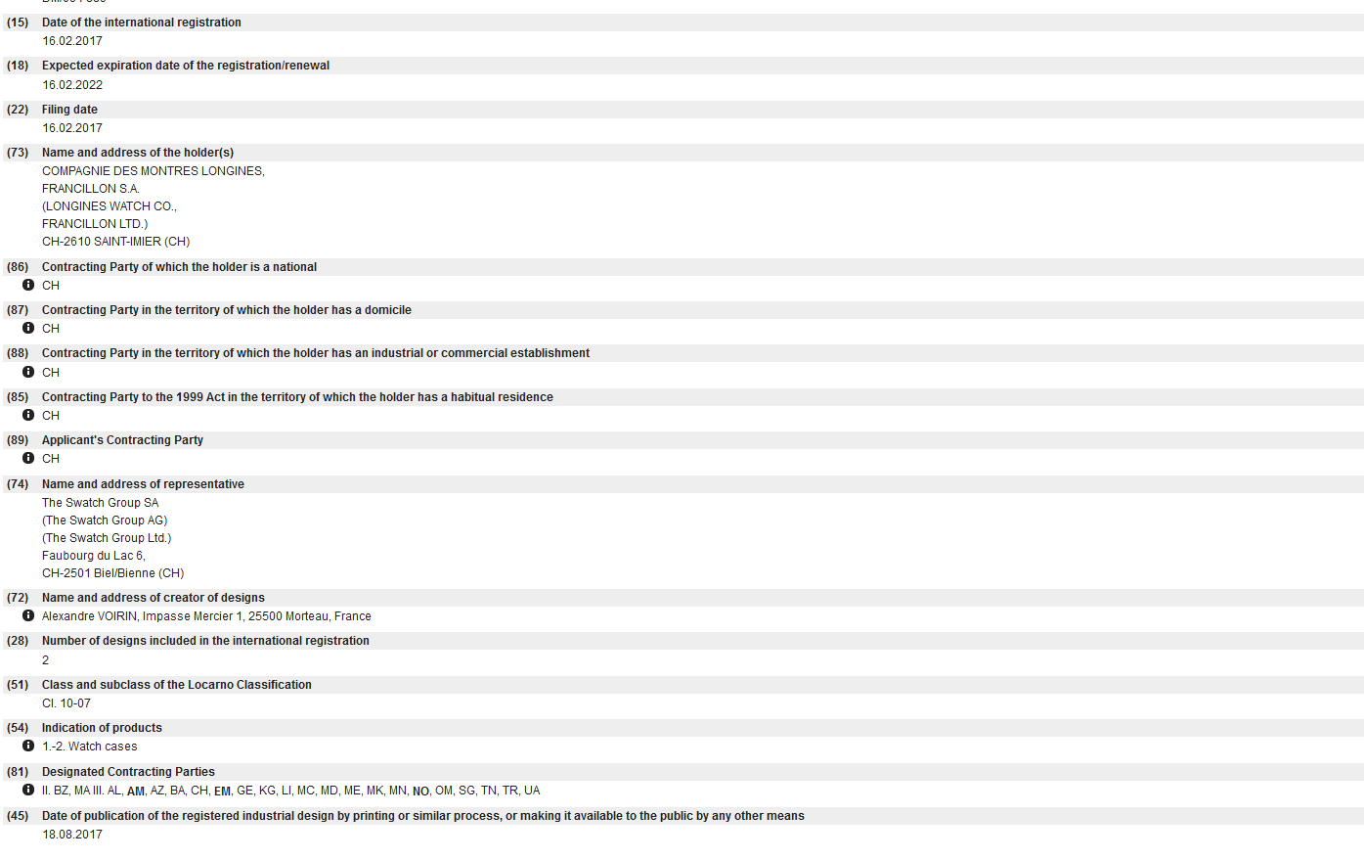

Slide 12
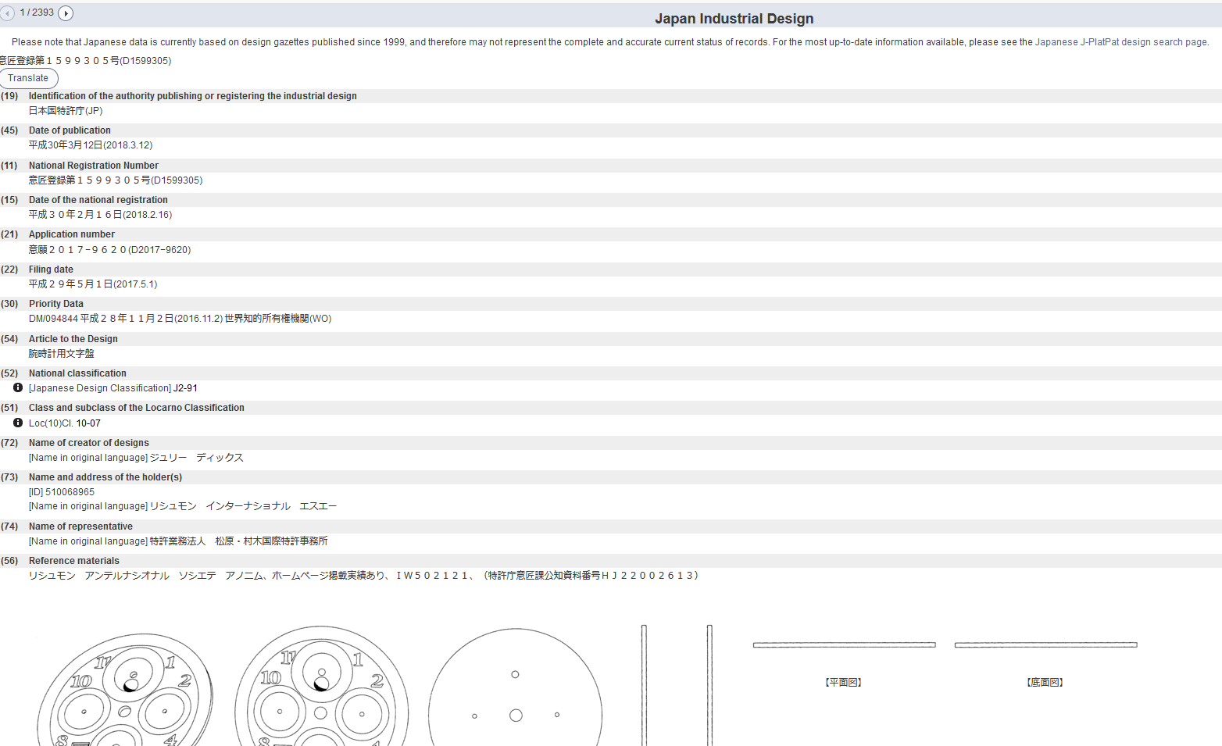

Slide 13
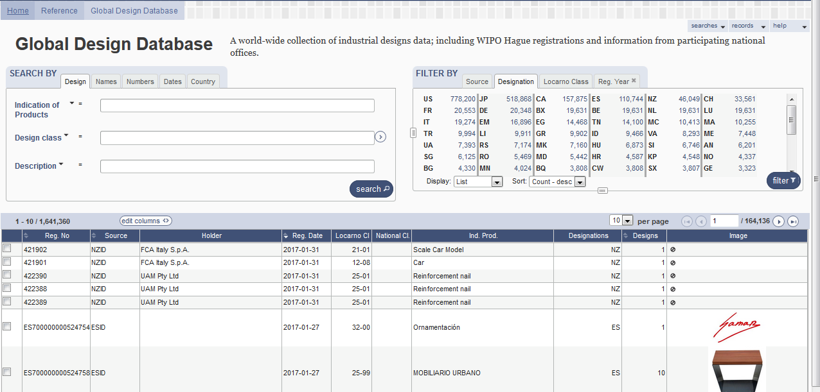

Slide 14
Coverage

Slide 15
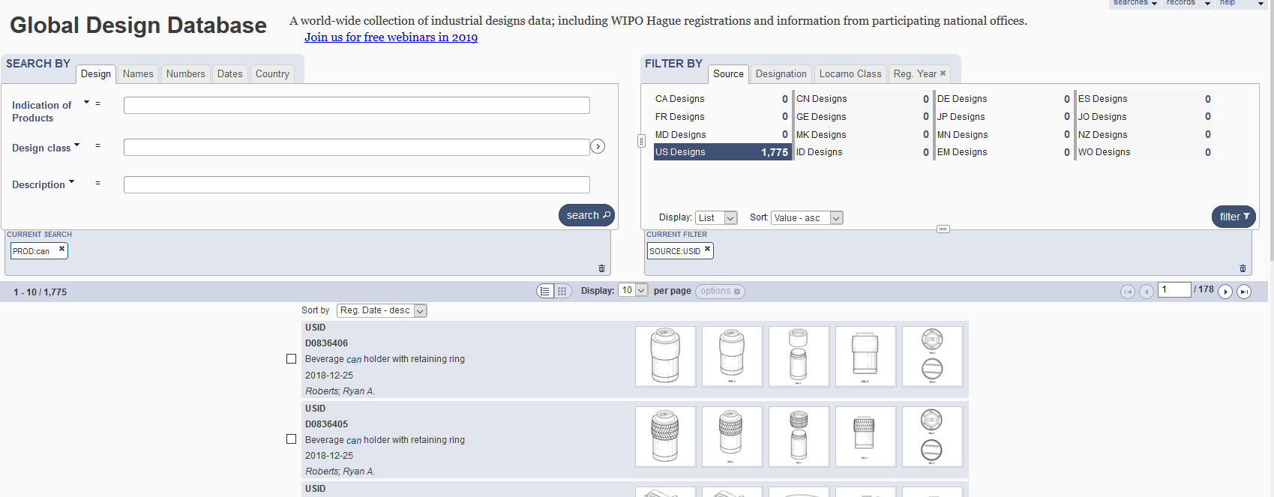
5
1
2
3
4

Slide 16
1

Slide 17
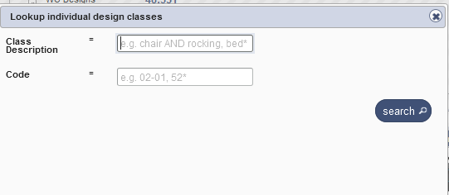
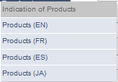
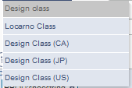
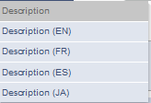
Search by design

Slide 18
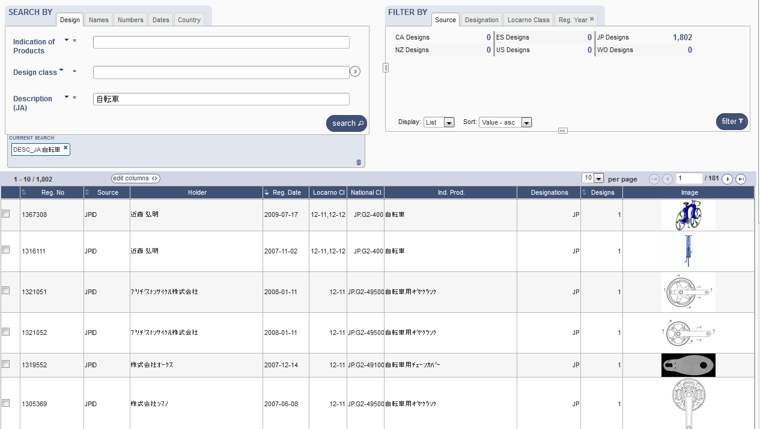
Search by Description JA

Slide 19
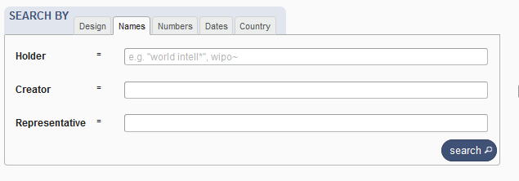
Search by name

Slide 20
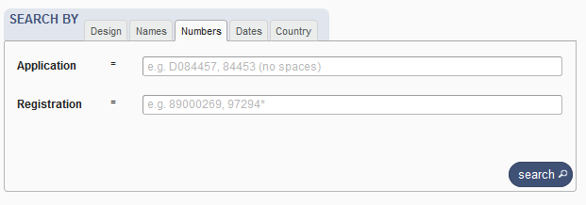
Search by numbers

Slide 21
Search by dates

Slide 22
Search by country

Slide 23
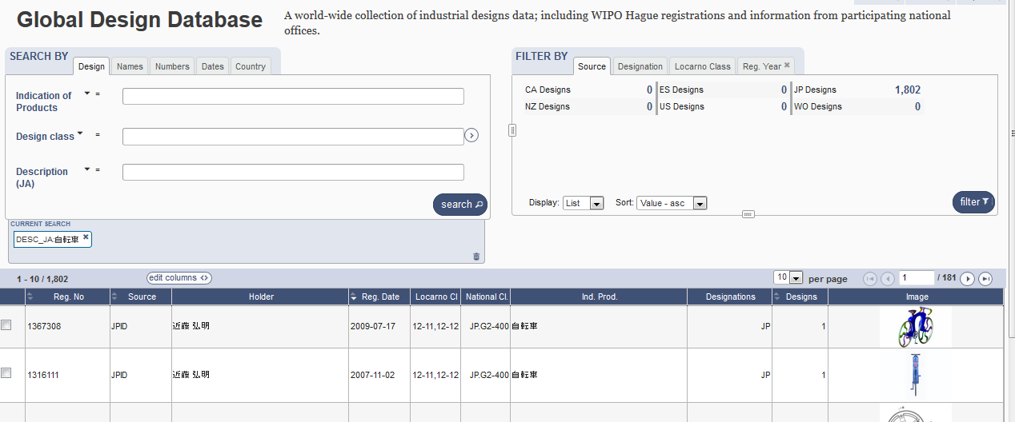

Slide 24
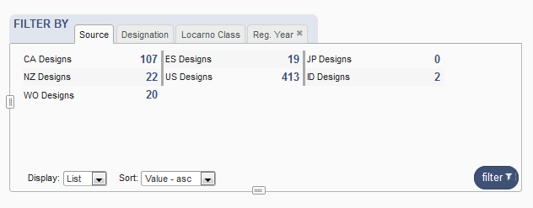
Filter by

Slide 25
Filter by Source

Slide 26
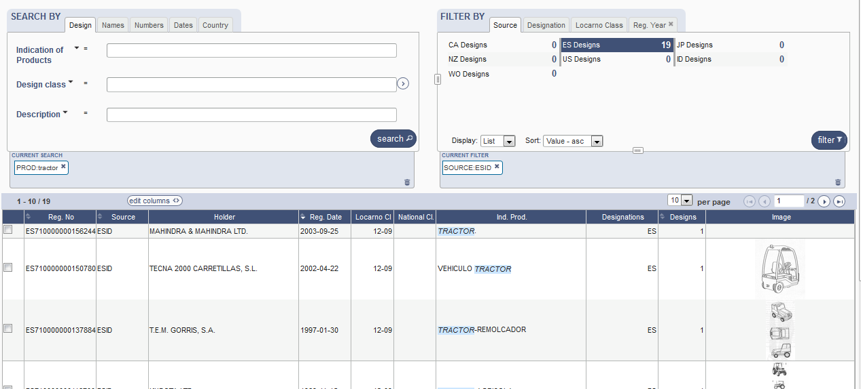

Slide 27
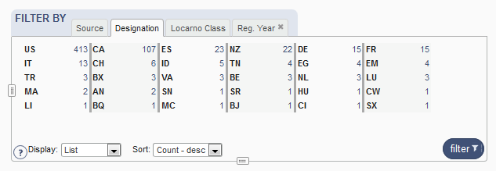
Filter by Designation

Slide 28
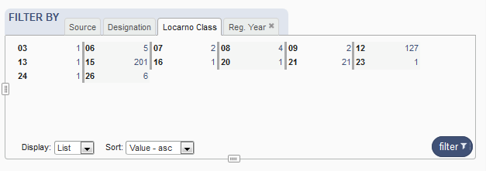
Filter by Locarno Class

Slide 29
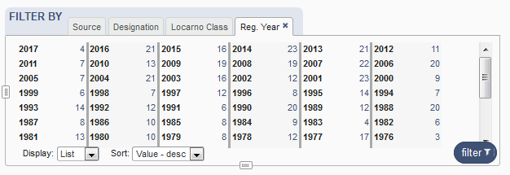
Filter by Registration Year

Slide 30
Options

Slide 31
3

Slide 32
4

Slide 33
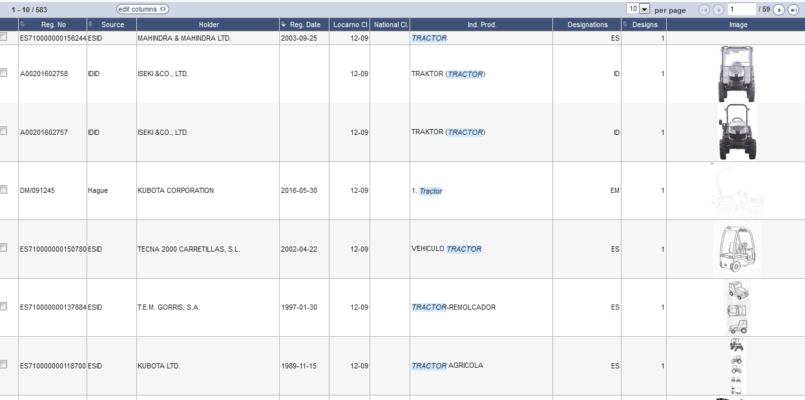
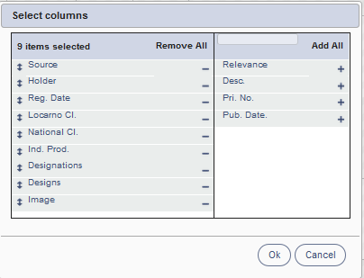
Results

Slide 34
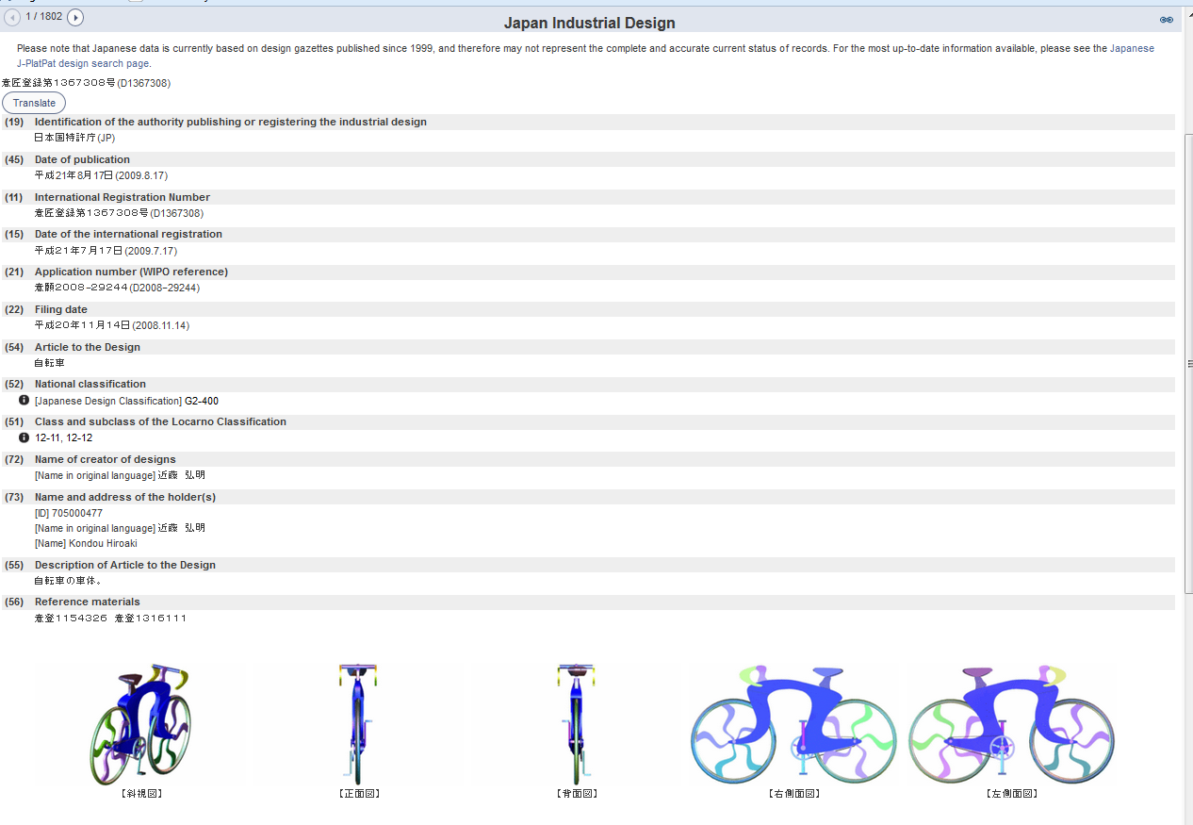
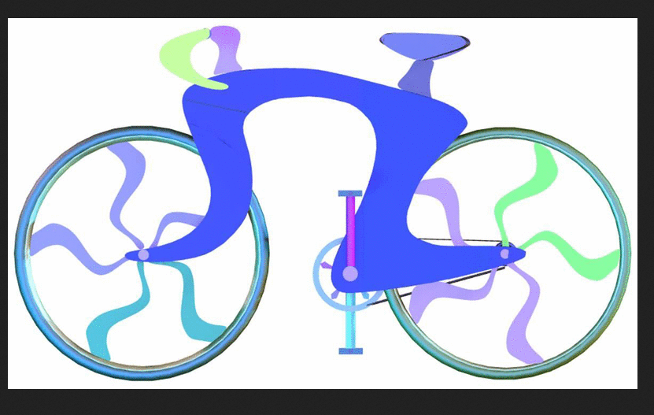
Individual record

Slide 35
5

Slide 37
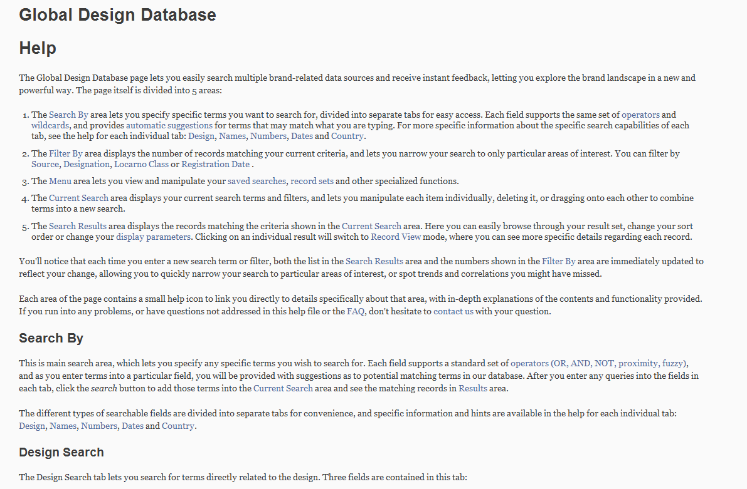
Help

Slide 38
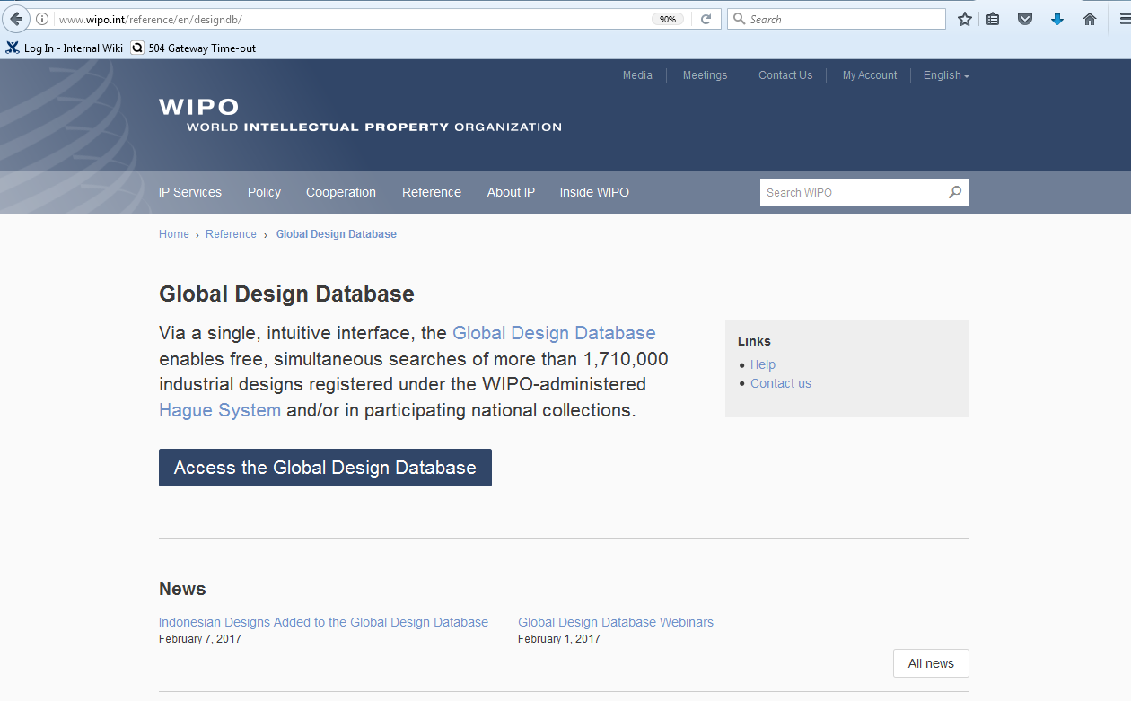

Slide 39
Patent database webinar
Overview of the PATENTSCOPE search system
January 29 at 5:30 pm https://global.gotowebinar.com/manageWebinar.tmpl?webinar=8928123874024922115
January 31 at 8:30 am
https://global.gotowebinar.com/manageWebinar.tmpl?webinar=8928123874024922115

Slide 40
Global Brand Database webinar
How to perform a search in the GBD
February 12 at 5:30 pm CET https://global.gotowebinar.com/manageWebinar.tmpl?webinar=2814607226678118146

Slide 41
mulțumesc
mulțumesc
gbd@wipo.int

