Slide 1
Performing effectives searches in the Global Design Database
Internet
May
2019
Sandrine Ammann
Marketing & Communications Officer

Slide 2
Click the Raise hand button if you hear me otherwise send me a message please!

Slide 5
Questions/concerns
gbd@wipo.int

Slide 6
Agenda
Interface:
Coverage
Search features
Filter features
Results
Menus
Webinars
Q&A

Slide 7
Why is the GDD useful?
Details about designs
Explore design landscape
Notes:
A service on top of global industrial designs that aims to improve search quality and examination quality of designs data

Slide 8
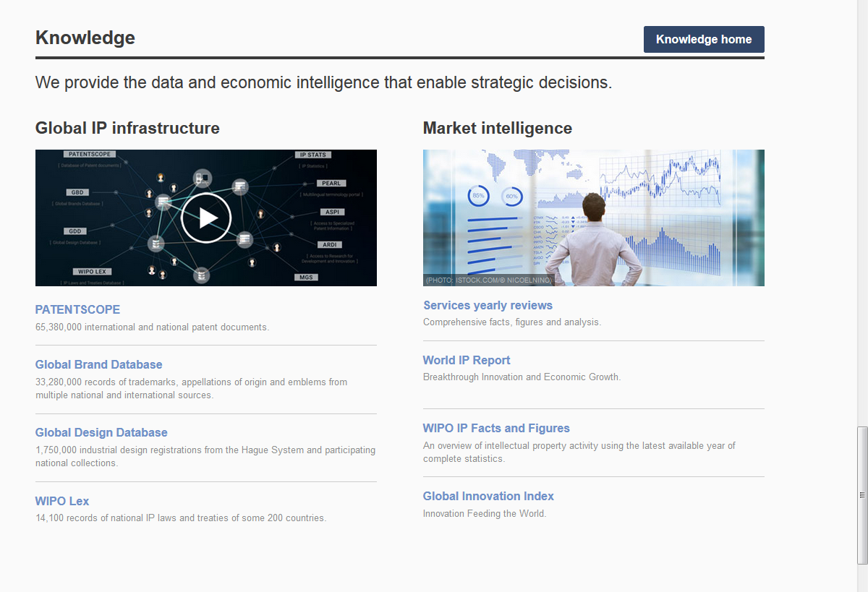
Access: www.wipo.int/designdb www.wipo.int

Slide 9
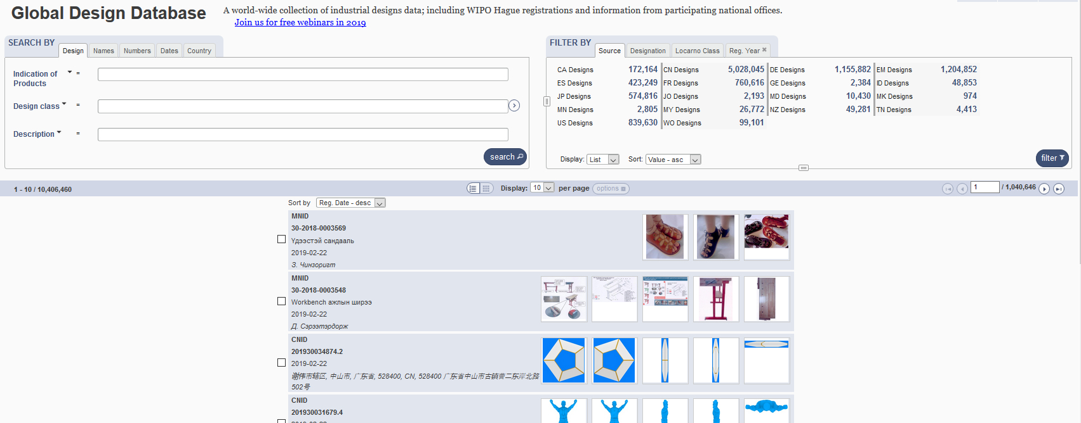
The Global Design Database

Slide 10
Combining many search criterias
Design Apple
2 Locarno classifications: 20 & 25
2 registration years: 2017 & 2016
No need to build complex queries

Slide 11
2 steps
1
2
- Design Apple
- 2 Locarno classifications: 20 & 25
-2 registration years: 2017 & 2016

Slide 12
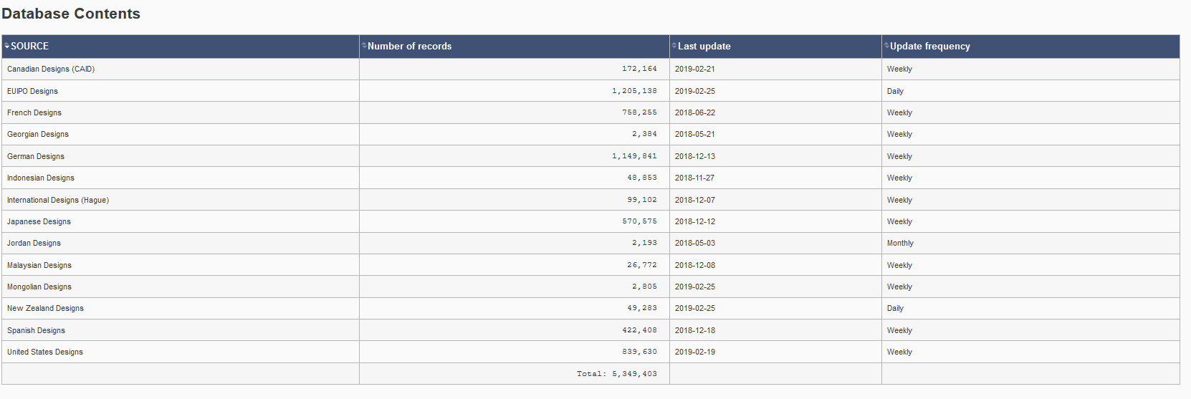
Coverage
http://www.wipo.int/designdb/en/designdb-help.jsp#db

Slide 13
Coverage

Slide 14
Coverage: new

Slide 15
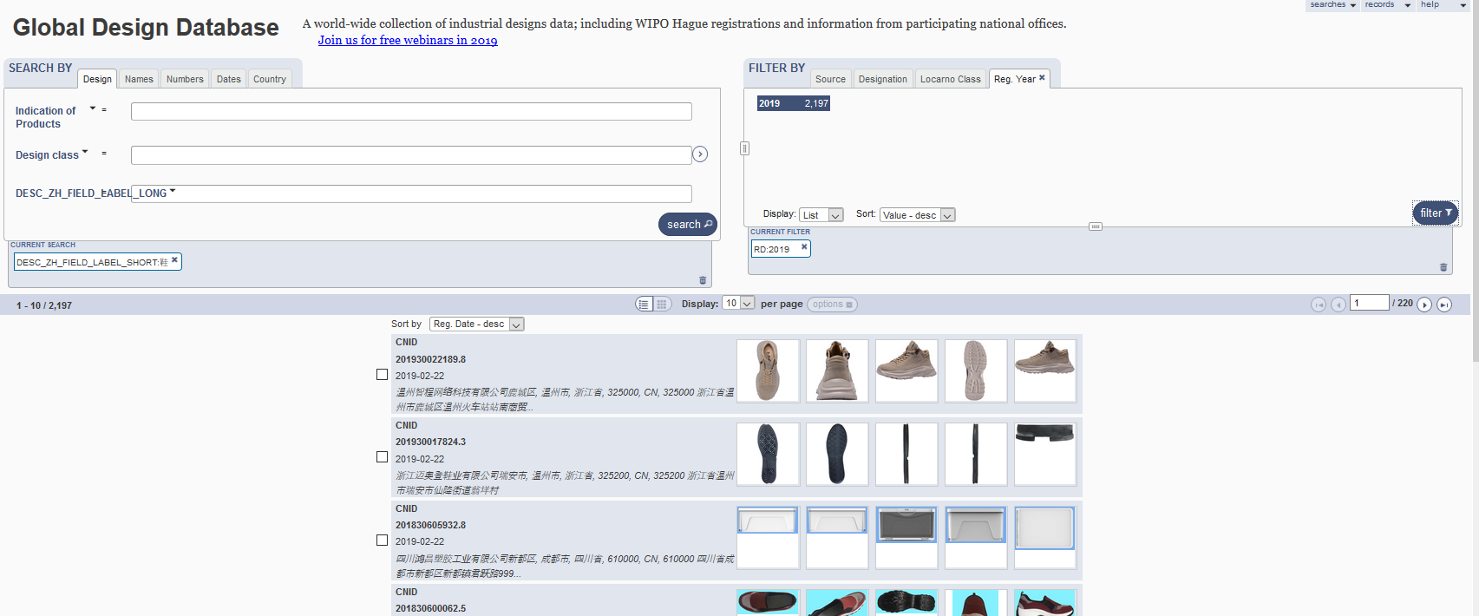
5
1
2
3
4

Slide 16
1

Slide 17
Boolean, proximity, operators, fuzzy

Slide 18
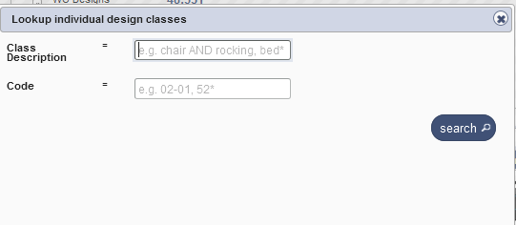
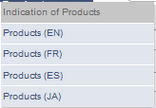
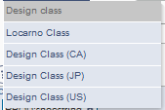
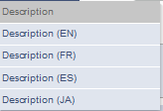
Search by design

Slide 19
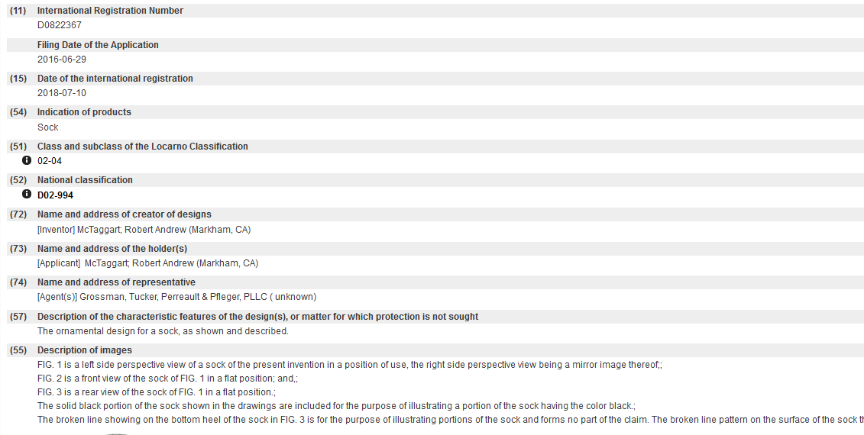
Indication of production/Description

Slide 21
Search by Description JA

Slide 22
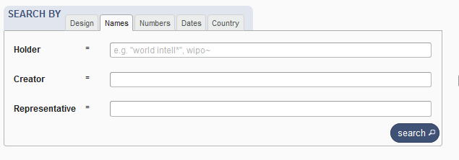
Search by name

Slide 23
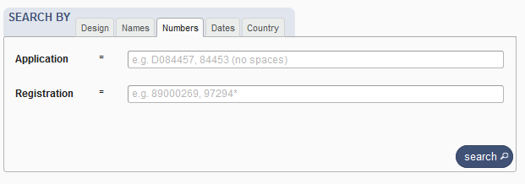
Search by numbers

Slide 24
Search by dates

Slide 25
Search by country

Slide 26
2

Slide 27
Filter by

Slide 28
Filter by Source

Slide 29
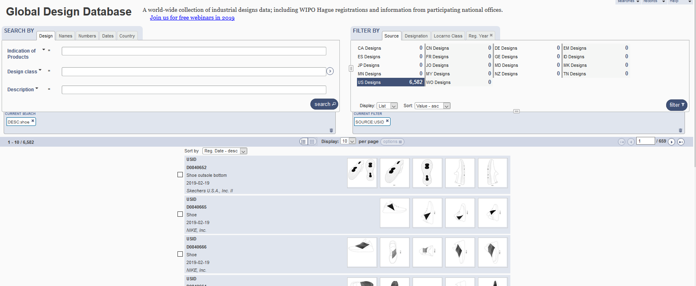

Slide 30
Filter by Designation

Slide 31
Filter by Locarno Class

Slide 32
Filter by Registration Year

Slide 33
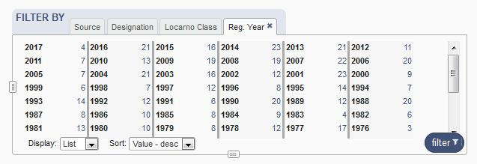
Options

Slide 34
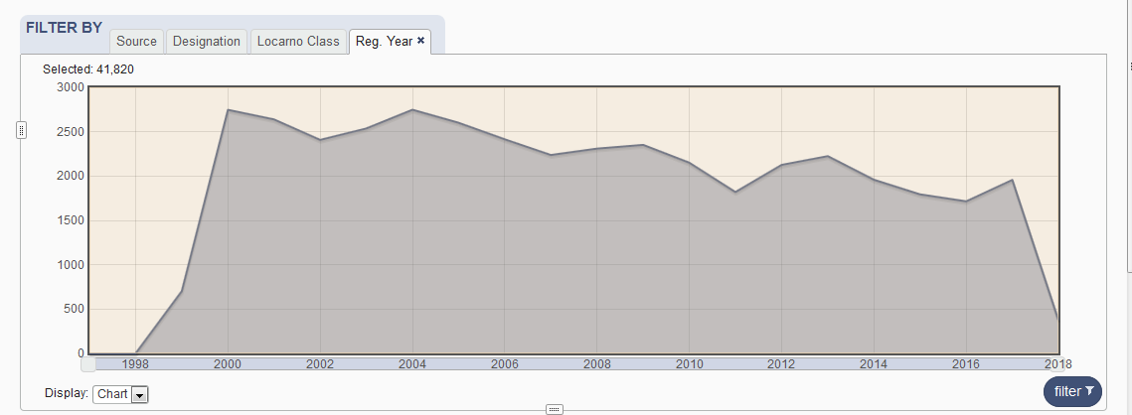

Slide 35
3
3
3

Slide 37
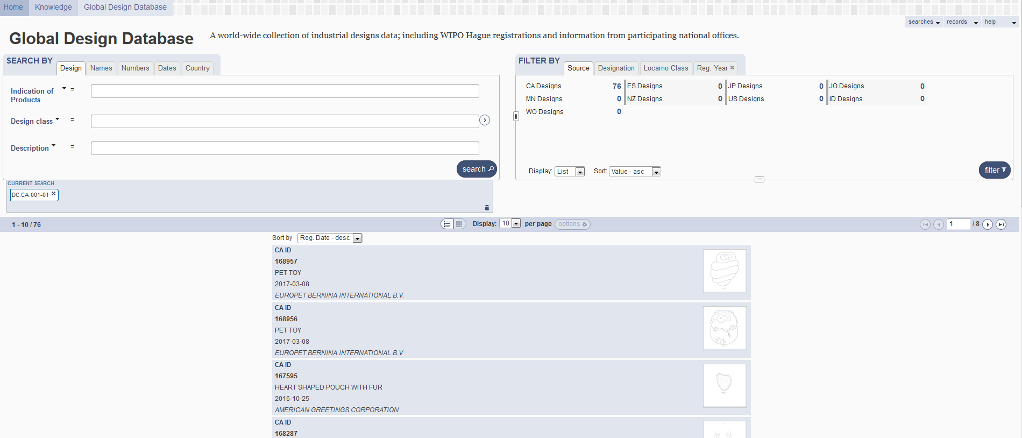
Result list
4

Slide 38
2 parts

Slide 39
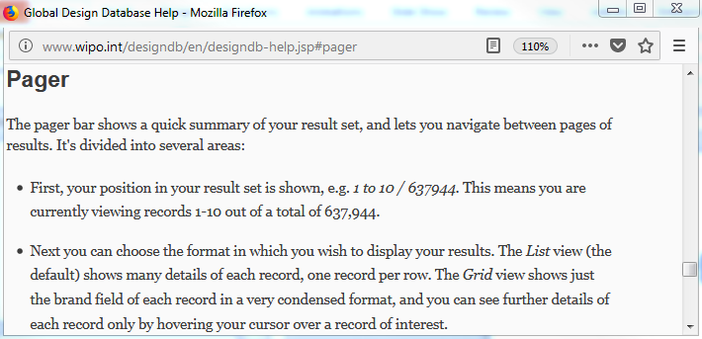
Pager bar

Slide 40
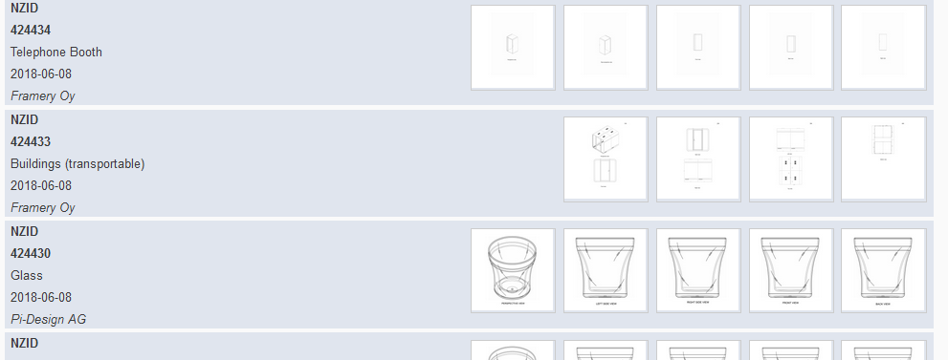
Display

Slide 41
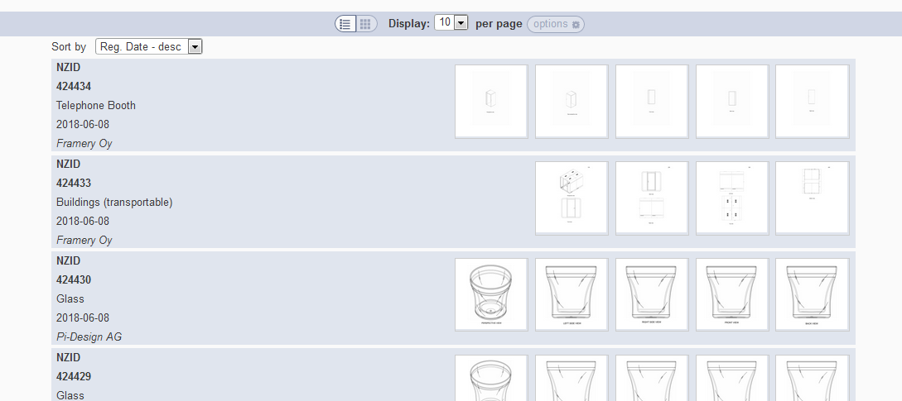
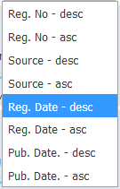
Grid view
Notes:
In case the design has multi models (hauge, new Zealand…), we show the images of every model
In case the design has one model (france, spain…), we should the first 5 images of the model

Slide 42
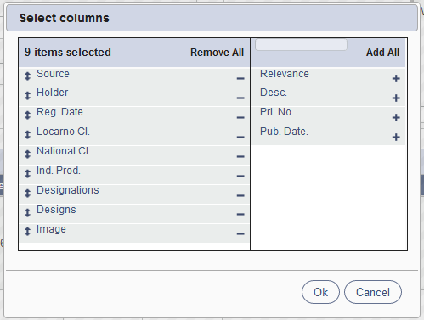
List view

Slide 43
Columns customized

Slide 44
2 parts

Slide 45
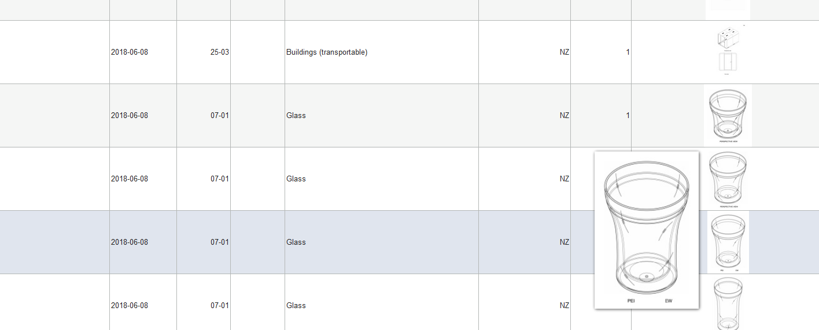

Slide 46
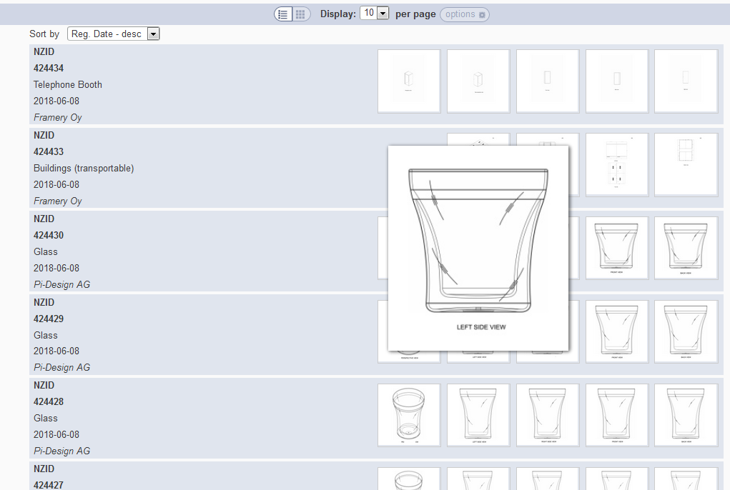

Slide 47
Back button/link

Slide 48
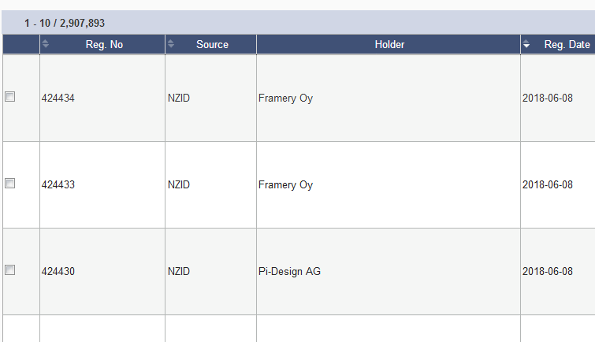
Options: checkbox

Slide 49
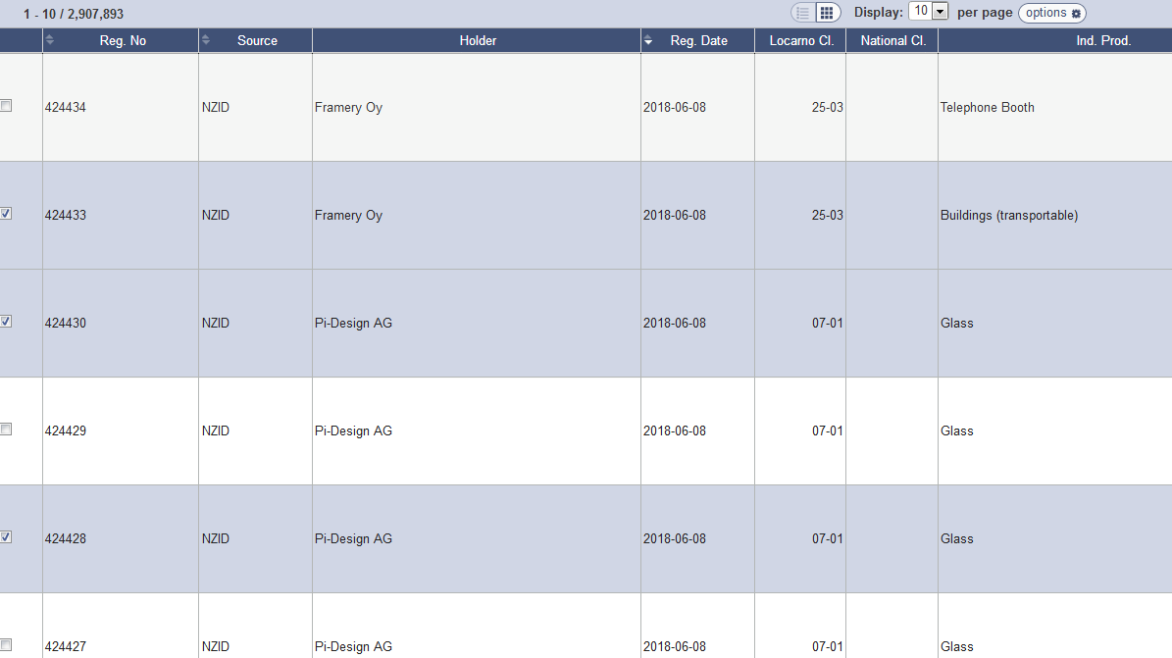

Slide 50
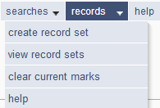

Slide 51
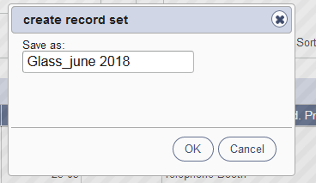
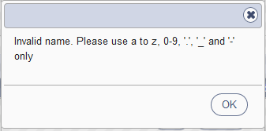
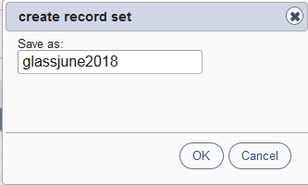
Save a record set

Slide 52
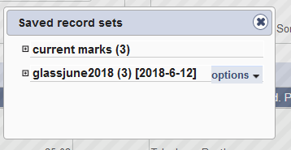
Record sets/current designs

Slide 53
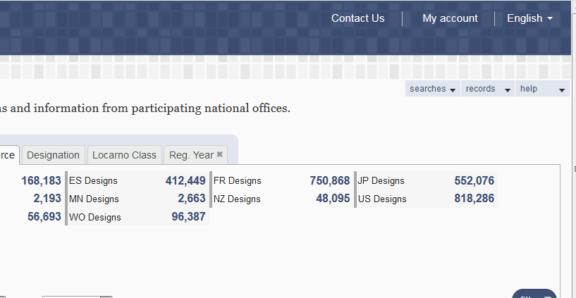
My account

Slide 54
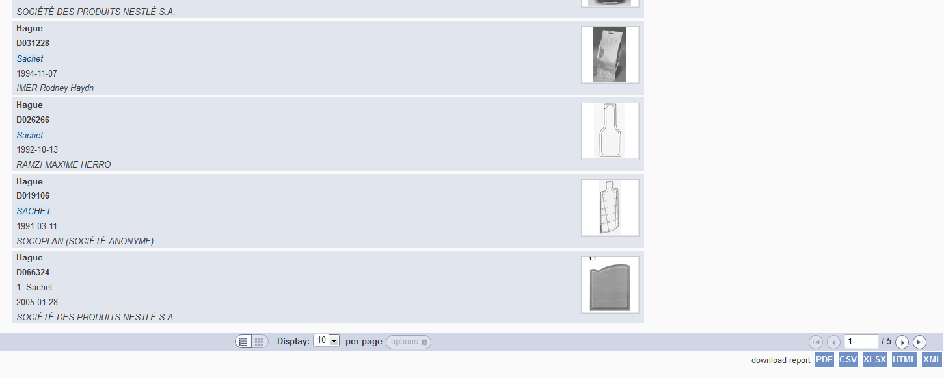
Download reports

Slide 55
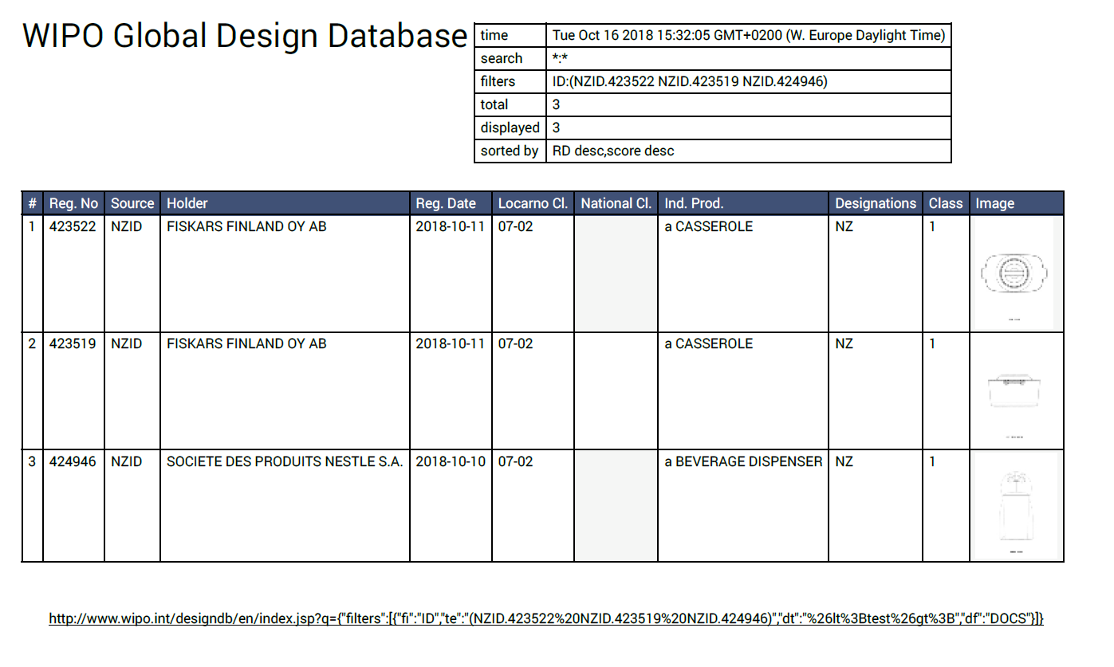

Slide 56
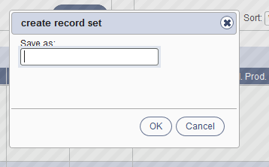
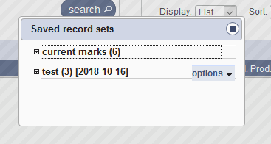

Slide 57
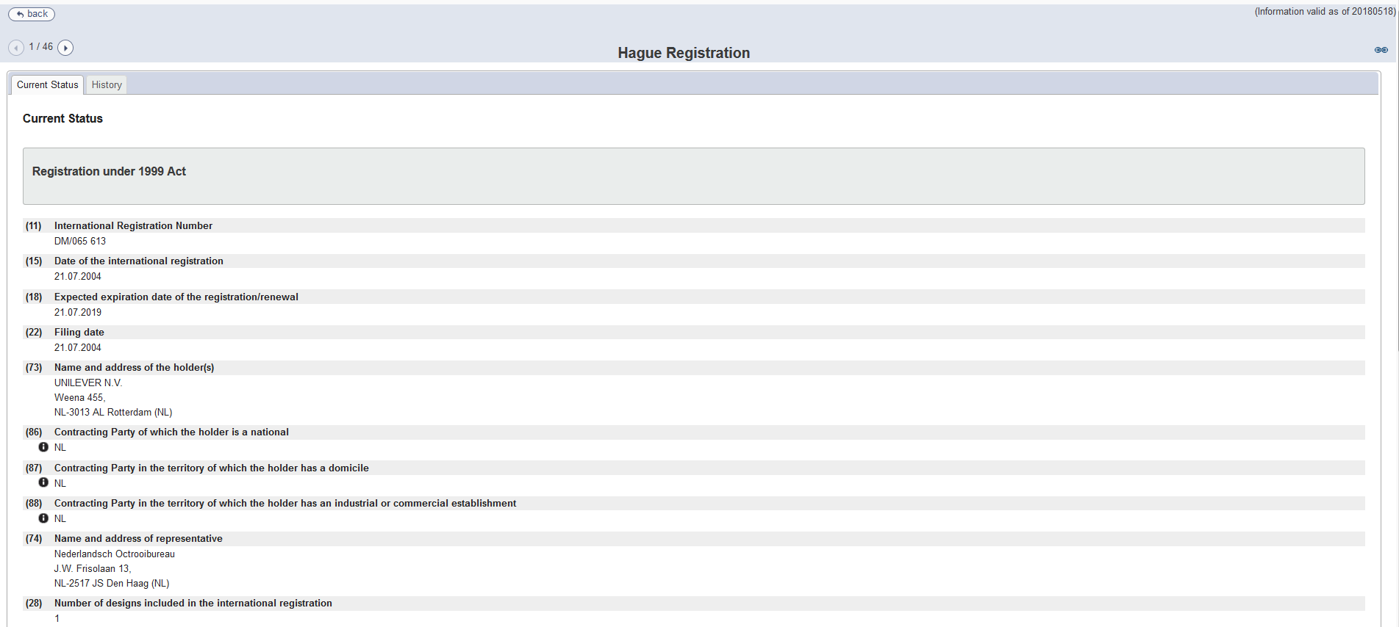
Individual record

Slide 58
5

Slide 60
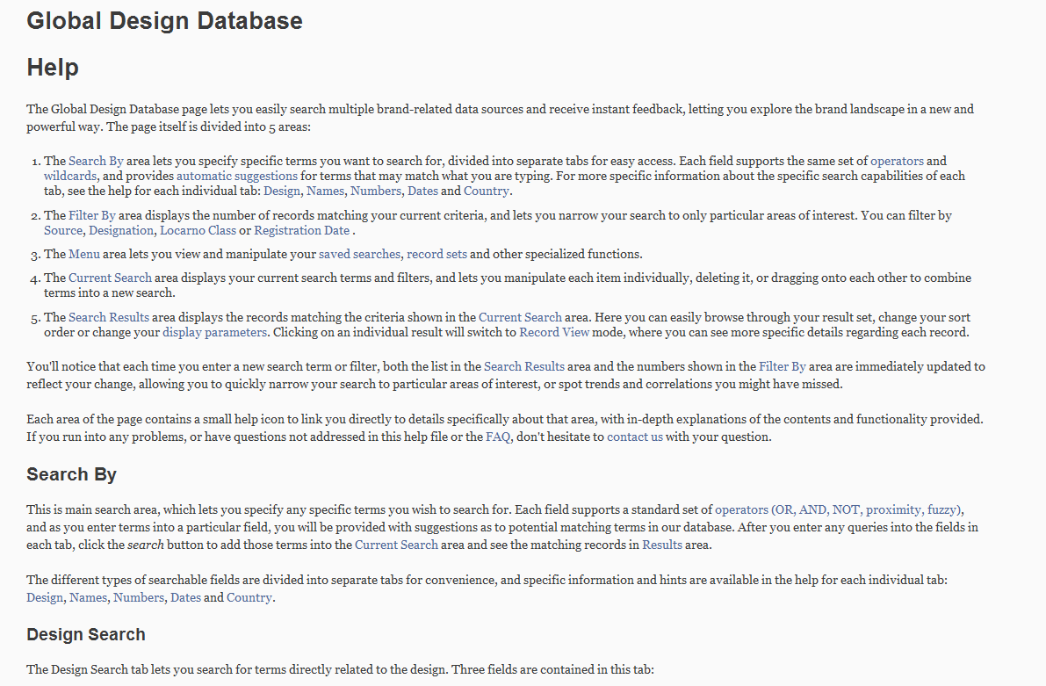
Help

Slide 61
Plans for the future
Add more collections

Slide 62
Webinars

Slide 63
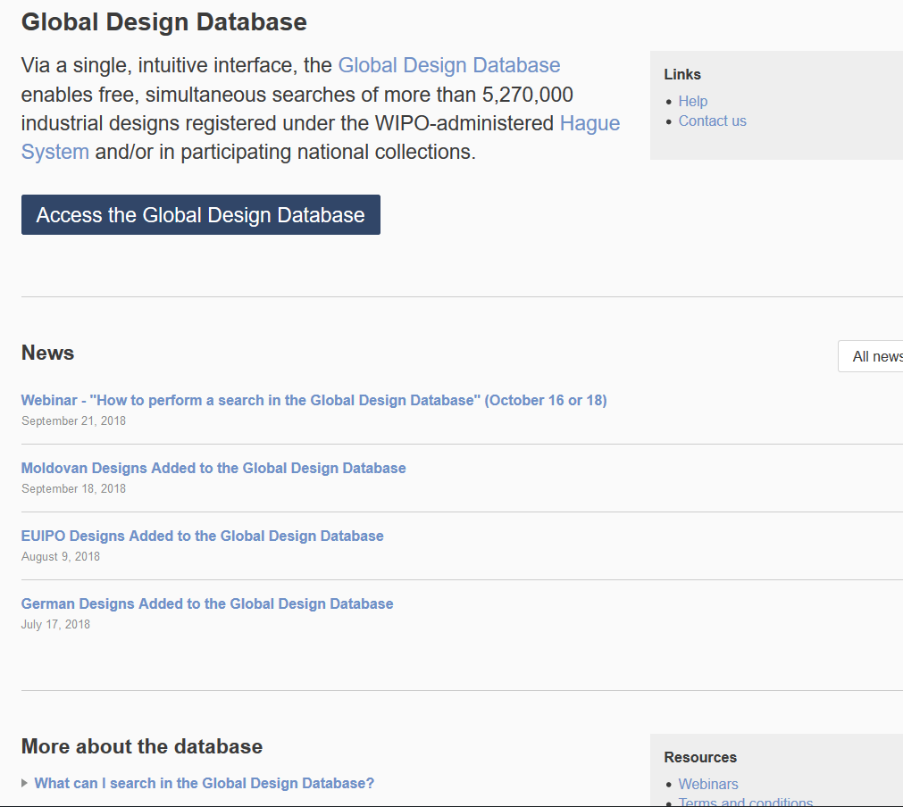

Slide 64
PATENTSCOPE webinar
Translation tools
May 21/23
https://attendee.gotowebinar.com/rt/1857184387006862083

Slide 65
Global Brand Database: webinar
Overview
May 14 at 5:30 PM CET
https://attendee.gotowebinar.com/register/8022051525988105218

Slide 67
mulțumesc
mulțumesc
gbd@wipo.int

