Slide 1
Customization in the
PATENTSCOPE search system
Cyberworld
November
2013
Sandrine Ammann
Marketing & communications officer

Slide 2
Agenda
What can be customized in PATENTSCOPE:
    Interface
    Search results
    CLIR
Q&A

Slide 3
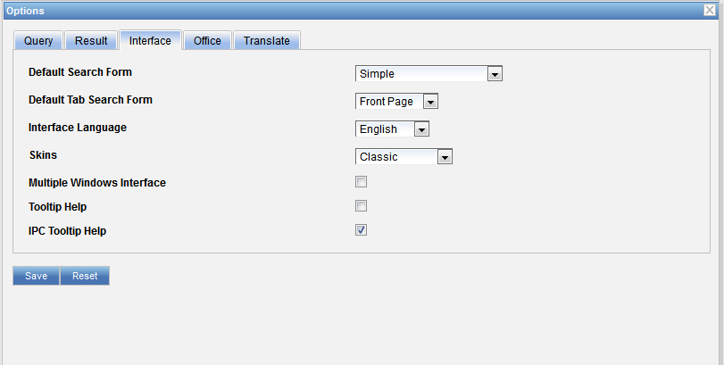
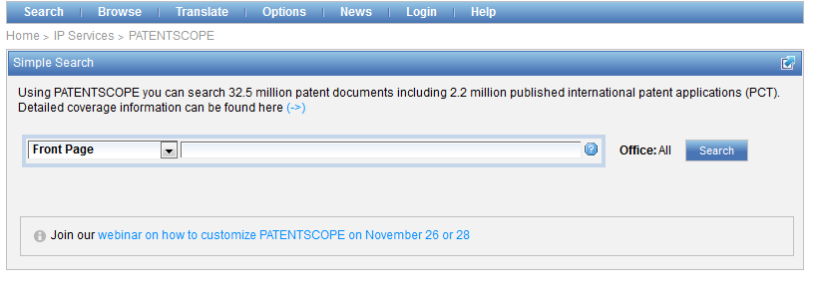

Customization

Slide 4
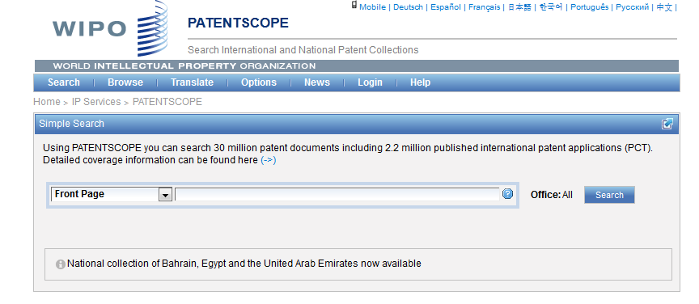
Languages of the interface

Slide 5

Language of interface and MT

Slide 6
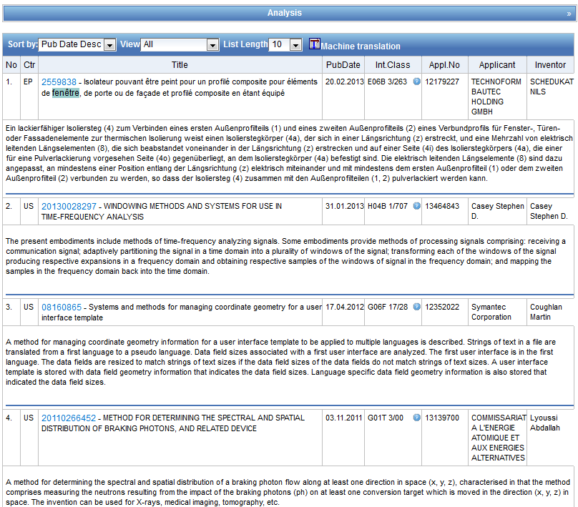

Slide 7
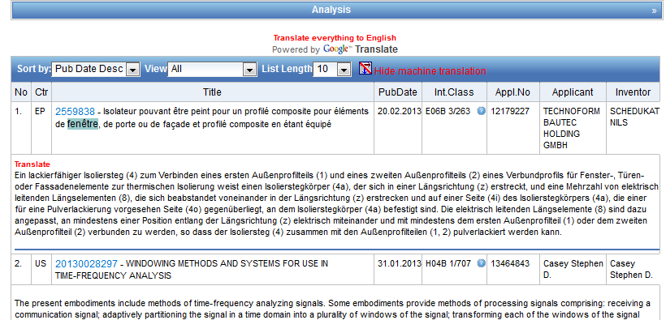

Slide 8
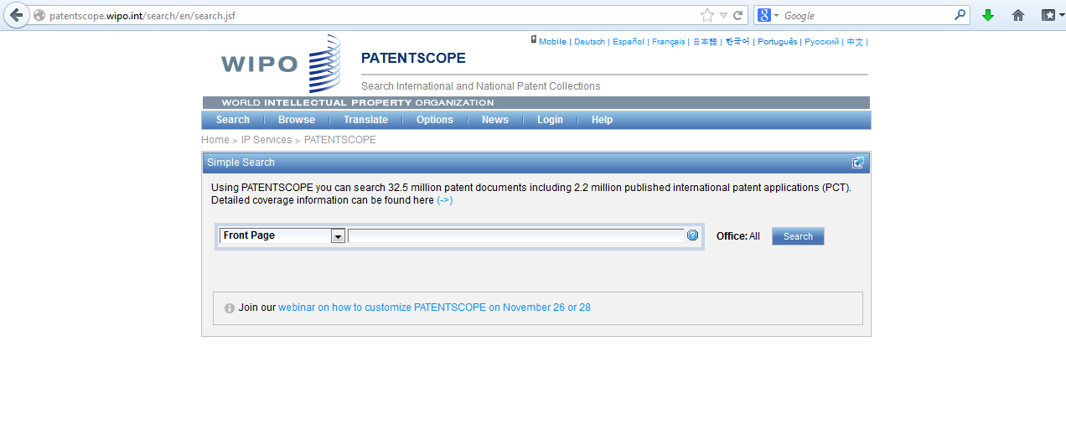
Interface

Slide 9
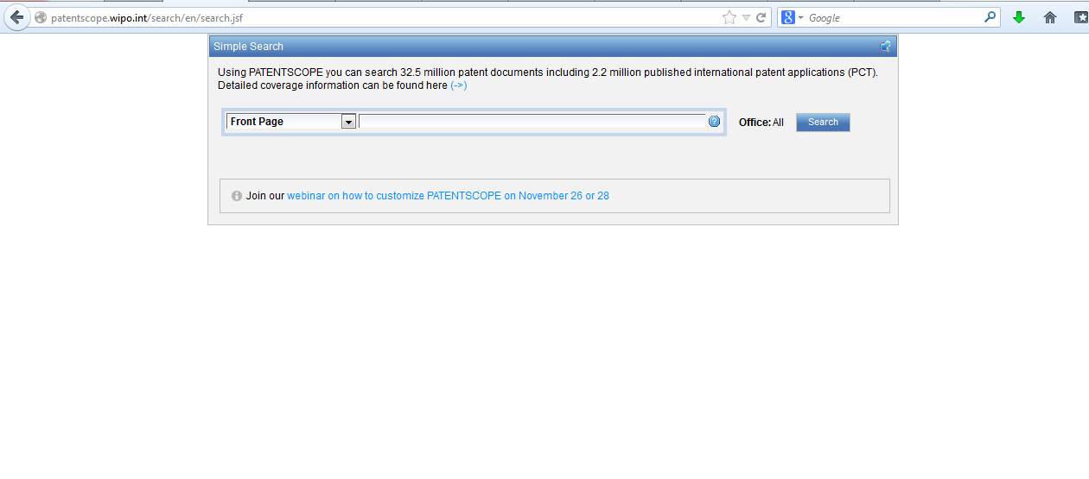
Banners

Slide 10
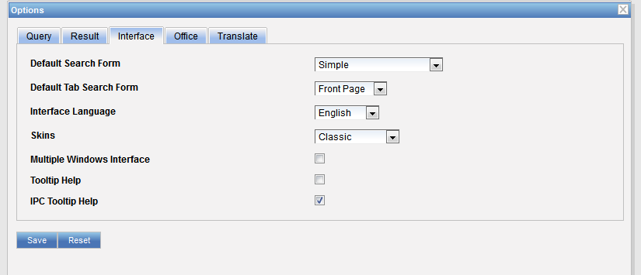
Default search interface & field

Slide 11
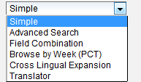
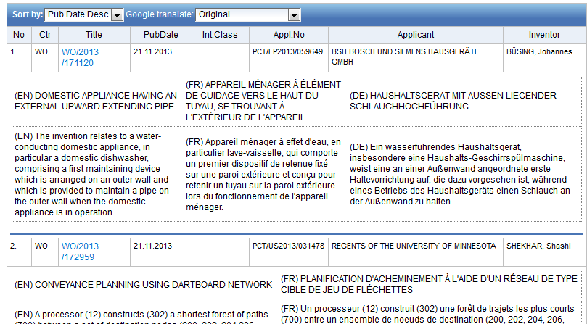
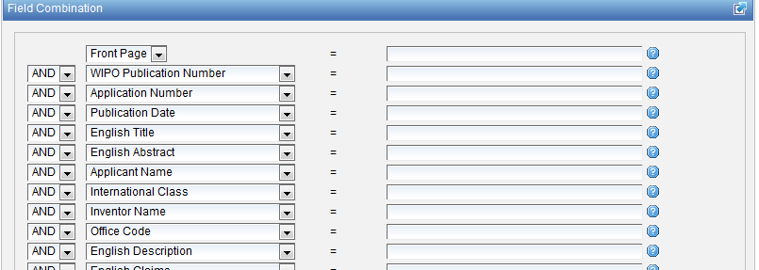
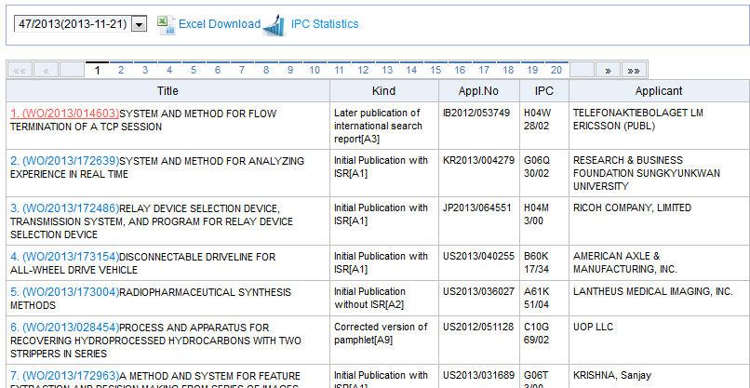
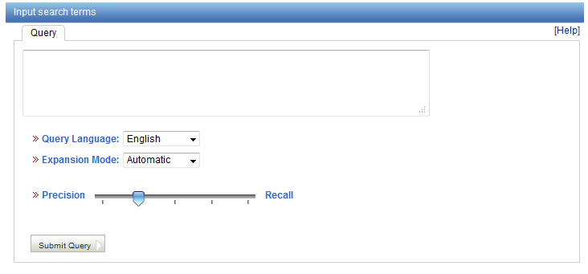
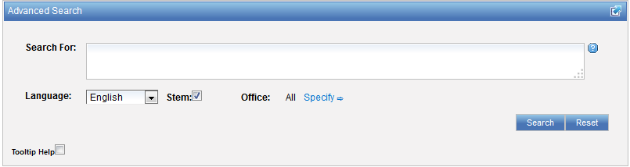
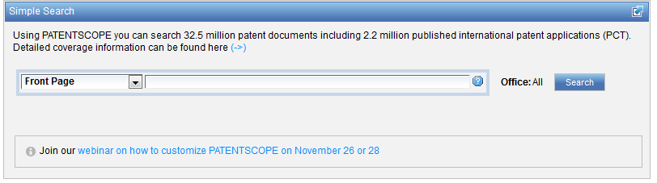
Default search form

Slide 12
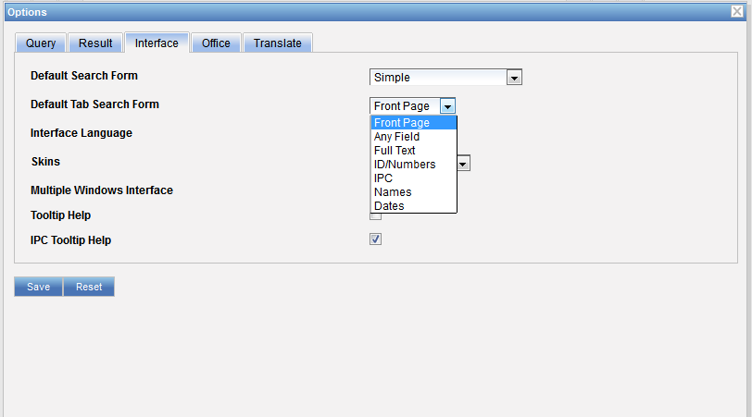
Default tab search form

Slide 13
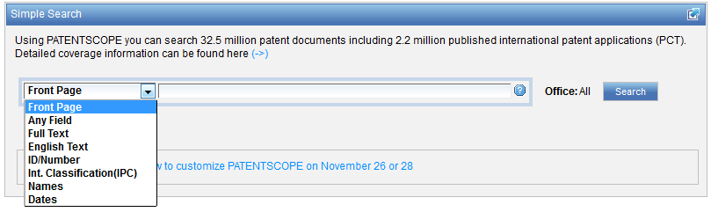
Default tab search form

Slide 14
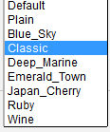
Skins

Slide 15
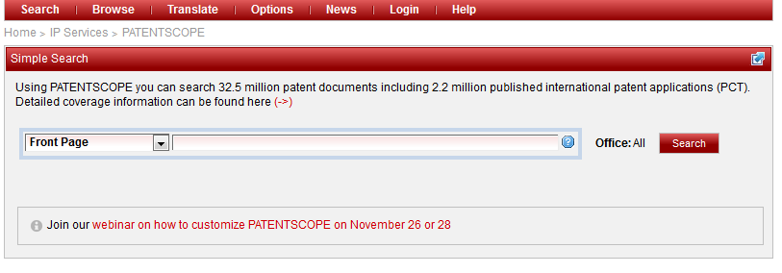
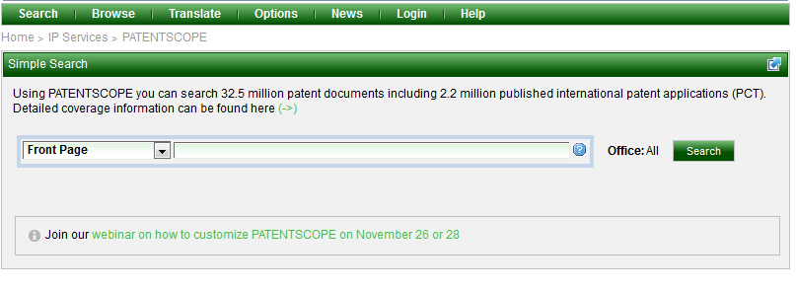
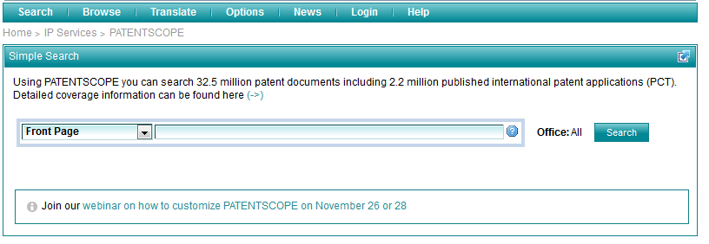
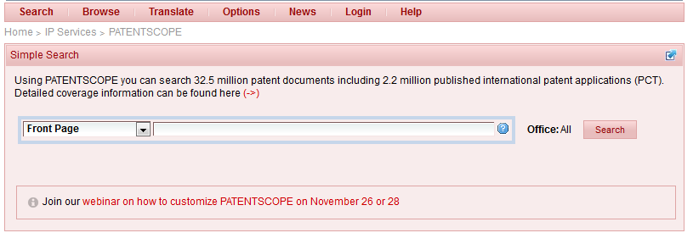
Skins

Slide 16
Multiple windows

Slide 17
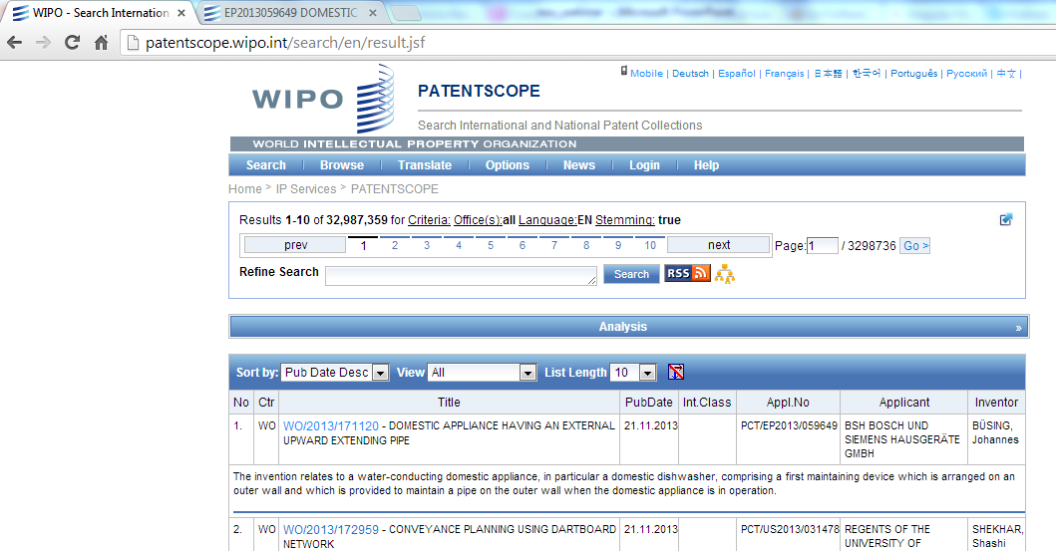
Multiple windows

Slide 18
Tooltip help

Slide 19
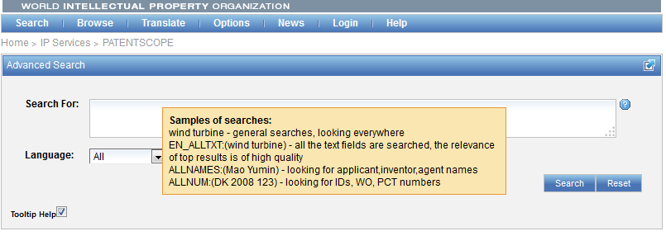
Tooltip help

Slide 20
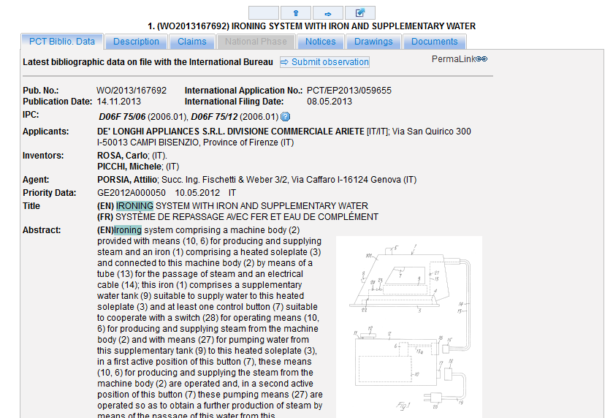
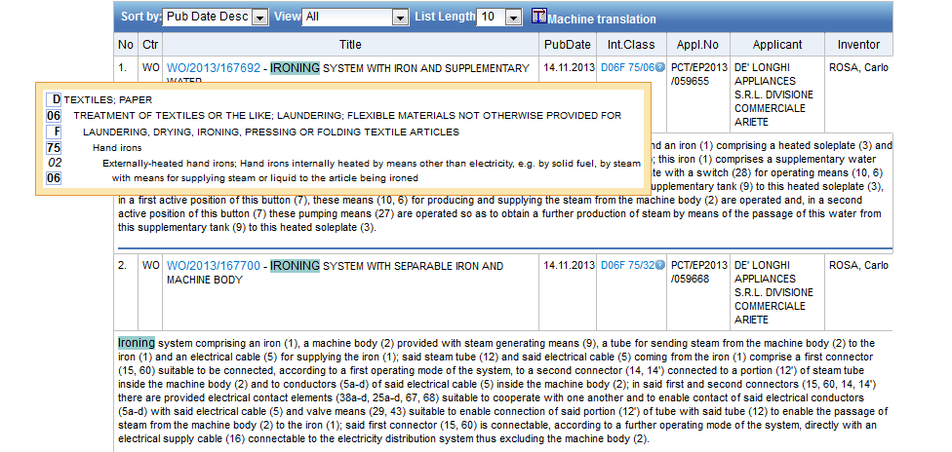
IPC tooltip help

Slide 21
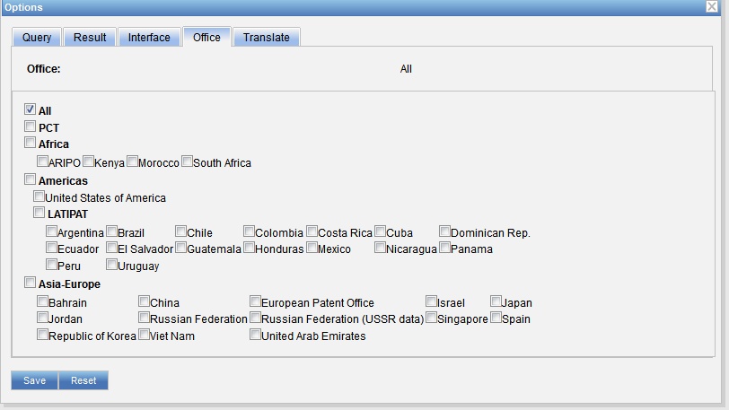
Offices

Slide 22
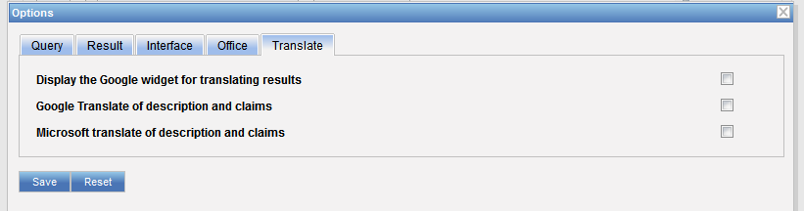
Translate

Slide 23
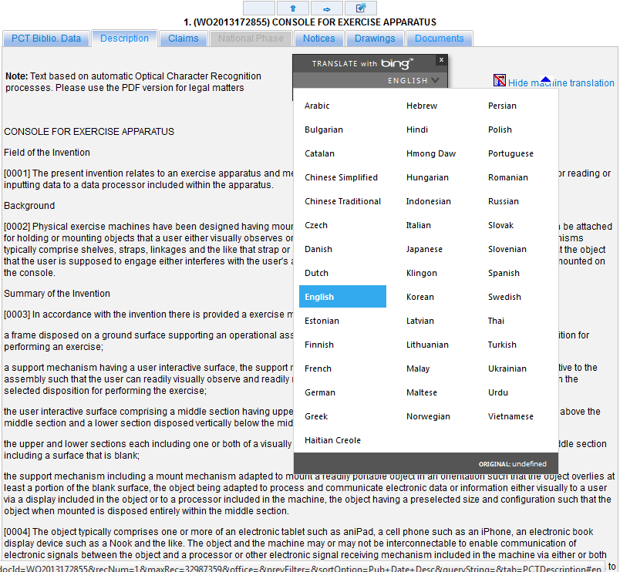
Bing

Slide 24
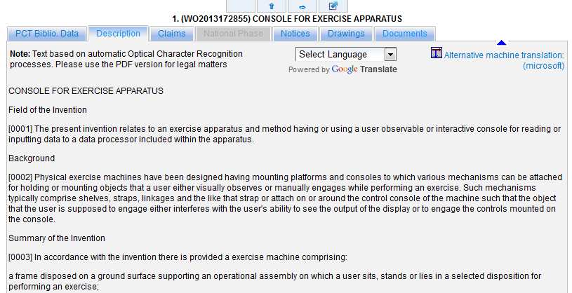
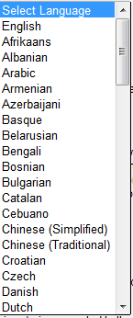
Google translate

Slide 25
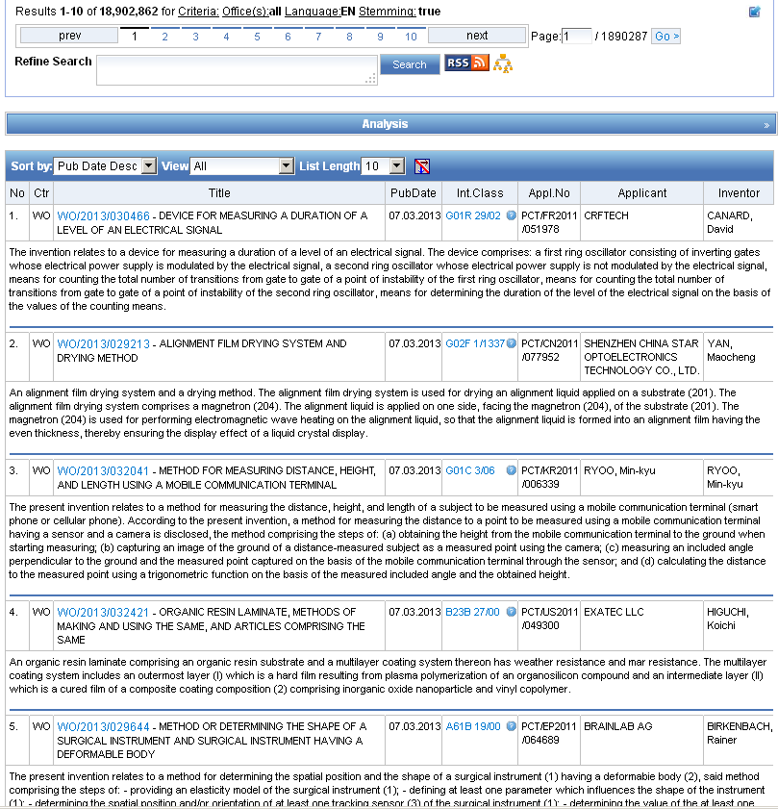
Reading the result list

Slide 26



Options

Slide 27
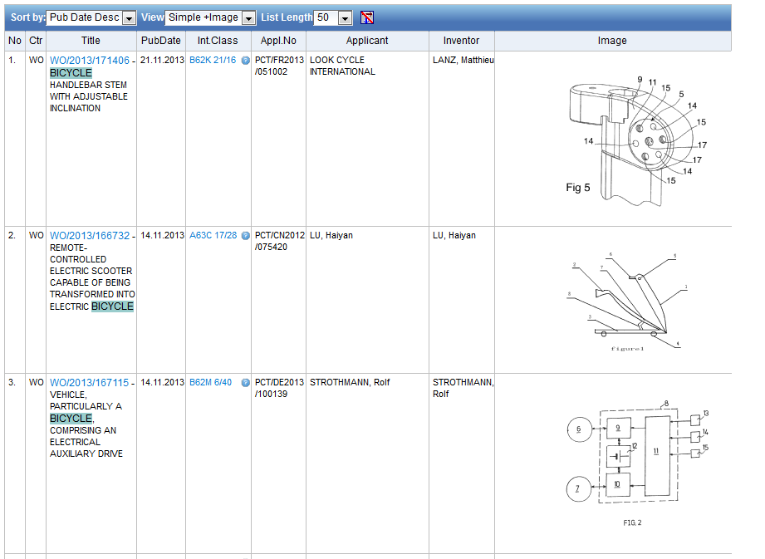

Slide 28
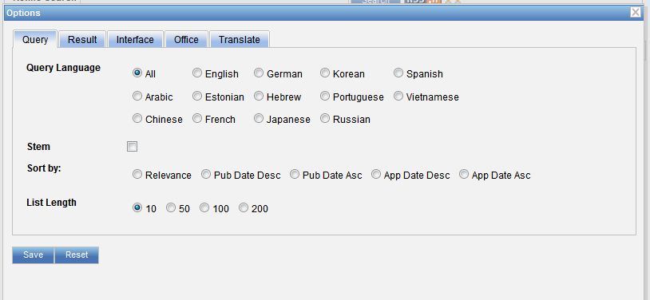
Result list

Slide 29
Stemming
Process that removes common ending from words by English Snowball algorithm
electric¦al = electric
electric¦ity = electric
electron¦ics = electron

Slide 30
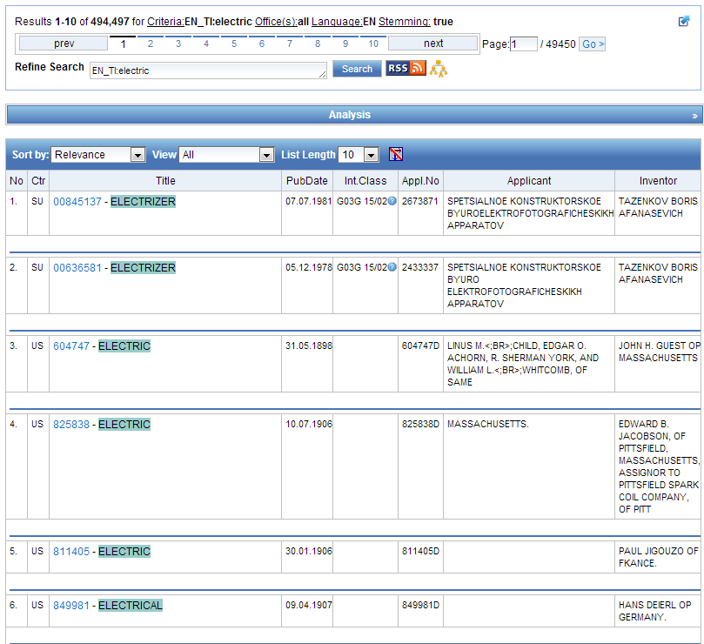
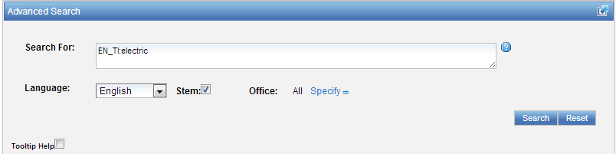

Slide 31
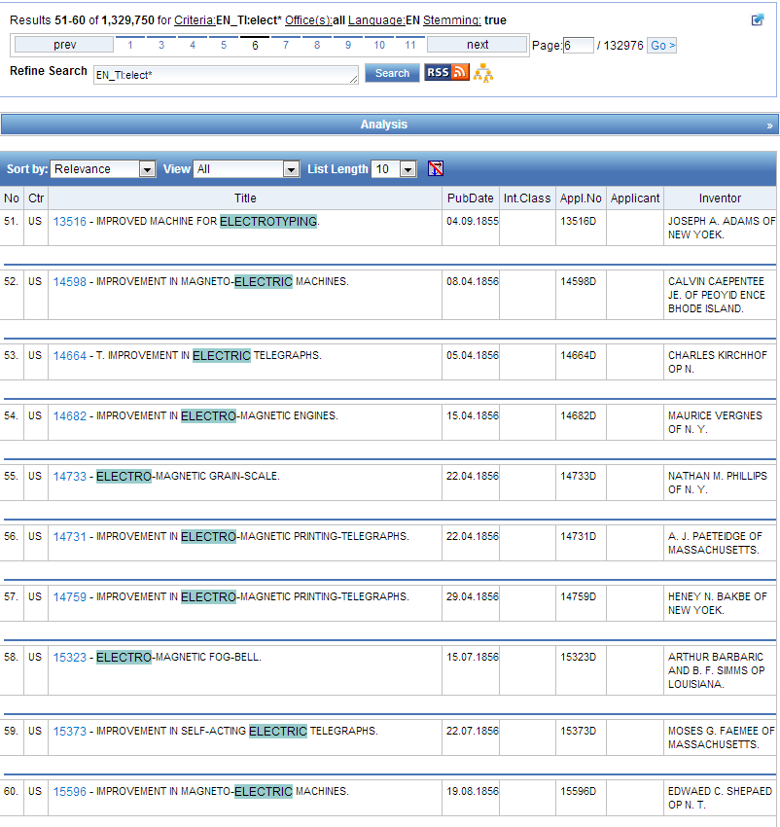
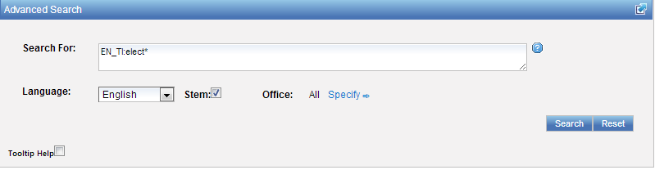

Slide 32
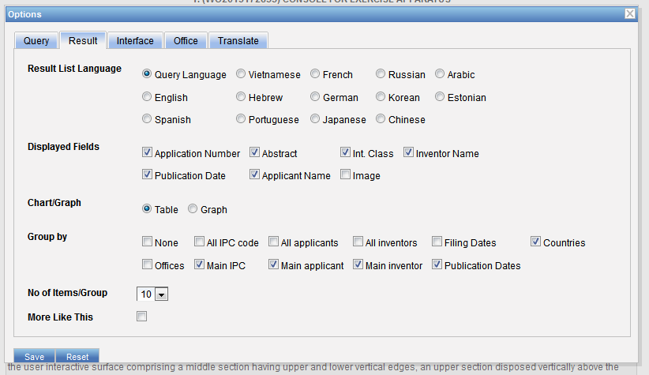
Result list

Slide 33
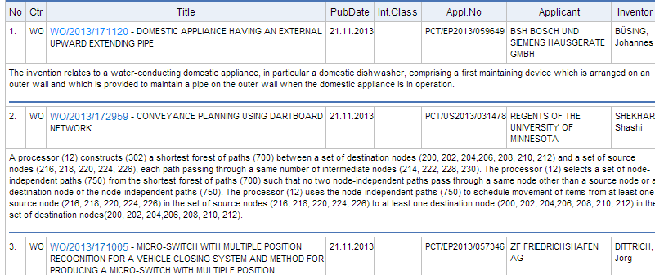

Slide 35
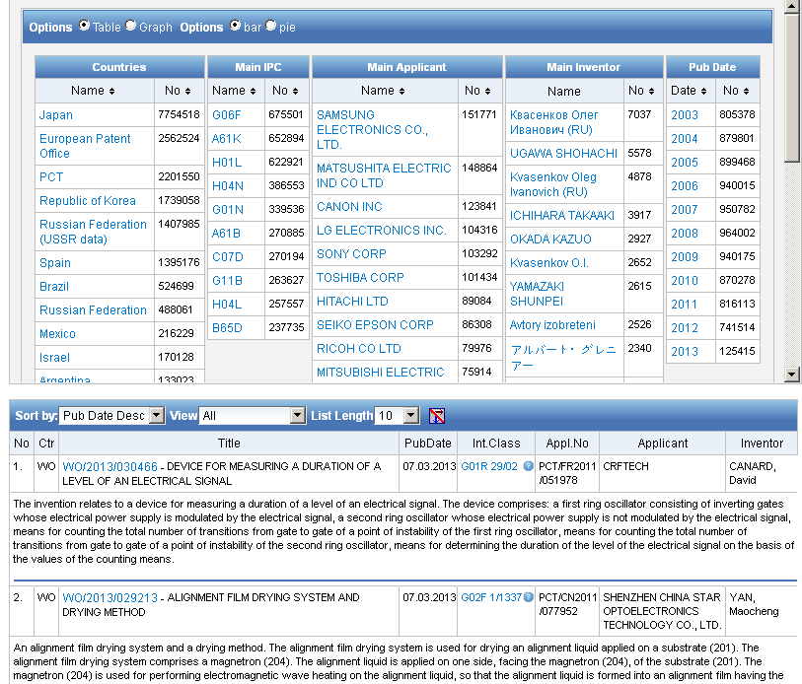
Analysis

Slide 36
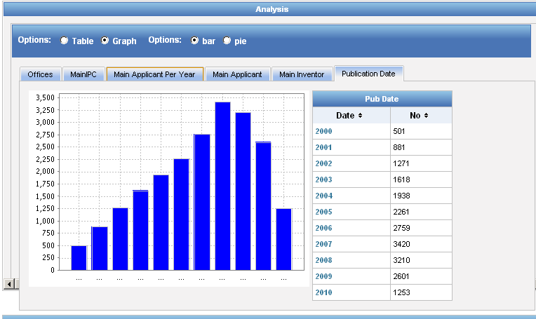
Display options: table/graph –bar/pie

Slide 37
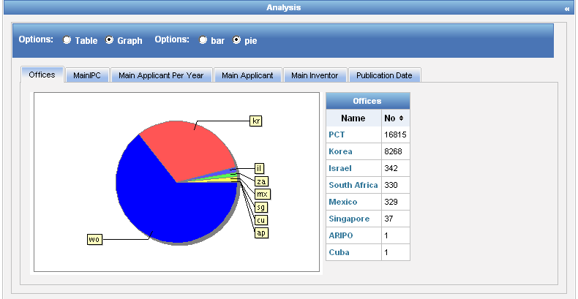
Display options: table/graph –bar/pie
Notes:
37
In both bar and pie options, the tabs allow you to see the information graphically for the Offices, Main IPC, Main Applicant, Main Inventor and Publication Date.
The charts can be saved in GIF format for inclusion in documents or reports by right-clicking in a corner of the image and selecting “Copy image” or “Save image”.

Slide 38


Slide 39
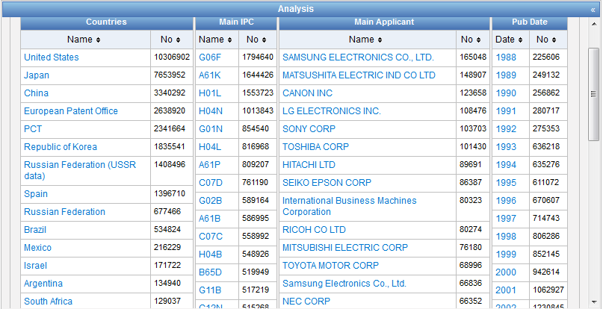

Slide 40
More like this…
Notes:
More Like This returns a list of similar documents that are related to a given document

Slide 41
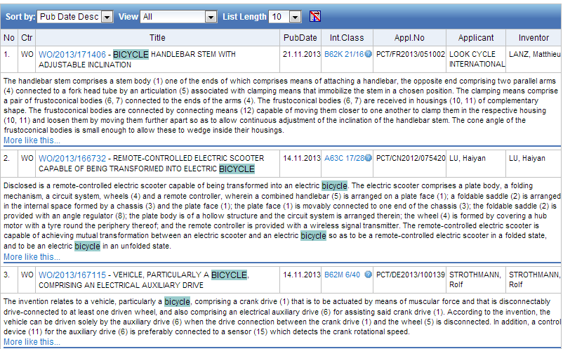

Slide 42
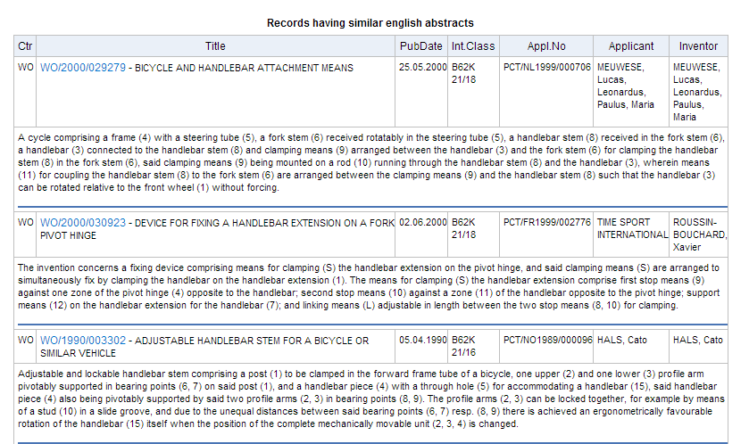

Slide 43
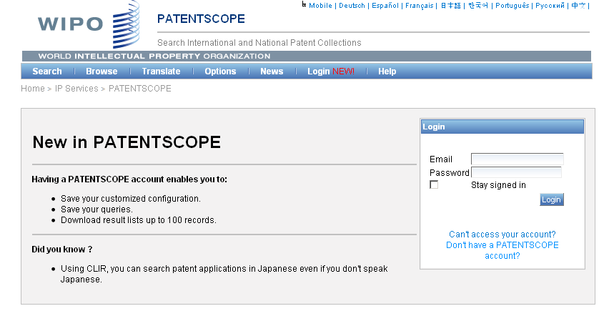
PATENTSCOPE account

Slide 44
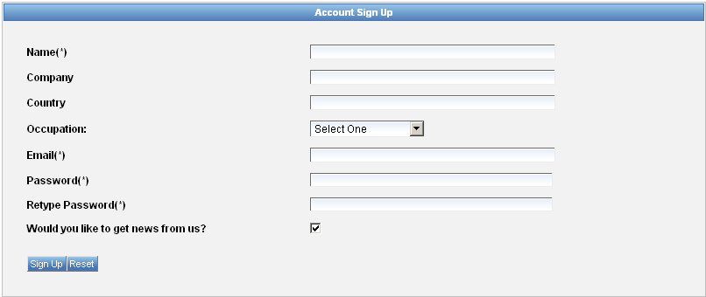
Signing up

Slide 45
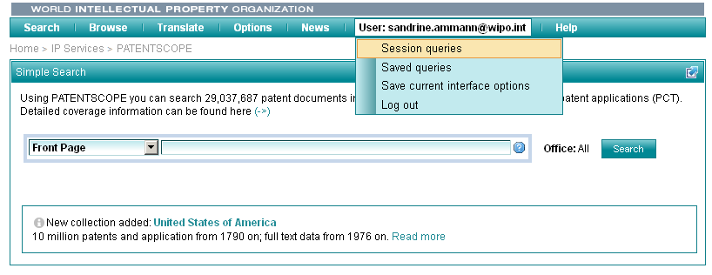
Once logged-in

Slide 46
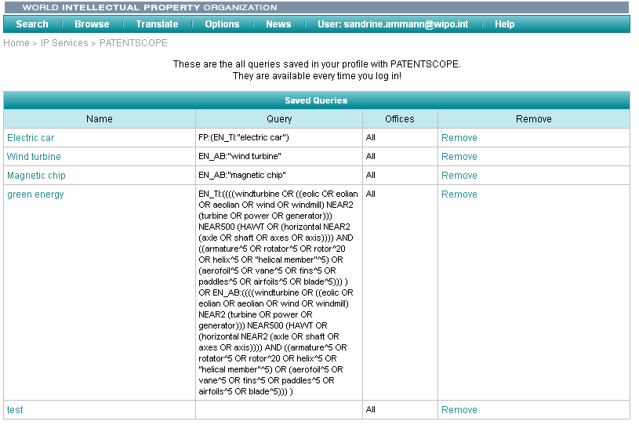
Saved queries

Slide 47

Downloading the results

Slide 48

Downloaded results

Slide 49
CLIR
CLIR stands for Cross Lingual Information Retrieval and will allow you to search a term or a phrase and its variants in:
Chinese
Dutch
English
French
German
Italian
Japanese
Korean
Portuguese
Russian
Spanish and
Swedish
Notes:
49
You will use this tool in order to:
-Find synonyms in order to retrieve comprehensive results
-To search in a language that one does know

Slide 50

CLIR: the interface
Notes:
50
There is query box
Query language
Expansion mode

Slide 51

CLIR: precision vs recall

Slide 52


Example: precision

Slide 53


Example: recall

Slide 54
CLIR: supervised mode
2 modes: automatic and supervised
Automatic: 1 step
Supervised: 4 steps

Slide 55

Automatic mode

Slide 56

Automatic mode: results

Slide 57

Supervised mode: 1 of 4 steps

Slide 58


Supervised mode : 2 of 4 steps

Slide 59

Supervised mode : 3 of 4 steps

Slide 60

Supervised mode : 4 of 4 steps

Slide 61

Supervised mode: results

Slide 62


Slide 63


patentscope@wipo.int

Slide 64


mulțumesc
mulțumesc

