Slide 1
PATENTSCOPE Overview
Cyber world
January
2014
Sandrine Ammann
Marketing & Communications Officer

Slide 2


To the PATENTSCOPE search system webinar
Overview

Slide 3
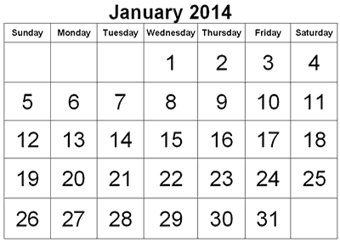
Webinars in 2014
Focus on the search interface:
  Coverage
  Interfaces
  Account
  How to search/browse
  Reading the results
  Multilingual tools

Slide 4
Webinars in 2014
Monthly
Announced here: http://www.wipo.int/patentscope/en/webinar/
On specific features/functionalities or overview
Special requests: patentscope@wipo.int

Slide 5

THE COVERAGE

Slide 6
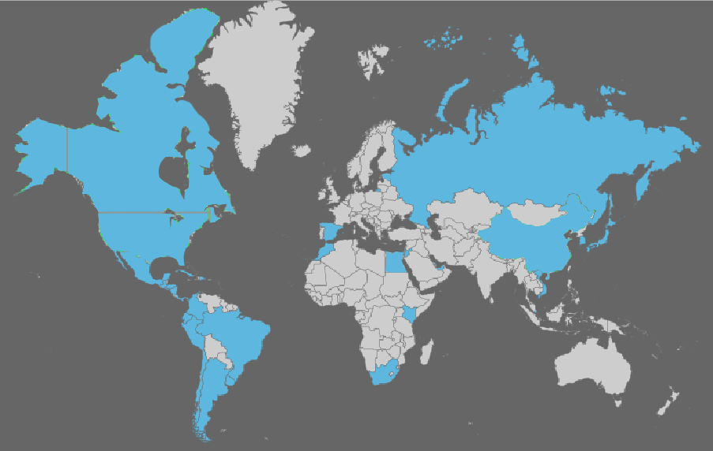
Coverage : Collections
As well as PCT applications, the ARIPO, EPO and LATIPAT collections
Notes:
ARIPO: African Regional IP Org
PCT: 1st publication worldwide

Slide 7
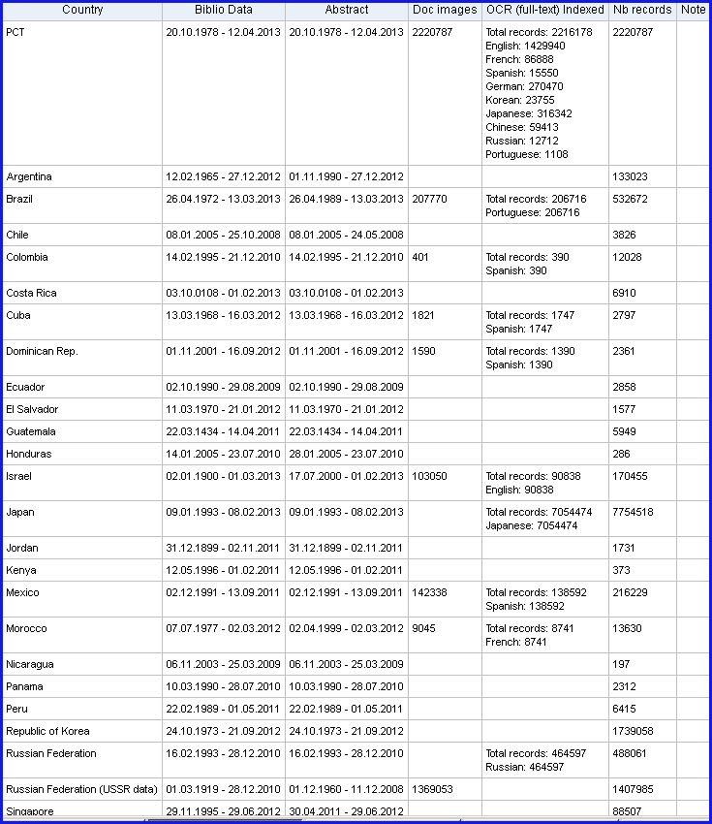
Coverage : Details of collections

Slide 8
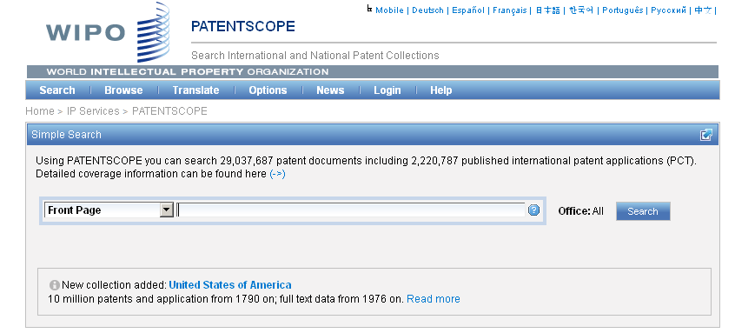
Languages of the interface

Slide 9
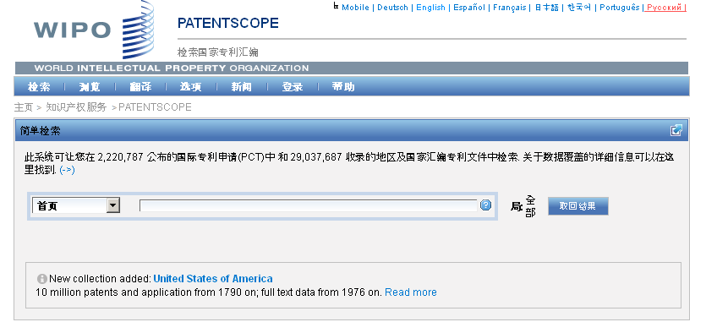
Interface in Chinese

Slide 10
Mobile interface

Slide 11
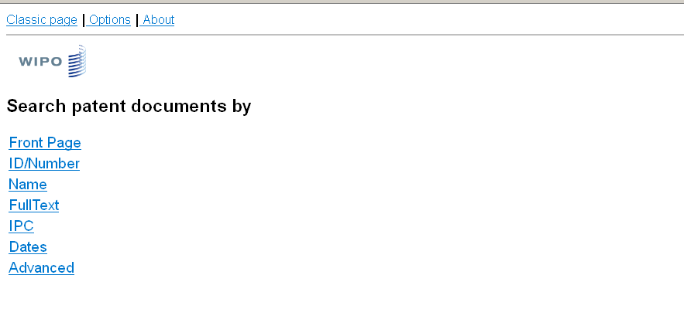
Mobile interface

Slide 12
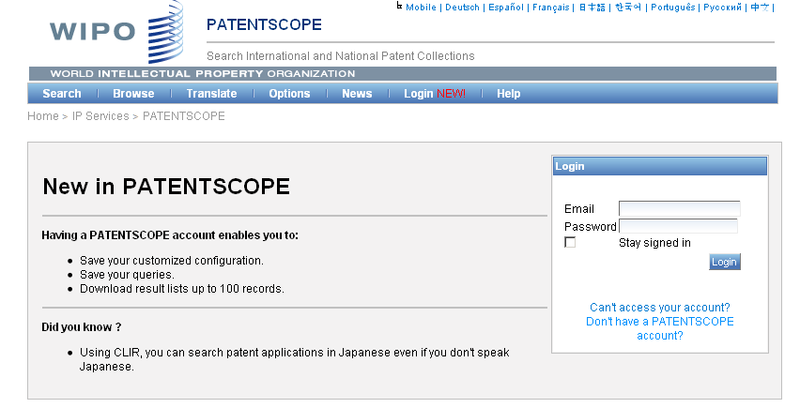
PATENTSCOPE account

Slide 13
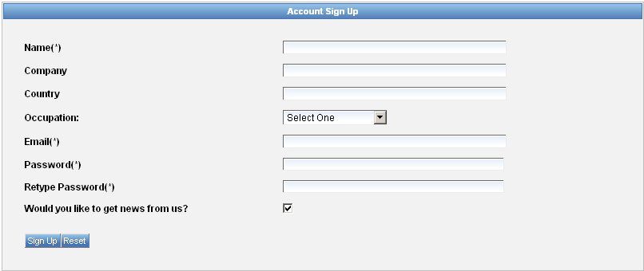
Signing up

Slide 14
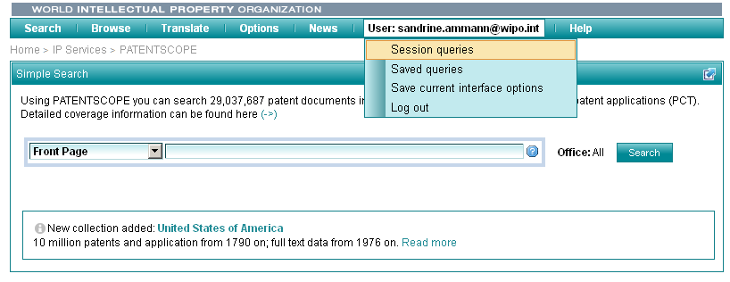
Once logged-in

Slide 15
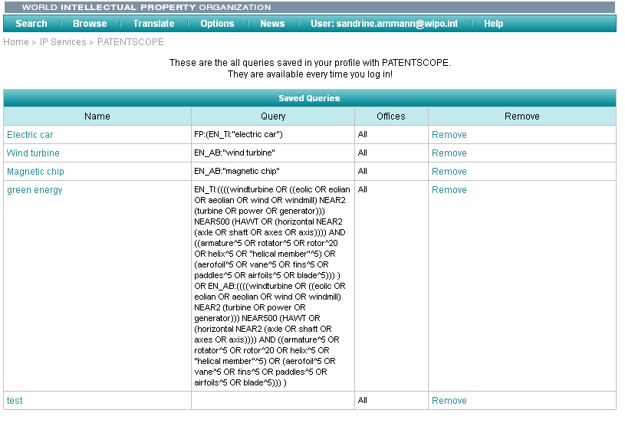
Saved queries

Slide 16
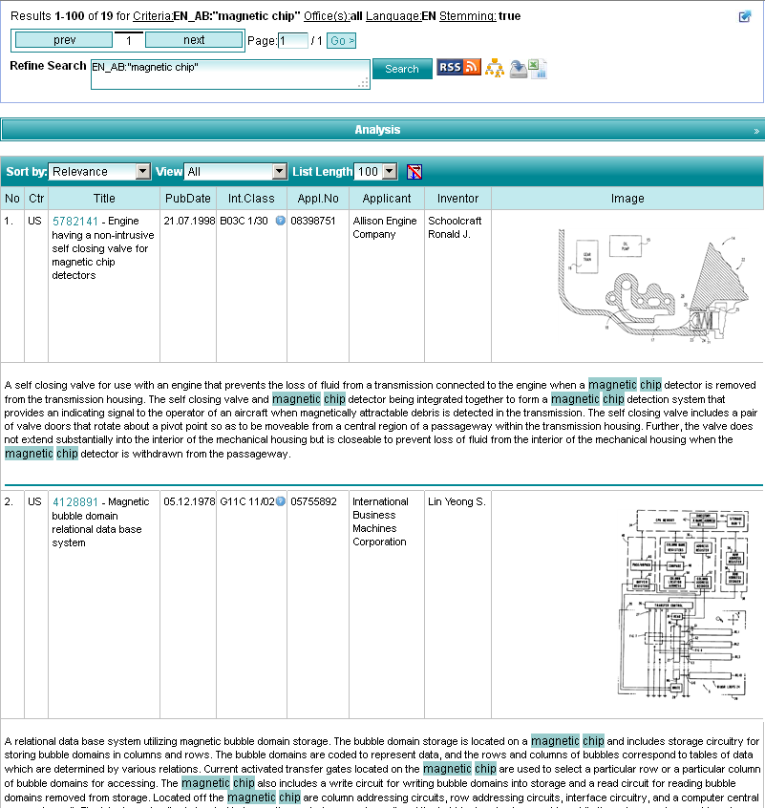
Downloading the results

Slide 17
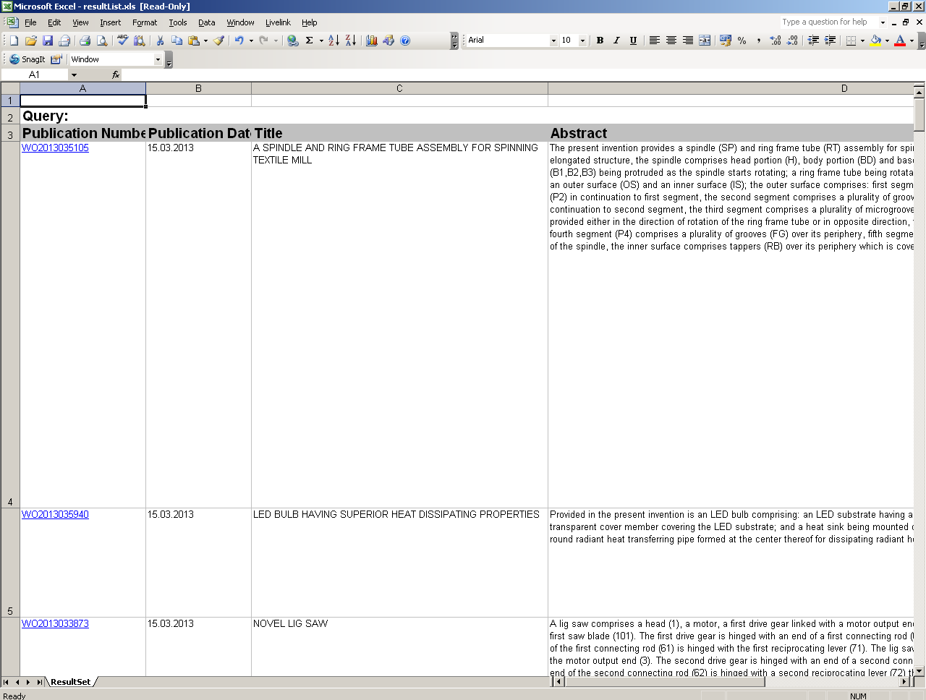
Downloaded results

Slide 18
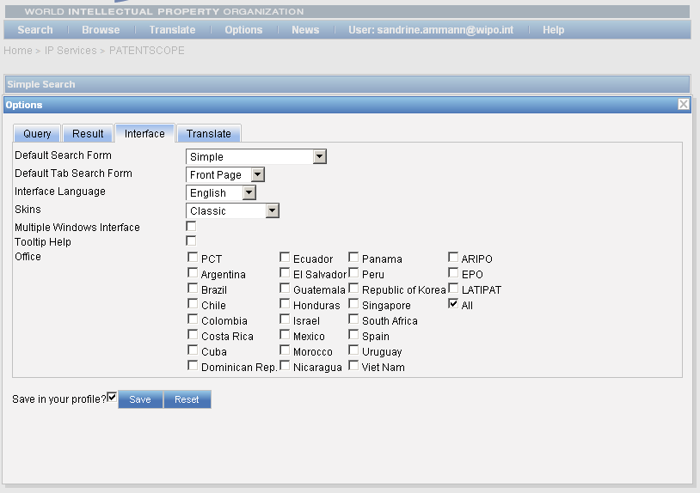
Account customization

Slide 19
PATENTSCOPE: how to search
Browse by week or sequence listing
Search patent documents:
  Simple
  Advanced
  Field combination
  CLIR

Slide 20
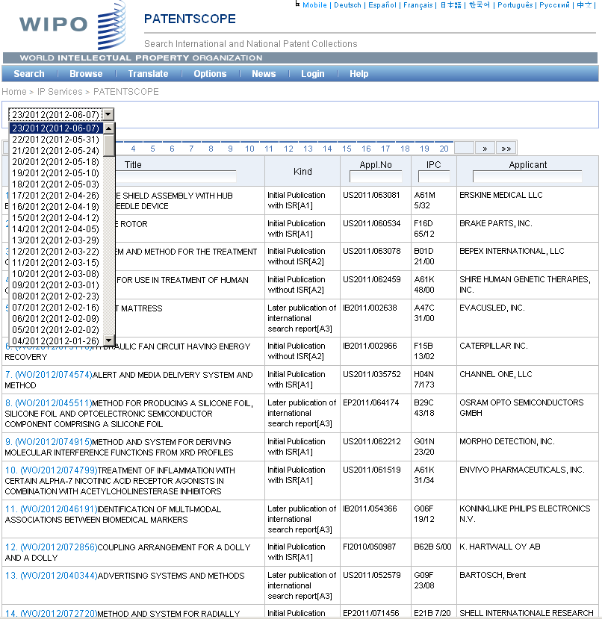

Slide 21
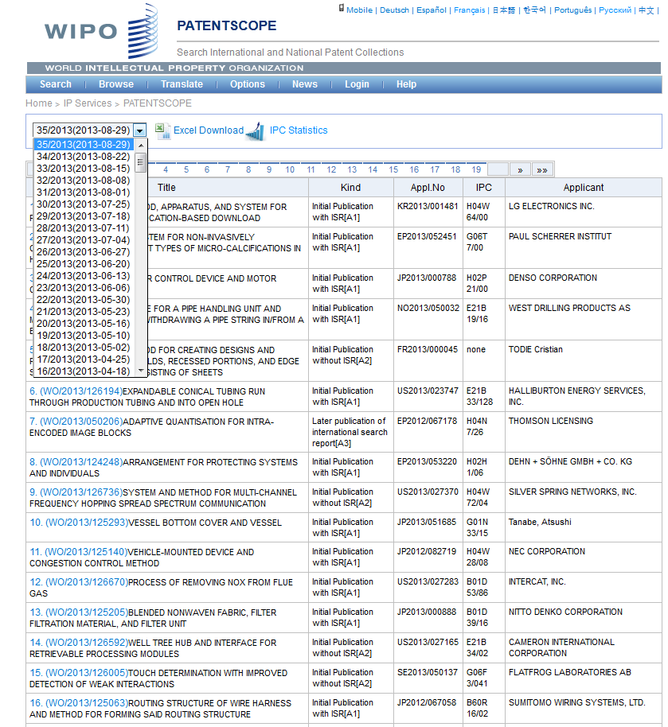

Slide 22
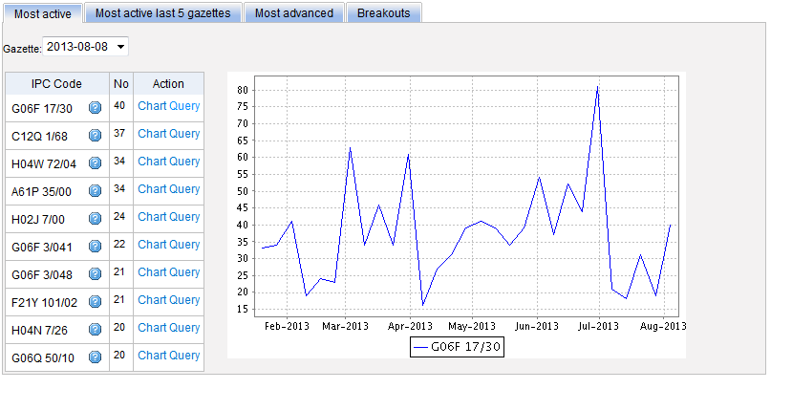
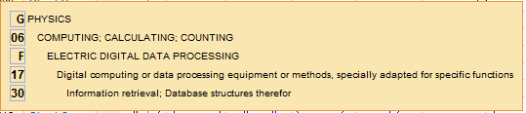
Most active

Slide 23
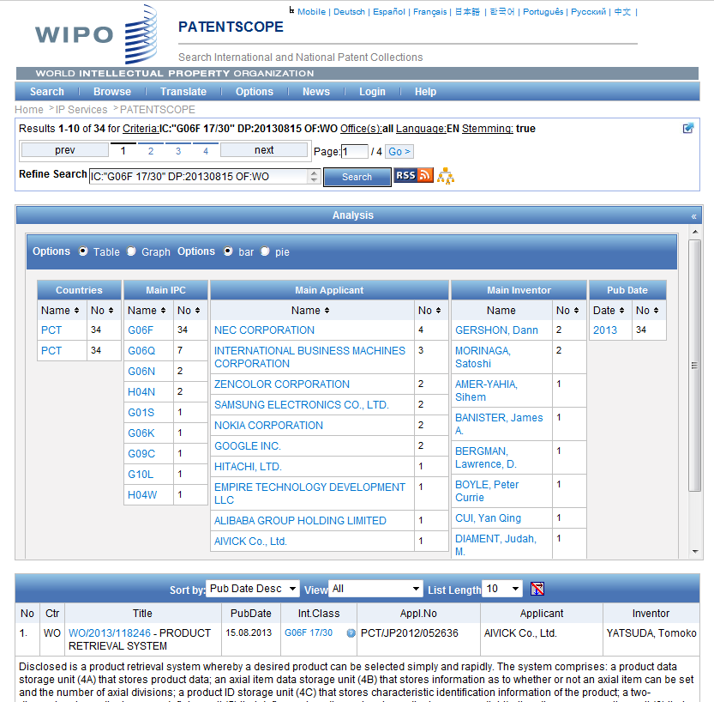

Slide 24
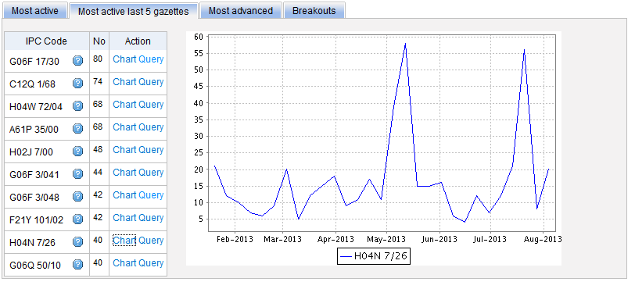
Most active last 5 gazettes

Slide 25
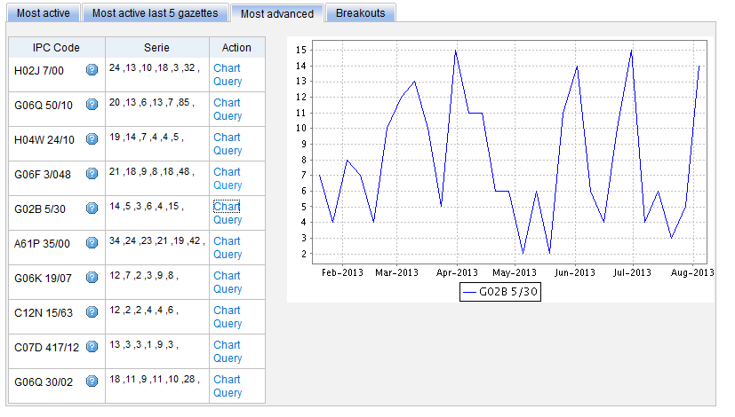
Most advanced

Slide 26
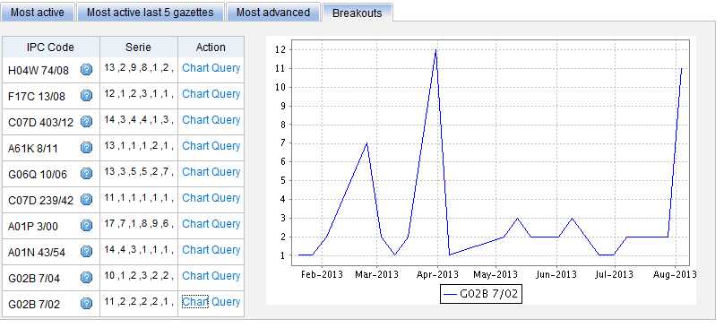
Breakouts

Slide 27
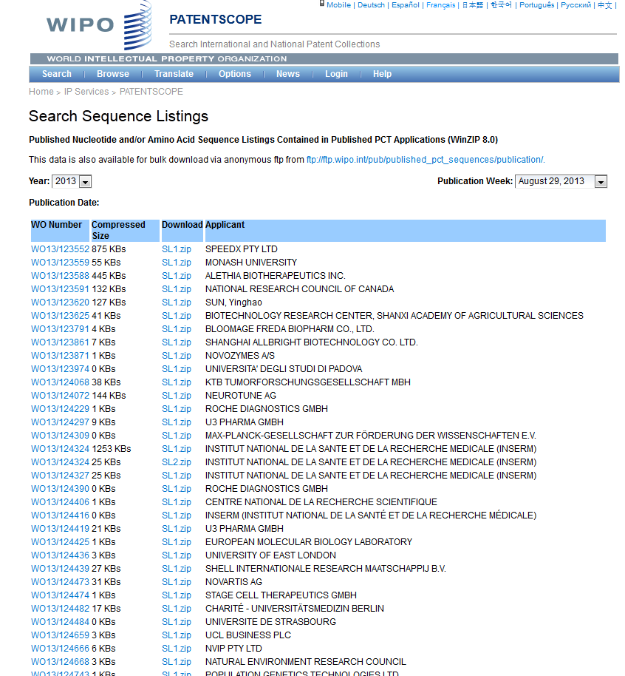

Slide 28
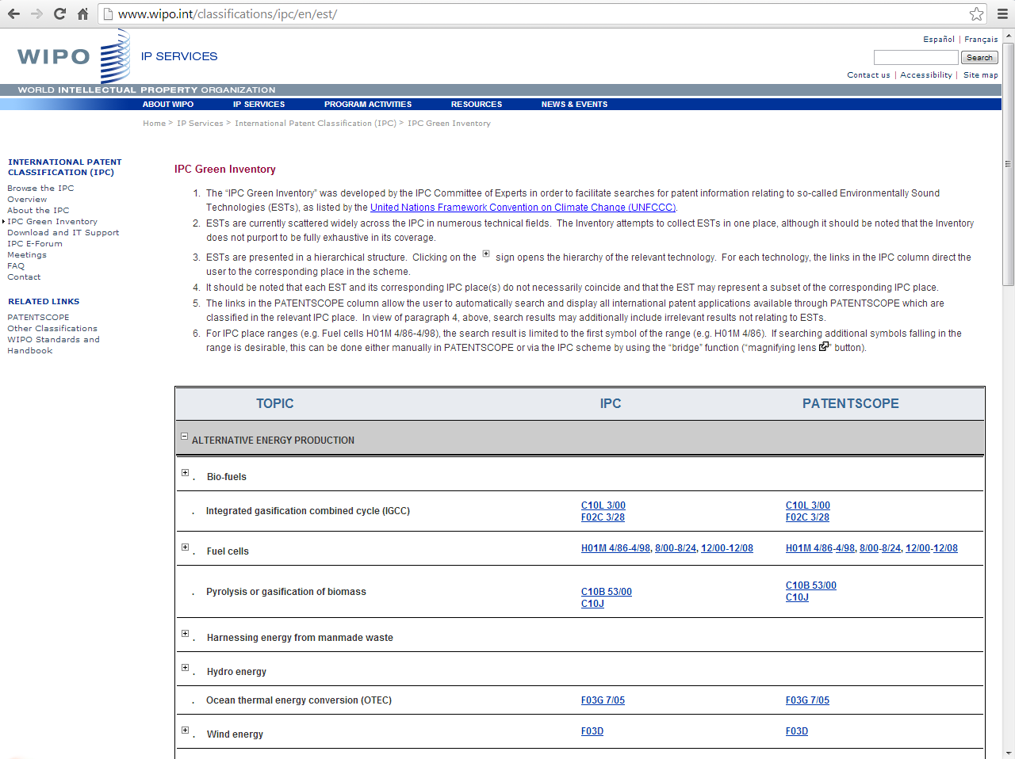
IPC Green Inventory

Slide 29
PATENTSCOPE: how to search
Browse by week or sequence listing
Search patent documents:
  Simple
  Advanced
  Field combination
  CLIR

Slide 30
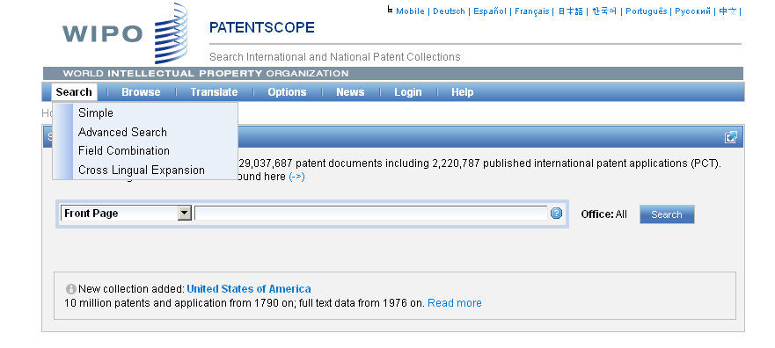
4 ways to search

Slide 31
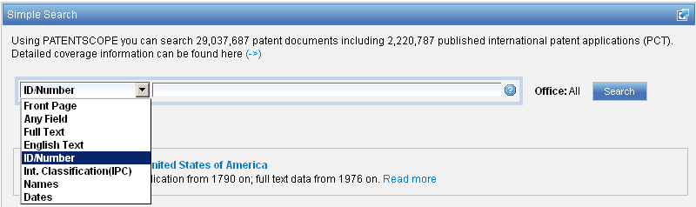
Interface : Simple
Basic search fields are provided

Slide 32
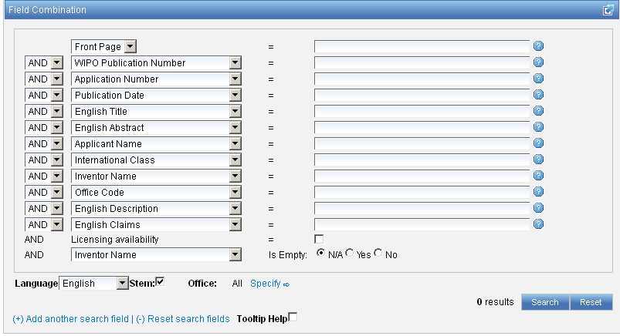
Interface : Field Combination - Structured
Additional search fields can be selected

Slide 33
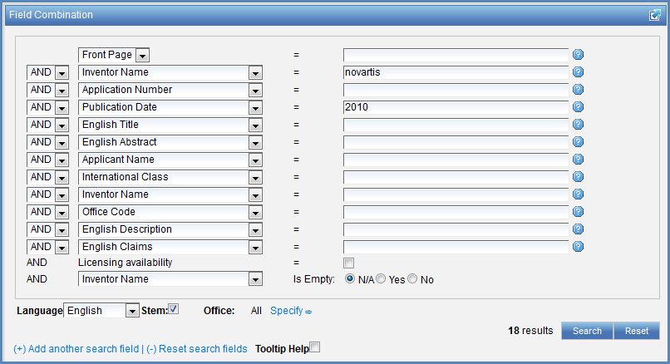

Search examples
Patent documents containing Novartis as inventor and published in 2010
Patent documents without an IPC code
Notes:
33
3. there is also the option to select a field that is empty: for example you could search. On the last line, select the IPC in the drop-down box and tick yes next to empty.

Slide 34
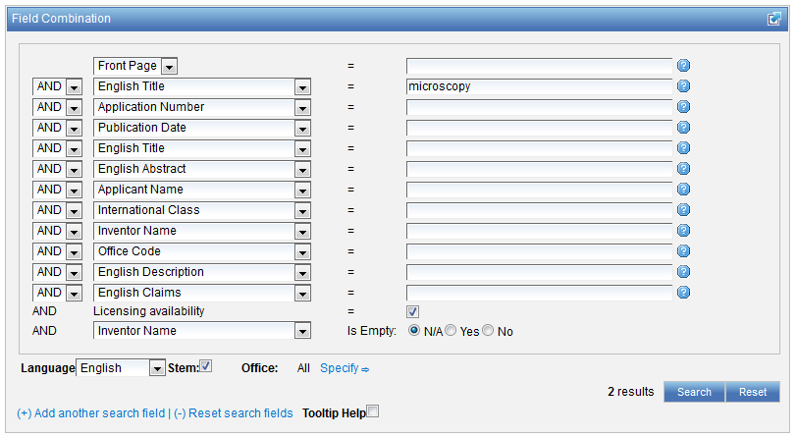
Search examples
Patent documents containing microscopy with licensing availability.
Notes:
34
In the drop-down box, select the field Applicant name and enter Steve Jobs; select AND and the field Publication date and enter 2007
In the drop-down boy, select English description and enter microchip, then tick the Licensing availability box (one before last in the Field Combination interface).

Slide 35
Stemming
Process that removes common ending from words by English Snowball algorithm
electric¦al = electric
electric¦ity = electric
electron¦ics = electron
More accurate results than wildcards:
elect* electoral, etc.

Slide 36
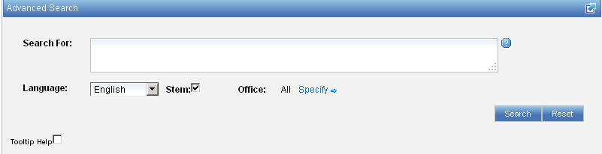
Interface : Advanced
Full flexibilities are enabled

Slide 37
To help you fine-tune your search
1. Boolean operators
2. Proximity operators
3. Field codes
4 .Stemming/wildcard/fuzzy searches
5. Grouping/nesting
6. Date searches

Slide 38
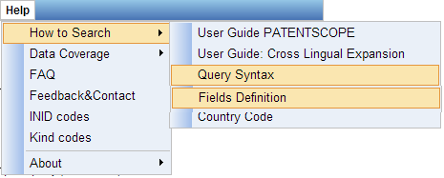
Help menu

Slide 39
Search examples: field code, Boolean and range operator
Inventions made by Steve Jobs published during the period from 2007 to 2009 comprising the keyword “touch” in the description.
IN:(Jobs) AND PD:[2007 TO 2009] AND EN_DE:(touch)
This search query uses field codes, a Boolean operator, and a range operator.
The field codes are IN for inventor, PD for publication date, and EN_DE for English description.
The Boolean operator AND is used to ensure that all search terms are included in the search results (i.e. that the results are for Jobs as inventor, within the given publication date range, and using the word “touch”).
The range operator TO is used to define a range of publication date values.
Notes:
39
Searching for..

Slide 40
CLIR
CLIR stands for Cross Lingual Information Retrieval and will allow you to search a term or a phrase and its variants in:
Chinese
Dutch
English
French
German
Italian
Japanese
Korean
Portuguese
Russian
Spanish and
Swedish
Notes:
40
You will use this tool in order to:
-Find synonyms in order to retrieve comprehensive results
-To search in a language that one does know

Slide 41
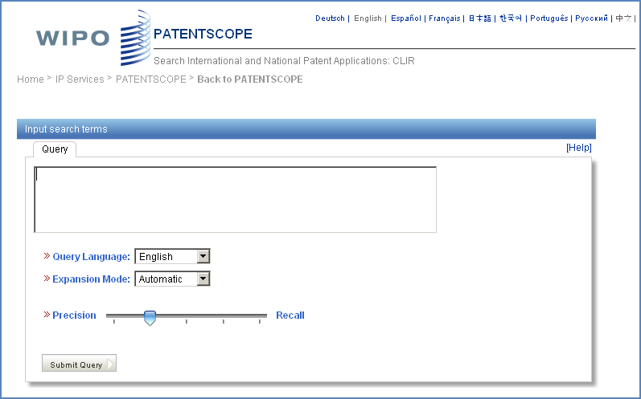
CLIR: the interface
Notes:
41
There is query box
Query language
Expansion mode

Slide 42
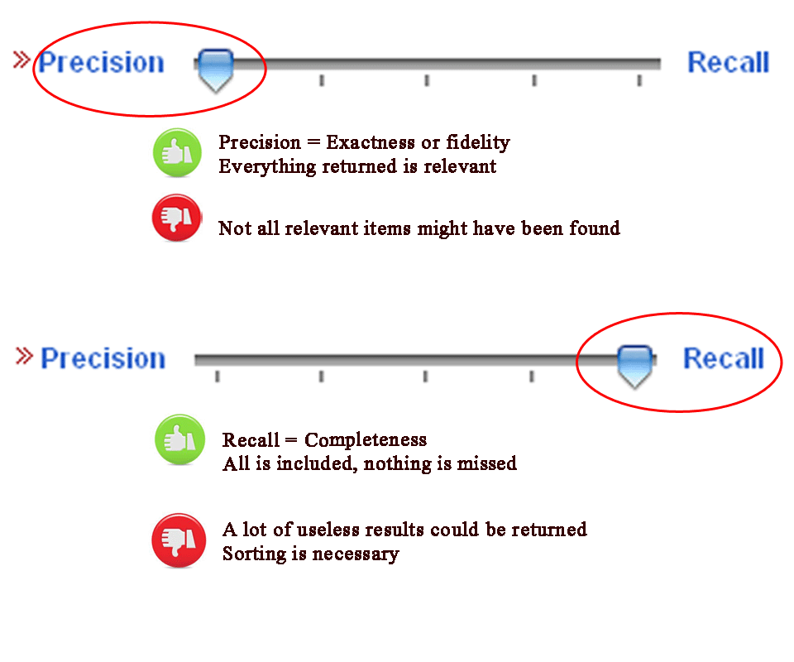
CLIR: precision vs recall

Slide 43
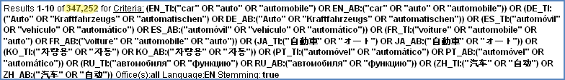
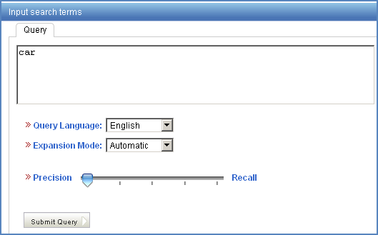
Example: precision

Slide 44
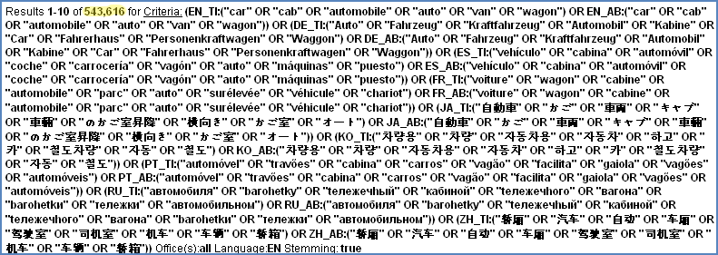
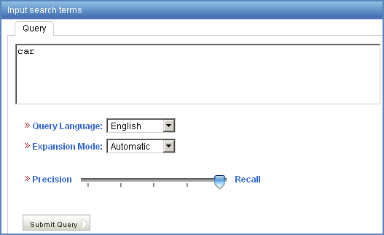
Example: recall

Slide 45
CLIR: supervised mode
2 modes: automatic and supervised
Automatic: 1 step
Supervised: 4 steps

Slide 46
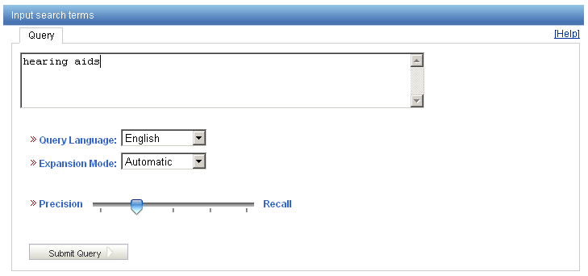
Automatic mode

Slide 47
Automatic mode: results
(EN_TI:("hearing aids" OR "hearing prosthetic"~21 OR "auditory aids"~21 OR "auditory prosthetic"~21) OR EN_AB:("hearing aids" OR "hearing prosthetic"~21 OR "auditory aids"~21 OR "auditory prosthetic"~21)) OR (DE_TI:("Hörgeräte" OR "Hörhilfegeräten") OR DE_AB:("Hörgeräte" OR "Hörhilfegeräten")) OR (ES_TI:("audífonos") OR ES_AB:("audífonos")) OR (FR_TI:("audioprothèses" OR "appareils de correction auditive" OR "production d'appareils auditifs") OR FR_AB:("audioprothèses" OR "appareils de correction auditive" OR "production d'appareils auditifs")) OR (JA_TI:("穴形補聴器") OR JA_AB:("穴形補聴器")) OR (KO_TI:("보청") OR KO_AB:("보청")) OR (PT_TI:("audiofone" OR "auxìlio de audição") OR PT_AB:("audiofone" OR "auxìlio de audição")) OR (RU_TI:("слуха протезно"~22 OR "прослушивания протезно"~22 OR "слуха спидом"~22 OR "слуха наведения"~22 OR "прослушивания спидом"~22 OR "прослушивания наведения"~22 OR "слухоулучшающих протезно"~22 OR "слуховой протезно"~22 OR "слухоулучшающих спидом"~22) OR RU_AB:("слуха протезно"~22 OR "прослушивания протезно"~22 OR "слуха спидом"~22 OR "слуха наведения"~22 OR "прослушивания спидом"~22 OR "прослушивания наведения"~22 OR "слухоулучшающих протезно"~22 OR "слуховой протезно"~22 OR "слухоулучшающих спидом"~22)) OR (ZH_TI:("助听器") OR ZH_AB:("助听器"))

Slide 48
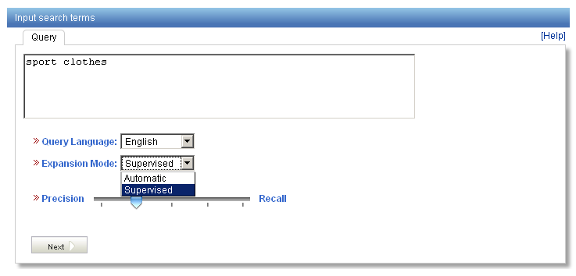
Supervised mode: 1 of 4 steps

Slide 49
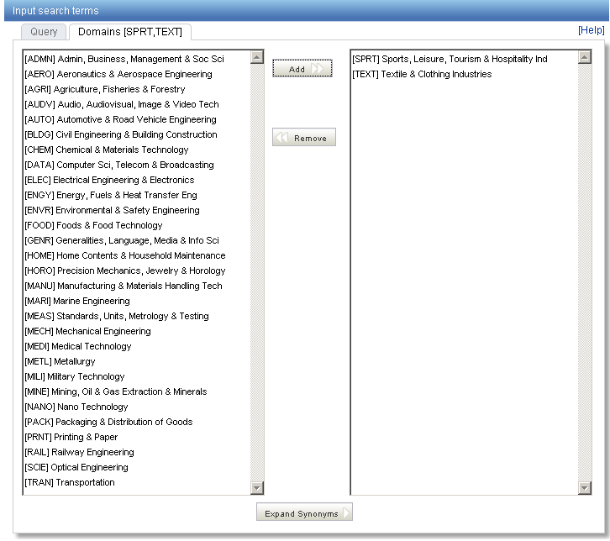
Supervised mode : 2 of 4 steps

Slide 50
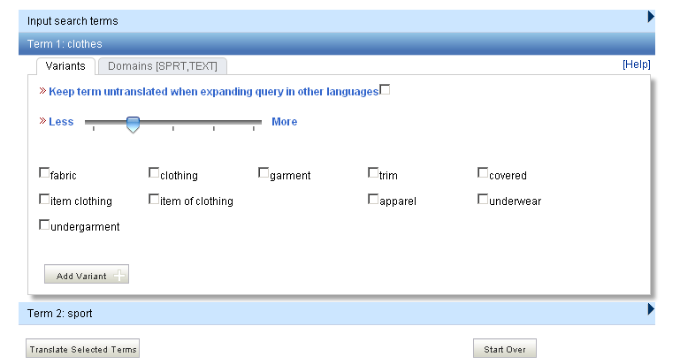
Supervised mode : 3 of 4 steps

Slide 51
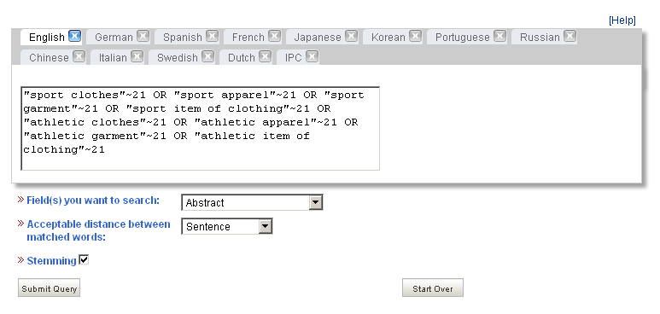
Supervised mode : 4 of 4 steps

Slide 52
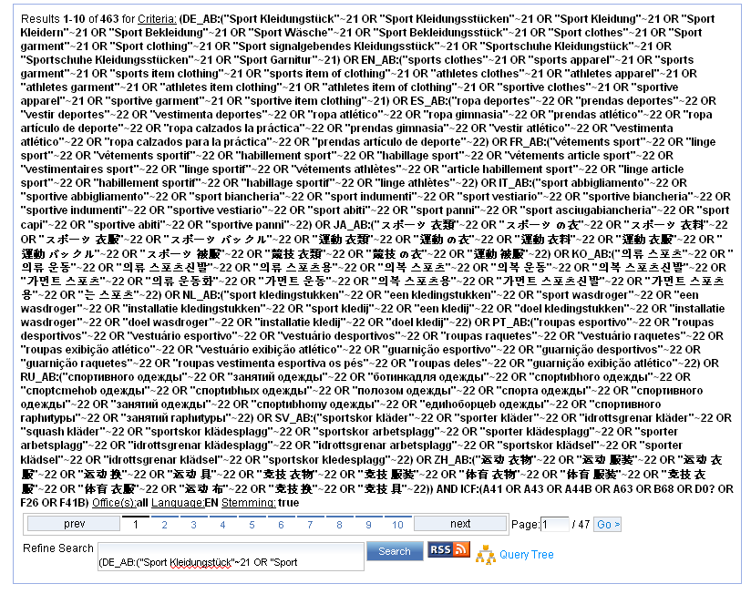
Supervised mode: results

Slide 53
Search examples: clothes for sport
Entering “sports clothes” in the Simple search interface will return 11 results
Entering “sports clothes” in the CLIR interface (in automatic mode) will return 791 results
Entering “sports clothes” in the CLIR interface (in supervised mode) will return 455 results
Notes:
53
CLIR will provide you with synonyms of both terms composing the query “sport” and “clothing” and synonyms of “sport clothing” in 11 languages which will allow you to find documents in Japanese for example.
The nb of results in the supervised mode is less because there are more relevant in fact in the auto mode you neter your query and the system retrieves results while in the supervised mode you need to paricpate actively in the selection process

Slide 54
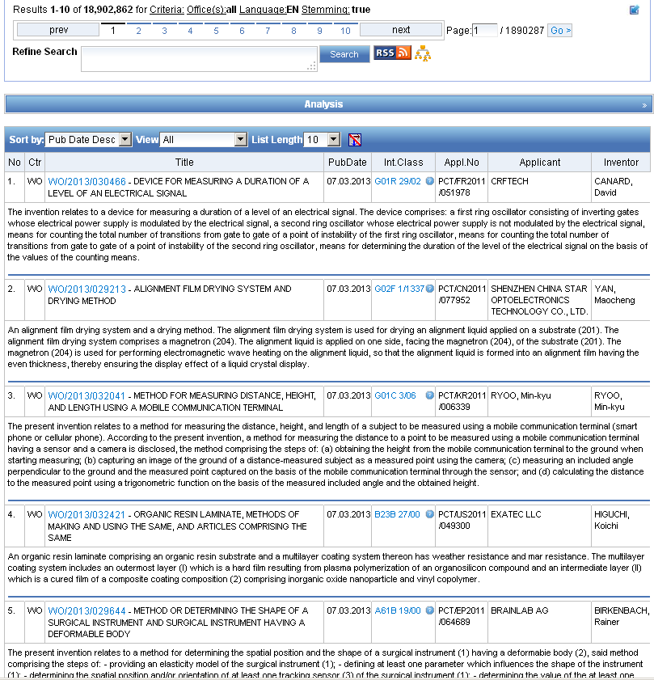
Reading the result list

Slide 55
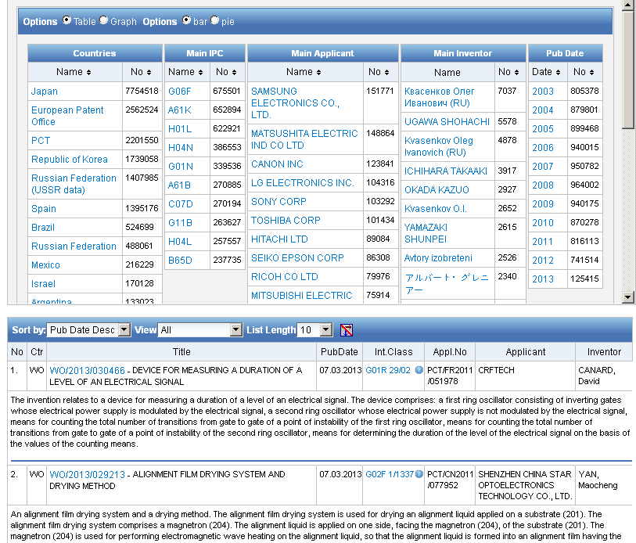
Analysis

Slide 56
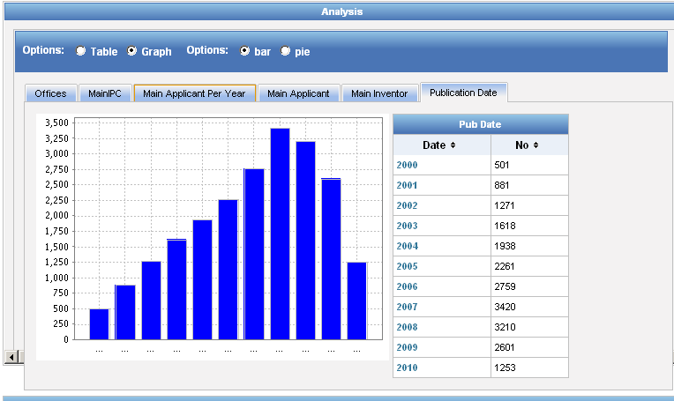
Display options: table/graph –bar/pie

Slide 57
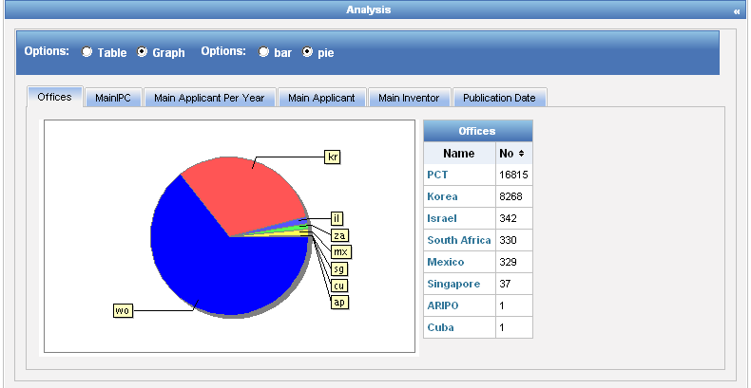
Display options: table/graph –bar/pie
Notes:
57
In both bar and pie options, the tabs allow you to see the information graphically for the Offices, Main IPC, Main Applicant, Main Inventor and Publication Date.
The charts can be saved in GIF format for inclusion in documents or reports by right-clicking in a corner of the image and selecting “Copy image” or “Save image”.

Slide 58



Options

Slide 59
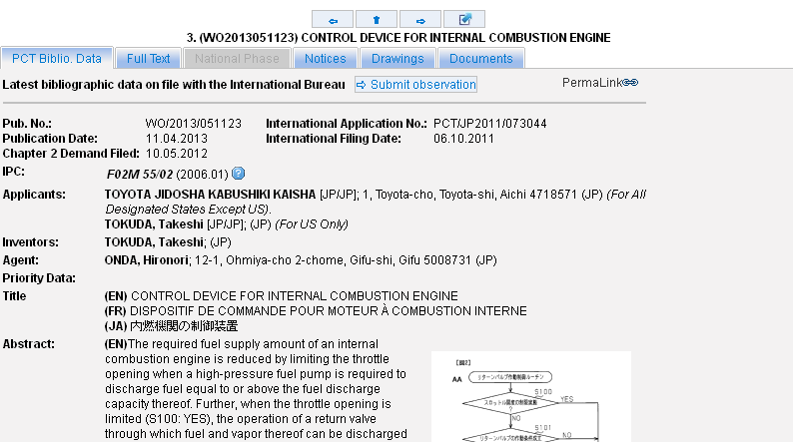
Tabs

Slide 60
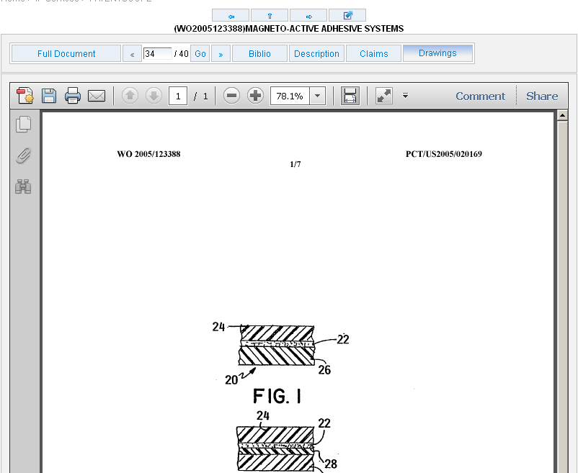
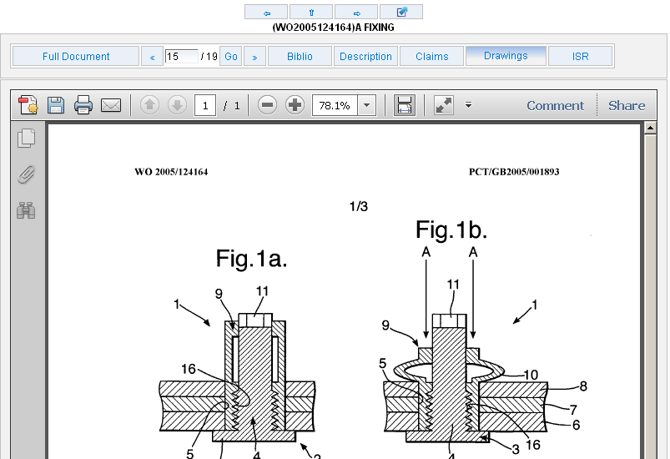
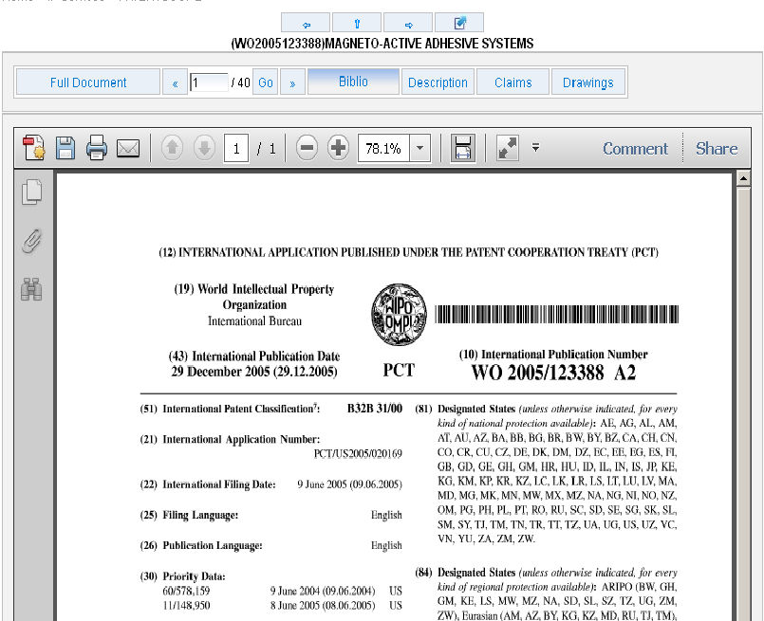

Documents tab

Slide 61

PDFs

Slide 62

Multilingual tools

Slide 63

Translation Assistant for Patent Titles and Abstracts (TAPTA)
Notes:
63
Language pairs available: EN=>FR, FR=>EN, EN=>ZH, ZH=>EN
Technical domain aware system using 32 domains derived from the International Patent Classification

Slide 64

32 Technical domains from the IPC
[ADMN] Admin, Business, Management & Soc Sci
[AERO] Aeronautics & Aerospace Engineering
[AGRI] Agriculture, Fisheries & Forestry
[AUDV] Audio, Audiovisual, Image & Video Tech
[AUTO] Automotive & Road Vehicle Engineering
[BLDG] Civil Engineering & Building Construction
[CHEM] Chemical & Materials Technology
[DATA] Computer Sci, Telecom & Broadcasting
[ELEC] Electrical Engineering & Electronics
[ENGY] Energy, Fuels & Heat Transfer Eng
[ENVR] Environmental & Safety Engineering
[FOOD] Foods & Food Technology
[GENR] Generalities, Language, Media & Info Sci
[HOME] Home Contents & Household Maintenance
[HORO] Precision Mechanics, Jewelry & Horology
[MANU] Manufacturing & Materials Handling Tech
[MARI] Marine Engineering
[MEAS] Standards, Units, Metrology & Testing
[MECH] Mechanical Engineering
[MEDI] Medical Technology
[METL] Metallurgy
[MILI] Military Technology
[MINE] Mining, Oil & Gas Extraction & Minerals
[NANO] Nano Technology
[PACK] Packaging & Distribution of Goods
[PRNT] Printing & Paper
[RAIL] Railway Engineering
[SCIE] Optical Engineering
[SPRT] Sports, Leisure, Tourism & Hospitality
[TEXT] Textile & Clothing Industries
[TRAN] Transportation

Slide 65

TAPTA: how does it work?

Slide 66


Slide 67



Slide 68

TAPTA: post-editing & exporting

Slide 69


Slide 70


Slides and recording
+
www.wipo.int/patentscope/en/webinar/index.html

Slide 71


patentscope@wipo.int

Slide 72

mulțumesc
mulțumesc

