Slide 1
CLIR
Cyberworld
April
2014
Sandrine Ammann
Marketing & Communications Officer

Slide 2


To the PATENTSCOPE search system webinar
CLIR

Slide 3
Agenda
CLIR
  What is CLIR?
  Why was it developed?
  How to search using CLIR?
  Why is it useful?
  How to make the best of CLIR?
  How was it developed?
  What is next?
  Q & A session

Slide 4
What is CLIR?
Tool to search in one of the languages supported and retrieve original query and its synonyms in the 11 other languages supported
Ex: enter “jackhammer”

Slide 5
FP:((EN_TI:("jackhammer" OR "hammer drill") OR EN_AB:("jackhammer" OR "hammer drill")) OR (DE_TI:("Bohrhammer" OR "Schlaghammer") OR DE_AB:("Bohrhammer" OR "Schlaghammer")) OR (ES_TI:("martillo de perforación" OR "taladro de percusión" OR "martillo perforador electoneumatico") OR ES_AB:("martillo de perforación" OR "taladro de percusión" OR "martillo perforador electoneumatico")) OR (FR_TI:("perceuse à percussion" OR "foreuse à percussion" OR "marteau piquer" OR "brisé béton" OR "aspiration de perçage" OR "perforatrice à percussion" OR "marteau foreur" OR "perçage à percussion" OR "marteau piqueur") OR FR_AB:("perceuse à percussion" OR "foreuse à percussion" OR "marteau piquer" OR "brisé béton" OR "aspiration de perçage" OR "perforatrice à percussion" OR "marteau foreur" OR "perçage à percussion" OR "marteau piqueur")) OR (IT_TI:("trapano battente" OR "trapano a percussione" OR "martello perforatore") OR IT_AB:("trapano battente" OR "trapano a percussione" OR "martello perforatore")) OR (JA_TI:("ハンマドリル" OR "ハンマードリル") OR JA_AB:("ハンマドリル" OR "ハンマードリル")) OR (KO_TI:("를 구비한 해머 드릴" OR "햄머드릴") OR KO_AB:("를 구비한 해머 드릴" OR "햄머드릴")) OR (NL_TI:("boorhamer") OR NL_AB:("boorhamer")) OR (PT_TI:("furadeira de percussão") OR PT_AB:("furadeira de percussão")) OR (RU_TI:("отбойный молоток" OR "помощи бурильногомолотка") OR RU_AB:("отбойный молоток" OR "помощи бурильногомолотка")) OR (SV_TI:("borrhammare" OR "slagborrmaskin") OR SV_AB:("borrhammare" OR "slagborrmaskin")) OR (ZH_TI:("拆除" OR "锤钻" OR "冲击钻机") OR ZH_AB:("拆除" OR "锤钻" OR "冲击钻机")))

Slide 6
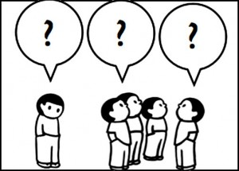
Why CLIR?

Slide 7
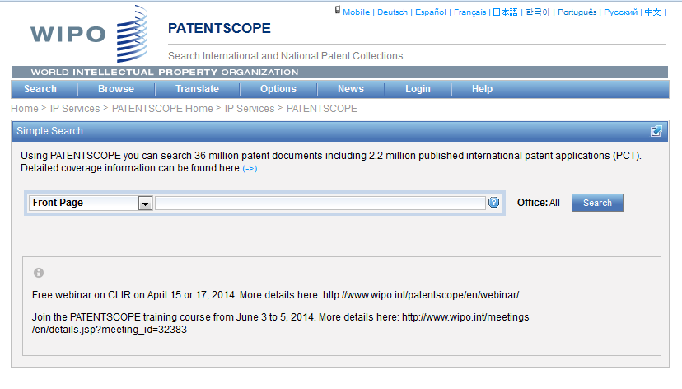
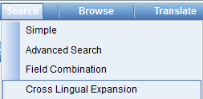

Slide 8
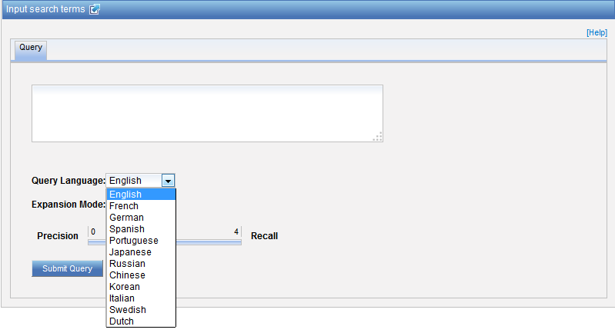
Languages

Slide 9
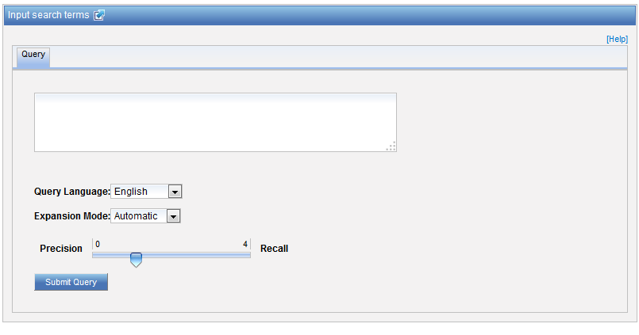
CLIR interface

Slide 10

Query language
Define the language of the query:

Slide 11

Expansion mode
2 modes

Slide 12

Precision vs recall
Precision = most precise results quality
Recall = higher number of documents quantity

Slide 13
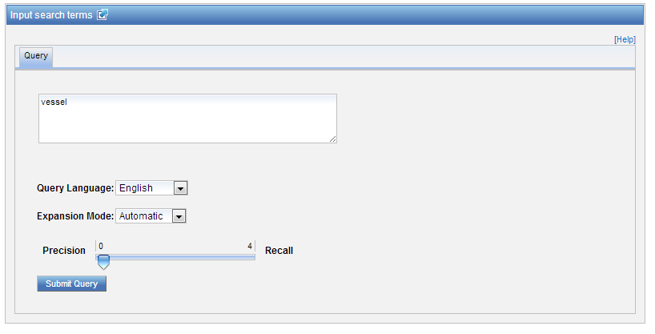
Exemple: precision

Slide 14
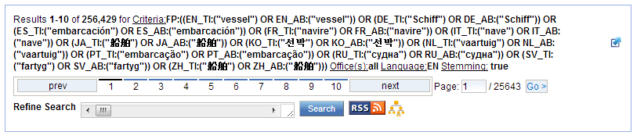

Slide 15
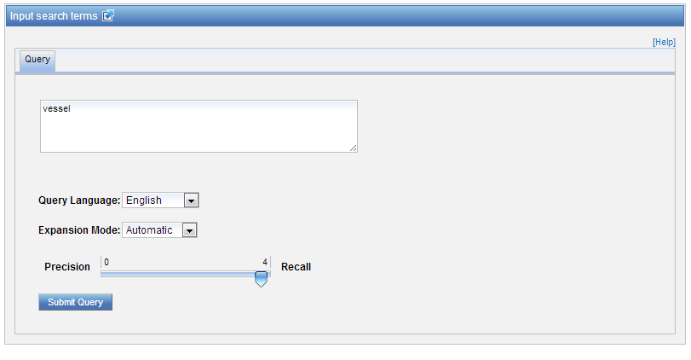
Exemple: recall

Slide 16
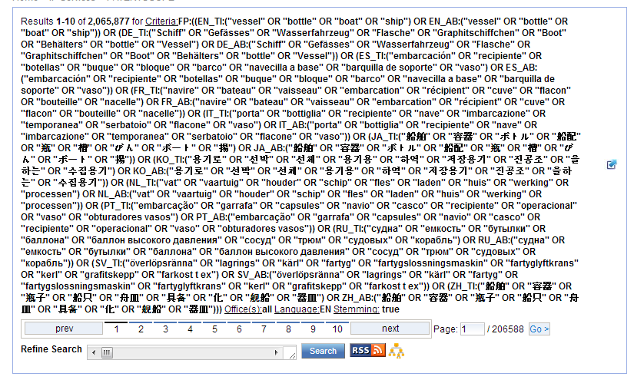

Slide 17
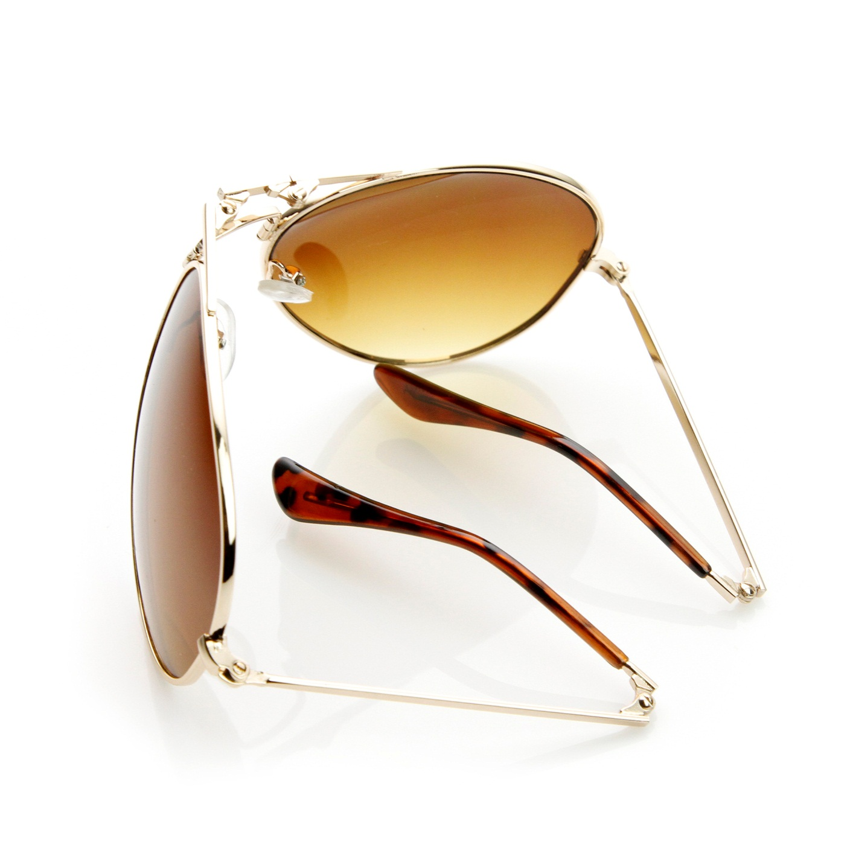
How to search using CLIR - example

Slide 18
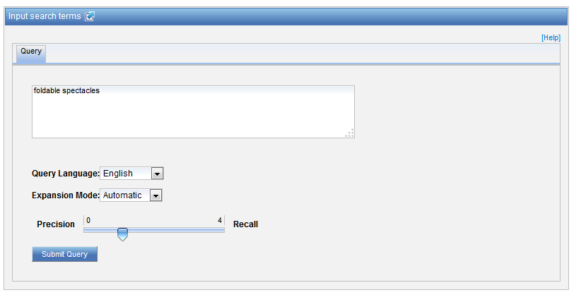
Example – automatic mode

Slide 19
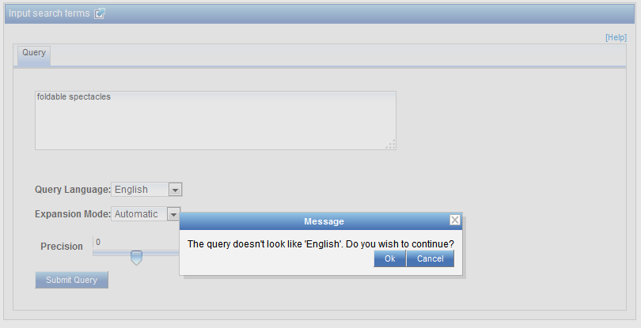
Message

Slide 20


Slide 21
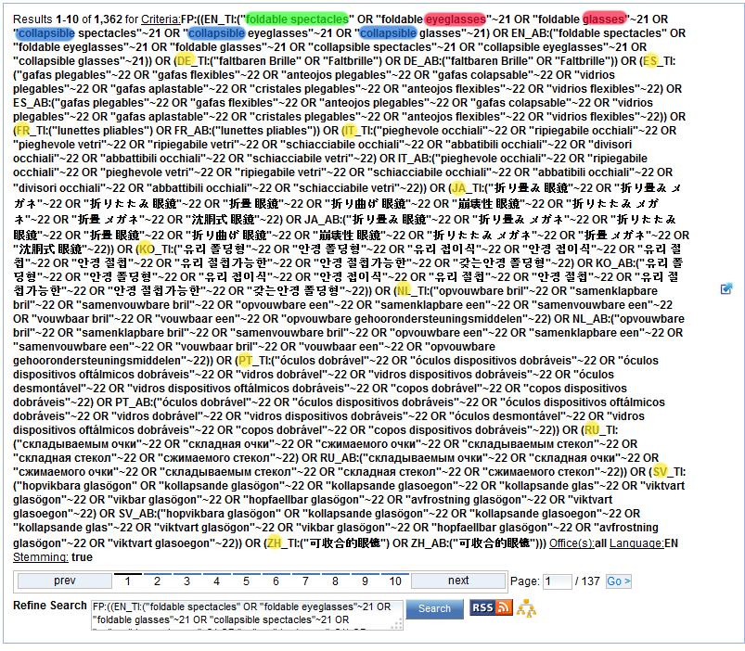
Result

Slide 22
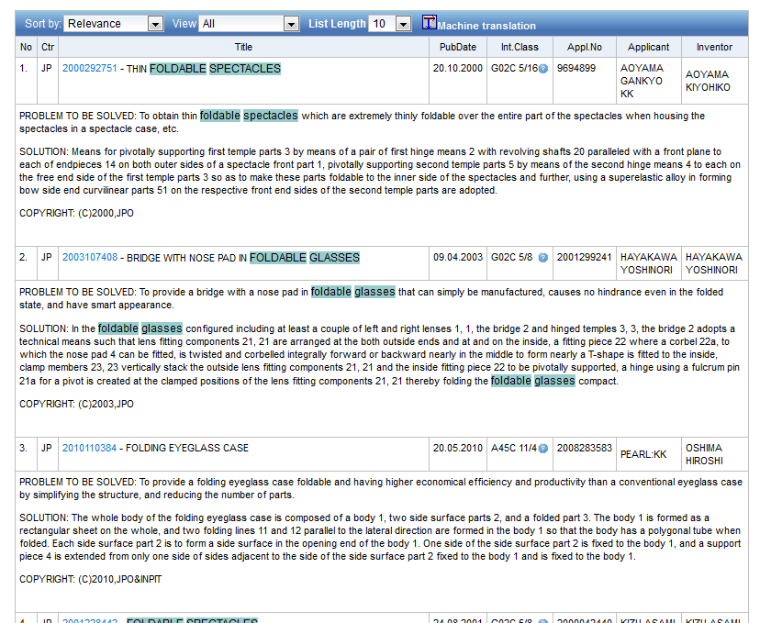

Slide 23
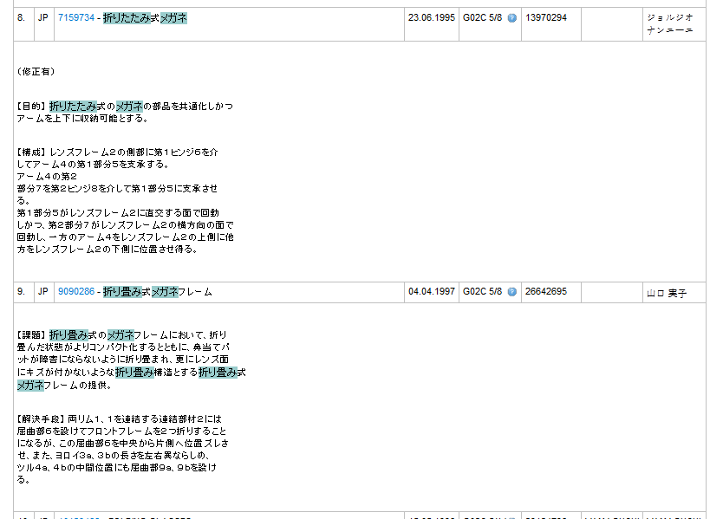

Slide 25
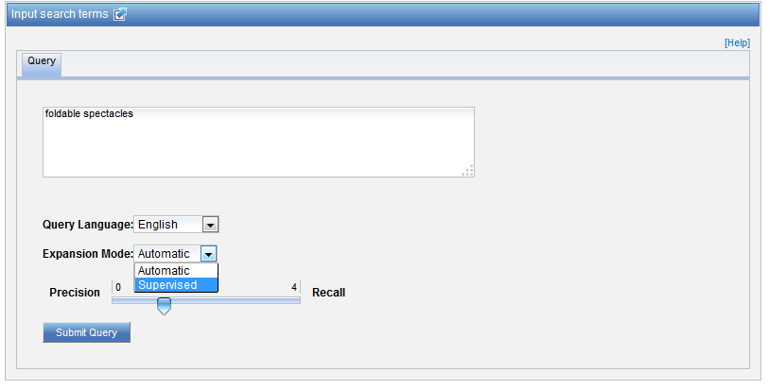
Example - supervised

Slide 26
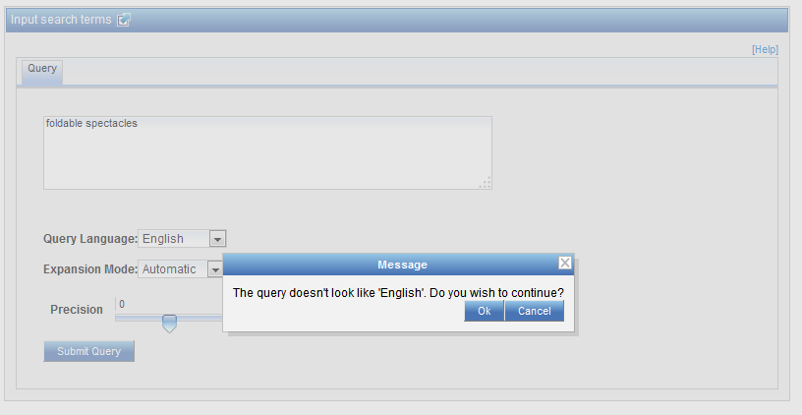
Message

Slide 27
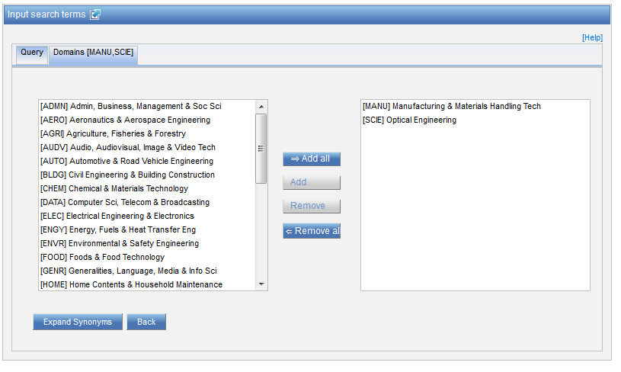
Technical fields

Slide 28
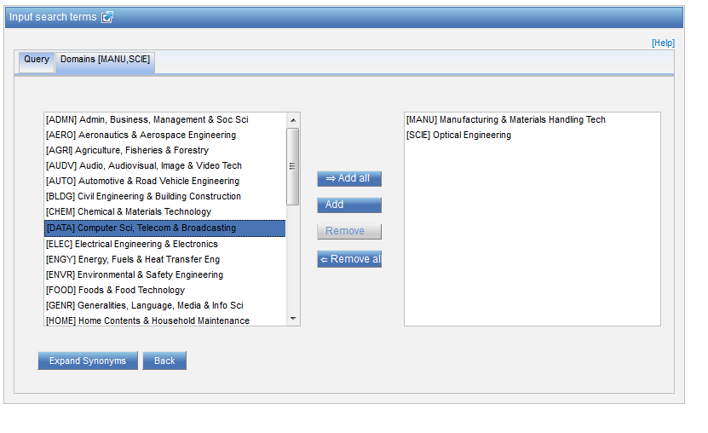
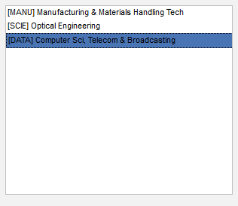
Technical fields

Slide 29
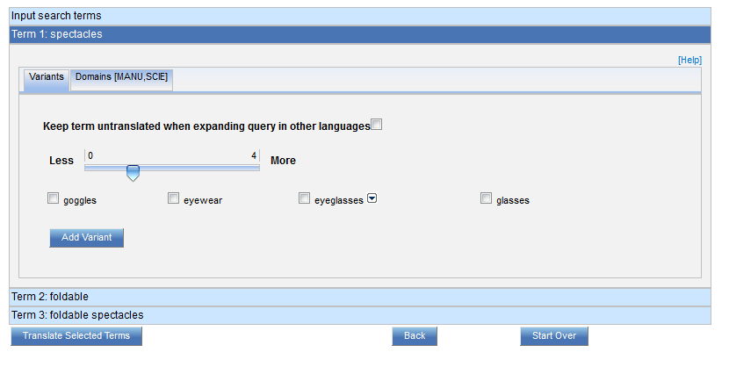
Variants term 1

Slide 30
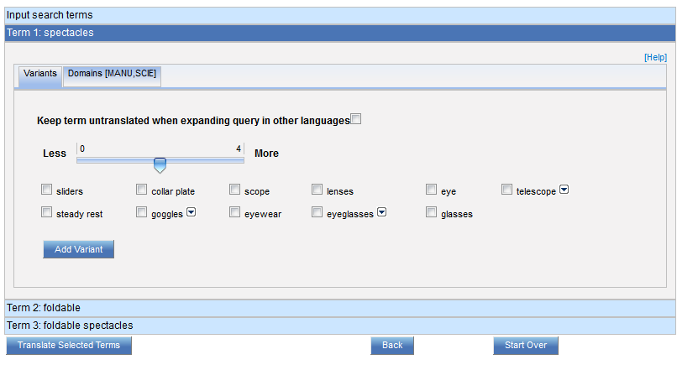
More variants term 1

Slide 31
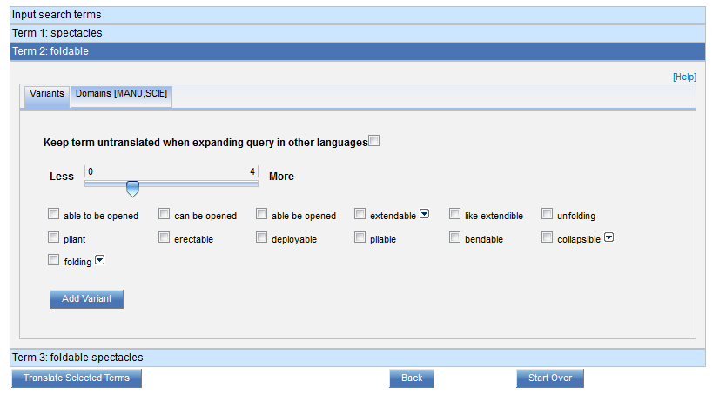
Variants term 2

Slide 32
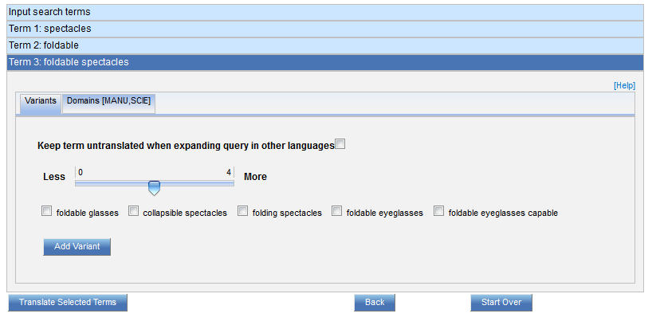
Variants term 3

Slide 33
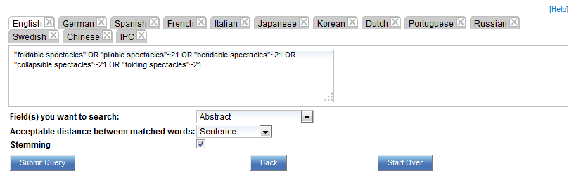
Translations

Slide 34
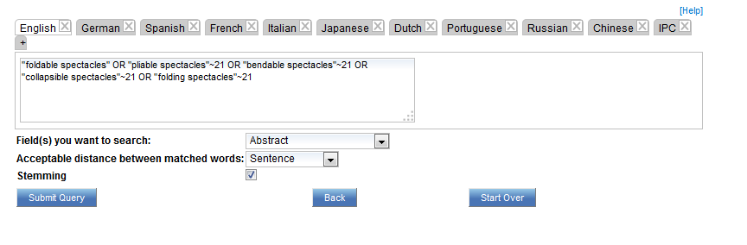
Translations

Slide 35
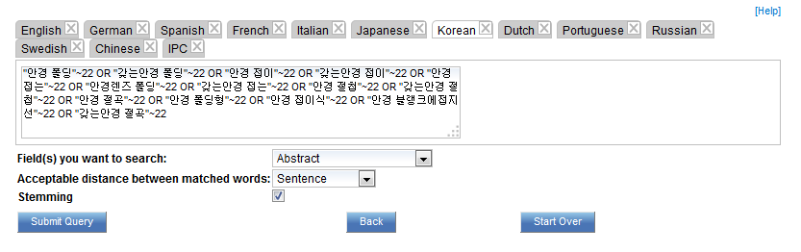
Translation - Korean

Slide 36
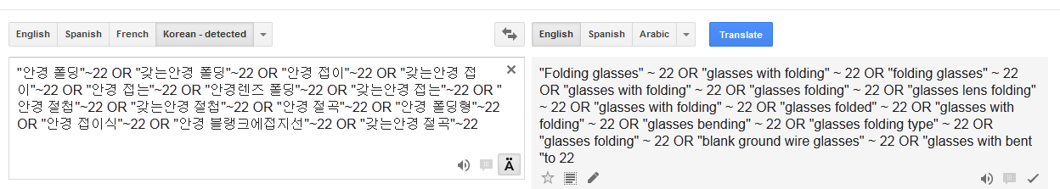
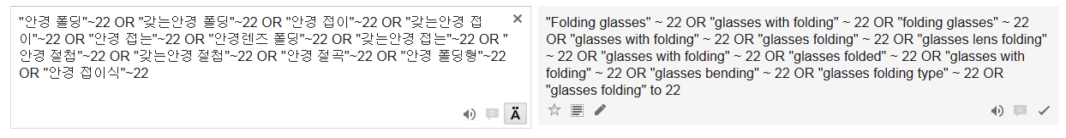
Check and edit in Google Translate
EDIT

Slide 37
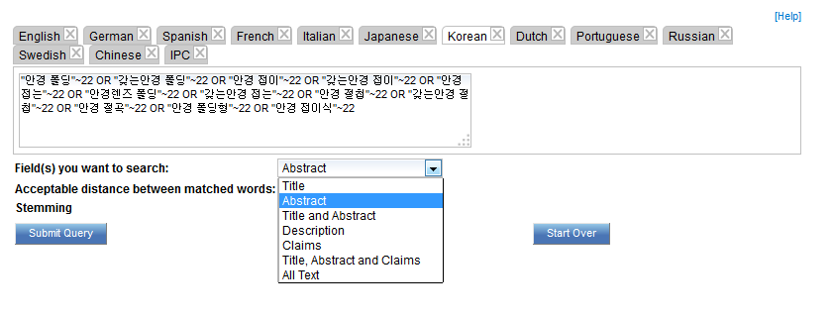
Search fields

Slide 38
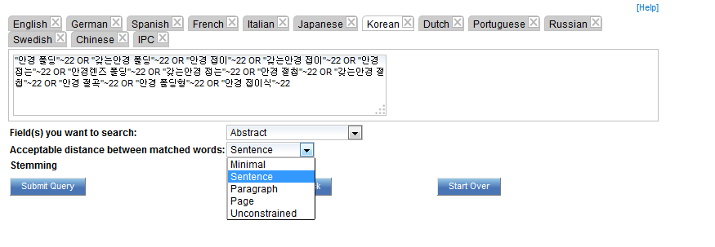
Acceptable distance

Slide 39
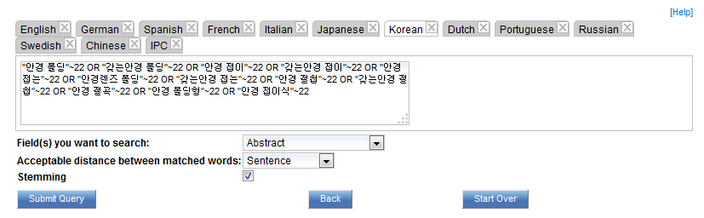
Stemming

Slide 40
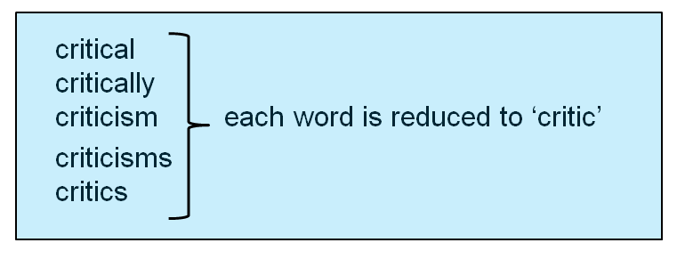
Stemming
Process that removes common endings of words

Slide 41
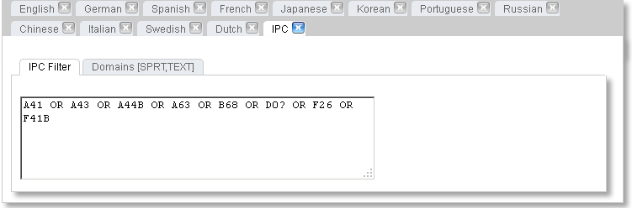
Checking: IPC

Slide 42
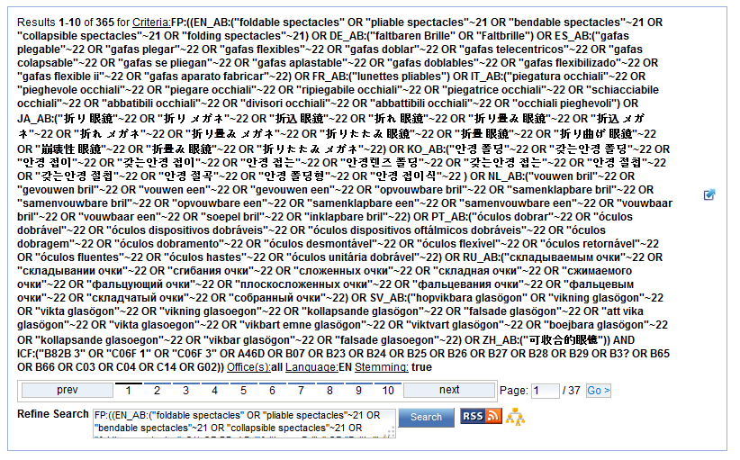

Slide 43
Why is CLIR useful?
Search full text collections simultaneously in many foreign languages
B) Improve significantly the number of relevant results without increasing significantly the number of irrelevant results
C) Have confidence in your searches:
No black box: users have access to the CLIR generated Boolean queries (albeit complex) and have the full control on them
D) Have a responsive system even for complex queries

Slide 44
How to make the most of out CLIR?
Expansion modes
Keyword very specific with only 1 meaning AUTOMATIC
For any other queries, SUPERVISED is recommended
Variants/synonyms
Select words that you would like to appear in your search results
If you have too much noise in the result list, remove generic variant

Slide 45
How to make the most of out CLIR?
Parameters
1. Title and abstract: unconstrained distance
2. Claims: sentence/paragraph distance
3. Description: sentence/paragraph distance
Stemming recommended

Slide 46
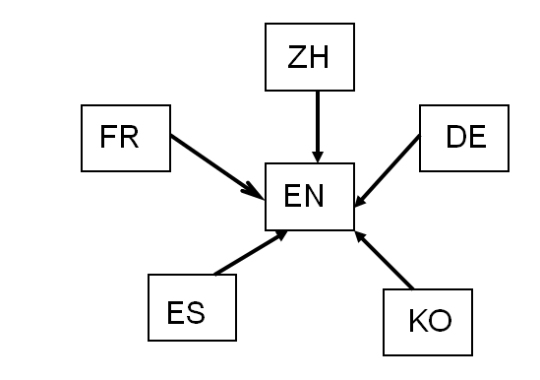
How was it developed?
Compilation of a long list of titles in language pairs
Creation of in-house extraction methodology
Tool learns statistical bilingual dictionaries of titles

Slide 47



Quality of dictionaries
Quality of dictionaries: no human intervention
  The more title available, the better the coverage
  Chinese Korean Dutch
  English Portuguese Italian
  French Russian Swedish
  German Spanish
  Japanese

Slide 48
Disambuguation
Disambiguation: process of identifying the sense of a word in a sentence. http://en.wikipedia.org/wiki/Disambiguation_%28disambiguation%29
Disambiguation is applied to keywords:
Technical domains based on the IPC
Synonyms selection

Slide 49
What is next?
Improve terminology coverage of already supported languages
Add other languages: over 200’000 titles and abstracts with associated high quality translations in English
Notes:
(Arabic)?
(ideally 500’000)

Slide 50


Slide 51
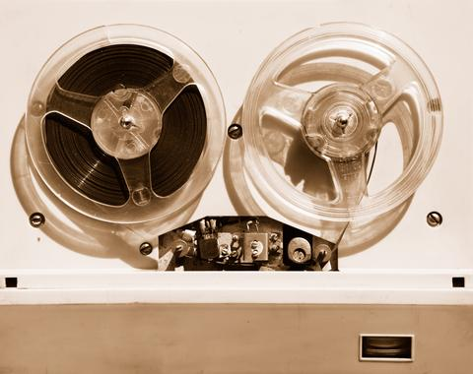

Slides and recording
+
www.wipo.int/patentscope/en/webinar/index.html

Slide 52
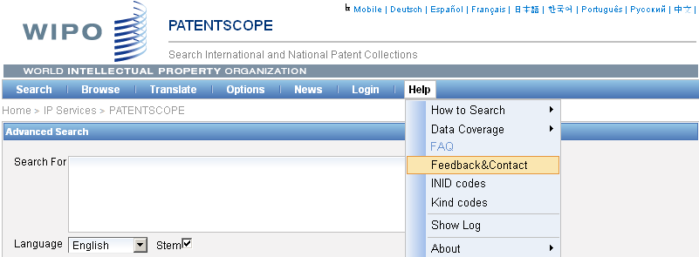

patentscope@wipo.int

Slide 53

mulțumesc
mulțumesc

