Slide 1
How to search with the PATENTSCOPE search system
Cyberspace
May
2013
Sandrine Ammann
Marketing & Communications Officer

Slide 2


To the PATENTSCOPE search system webinar
How to search with…

Slide 3
Agenda
Where to find coverage information
Browse interfaces
  PCT applications
  Sequence listing
  PIC Green Inventory
Search interfaces
  Simple
  Advanced
  Field Combination
Translation tools
Q&A

Slide 4
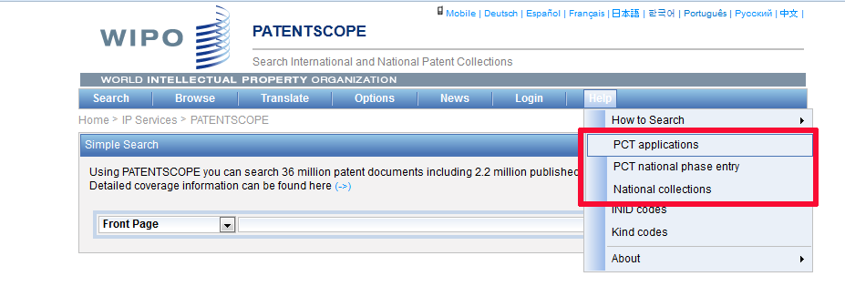
Data coverage

Slide 5
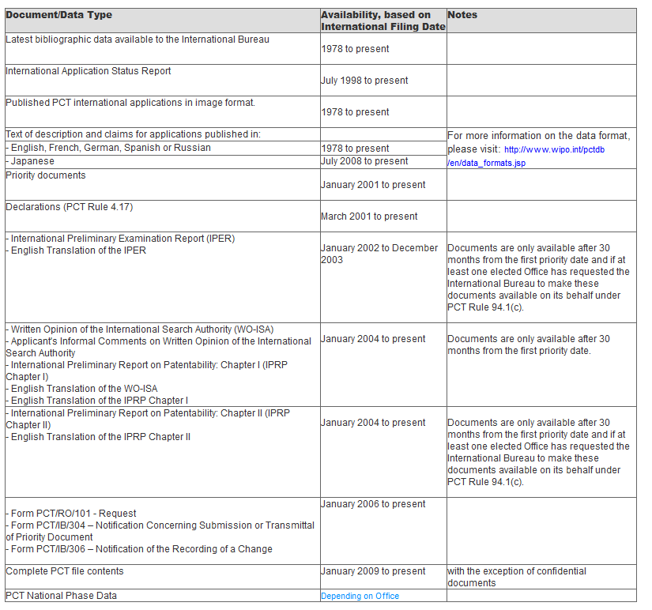
PCT applications

Slide 6
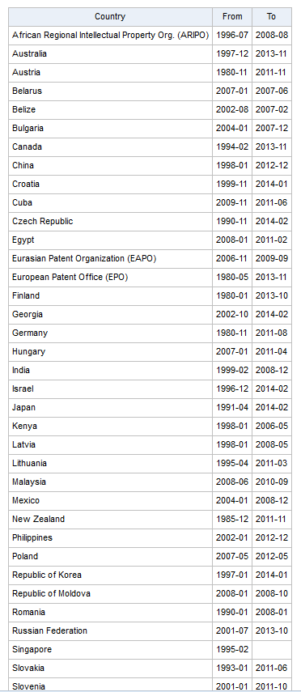
PCT national phase entry

Slide 7
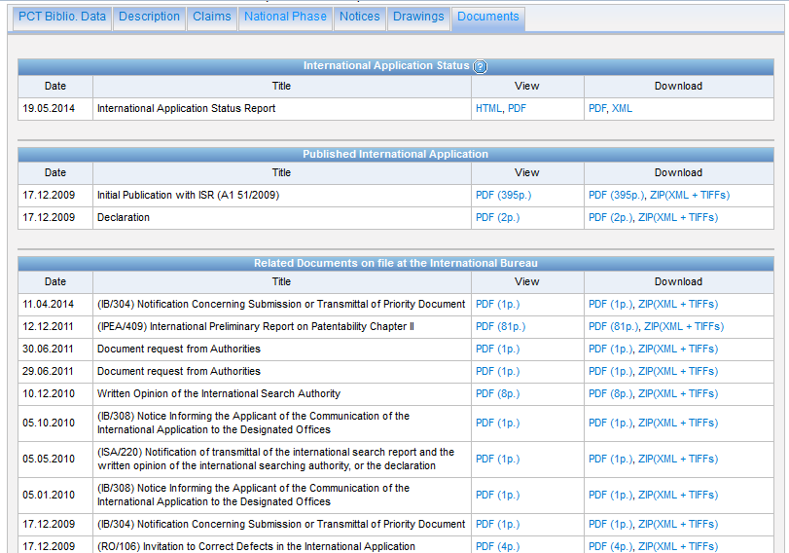
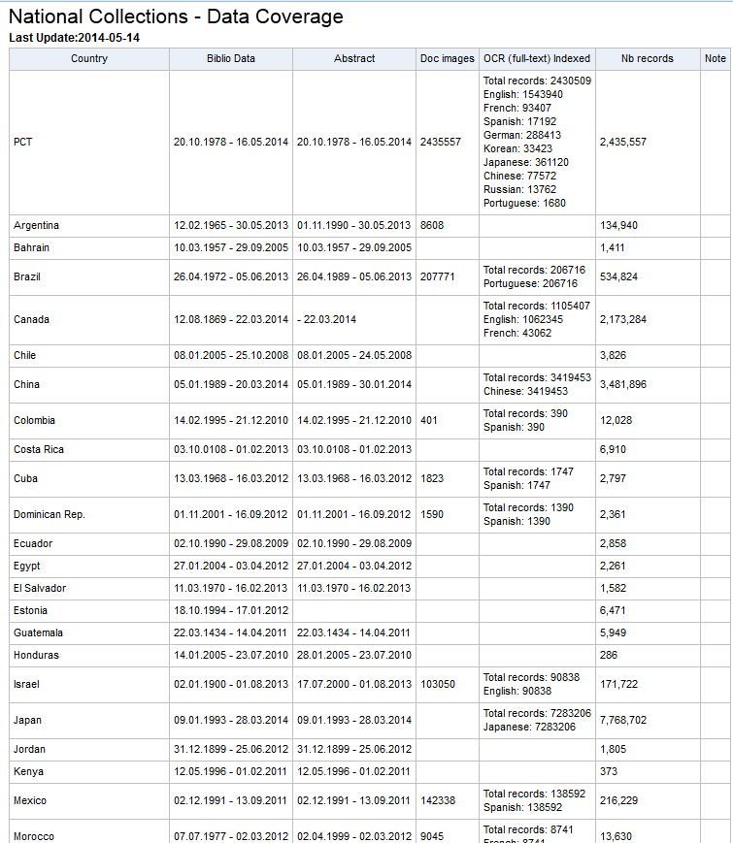
National collections

Slide 8
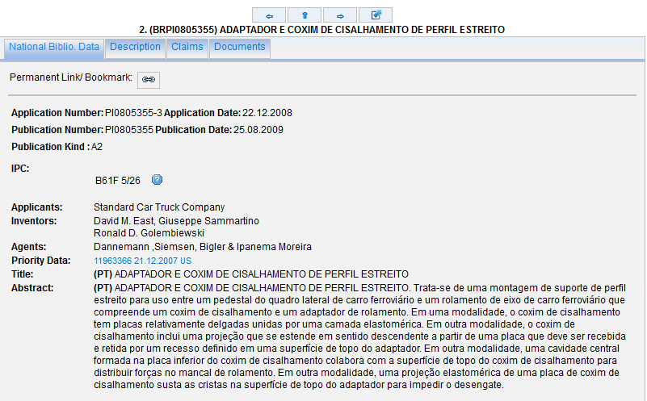
National collections

Slide 9
National collections vs national phase entry
National/regional collections = data from national/regional offices
National phase entry = PCT procedure

Slide 10
PCT procedure steps
Filing: you file an international application, complying with the PCT formality requirements, in one language, and you pay one set of fees.
International Search: an “International Searching Authority (ISA)” (one of the world’s major patent Offices) identifies the published documents which may have an influence on whether your invention is patentable and establishes an opinion on your invention’s potential patentability.
International Publication: as soon as possible after the expiration of 18 months from the earliest filing date, the content of your international application is disclosed to the world.
Supplementary International Search (optional): an ISA which is willing to carry out supplementary searches and which did not carry out the main search, identifies published documents which may not have been searched by the ISA which carried out the main search because of the diversity of prior art in different languages and different technical fields.
International Preliminary Examination (optional): one of the ISAs, at your request, carries out an additional patentability analysis, after international publication, usually on an amended version of your application.
National Phase: after the end of the PCT procedure, you start to pursue the grant of your patents directly before the national (or regional) patent Offices of the countries in which you want to obtain them.
Source: http://www.wipo.int/pct/en/faqs/faqs.html

Slide 11
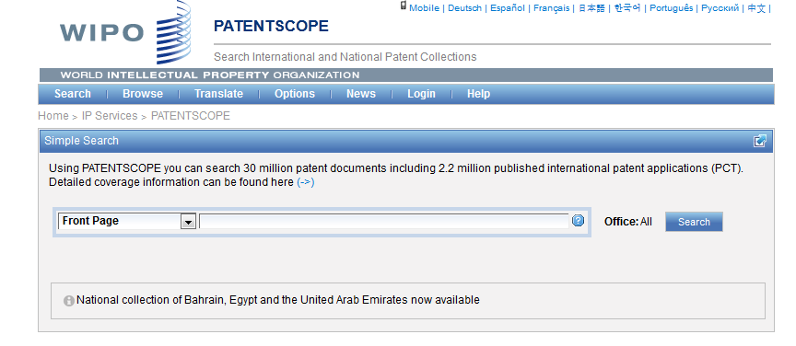
Languages of the interface

Slide 12
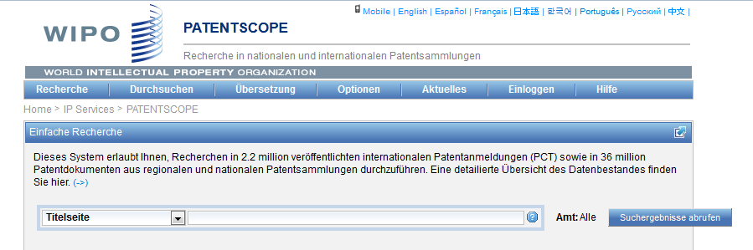
Interface in German

Slide 13
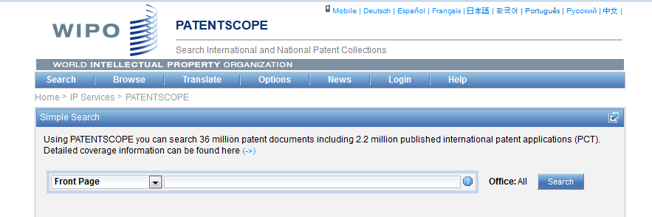
Mobile interface

Slide 14
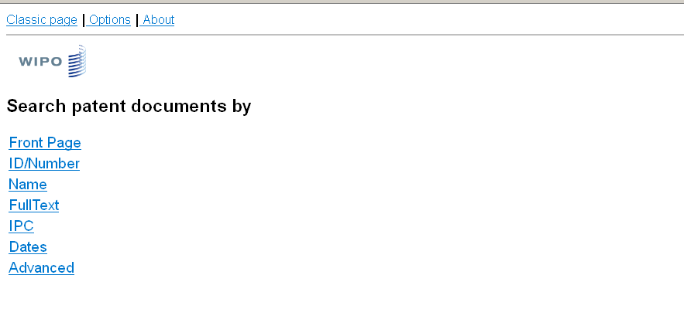
Mobile interface

Slide 15
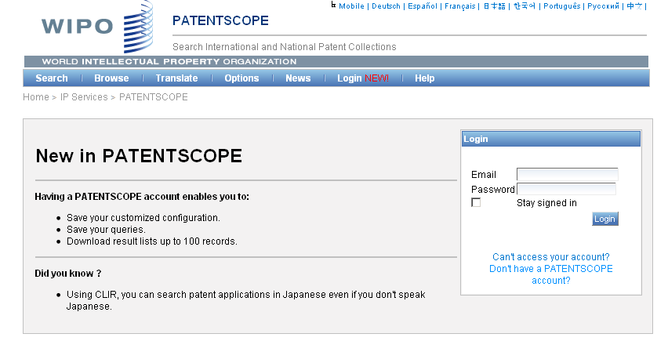
PATENTSCOPE account

Slide 16
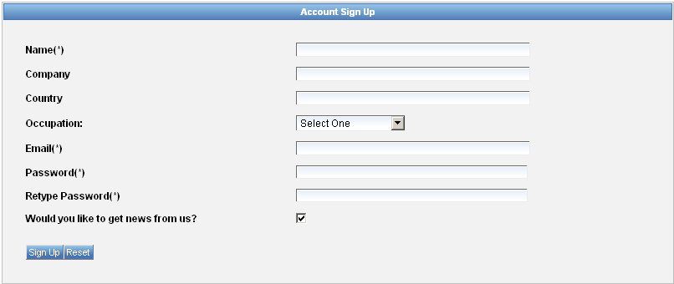
Signing up

Slide 17
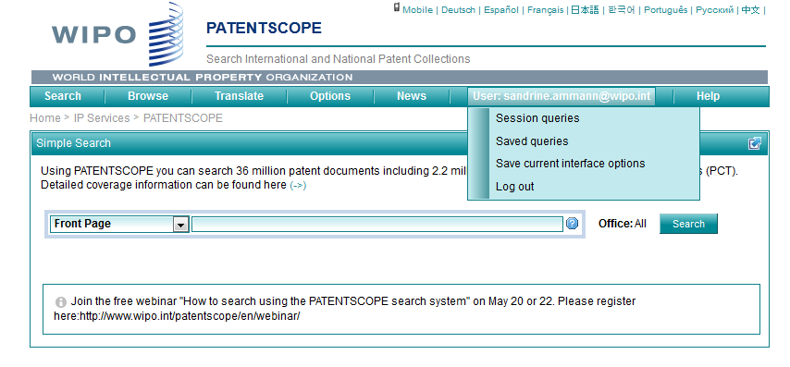
Once logged-in

Slide 18
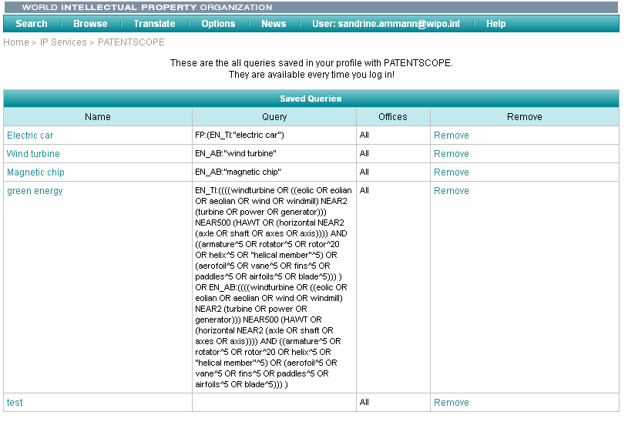
Saved queries

Slide 19
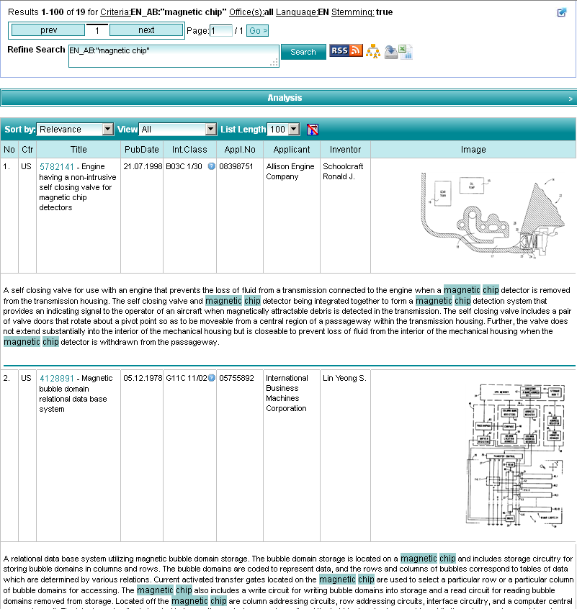
Downloading the results

Slide 20
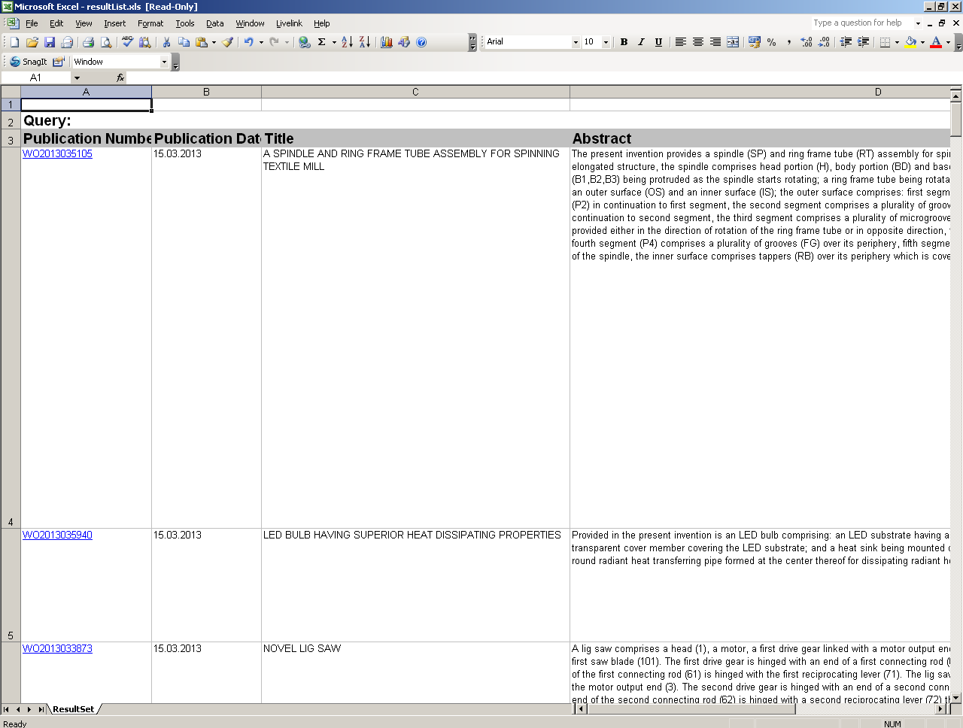
Downloaded results

Slide 21
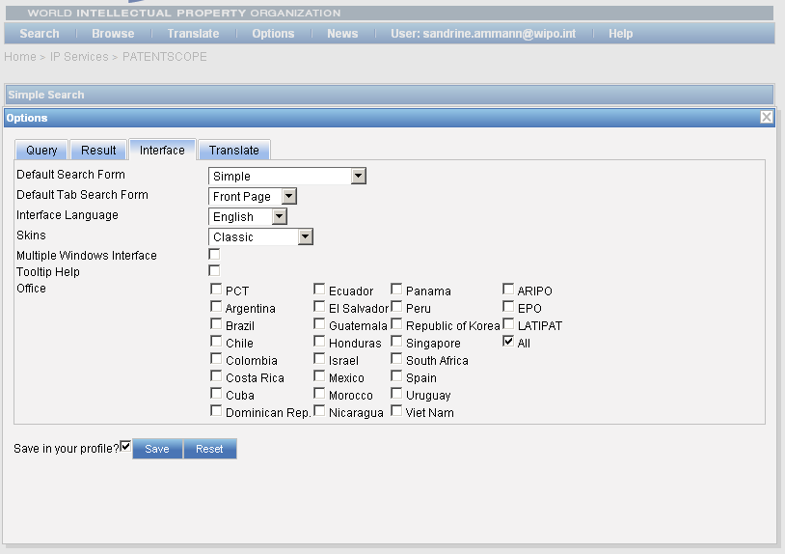
Account customization

Slide 22
PATENTSCOPE: how to search
Browse:
  by week
  sequence listing
  IPC green inventory
  patent register
Search patent documents:
  Simple
  Advanced
  Field combination
  CLIR

Slide 23
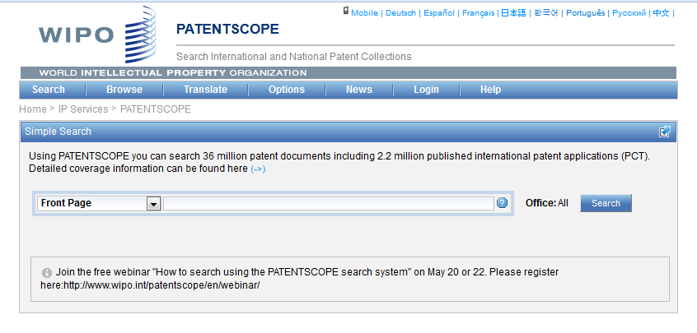
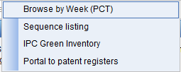
Browse menu

Slide 24
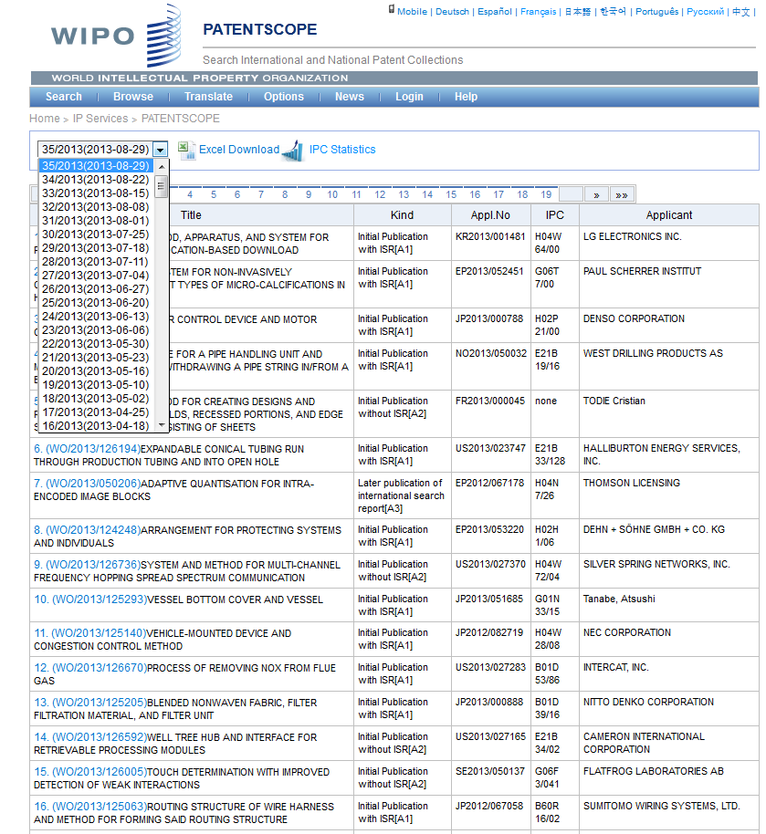

Slide 25
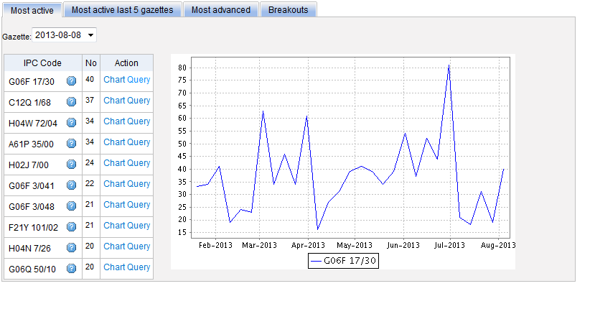
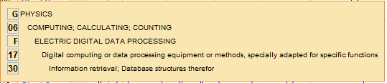
Most active

Slide 26
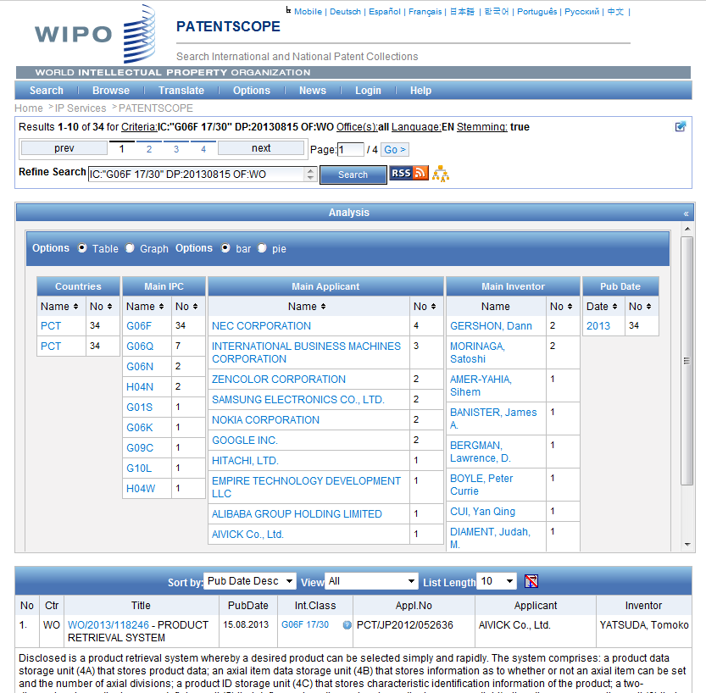

Slide 27
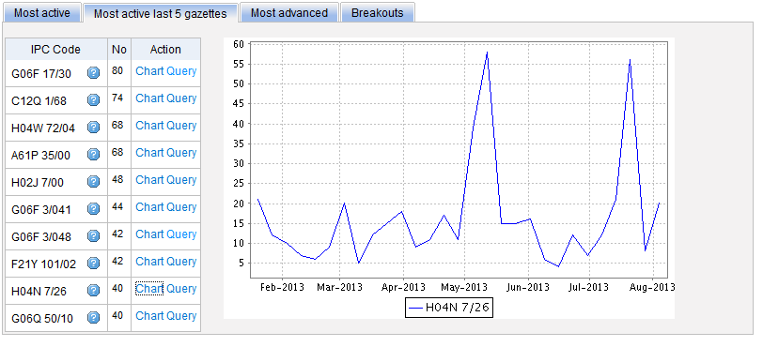
Most active last 5 gazettes

Slide 28
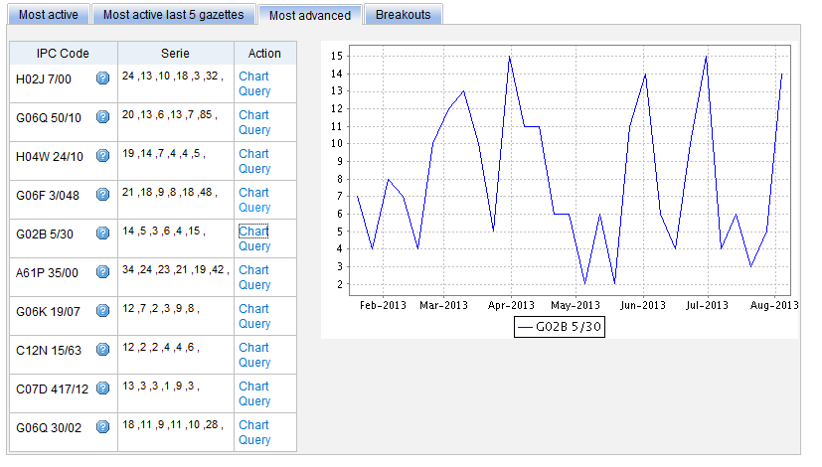
Most advanced

Slide 29
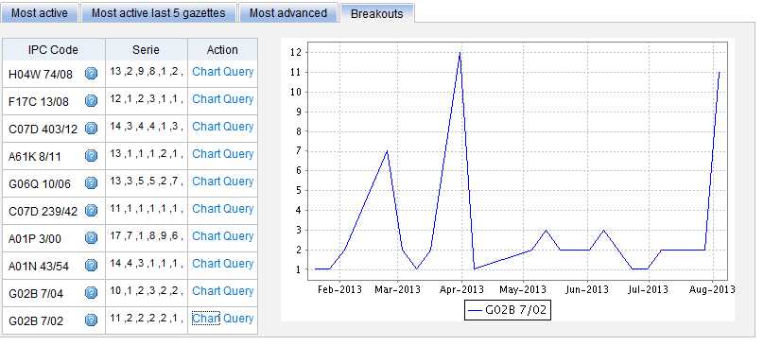
Breakouts

Slide 30
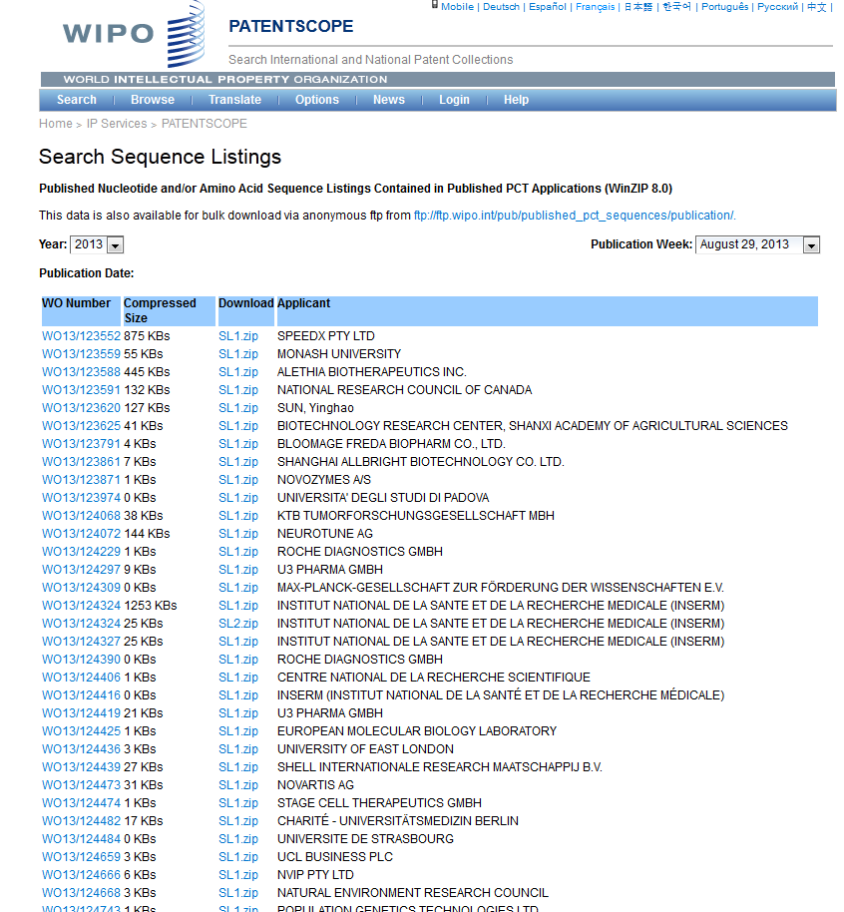

Slide 31
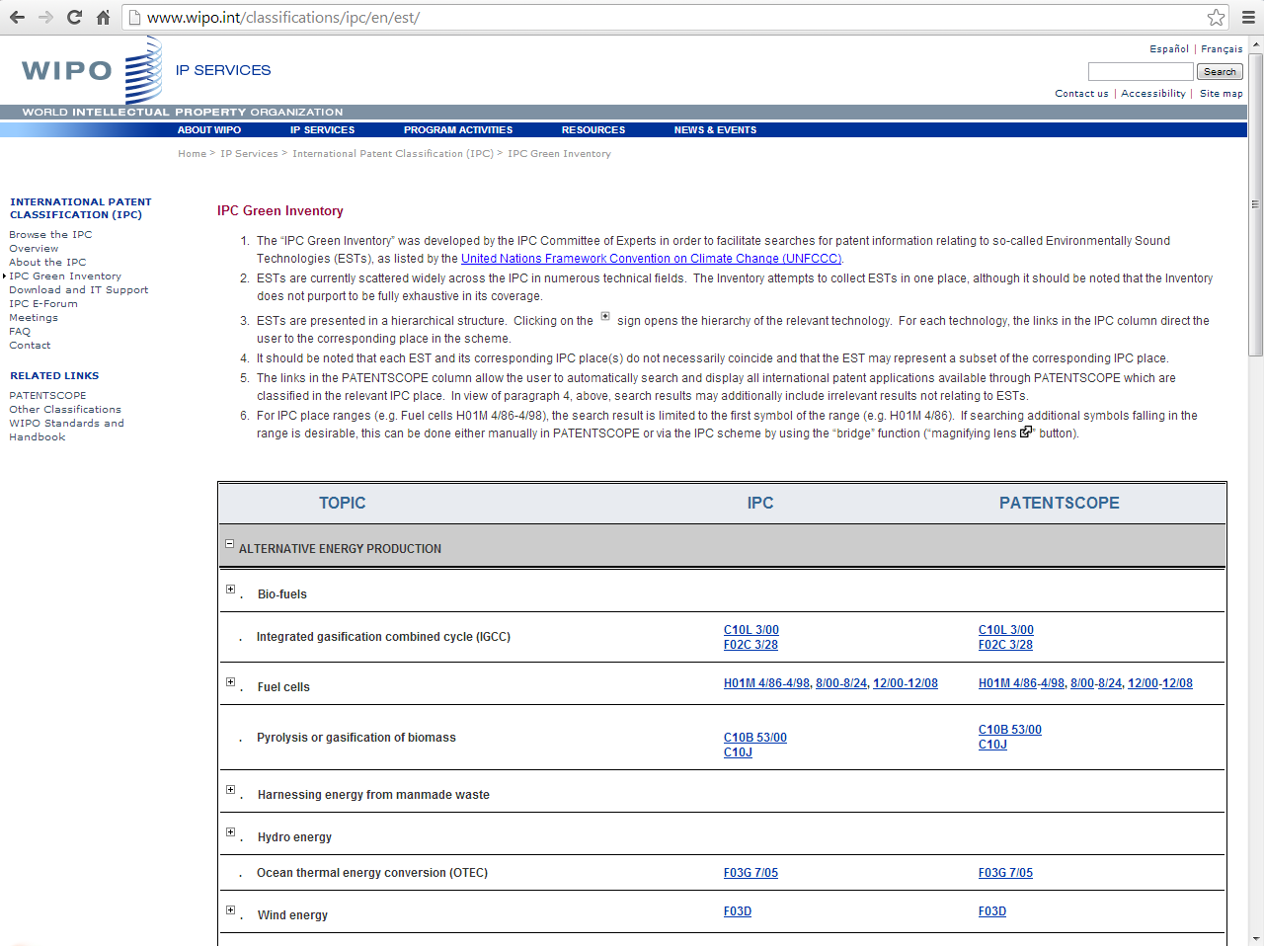
IPC Green Inventory

Slide 32
PATENTSCOPE: how to search
Browse menu
Search patent documents:
  Simple
  Advanced
  Field combination
  CLIR

Slide 33
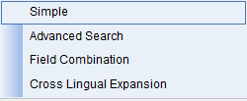
Search menu: 4 options

Slide 34
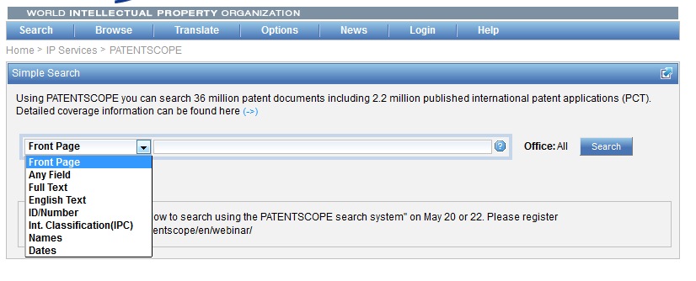
Interface : Simple
Basic search fields are provided

Slide 35
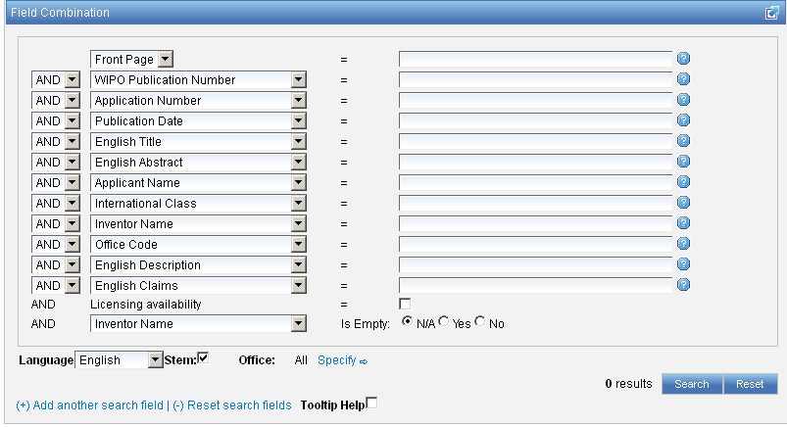
Interface : Field Combination - Structured
Additional search fields can be selected

Slide 36
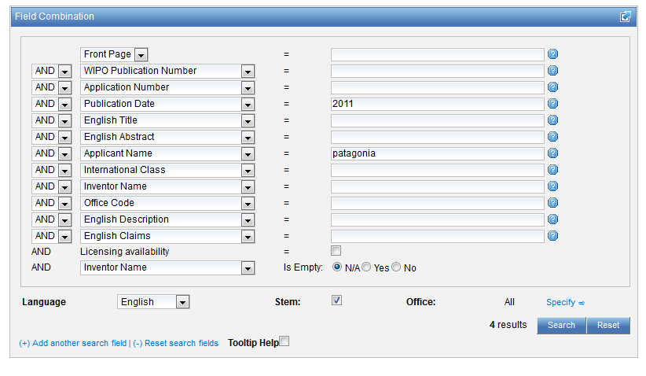
Search example: applicant + date
Applicant: Patagonia and publication date: 2011

Slide 37
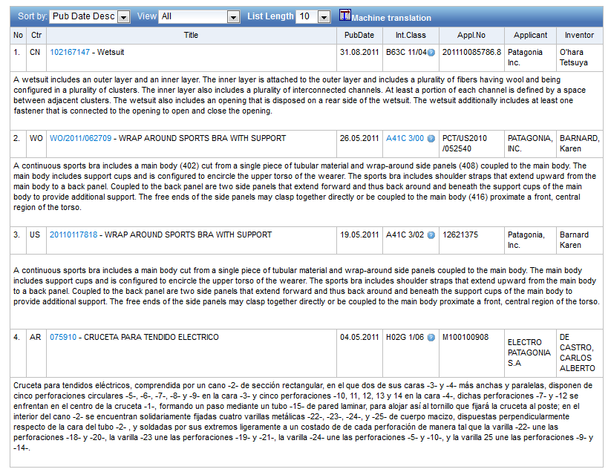

Slide 38

Search examples: keyword + licensing info
Patent documents containing microchip with licensing availability.
Notes:
38
In the drop-down box, select the field Applicant name and enter Steve Jobs; select AND and the field Publication date and enter 2007
In the drop-down boy, select English description and enter microchip, then tick the Licensing availability box (one before last in the Field Combination interface).

Slide 39
Licensing availability info
PCT feature launched in January 2012
Applicants interested in licensing the inventions contained in their international applications can request the International Bureau (IB) to make this information available in PATENTSCOPE

Slide 40
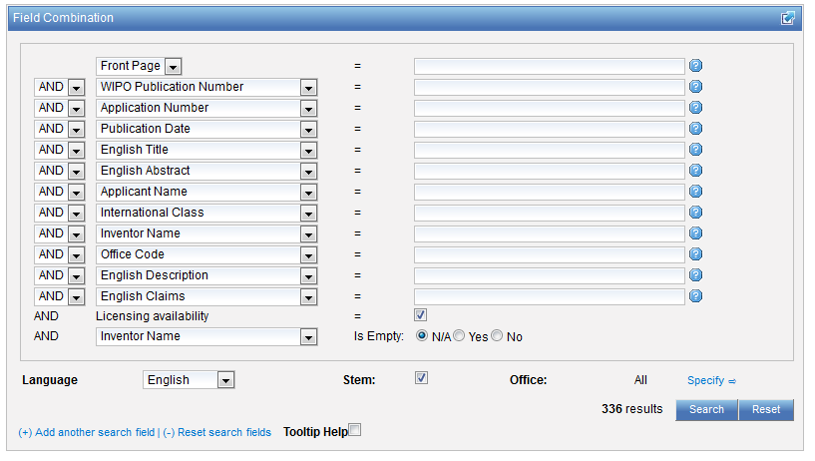

Slide 41
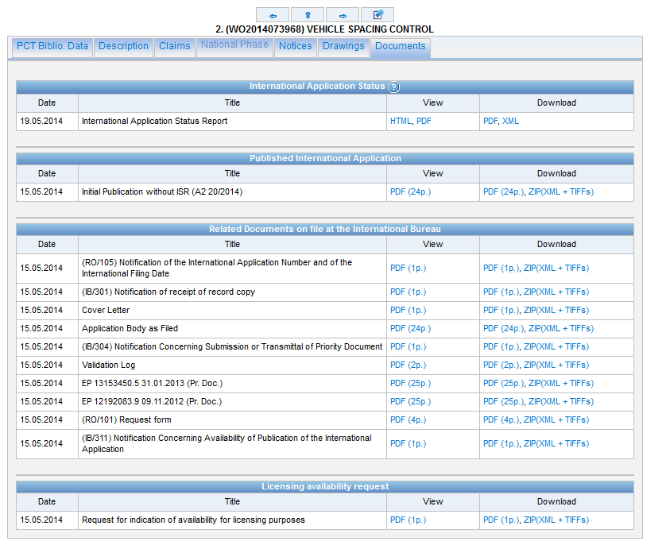

Slide 42

Search examples: empty field
Patent documents without an IPC code
Notes:
42
3. there is also the option to select a field that is empty: for example you could search. On the last line, select the IPC in the drop-down box and tick yes next to empty.

Slide 44
Stemming
Process that removes common ending from words by English Snowball algorithm
electric¦al = electric
electric¦ity = electric
electron¦ics = electron

Slide 45
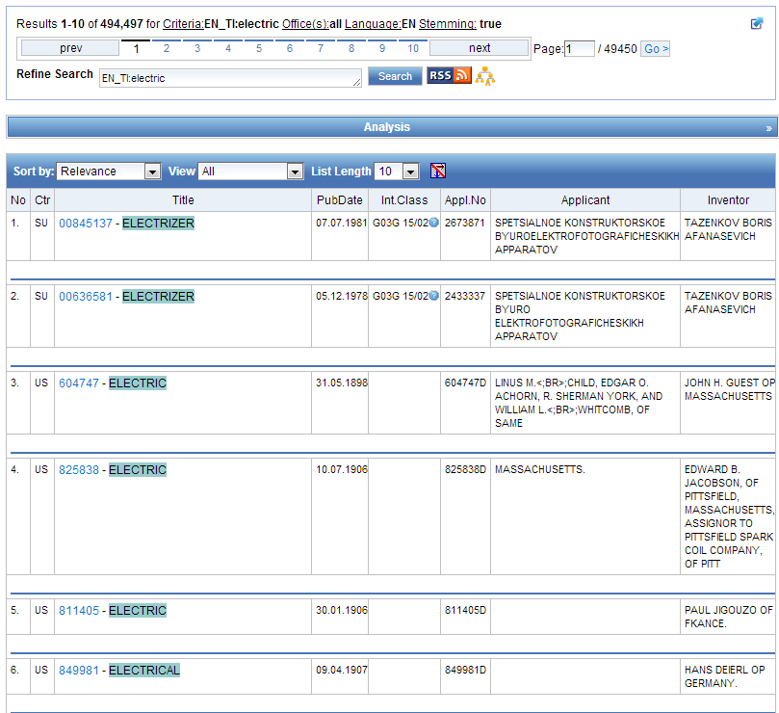
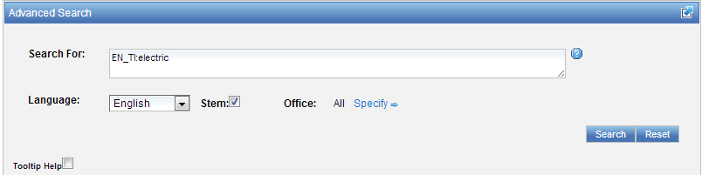

Slide 46
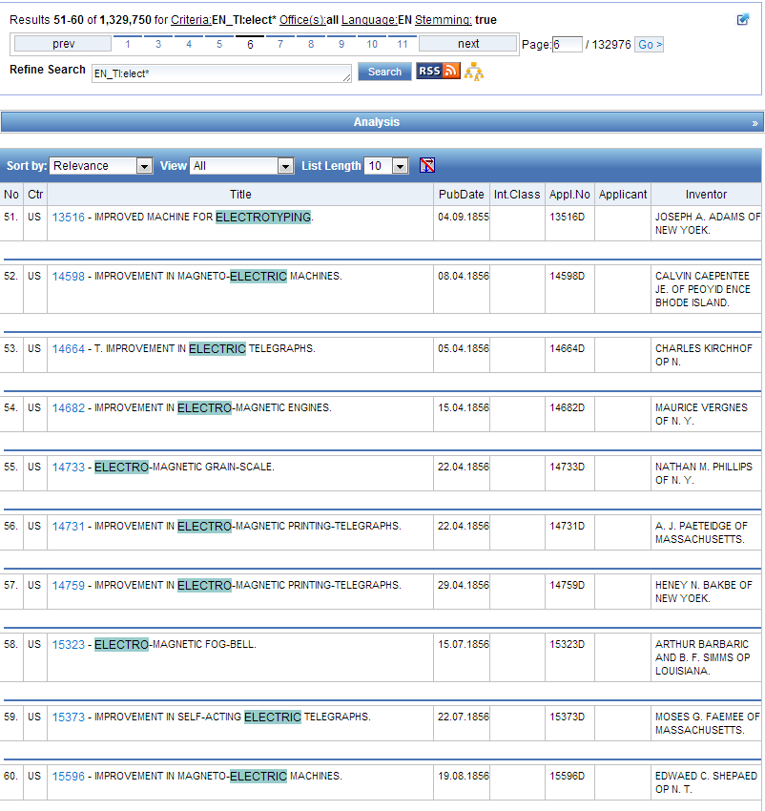
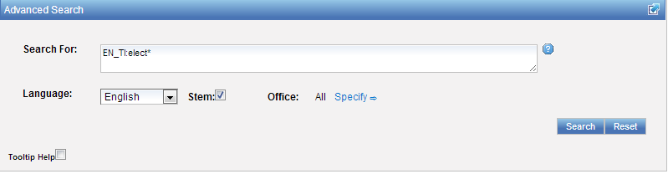

Slide 47
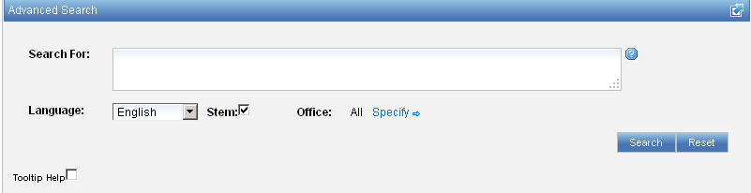
Interface : Advanced
Full flexibilities are enabled

Slide 48
To help you fine-tune your search
1. Boolean operators
2. Proximity operators
3. Field codes
4 .Stemming/wildcard/fuzzy searches
5. Grouping/nesting
6. Date searches

Slide 49
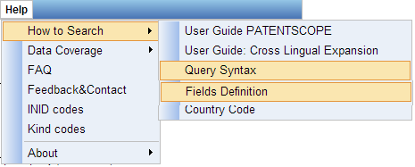
Help menu

Slide 50
Search examples: field code, Boolean and range operator
Inventions made by Steve Jobs published during the period from 2007 to 2009 comprising the keyword “touch” in the description.
IN:(Jobs) AND PD:[2007 TO 2009] AND EN_DE:(touch)
This search query uses field codes, a Boolean operator, and a range operator.
The field codes are IN for inventor, PD for publication date, and EN_DE for English description.
The Boolean operator AND is used to ensure that all search terms are included in the search results (i.e. that the results are for Jobs as inventor, within the given publication date range, and using the word “touch”).
The range operator TO is used to define a range of publication date values.
Notes:
50
Searching for..

Slide 51
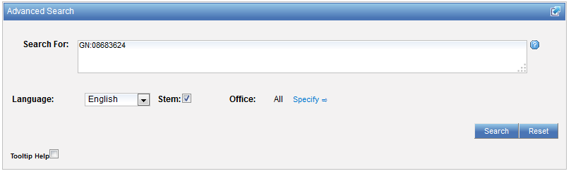
Number search
issued US patent: 08683624

Slide 52
IPC searches
IC :A
IC :A47
IC :A47L
IC :A47L1
IC:A47L11
IC:A47L11/03

Slide 53
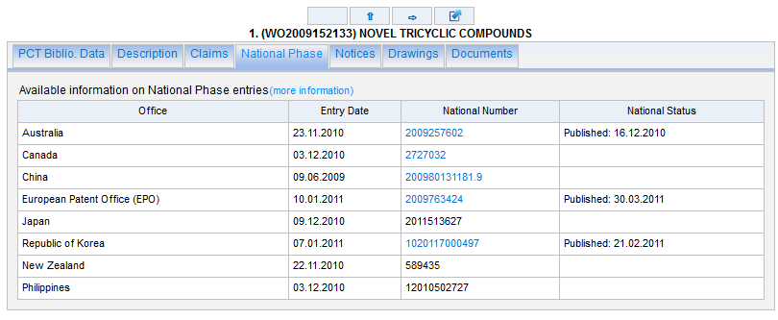
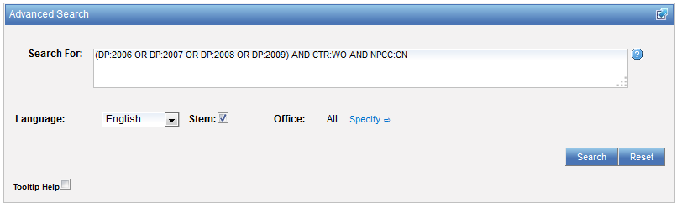
Date + national phase entry
PCT applications with publication date between 2006 and 2009, national phase office China

Slide 54
CLIR
CLIR stands for Cross Lingual Information Retrieval and will allow you to search a term or a phrase and its variants in:
Chinese
Dutch
English
French
German
Italian
Japanese
Korean
Portuguese
Russian
Spanish and
Swedish
Notes:
54
You will use this tool in order to:
-Find synonyms in order to retrieve comprehensive results
-To search in a language that one does know

Slide 55
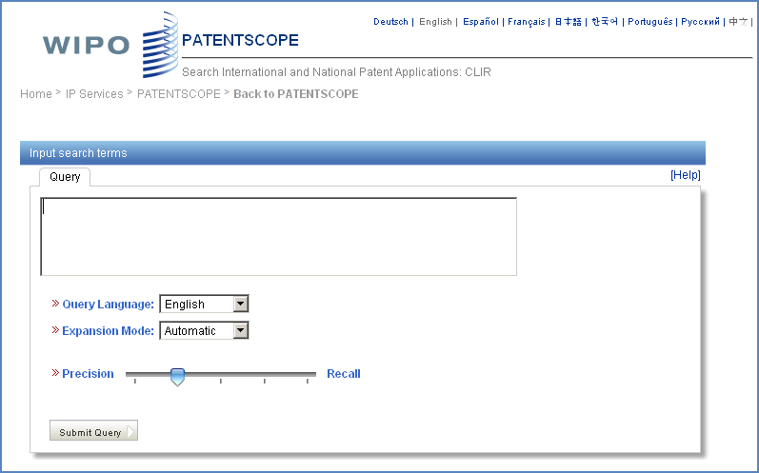
CLIR: the interface
Notes:
55
There is query box
Query language
Expansion mode

Slide 56
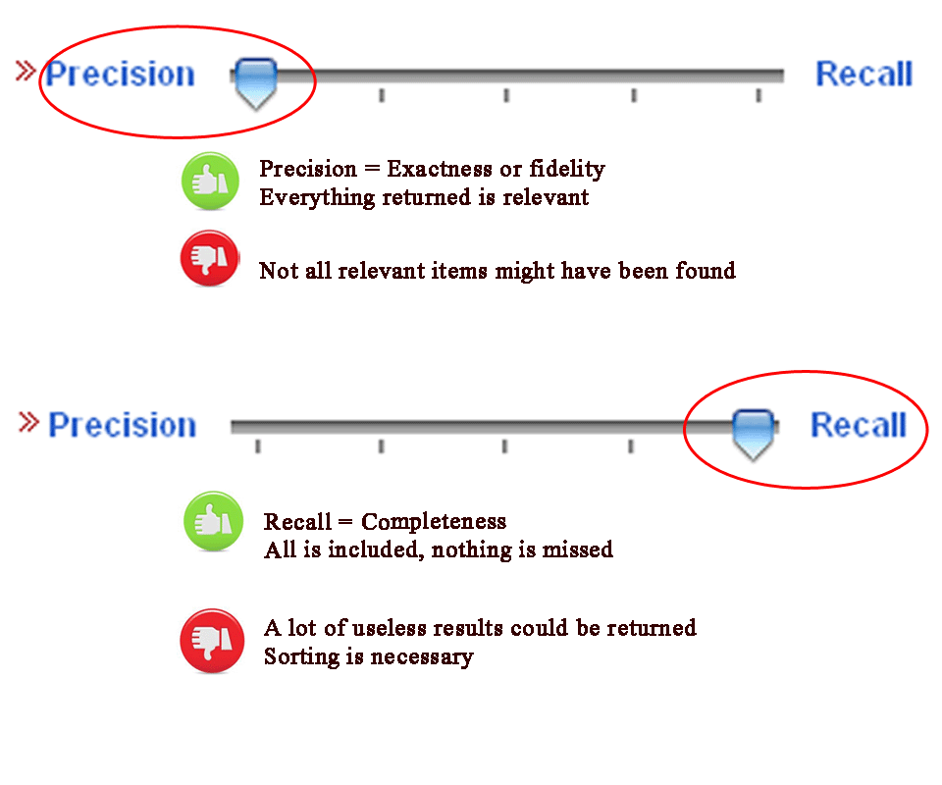
CLIR: precision vs recall

Slide 57
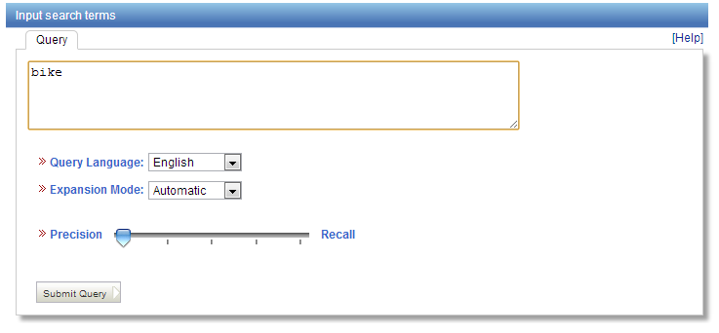
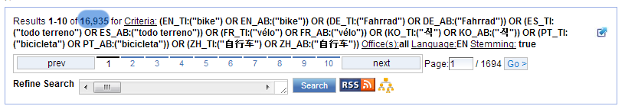
Example: precision

Slide 58
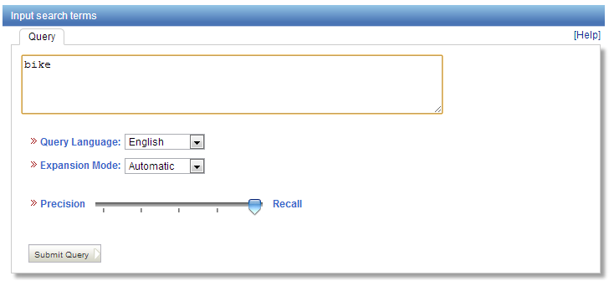
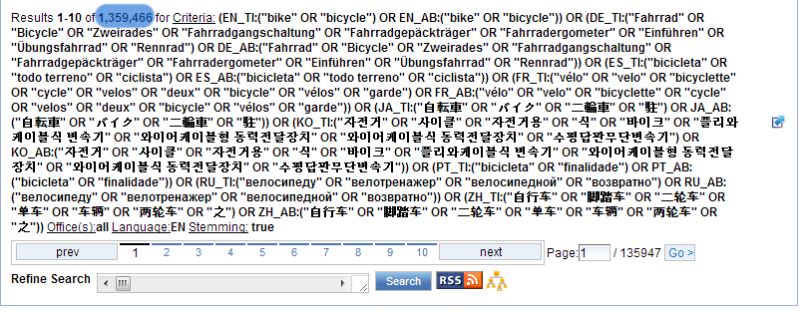
Example: recall

Slide 59
CLIR: supervised mode
2 modes: automatic and supervised
Automatic: 1 step
Supervised: 4 steps

Slide 60

Automatic mode

Slide 61

Automatic mode: results

Slide 62

Supervised mode: 1 of 4 steps

Slide 63


Supervised mode : 2 of 4 steps

Slide 64

Supervised mode : 3 of 4 steps

Slide 65

Supervised mode : 4 of 4 steps

Slide 66

Supervised mode: results

Slide 67

Reading the result list

Slide 68

Analysis

Slide 69

Display options: table/graph –bar/pie

Slide 70

Display options: table/graph –bar/pie
Notes:
70
In both bar and pie options, the tabs allow you to see the information graphically for the Offices, Main IPC, Main Applicant, Main Inventor and Publication Date.
The charts can be saved in GIF format for inclusion in documents or reports by right-clicking in a corner of the image and selecting “Copy image” or “Save image”.

Slide 71



Options

Slide 72

Tabs

Slide 73



Documents tab

Slide 74

Multilingual tools

Slide 75

Translation Assistant for Patent Titles and Abstracts (TAPTA)
Notes:
75
Language pairs available: EN=>FR, FR=>EN, EN=>ZH, ZH=>EN
Technical domain aware system using 32 domains derived from the International Patent Classification

Slide 76

32 Technical domains from the IPC
[ADMN] Admin, Business, Management & Soc Sci
[AERO] Aeronautics & Aerospace Engineering
[AGRI] Agriculture, Fisheries & Forestry
[AUDV] Audio, Audiovisual, Image & Video Tech
[AUTO] Automotive & Road Vehicle Engineering
[BLDG] Civil Engineering & Building Construction
[CHEM] Chemical & Materials Technology
[DATA] Computer Sci, Telecom & Broadcasting
[ELEC] Electrical Engineering & Electronics
[ENGY] Energy, Fuels & Heat Transfer Eng
[ENVR] Environmental & Safety Engineering
[FOOD] Foods & Food Technology
[GENR] Generalities, Language, Media & Info Sci
[HOME] Home Contents & Household Maintenance
[HORO] Precision Mechanics, Jewelry & Horology
[MANU] Manufacturing & Materials Handling Tech
[MARI] Marine Engineering
[MEAS] Standards, Units, Metrology & Testing
[MECH] Mechanical Engineering
[MEDI] Medical Technology
[METL] Metallurgy
[MILI] Military Technology
[MINE] Mining, Oil & Gas Extraction & Minerals
[NANO] Nano Technology
[PACK] Packaging & Distribution of Goods
[PRNT] Printing & Paper
[RAIL] Railway Engineering
[SCIE] Optical Engineering
[SPRT] Sports, Leisure, Tourism & Hospitality
[TEXT] Textile & Clothing Industries
[TRAN] Transportation

Slide 77

TAPTA: how does it work?

Slide 78


Slide 79


Slide 80

TAPTA: post-editing & exporting

Slide 81


Slide 82


Slides and recording
+
www.wipo.int/patentscope/en/webinar/index.html

Slide 83


patentscope@wipo.int

Slide 84

mulțumesc
mulțumesc

