Slide 1
PATENTSCOPE
Result list and analysis tools
Web
September
2015
Sandrine Ammann
Marketing & Communications Officer

Slide 2
To the PATENTSCOPE search system webinar
Result list & analysis tools

Slide 3
Agenda
Slide Text
What’s news
Search result list
Translation tools
Analysis tools
Quiz
Q&A

Slide 4
New national collection

Slide 5
UK national collection
Bibliographic data from 05.07.1782 to 23.07.2015
Abstract from 15.08.1855 to 23.07.2015

Slide 6
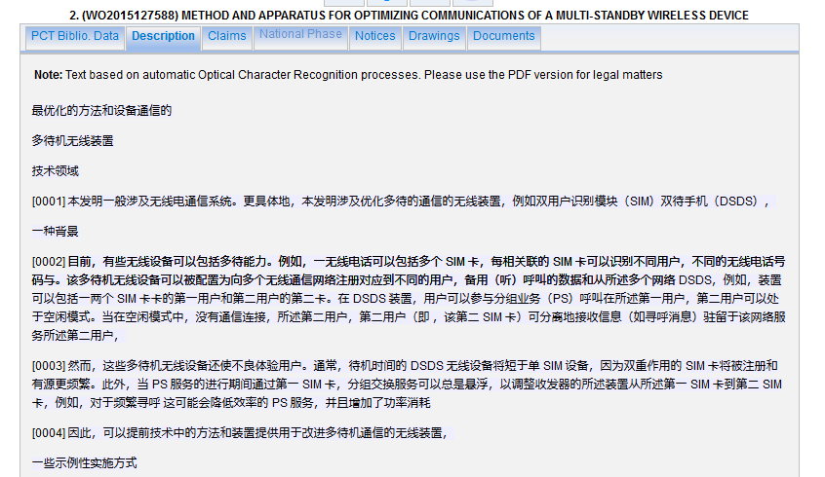
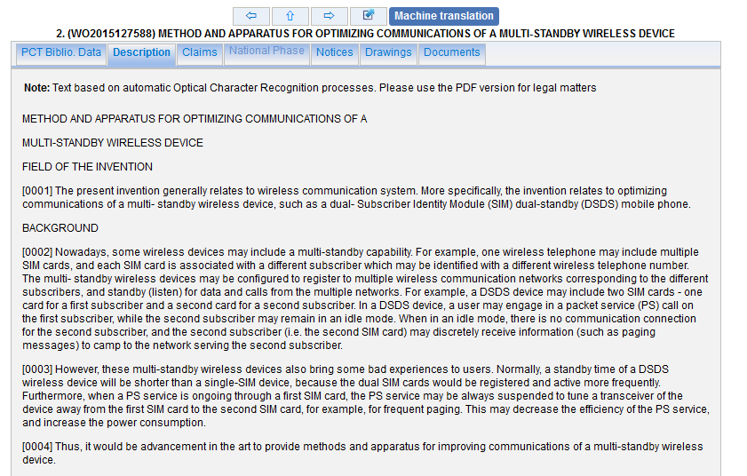
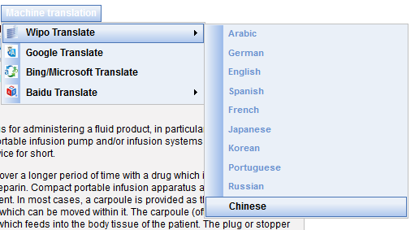
WIPO translate Chinese full-text

Slide 7
Search results list

Slide 8
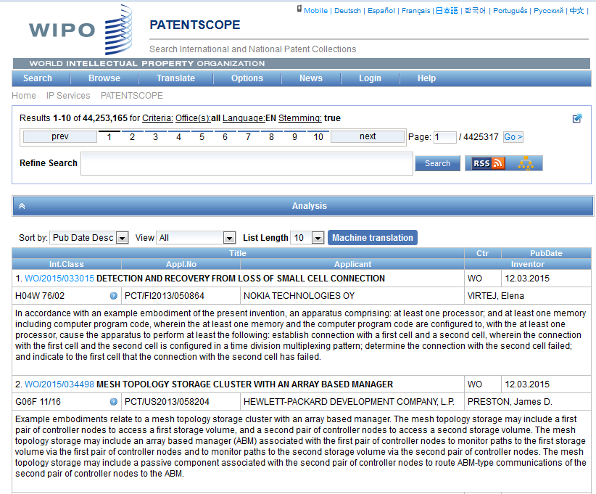

Slide 9
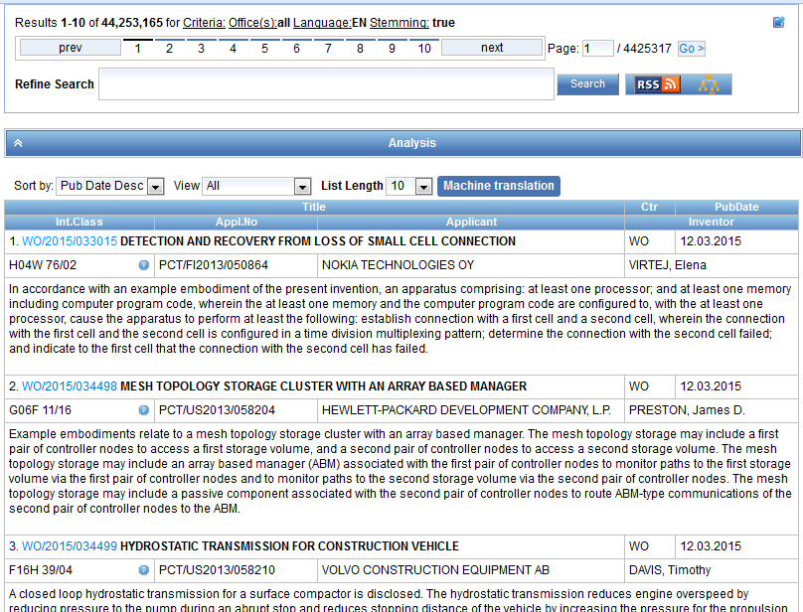

Slide 10
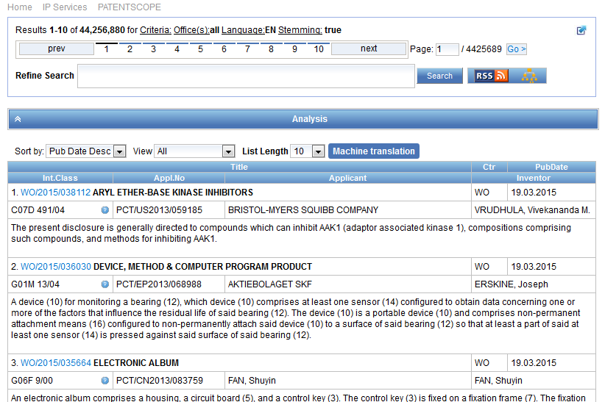
Result list

Slide 11
The first box

Slide 12
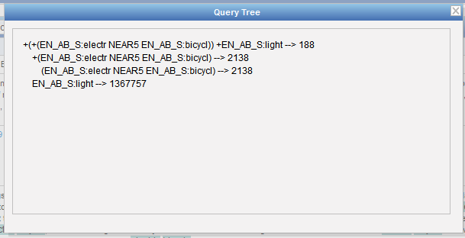

Slide 13
Stemming
Process that removes common ending from words by English Snowball algorithm
electric¦al = electric
electric¦ity = electric
electron¦ics = electron
More accurate results than wildcards:
elect* electoral, etc.

Slide 14
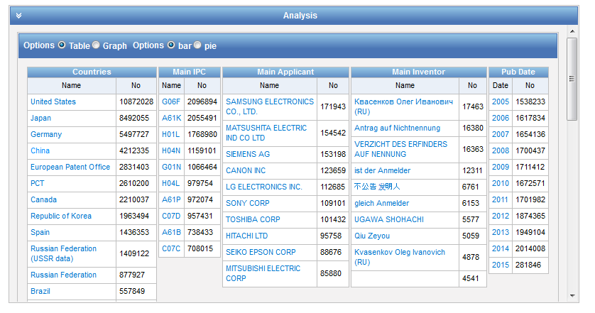
Analysis

Slide 15
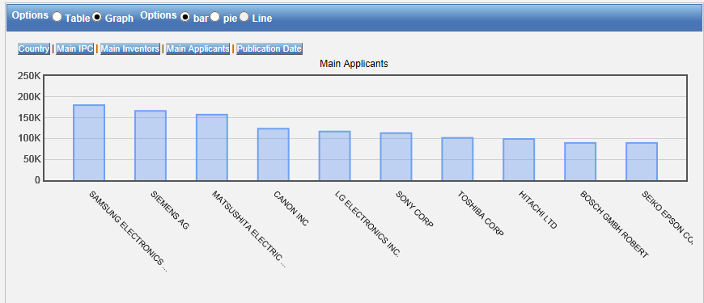
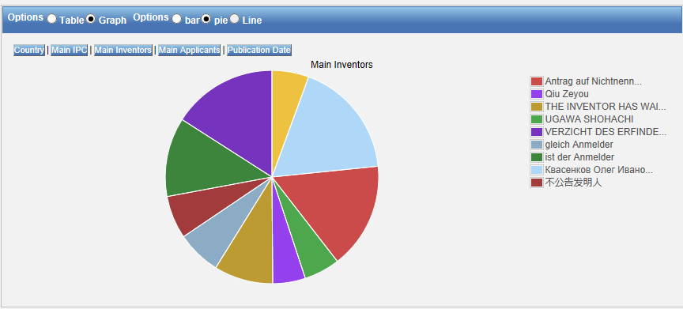
Table – Graph: pie or bar

Slide 16
Table/graph customization

Slide 17
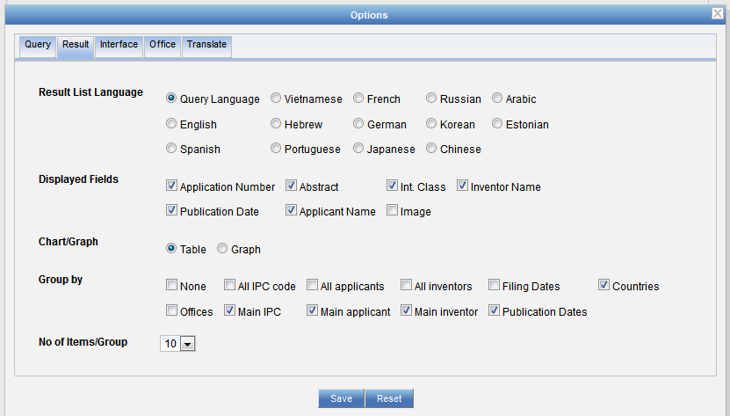
Table/graph customization

Slide 18
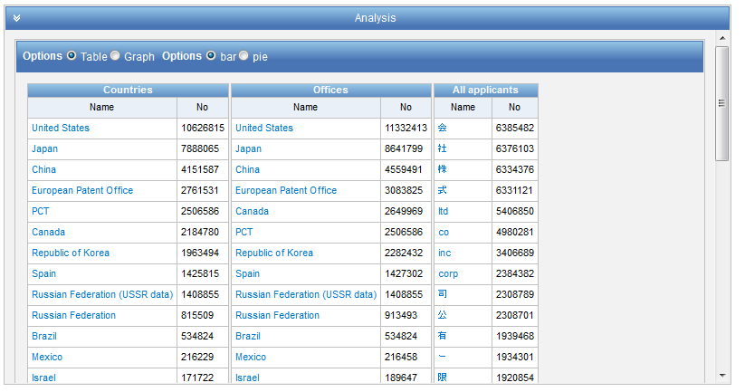

Slide 19
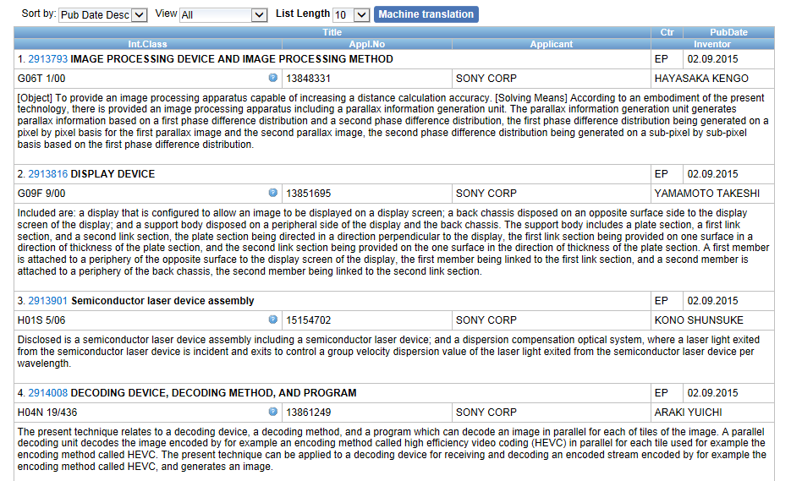
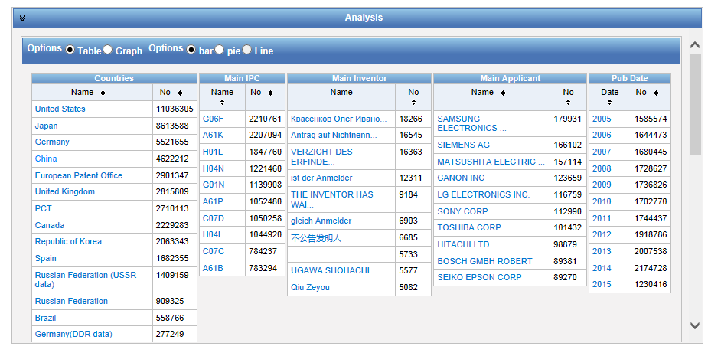
Narrow down your results

Slide 20
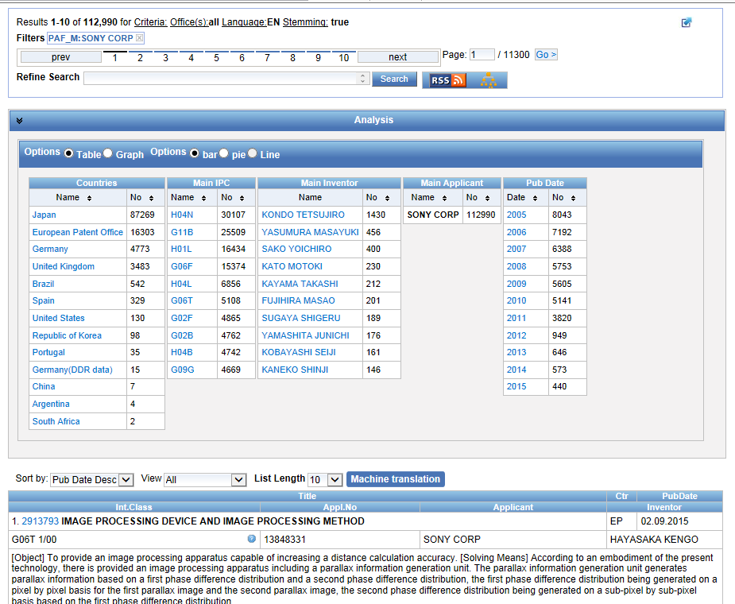

Slide 21
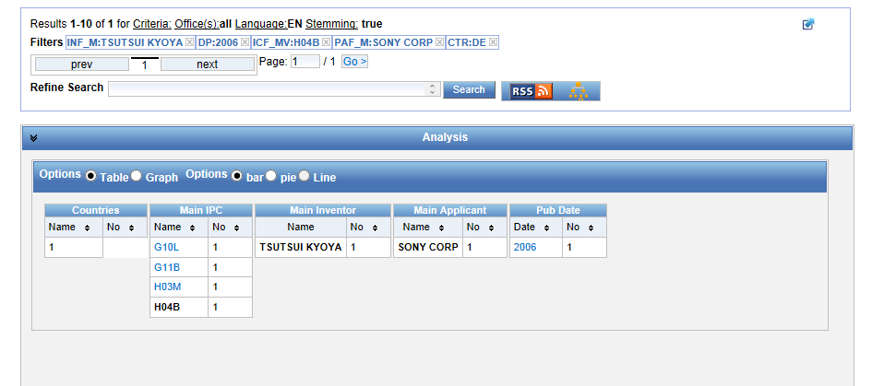

Slide 22
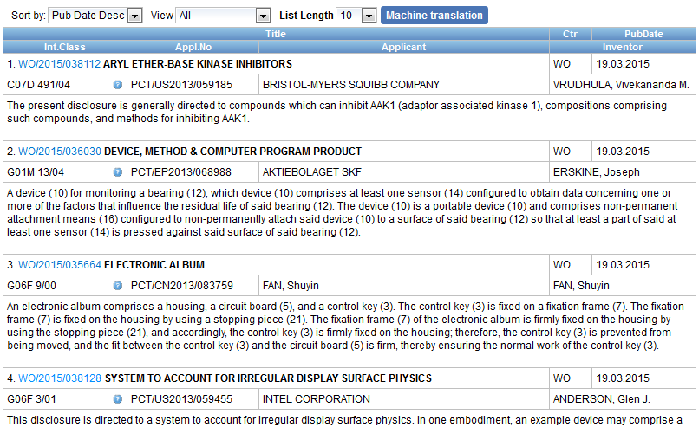

Slide 23
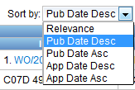
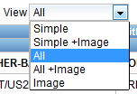
Display options

Slide 24
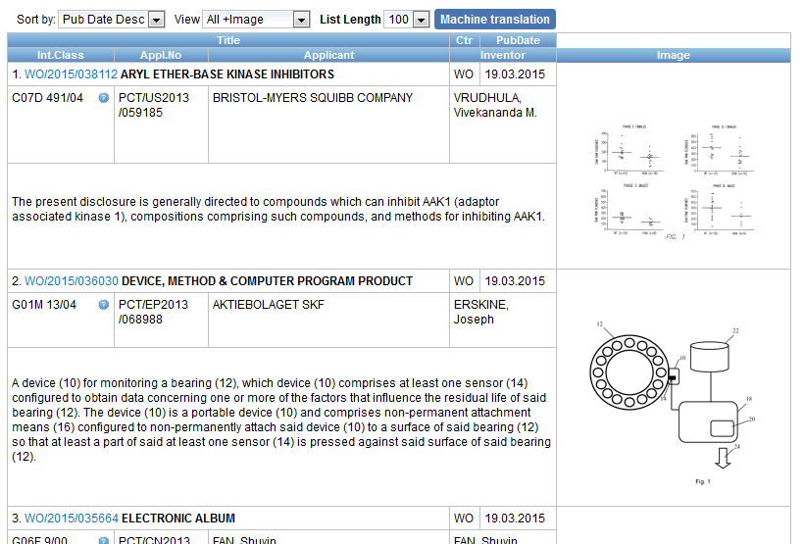
Display with images

Slide 25
Translation tools integrated
Search result list
Description
Claims
Full-text

Slide 27
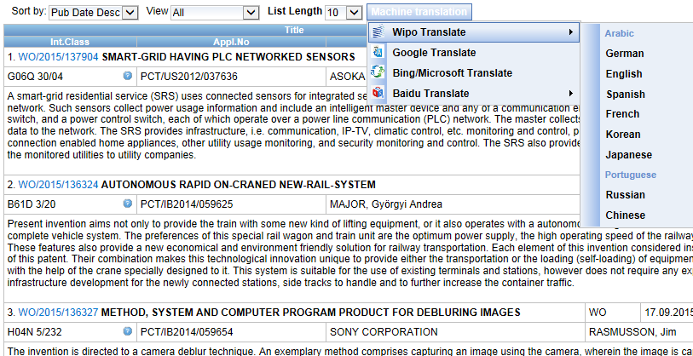
In the search result list

Slide 28
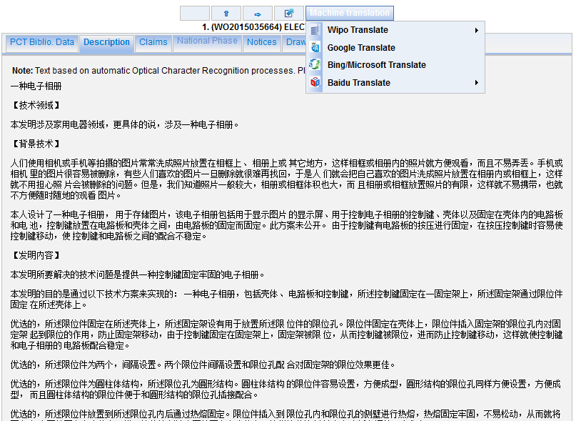

Slide 30
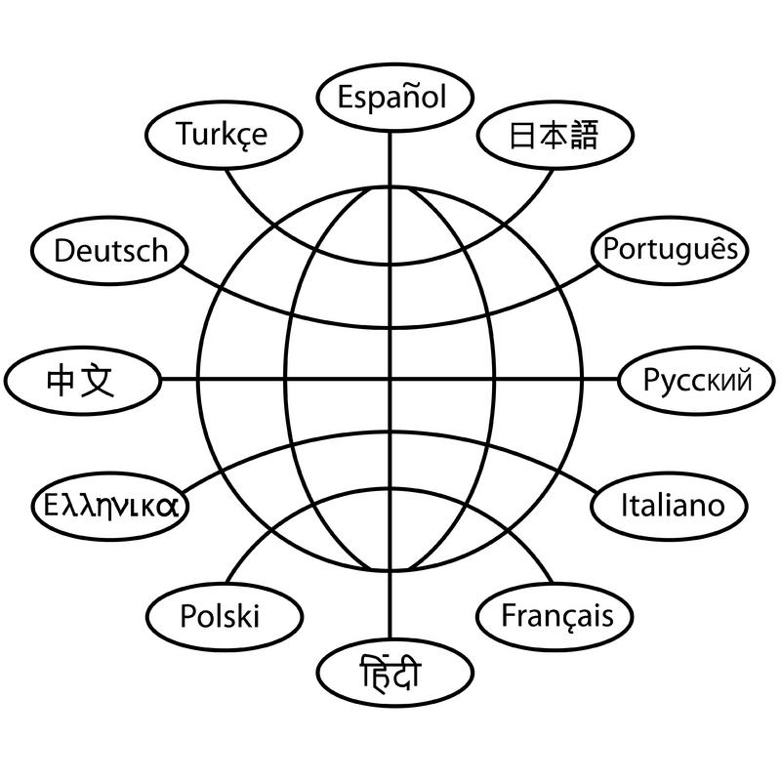
Translation tools

Slide 31
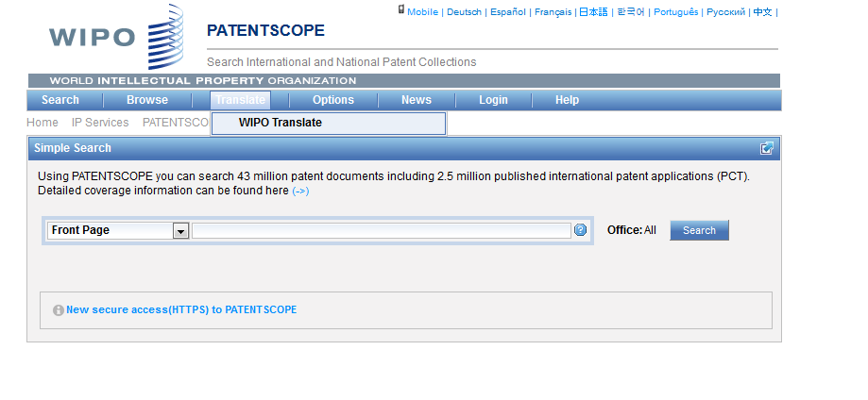
WIPO Translate

Slide 32
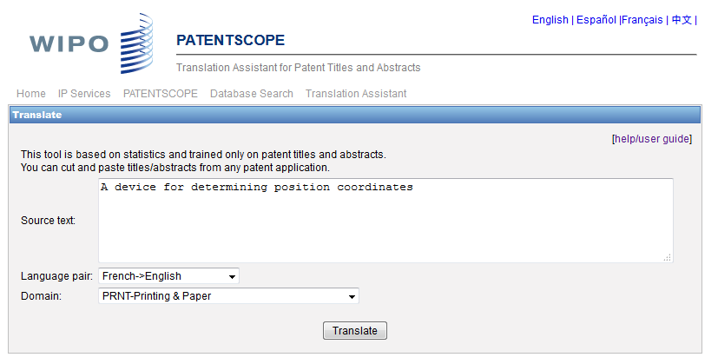
WIPO translate: interface

Slide 33
32 Technical domains from the IPC
[ADMN] Admin, Business, Management & Soc Sci
[AERO] Aeronautics & Aerospace Engineering
[AGRI] Agriculture, Fisheries & Forestry
[AUDV] Audio, Audiovisual, Image & Video Tech
[AUTO] Automotive & Road Vehicle Engineering
[BLDG] Civil Engineering & Building Construction
[CHEM] Chemical & Materials Technology
[DATA] Computer Sci, Telecom & Broadcasting
[ELEC] Electrical Engineering & Electronics
[ENGY] Energy, Fuels & Heat Transfer Eng
[ENVR] Environmental & Safety Engineering
[FOOD] Foods & Food Technology
[GENR] Generalities, Language, Media & Info Sci
[HOME] Home Contents & Household Maintenance
[HORO] Precision Mechanics, Jewelry & Horology
[MANU] Manufacturing & Materials Handling Tech
[MARI] Marine Engineering
[MEAS] Standards, Units, Metrology & Testing
[MECH] Mechanical Engineering
[MEDI] Medical Technology
[METL] Metallurgy
[MILI] Military Technology
[MINE] Mining, Oil & Gas Extraction & Minerals
[NANO] Nano Technology
[PACK] Packaging & Distribution of Goods
[PRNT] Printing & Paper
[RAIL] Railway Engineering
[SCIE] Optical Engineering
[SPRT] Sports, Leisure, Tourism & Hospitality
[TEXT] Textile & Clothing Industries
[TRAN] Transportation

Slide 34
Language pairs
Chinese-English; English –Chinese
French-English; English – French
German-English; English-German
Japanese-English; English-Japanese
Korean-English; Korean –English
Russian-English; English-Russian
Spanish-English; English Spanish

Slide 35
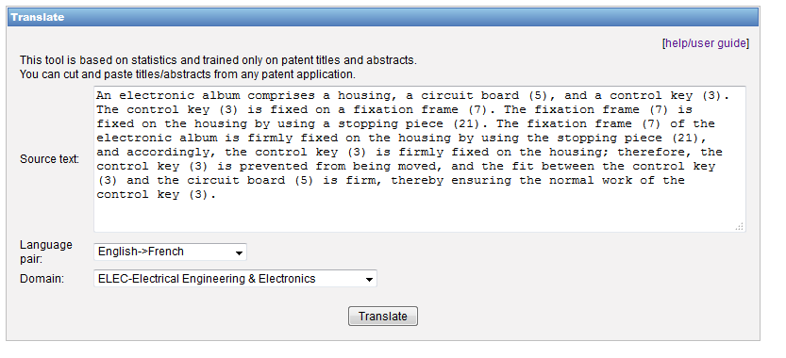
WIPO Translate: an example

Slide 36
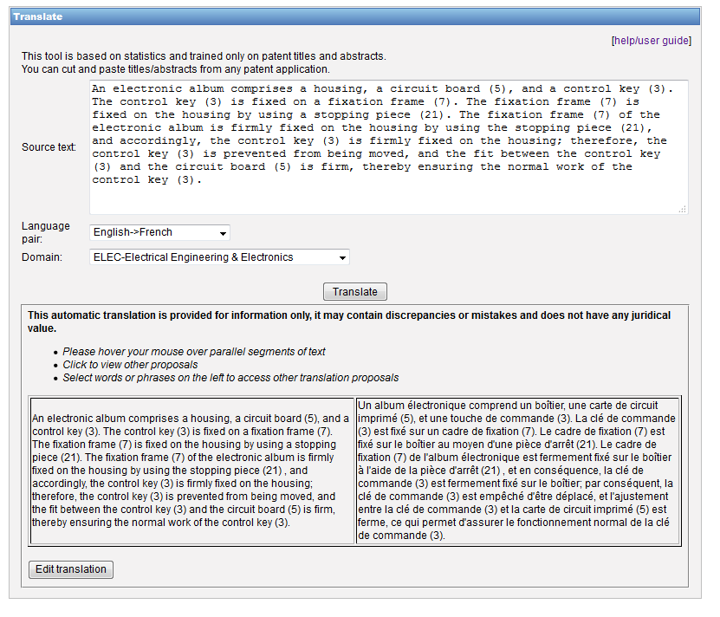

Slide 37
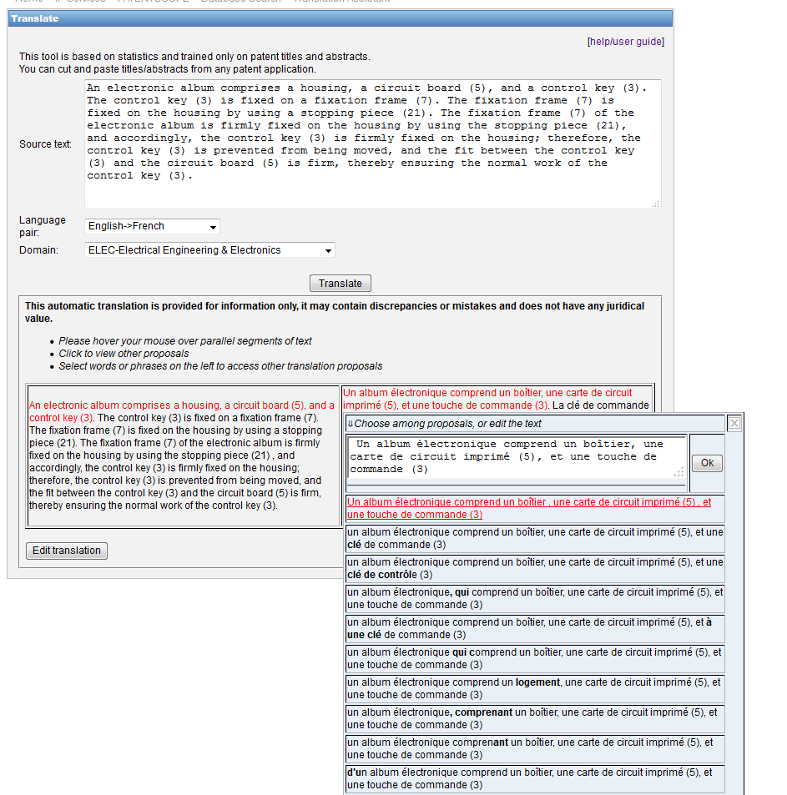

Slide 38
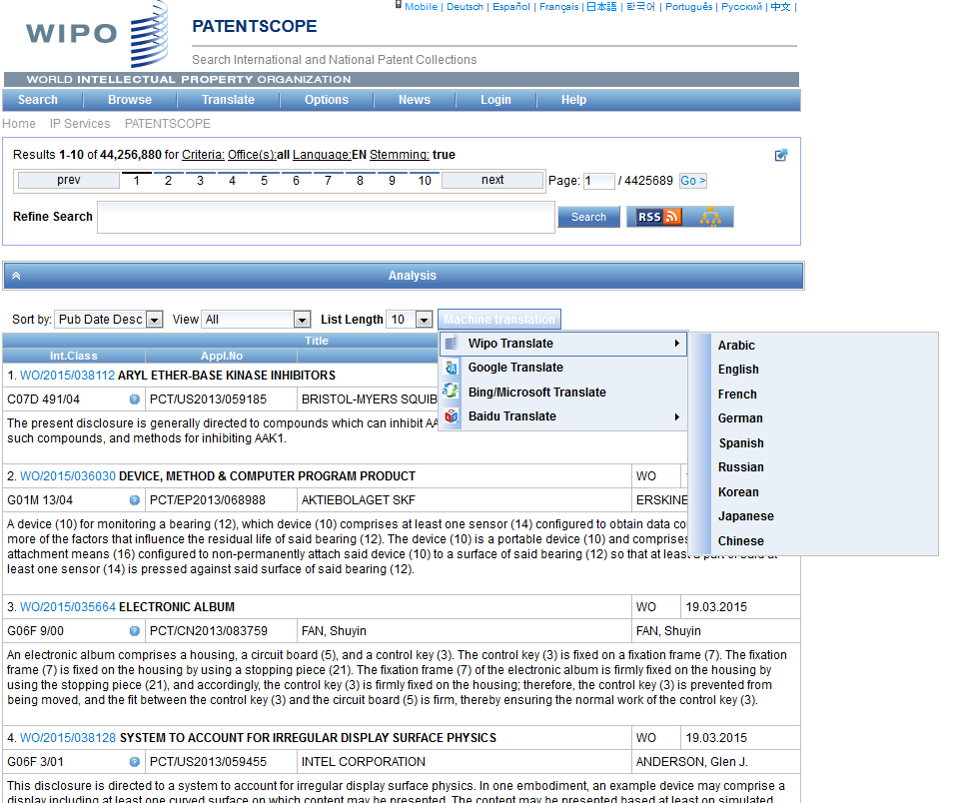
WIPO Translate: search result list

Slide 39
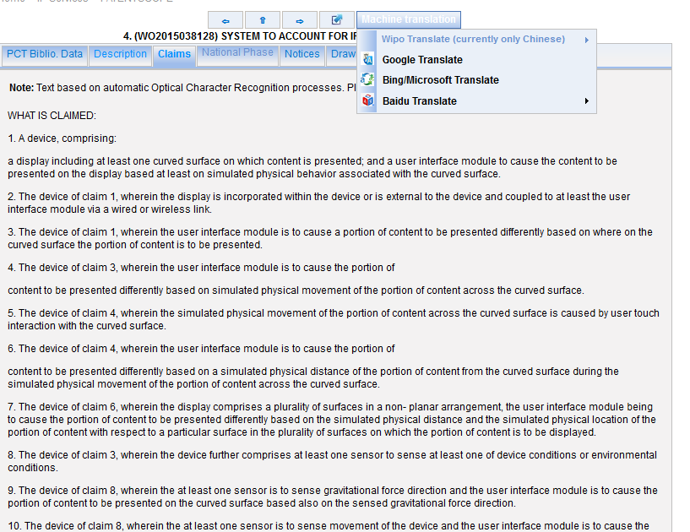
WIPO Translate: description/claims

Slide 40
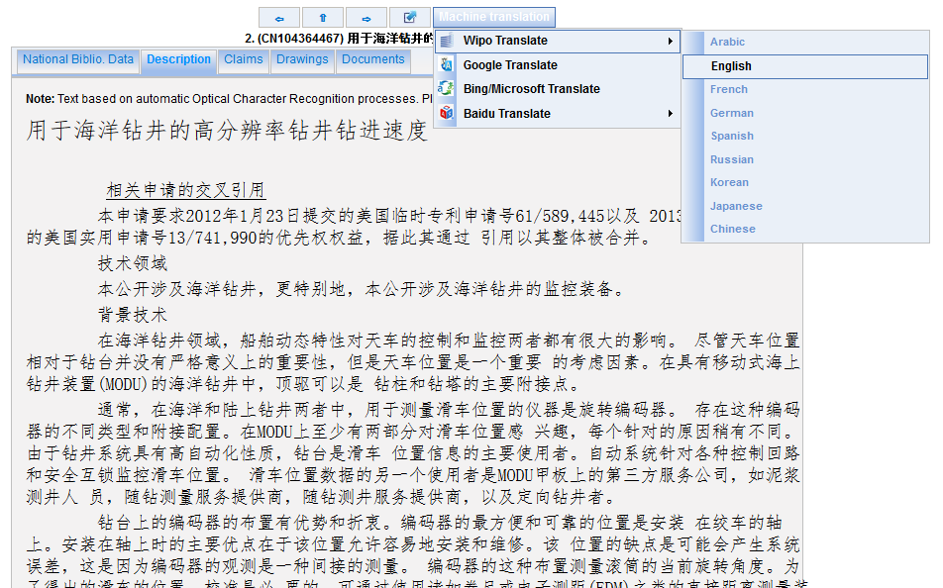

Slide 41
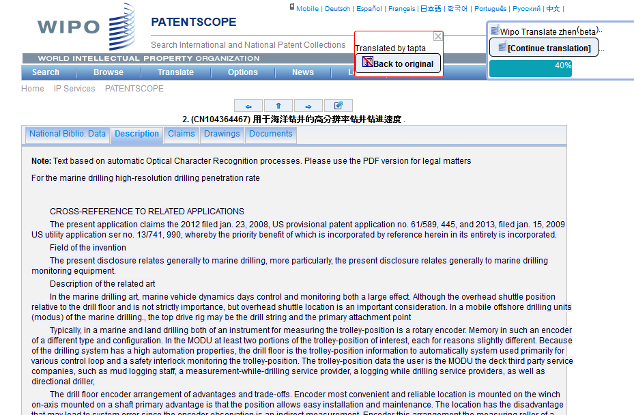

Slide 42
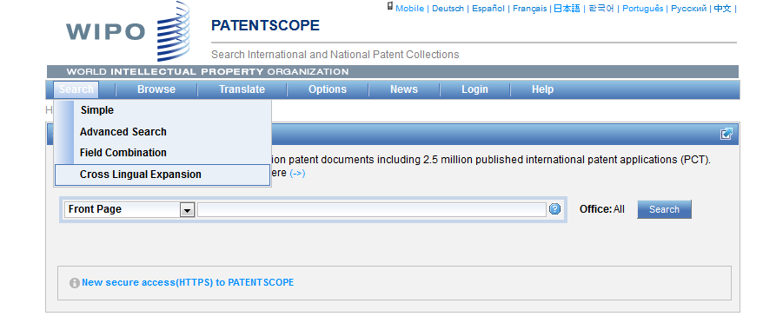
CLIR

Slide 43
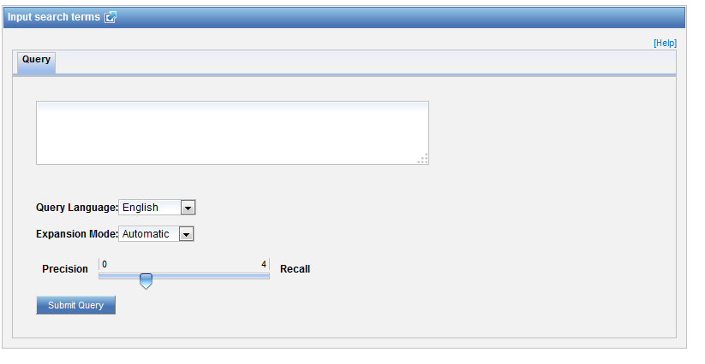
CLIR: interface

Slide 44
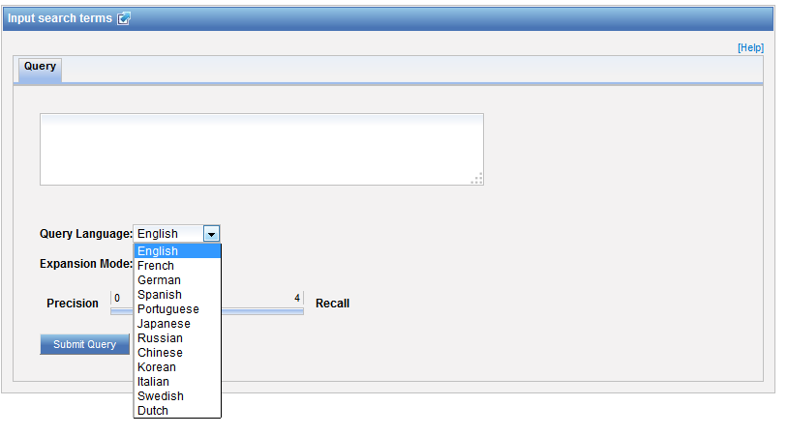
CLIR: query language

Slide 45
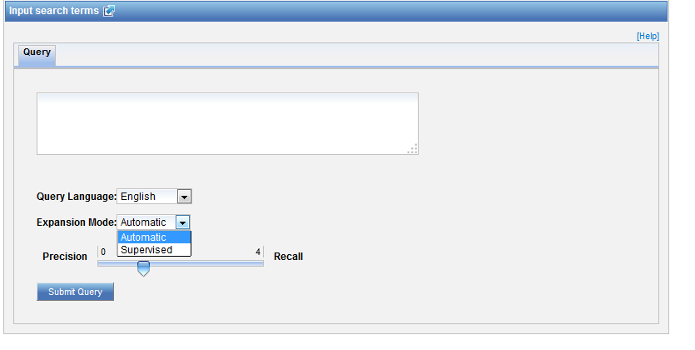
CLIR: expansion mode

Slide 46
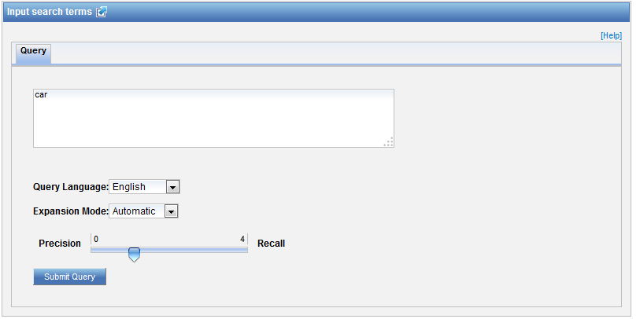
CLIR: an example

Slide 47
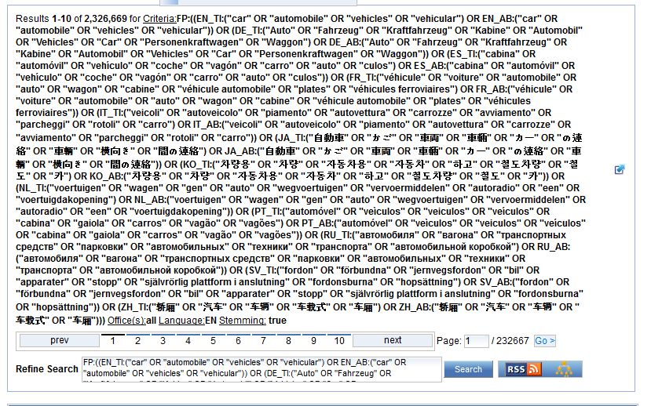
CLIR: an example

Slide 48
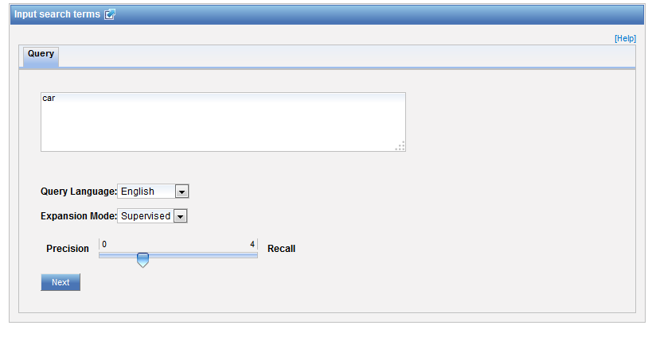
CLIR: supervised

Slide 49
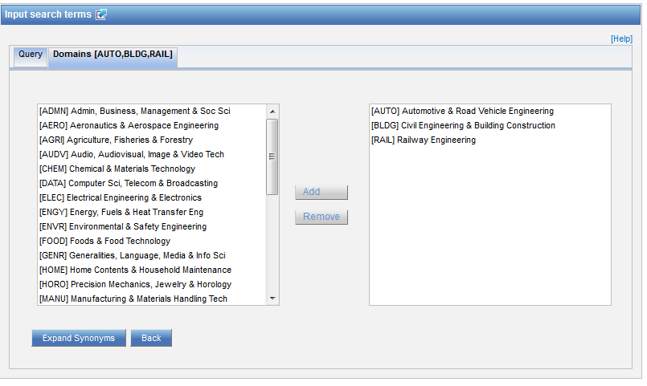
Domain selection

Slide 50
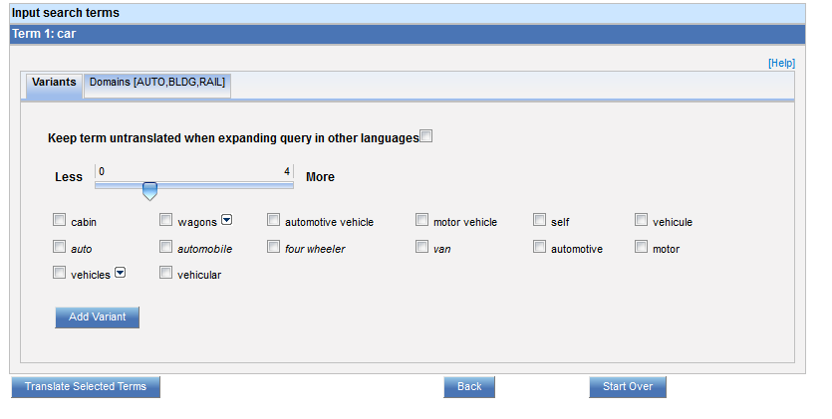
Variants selection

Slide 51
Summary of variants

Slide 52
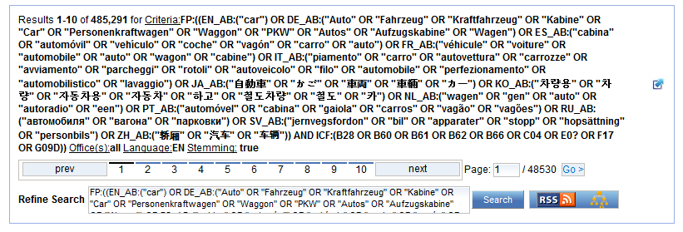
Results

Slide 53
Analysis tools - statistics

Slide 54
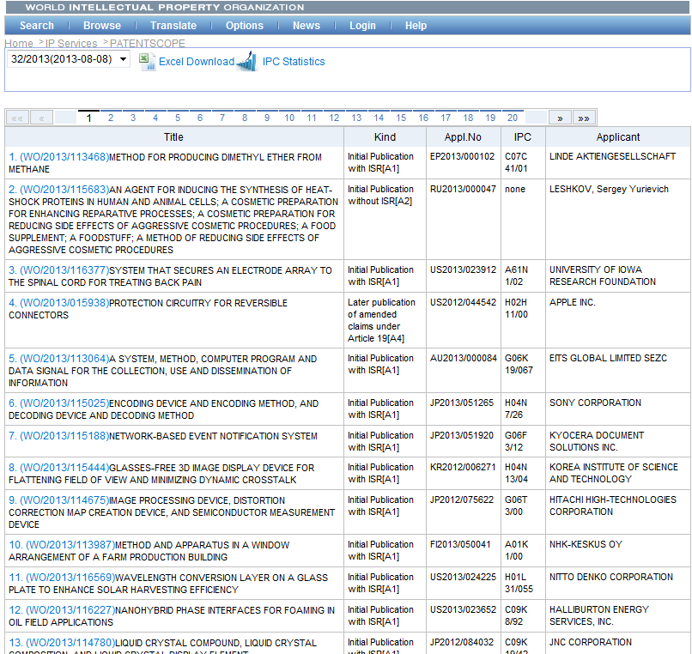

Slide 55
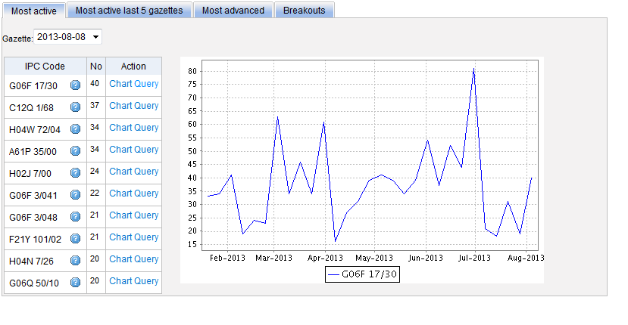
Most active

Slide 56
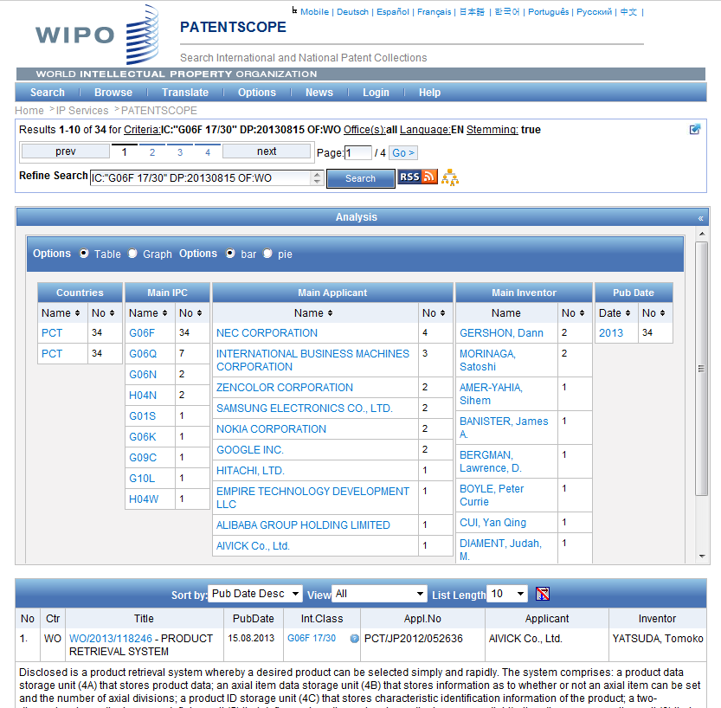

Slide 57
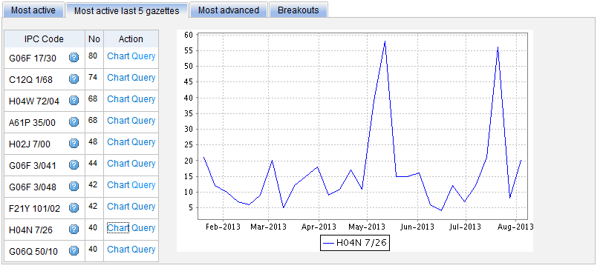
Most active last 5 gazettes

Slide 58
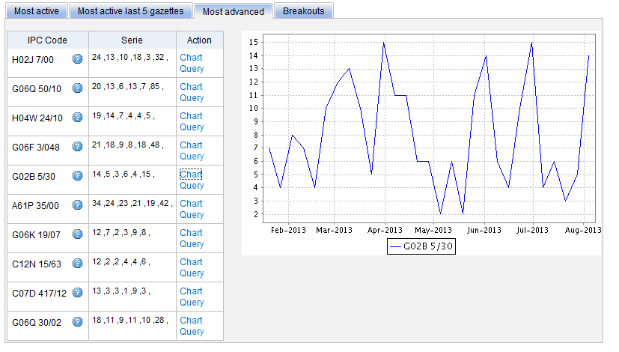
Most advanced

Slide 59
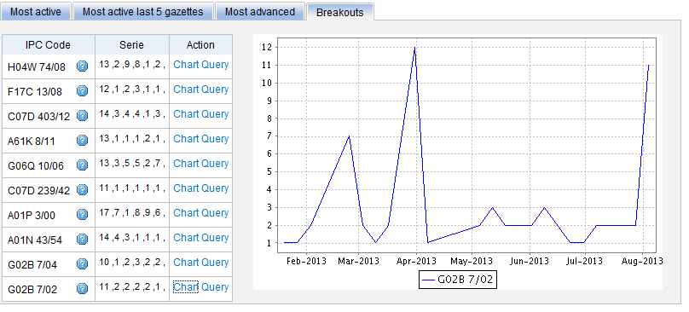
Breakouts

Slide 60
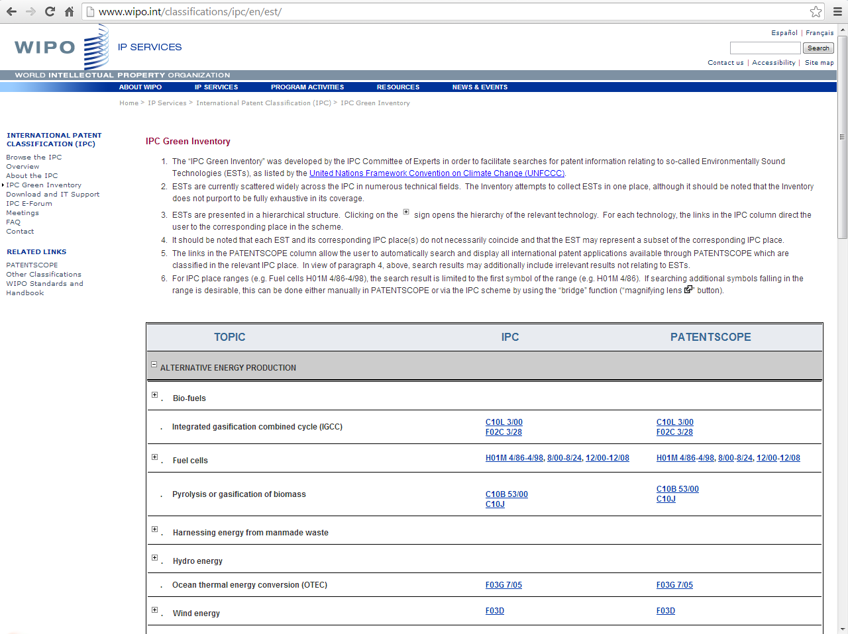
IPC Green Inventory

Slide 61
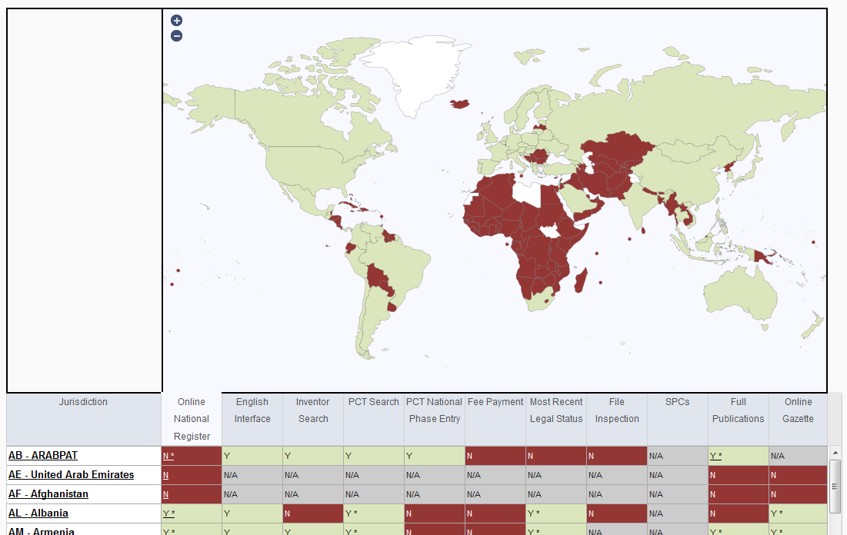
Patent Register Portal

Slide 63
Q1: which translation tools are available in the result list?
A
Bing
B
WIPO translate
C
Baidu
D
Google

Slide 64
Q1: which translation tools are available in the result list?
A
Bing
B
WIPO translate
C
Baidu
D
Google
Spain

Slide 65
Q2: How to narrow down your results?
A
Manually by looking at results
B
In Analysis box, select criteria

Slide 66
Q2: How to narrow down your results?
A
Manually by looking at results
B
In Analysis box, select criteria

Slide 67
Q3: where do you find IPC statistics?
A
Search menu
B
Help menu
C
Browse menu
D
Result list

Slide 68
Q3: where do you find IPC statistics?
A
Search menu
B
Help menu
C
Browse menu
D
Result list

Slide 70
www.wipo.int/patentscope/en/webinar/index.html

Slide 71
patentscope@wipo.int

Slide 72
October webinar: How to search using PATENTSCOPE
Tue, October 20
5:30 PM - 6:30 PM CEST
Thu, October 22
8:30 AM - 9:30 AM CEST
To sign up: http://www.wipo.int/patentscope/en/webinar/

Slide 73
mulțumesc
mulțumesc

