Slide 1
Complex queries
in PATENTSCOPE
Web
November
2015
Sandrine Ammann
Marketing & Communications Officer

Slide 2
Agenda
Latest development
Complex queries:
Interfaces
Search syntax
Field definition
Quiz
Q&A

Slide 3
Latest developments
50 Million

Slide 4
Figures
3,400,000 records: bibliographic data, searchable full-text and drawings in Korean
Front file in WIPO standard ST96
New data available within 1 month after pub in KIPRIS
over 50 million the total number of patent documents
5 the number of IP5 offices whose full-text is searchable

Slide 5
Complex queries

Slide 6
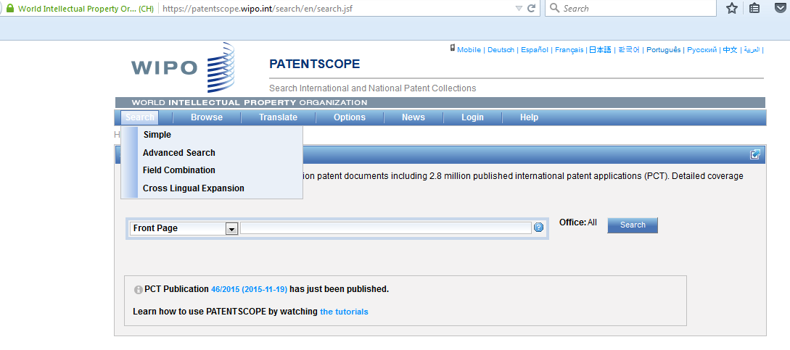

Slide 7
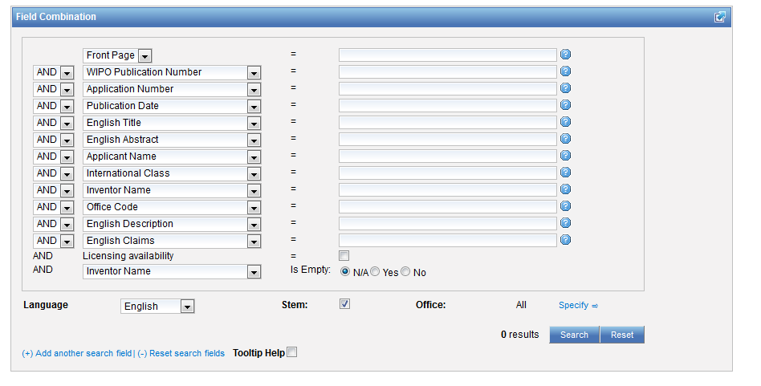
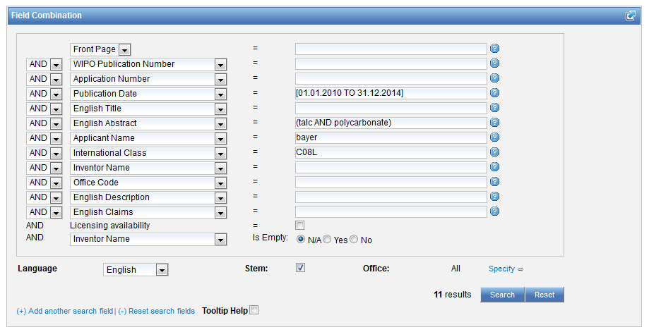
Interface Field Combination

Slide 8
Pros and cons
The fields are predefined but space is limited
Combination of AND and OR not possible, limited to either all AND or all OR

Slide 9
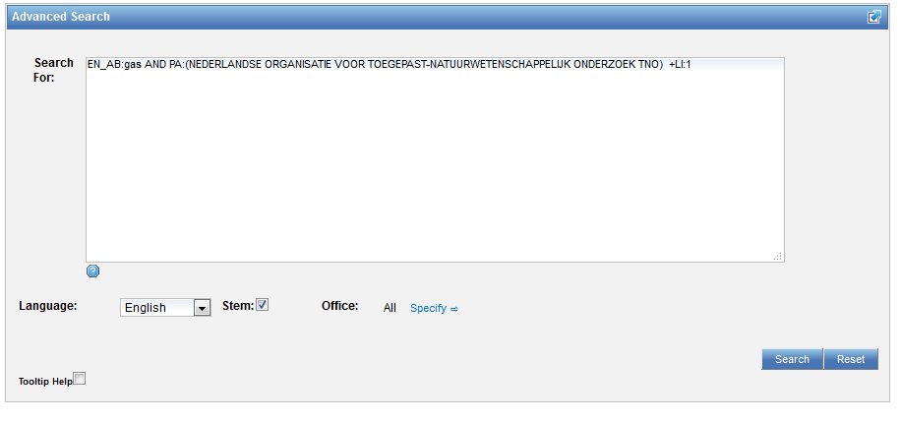
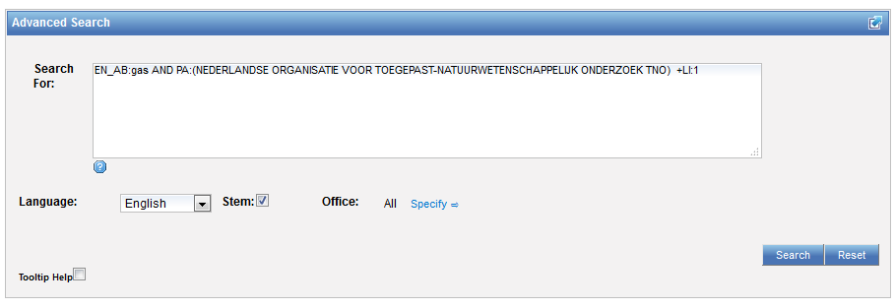
Interface: Advanced search

Slide 10
To help you fine-tune your search
1. Boolean operators
2. Proximity operators
3. Field codes
4 .Stemming/wildcard/fuzzy searches
5. Grouping/nesting

Slide 11
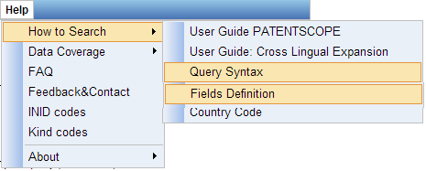
Help menu

Slide 12
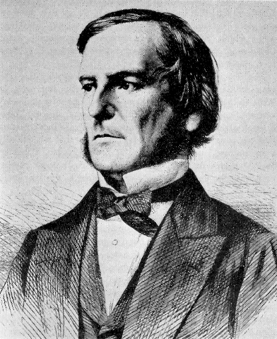
Boolean operators
AND
OR
NOT
ANDNOT

Slide 13
ANDNOT - NOT
Use ANDNOT when searching A excluding B
bicycle ANDNOT boat
Use NOT when searching all documents except A
NOT(car AND bicycle AND boat)

Slide 14
Boolean operators
Narrow, broad and related terms grouped together in proximity and related to other groups of terms expressing functionality or application
Are some words required to be in your results?
Are any words to be excluded?
Should words be near? How near?

Slide 15
Proximity operator NEAR
Proximity searching
Find words that are next to each other
NEAR2 = 2 defines the maximum number of word gaps between 2 search terms

Slide 16
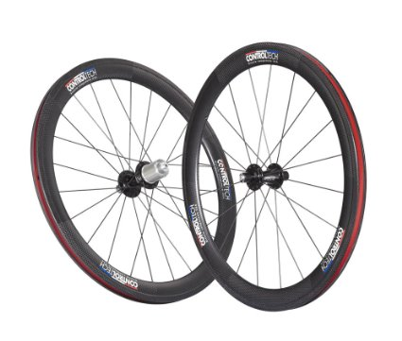
NEAR: an example
carbon AND wheel 116,383 results
"wheels made of carbon",
"carbon may be used to make said wheel“
carbon NEAR10 wheel 2,971 results

Slide 17
Proximity search: BEFORE
the order of terms is significant.
trunk BEFORE cutting

Slide 18
BEFORE a particular date
Anything published before October 25th, 1999
DP:[1900 TO 25.10.1999]
DP:[25.10.1999-100Years TO 25.10.1999]

Slide 19
Ranges – include/exclude numbers
DP:[01.01.2000 TO 01.01.2001] = inclusive
DP:{01.01.2000 TO 01.01.2001} = exclusive

Slide 20
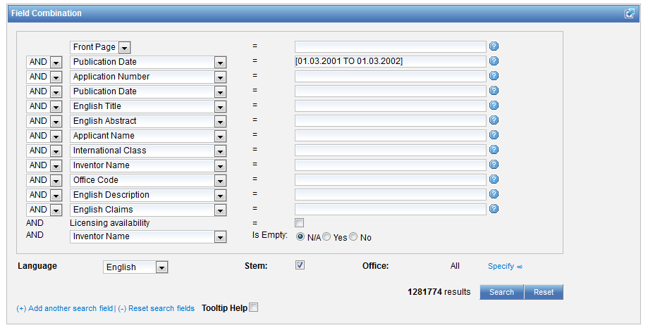
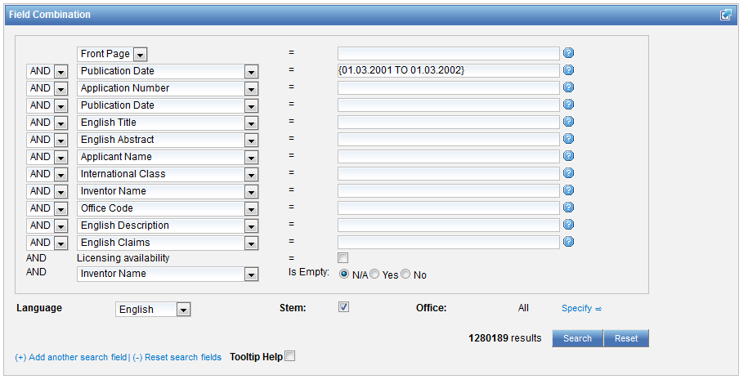

Slide 21
Wildcards – truncation: ? *
plural form of a word, or alternative spellings
* stands for 0 or more characters
? stands single character
te?t = test or text
electric* = electrical; electricity
behavi*r = behaviour or behavior
micro?p* = microspeaker, microsporidial

Slide 22
Wildcards - Stemming
elect* would search for words like elect, elects, electron, electrons, electric, electrical, electricity, electoral
electric stemmed will find electricity electrical

Slide 23
Fuzzy searches
Use of the tilde: ~
Examples:
roam~ foam / roams
Roam~0.8
Notes:
Smilar in spelling

Slide 24
^ caret = weighting factor
Same result but ranking will be different
touch^3 AND polarize

Slide 25
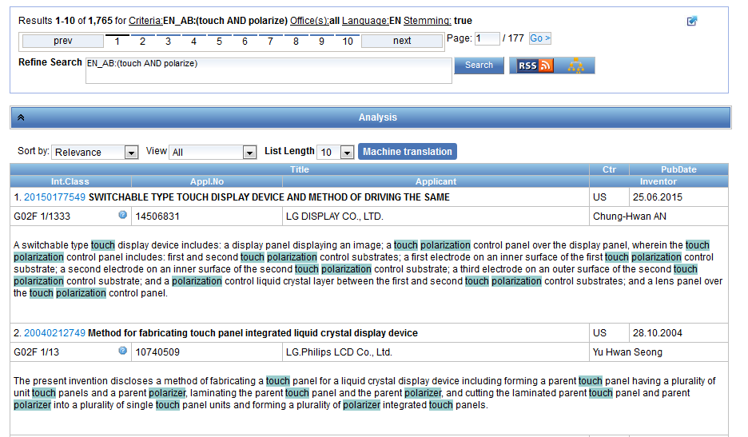

Slide 26
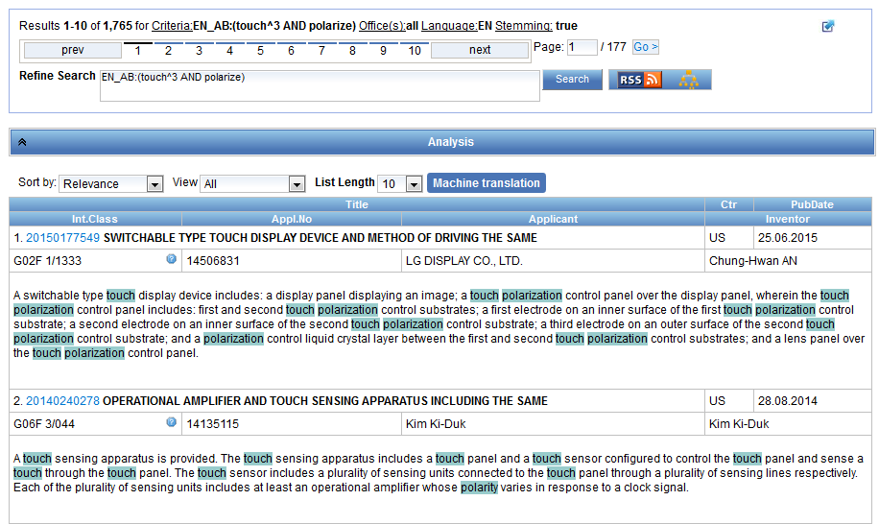

Slide 27
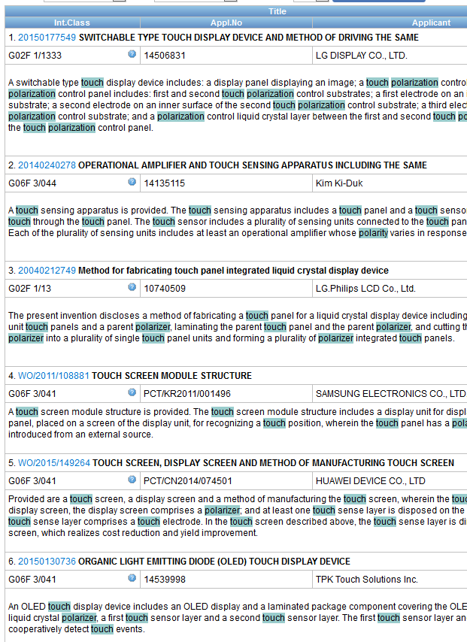

Slide 28
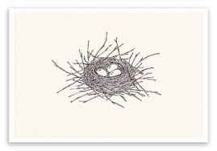
Grouping

Slide 29
Grouping/nesting
Solar OR (wind AND turbine)
(solar OR wind) AND turbine
EN_TI: electric car
electric will be searched in English title but car in all fields
EN_TI: (electric car)
Both electric and car will be searched in the English title

Slide 30
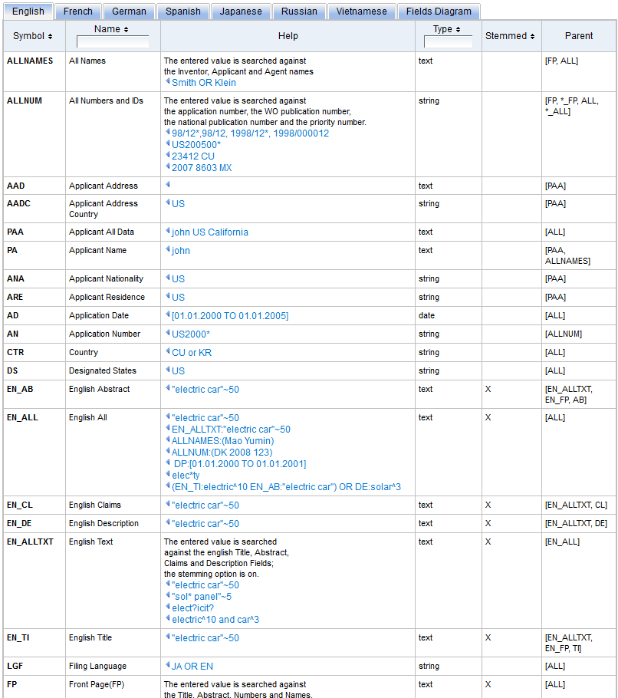
Fields: http://patentscope.wipo.int/search/en/help/fieldsHelp.jsf

Slide 31
Examples
FP = front page
ALL = all fields
ALL_NAMES = all names
IC = IPC
DP = publication date
CTR = country either WO or country from national collection
NPCC= national phase entry
AN = origin of PCT
NPCC:US and NPEDD:Last1Year

Slide 32
Intuitive queries
PCTHavingThirdPartyObservations
PCTPublishedLastWeek
PCTHavingApplicantFromUS
DP:Last1Year
DP:[Today-1Week TO Today]

Slide 33
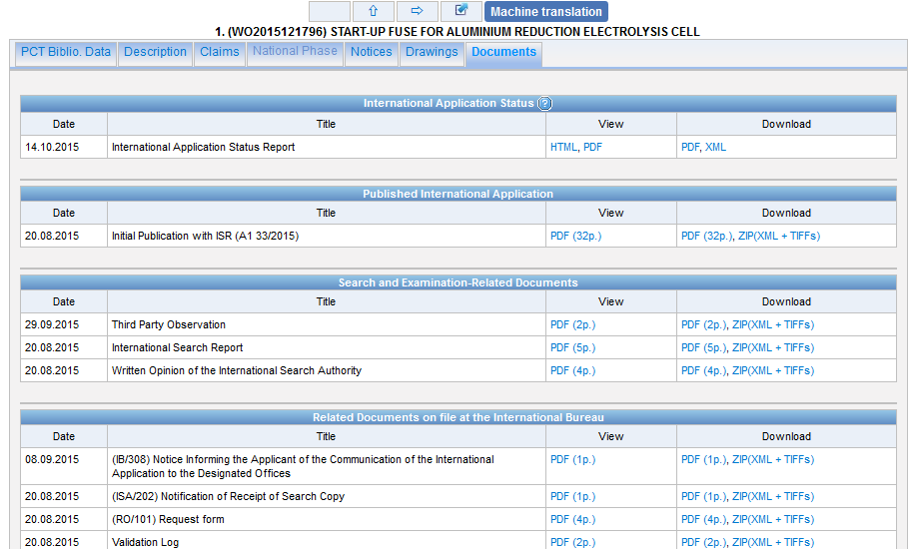
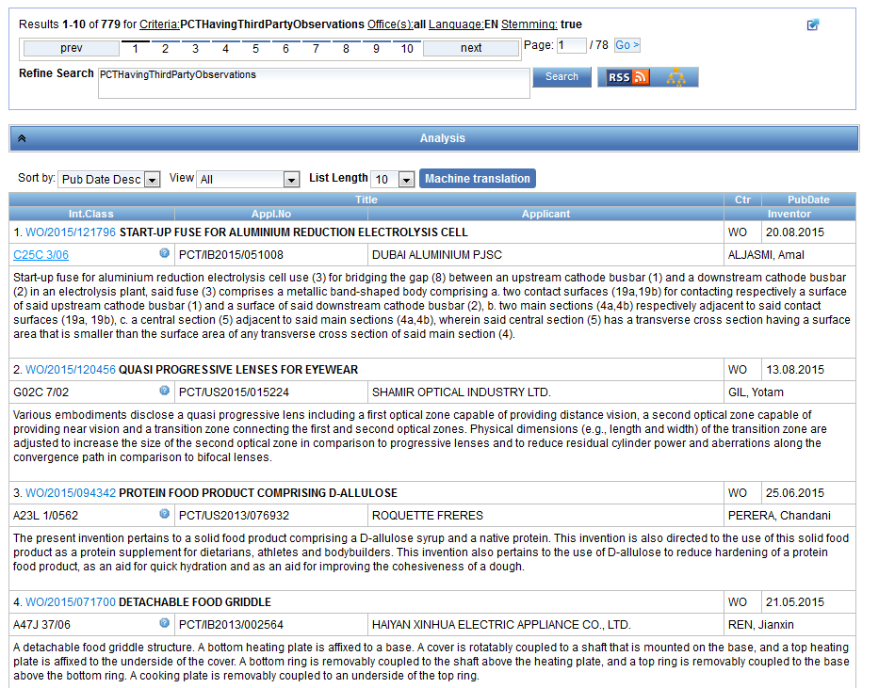

Slide 34
Fields rules
Basic fields: elements of a patent document
Derived fields
2 letter code = individual field
EN_TI FR_AB ES_DE_S
Convention: language specified by 2 letters
if not specified all languages
S = stemmed
: to separate term without any space

Slide 35
Fields: golden rules
EN_ALL = default field field indicator not required
Field name followed by : ":" or "/"
The field is only valid for the term that it directly precedes, so the query:
EN_TI:("wind turbine" AND electric) solar
Results: "wind turbine" AND electric in the title field. "solar" in the default field (EN_ALL ).

Slide 36
Most common errors
(….) "…"
" not “
Field name
No space
No wildcard at the beginning of a word

Slide 38
Q1: Which operator/s is/are supported in PATENTSCOPE?
A
AND
B
NEAR
C
OR
D
BEFORE

Slide 39
Q1: Which operator/s is/are supported in PATENTSCOPE?
A
AND
B
NEAR
C
OR
D
BEFORE
Spain

Slide 40
Q2:How many patent documents are available in PATENTSCOPE?
A
About 30 million
B
Over 50 million

Slide 41
Q2: How many patent documents are available in PATENTSCOPE?
A
About 30 million
B
Over 50 million

Slide 42
Q3: Which the correct way of using NEAR?
A
(electric AND car) NEAR power
B
EN_AB: hearing NEAR aid
C
EN_AB: (hearing NEAR aid)
D
power NEAR (electric AND car)

Slide 43
Q3: Which the correct way of using NEAR?
A
(electric AND car) NEAR power
B
EN_AB: hearing NEAR aid
C
EN_AB: (hearing NEAR aid)
D
power NEAR (electric AND car)

Slide 45
patentscope@wipo.int

Slide 46
December webinar: Retrospective of 2015 & plans for 2016
Tue, December 15
5:30 PM - 6:30 PM CEST
Thu, December 17
8:30 AM - 9:30 AM CEST
To sign up: http://www.wipo.int/patentscope/en/webinar/

Slide 47
mulțumesc
mulțumesc

