Slide 1
CLIR
PATENTSCOPE search system
Cyberworld
February
2016
Sandrine Ammann
Marketing & Communications Officer

Slide 2


To the PATENTSCOPE search system webinar
CLIR

Slide 3
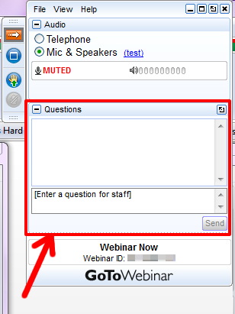

Slide 4
Questions/concerns
patentscope@wipo.int

Slide 5
Agenda
Latest development
CLIR
  What is CLIR?
  How to use it?
  Why is it useful?
  How was it developed?
  Q & A session

Slide 6

Latest developement

Slide 7

National collection of Tunisia
about 3,500 bibliographic data records

Slide 8
CLIR
Cross-Lingual Information Retrieval

Slide 9
Q.1 How many of you are already familiar with CLIR?
A
yes
B
no

Slide 10
What is it?
1. Finds synonyms:
container receptacles/ reservoir/tank
2. Translates into 13 languages
container
emballage
conteneurs
contenants
Verpackung
Transportbehälter
Behältnisses
behaallare
viravattenbehållare
pappersmaskins
集装箱
容器
盒
Zbiorników
Pojemnika
kontenerowego
envase
contenedor
tanque
contentor
receptáculo
embalagem
용기
기
탱크
recipienti
serbatoio
riserva
Контейнера
Емкости
резервуара
toevoertank
watervat
opslagtank
コンテナ
タンク
貯槽
Fartøj
Påfyldningsindretning

Slide 11
CLIR – 14 languages available
NON-ASIAN
Danish
Dutch
English
French
German
Italian
Polish
Portuguese
Russian
Spanish
Swedish
ASIAN
Chinese
Japanese
Korean

Slide 12
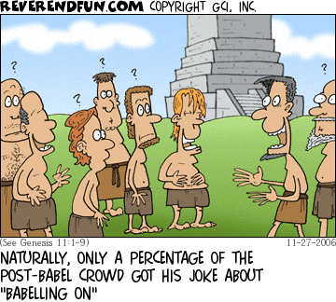
Historical background

Slide 13
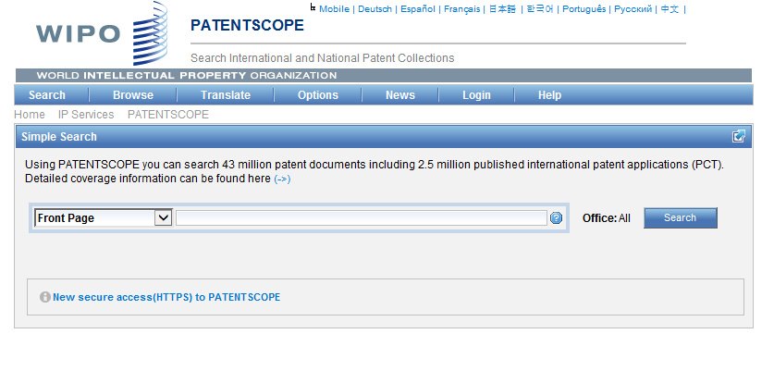
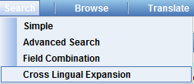
Where to find it?

Slide 14
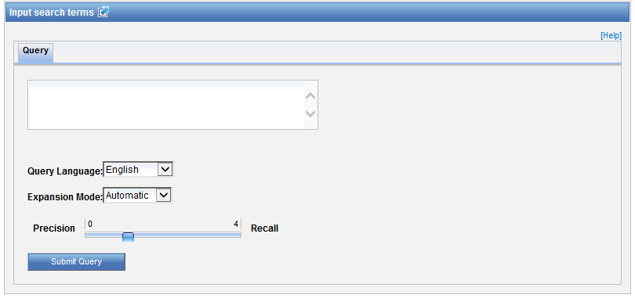
How to use it? Interface

Slide 15
Query language
Define the language of the query:

Slide 16
Expansion mode
2 modes:
  Automatic = 1 step
  Supervised = 4 steps

Slide 17
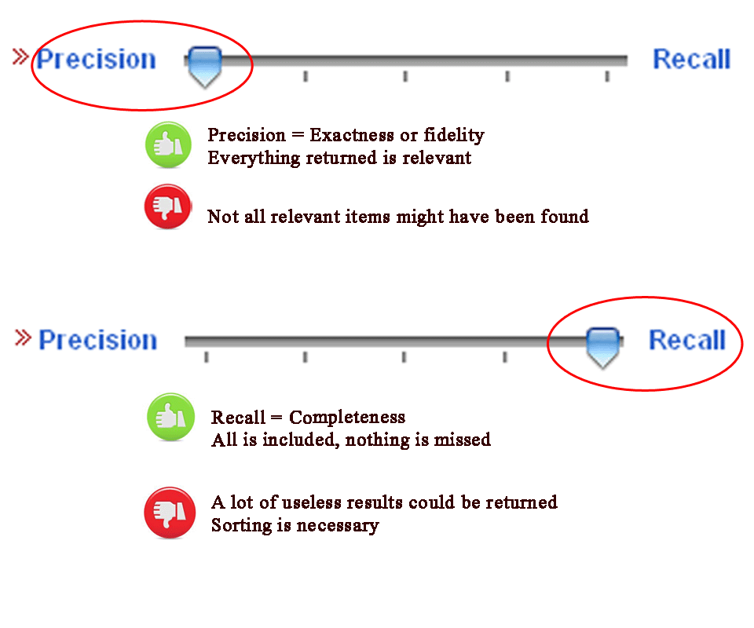
CLIR: precision vs recall

Slide 18
CLIR: precision vs recall
Precision = the ability to retrieve the most precise results.
Trying to find only precisely relevant items (high precision) = miss important items because they don't use quite the same vocabulary.
Recall = the ability to retrieve as many documents as possible that match or are related to a query.
Trying to find all the relevant items (high recall) = often get a lot of junk.

Slide 19
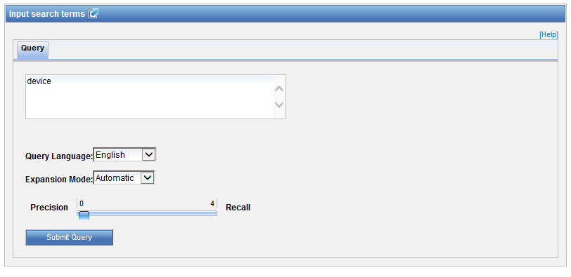
Example: precision

Slide 20
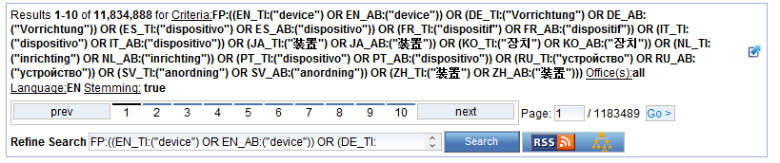
Results for «precision»

Slide 21

Example: recall

Slide 22
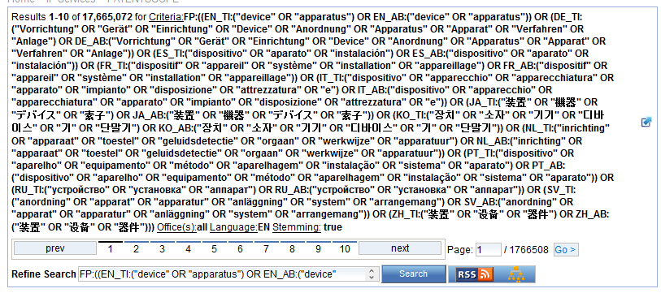
Results for «recall»

Slide 23

Example
Source:https://www.kickstarter.com/projects/igreenpod/biodegradable-coffee-pod-from-portland-oregon

Slide 24
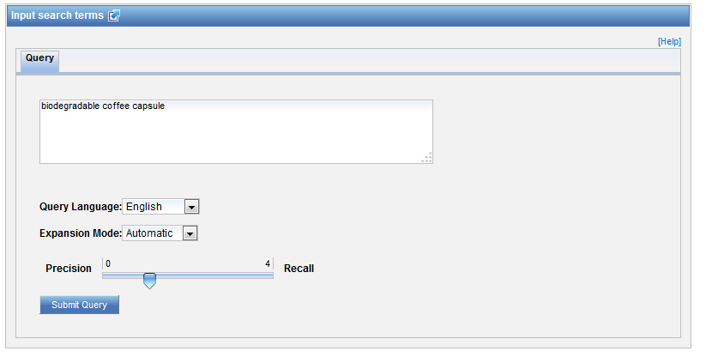

Automatic mode

Slide 25
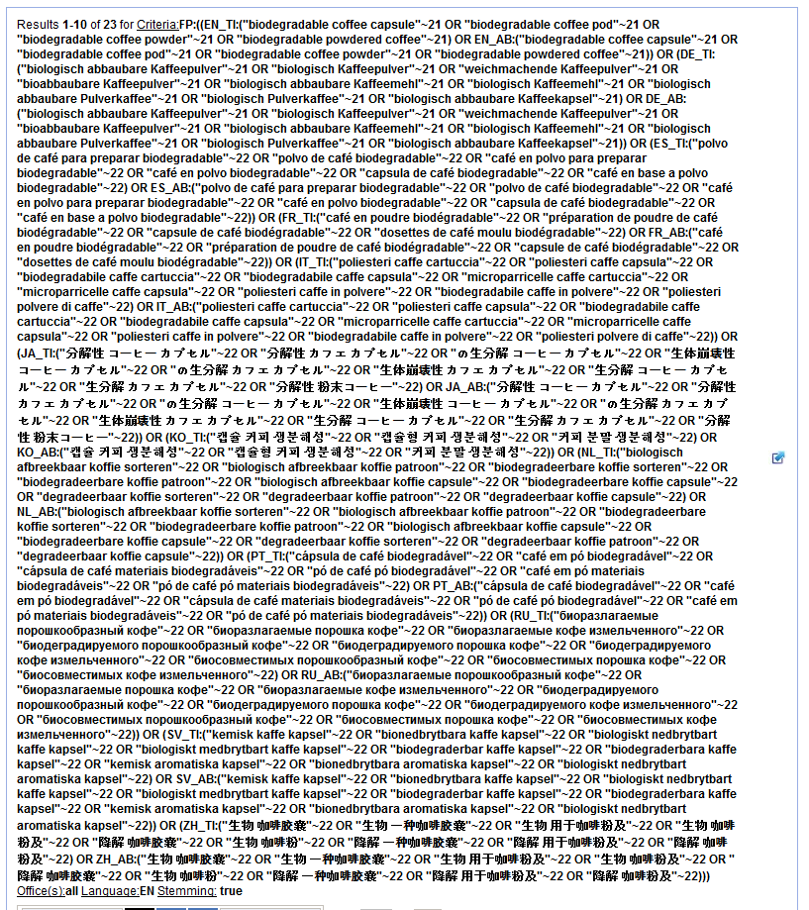

Slide 26
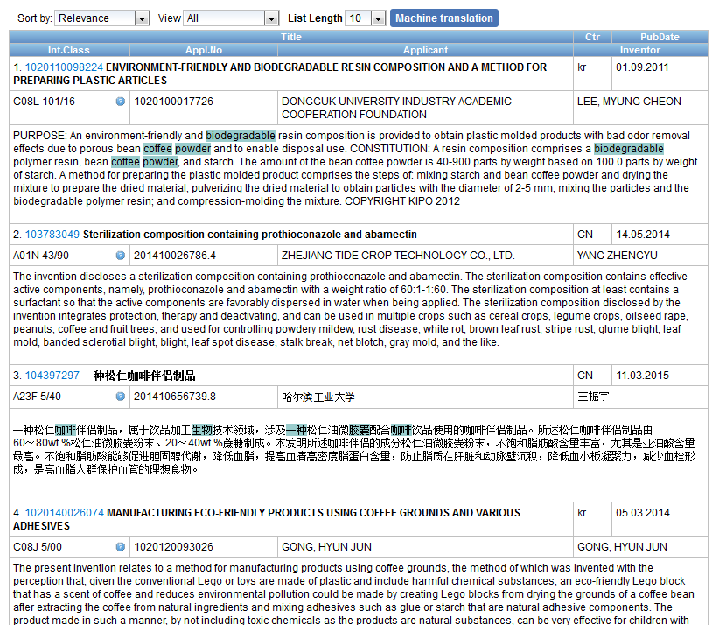
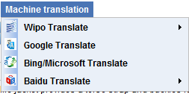
Result list

Slide 27
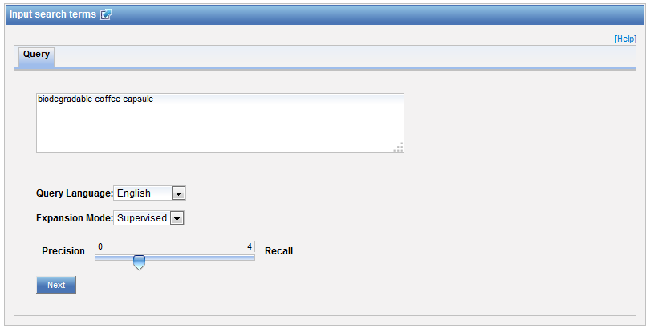

Supervised mode

Slide 28
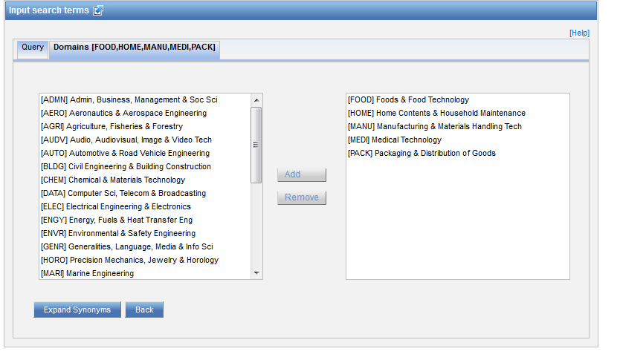
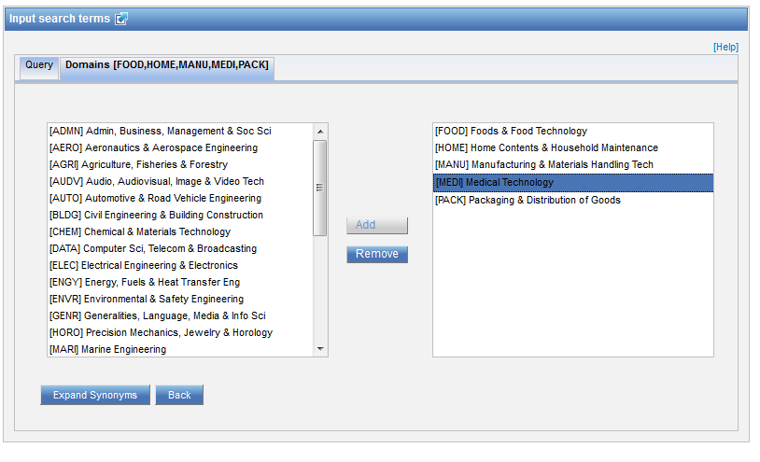
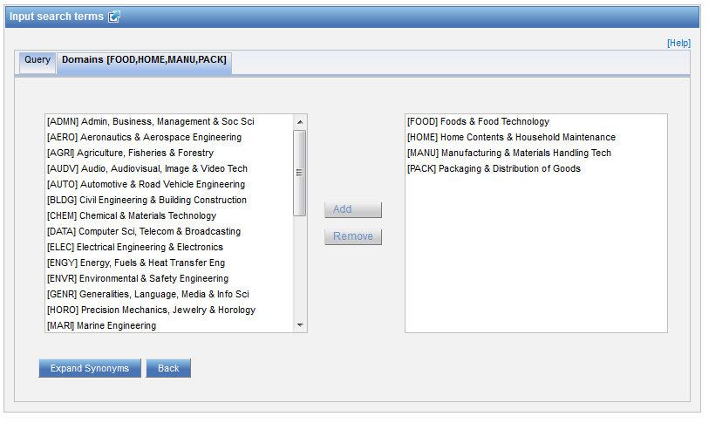
Step 1: technical field selection

Slide 29
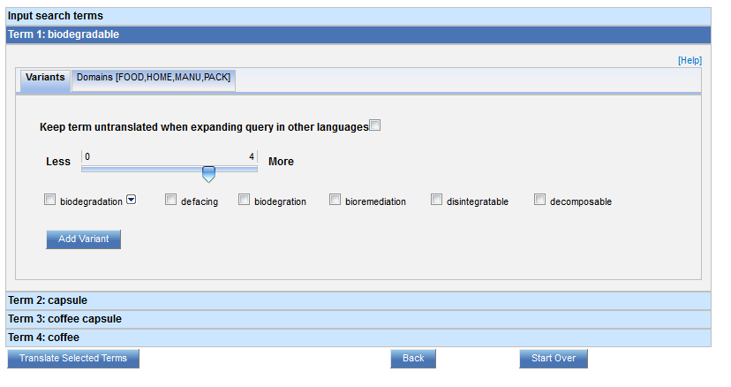
Step 2: synonym selection

Slide 30
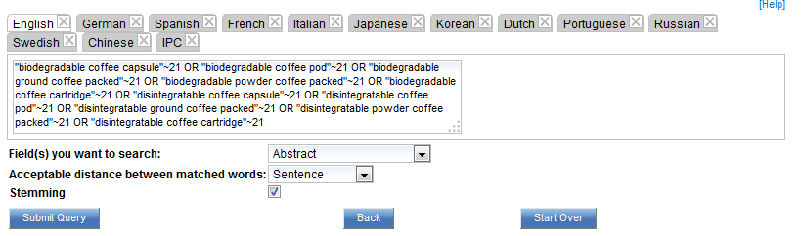
Step 3: translated term selection

Slide 31
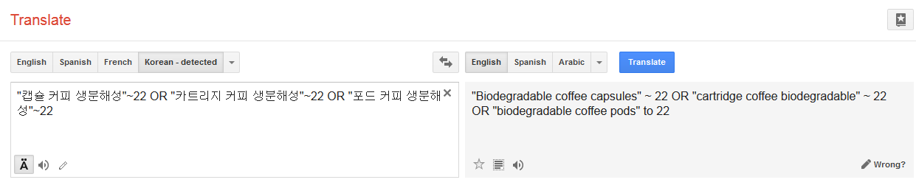
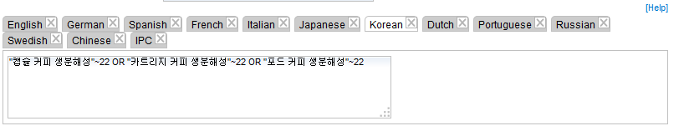
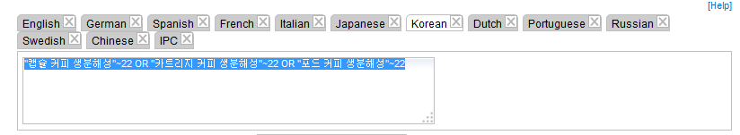
Relevance checking

Slide 32
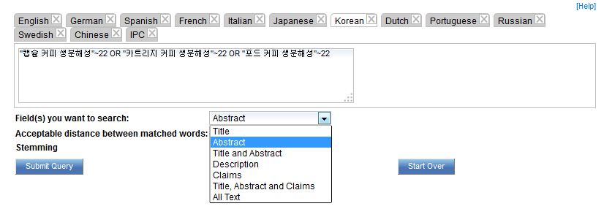
Fields

Slide 33
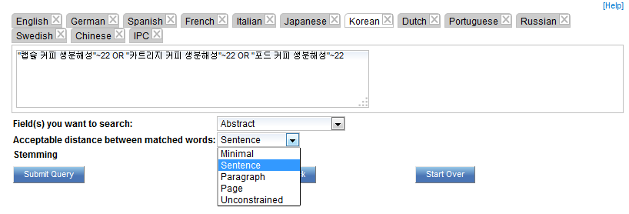
Acceptable distance

Slide 34
Stemming

Slide 35
Stemming
Use of the root form of a word
        displayed
        Display displaying
        displays

Slide 36
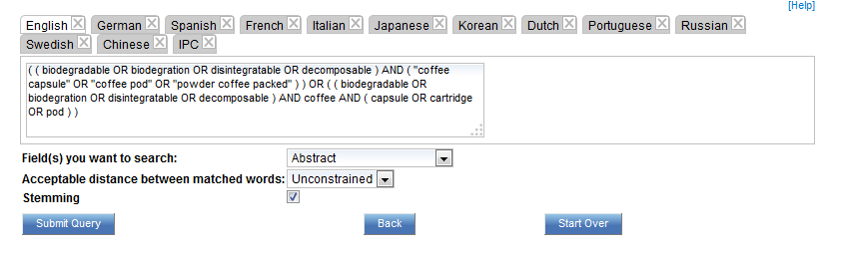
IPC checking

Slide 37
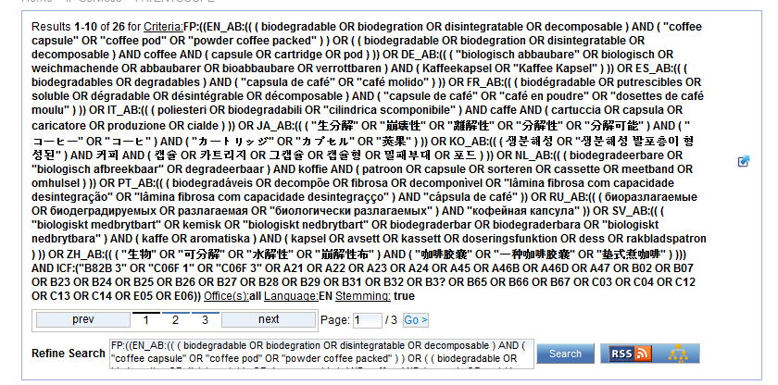

Slide 38
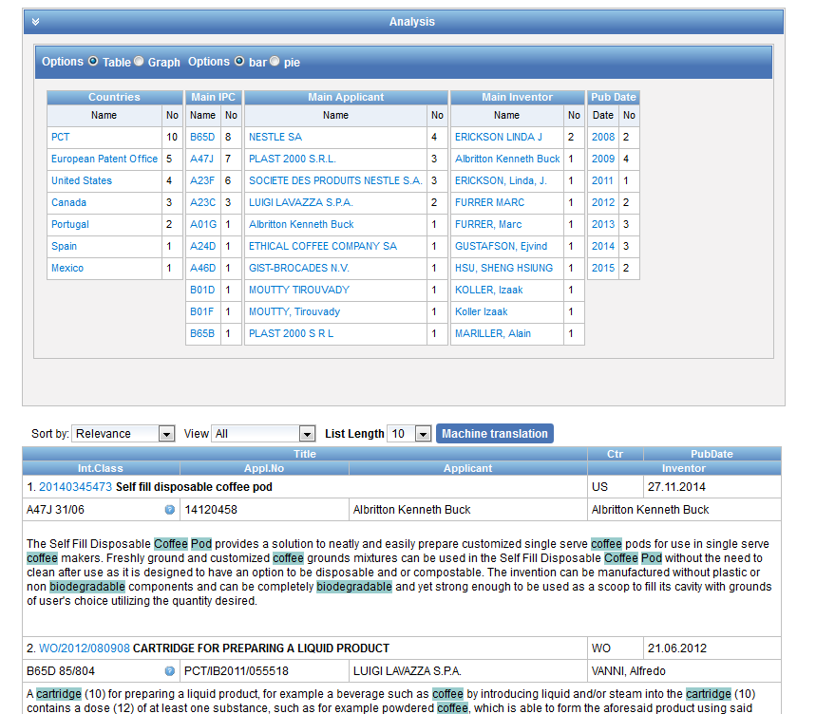

Slide 39
Why is CLIR useful?
Search full text collections simultaneously in many foreign languages
B) Improve significantly the number of relevant results without increasing significantly the number of irrelevant results
C) Have confidence in your searches:
No black box: users have access to the CLIR generated Boolean queries (albeit complex) and have the full control on them
D) Have a responsive system even for complex queries

Slide 40
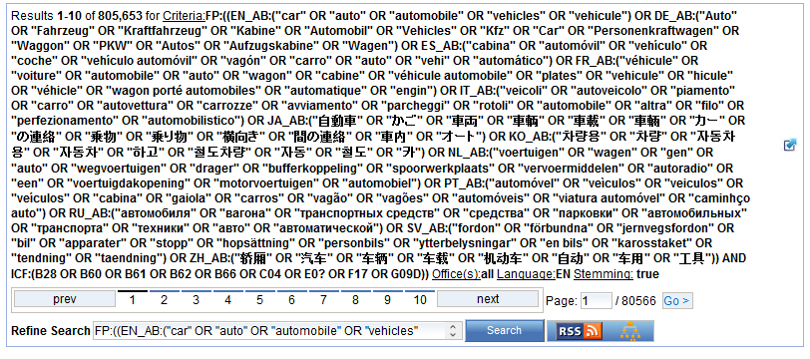

Slide 41
Q.2 which expansion mode was used to obtain this result list?
A
Automatic
B
Supervised

Slide 42

Q.2: which expansion mode was used to obtain this result list?
A
Automatic
C
Supervised

Slide 43
Q.3: which languages are supported by CLIR?
A
Chinese
B
Swedish
C
Korean
D
French

Slide 44
Q.3: which languages are supported by CLIR?
A
Chinese
B
Swedish
C
Korean
D
French
Spain

Slide 45
How to make the most of out CLIR?
Expansion modes
Keyword very specific with only 1 meaning AUTOMATIC
For any other queries, SUPERVISED is recommended
Variants/synonyms
Select words that you would like to appear in your search results
If you have too much noise in the result list, remove generic variant

Slide 46
How to make the most of out CLIR?
Parameters
1. Title and abstract: unconstrained distance
2. Claims: sentence/paragraph distance
3. Description: sentence/paragraph distance
Stemming recommended

Slide 47
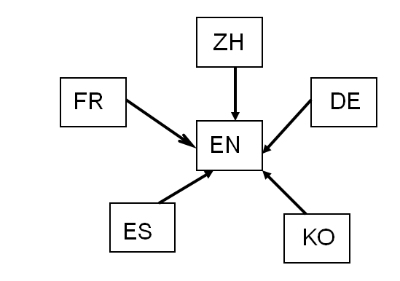
How was it developed?
Compilation of a long list of titles in language pairs
Creation of in-house extraction methodology
Tool learns statistical bilingual dictionaries of titles

Slide 48



Quality of dictionaries
Quality of dictionaries: no human intervention
  The more title available, the better the coverage
  Chinese Korean Dutch
  English Portuguese Italian
  French Russian Swedish
  German Spanish Polish
  Japanese Danish

Slide 49
Disambiguation
Disambiguation: process of identifying the sense of a word in a sentence. http://en.wikipedia.org/wiki/Disambiguation_%28disambiguation%29
Disambiguation is applied to keywords:
Technical domains based on the IPC
Synonyms selection

Slide 50


Slide 51
Next webinar
Complex queries in PATENTSCOPE
March 15 or 17
To register:
  https://attendee.gotowebinar.com/rt/8798711330682238977
  http://www.wipo.int/patentscope/en/webinar/

Slide 52
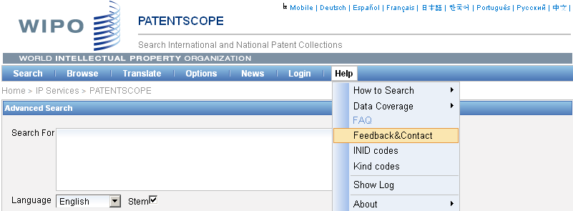

patentscope@wipo.int

Slide 53

mulțumesc
mulțumesc

