Slide 1
CLIR
PATENTSCOPE search system
Cyberworld
May
2017
Sandrine Ammann
Marketing & Communications Officer

Slide 2


Slide 3
Agenda
Latest development
CLIR
  What is CLIR?
  How to use it?
  Why is it useful?
  How was it developed?
  Q & A session

Slide 4

Latest developement

Slide 5
New national collections
Australia
Denmark
France
Saudi Arabia
Detailed coverage: https://patentscope.wipo.int/search/en/help/data_coverage.jsf

Slide 6
CLIR
Cross-Lingual Information Retrieval

Slide 7
Q:1 How many of you are already familiar with CLIR?
A
yes
B
no

Slide 8
What is it?
1. Finds synonyms:
container receptacles/ reservoir/tank
2. Translates into 13 languages
container
emballage
conteneurs
contenants
Verpackung
Transportbehälter
Behältnisses
behaallare
viravattenbehållare
pappersmaskins
集装箱
容器
盒
Zbiorników
Pojemnika
kontenerowego
envase
contenedor
tanque
contentor
receptáculo
embalagem
용기
기
탱크
recipienti
serbatoio
riserva
Контейнера
Емкости
резервуара
toevoertank
watervat
opslagtank
コンテナ
タンク
貯槽
Fartøj
Påfyldningsindretning

Slide 9
CLIR – 14 languages available
NON-ASIAN
Danish
Dutch
English
French
German
Italian
Polish
Portuguese
Russian
Spanish
Swedish
ASIAN
Chinese
Japanese
Korean

Slide 10
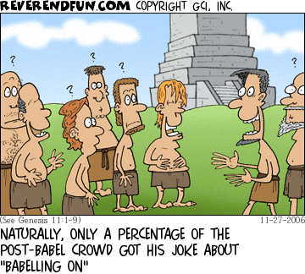
Historical background

Slide 11
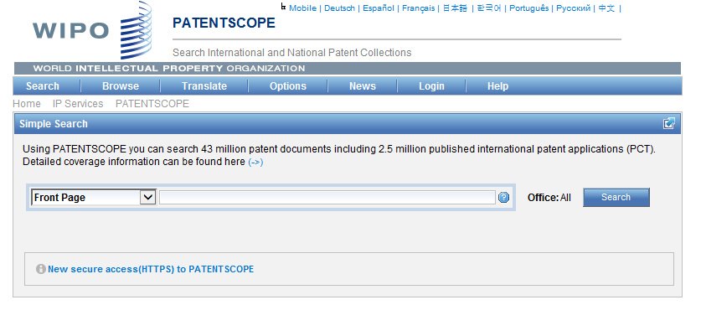
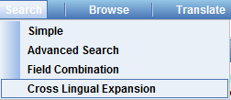
Where to find it?

Slide 12
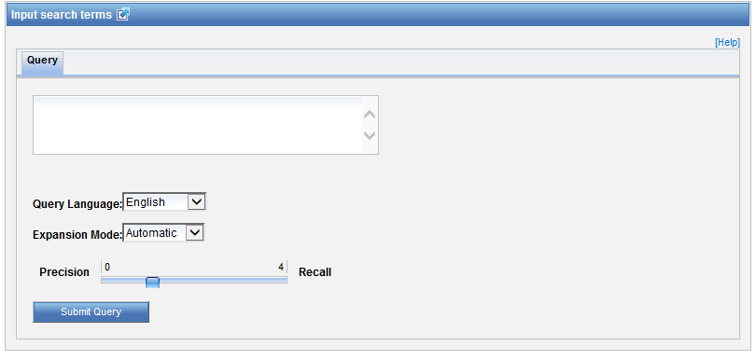
How to use it? Interface

Slide 13
Query language
Define the language of the query:

Slide 14
Expansion mode
2 modes:
  Automatic = 1 step
  Supervised = 4 steps

Slide 15
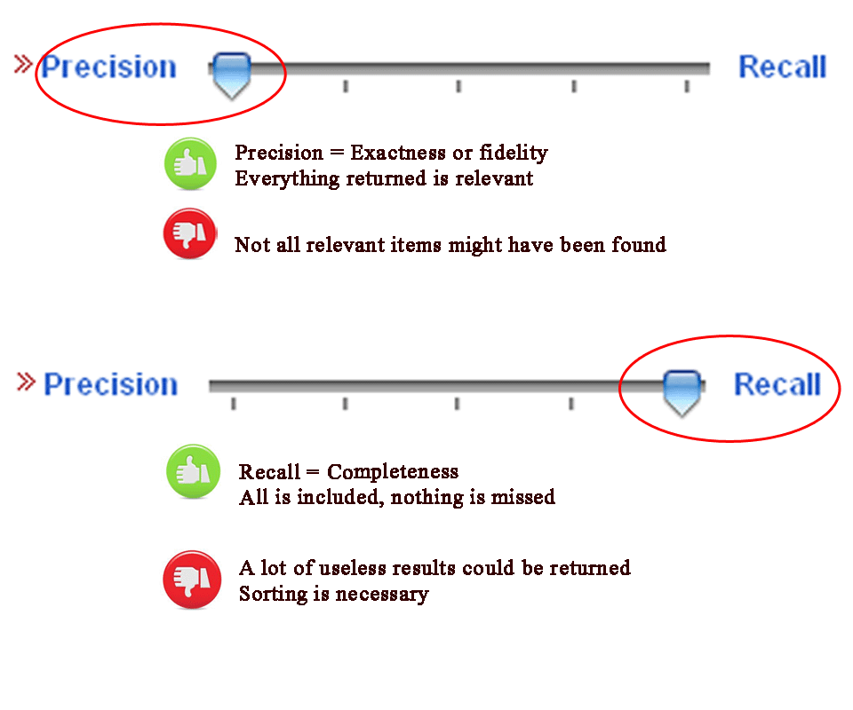
CLIR: precision vs recall

Slide 16
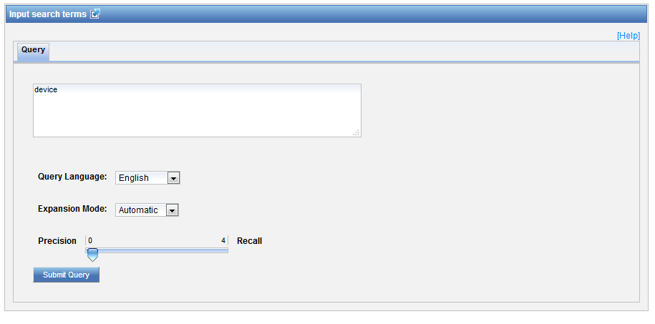
Example: precision

Slide 17
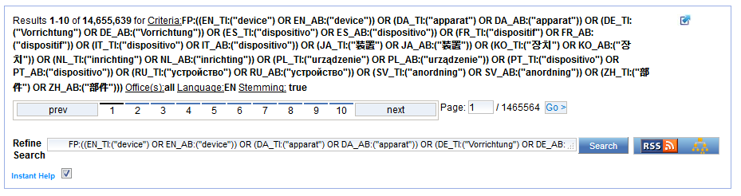
Results for «precision»

Slide 18
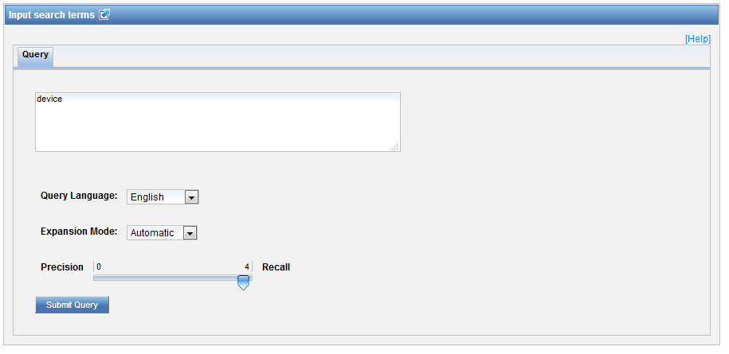
Example: recall

Slide 19
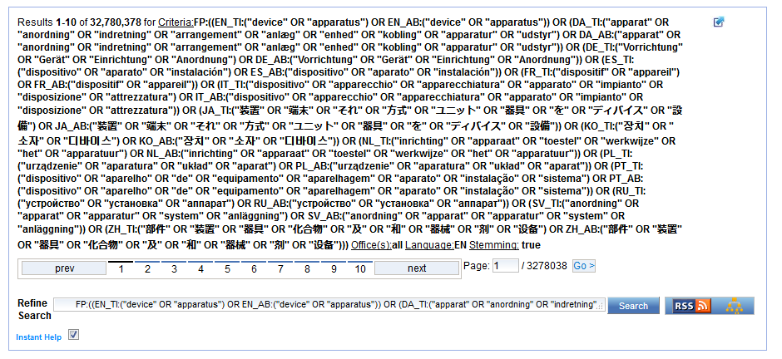
Results for «recall»

Slide 20

Example
Source:https://www.kickstarter.com/projects/igreenpod/biodegradable-coffee-pod-from-portland-oregon

Slide 21
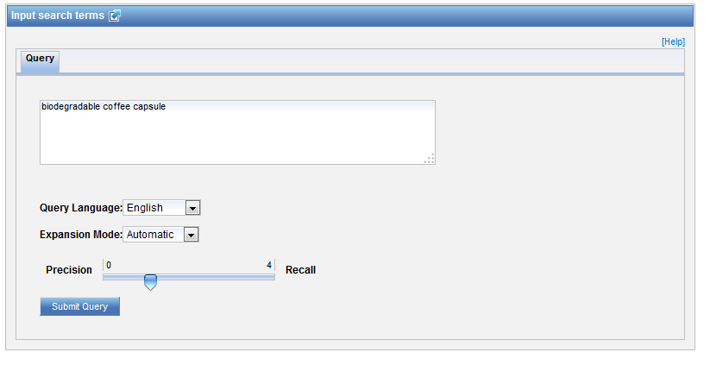

Automatic mode

Slide 22
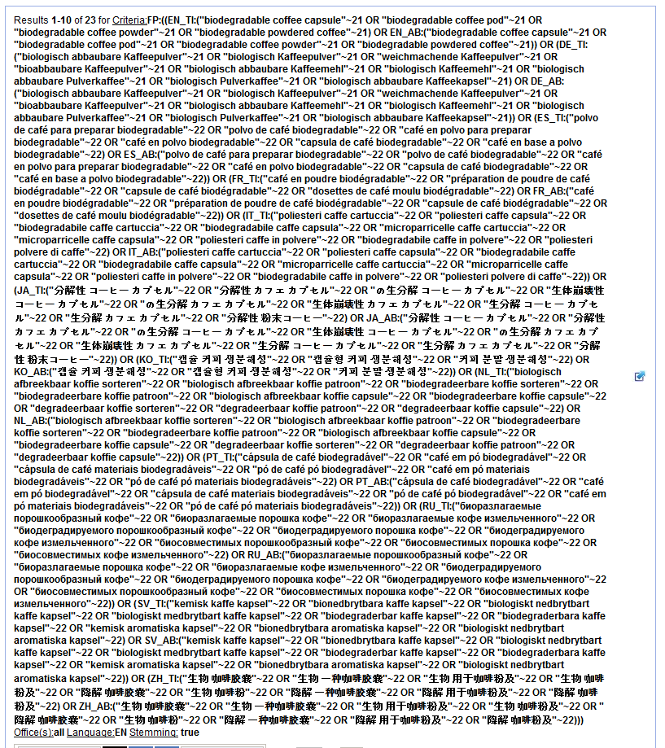

Slide 23
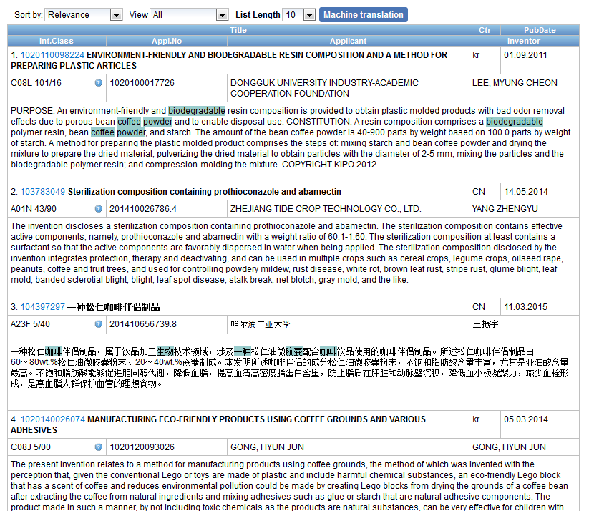
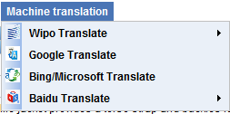
Result list

Slide 24
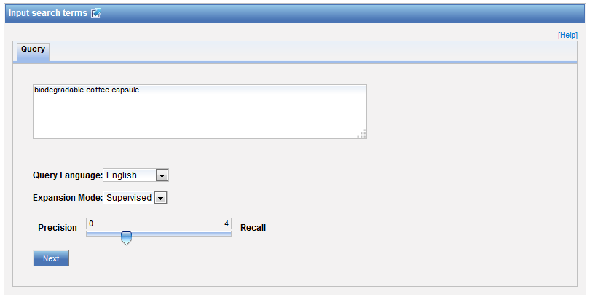

Supervised mode

Slide 25
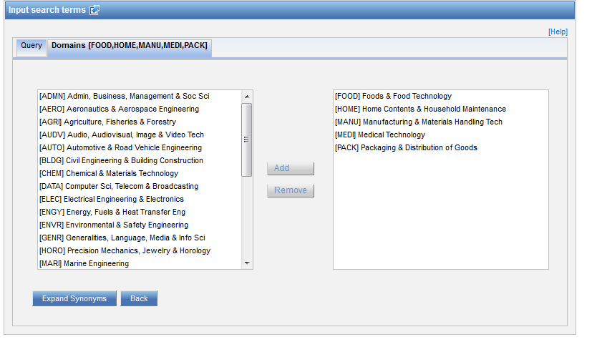
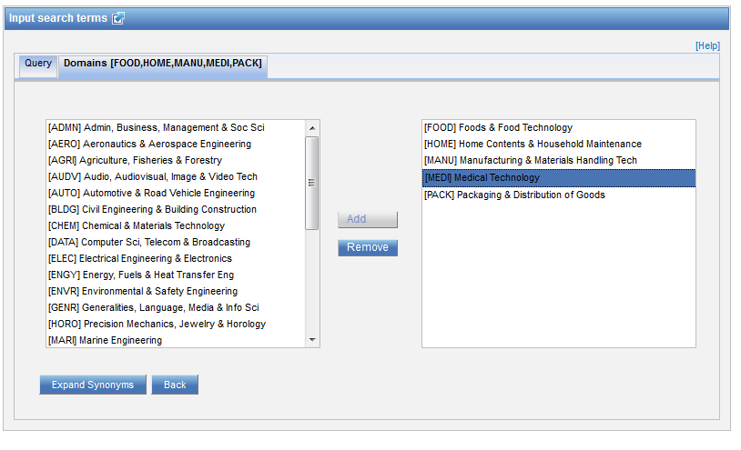
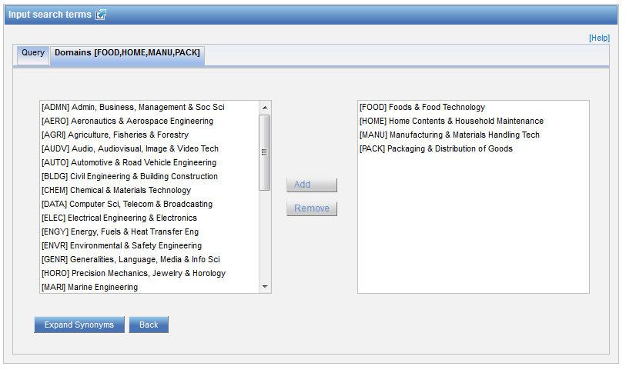
Step 1: technical field selection

Slide 26
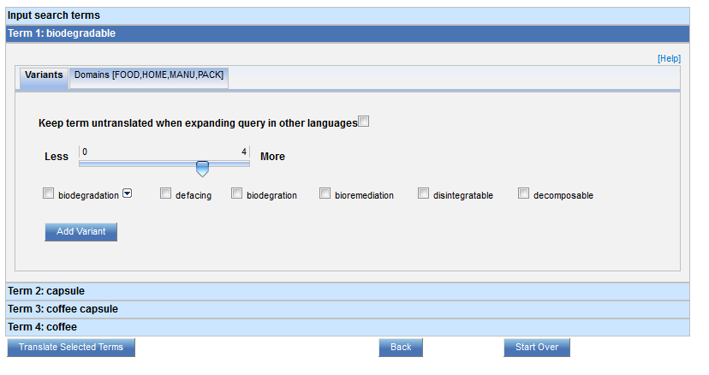
Step 2: synonym selection

Slide 27
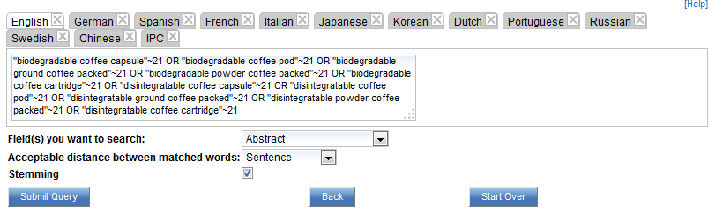
Step 3: translated term selection

Slide 28
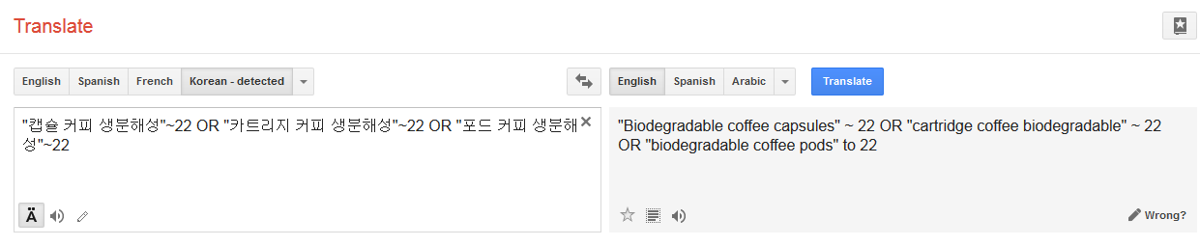
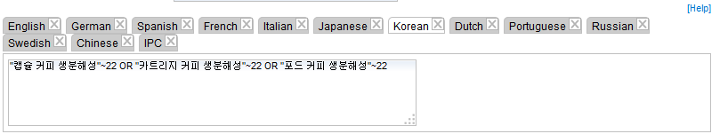
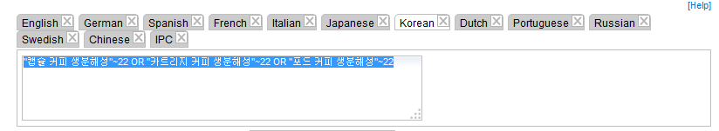
Relevance checking

Slide 29
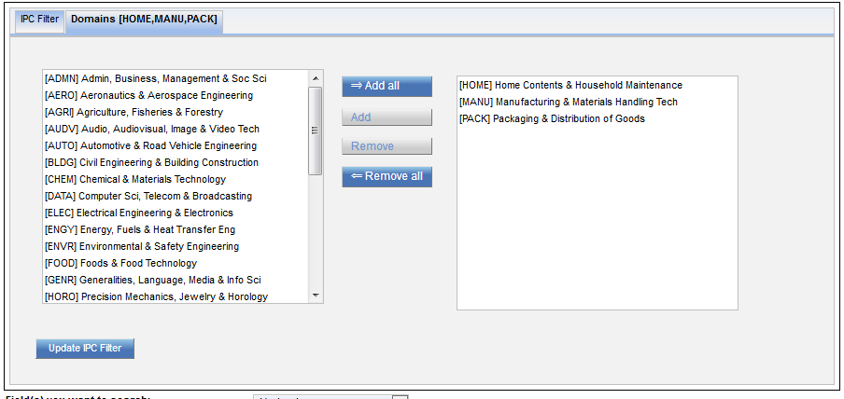
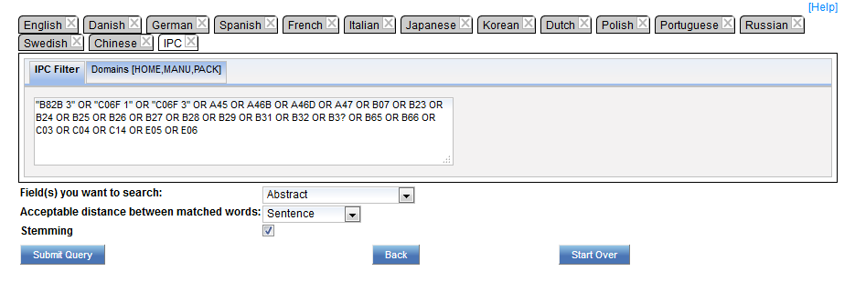
IPC checking

Slide 30
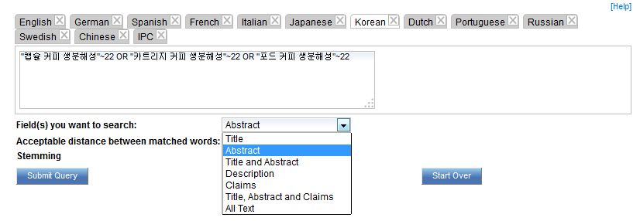
Fields

Slide 31
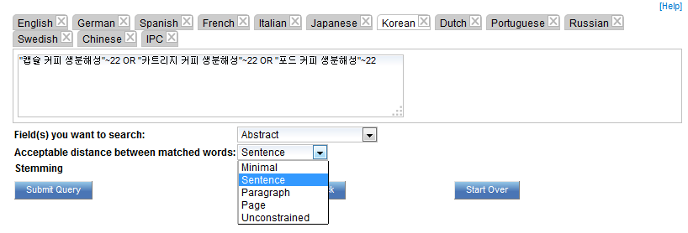
Acceptable distance

Slide 32
Stemming

Slide 33
Stemming
        displayed
        Display displaying
        displays

Slide 34
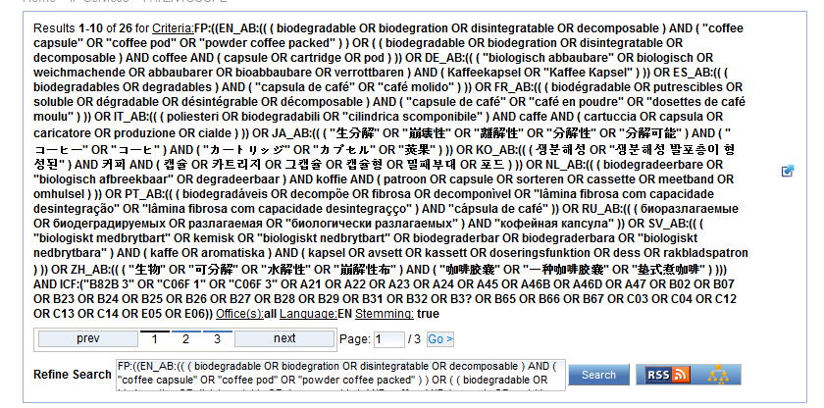

Slide 35
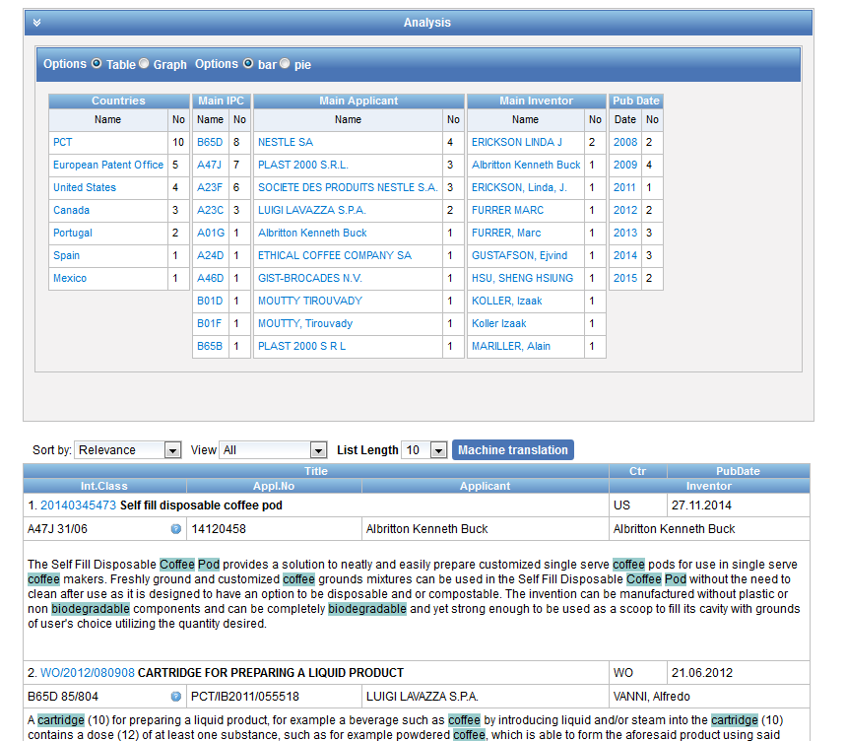

Slide 36
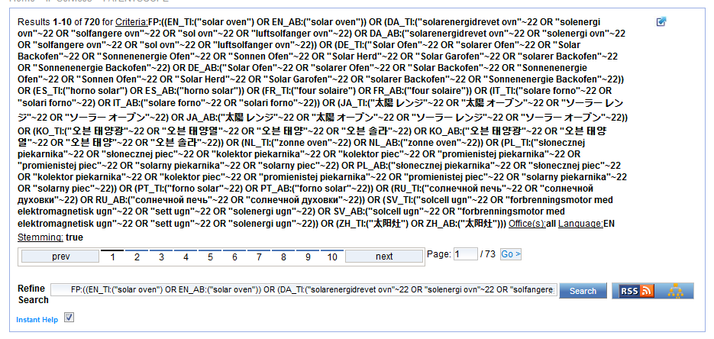
Query combination
solar oven + publication date
DP:[01.01.2010 TO 31.12.2013]

Slide 37
Why is CLIR useful?
Search full text collections simultaneously in many foreign languages
B) Improve significantly the number of relevant results without increasing significantly the number of irrelevant results
C) Have confidence in your searches:
No black box: users have access to the CLIR generated Boolean queries (albeit complex) and have the full control on them
D) Have a responsive system even for complex queries

Slide 38
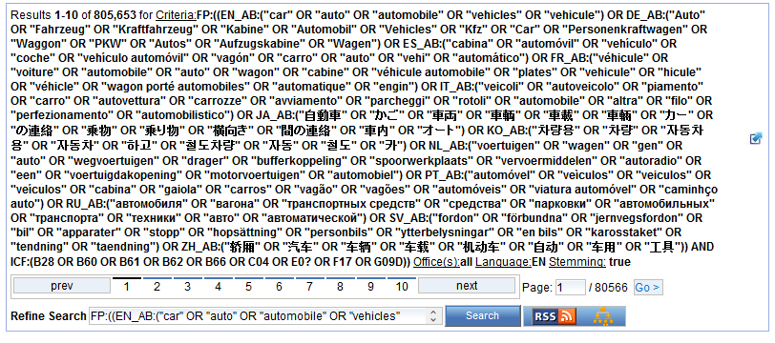

Slide 39
Q:3 which expansion mode was used to obtain this result list?
A
Automatic
B
Supervised

Slide 40

Q:3: which expansion mode was used to obtain this result list?
A
Automatic
C
Supervised

Slide 41
Q:2: which languages are supported by CLIR?
A
Chinese
B
Swedish
C
Korean
D
French

Slide 42
Q:2: which languages are supported by CLIR?
A
Chinese
B
Swedish
C
Korean
D
French
Spain

Slide 43
How to make the most of out CLIR?
Expansion modes:
  1meaning keyword = AUTOMATIC
  All other queries = SUPERVISED
Variants/synonyms
  words to be included in search results
  too many results delete generic variants

Slide 44
How to make the most of out CLIR?
Parameters:
  1. Title and abstract: unconstrained distance
  2. Claims: sentence/paragraph distance
  3. Description: sentence/paragraph distance
Stemming recommended

Slide 45
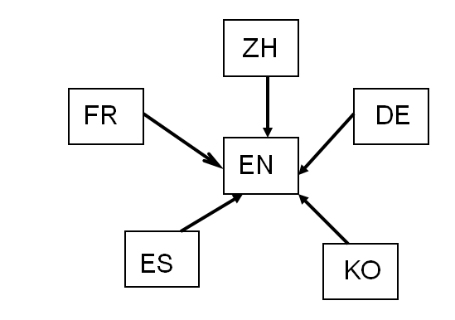
How was it developed?
Compilation of long lists of titles in language pairs
Creation of in-house extraction methodology
Tool learns statistical bilingual dictionaries of titles

Slide 46



Quality of dictionaries
  Chinese Korean Dutch
  English Portuguese Italian
  French Russian Swedish
  German Spanish Polish
  Japanese Danish

Slide 47
Disambiguation
Process of identifying the sense of a word in a sentence. http://en.wikipedia.org/wiki/Disambiguation_%28disambiguation%29
Applied to keywords:
  technical domains
  variants

Slide 48


Slide 49
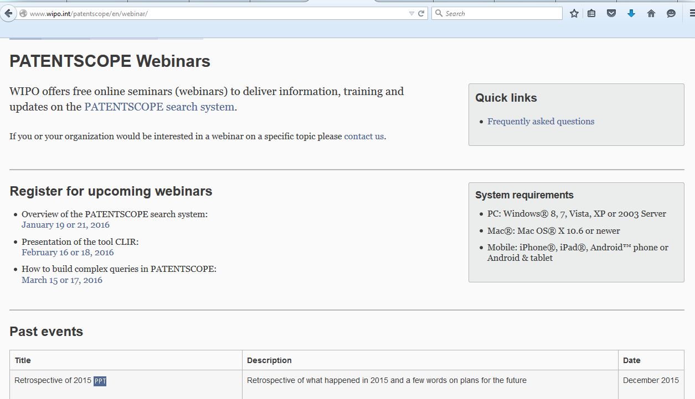
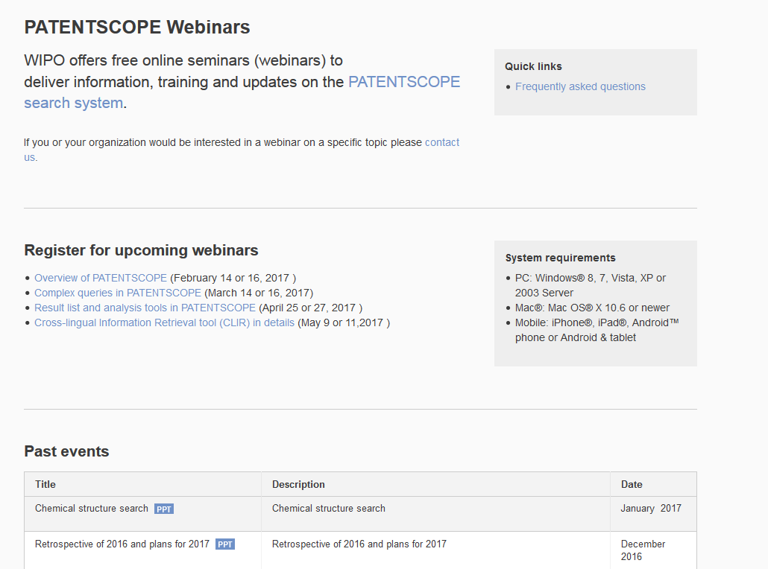
Future/past webinars:
wipo.int/patentscope/en/webinar

Slide 50
Global Design Database: webinar
The Global Design Database: an introduction
  July 25 at 5:30pm CET
  https://attendee.gotowebinar.com/rt/1717422151261026817
  July 27 at 8:30 am CET
  https://attendee.gotowebinar.com/rt/1717422151261026817

Slide 51
Global Brand Database: webinar
Performing effective searches in the Global Brand Database
  August 29 at 5:30pm CET
  https://attendee.gotowebinar.com/rt/1767524697735436802
  August 31 at 8:30 am CET
  https://attendee.gotowebinar.com/rt/1767524697735436802

Slide 52
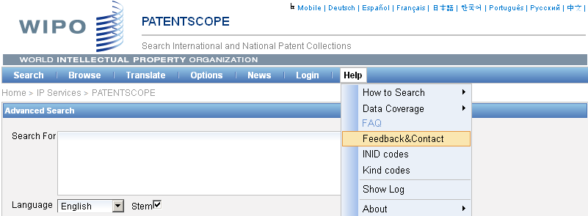
Forum

Slide 53
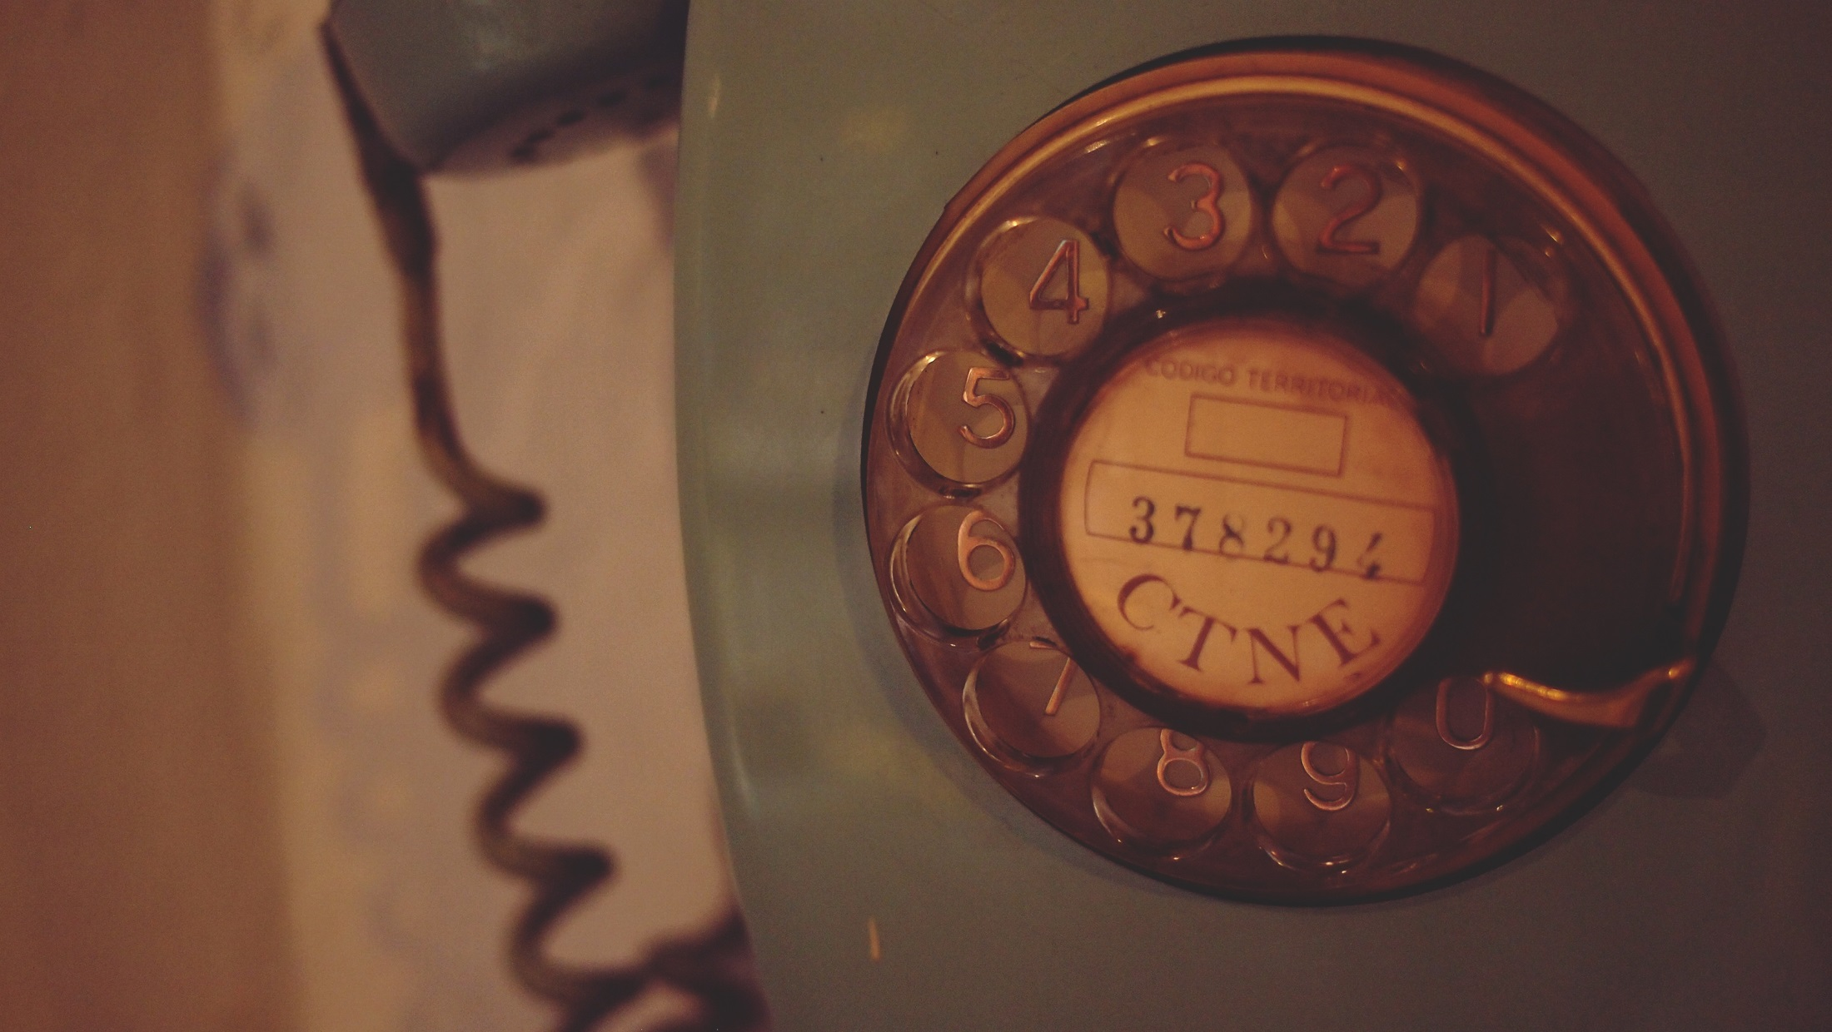
patentscope@wipo.int

