Slide 1
Overview of the PATENTSCOPE search system
Online
January
2019
Sandrine Ammann
Marketing & Communications Officer

Slide 2
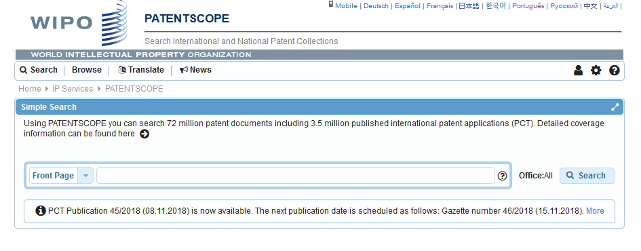
https://patentscope.wipo.int/

Slide 4
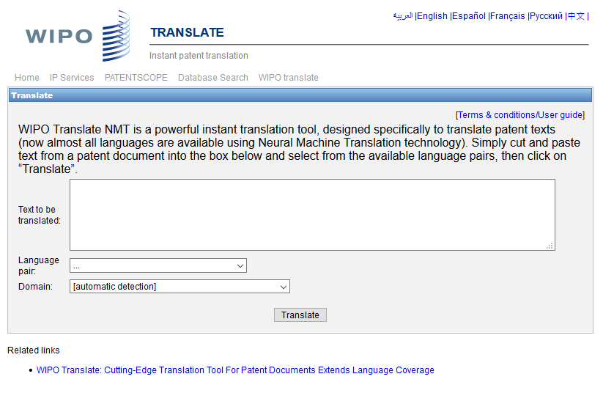
WIPO Translate

Slide 5
32 Technical domains from the IPC
[ADMN] Admin, Business, Management & Soc Sci
[AERO] Aeronautics & Aerospace Engineering
[AGRI] Agriculture, Fisheries & Forestry
[AUDV] Audio, Audiovisual, Image & Video Tech
[AUTO] Automotive & Road Vehicle Engineering
[BLDG] Civil Engineering & Building Construction
[CHEM] Chemical & Materials Technology
[DATA] Computer Sci, Telecom & Broadcasting
[ELEC] Electrical Engineering & Electronics
[ENGY] Energy, Fuels & Heat Transfer Eng
[ENVR] Environmental & Safety Engineering
[FOOD] Foods & Food Technology
[GENR] Generalities, Language, Media & Info Sci
[HOME] Home Contents & Household Maintenance
[HORO] Precision Mechanics, Jewelry & Horology
[MANU] Manufacturing & Materials Handling Tech
[MARI] Marine Engineering
[MEAS] Standards, Units, Metrology & Testing
[MECH] Mechanical Engineering
[MEDI] Medical Technology
[METL] Metallurgy
[MILI] Military Technology
[MINE] Mining, Oil & Gas Extraction & Minerals
[NANO] Nano Technology
[PACK] Packaging & Distribution of Goods
[PRNT] Printing & Paper
[RAIL] Railway Engineering
[SCIE] Optical Engineering
[SPRT] Sports, Leisure, Tourism & Hospitality
[TEXT] Textile & Clothing Industries
[TRAN] Transportation

Slide 6
Language pairs

Slide 7
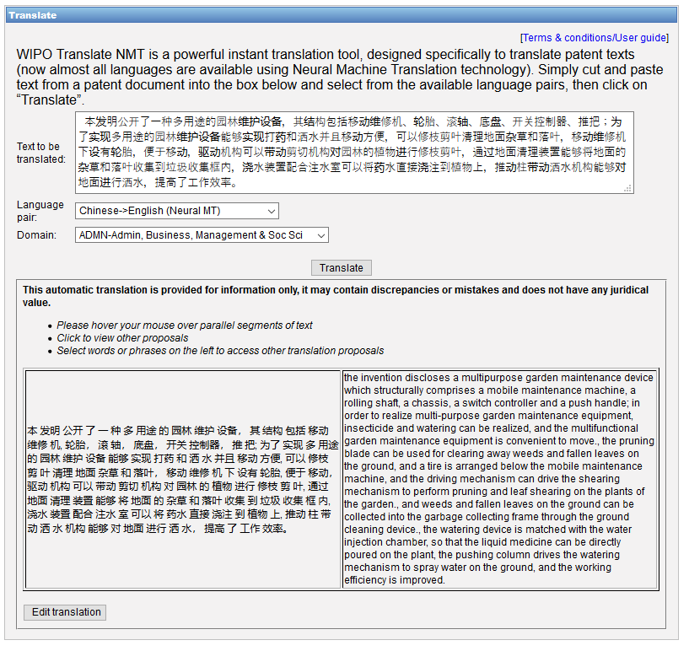

Slide 10
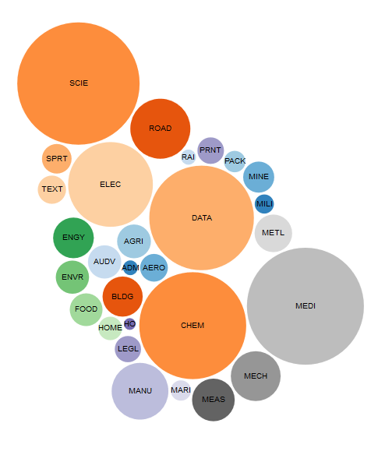
WIPO Pearl

Slide 11
WIPO Pearl
WIPO’s online terminology database
17’000 concepts, 160’000 terms
10 languages
Contents validated by WIPO language experts and terminologists

Slide 12
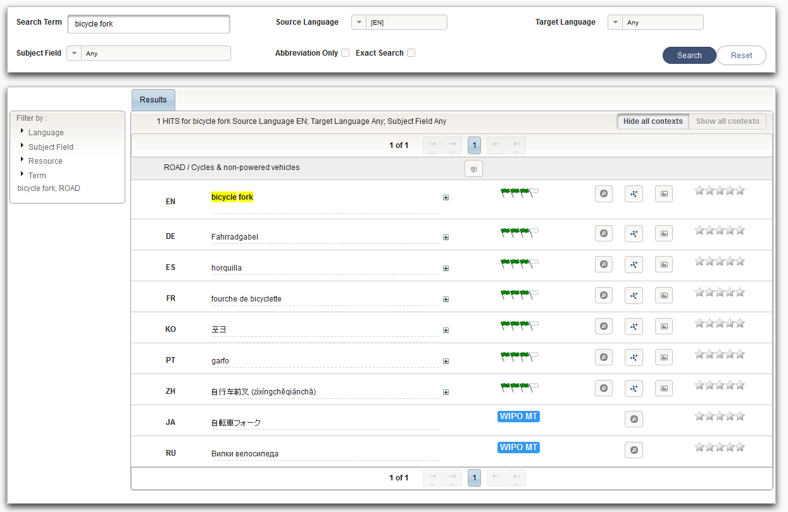
Example: bicycle fork

Slide 13
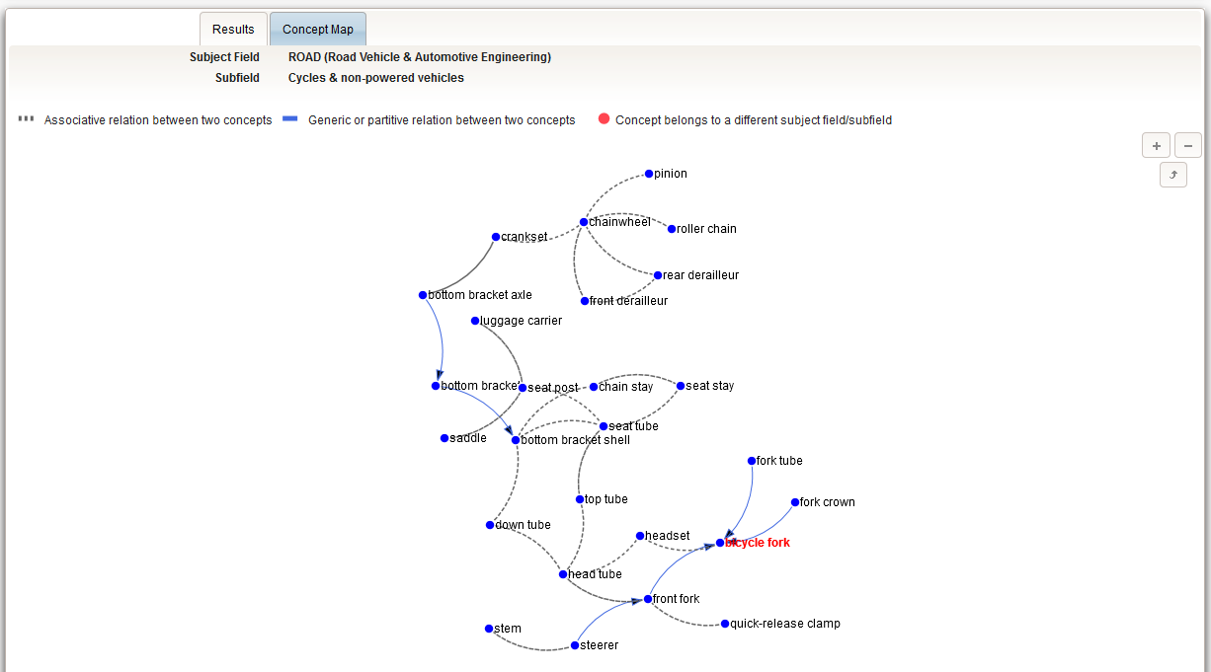

Slide 14
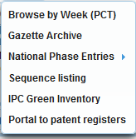

Slide 15
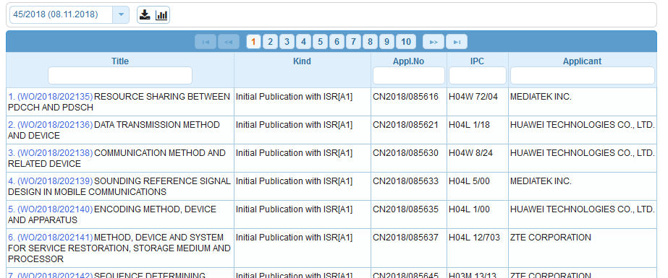
Weekly PCT publication

Slide 16
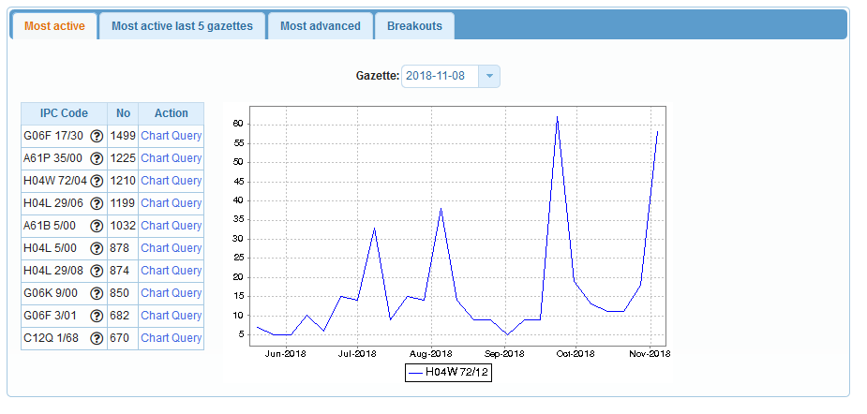
IPC Statistics

Slide 18
Gazette Archive

Slide 20
National Phase Entries

Slide 22
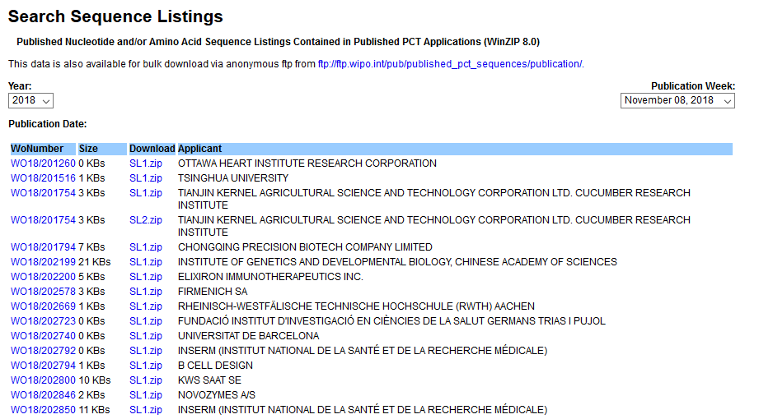
Sequence Listing

Slide 24
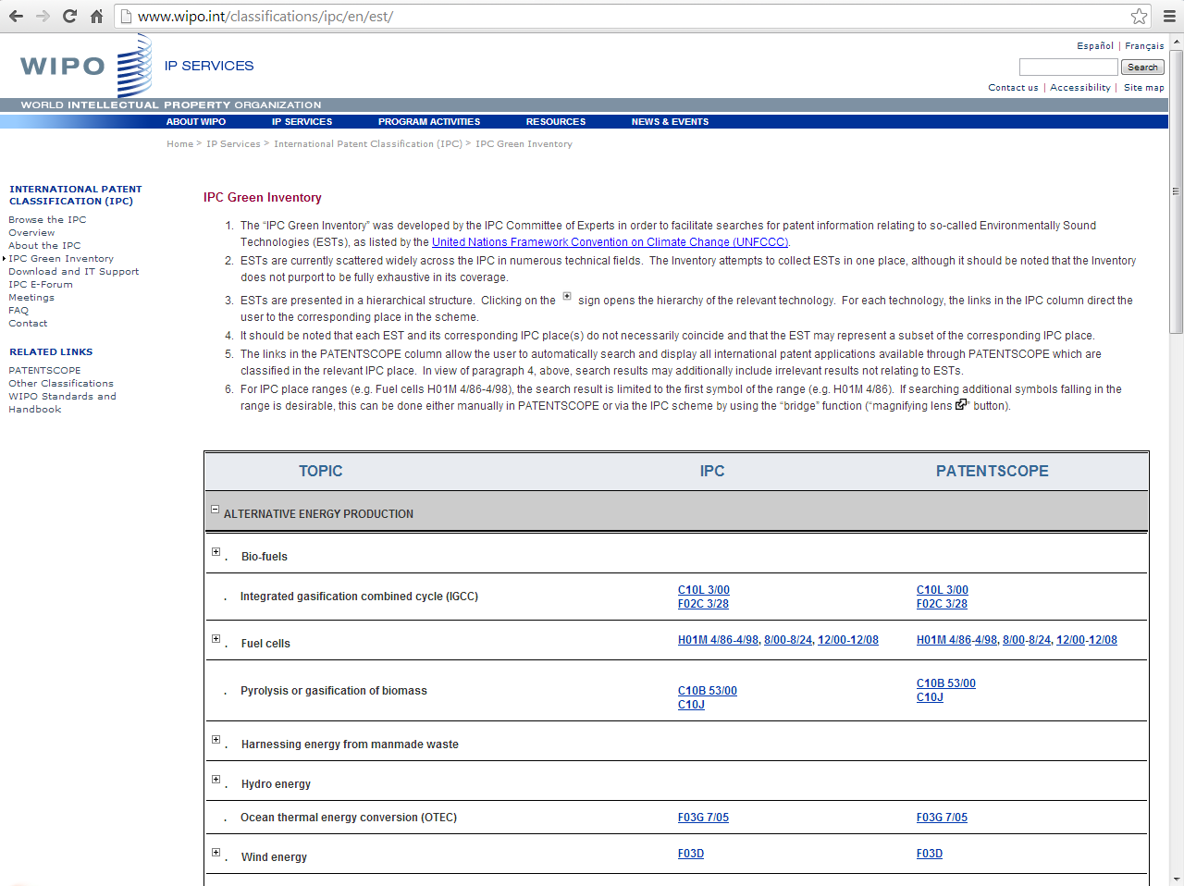
IPC Green Inventory

Slide 26
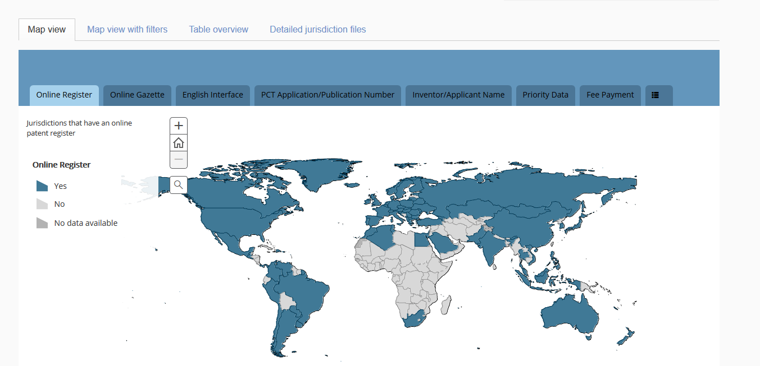
Portal to patent registers

Slide 27
Searches

Slide 28
Chemical compounds

Slide 29
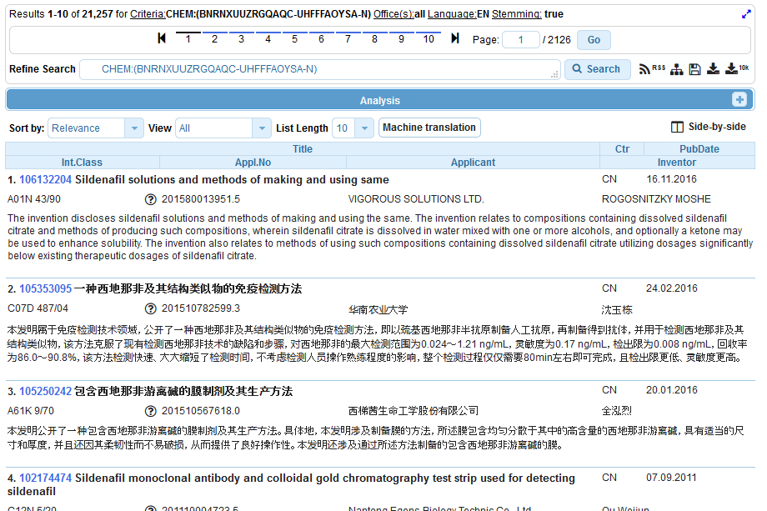

Slide 30
Searches

Slide 31
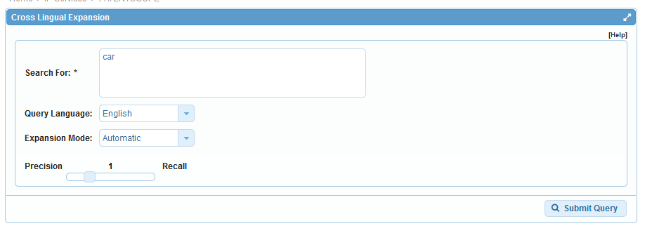
CLIR

Slide 33
Languages
Chinese
Danish
Dutch
English
French
German
Italian
Japanese
Korean
Polish
Portuguese
Russian
Spanish
Swedish

Slide 34
Searches

Slide 35
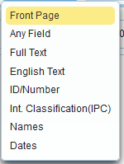
Simple seach

Slide 36
Searches

Slide 37
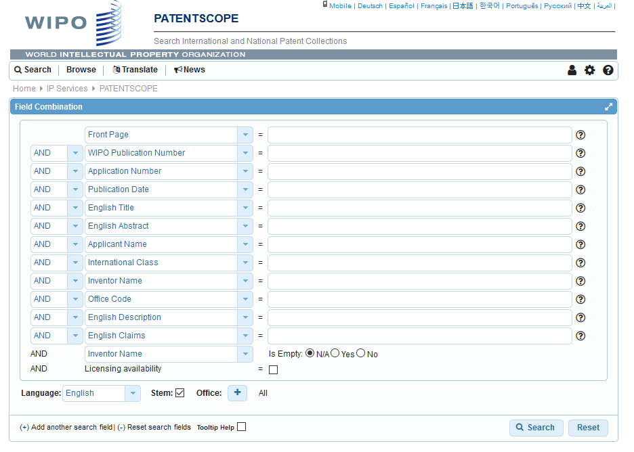

Slide 38
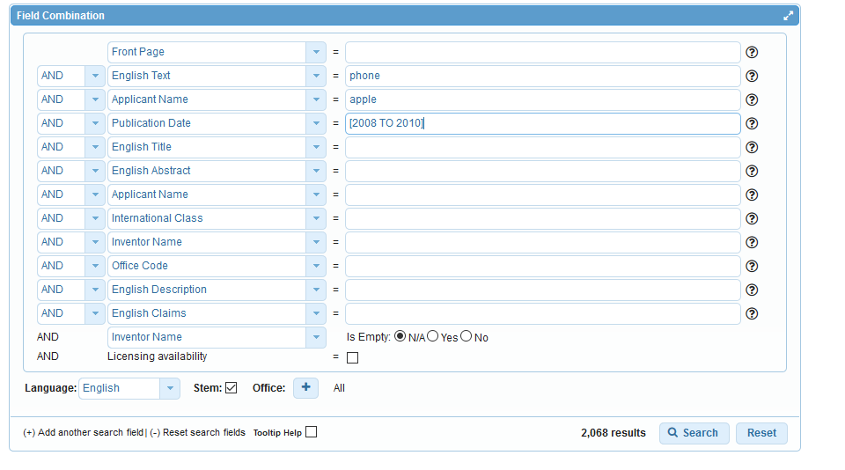
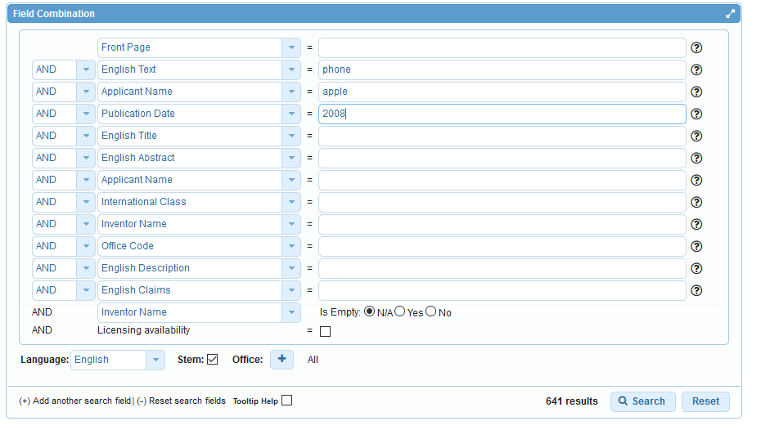

Slide 39
Searches

Slide 40
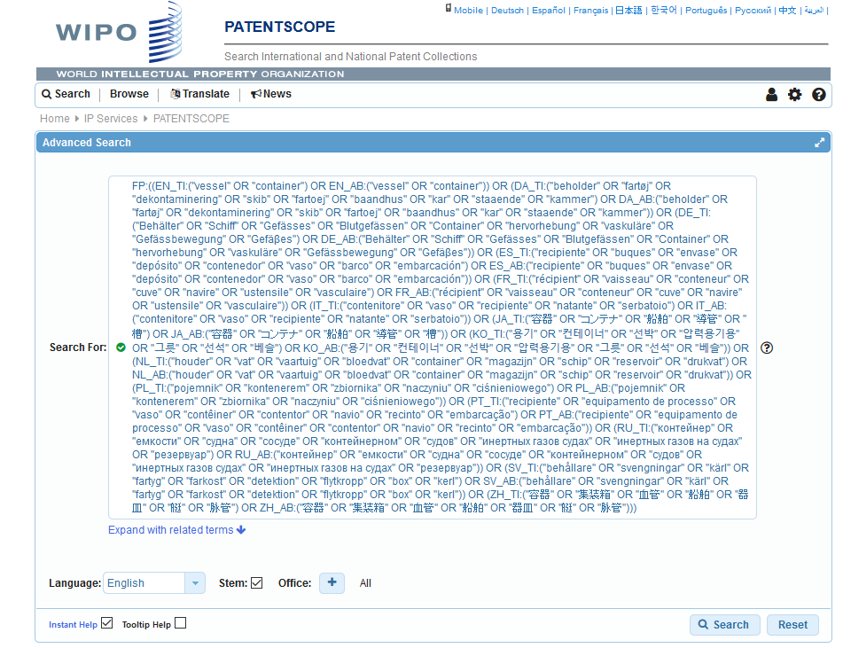
Interface: Advanced search

Slide 41
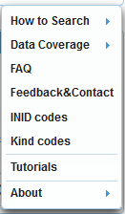

Slide 42
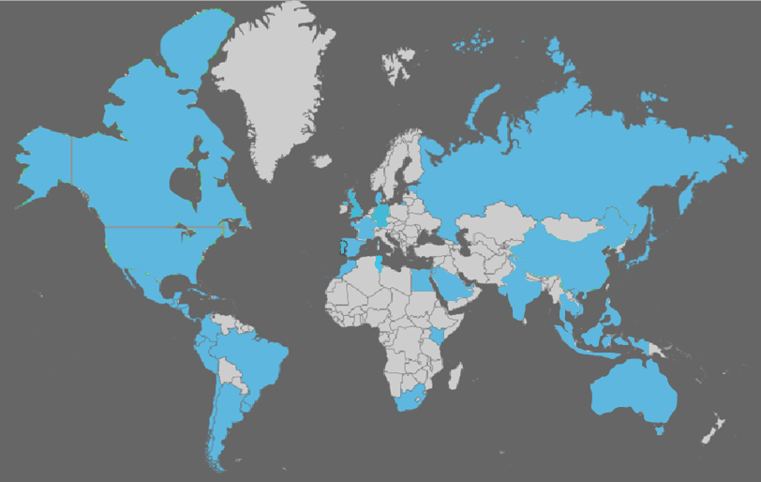
Coverage: what is included?
PCT published applications
National/regional patent collections

Slide 43
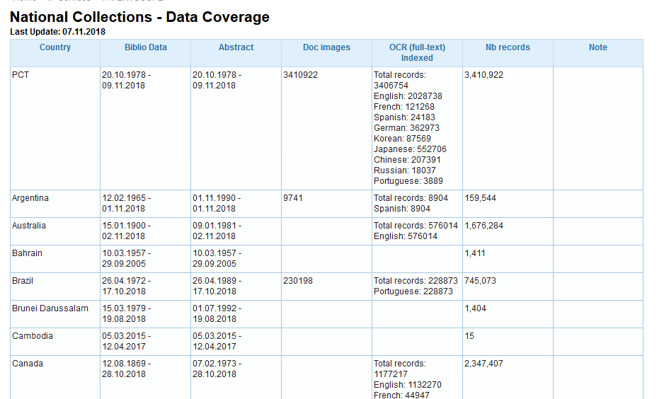
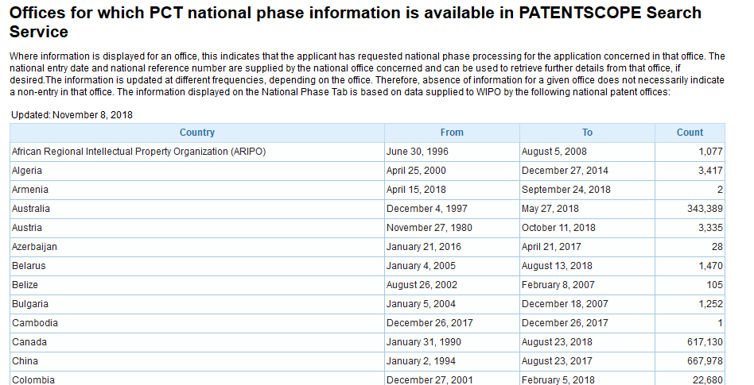
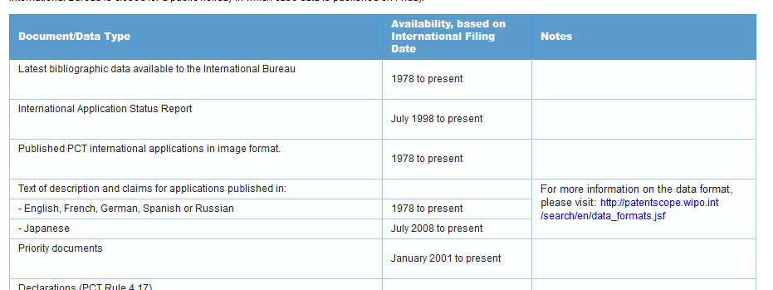

Slide 44
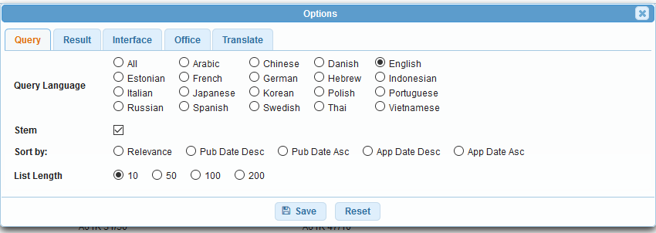

Slide 45
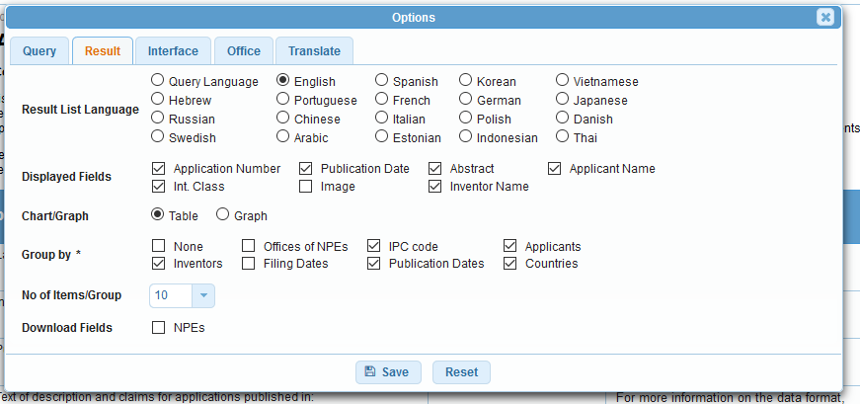
Options - results

Slide 46
Options - results

Slide 47
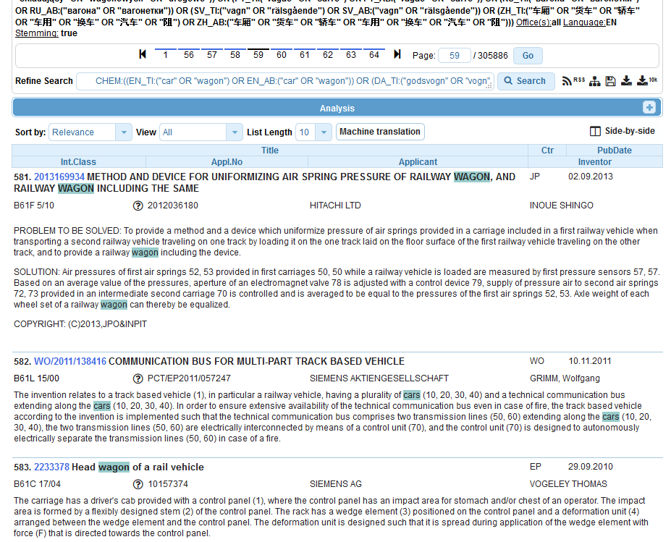

Slide 48
Options - results

Slide 49
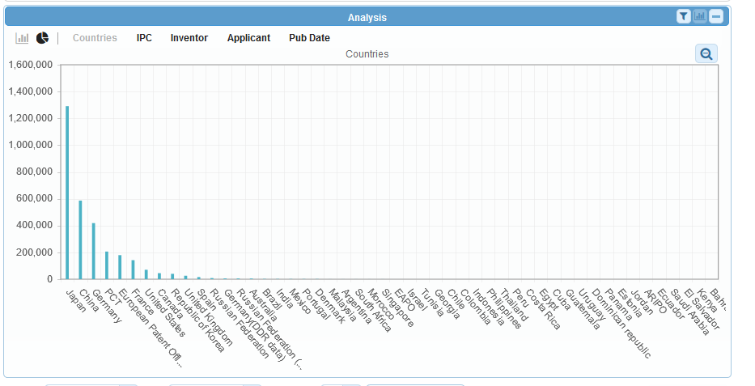
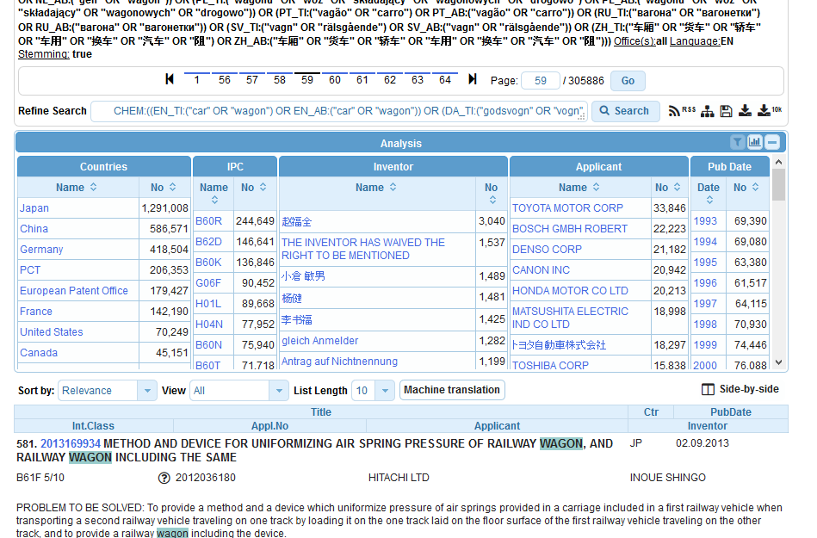
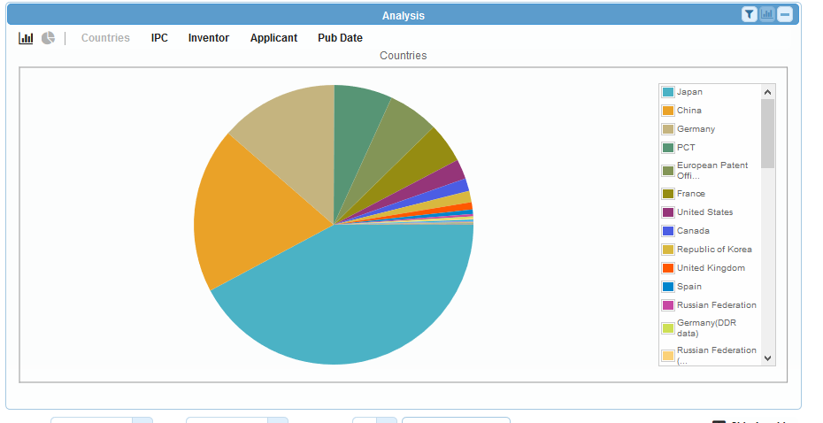

Slide 50
Options - results

Slide 52
Options - results

Slide 54
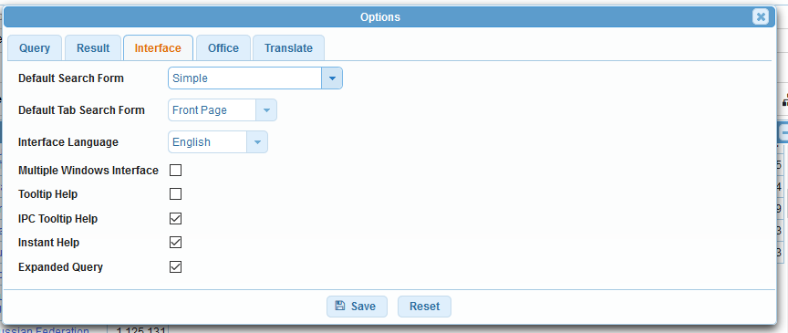
Options - interface

Slide 55
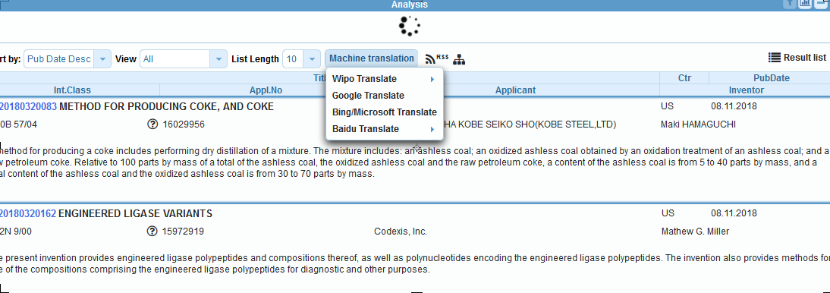
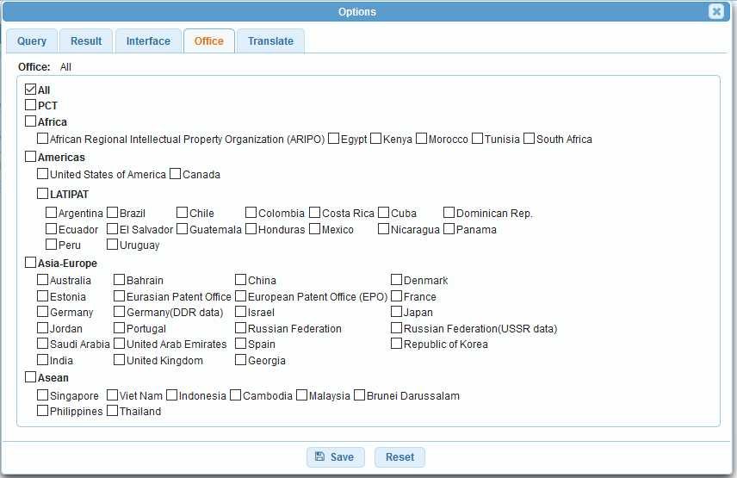
Options: office - translate

Slide 56
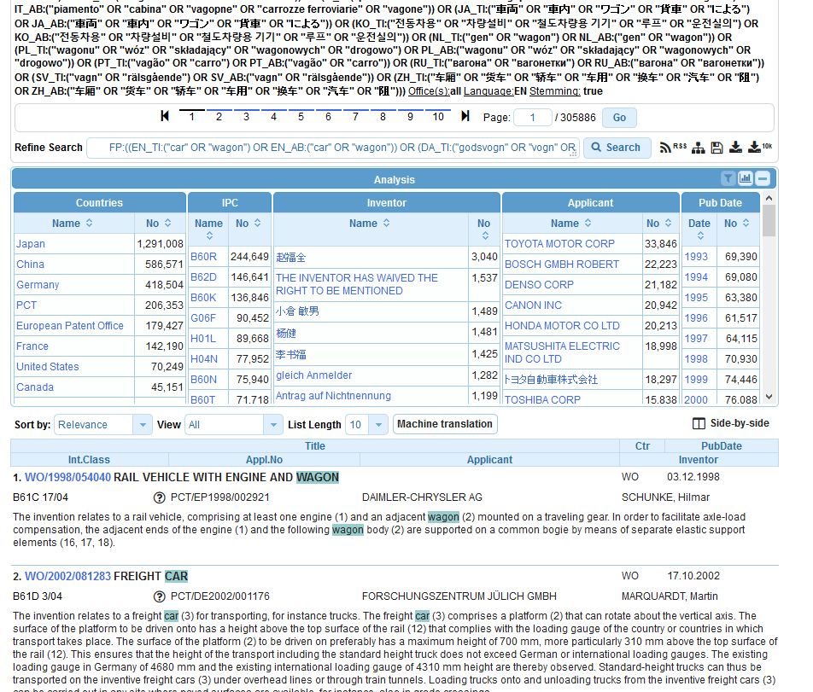
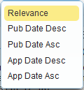
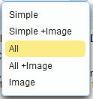

Slide 57
Next webinar: February 19 or 21
Chemical structure search
To register: https://attendee.gotowebinar.com/rt/2974686224036468995

Slide 58
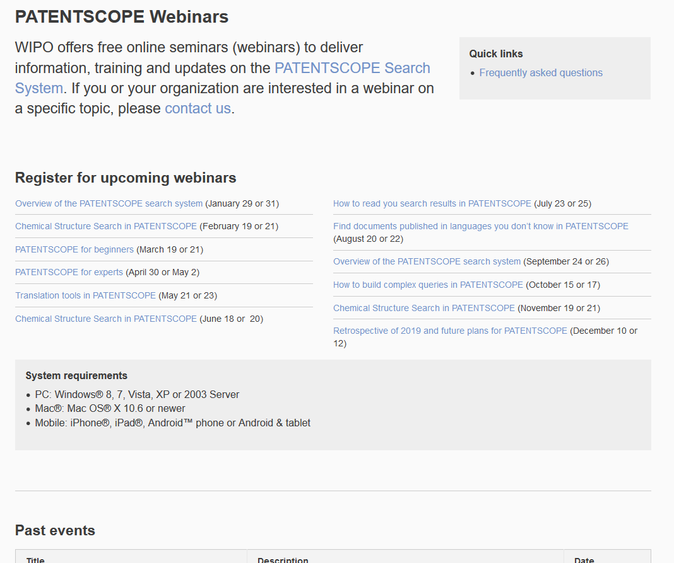
Future/past webinars
wipo.int/patentscope/en/webinar

Slide 59
Global Brand Database, Global Design Database
Webinars:
https://www.wipo.int/reference/en/designdb/webinar/index.html
https://www.wipo.int/reference/en/branddb/webinar/index.html

Slide 60
patentscope@wipo.int

Slide 61
patentscope@wipo.int

