Slide 1
PATENTSCOPE:
For Beginners
Cyber world
March
2019
Sandrine Ammann
Marketing & Communications Officer

Slide 2
Agenda
  Interfaces
    Simple interface
    Field Combination interface
    Advanced interface
    Chemical compounds
  User account
  Quiz
  Useful features
  Webinars
  Q & A session

Slide 3
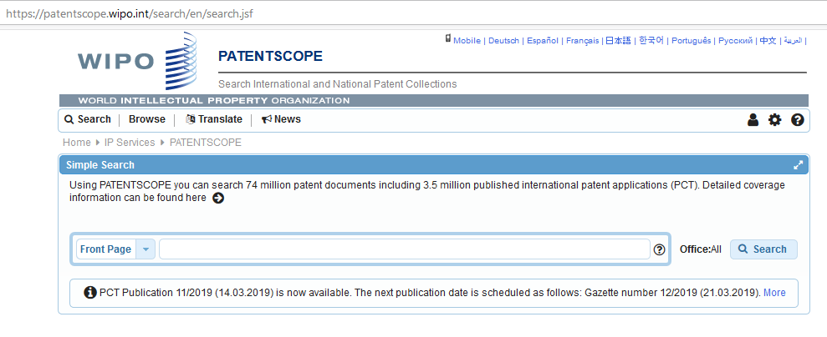
https://patentscope.wipo.int/search/en/search.jsf

Slide 4
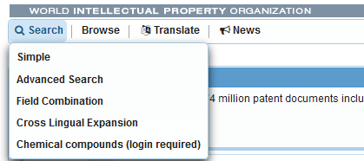
PATENTSCOPE: how to search

Slide 5
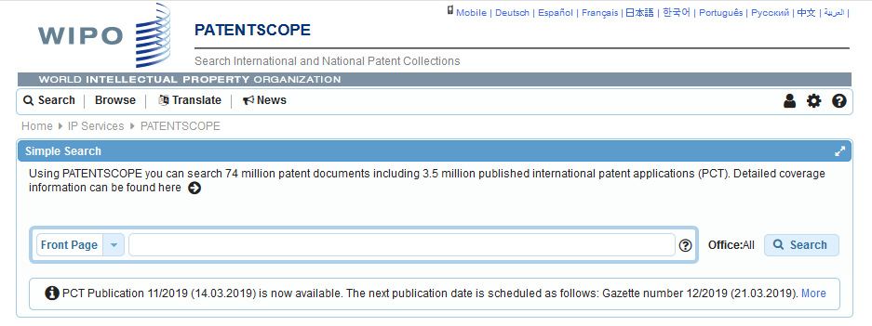
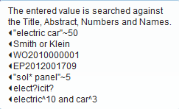
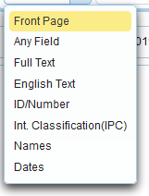
Interface : Simple

Slide 6
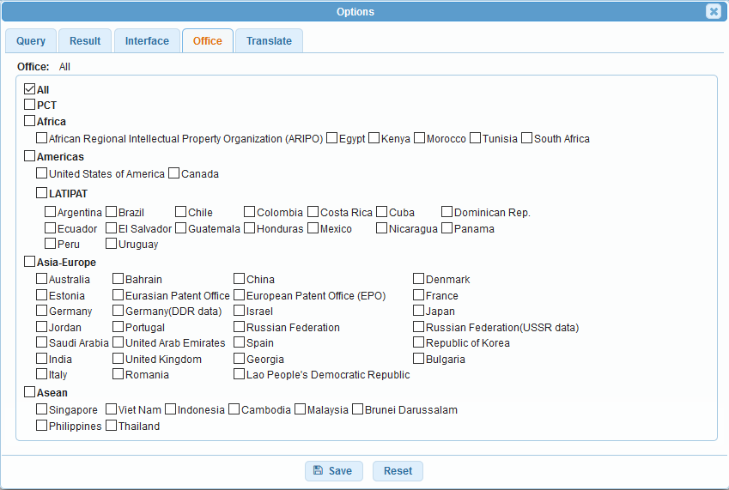
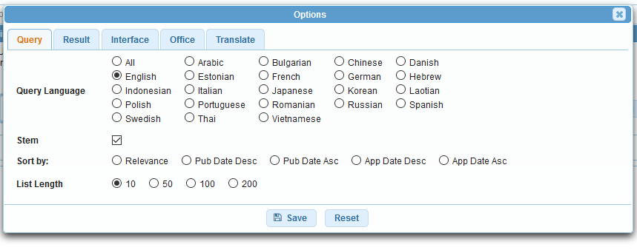
Collections selection

Slide 7
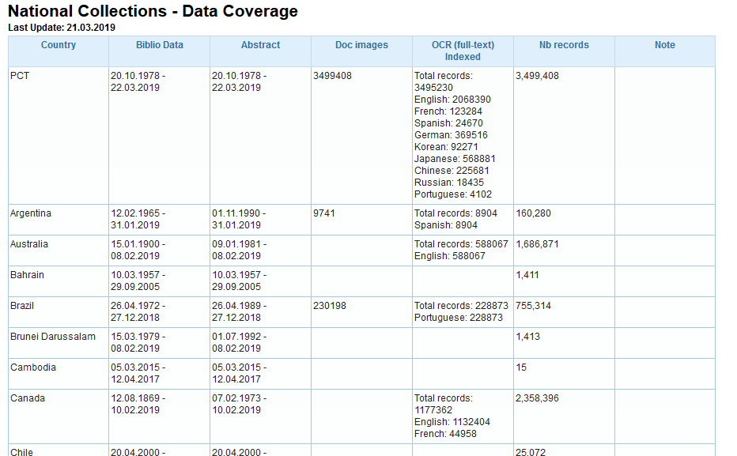
Coverage: collections-national phase
https://patentscope.wipo.int/search/en/help/data_coverage.jsf

Slide 8
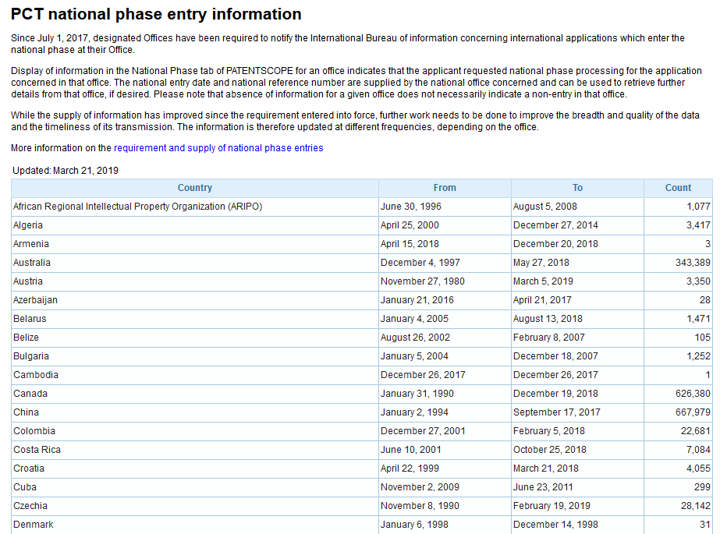
https://patentscope.wipo.int/search/en/nationalphase.jsf

Slide 9
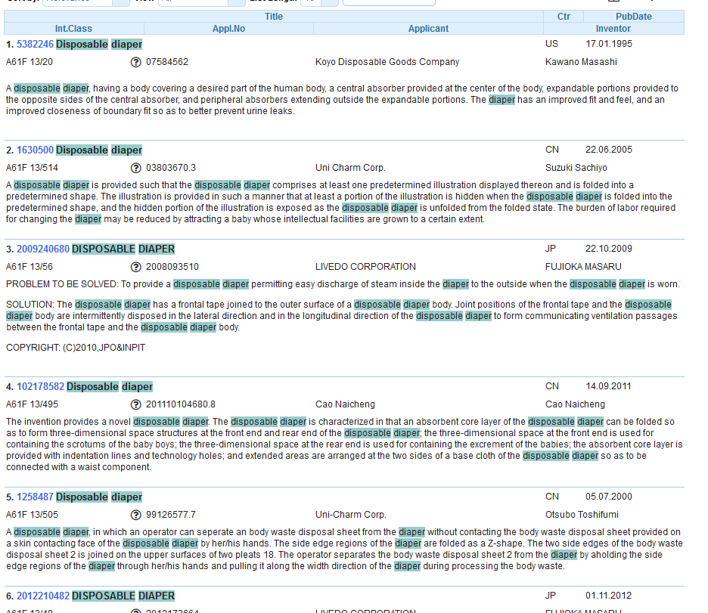
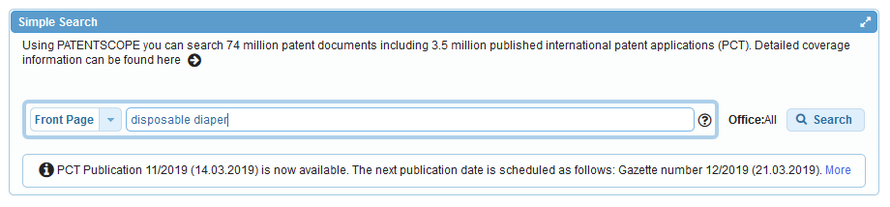
Interface simple - keywords

Slide 10
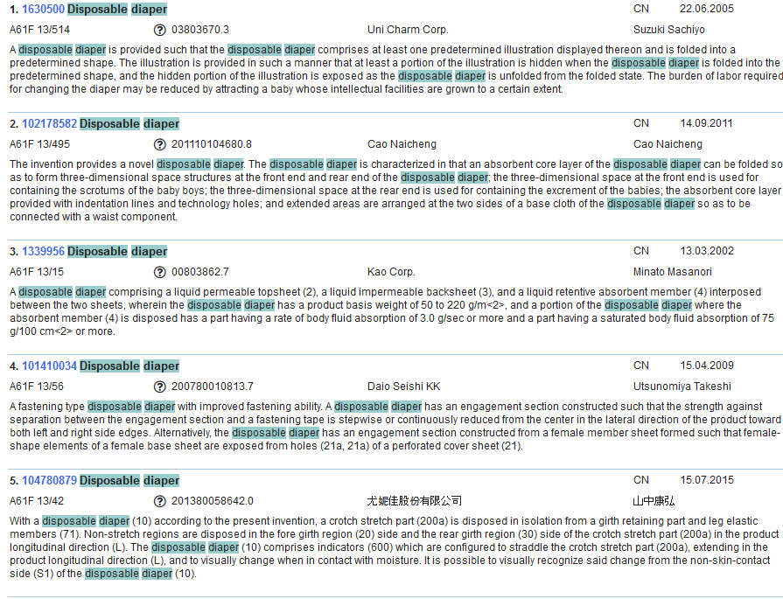
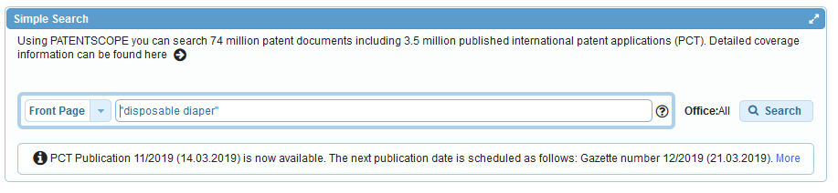

Slide 11
Interface: Field combination

Slide 12
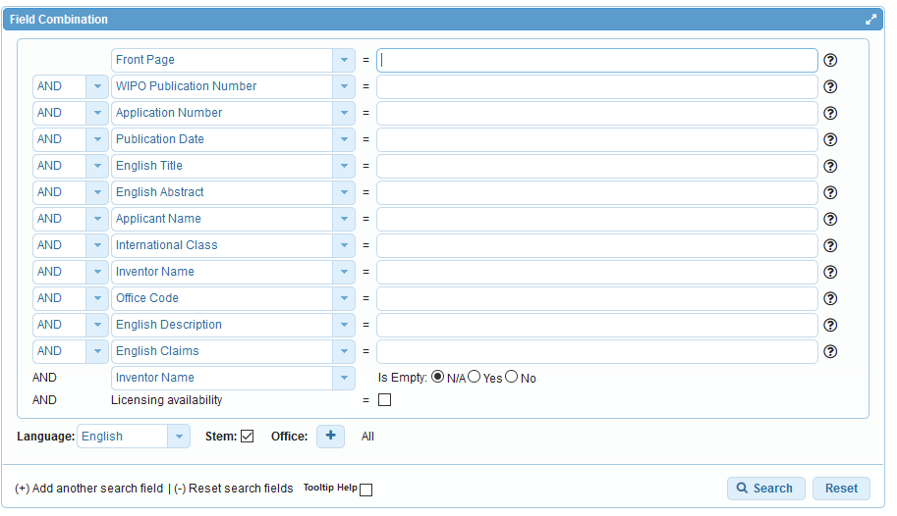

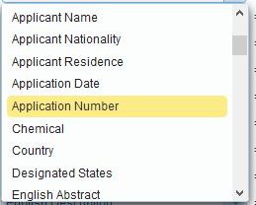
Field Combination

Slide 13
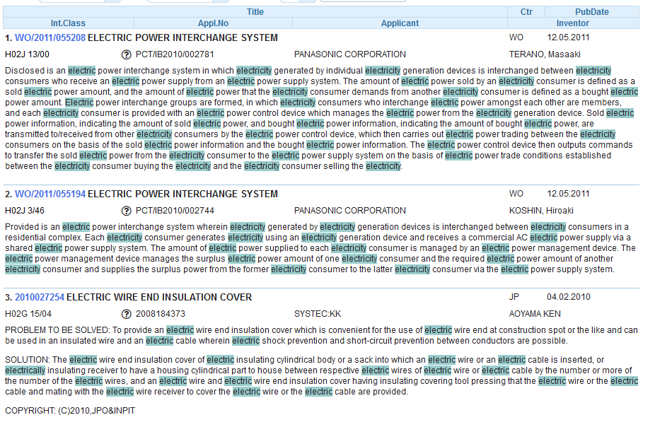
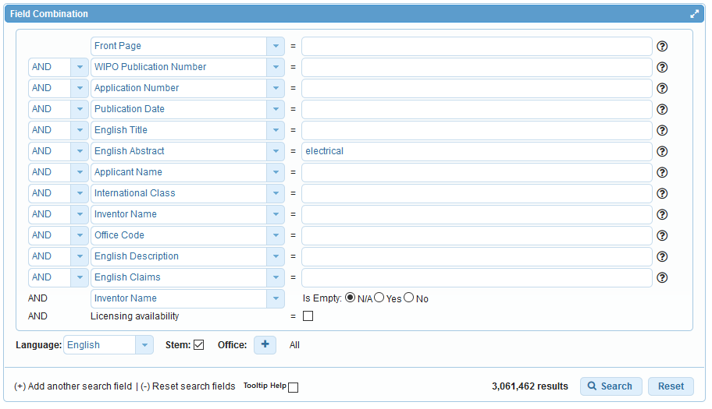
Stem

Slide 14
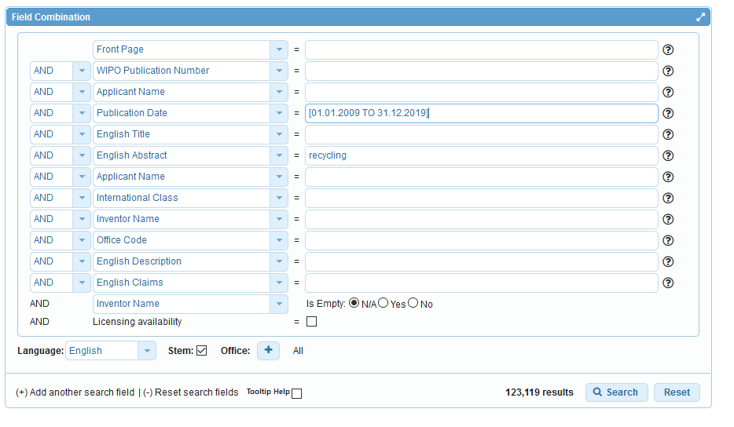

Slide 15
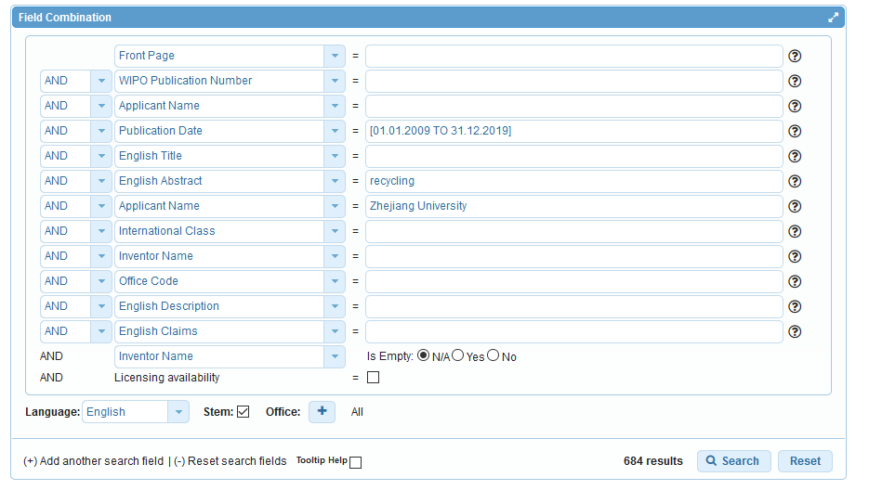

Slide 16
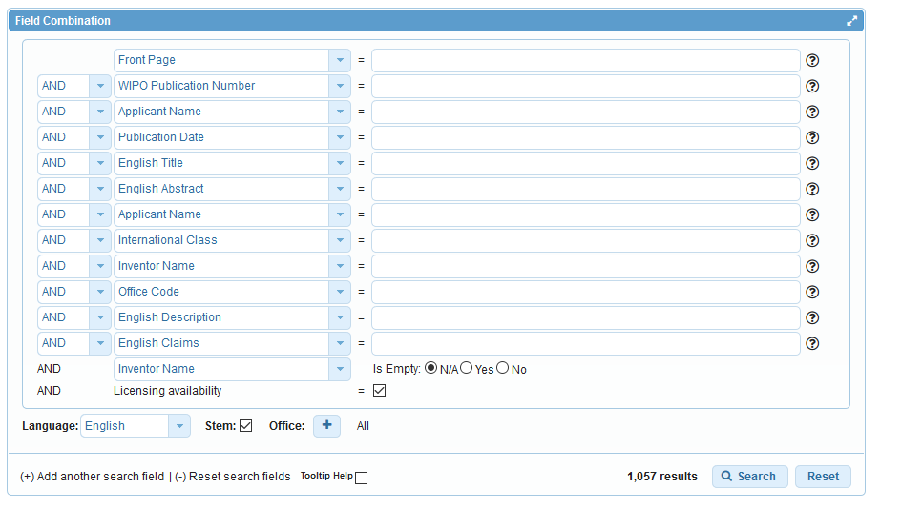
Licensing availability

Slide 17
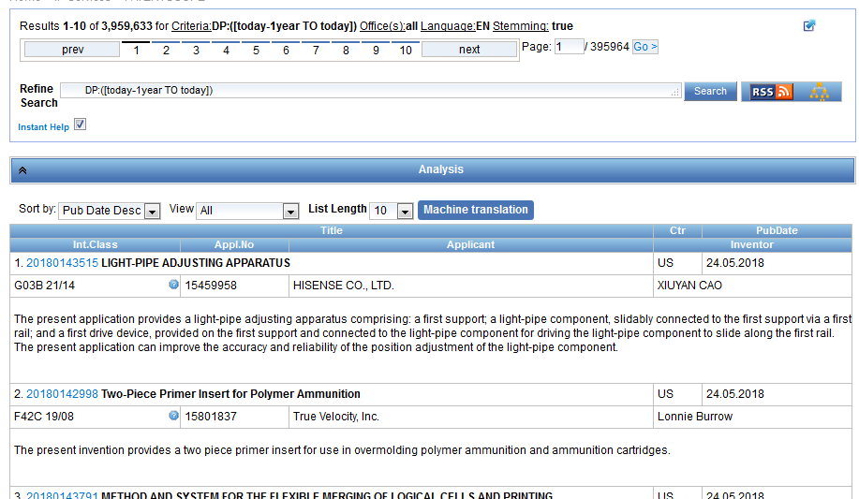
Analysis bar

Slide 18
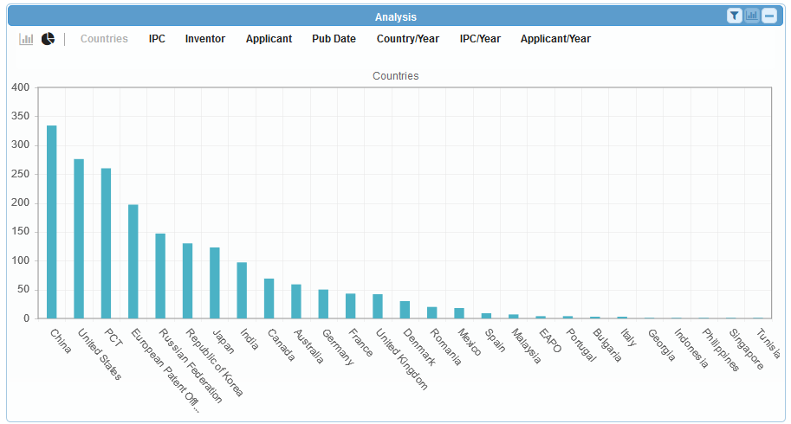
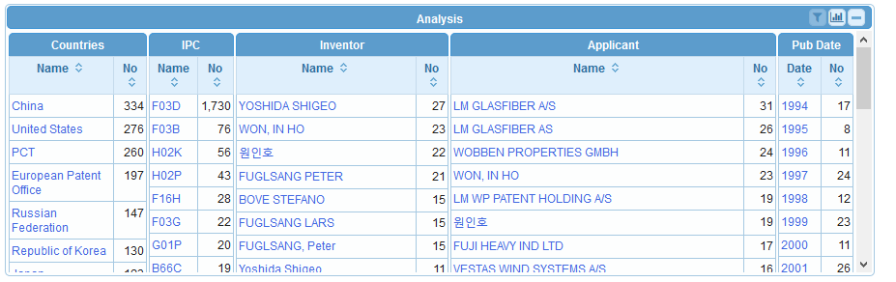

Analysis bar

Slide 19
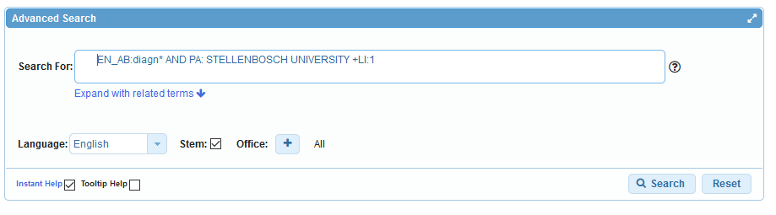
Interface: Advanced search

Slide 20
Instant help
Validates search query
Suggests terms
Provides:
  List of IPC codes
  List of countries

Slide 23
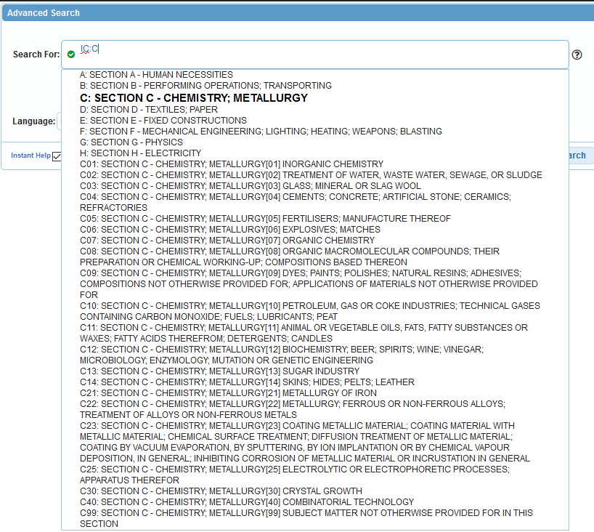

Slide 24
Tooltip help

Slide 25
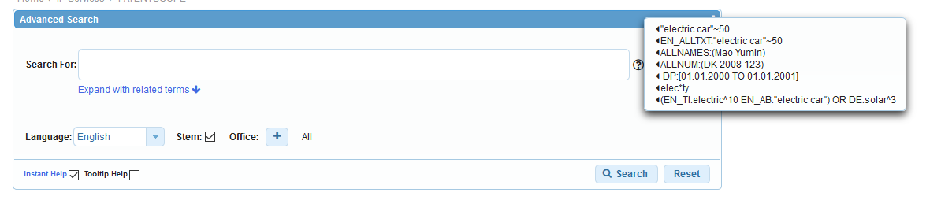
Question mark help

Slide 26
Help menu

Slide 27
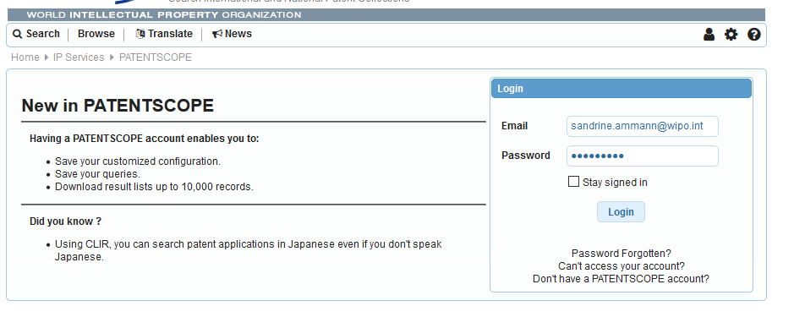
PATENTSCOPE account

Slide 28
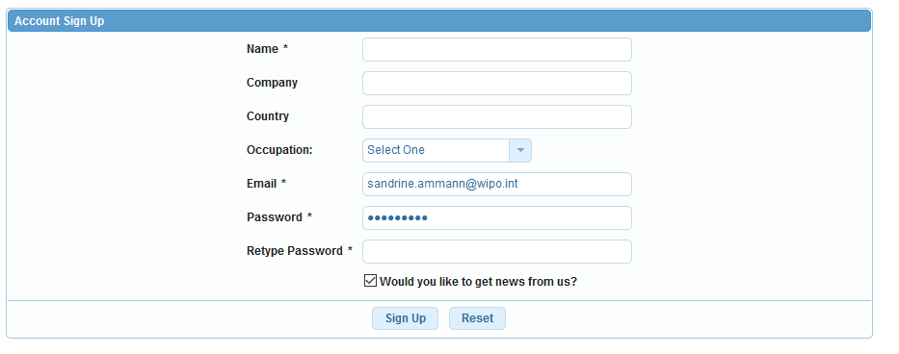
Signing up

Slide 29
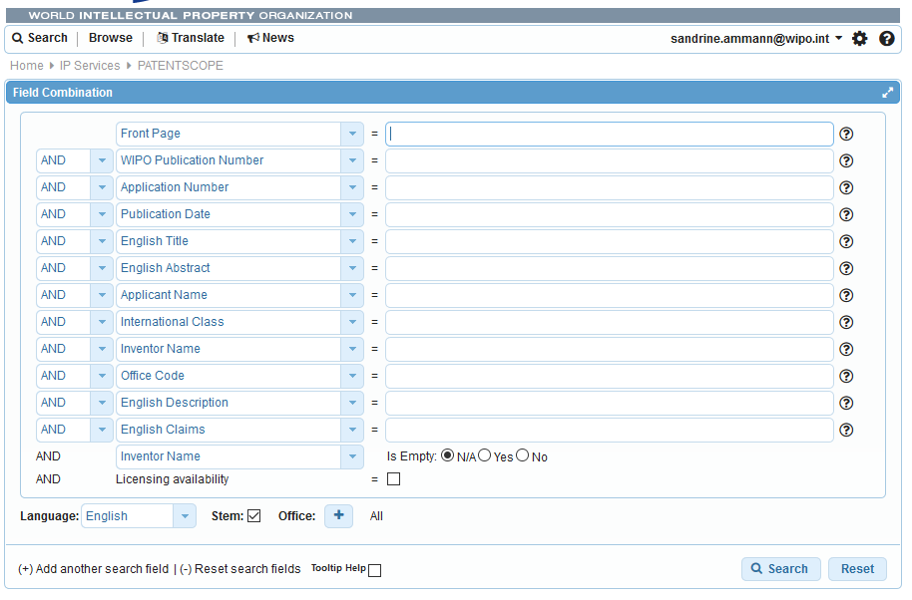
Once logged-in

Slide 30
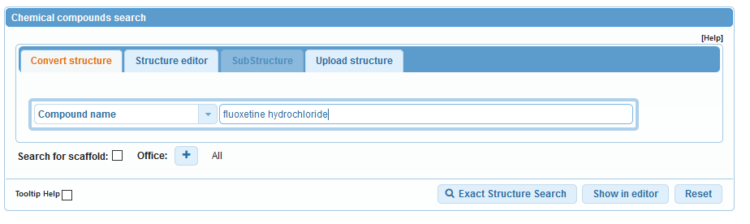
Chemical compound search

Slide 31
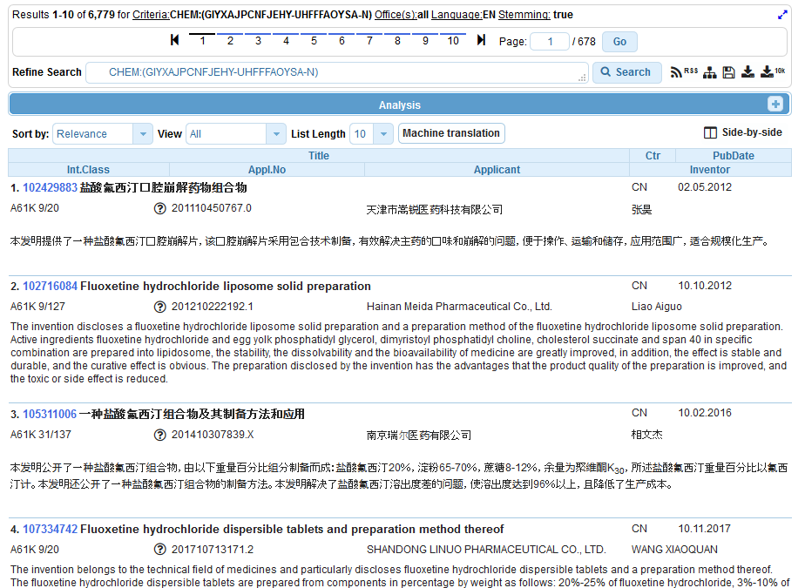

Slide 32
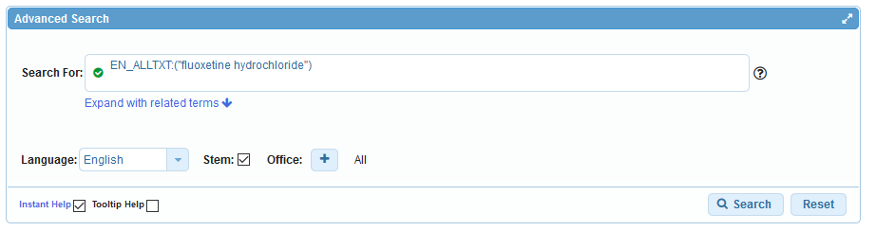
Advanced search

Slide 33
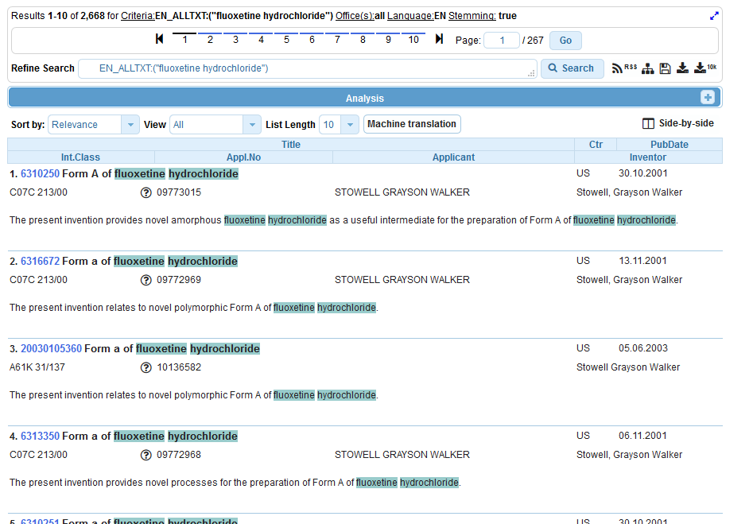

Slide 34
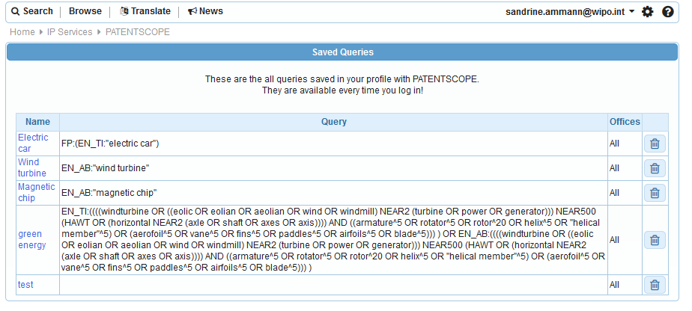
Saved queries

Slide 35
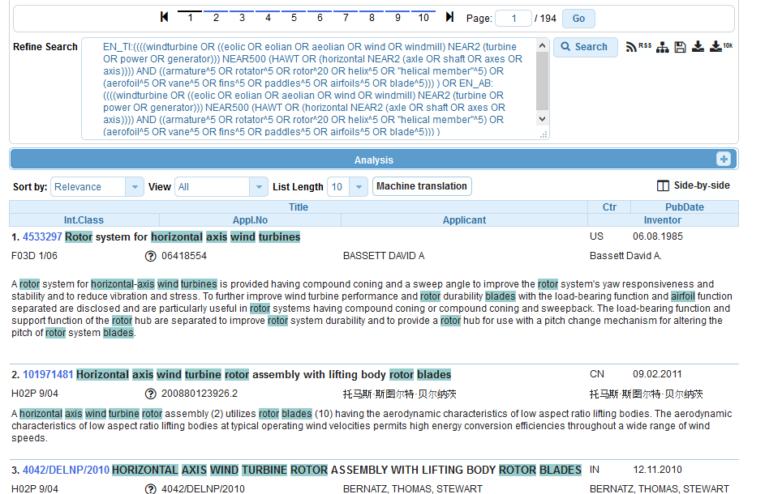
Downloading the results

Slide 36
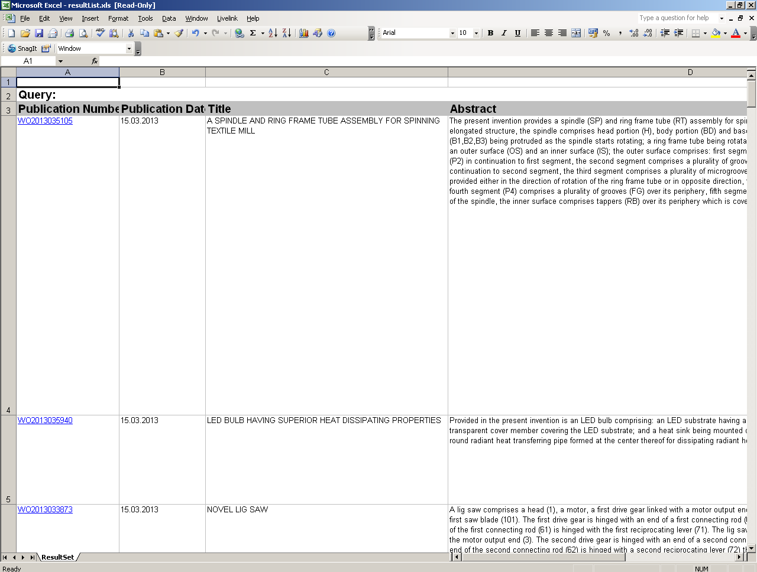
Downloaded results

Slide 37
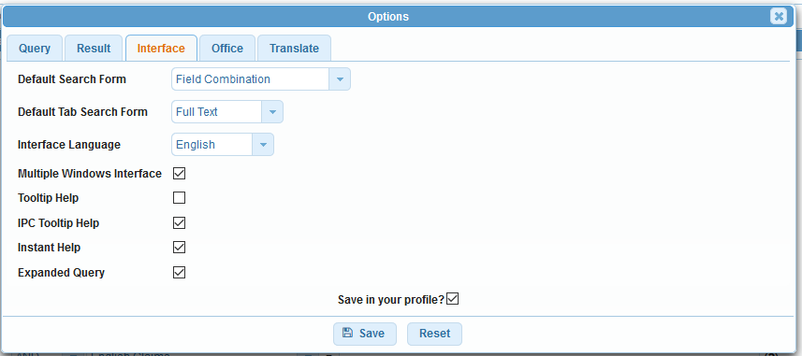
Account customization

Slide 38


Slide 39
Q1: Using the PATENTSCOPE account, can you download the entire result list?
A
No
B
Yes

Slide 40

Q1: Using the PATENTSCOPE account, can you download the entire result list?
A
No
B
Yes

Slide 41
Q 2: if you would like to combine operators AND and OR which interface should you use?
A
Advanced search
B
Field combination

Slide 42
Q 2: if you would like to combine operators AND and OR which interface should you use?
A
Advanced search interface
B
Field combination

Slide 43
Q3: which data are you selecting here?
A
PCT national phase
B
National/regional collections

Slide 44
Q3: which data are you selecting here?
A
PCT national phase
B
National/regional collections

Slide 45
Browse

Slide 46
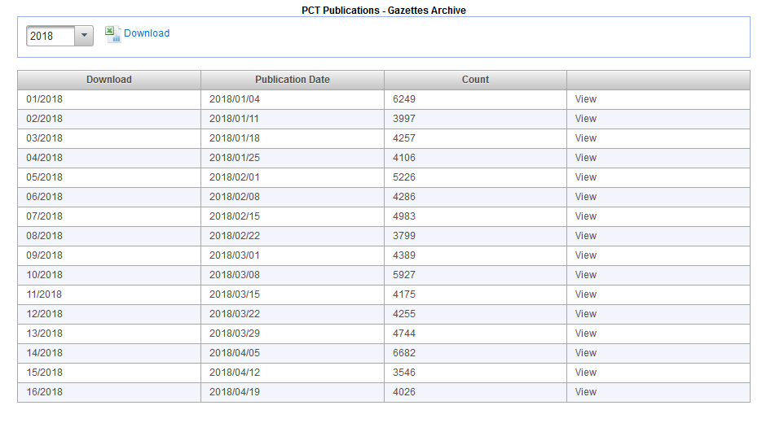
Gazette Archive

Slide 47
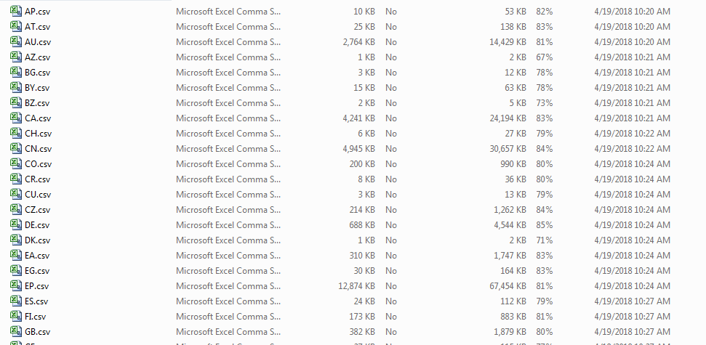
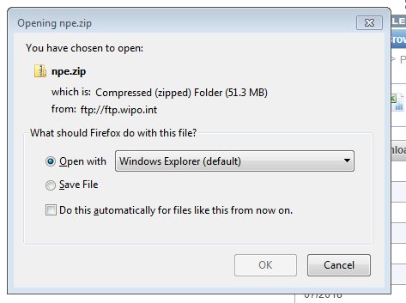
Download national phase entries

Slide 48
Forum

Slide 49
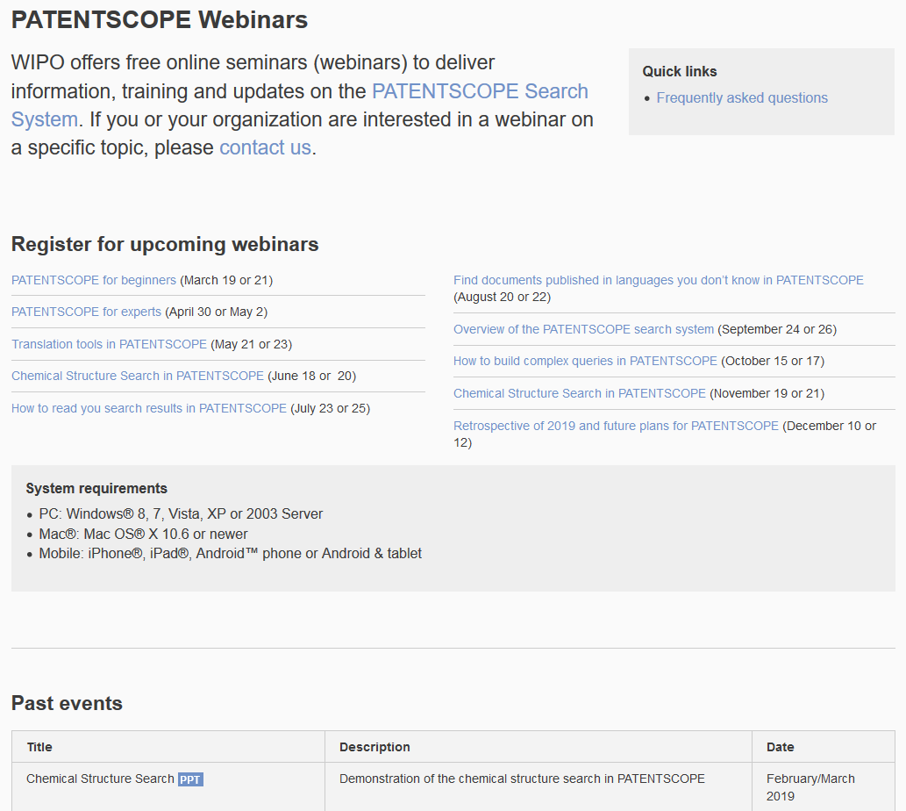
Future/past webinars:
wipo.int/patentscope/en/webinar

Slide 50
Next webinar
PATENTSCOPE for experts
  April 30 at 5:30 pm
  https://attendee.gotowebinar.com/rt/5502715244456302339
  May 2 at 8:30 am
  https://attendee.gotowebinar.com/rt/5502715244456302339

Slide 51
Global Brand Database: webinar
Image searching in The Global Brand Database
  May 1 at 5:30pm CET
  https://attendee.gotowebinar.com/register/1932484440876267010

Slide 52
Global Design Database: webinar
Performing effective searches in the Global Design Database
  May 3 at 5:30pm CET
  https://attendee.gotowebinar.com/rt/5681778409662221570

Slide 53

patentscope@wipo.int

