Slide 2
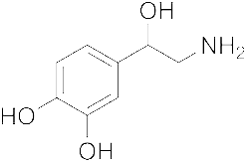
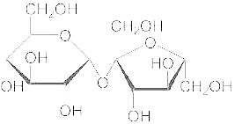
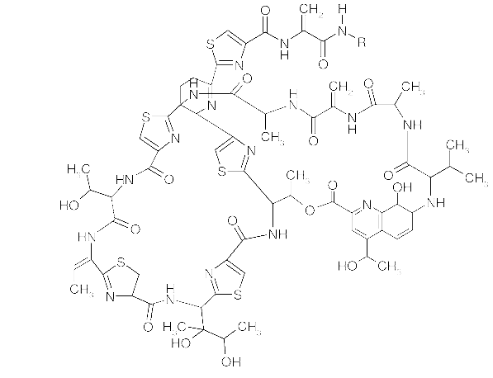
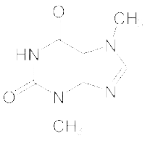
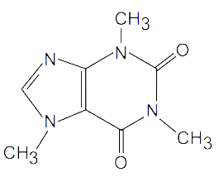
Agenda
Chemical structure search
Access
How does it work?
Q&A

Slide 3
Access
Available at https://patentscope.wipo.int
Access only with a WIPO account

Slide 4
Structure search - the concept
Recognize the names of chemical compounds in patent texts and their structures from embedded drawings included in patent texts
Standardize all the different representations of chemical structures into InchIkeys
Implement search functions using InchIkeys that can be used by non chemists

Slide 5
InchI and Inchikeys
Definition: a short, fixed-length character signature based on a hash code of the InChI string.
InChIkeys provide a precise, robust, IUPAC* approved structure-derived tag for a chemical substance.
*International Union of Pure and Applied Chemistry

Slide 6
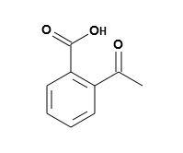
Example: InchI – InchIKey for aspirin
InChIKey = a fixed-length (27-character) condensed digital representation of an InChI
InChI = is a textual identifier developed to make it easy to perform web searches for chemical structures

Slide 7
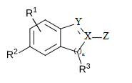
Scope
Works on developed exact formulas ≠ Markush structures (-R) that are chemical symbols used to indicate a collection of chemicals with similar structures.

Slide 8
Coverage
Collections filtered by IPC codes:
PCT
IP5
Russia
Eurasian Patent Office
Fields:
Title
Abstract
Description
Claim

Slide 9
Limitations
Long automated procedures, no supervision
Will not recognize 100%! Same drawbacks as the OCR
Depends on OCR quality for PCT applications
Does not work with simple formulas such H2O
Not all collections and related languages
Notes:
Simple formulae like H2O are not captured to avoid information overload (and they can be searched by keywords).

Slide 10
Why is it useful?
Common names such as “aspirin”, “paracetamol” might not be used in patent documents
There are many ways of representing formulas
Expand your searches with the substructure search

Slide 11
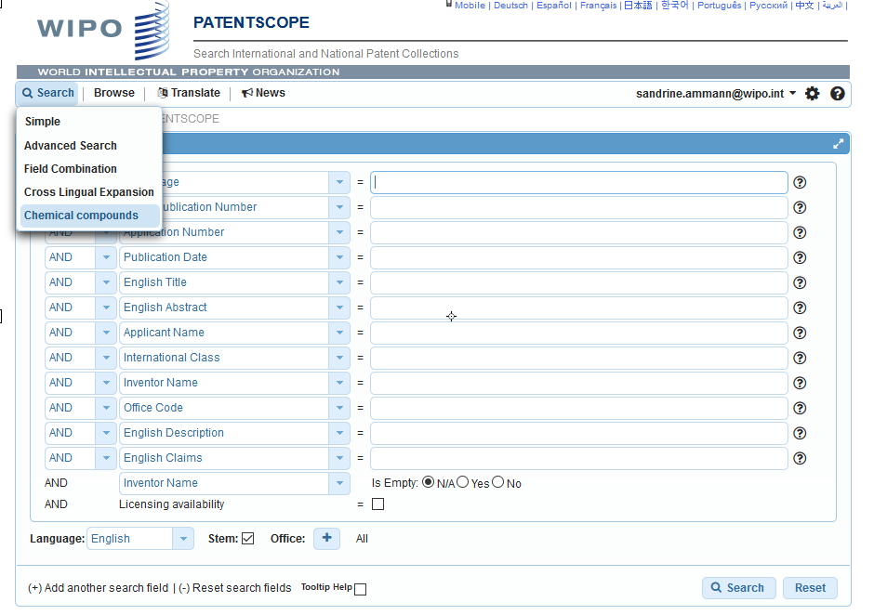
How does it work?

Slide 12
4 options

Slide 13
Scaffold
Basic skeleton of a molecule to which further groups and moieties are attached
Secondary information is ignored

Slide 14
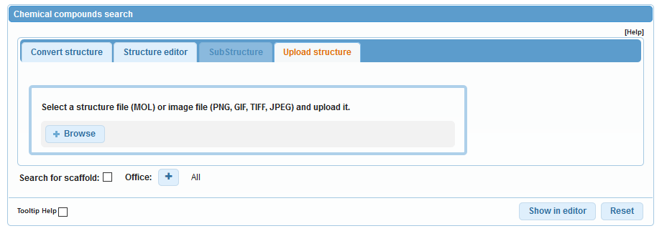
Upload a structure

Slide 15
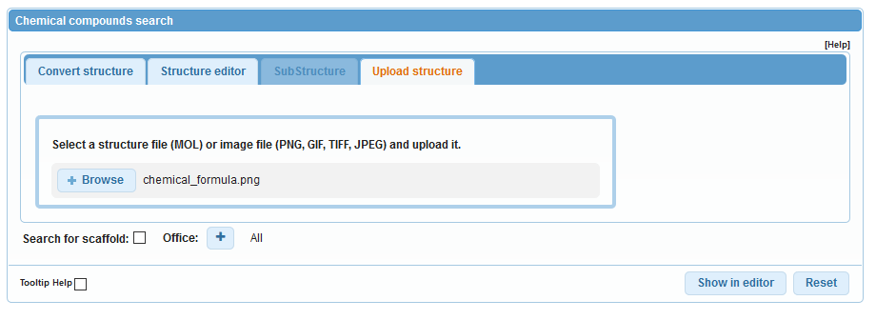
Example

Slide 16
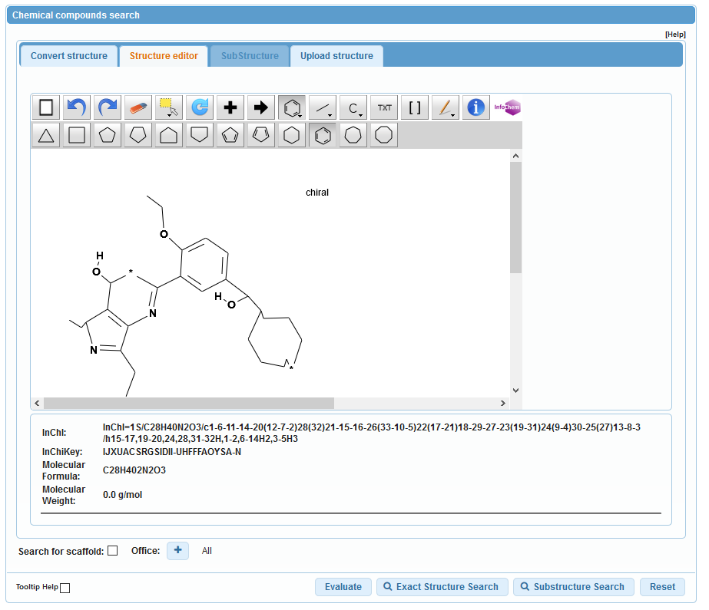

Slide 17
Structure editor

Slide 18
Convert a structure

Slide 19
Convert structure: ex.: paracetamol

Slide 20
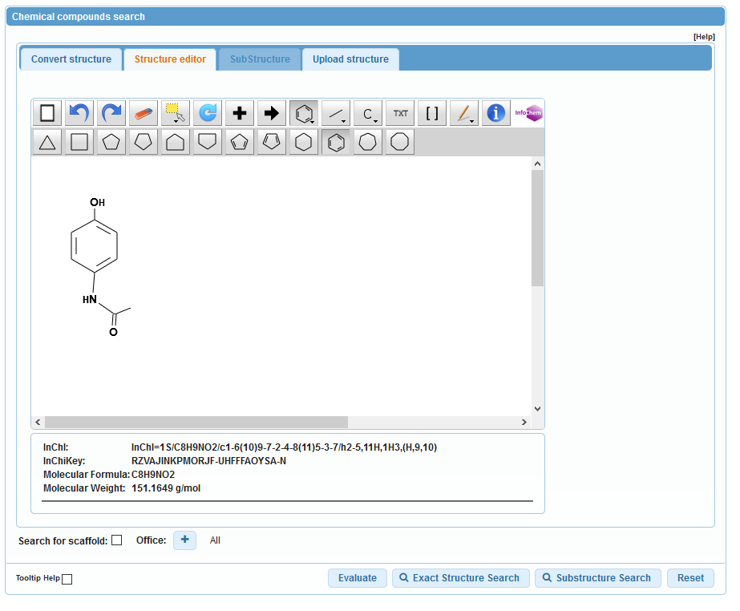

Slide 21
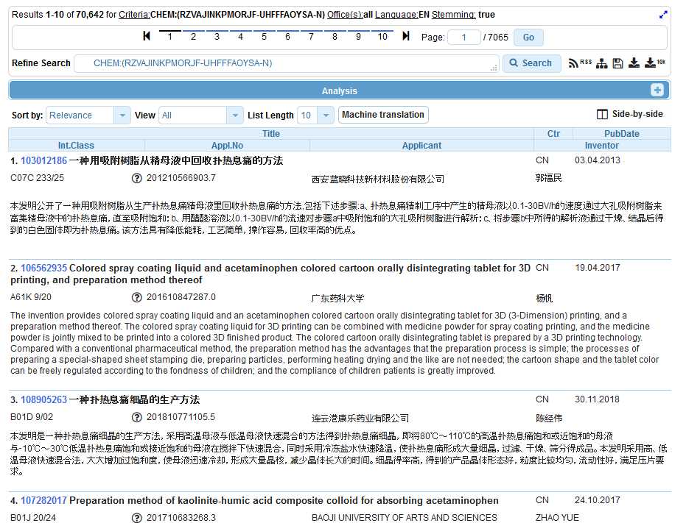
Results

Slide 22
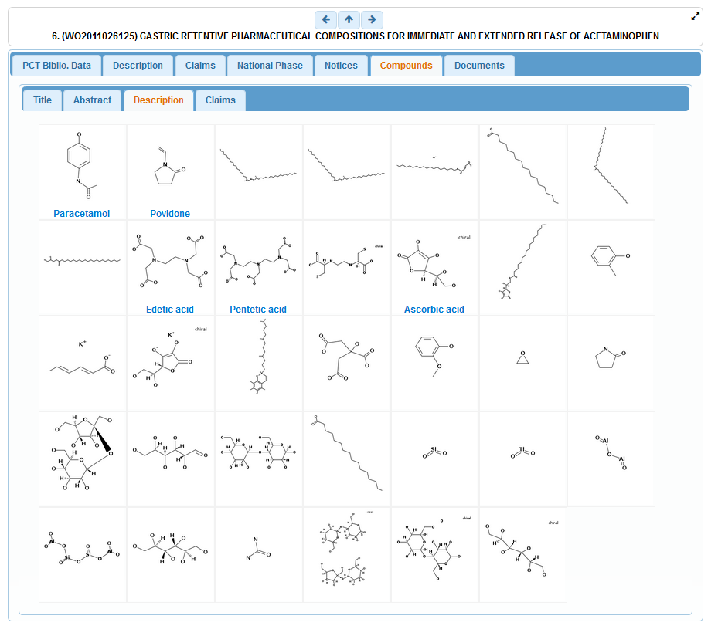

Slide 23
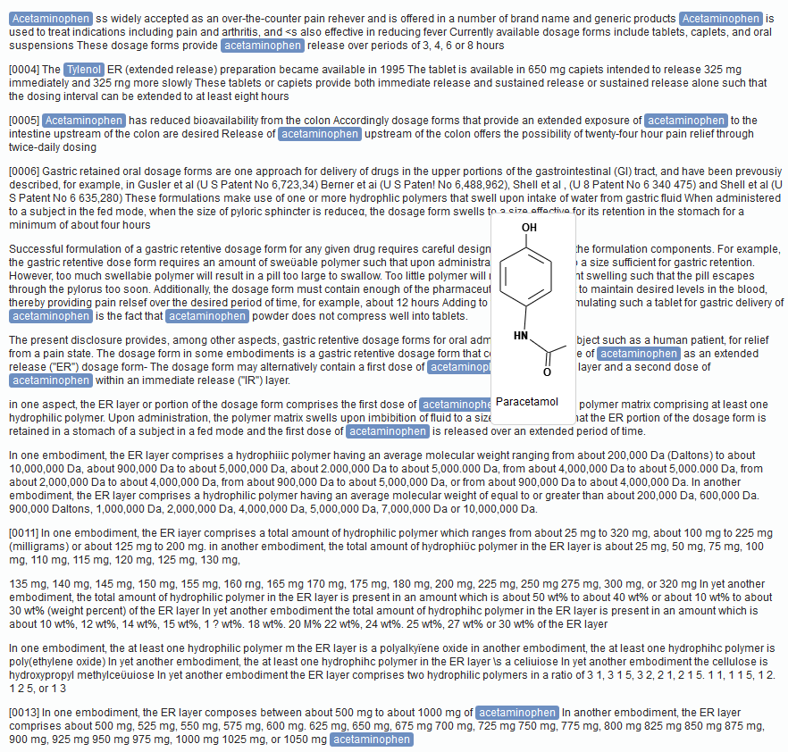

Slide 24
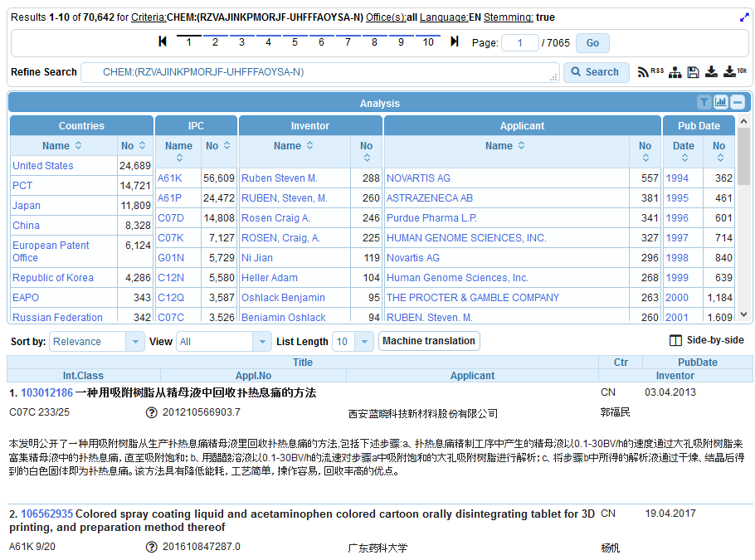
Analysis

Slide 25
Combine results with searches

Slide 26
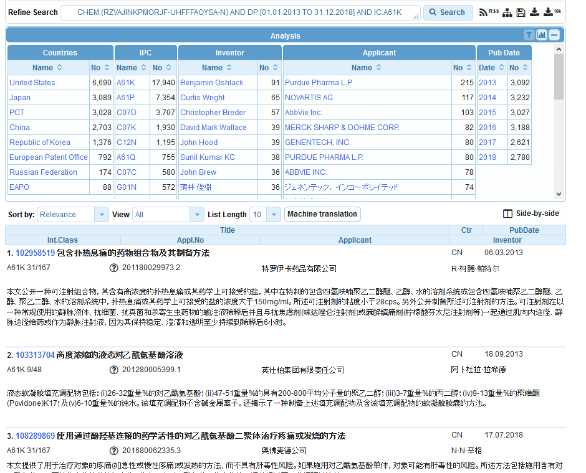

Slide 27
Search example: Theobromine
Its chemical formula is C₇H₈N₄O₂ and IUPAC name:
3,7-dimethyl-1H-purine-2,6-dione
Theobromine is found in the seeds of the plant Theobroma Cacao, which is the well-known source of chocolate and cocoa. It has a bitter flavor, which gives dark chocolate its typical bitter taste.
Notes:
I will now show you how to use the system with the example of theobromine.
The IUPAC name of theobromine is 3,7 dimethyl 1H purine 2,6 dione. It can be found in dark chocolate and is responsible for it’s bitter taste.
27

Slide 28
Convert structure
Notes:
I enter theobromine in the search by component name text field but instead of clicking the search button directly, I click the «show in editor» button to show you the information the system can find about this name.

Slide 29
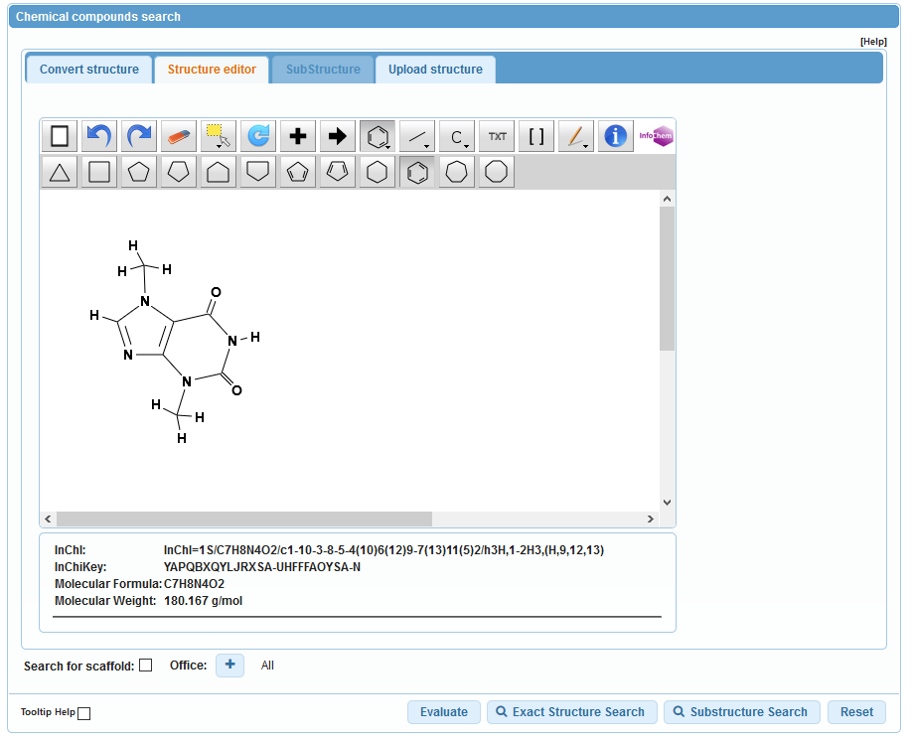
Notes:
We see indeed that theobromine is a recognized compound, we have even a drawing of its formula but more importantly we have the corresponding Inchi key which is displayed here. Now, we click on the Search button.

Slide 30
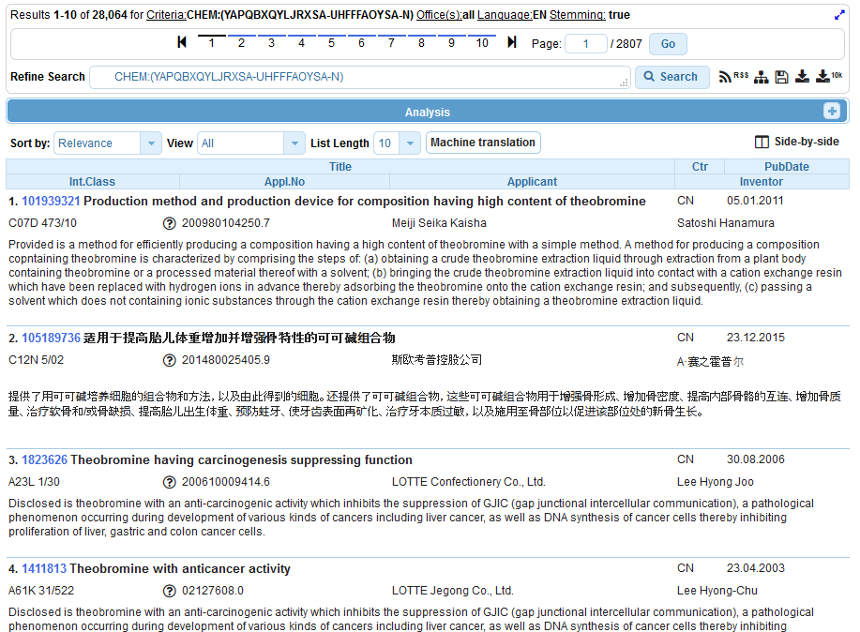
Notes:
And the system displays the results list of the PATENTSCOPE documents citing theobromine or any of its other representations in the title or abstract or description or claims. We see here that there are almost 6000 results and we see here the new PATENTSCOPE indexed field called CHEM that has been used to perform the search.
As with most PATENTSCOPE queries, the result list can be sorted by relevancy, which will show first the documents citing the compound the most frequently.
Now, let us click on the first result to see the details of the retrieved patent application.

Slide 31
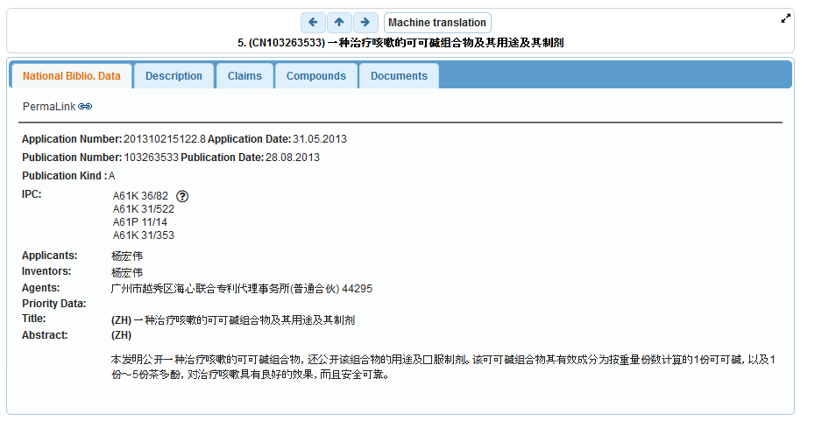

Slide 32
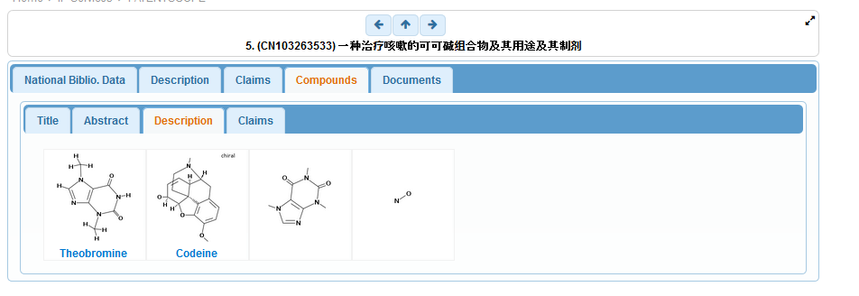
Notes:
Well, as expected, it shows the compounds detected in the document respectîvely in the title, abstract, description and claims of the application.
If we click on theobromine,

Slide 33
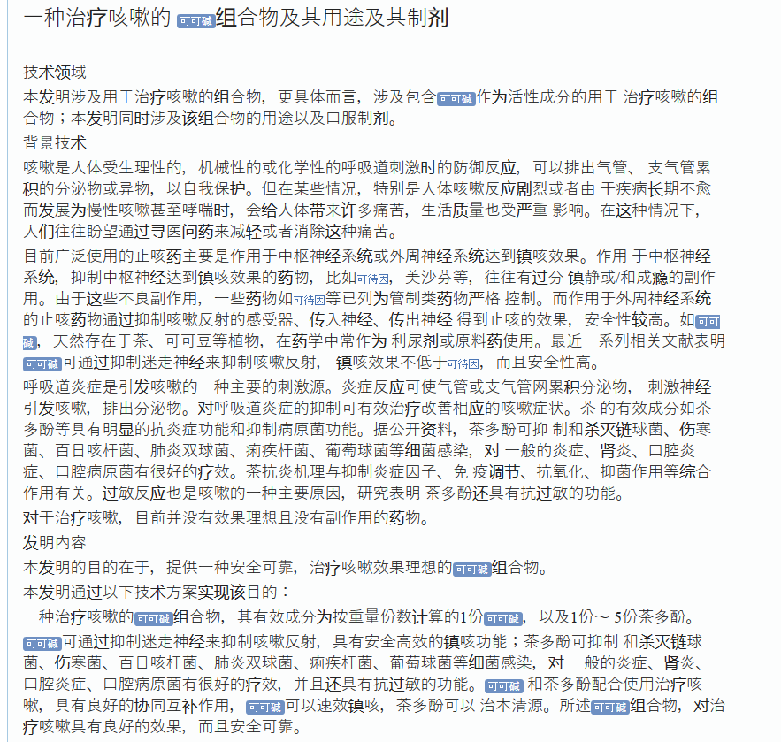
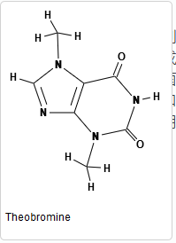
Notes:
Then the system opens the corresponding part of the document containing the compound, here the description.
If you move your mouse over the compound representation in the text, then the system displays the drawing of the formula. All recognized formulae are displayed also in blue and can be examined the same way, for example this is caffeine.

Slide 34
Add search criteria
PCT applications
Chocolate in English abstract
Notes:
Now let us imagine we want to restrict our search to PCT applications citing chocolate in their abstract.
This is done by combining the chemical compound search with other criteria using boolean logic as displayed here and now we only have 9 results to look at.

Slide 35
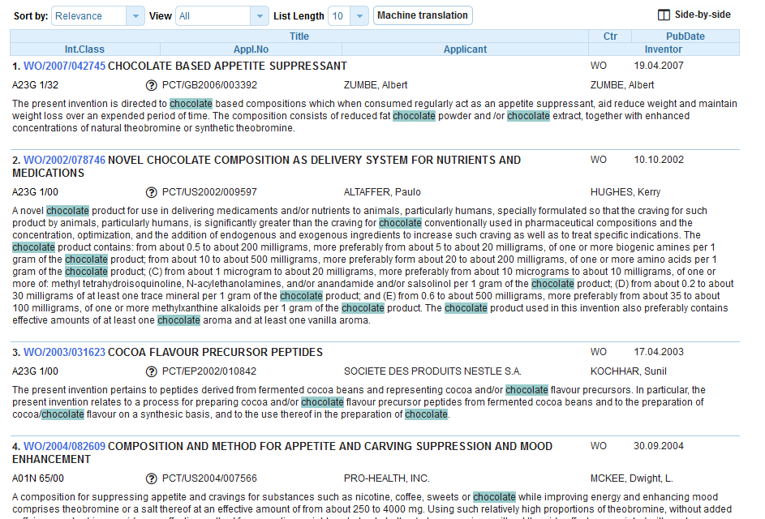

Slide 36
Example: fluoxetine hydrochloride
Its chemical formula is C₁₇H₁₉ClF₃NO
the first highly specific serotonin uptake inhibitor. It is used as an antidepressant and often has a more acceptable side-effects profile than traditional antidepressants.
Synonyms: Prozac, Sarafem

Slide 37
Chemical compound search

Slide 38
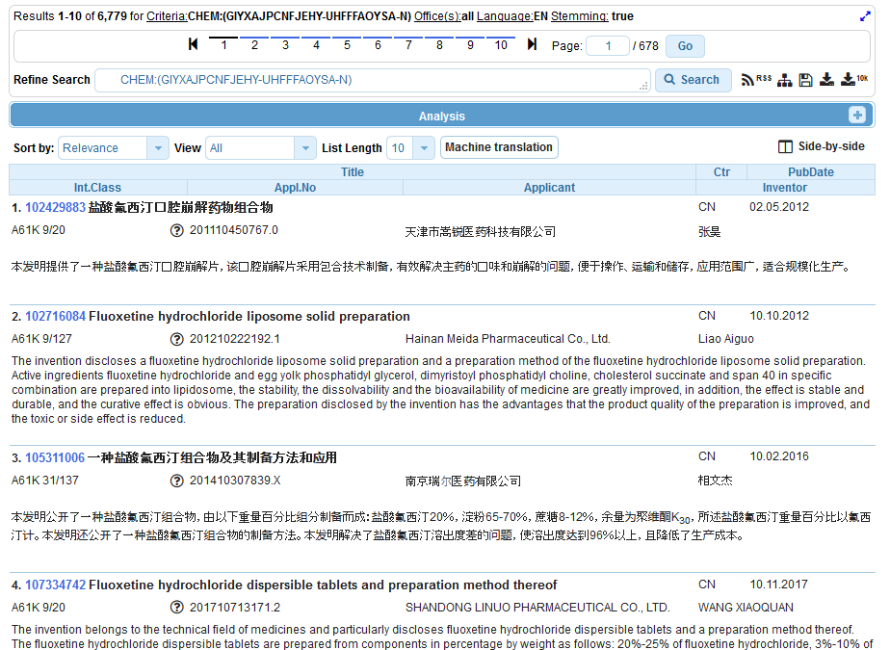

Slide 39
Advanced search

Slide 40
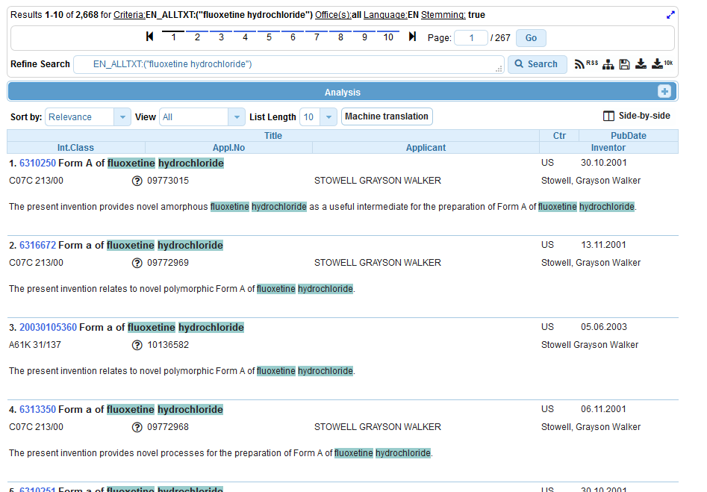

Slide 41
Example formula searching
4-(3-chloro-2-fluoroanilino)-7-methoxy-6-((1-(N-methylcarbamoylmethyl)piperidin-4-yl)oxy)quinazoline

Slide 42
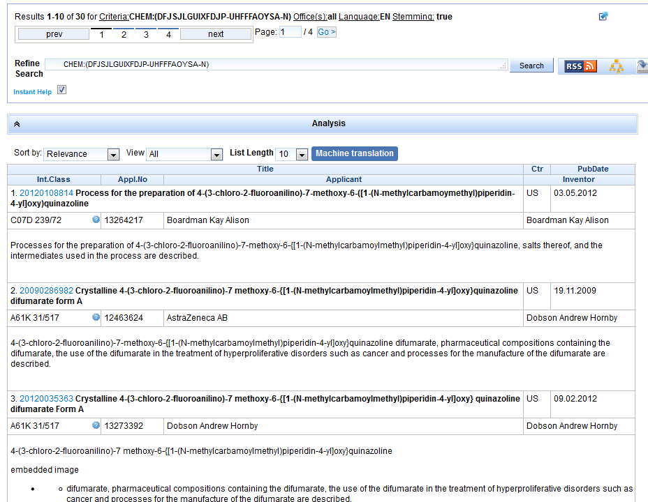

Slide 43
Example: Ritonavir

Slide 44
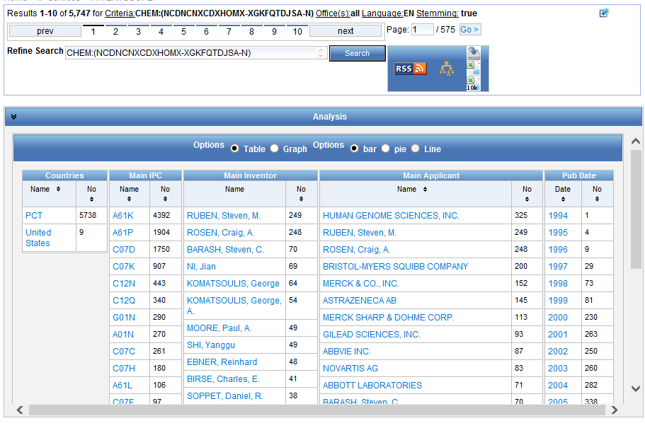

Slide 45
Patent landscape Report on Ritonavir-
Ritonavir is an antiretroviral drug from the protease inhibitor class used to treat HIV infection and AIDS. Ritonavir is included in the WHO Model List of Essential Medicines (EML)1.
The originator company is Abbott Laboratories, which markets Ritonavir under the brand name Norvir, or in combination with the protease inhibitor Lopinavir, as Kaletra or Aluvia. The U.S. Food and Drug Administration (FDA) approved the drug in March 1996 for oral solution and in June 1999 for capsules.
http://www.wipo.int/edocs/pubdocs/en/patents/946/wipo_pub_946.pdf

Slide 46
Search by CAS number
CAS83-88-5

Slide 47
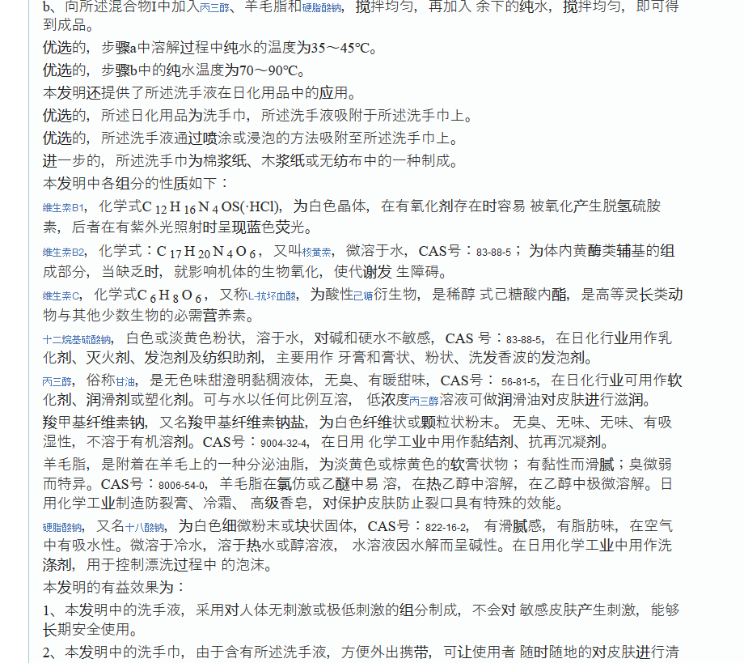
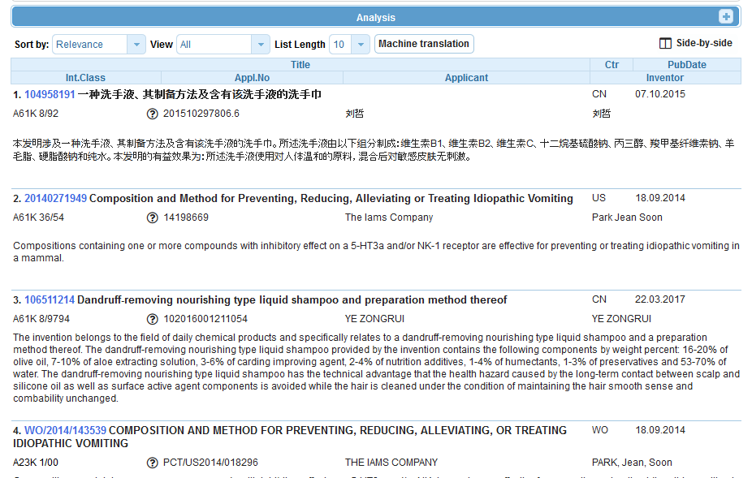

Slide 48
Sub-structure search – the concept
Identification of elements in larger structures
Notes:
Back in October 2016, we added the chemical search tool
It’s was developed on by InfoChem
You can draw the molecule or can search by compound name, INN, Inchi, SMILES or upload a MOL of images file
Chemical annotation of PATENTSCOPE full-text documents using InfoChem’s ICANNOTATOR

Slide 49
Substructure search

Slide 50
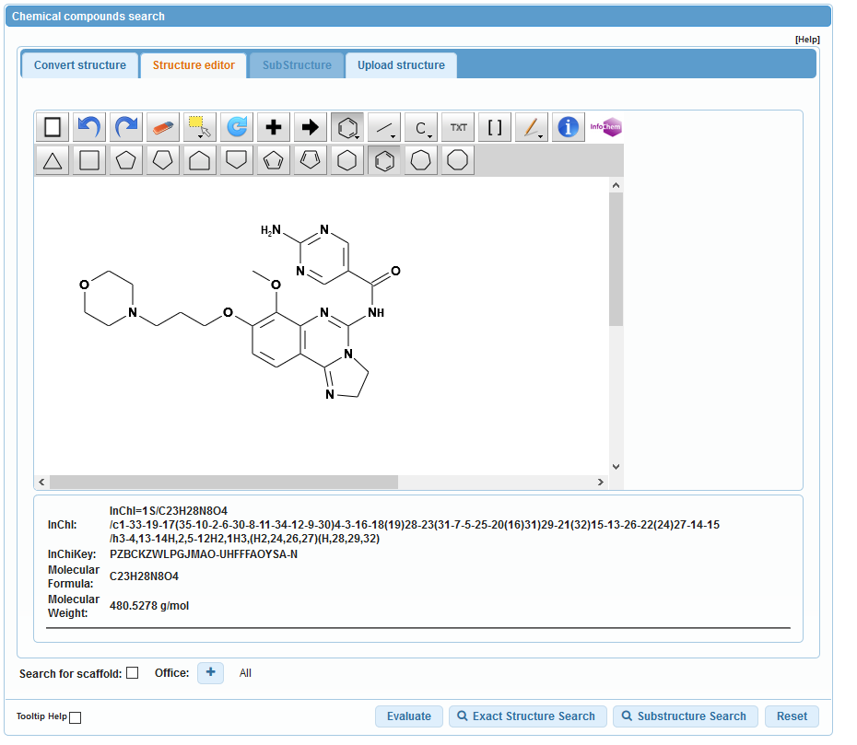

Slide 51
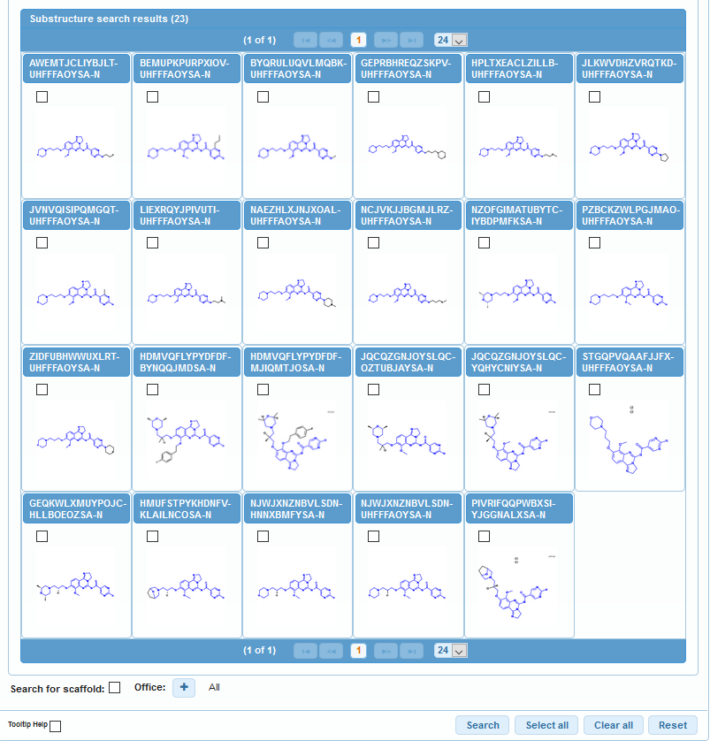

Slide 52
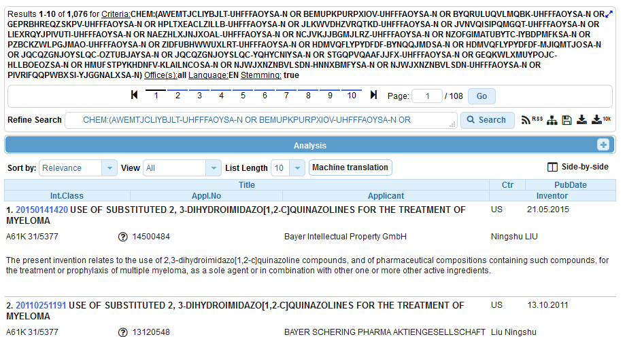

Slide 53
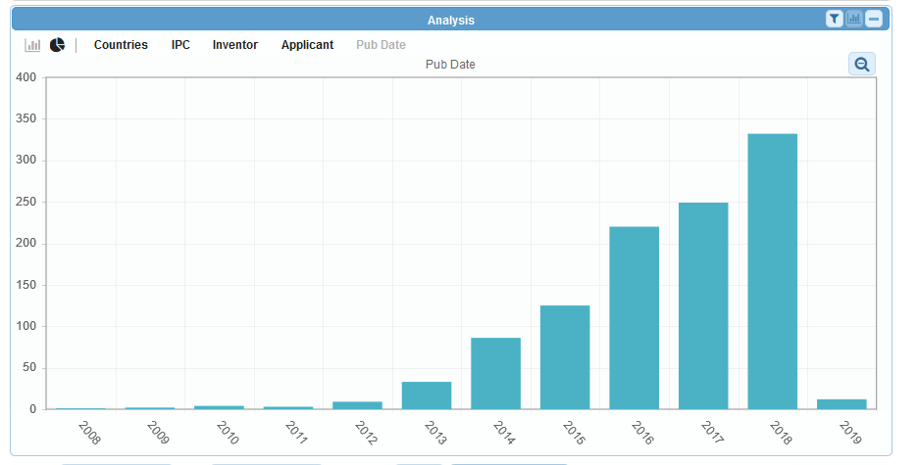

Slide 54
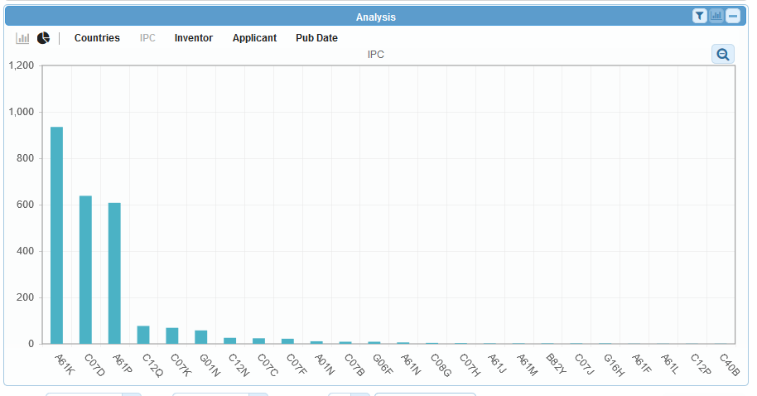

Slide 55
Photo by Ani Kolleshi on Unsplash

Slide 56
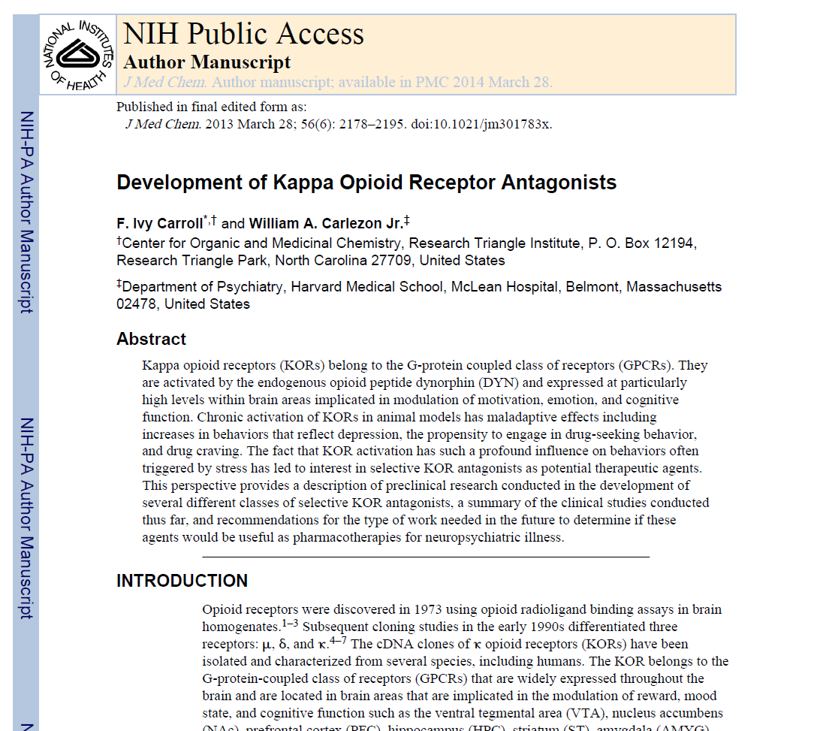

Slide 57
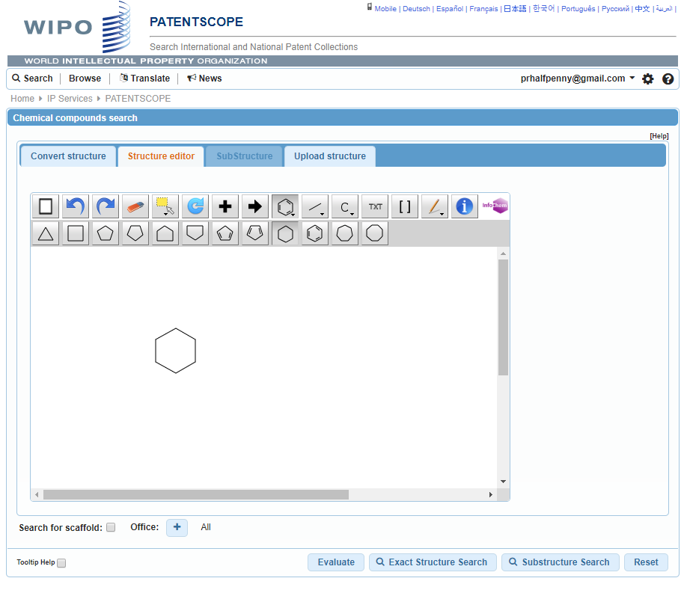

Slide 58
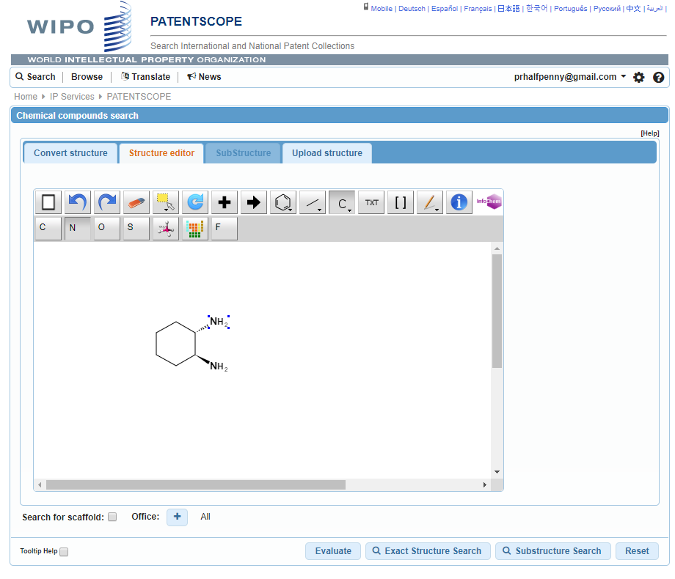

Slide 59
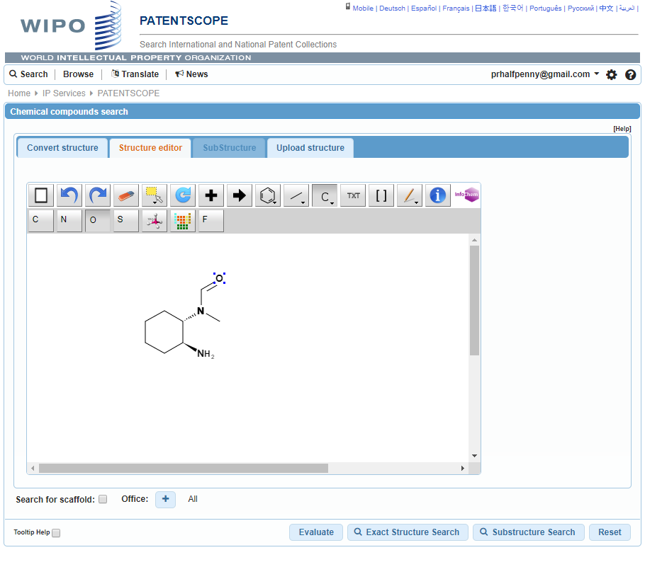

Slide 60
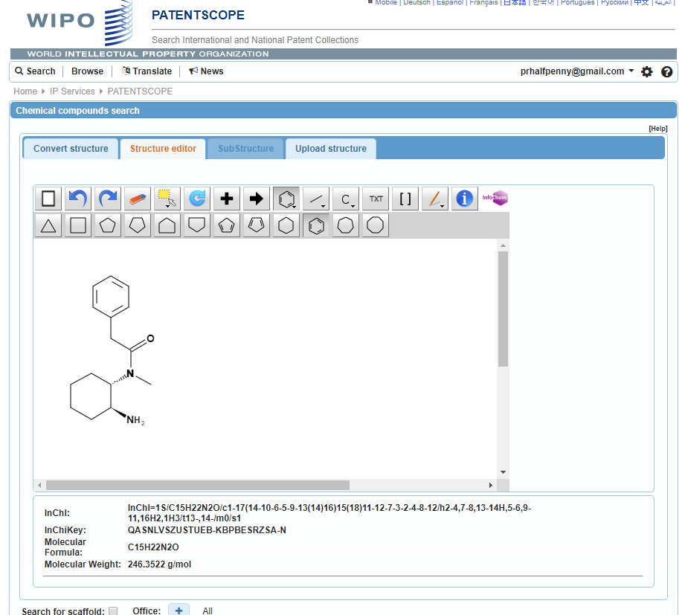

Slide 61
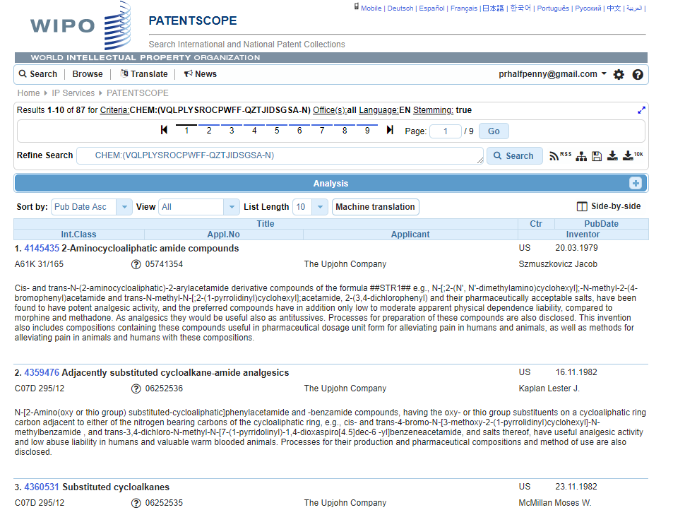

Slide 62
Can I search?
Stereoisomer
Monomer
Enantiomer
CAS name
Polymer, Poly(vinyl alcohol)
Inorganic cluster
Metal-organic framework
Transformable into InchI reactions
Reaction search
DNA sequence listing
Reaction search

Slide 63
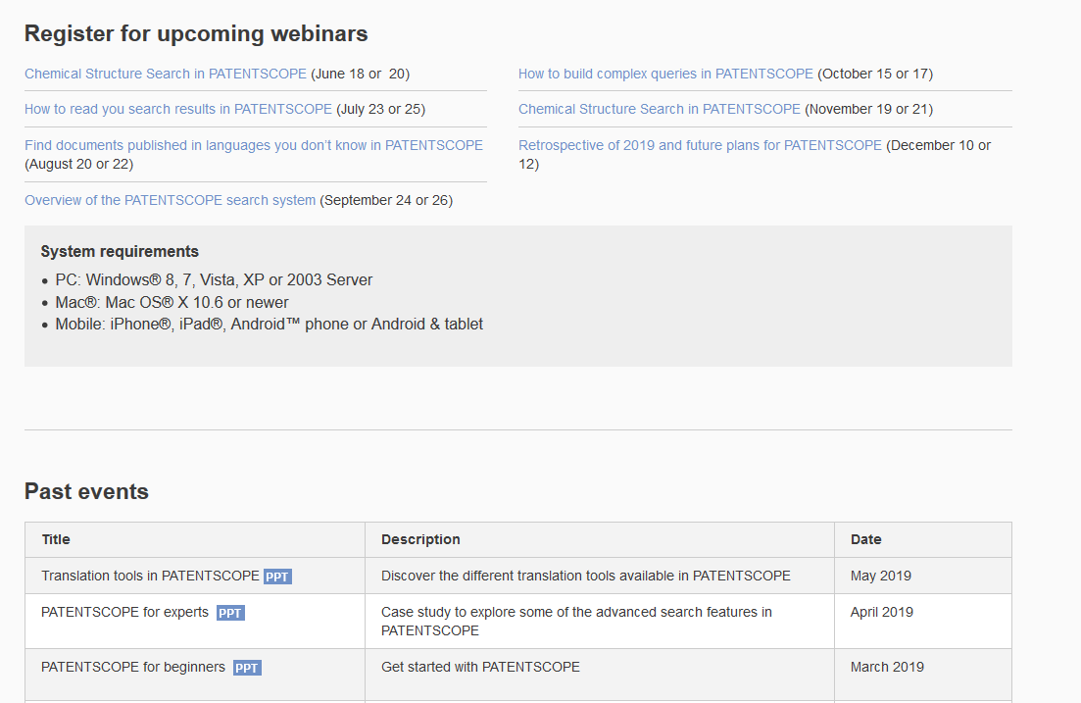
Future/past webinars:
wipo.int/patentscope/en/webinar

Slide 64
Next webinar
How to read your search results
July 23 at 5:30 pm
https://attendee.gotowebinar.com/rt/5297849839922624515
July 25 at 8:30 am
https://attendee.gotowebinar.com/rt/5297849839922624515

Slide 65
Global Brand Database: webinar
Búsqueda de DCI
Junio 26 @ 5:30 pm CET
https://attendee.gotowebinar.com/register/2926071320796952076
Inns search
July 3 at 5:30 pm CET
https://attendee.gotowebinar.com/register/7712387273527386123

Slide 66
Global Design Database: webinar
How to read, save and share your results in the Global Design Database
June 25 at 5:30 pm CET
https://attendee.gotowebinar.com/register/4273995607295080194

Slide 68
Q: Is the highlighting in the different parts of the document automatically done?
Yes
Q: How far back does the chemical structure search cover?
- China [1996 -2019]
- European Patent Office [1978 -2019]
- Eurasian Patent Office [1998 -2018]
- Japan [1993 -2019]
- Republic of Korea [1980 -2019]
- PCT [1979 -2019]
- Russia [1995 -2019]
- United States [1979 -2019]

Slide 69
Q: Can you go back and modify a structure you drew for another search?
No
Q: Can you look for a combination of two compounds
Yes: first you find the InchIkey of both compounds using Chemical Structure Search and then you combine them in Advanced Search

Slide 70
Q: When you draw a structure it doesn't give you common names and related synonyms?
Not in the Editor but in the documents in the result list
Q: Can I limit the structure search in claims?
Using the following query structure you can target parts/s of the patent document:
CHEM:(BSYNRYMUTXBXSQ-UHFFFAOYSA-N BEFORE1000 abstract) --> results in titles
CHEM:(BSYNRYMUTXBXSQ-UHFFFAOYSA-N BEFORE1000 description) --> results in titles, abstract and claims
CHEM:(BSYNRYMUTXBXSQ-UHFFFAOYSA-N BEFORE1000 claims) --> results in titles and abstract

Slide 71
Q: Is it linked to chemical properties' webpages, such as Chemspider?
No
Q: Can we perform reaction search?
No
Q: Can the chemical search be country specific ?
Yes, once you performed your chemical search, go to the Advanced Search interface, where you will find your chemical search and then select the collection you are interested in by clicking the + sign next to Office

Slide 72
patentscope@wipo.int

