Slide 1
Complex queries in the PATENTSCOPE search system
Online
October
2019
Sandrine Ammann
Marketing & Communications Officer

Slide 2
Click this button if you can hear my voice and see my screen

Slide 5
Questions/concerns
patentscope@wipo.int

Slide 6
Complexity
“Complexity” of queries depends on:

Slide 7
Q: How many years of experience do you have in patent searching?
A
Less than 5 years
B
More than 5 years

Slide 8
Simple Search

Slide 9
Agenda
Interfaces
Search fields
Syntax
Examples
Combination of interfaces
Q&A

Slide 10
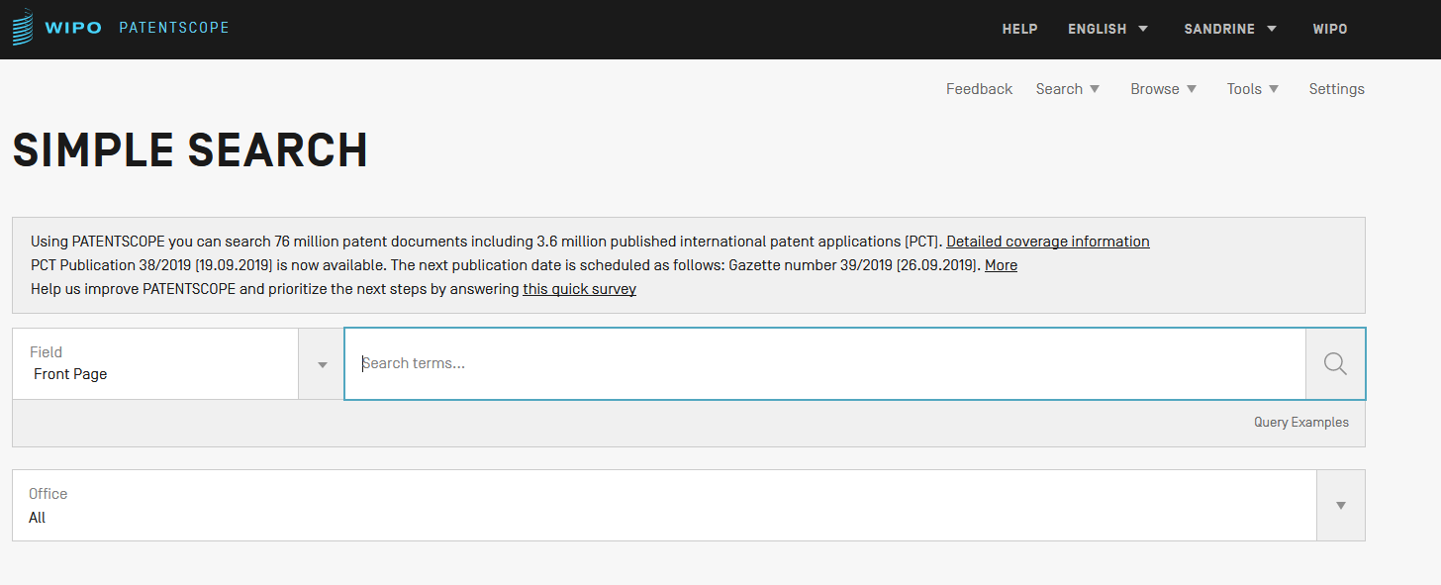
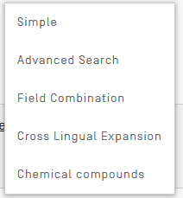
2 Interfaces

Slide 11
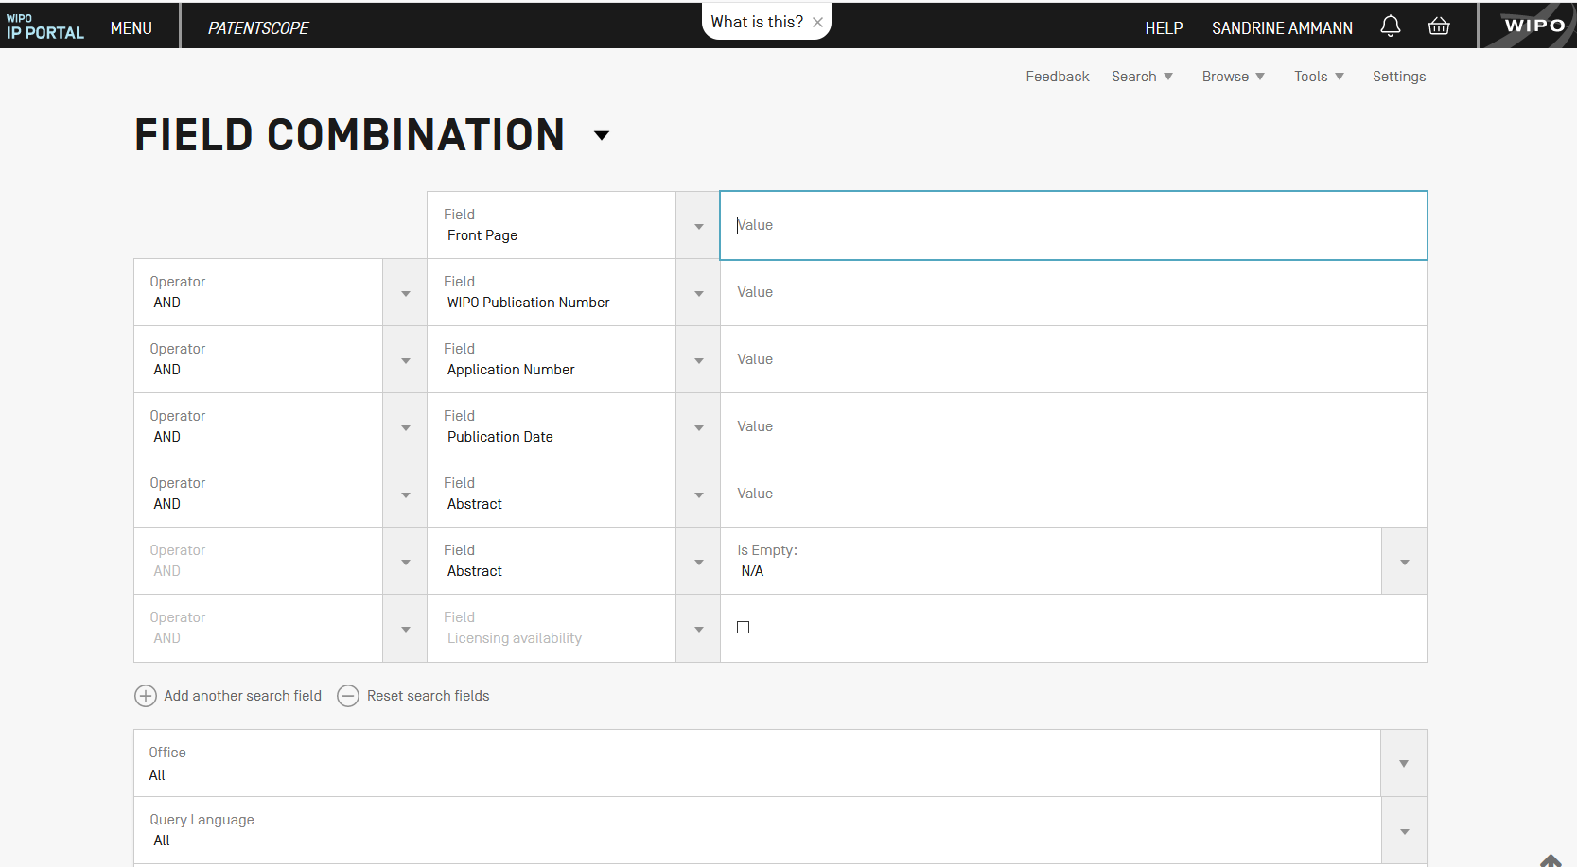

Slide 12
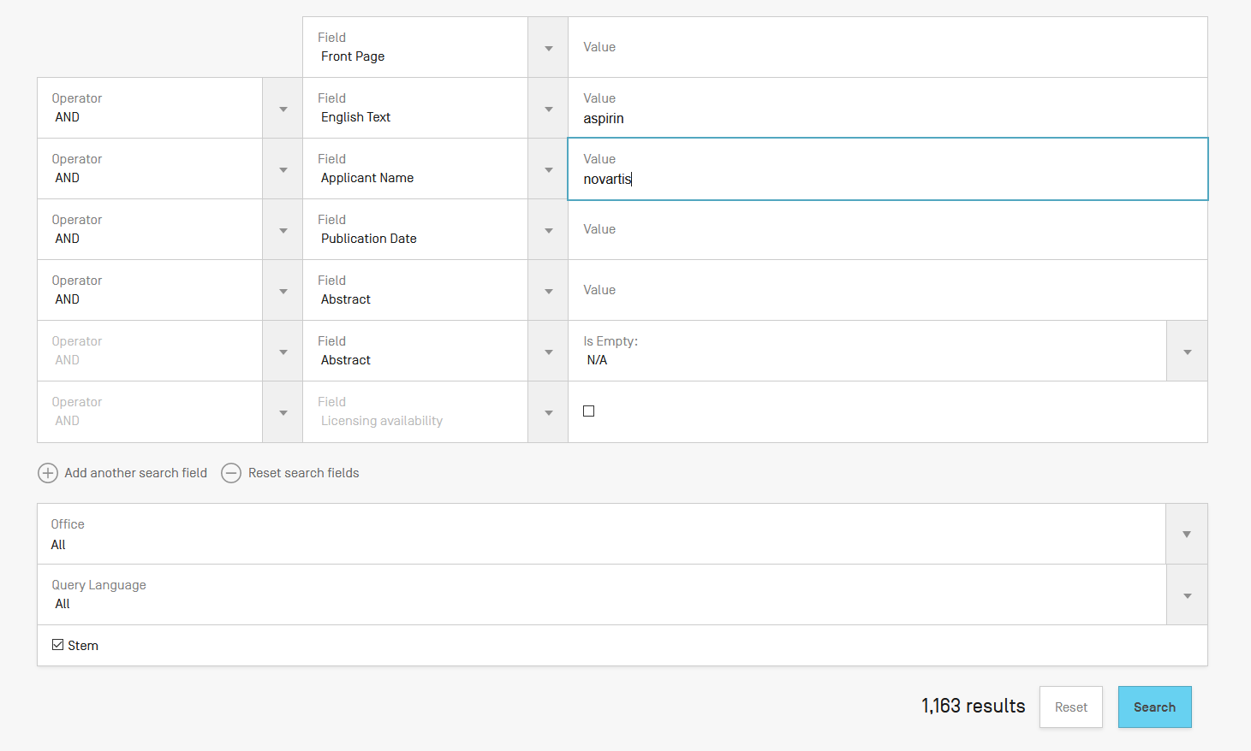

Slide 13
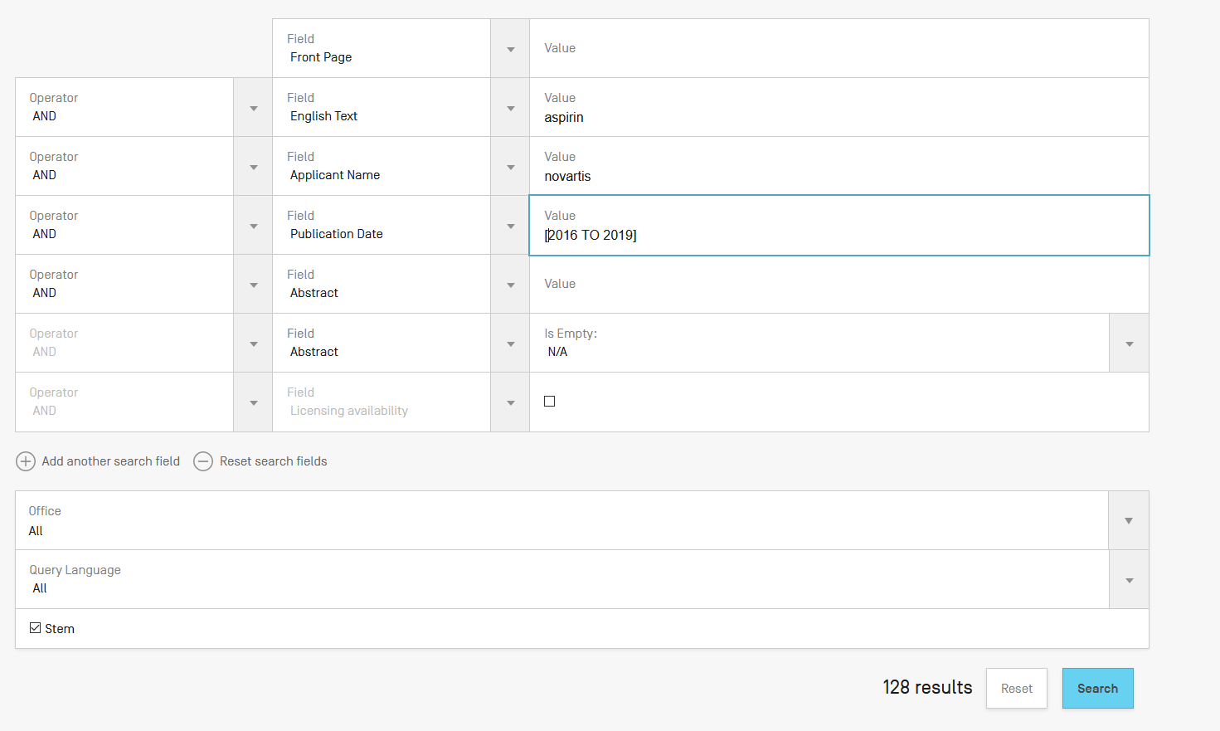

Slide 14
Field Combination - pros
Predefined fields
Immediate results on the same page

Slide 15
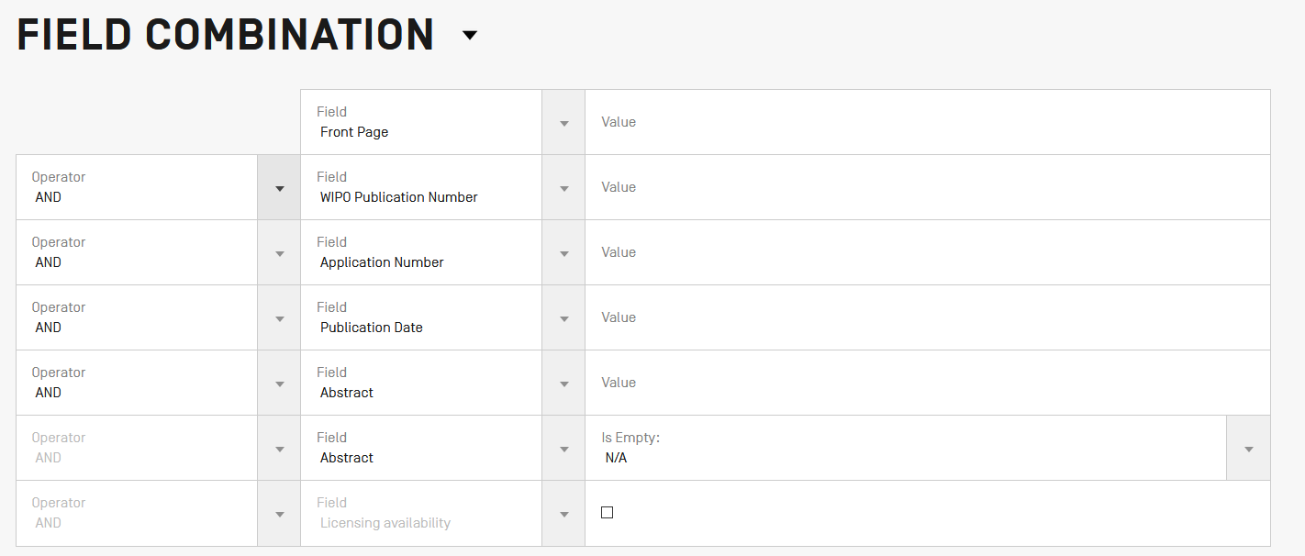
Field combination - cons

Slide 16
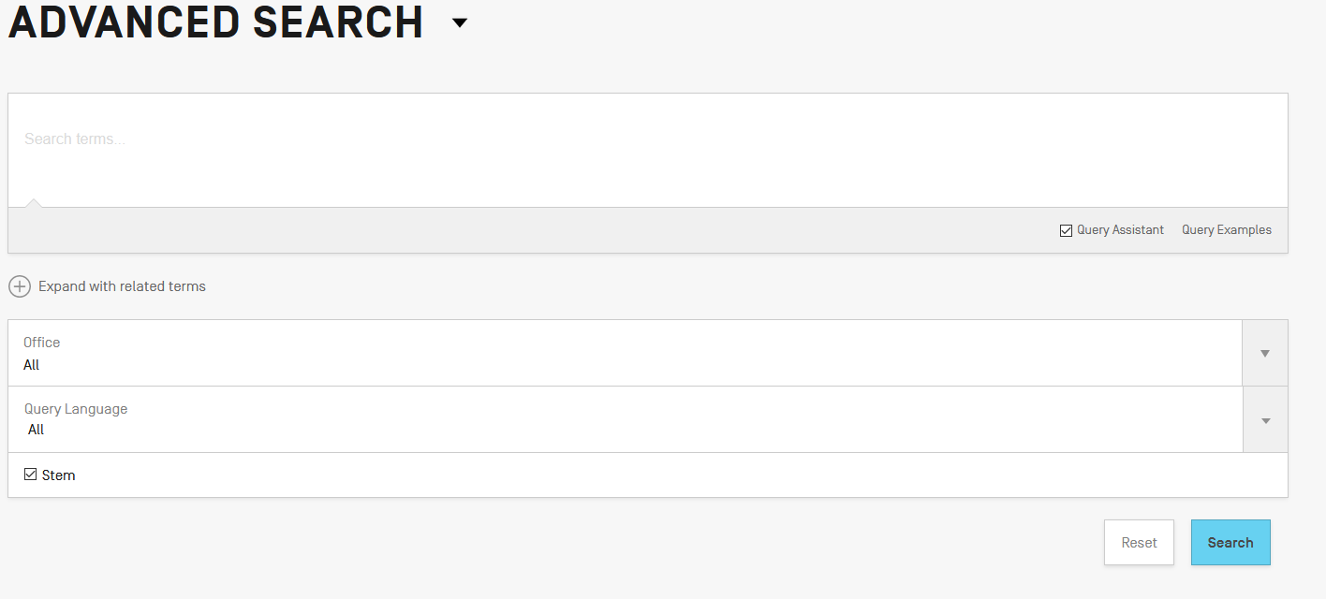
Interface: Advanced search

Slide 17
EN_ALLTXT; PA; DP = fields
AND = operator

Slide 18
Fields: where to search Source: http://spicewallpaper.blogspot.ch/2012/08/green-fields-with-blue-sky.html

Slide 19
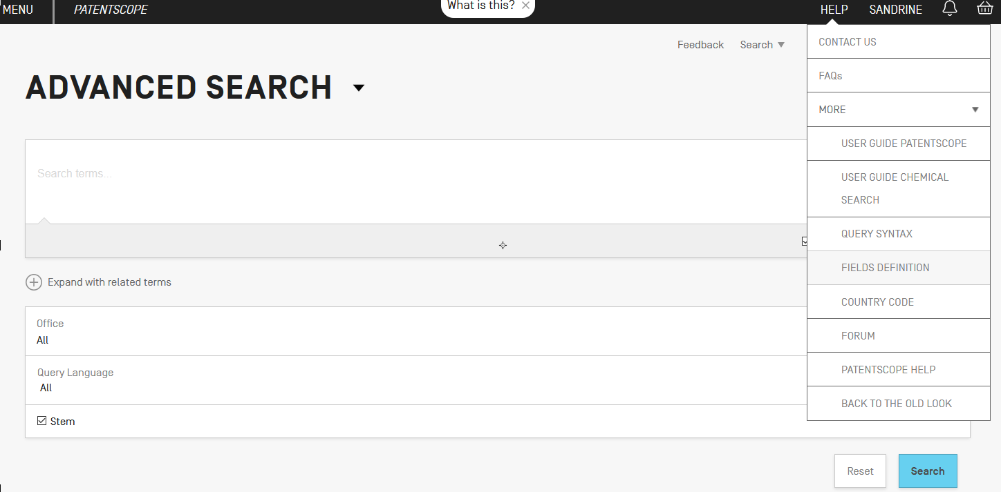

Slide 20
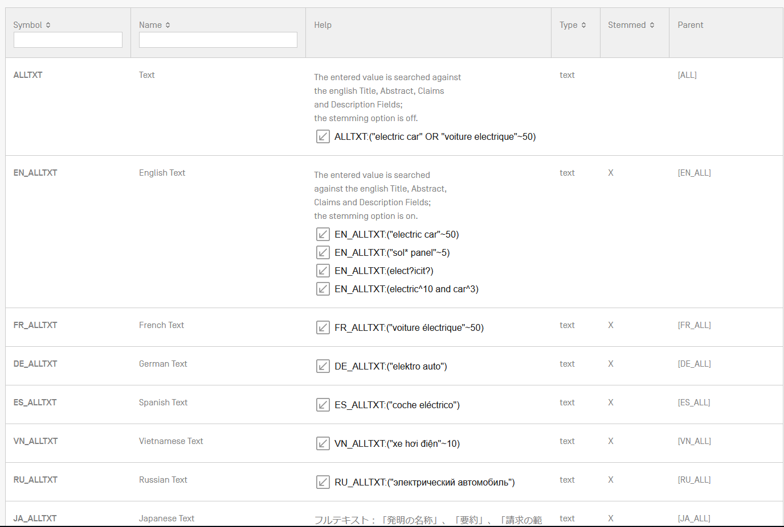

Slide 21
Examples
FP = front page
ALL = all fields
ALL_NAMES = all names
IC = IPC
DP = publication date
CTR = country either WO or country from nat collection
NPCC= national phase entry
AN = origin of PCT

Slide 22
Date search
Simple:
DP:01.02.2000
DP:20000201
DP:02.2000
DP:200002
DP:2000

Slide 23
Example: IPC
IC = International Classification
IC :A
IC :A47
IC :A47L
IC :A47L1
IC:A47L11
IC:A47L11/03

Slide 24
D06F 1/06 will include by default
D06F 1/08
1/10
1/16
To exclude subgroup: IC_EX
ICI = International Classification Inventive
ICN = International Classification Non-inventive
ICI_EX ICN_EX = no subgroup

Slide 25
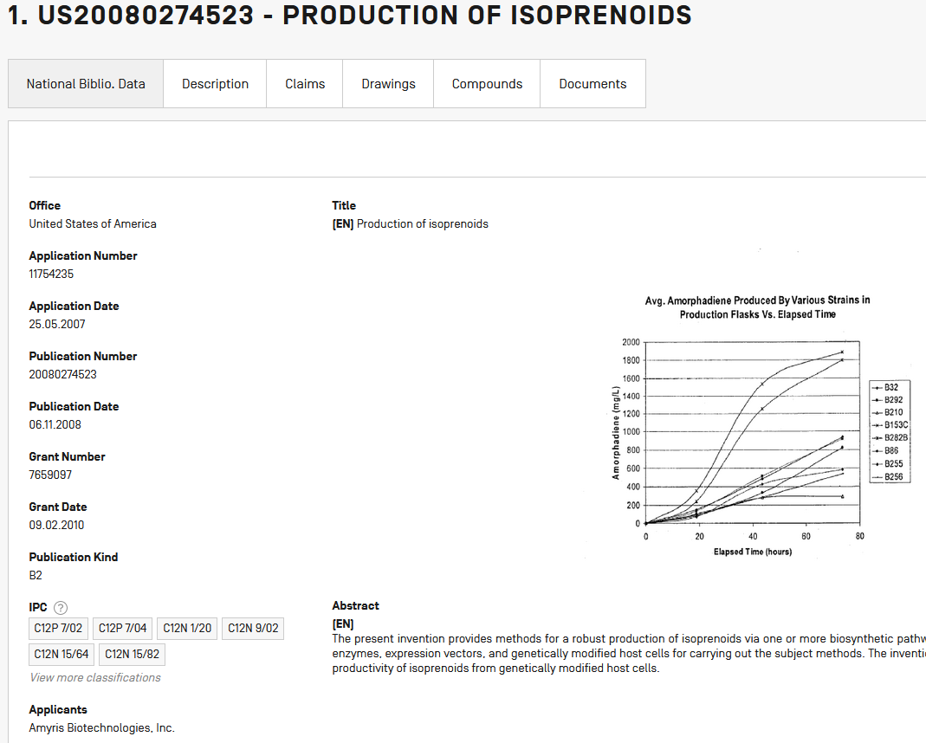
Example: grant

Slide 26
Fields rules
Basic fields: elements of a patent document
Derived fields
2 letter code = individual field
EN_TI FR_AB ES_DE_S
Convention: language specified by 2 letters
if not specified all languages
S = stemmed
: to separate term without any space

Slide 27
Fields: golden rules
EN_ALL = default field field indicator not required
Field name followed by : ":" or "/"
The field is only valid for the term that it directly precedes, so the query:
EN_TI:("wind turbine" AND electric) solar
"wind turbine" AND electric in the title field "solar" in the default field (EN_ALL ).

Slide 29
Grouping/nesting
Solar OR (wind AND turbine)
(solar OR wind) AND turbine
EN_TI: electric car
electric will be searched in English title but car in all fields
EN_TI: (electric car)
Both electric and car will be searched in the English title

Slide 30
Range search
Range:
DP:[01.01.2000 TO 01.01.2001]
Can also be used to search non-date fields
IN: {Smith to Terence}

Slide 31
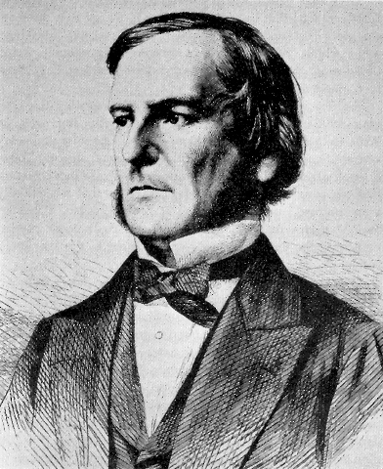
Boolean operators
AND
OR
NOT
ANDNOT

Slide 32
ANDNOT - NOT
Use ANDNOT when searching A excluding B
Ex: bicycle ANDNOT boat
Use NOT when searching all documents except A
Ex:NOT(car AND bicycle AND boat)

Slide 33
Proximity operator NEAR
Finds words that are next to each other
NEAR3 3 = the max nb of word gaps between 2 search terms

Slide 34
Proximity search: BEFORE
the order of terms is significant.
trunk BEFORE cutting

Slide 35
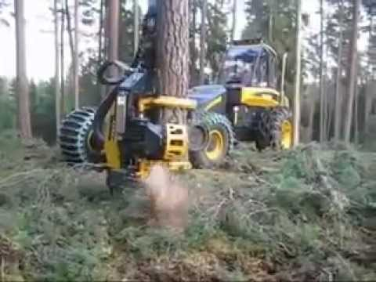
An example

Slide 36
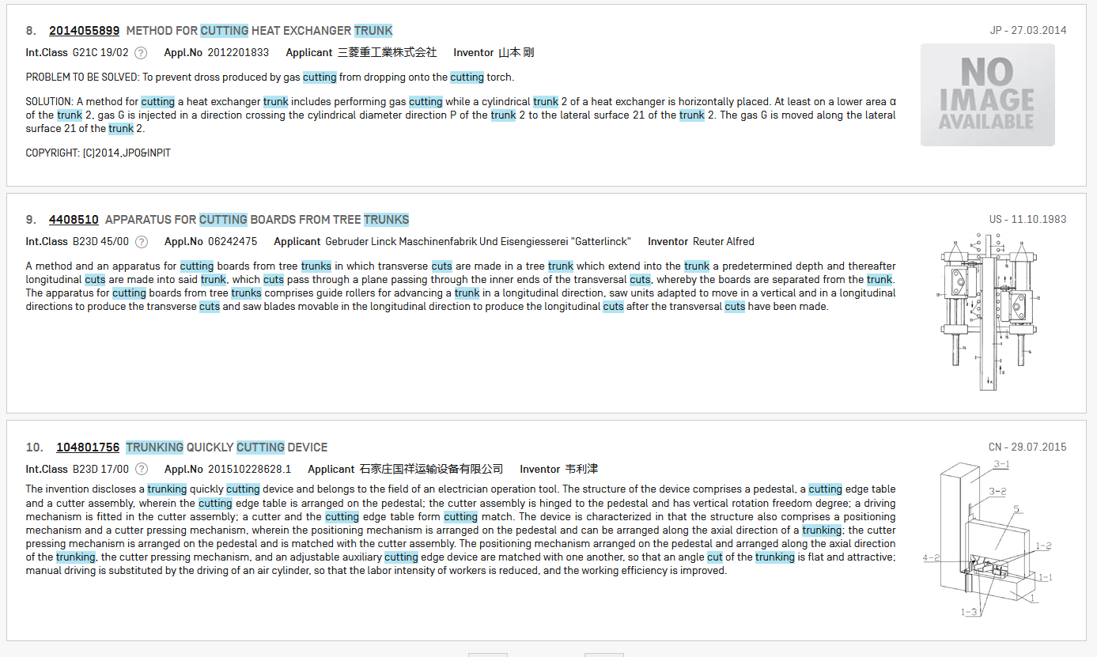

Slide 37
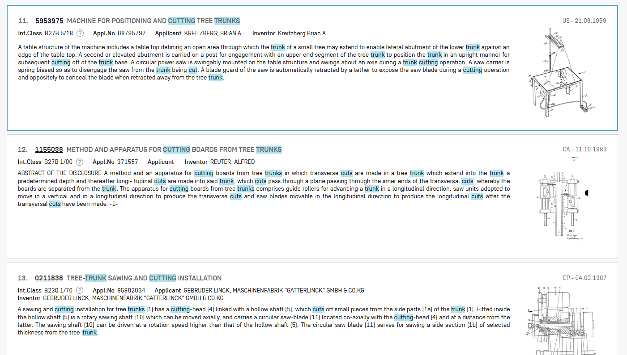

Slide 38
Keywords
Stemming
Wildcard
Truncation
Fuzzy

Slide 39
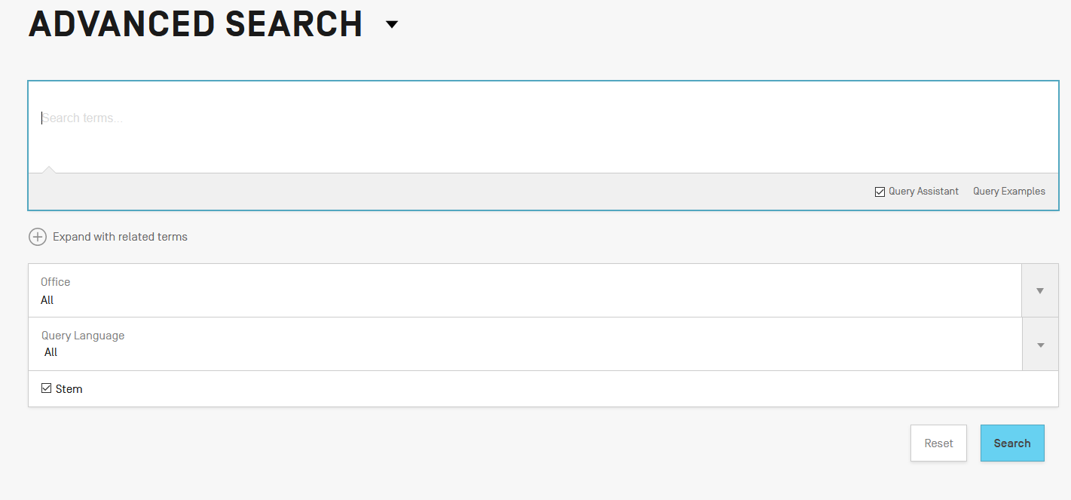
Stemming

Slide 40
Stemming
Stem = stemming
Process that removes common endings from words.
critical critically criticism each word is reduced to ‘critic’
criticisms critics

Slide 41
Stemming
no dictionary includes the necessary technical terms to express patent concepts
Porter Stemming Algorithm finds words that contain common roots
Save time and effort

Slide 42
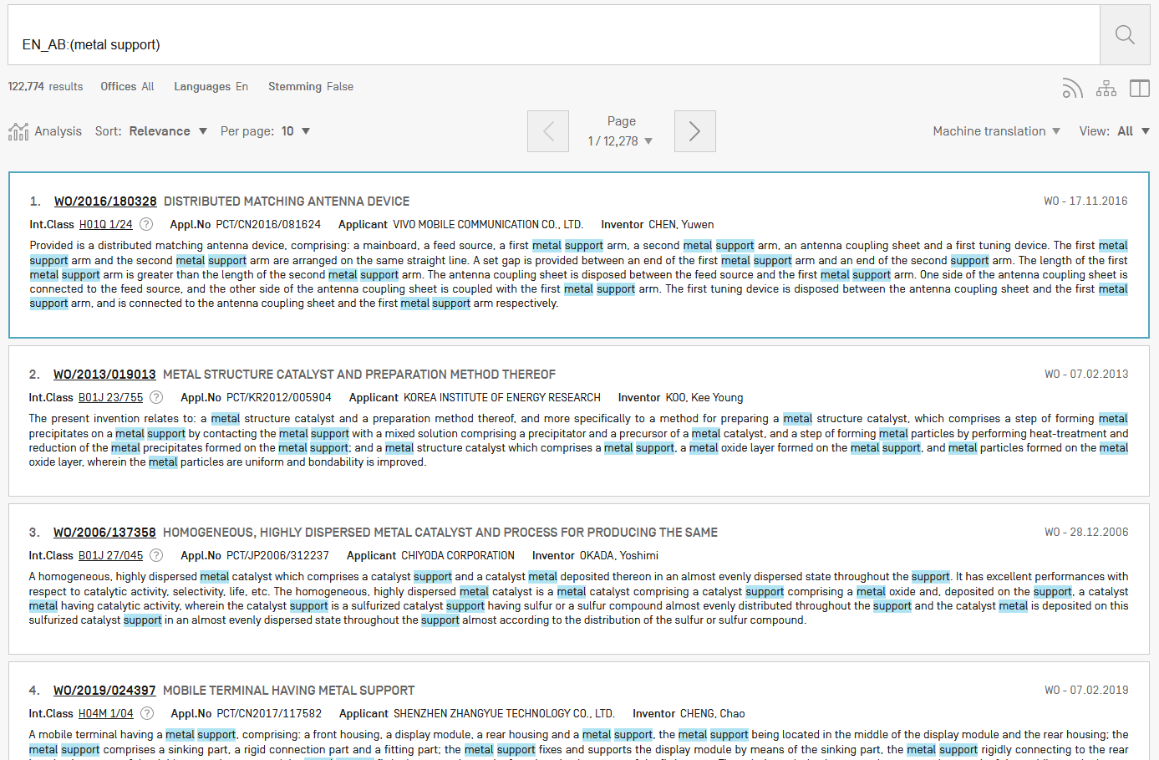
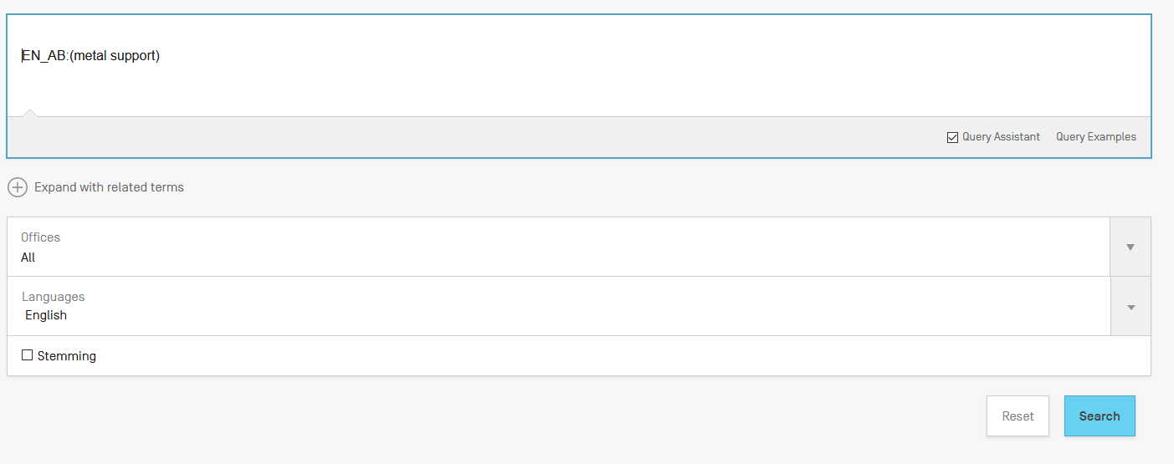
Search without stemming

Slide 43
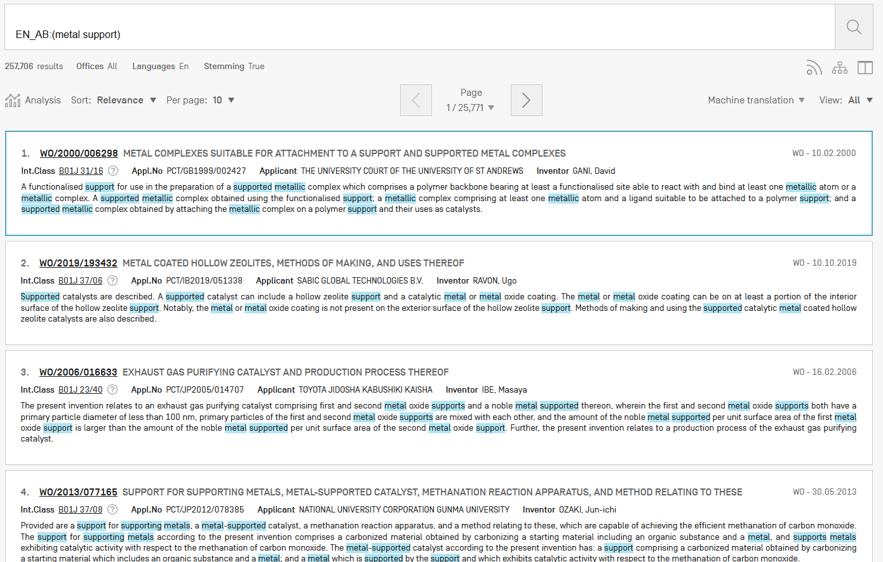
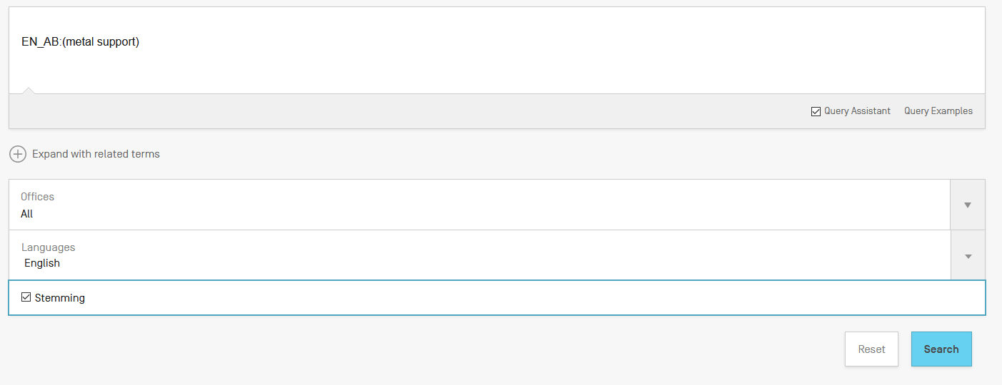
Same search with stemming

Slide 44
Wildcards/truncation : ? *
* stands for 0 or more characters
? stands single character
te?t = test or text
electric* = electrical; electricity
behavi*r = behaviour or behavior
micro?p* = microspeaker, microsporidial

Slide 45
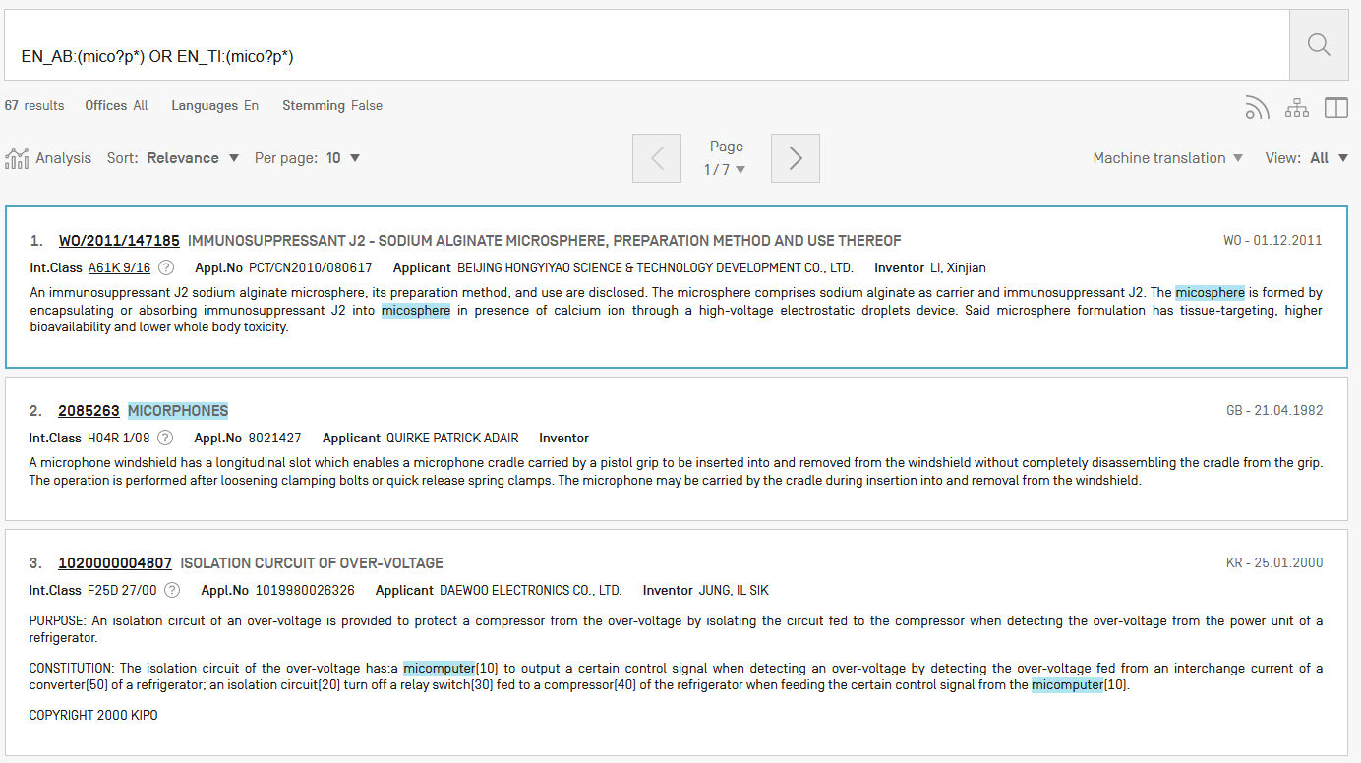

Slide 46
Use of wildcards
Spelling uncertainty (plural, tenses, foreign words):
tyre vs. tire t*re
University vs Universität Universit* Stuttgart
Multiple spelling variants are known:
color vs. colour col*
Preferred option over stemming:
electric vs. electricity electri*

Slide 47
Wildcard vs stemming
Logic results:
navy, navies or naval if nav* = navigating, navigation,
electricity or electric if elect* = electoral

Slide 48
Fuzzy searches
Use of the tilde: ~
Examples:
roam~ foam / roams
Roam~0.8
Useful to find misstpyed, misspelt or mis-OCRed words
Notes:
Smilar in spelling

Slide 49
^ caret = weighting factor
Same result but ranking will be different
touch^3 AND polarize

Slide 50
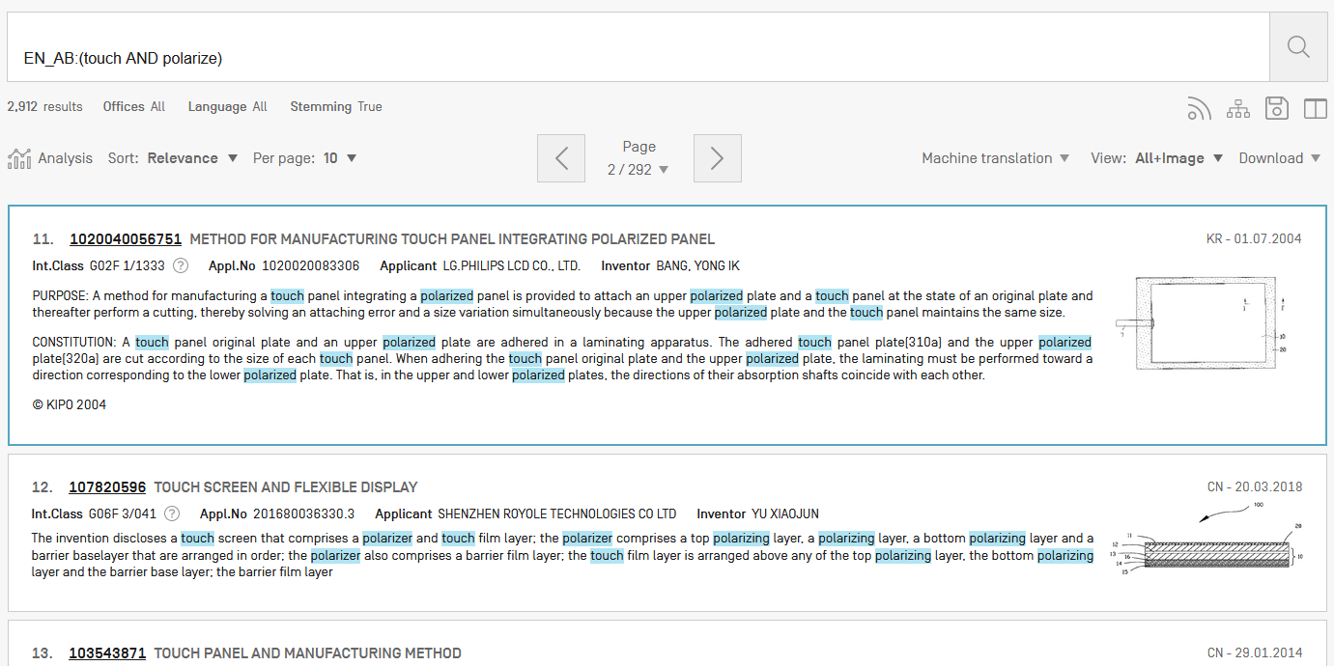
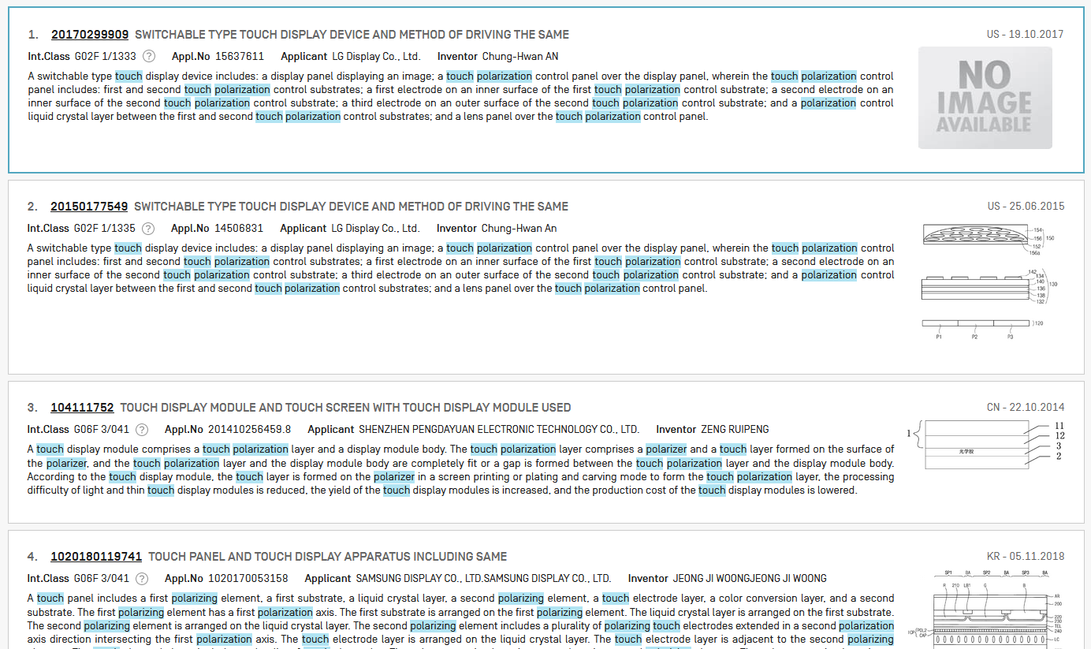

Slide 51
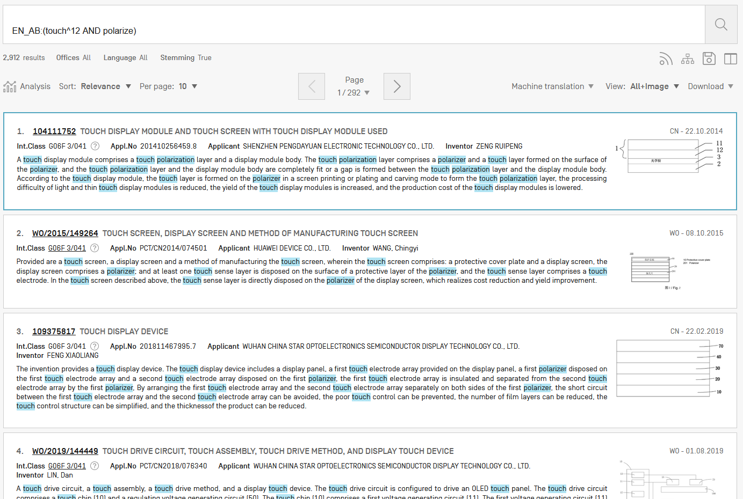

Slide 53
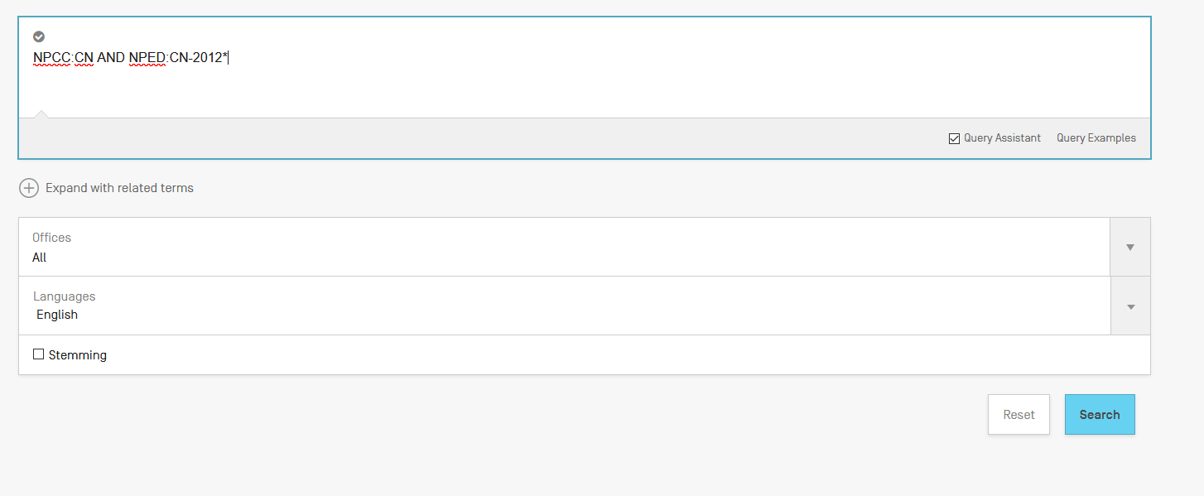
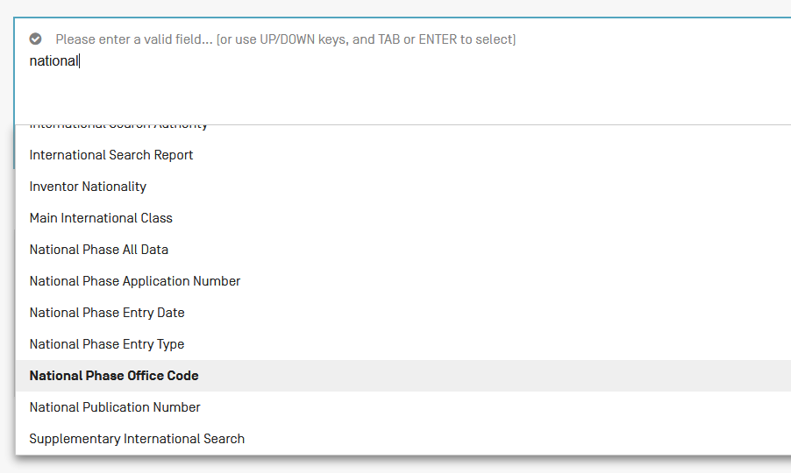
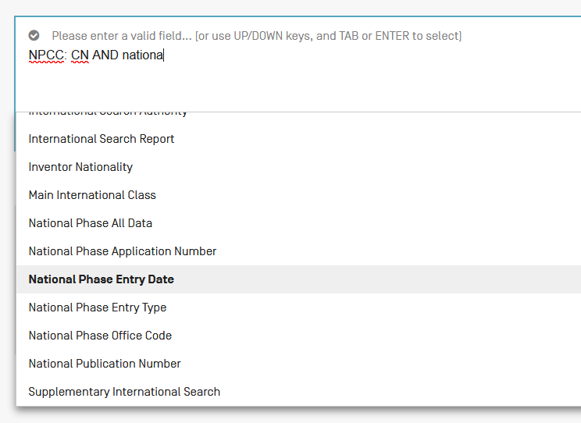
Example: national phase entry
All applications that entered national phase in China in 2012

Slide 54
Instant help
Validates search query
Suggests terms
Provides list of:
IPC codes
countries

Slide 55
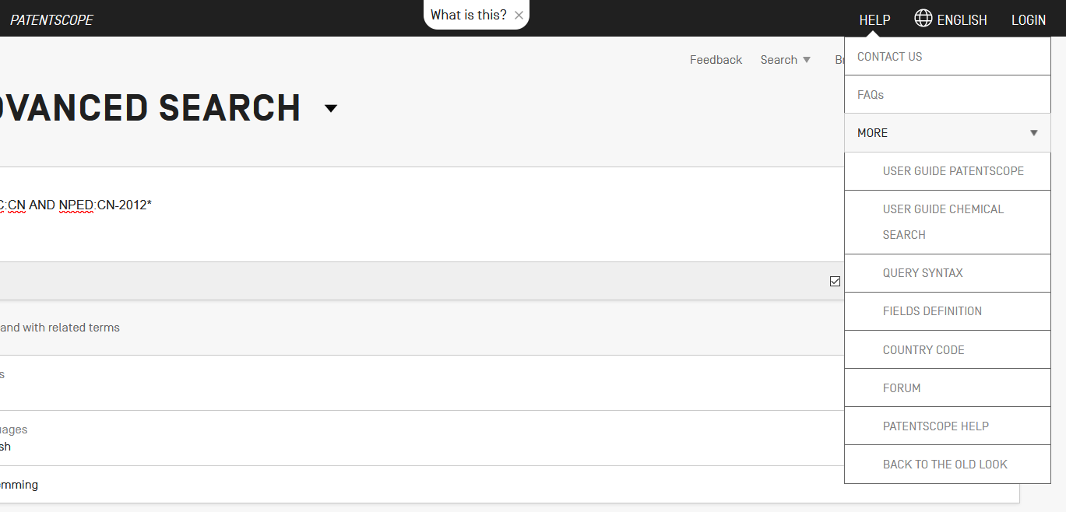
Help

Slide 57
Result combination
Combine search with chemical structure search
Combine search with CLIR

Slide 58
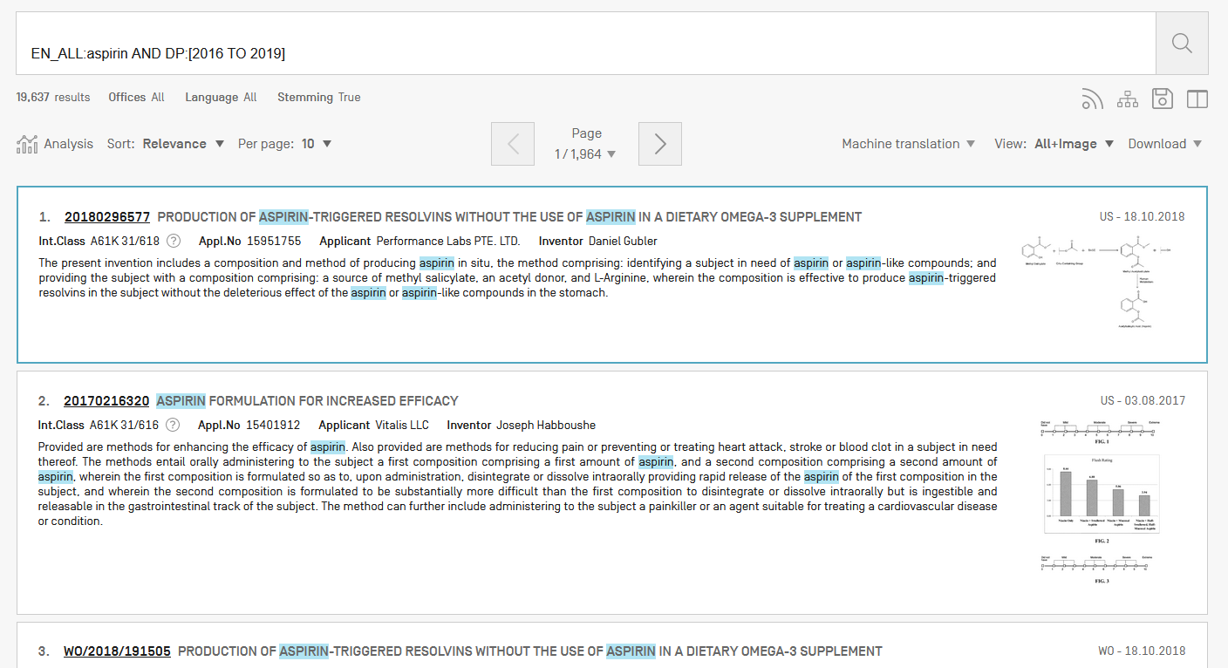
For queries with compounds

Slide 59
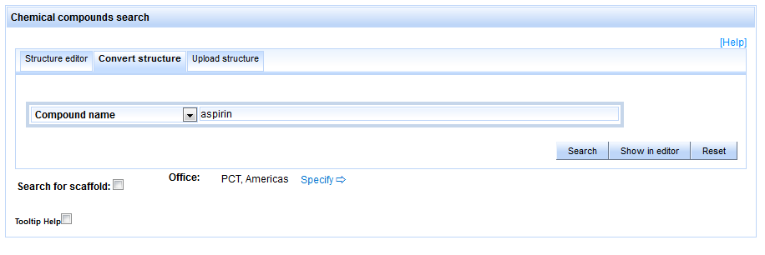

Slide 61
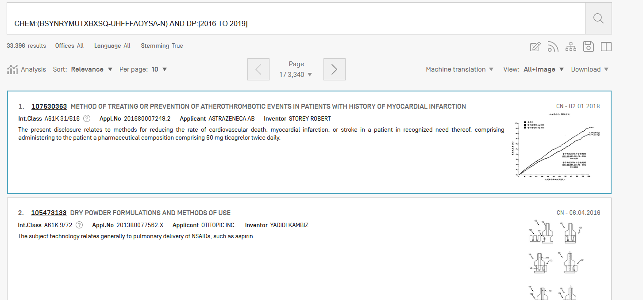

Slide 62
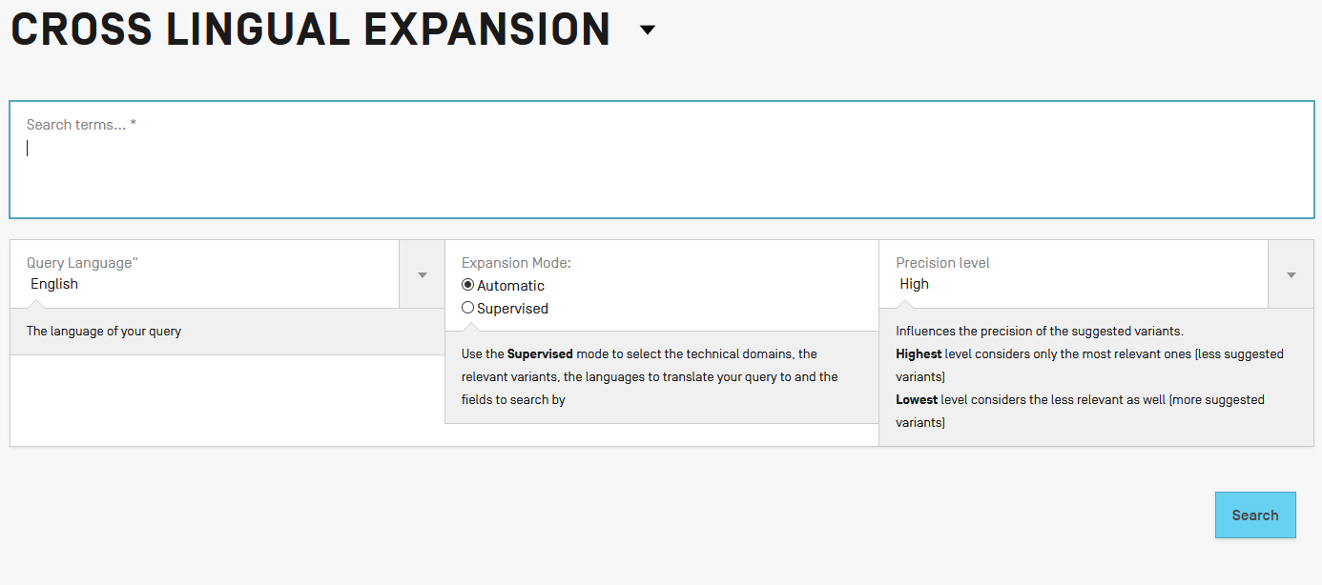
Combining with CLIR

Slide 63
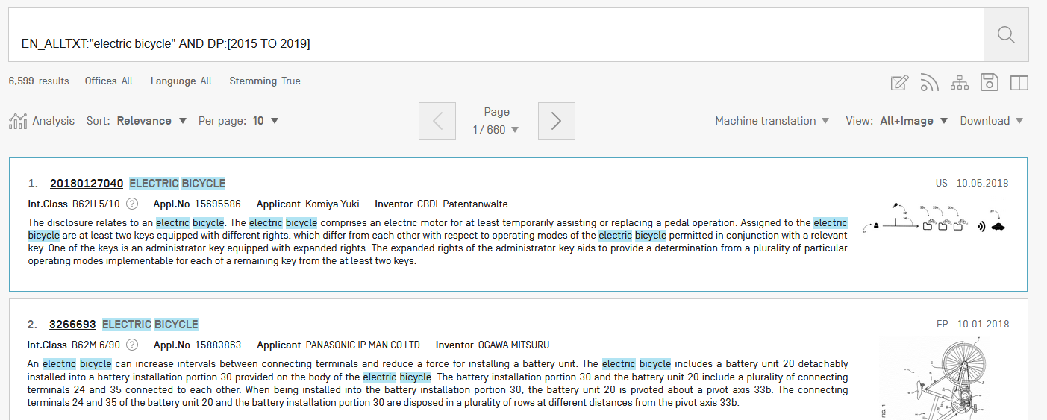

Slide 66
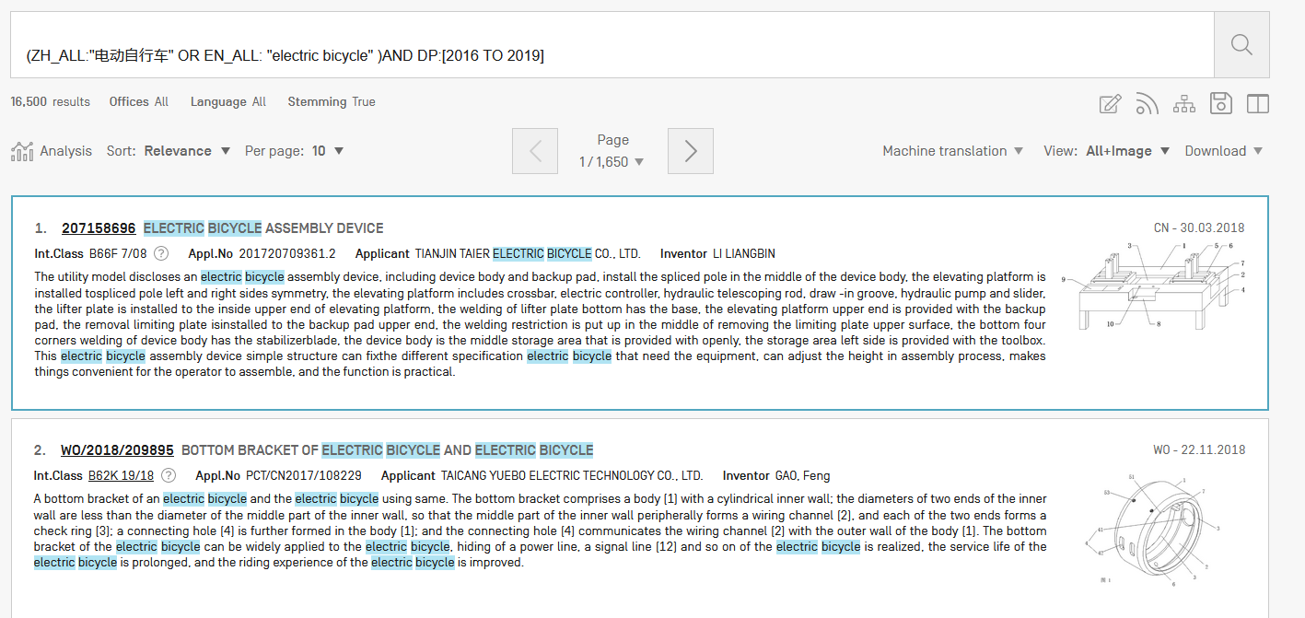

Slide 67
Most common errors
(….) "…"
" not “
Field name
No space
Wildcard at the beginning of a word

Slide 68
Next webinar: November 19 or 21
Chemical structure search in PATENTSCOPE
To register: http://www.wipo.int/patentscope/en/webinar/

Slide 69
wipo.int/patentscope/en/webinar

Slide 70
Global Brand Database: webinar
Overvire of the Global Brand Database
October 23 at 5:30pm CET
https://attendee.gotowebinar.com/register/6209538493436706818

Slide 71
Global Design Database: webinar
Overview of the Global Design Database
October 25 at 5:30pm CET
https://attendee.gotowebinar.com/register/790258985384599810

Slide 72
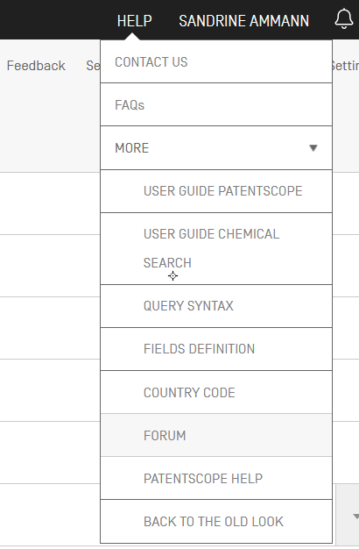

Slide 74
patentscope@wipo.int

