Slide 1
PATENTSCOPE:
For Beginners
Cyber world
February
2020
Sandrine Ammann
Marketing & Communications Officer

Slide 2
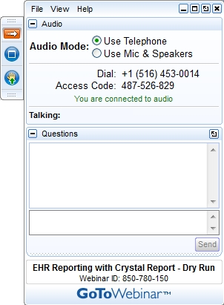
Raise your hand only if you can hear me otherwise please send me a message using the Questions box

Slide 3


Slide 4
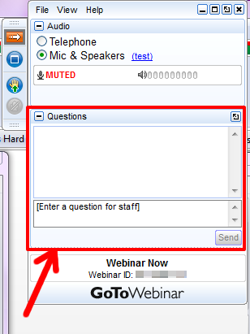

Slide 5
Questions/concerns
patentscope@wipo.int

Slide 6
Agenda
  Interfaces
  Quiz
  Webinars
  Q & A session

Slide 7
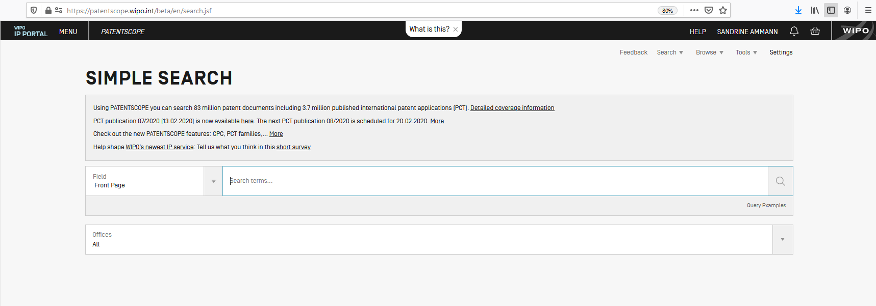
https://patentscope.wipo.int/search/en/search.jsf

Slide 8
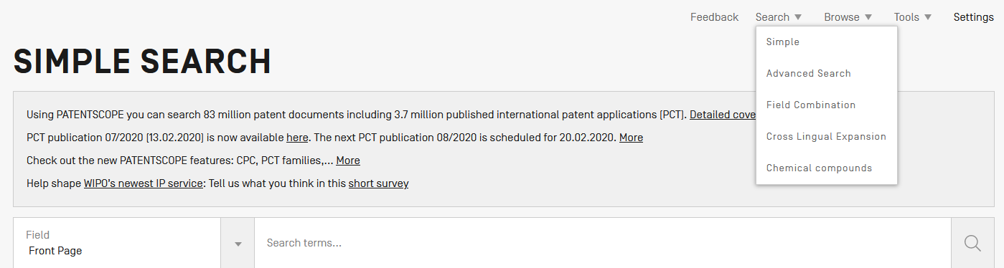
PATENTSCOPE: how to search

Slide 9
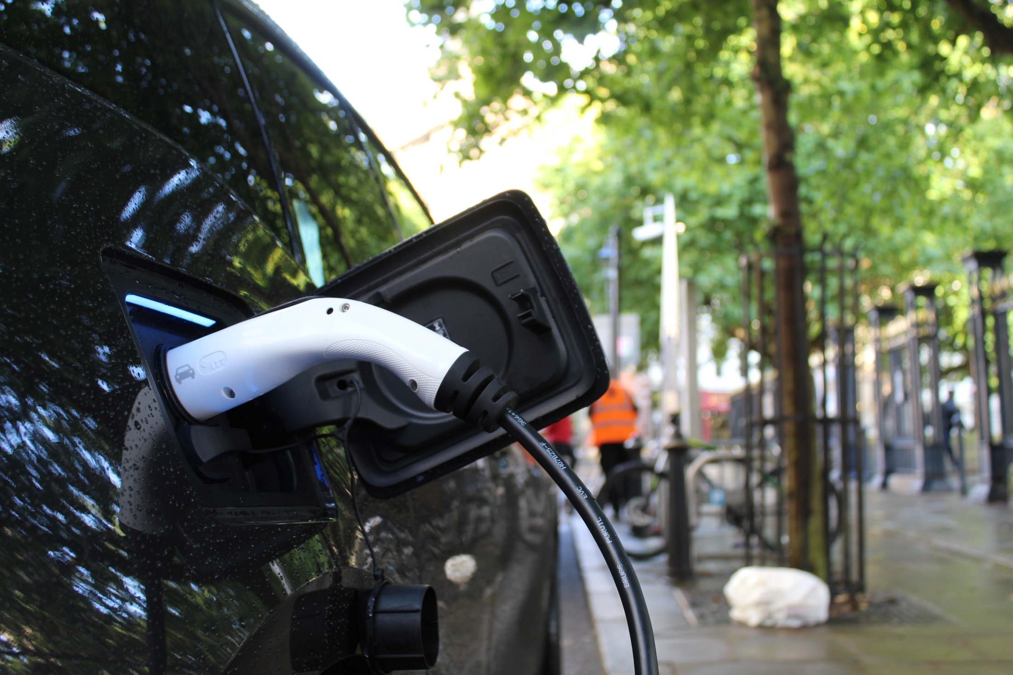
Which interface to use?

Slide 10

Simple search
  1 field
  Operators

Slide 11
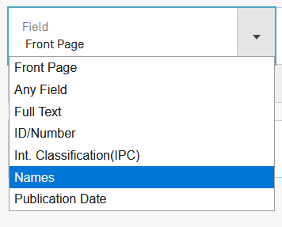
Simple search
FP (front page) = title, abstract, numbers, names

Slide 12
Our example
Electric car

Slide 13

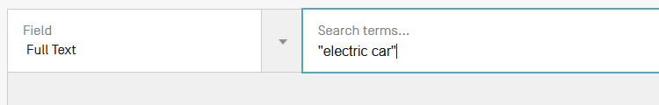


Slide 14
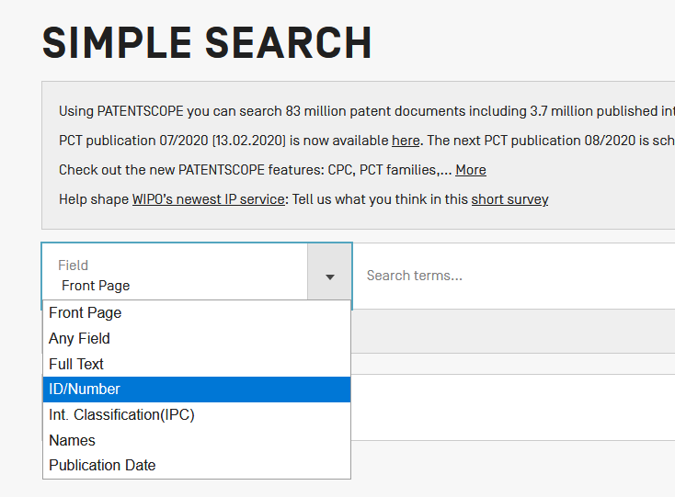
Number

Slide 15
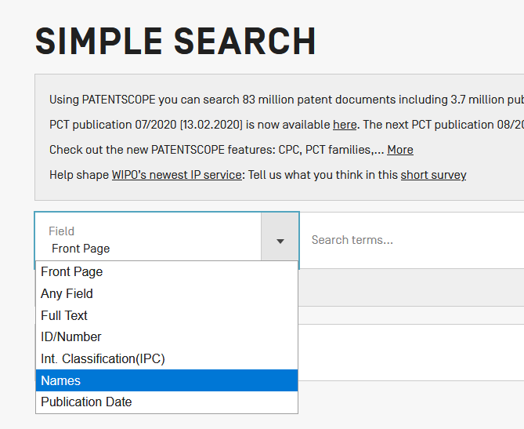
Names

Slide 16
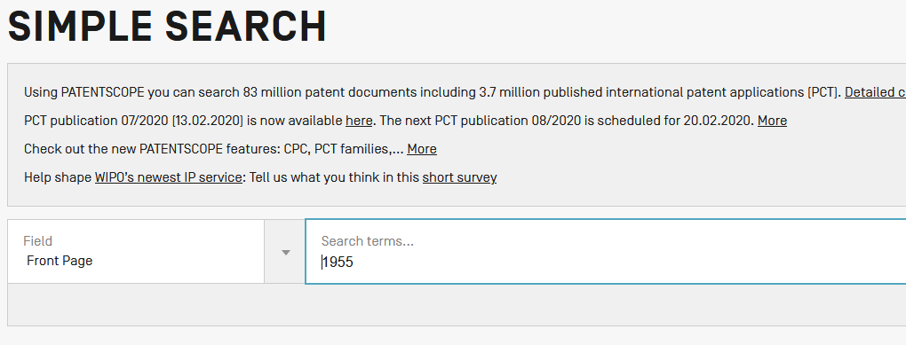

Slide 17
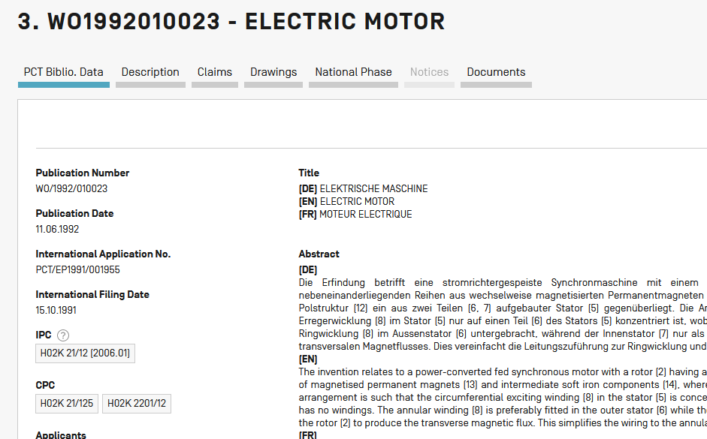

Slide 18
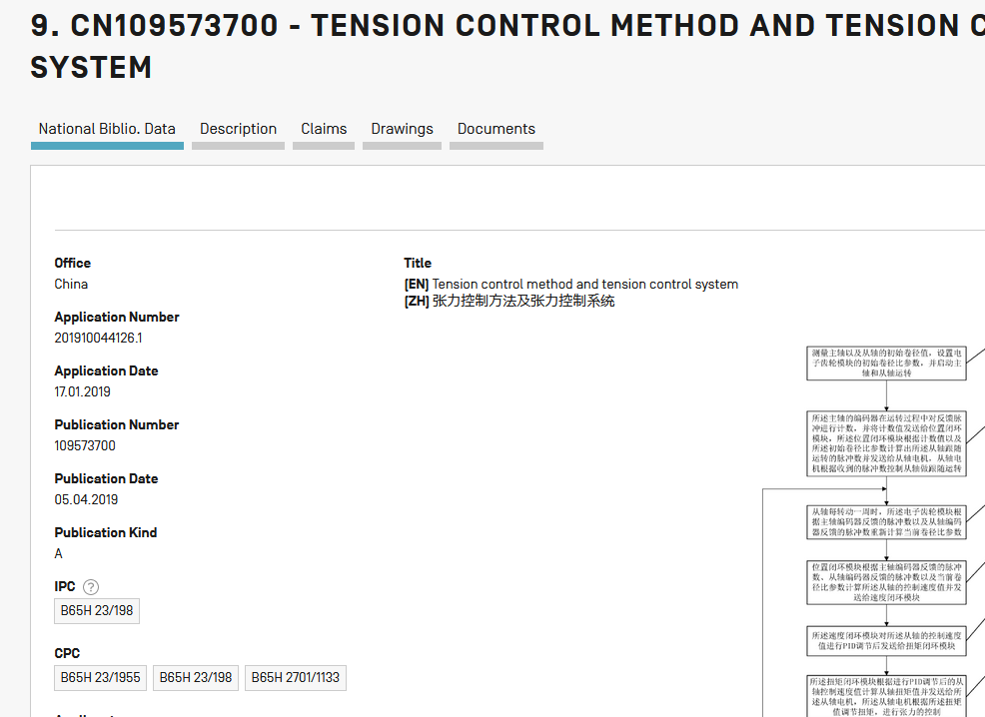

Slide 19
Simple search
1 field
Operators
Field has to be defined

Slide 20
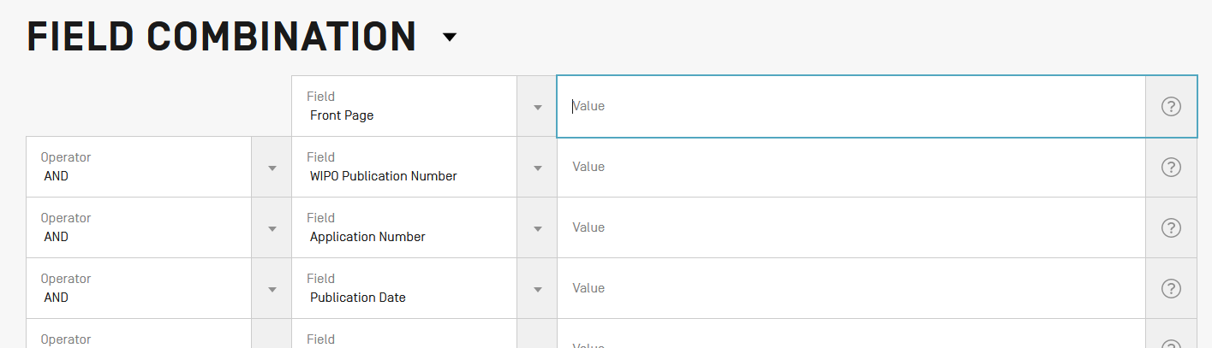
Field combination
2 or more fields
1 operator to combine the fields

Slide 21

Our example
Electric car
2019

Slide 22
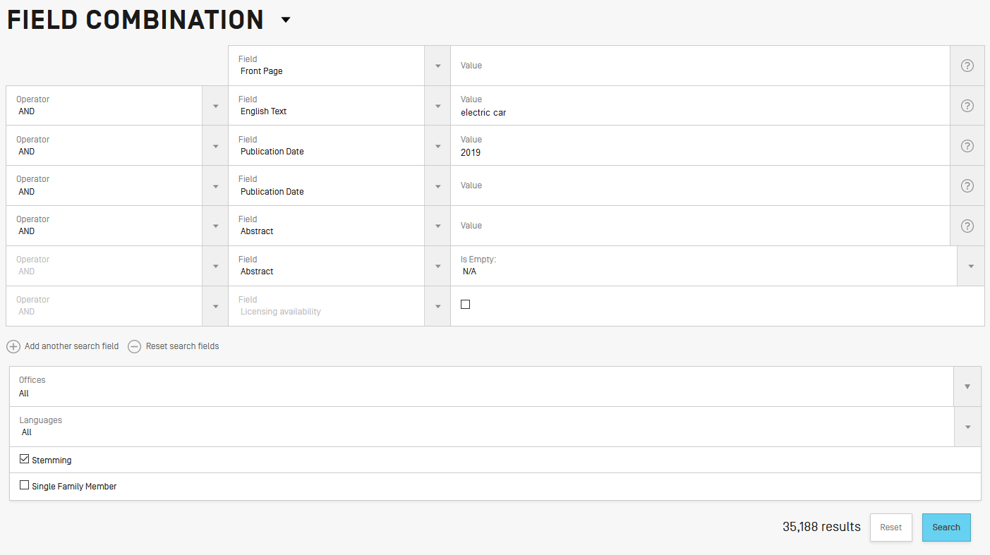

Slide 23
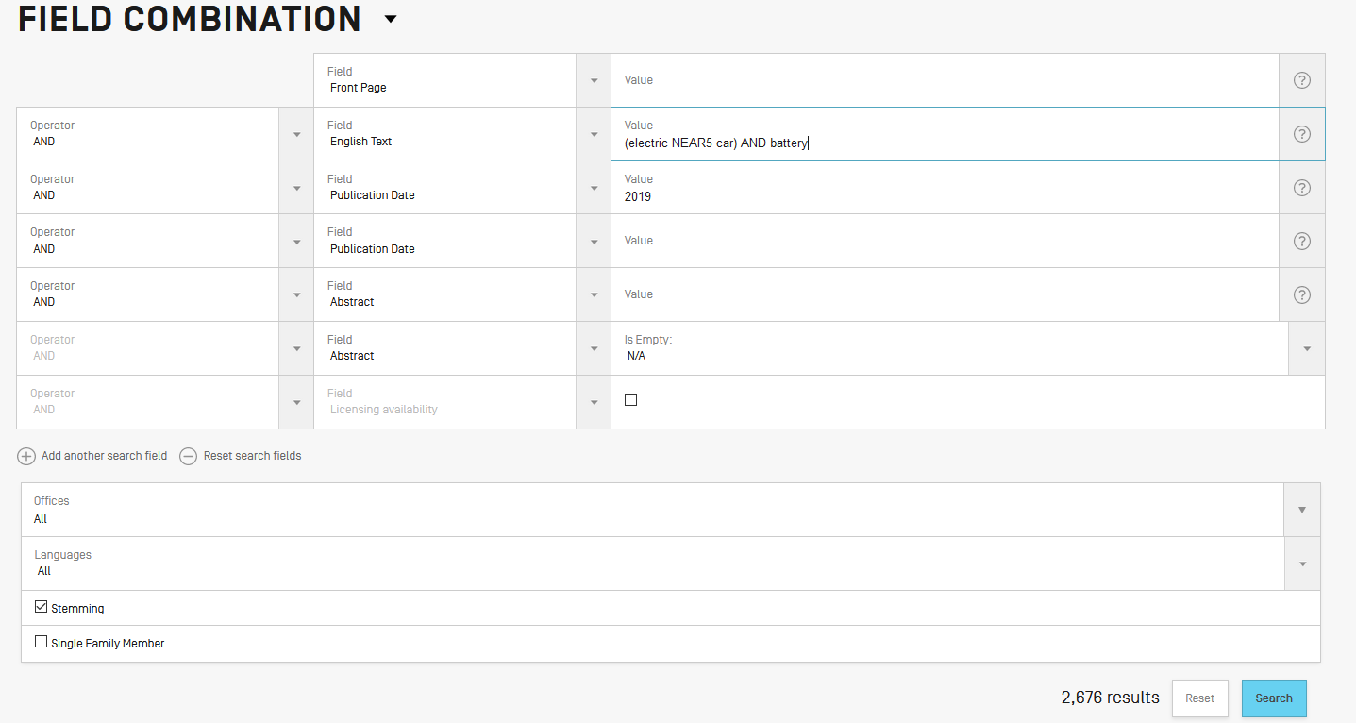

Slide 24
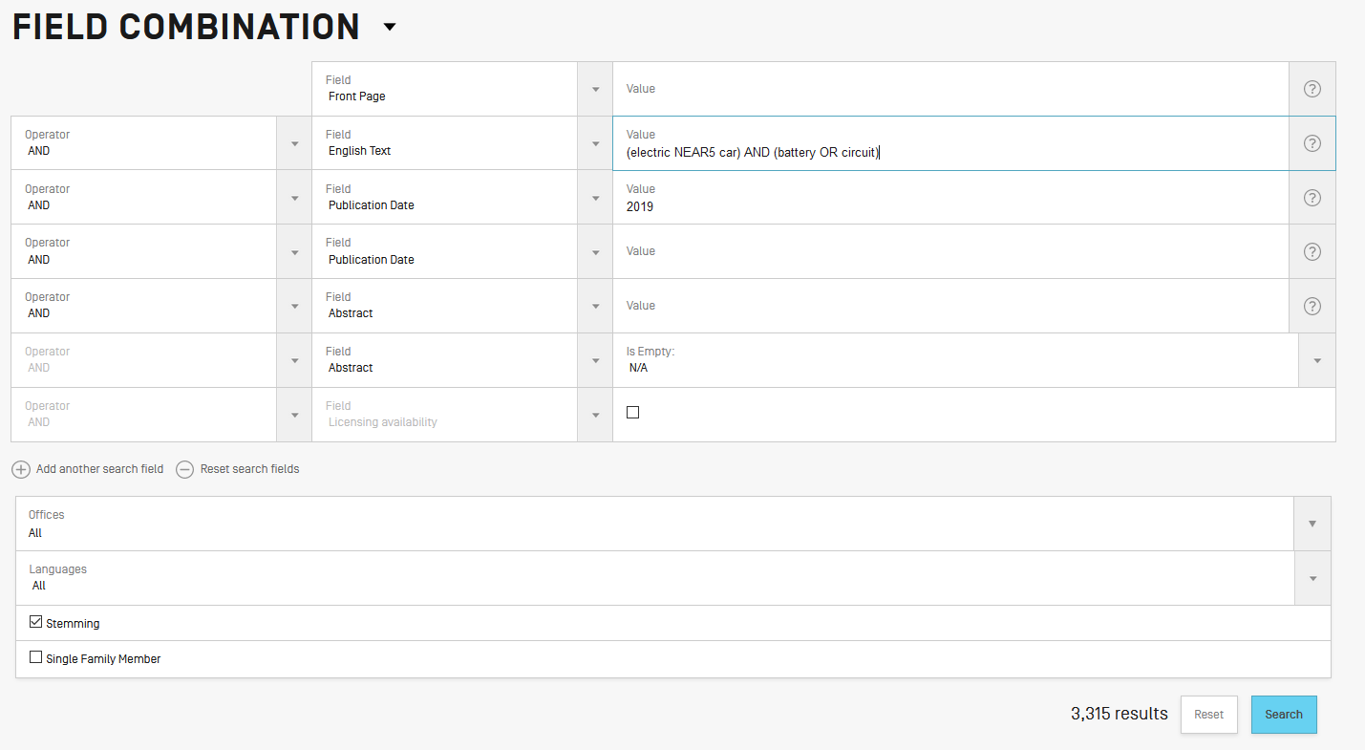

Slide 25
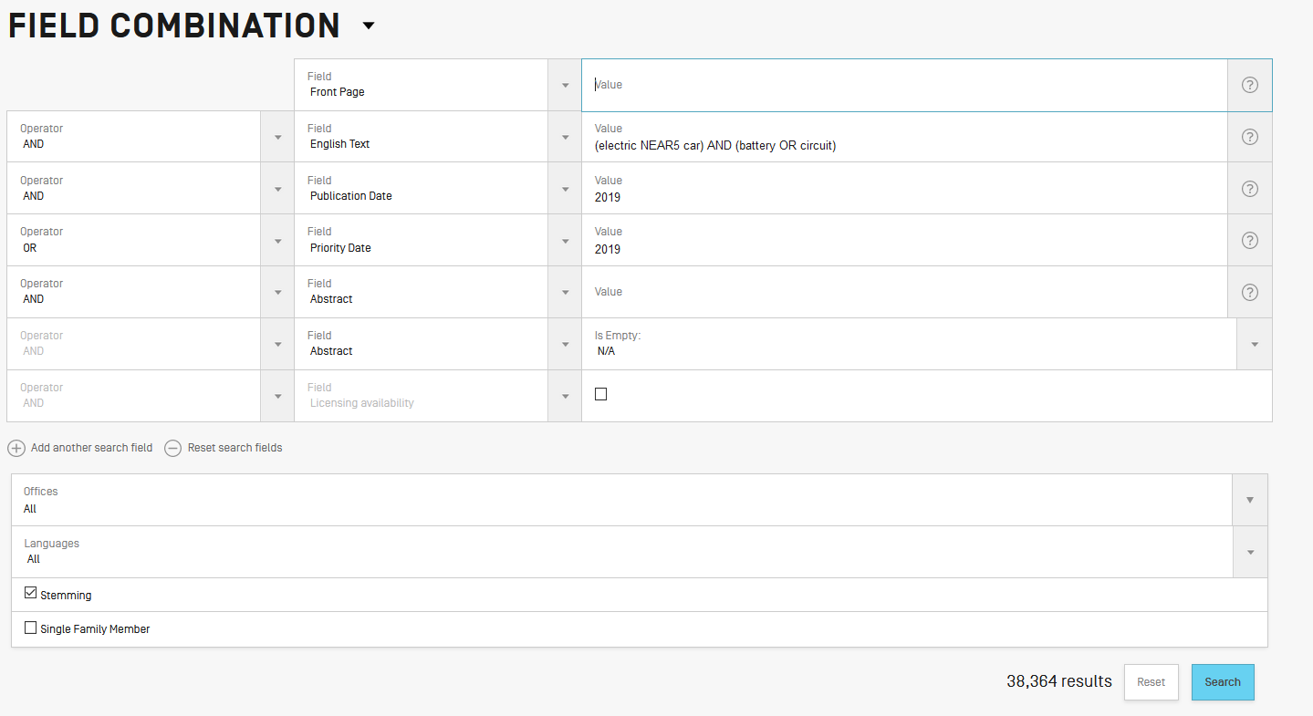

Slide 26


Slide 27
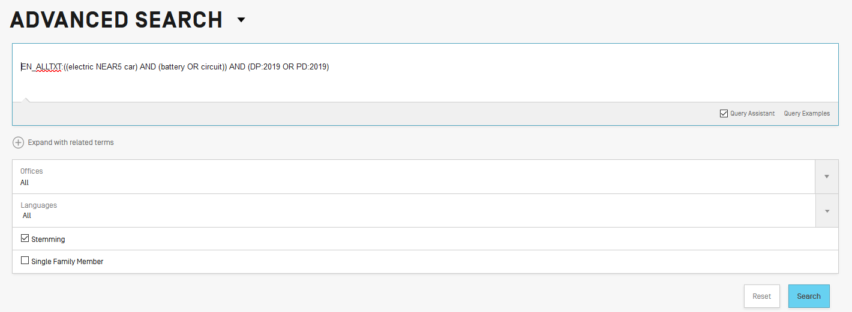

Slide 28
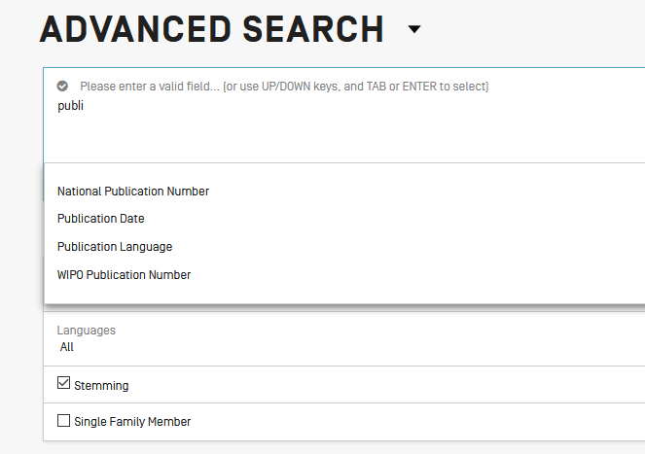

Slide 29
Instant help
Validates search query
Suggests terms
Provides:
  List of IPC codes
  List of countries

Slide 30
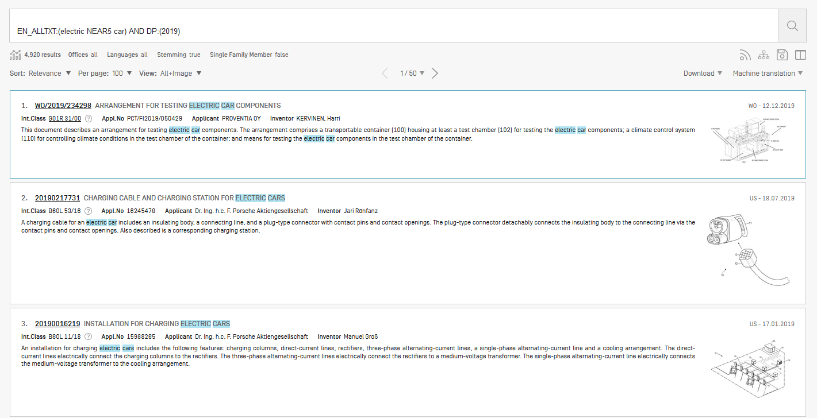
Result list

Slide 31
Document download

Slide 32
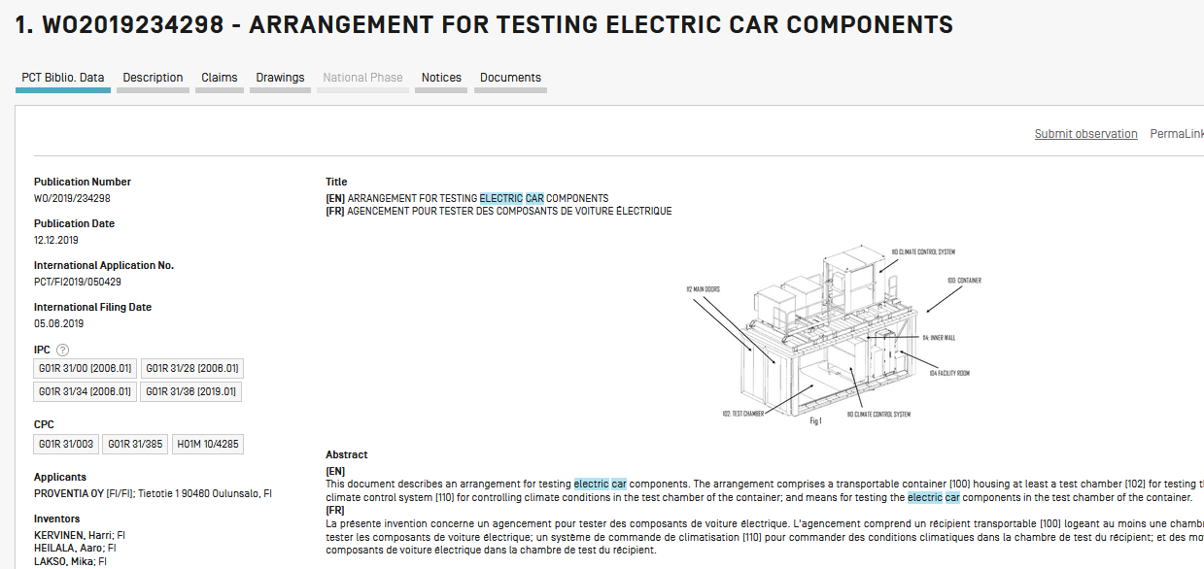

Slide 33
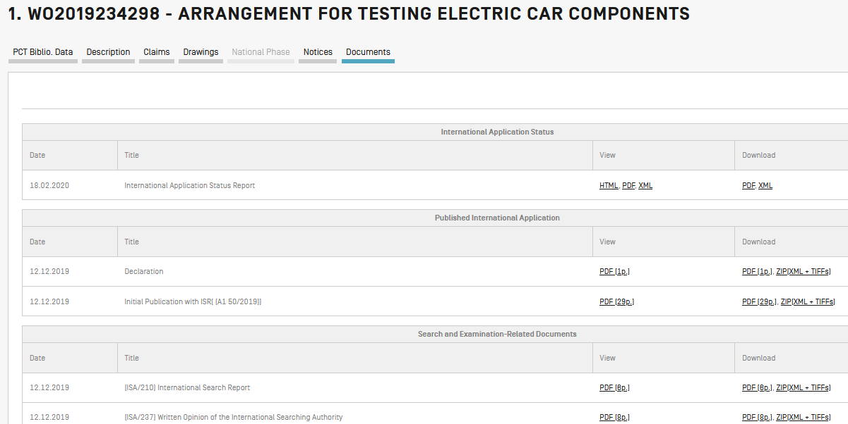

Slide 34
List download

Slide 35
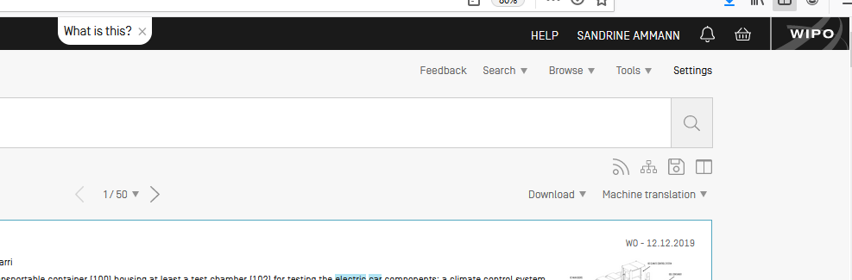
Logged-in

Slide 36
Save

Slide 37
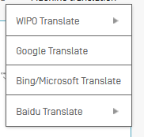
Translate

Slide 38
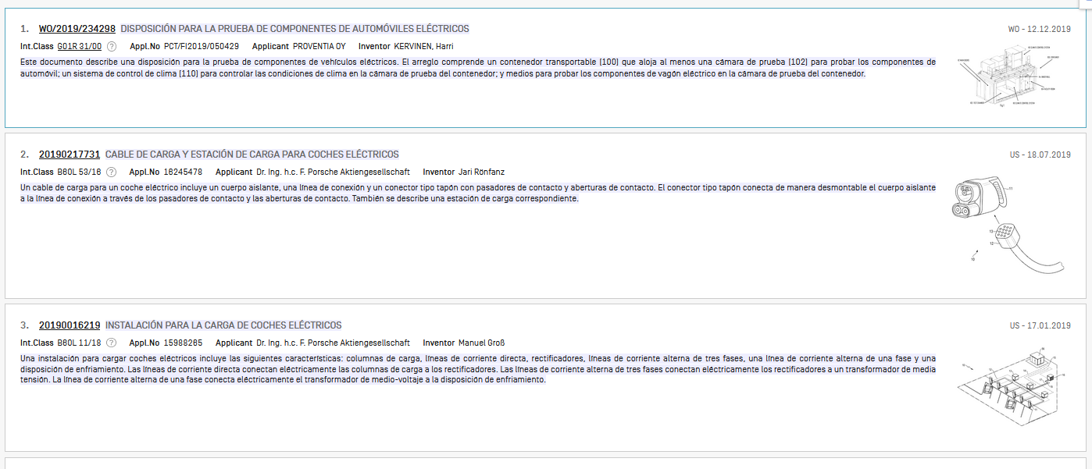

Slide 39
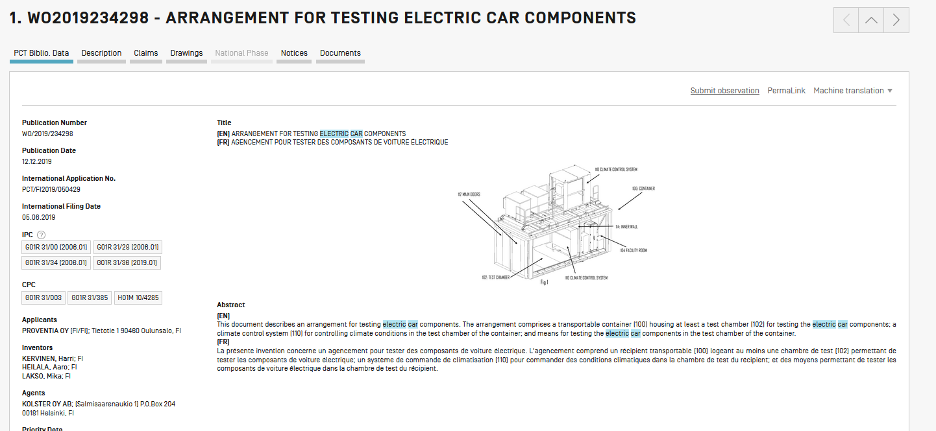

Slide 40
Sort/narrow down

Slide 41
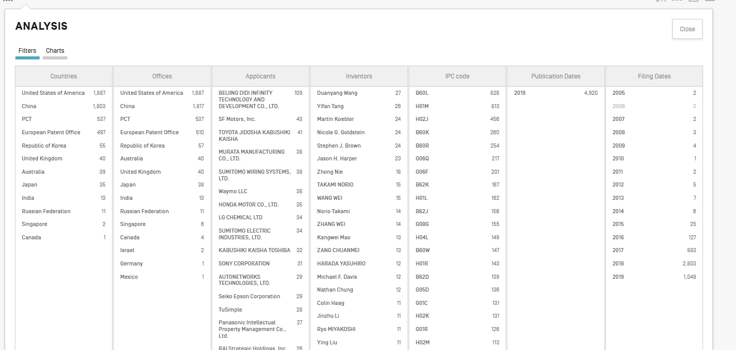

Slide 42
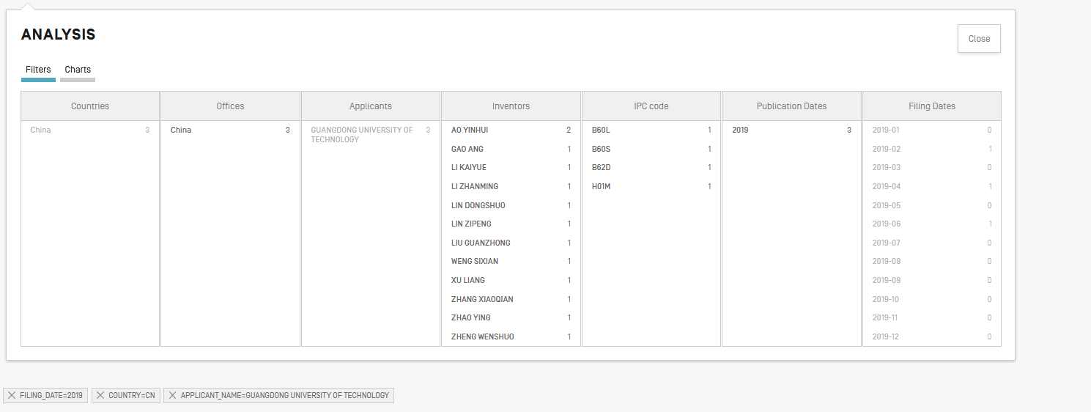

Slide 43
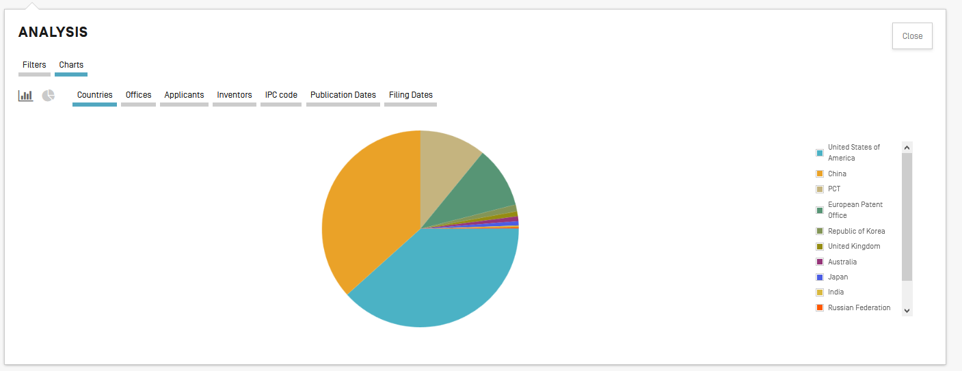

Slide 44
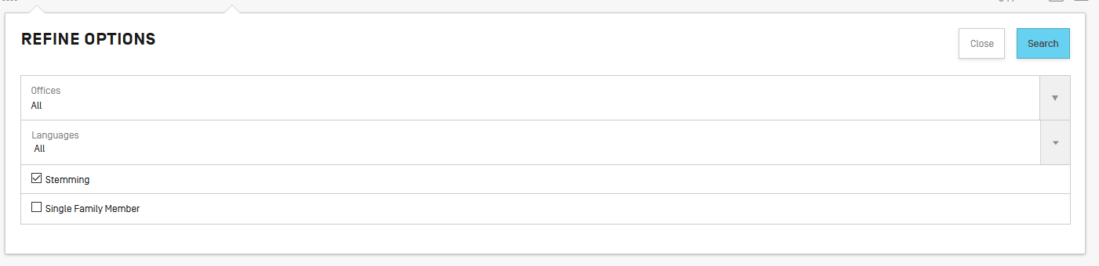
Collections

Slide 45
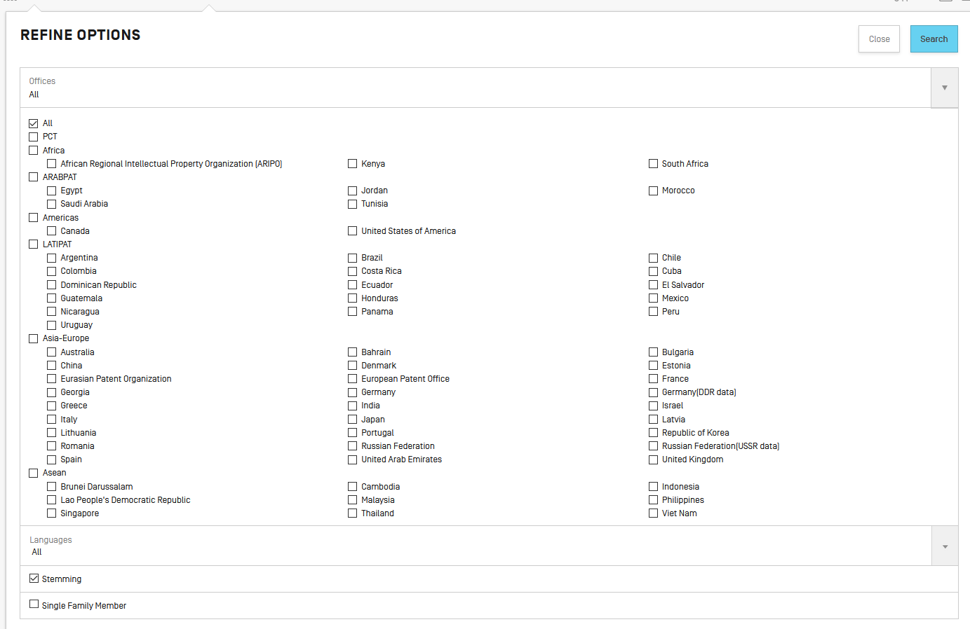

Slide 46


Slide 47
Q1: Using the PATENTSCOPE account, can you download the entire result list?
A
No
B
Yes

Slide 48

Q1: Using the PATENTSCOPE account, can you download the entire result list?
A
No
B
Yes

Slide 49
Q 2: if you would like to search in 4 fields combined by 2 operators which interface should you use?
A
Advanced search
B
Field combination

Slide 50
Q 2: if you would like to search in 4 fields combined by 2 operators which interface should you use?
A
Advanced search interface
B
Field combination

Slide 51
Q3: which data are you selecting here?
A
PCT national phase
B
National/regional collections

Slide 52
Q3: which data are you selecting here?
A
PCT national phase
B
National/regional collections

Slide 53
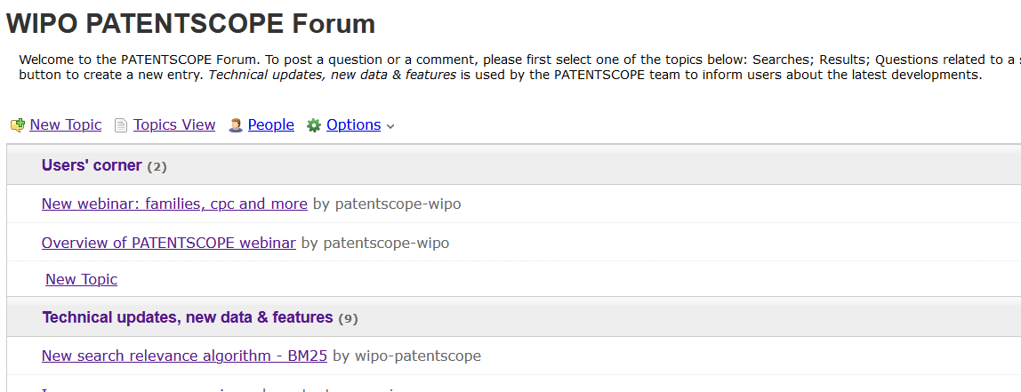
New in 2020!

Slide 54
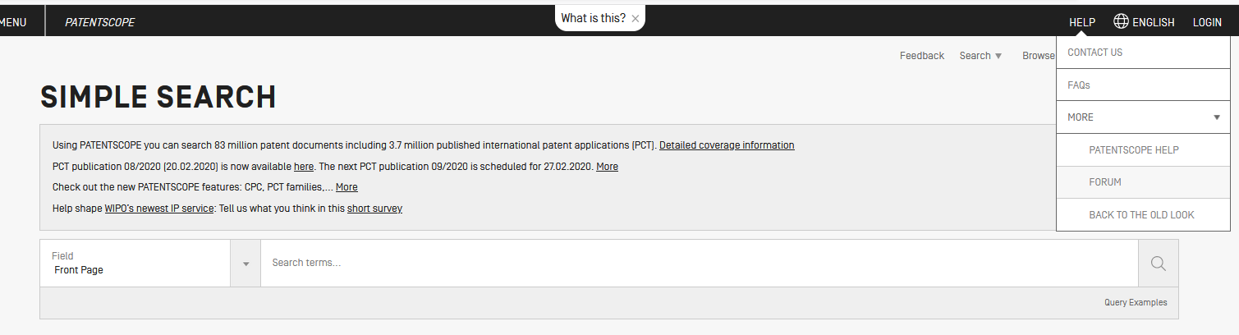

Slide 55
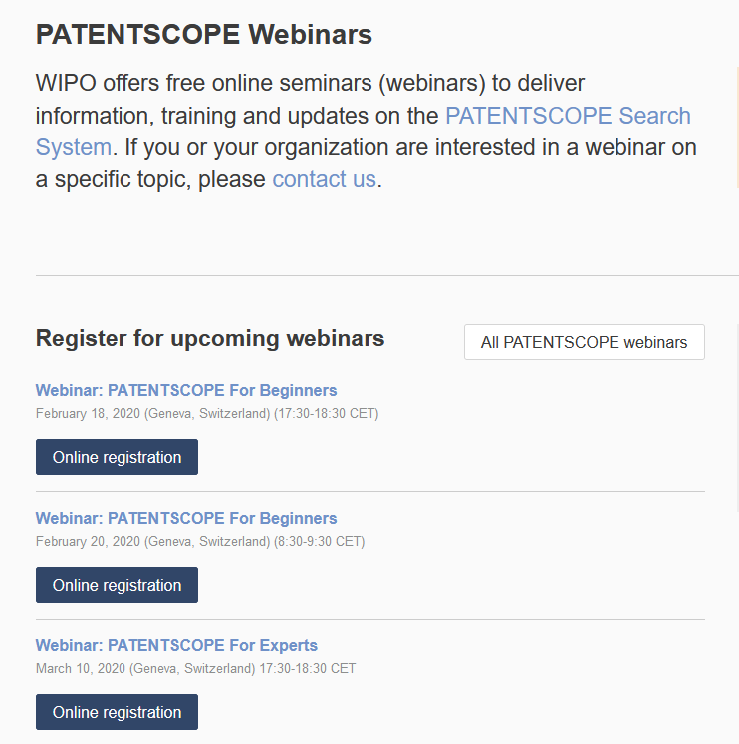
wipo.int/patentscope/en/webinar

Slide 56
Next webinar
PATENTSCOPE for experts
  March 10at 5:30 pm or March 12 at 8:30 am
  https://attendee.gotowebinar.com/rt/2679514638585844748

Slide 57
Global Brand Database: webinar
How to read, save and share your results
  March 6 at 5:30pm CET
  https://attendee.gotowebinar.com/register/133081992540373004

Slide 58
Global Design Database: webinar
Practical cases
  February 27 at 5:30pm CET
  https://attendee.gotowebinar.com/register/1884281858680424460

Slide 59


Slide 60

patentscope@wipo.int

