Slide 1
Retrospective of 2019 and plans for 2020
Web
December
2020
Sandrine Ammann
Marketing & Communications Officer

Slide 2
Photo by Jake weirick on Unsplash

Slide 3
New data
Greece
Latvia
Lithuania

Slide 4
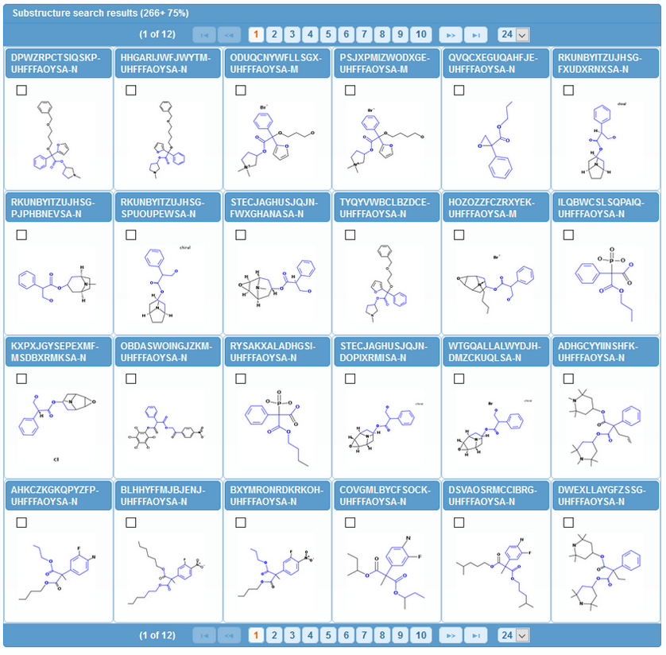
Substructure search

Slide 6
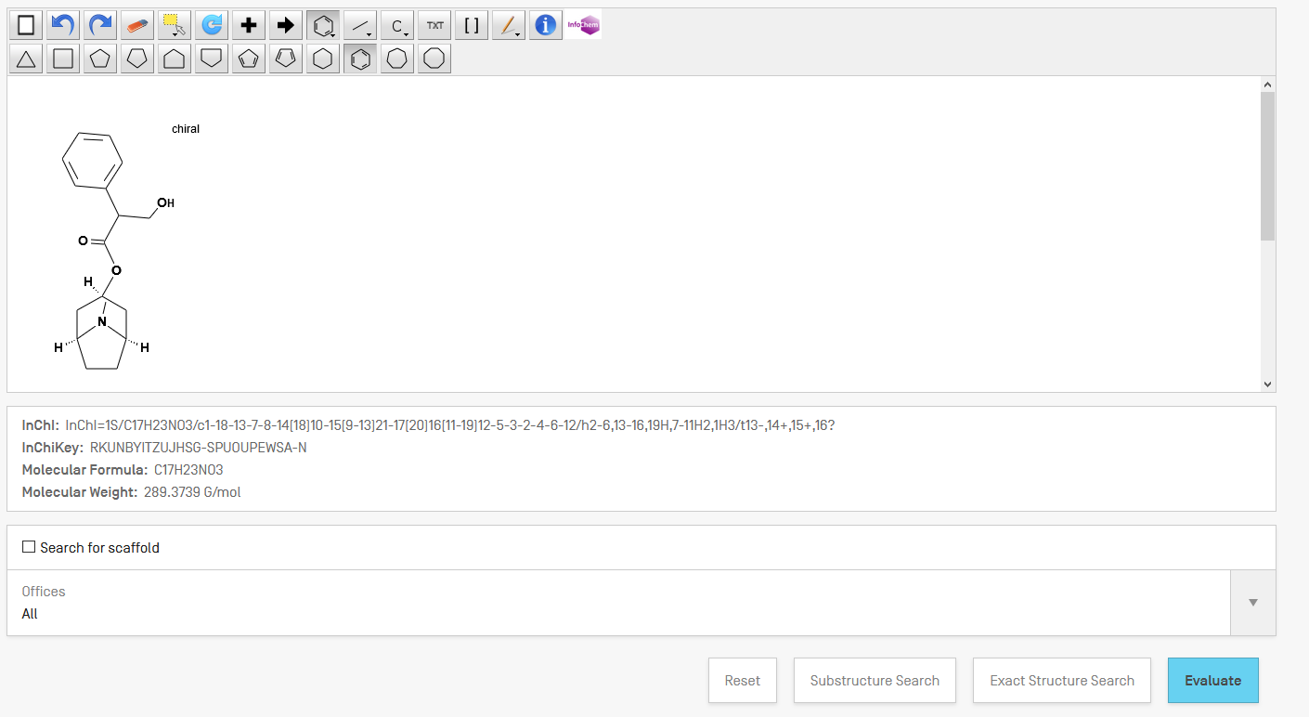

Slide 7
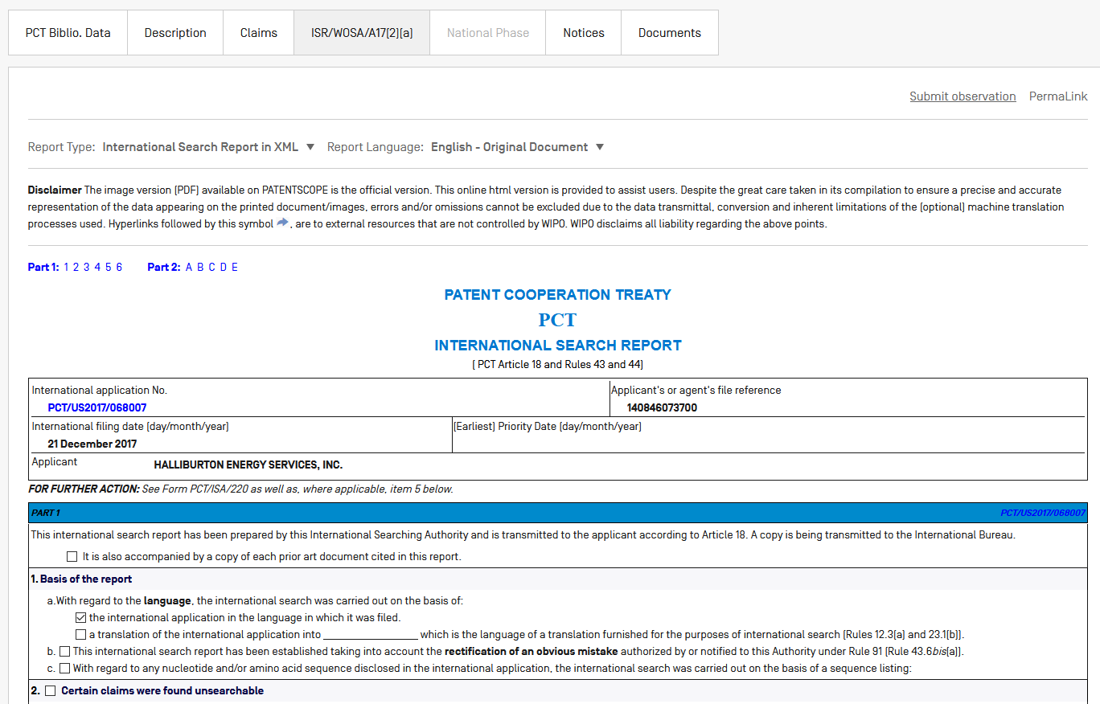
ISR/WOSA/Art.17(2)a

Slide 8
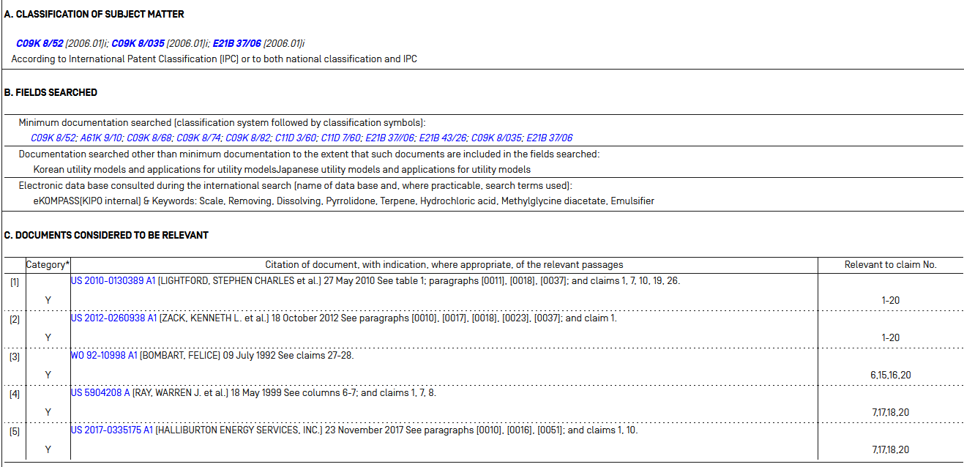

Slide 9
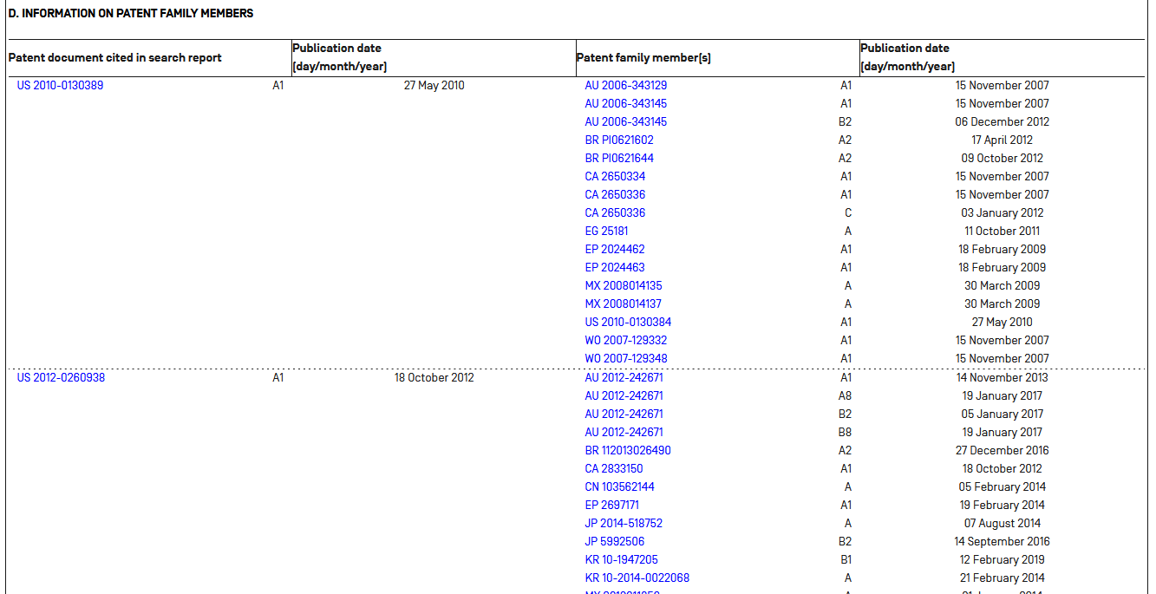

Slide 10
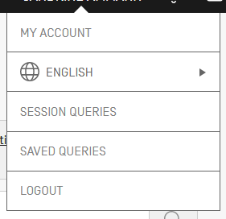
New user account

Slide 11
New interface

Slide 13
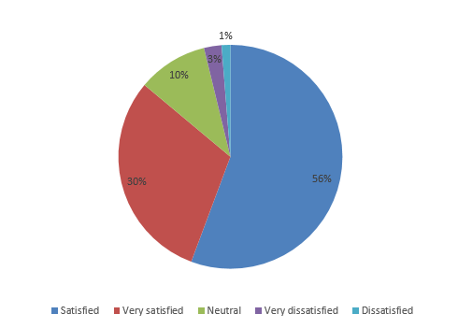
Survey 2019

Slide 14
Photo by Jon Tyson on Unsplash

Slide 15
New collections
New collections
Backfile of existing collections

Slide 16
Better lingustic search
12-14 languages improved

Slide 17
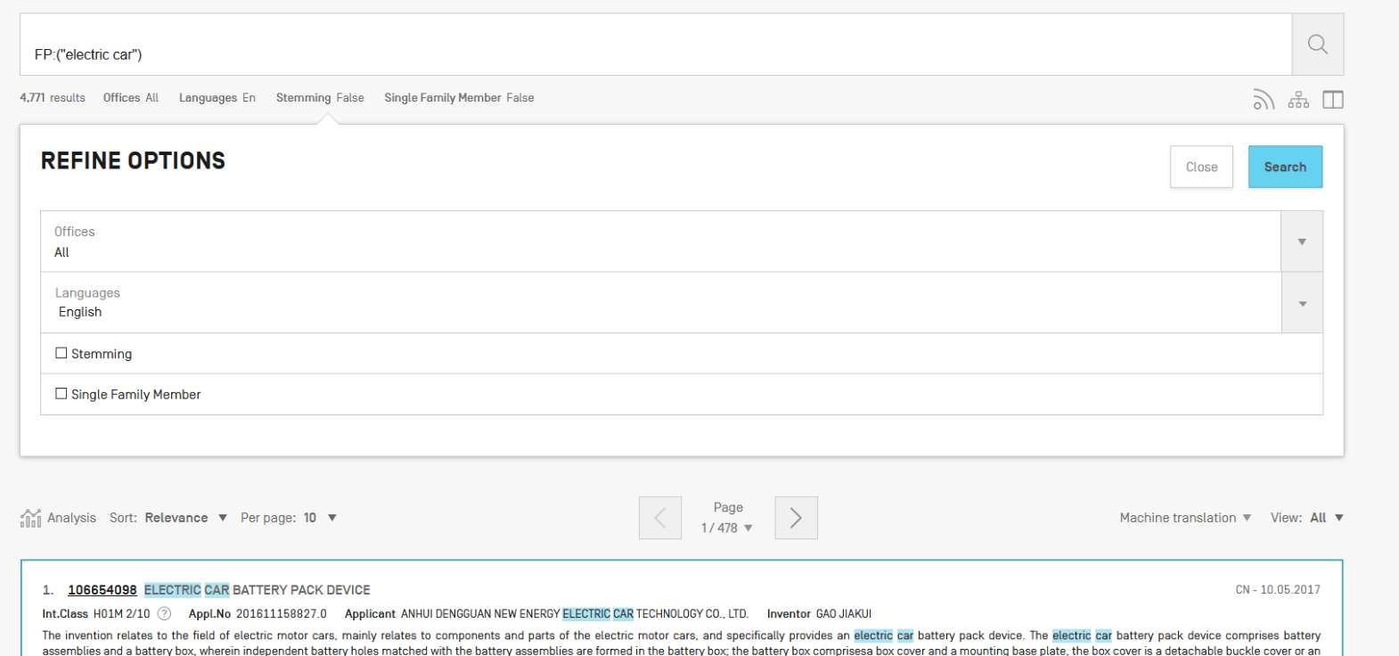

Slide 18
CPC
Available for PCTs
Searchable for PCTs
Related information in the Analysis

Slide 19
Alerts
Add family information
Code IPC
Republication

Slide 20
Photo by Aaron Burden on Unsplash

Slide 21
patentscope@wipo.int

