Slide 1
Overview of the PATENTSCOPE search system
Online
January
2020
Sandrine Ammann
Marketing & Communications Officer

Slide 2
Raise your hand only if you can hear me otherwise please send me a message using the Questions box

Slide 5
Questions/concerns
patentscope@wipo.int

Slide 7
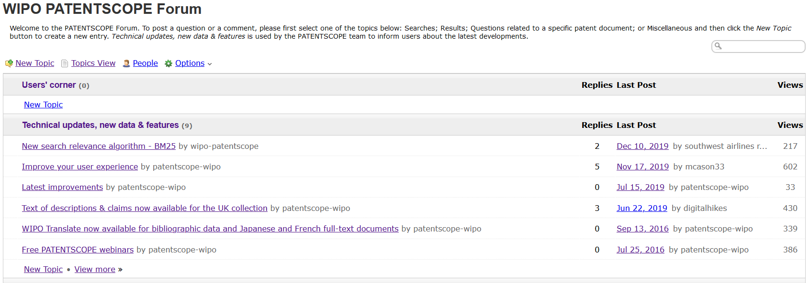
New in 2020!

Slide 8
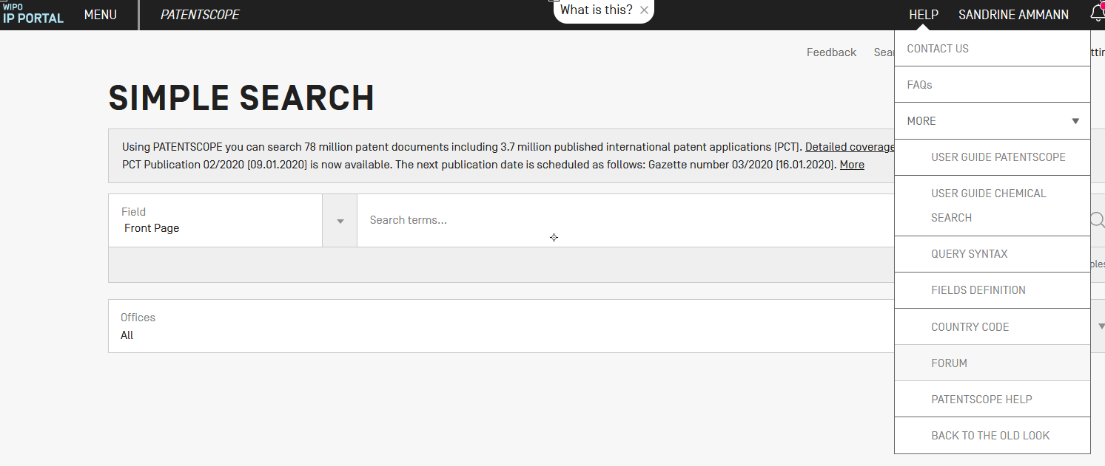

Slide 9
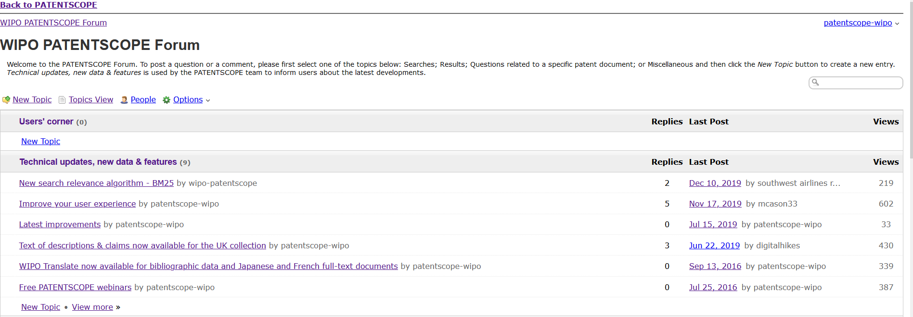

Slide 10
Testing
Transcription + translation of webinars

Slide 11
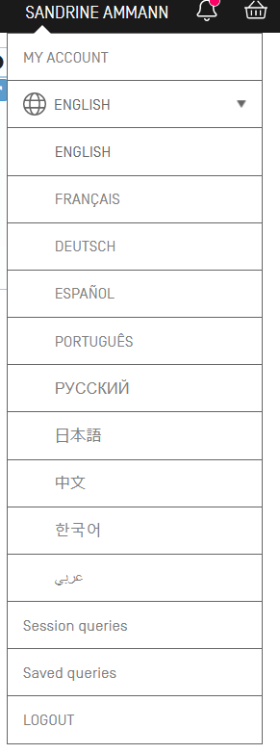
https://patentscope.wipo.int/beta

Slide 14
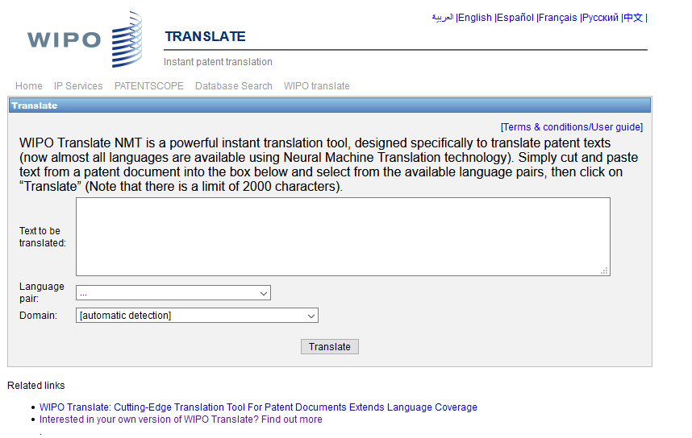
WIPO Translate

Slide 15
32 Technical domains from the IPC
[ADMN] Admin, Business, Management & Soc Sci
[AERO] Aeronautics & Aerospace Engineering
[AGRI] Agriculture, Fisheries & Forestry
[AUDV] Audio, Audiovisual, Image & Video Tech
[AUTO] Automotive & Road Vehicle Engineering
[BLDG] Civil Engineering & Building Construction
[CHEM] Chemical & Materials Technology
[DATA] Computer Sci, Telecom & Broadcasting
[ELEC] Electrical Engineering & Electronics
[ENGY] Energy, Fuels & Heat Transfer Eng
[ENVR] Environmental & Safety Engineering
[FOOD] Foods & Food Technology
[GENR] Generalities, Language, Media & Info Sci
[HOME] Home Contents & Household Maintenance
[HORO] Precision Mechanics, Jewelry & Horology
[MANU] Manufacturing & Materials Handling Tech
[MARI] Marine Engineering
[MEAS] Standards, Units, Metrology & Testing
[MECH] Mechanical Engineering
[MEDI] Medical Technology
[METL] Metallurgy
[MILI] Military Technology
[MINE] Mining, Oil & Gas Extraction & Minerals
[NANO] Nano Technology
[PACK] Packaging & Distribution of Goods
[PRNT] Printing & Paper
[RAIL] Railway Engineering
[SCIE] Optical Engineering
[SPRT] Sports, Leisure, Tourism & Hospitality
[TEXT] Textile & Clothing Industries
[TRAN] Transportation

Slide 16
Language pairs

Slide 17
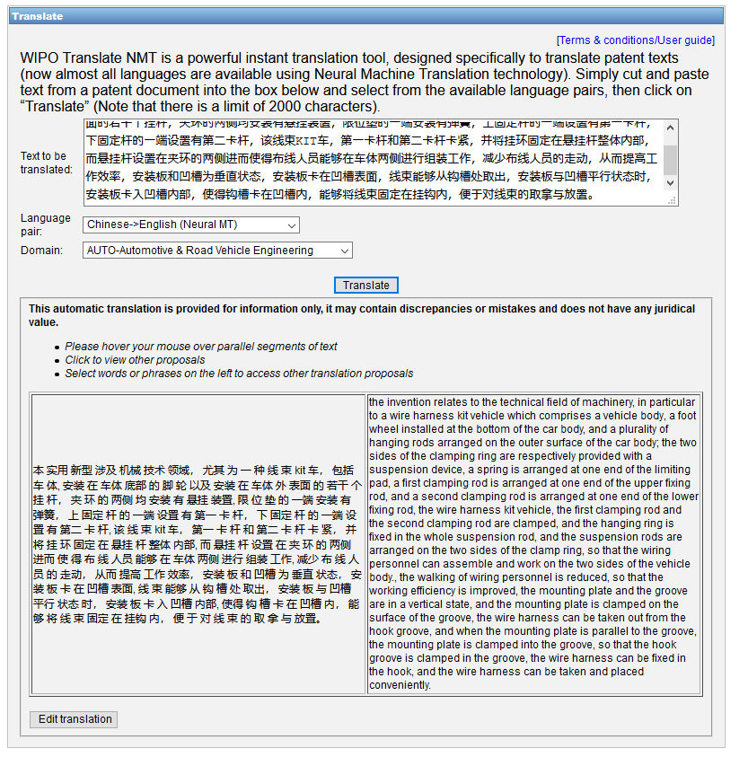

Slide 18
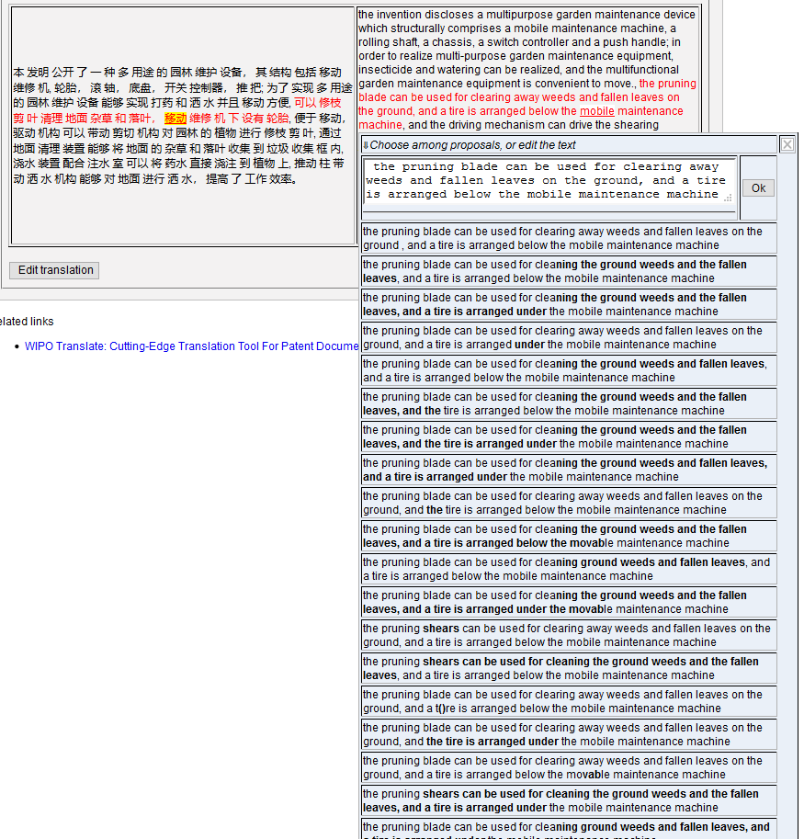
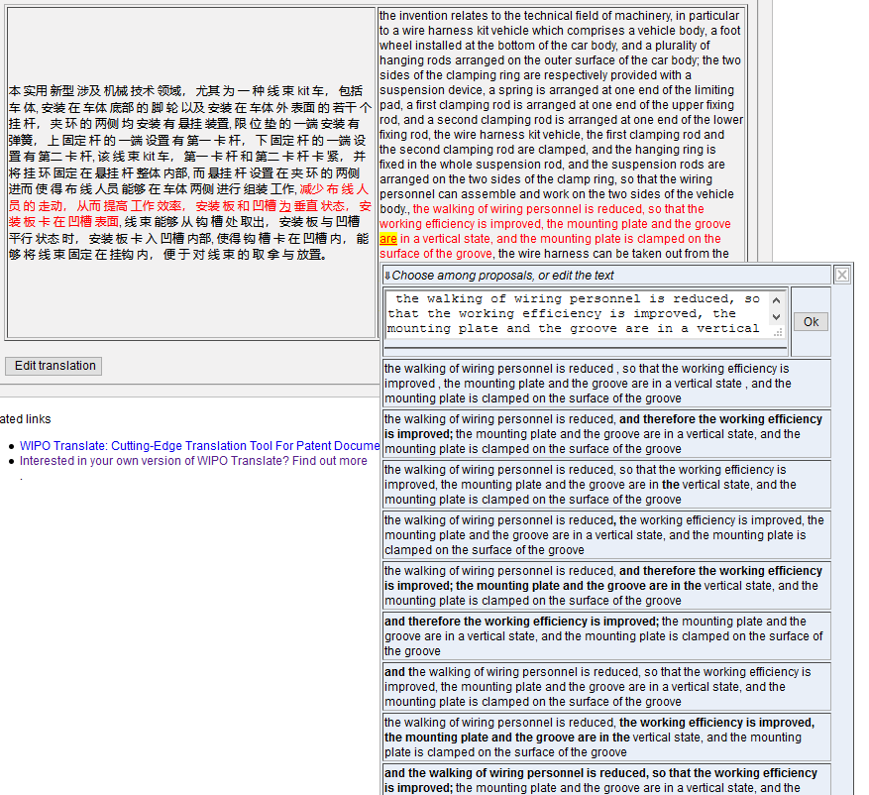

Slide 19
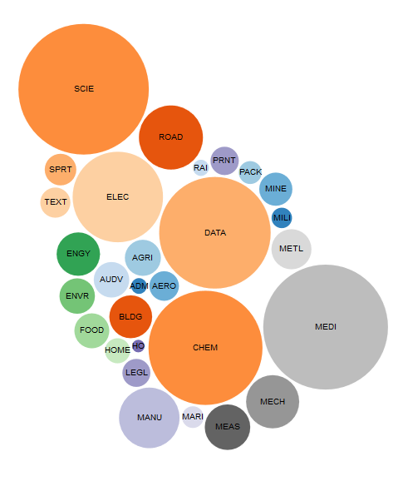
WIPO Pearl

Slide 20
WIPO Pearl
WIPO’s online terminology database
18’000 concepts, 180’000 terms
10 languages
Contents validated by WIPO language experts and terminologists

Slide 21
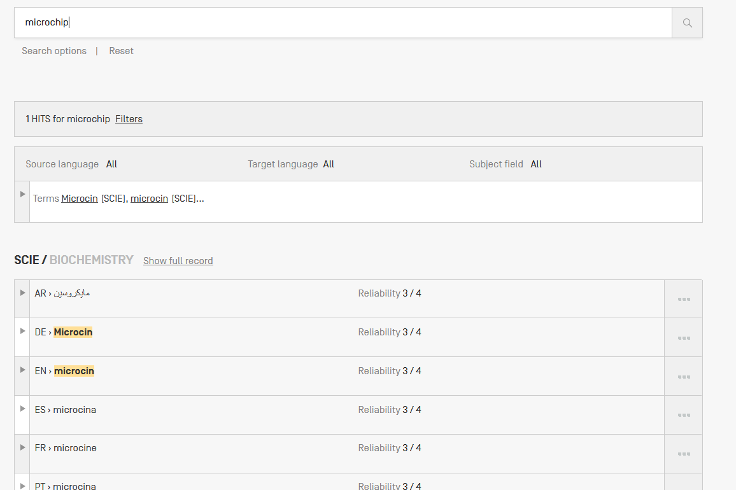
Example: microchip

Slide 22
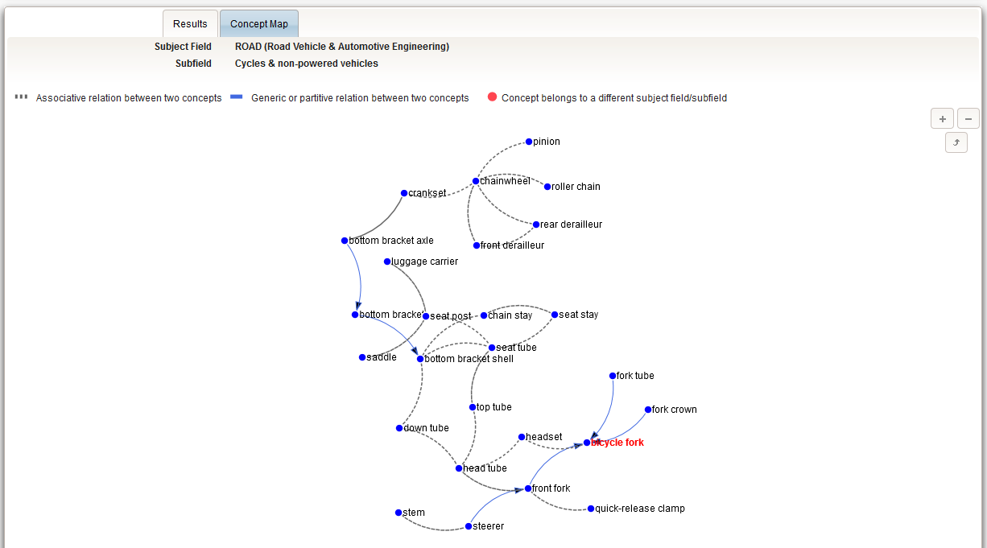

Slide 23
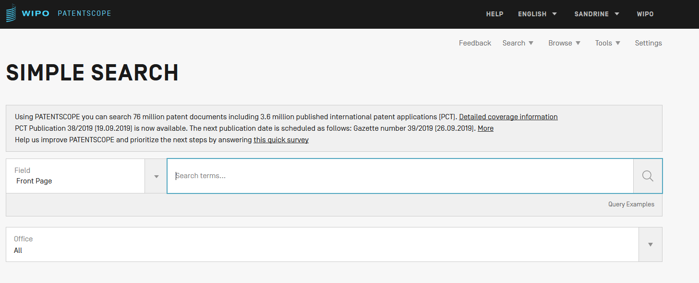
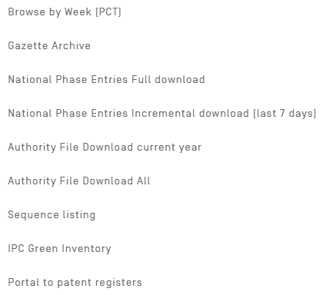

Slide 24
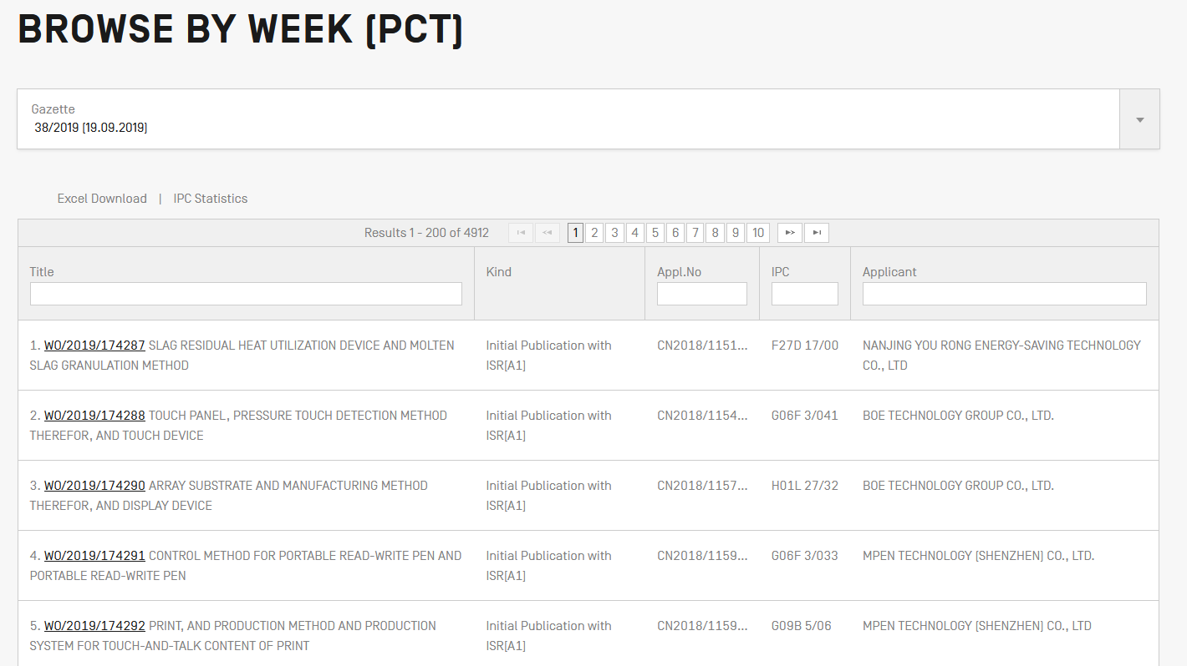

Slide 25
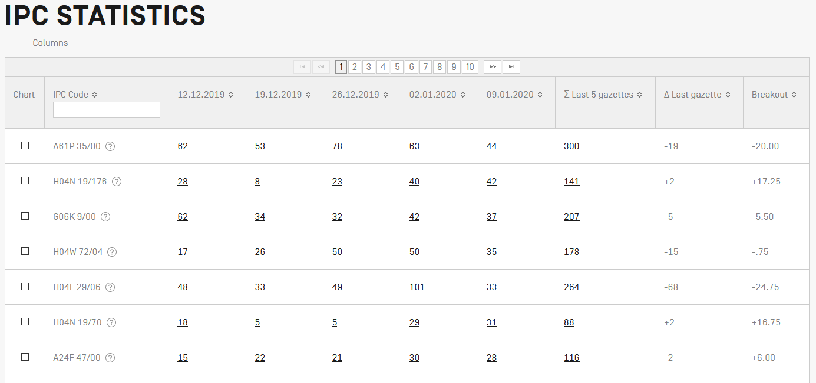
IPC Statistics

Slide 29
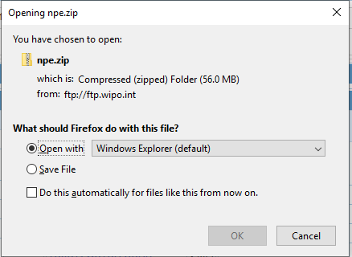

Slide 31
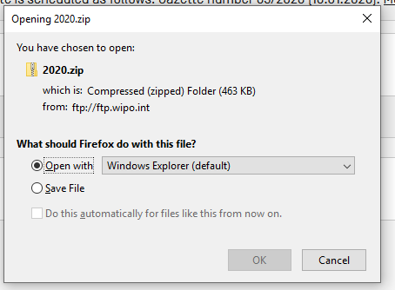

Slide 33
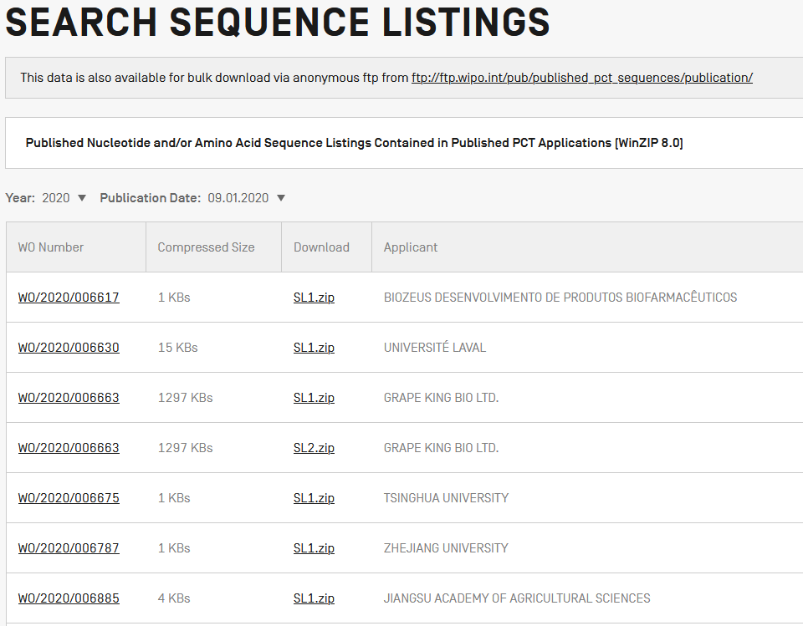

Slide 35
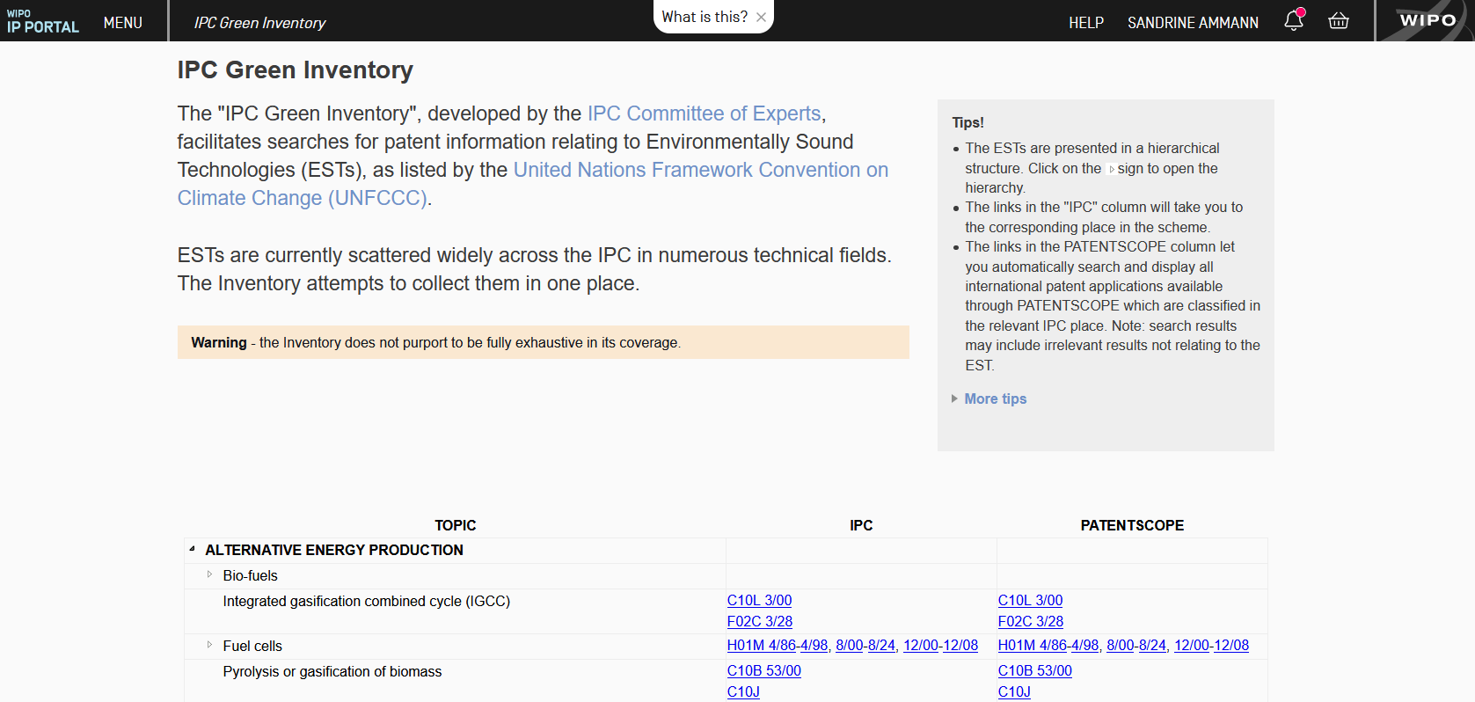

Slide 37
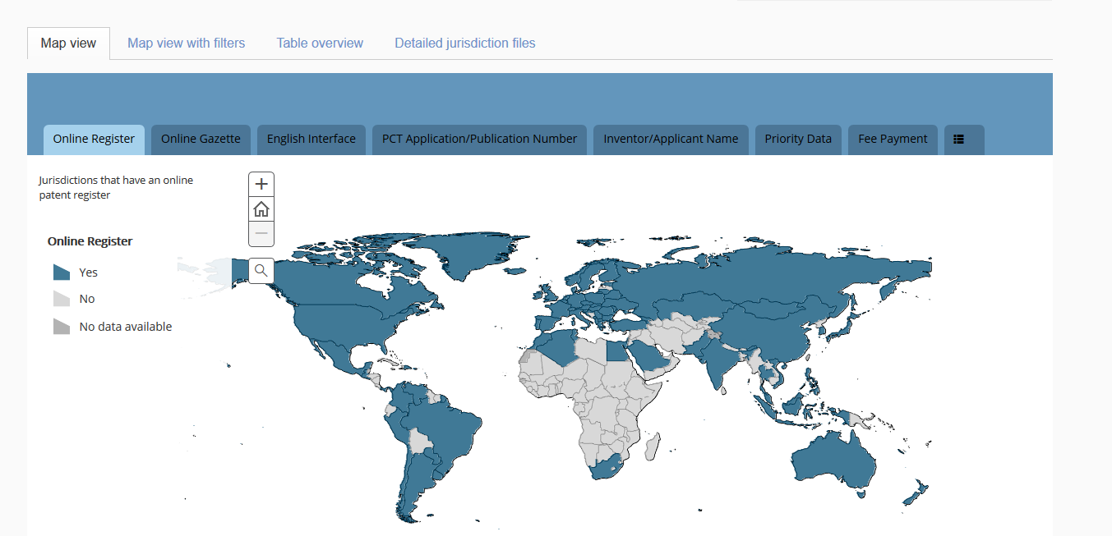
Portal to patent registers

Slide 38
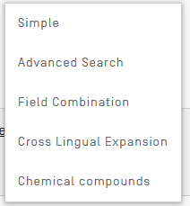
Searches

Slide 39
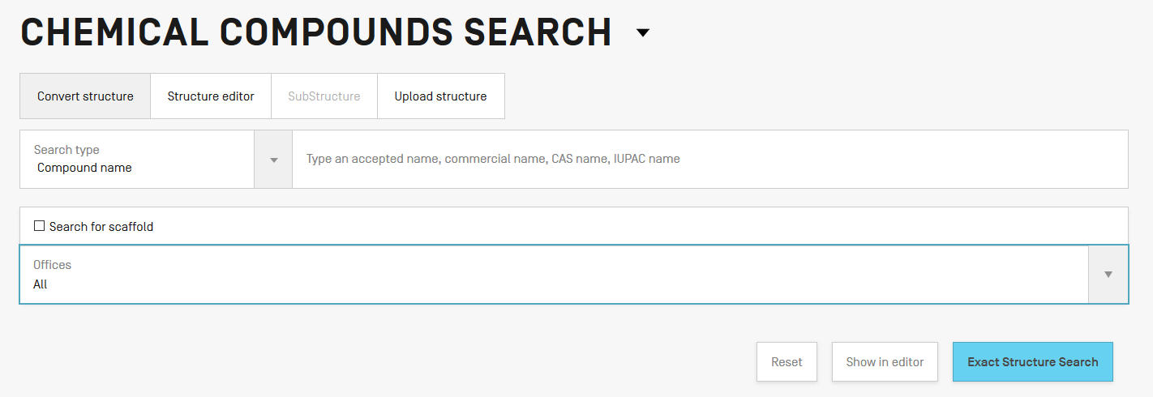

Slide 40
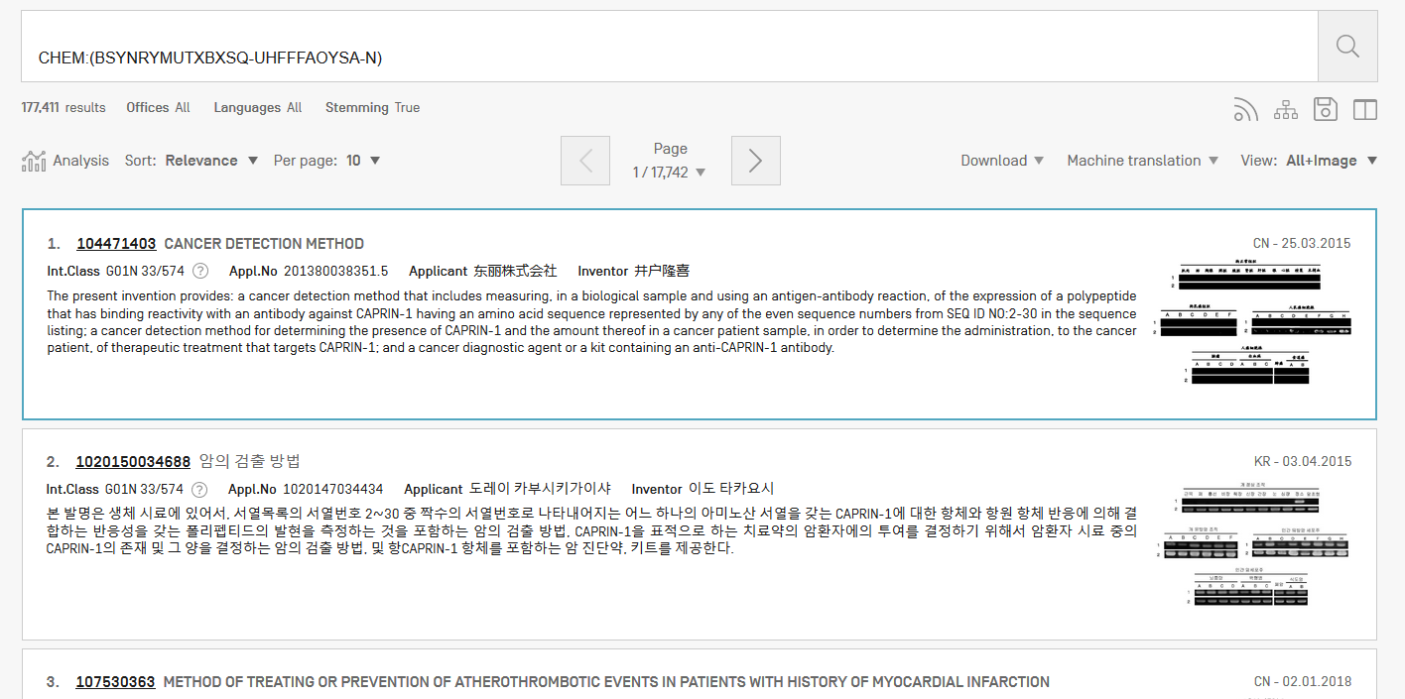
Results

Slide 41
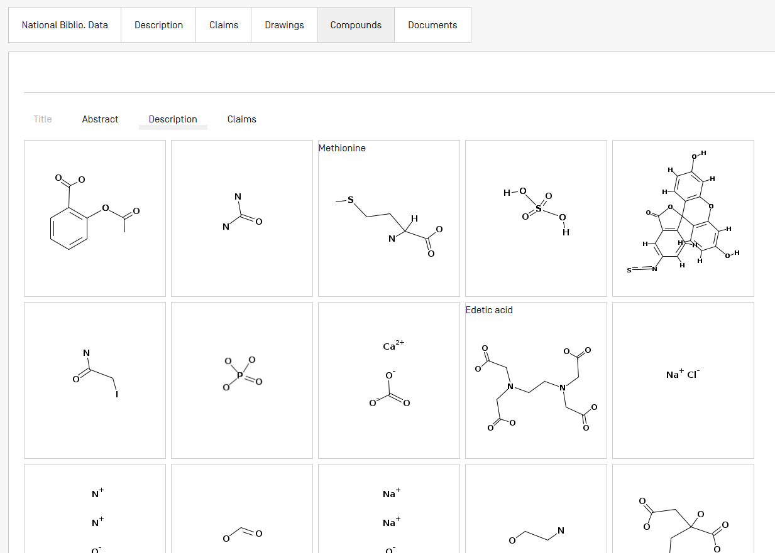

Slide 42
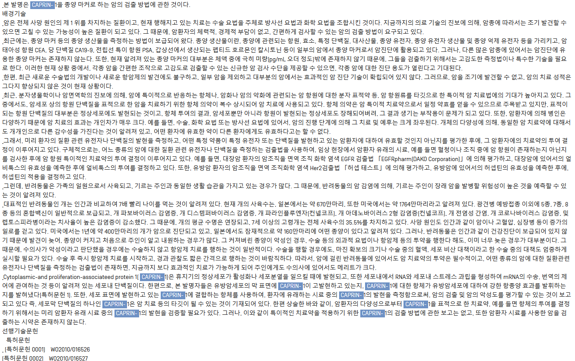

Slide 44
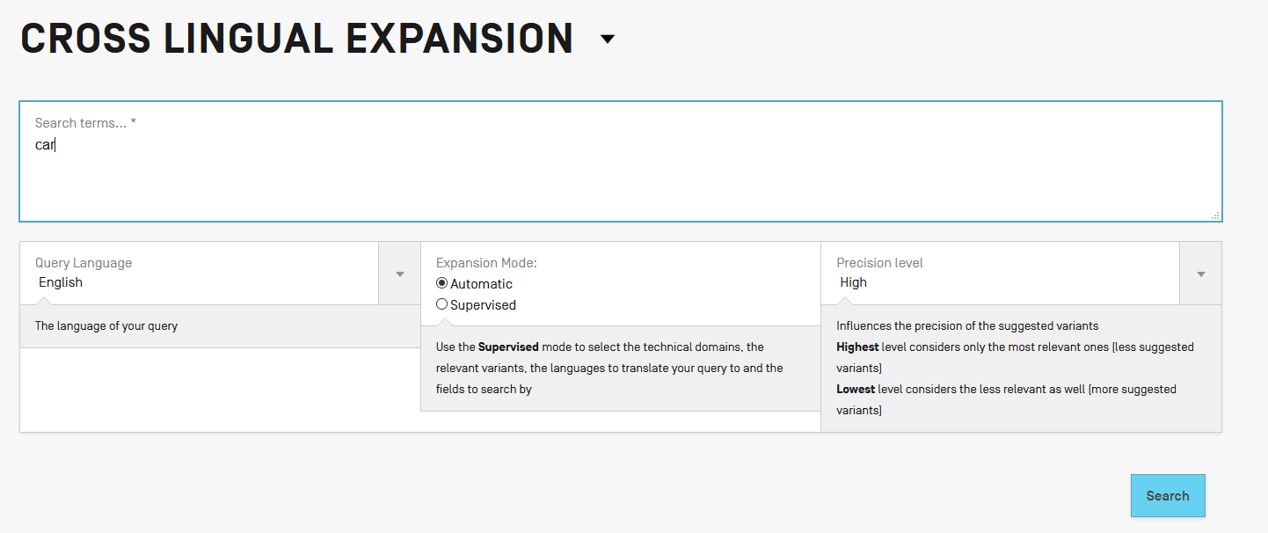

Slide 45
Languages
Chinese
Danish
Dutch
English
French
German
Italian
Japanese
Korean
Polish
Portuguese
Russian
Spanish
Swedish

Slide 50
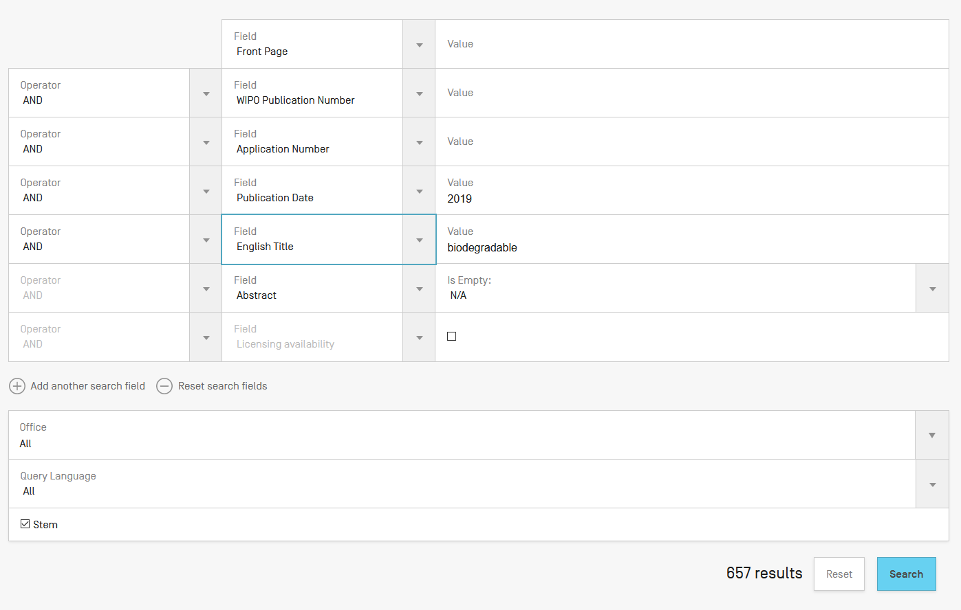

Slide 52
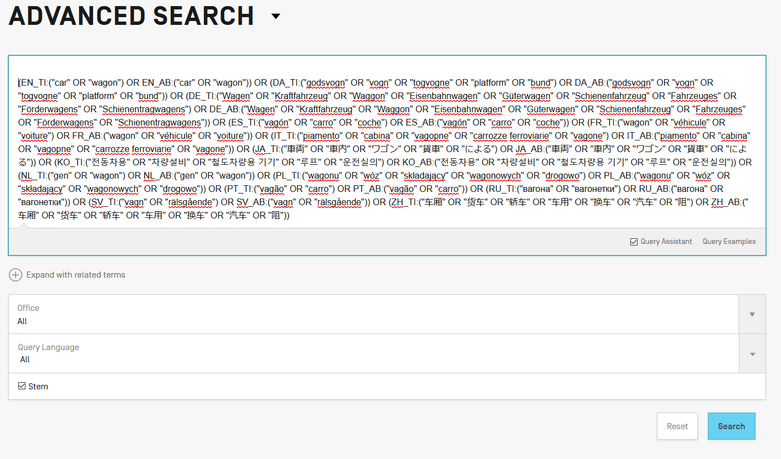

Slide 53
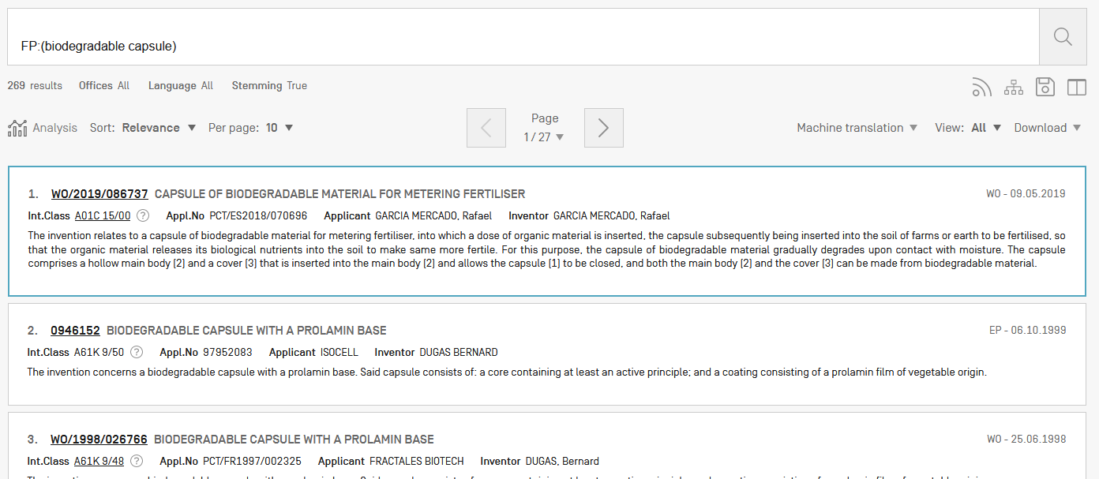

Slide 54
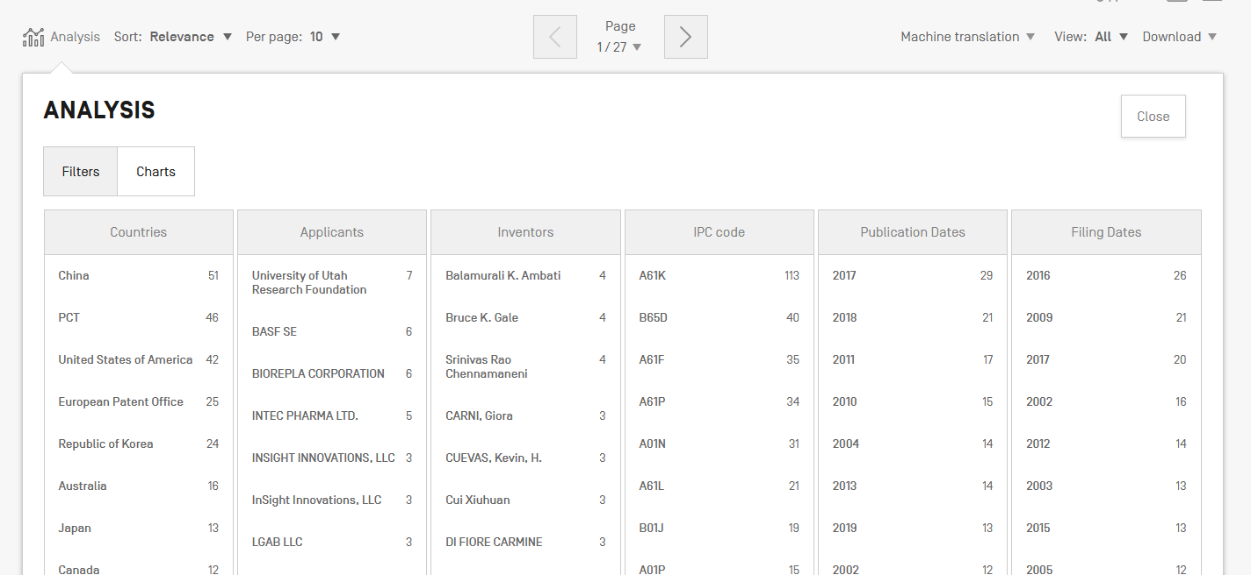
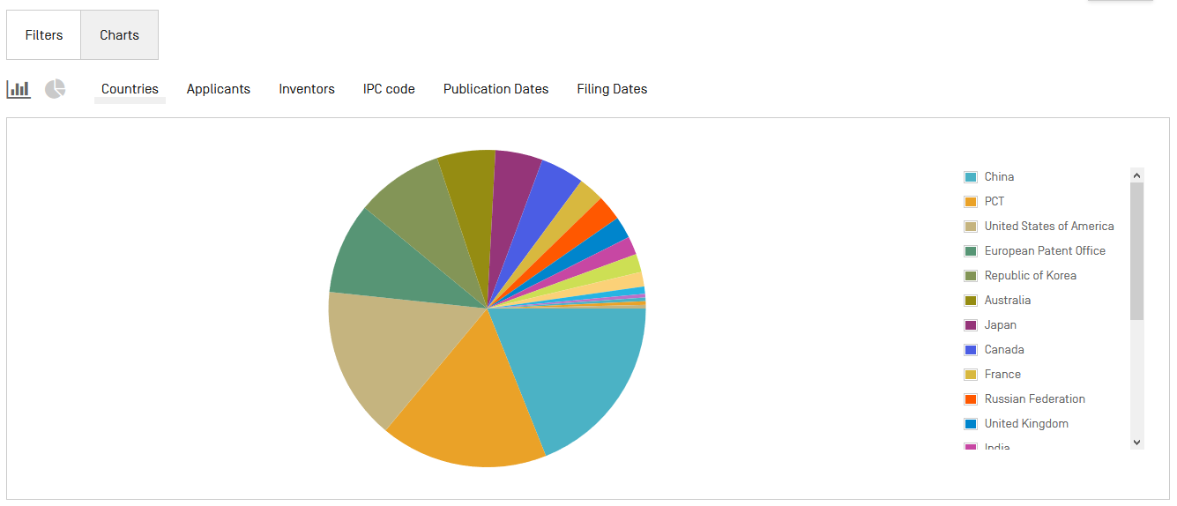

Slide 57
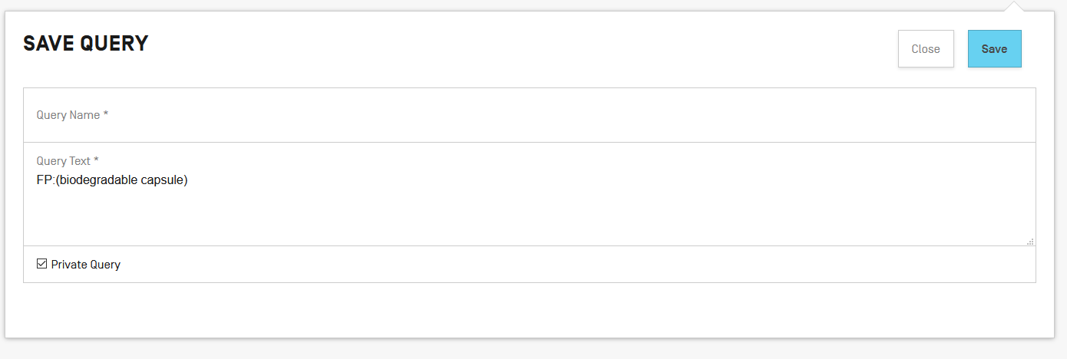

Slide 58
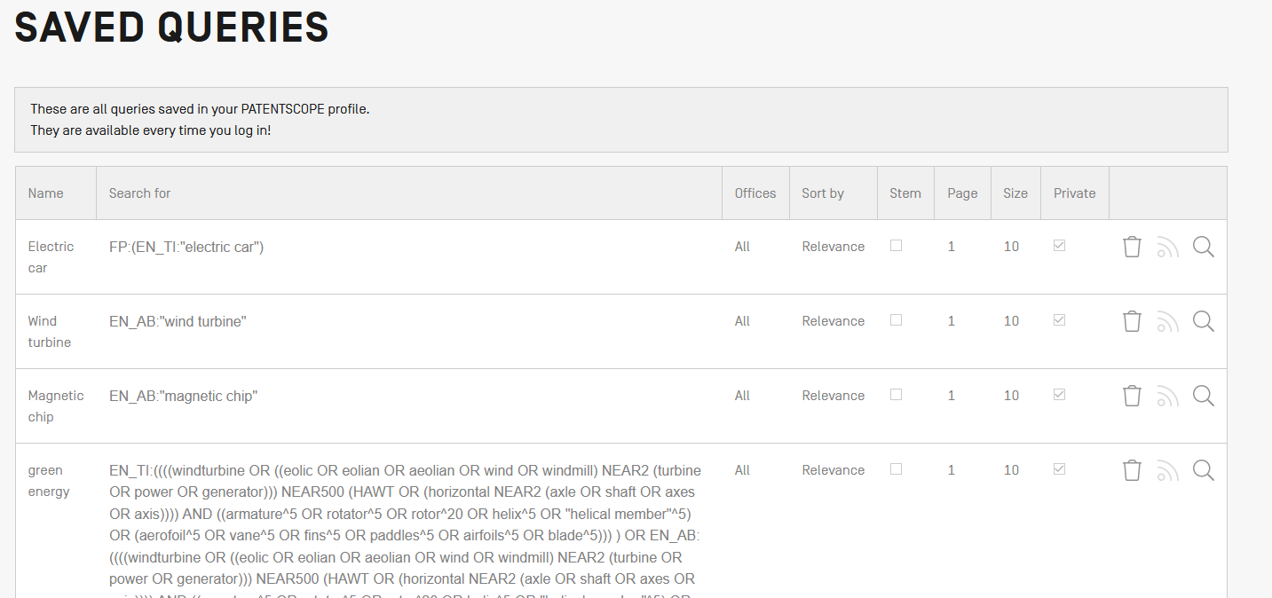

Slide 61
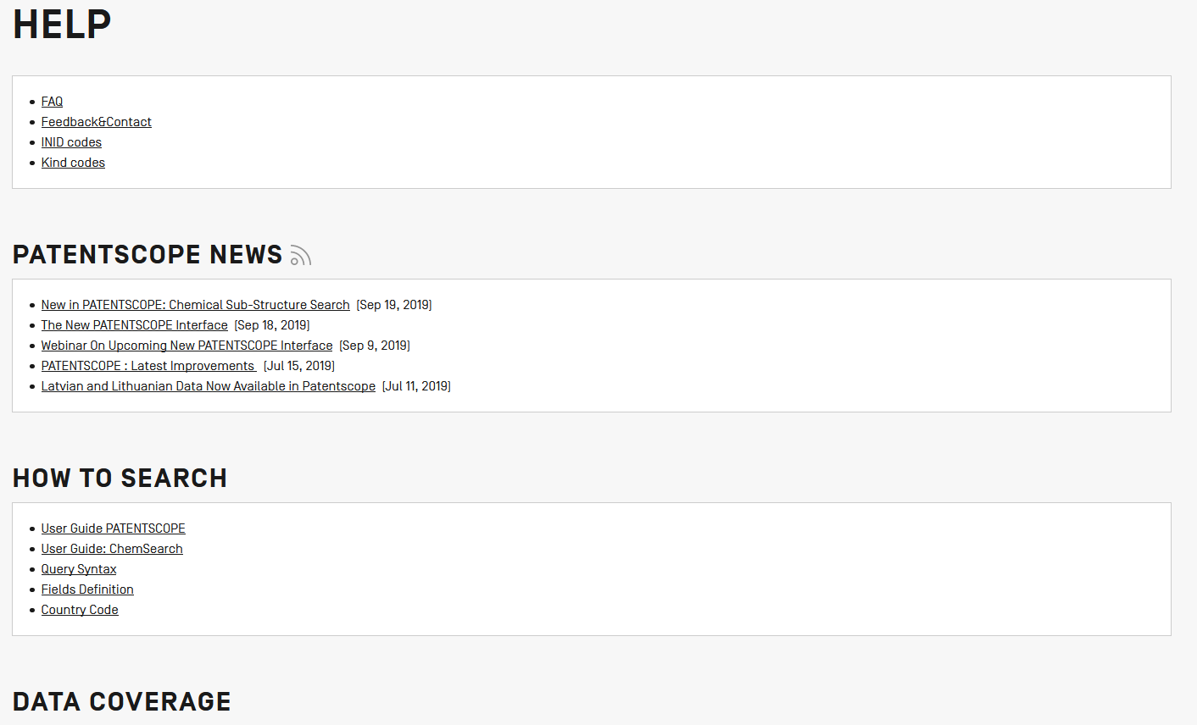

Slide 62
Coverage: what is included?
PCT published applications
National/regional patent collections

Slide 63
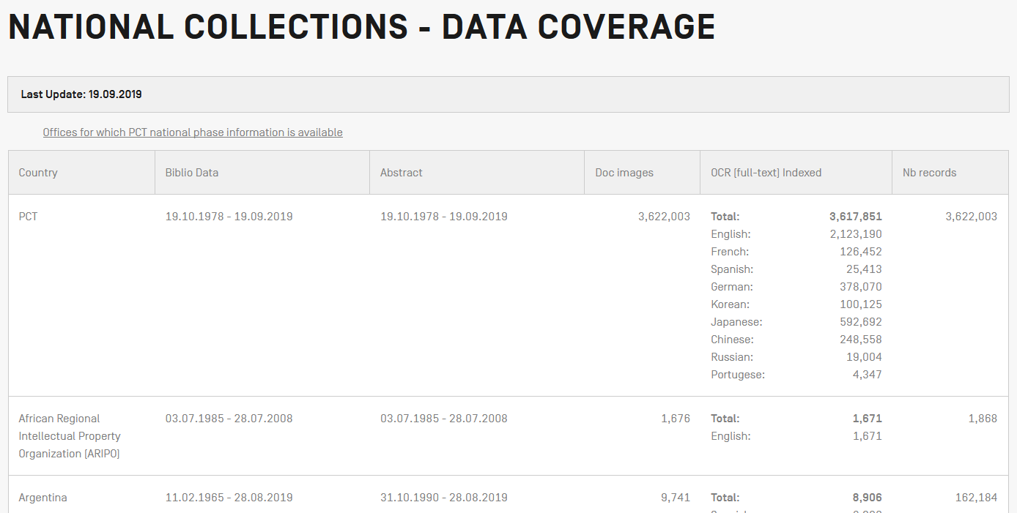
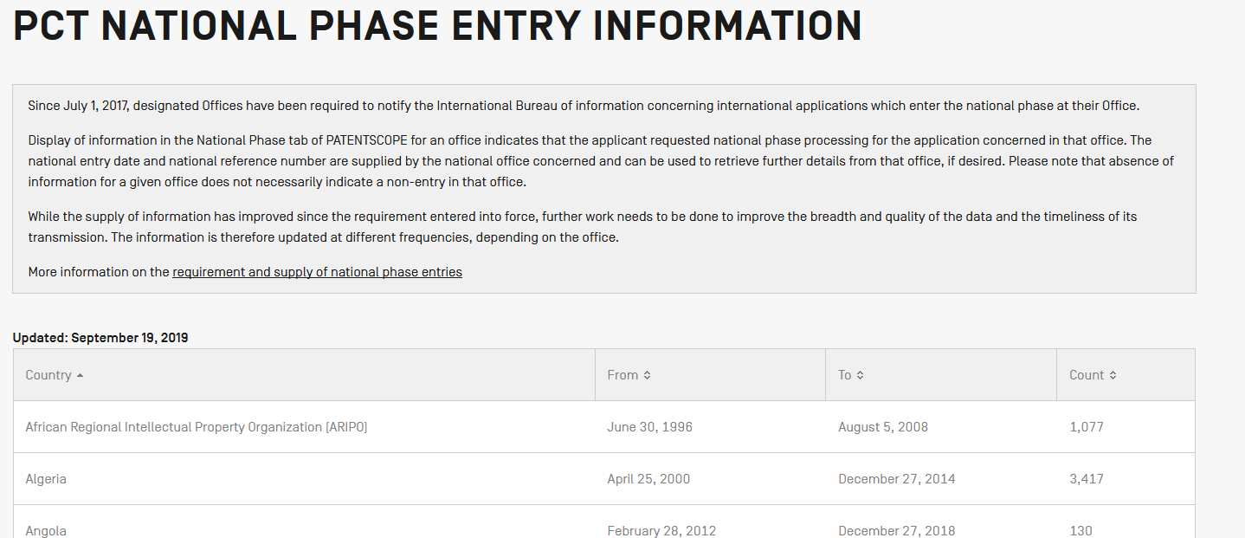
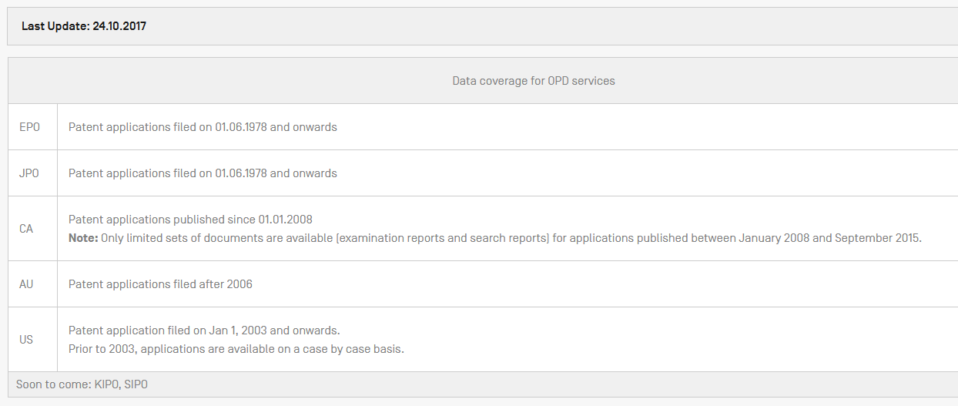

Slide 65
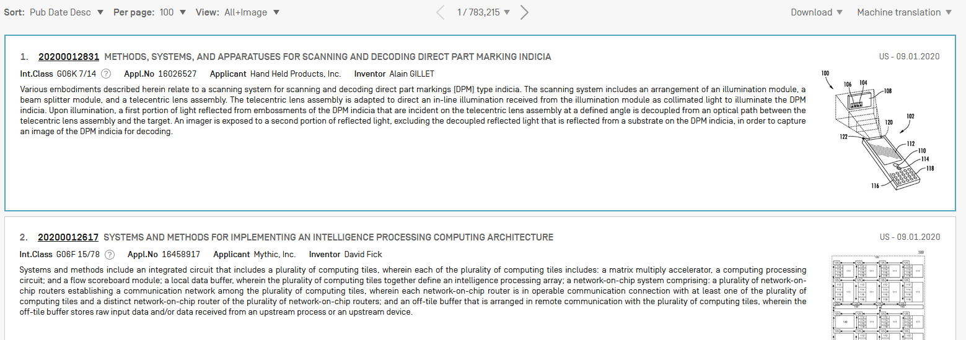

Slide 66
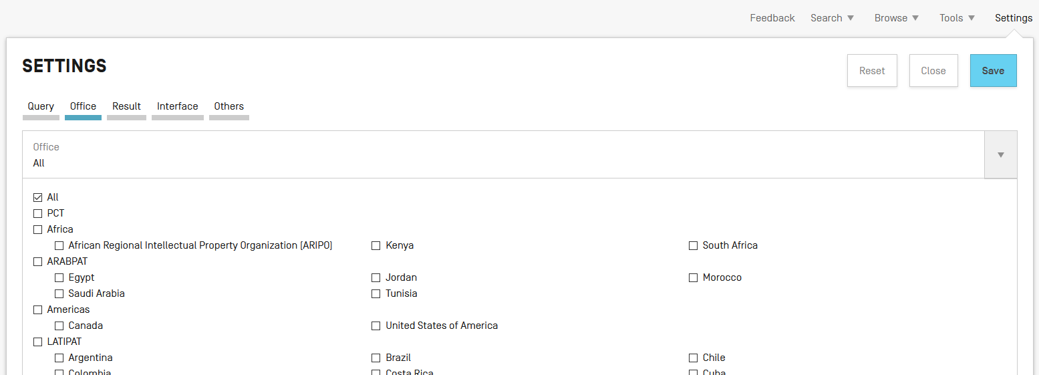

Slide 67
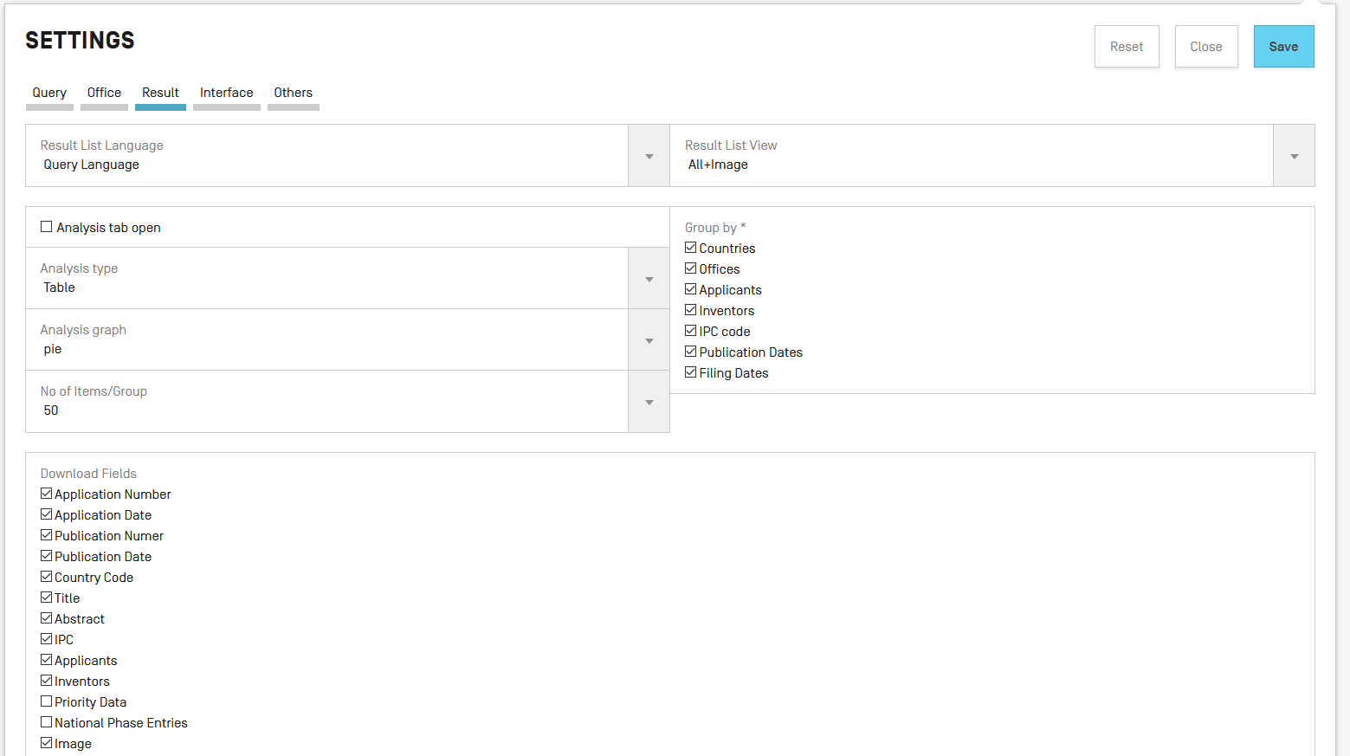

Slide 68
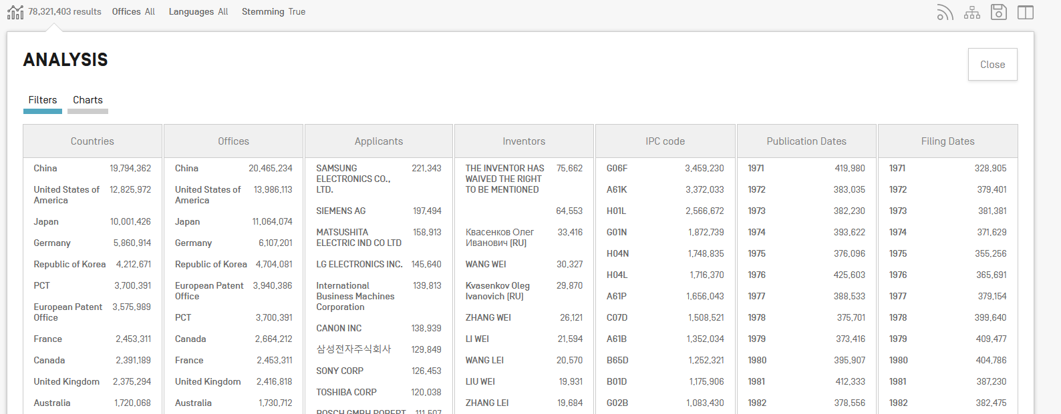

Slide 71
Next webinar
PATENTSCOPE for beginners
February 16 or 18
To register: https://attendee.gotowebinar.com/rt/3103569885139805708

Slide 72
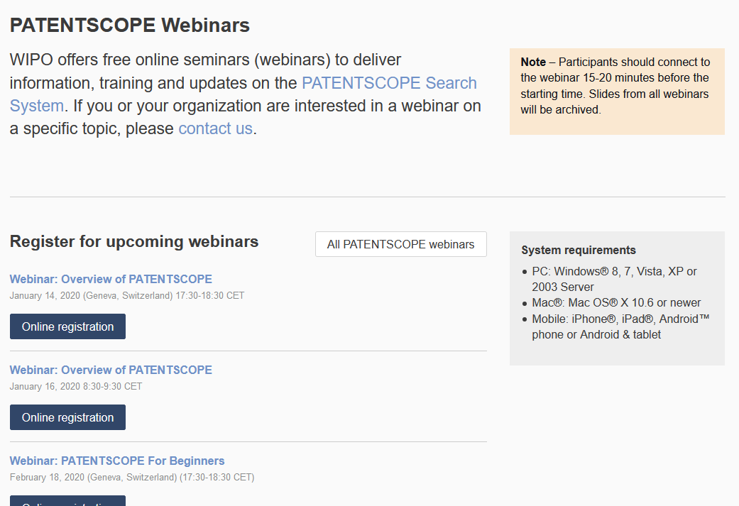
wipo.int/patentscope/en/webinar

Slide 73
Global Brand Database, Global Design Database
Webinars:
https://www.wipo.int/reference/en/branddb/webinar/index.html
https://www.wipo.int/reference/en/designdb/webinar/index.html

Slide 75
patentscope@wipo.int

