Slide 1

PCT Statistics
Meeting of International Authorities
Twenty-Fifth Session
Madrid
February 21 to 23, 2018

Slide 2
Outline
International Applications Filed
  Overall Trends and Forecasts
  Medium of Filing
  Languages
National Phase Entries
International Authorities
  International Search
  Supplementary International Search
  International Preliminary Examination

Slide 3
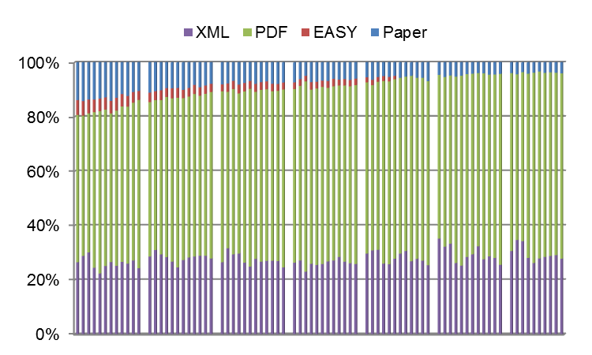
Medium of Filing
2011
2012
2013
2014
2015
2016
2017
Distribution in 2017 – 2016 distribution in parenthesis:
3.8% paper (4.5%),
96.2% (95.4%) fully electronic [PDF 66.6% (66.3%), XML 29.6% (29.2%)]

Slide 4
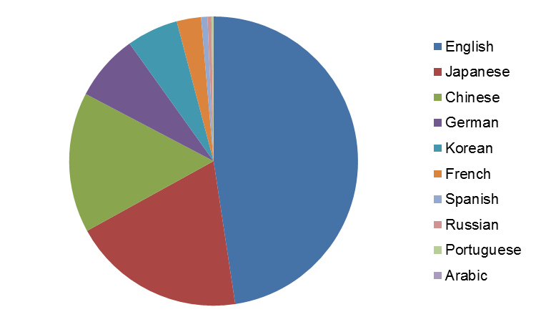
Publication Languages in 2017
2017 is the first year where less than half of PCT applications published were in English
Source: WIPO statistics database. February 2018

Slide 5
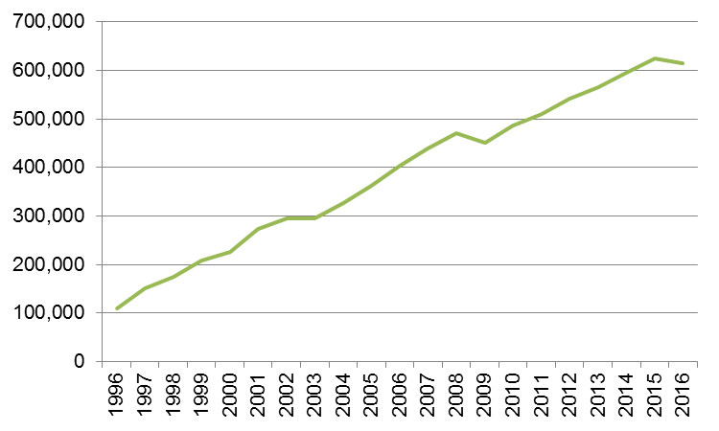
PCT National Phase Entries
615,400 total national phase entries in 2016 (-1.42%)
512,200 non-resident national phase entries in 2016 (-2.7%)
56.2% of all non-resident patent applications (57.6% in 2015)
Source: WIPO statistics database. December 2017

Slide 6
International Authorities
International Search Reports
  Distribution by International Authority
  Timeliness of Transmission to International Bureau
Supplementary International Search Reports
International Preliminary Examination Reports
  Demand
  Distribution by International Authority
  Timeliness of Transmission to International Bureau

Slide 7
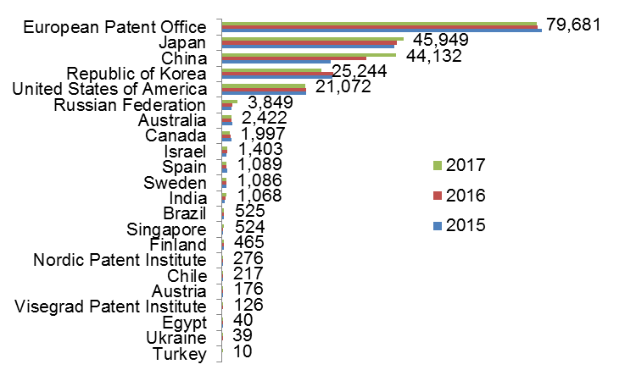
Distribution of ISRs established by ISA
Data based on international filing year of application
Data for 2017 are incomplete
Source: WIPO statistics database. February 2018

Slide 8
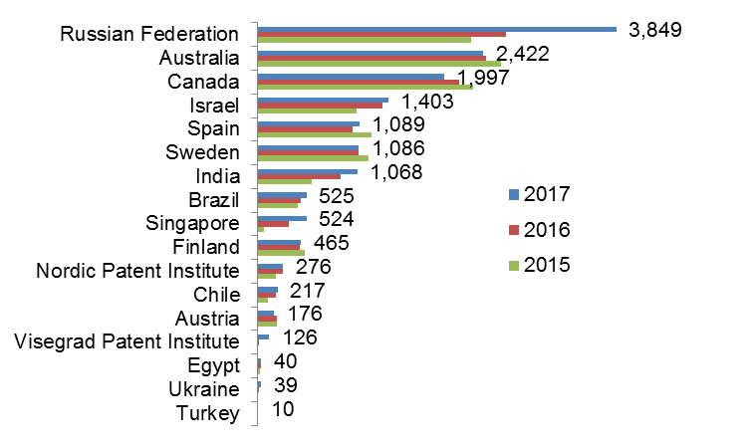
Distribution of ISRs established by ISA (excluding IP5 Offices)
Data based on international filing year of application
Data for 2017 are incomplete
Source: WIPO statistics database. February 2018

Slide 9
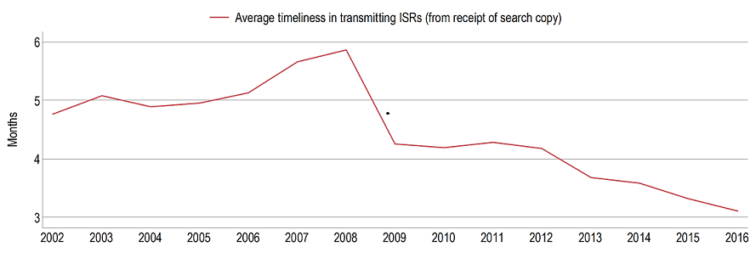
Average Timeliness in transmitting ISRs to the IB from Date of Receipt of Search Copy
Source: WIPO statistics database, April 2017 and February 2018. Excludes cases where the time limit of 9 months from the priority date applies.
Average timeliness in transmitting ISRs to the IB was 3.1 months in 2016 - shortest time since 2001
80.4% of PCT applications transmitted to IB within 3 months from date of receipt of search copy in 2016 – expected to rise to about 84% for 2017

Slide 10
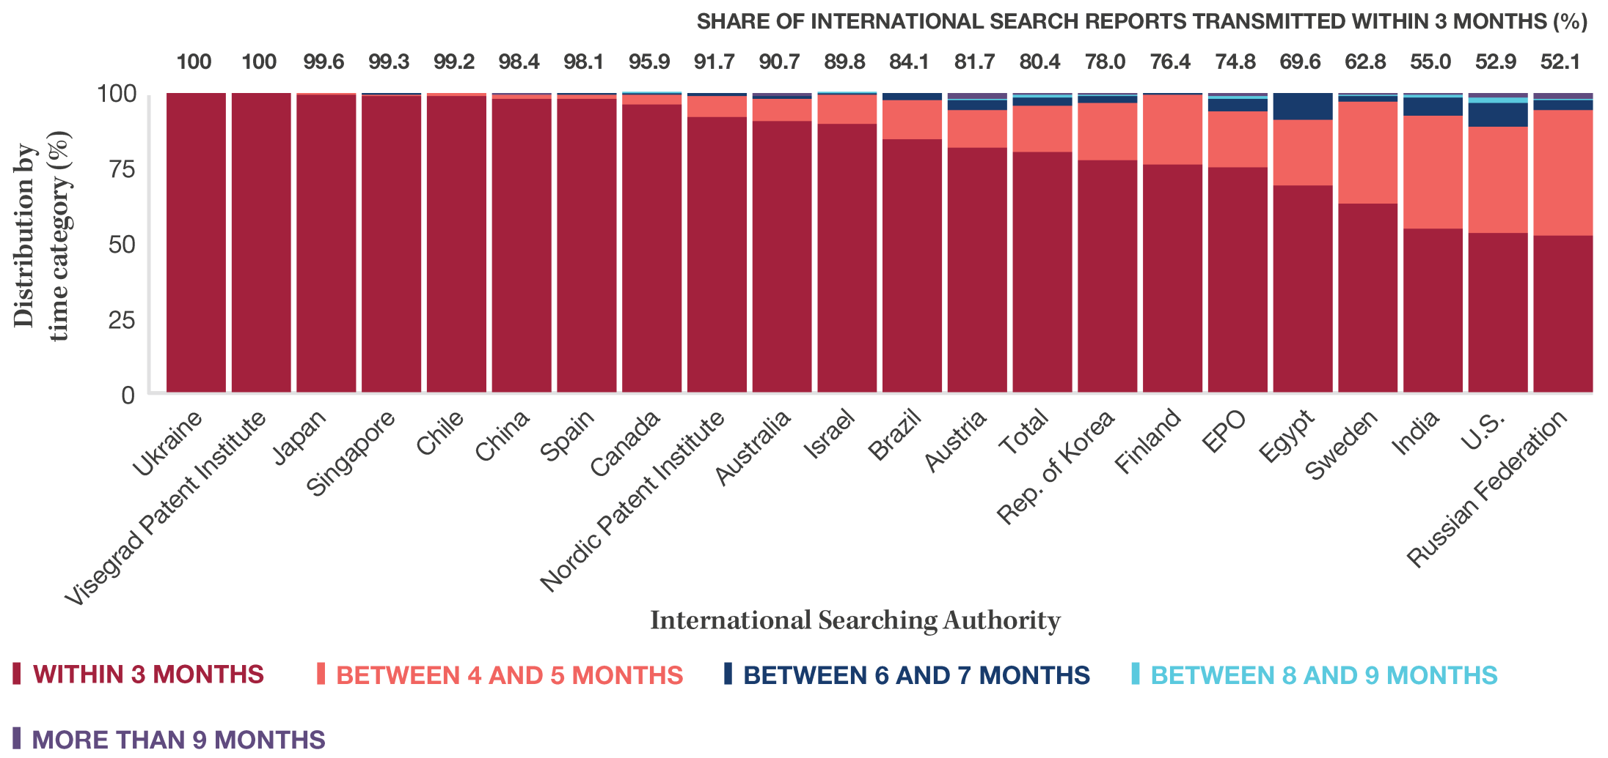
Timeliness in Transmitting ISRs to the IB measured from Date of Receipt of Search Copy by ISA for 2016
Provisional share transmitted within 3 months for 2017
100
99.6
99.3
98.4
96.4
95.2
99.6
90.8
94.4
92.2
88.3
84.1
87.7
71.1
77.3
65.0
86.4
92.3
59.8
62.0
99.0
99.8
Source: WIPO statistics database, April 2017 and February 2018. Excludes cases where the time limit of 9 months from the priority date applies.

Slide 11
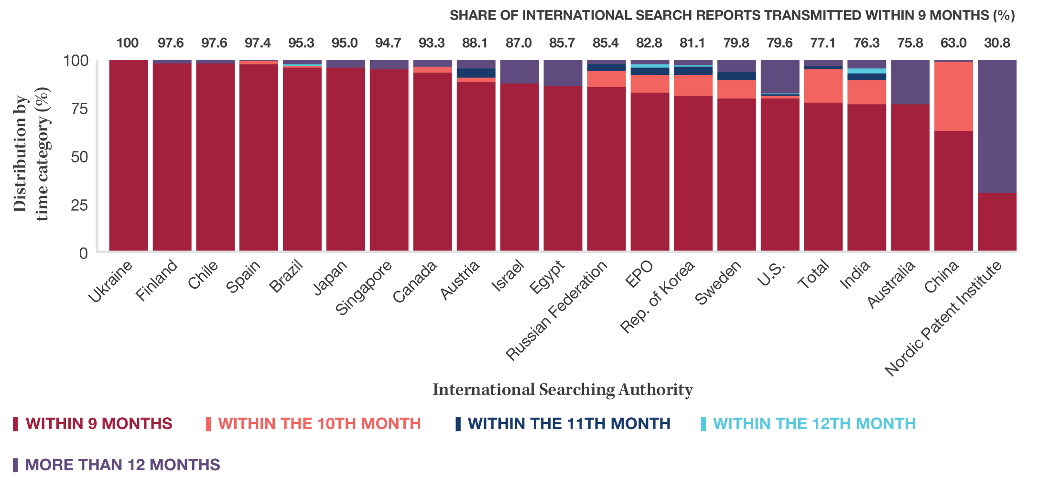
Timeliness in Transmitting ISRs to the IB measured from Priority Date by ISA for 2016
Provisional share transmitted within 9 months for 2017
100
99.1
96.9
96.7
95.2
99.9
100
94.6
76.9
100
90.0
77.3
80.2
85.9
82.9
93.3
79.9
95.7
92.8
68.0
19.2
77.1% of applications transmitted to IB within 9 months from priority date in 2016
– expected to rise to nearly 80% in 2017
Source: WIPO statistics database, April 2017 and February 2018.
Excludes cases where the time limit of 3 months from receipt of search copy applies.

Slide 12
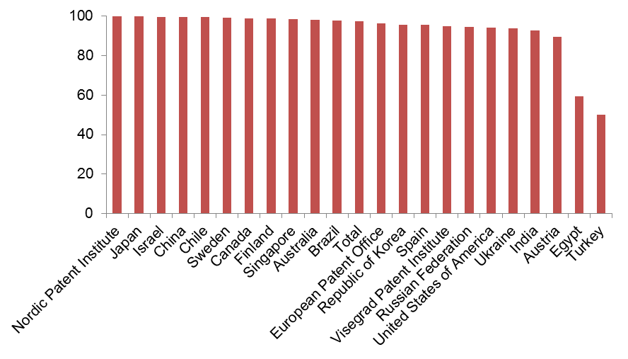
PCT A1 Publication Percentage by ISA in 2017
Overall Percentage of A1 International Publications = 97.4%
(96.2% in 2016)
Source: WIPO statistics database February 2018

Slide 13
Supplementary International Search Requests
 | 2012 | 2013 | 2014 | 2015 | 2016 | 2017
Total | 46 | 67 | 109 | 64 | 48 | 49
Austria | 2 | 2 | 2 | 2 |  | 1
European Patent Office | 21 | 30 | 61 | 40 | 44 | 40
Finland | 1
Nordic Patent Institute | 3
Russian Federation | 19 | 32 | 46 | 22 | 3 | 6
Singapore |  |  |  |  | 1
Sweden |  | 3
Ukraine |  |  |  |  |  | 2
Source: WIPO statistics database February 2018

Slide 14
International Preliminary Examination Demands
2017 figures are incomplete
Source: WIPO statistics database February 2018

Slide 15
International Preliminary Examination Reports
2017 figures are incomplete
Source: WIPO statistics database. February 2018

Slide 16
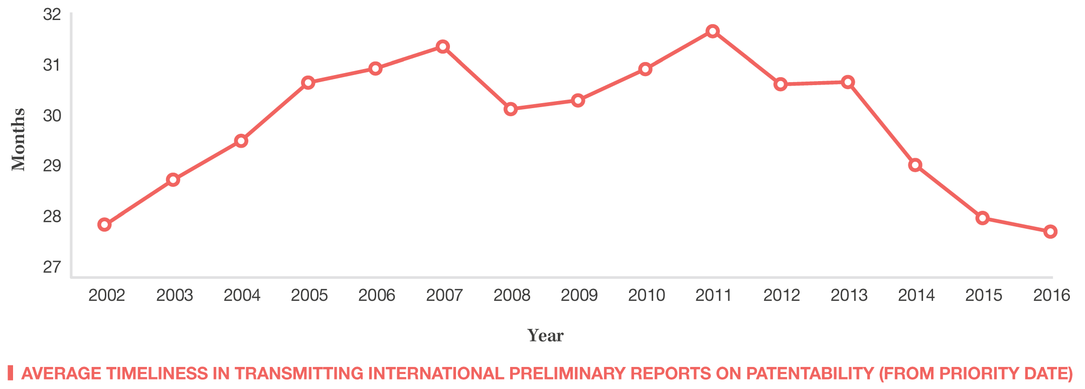
Average Timeliness in transmitting IPRPs
Average time in transmitting IPRPs fell to 27.6 months in 2016
85.8% of all IPRPs were transmitted to the IB within 28 months of priority date in 2016 (expected to rise to about 89% for 2017)
Source: WIPO statistics database, April 2017 and February 2018

Slide 17
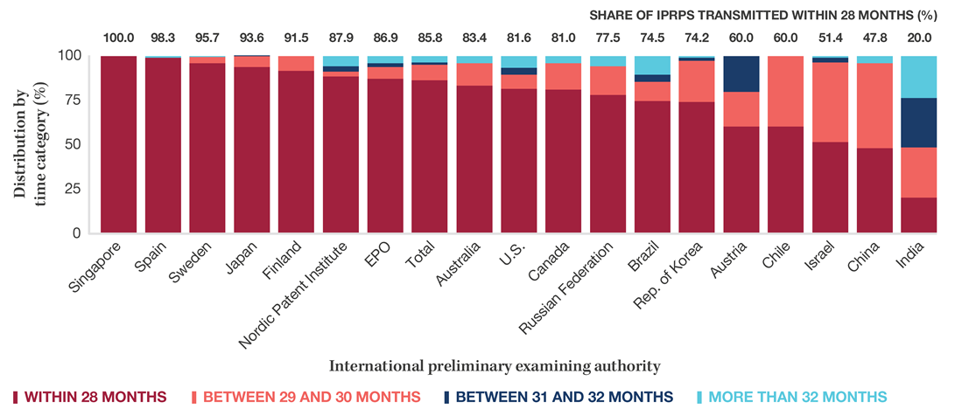
Timeliness in Transmitting IPRPs by IPEA in 2016
Provisional share transmitted within 28 months for 2017
100
97.8
90.9
94.5
86.8
78.8
92.4
89.3
85.0
78.5
87.0
92.2
86.3
57.7
37.5
100
59.4
49.4
21.2
Timeliness calculated as time elapsed between priority date and date on which International Bureau receives IPRP from the IPEA
Source: WIPO statistics database, April 2017 and February 2018.

Slide 18
Further information:
2017 PCT Yearly Review
The International Patent System
WIPO Publication No. 901E/2017
2017 World Intellectual Property Indicators
WIPO Publication No. 941E/2017
WIPO IP Statistics Data Center
http://www.wipo.int/ipstats/en/

