Slide 1

PCT Statistics
Meeting of International Authorities
Twenty-Seventh Session
Gatineau
February 6 and 7, 2019

Slide 2
Outline
International Applications Filed
  Overall Trends and Forecasts
  Medium of Filing
  Languages
National Phase Entries
International Authorities
  International Search
  Supplementary International Search
  International Preliminary Examination

Slide 3
Medium of Filing
Filing medium distribution for 2019 (2018):
67.9% (68.4%) PDF, 29.9% (28.6%) XML, 2.2% (3.0%) Paper
Source: WIPO statistics database. January 2020

Slide 4
Distribution of XML Filings by Receiving Office in 2019
63,044 XML filings from January to October 2019
JPO, KIPO and CNIPA received 99.4%, 96.7% and 12.4% of their applications in XML, respectively
Source: WIPO statistics database. January 2020

Slide 5
Receiving Offices receiving the most Paper Filings in 2019
77.1%
2.1%
Percentages show proportion of applications
received on paper at that receiving Office
3.3%
2.7%
0.60%
16.8%
0.47%
9.0%
10.2%
4.2%
4,777 applications received on paper from January to October 2019 (2.2% of total)
These 10 Offices account for 67.4% of paper filings
Source: WIPO statistics database. January 2020

Slide 6
Publication Languages in 2019
Source: WIPO statistics database. January 2020

Slide 7
PCT National Phase Entries
647,700 total national phase entries in 2018 (+2.6%)
527,300 non-resident national phase entries in 2018 (+2.3%)
PCT system accounted for 56.9% of all non-resident filings in 2018
(57.3% in 2017, 56.4% in 2016)
Source: WIPO statistics database. January 2020

Slide 8
International Authorities
International Search Reports
  Distribution by International Authority
  Timeliness of Transmission to International Bureau
Supplementary International Search Reports
International Preliminary Examination Reports
  Distribution by International Authority
  Timeliness of Transmission to International Bureau

Slide 9
Distribution of ISRs established by ISA
IP5 Offices produce 93.2% of International Search Reports
Data based on international filing year of application
Data for 2019 incomplete
Source: WIPO statistics database. January 2020

Slide 10
Distribution of ISRs established by ISA (excluding IP5 Offices)
Data based on international filing year of application
Data for 2019 incomplete
Source: WIPO statistics database. January 2020

Slide 11
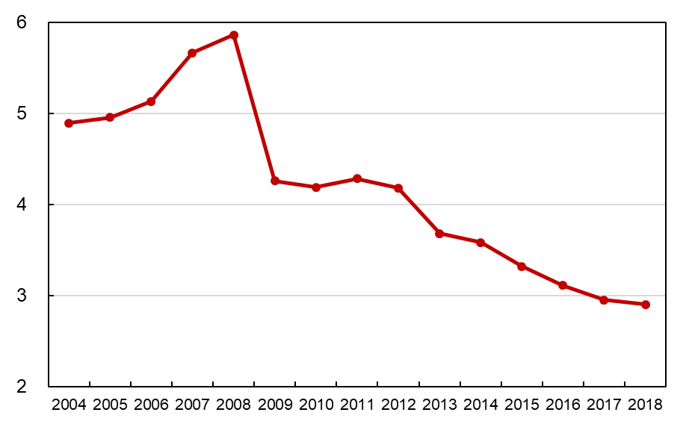
Average Timeliness in Transmitting ISR to IB from Date of Receipt of Search Copy
Months
Average timeliness in transmitting ISRs to the IB was 2.90 months in 2018
85.0% of PCT applications transmitted to IB within 3 months from date of receipt of search copy in 2018 -
expected to rise to about 86.6% in 2019
Source: WIPO statistics database. March 2019 and January 2020.

Slide 12
Timeliness in Transmitting ISRs to the IB measured from Date of Receipt of Search Copy by ISA for 2018
Provisional share transmitted within 3 months for 2019
99.5
99.5
98.6
98.7
100
93.6
76.9
91.0
77.9
85.5
85.2
77.6
99.7
99.0
99.4
96.4
95.3
96.8
37.0
86.6
83.4
78.6
74.4
Source: WIPO statistics database. March 2019 and January 2020. Excludes cases where Rule 42 time limit of 9 months from priority date applies.

Slide 13
Timeliness in Transmitting ISRs to the IB measured from Priority Date by ISA for 2018
Provisional share transmitted within 9 months for 2019
100
99.5
99.5
99.2
95.9
97.7
86.0
80.9
68.6
70.9
75.0
6.2
100
99.0
99.1
96.4
96.9
92.2
76.2
74.8
77.7
86.1
62.7
Source: WIPO statistics database. March 2019 and January 2020. Excludes cases where Rule 42 time limit of 3 months from date of receipt of search copy applies.

Slide 14
PCT A1 Publication Percentage by ISA in 2019
Percentage of A1 Publications = 97.2% (97.2% in 2018)
Source: WIPO statistics database. January 2020

Slide 15
Supplementary International Search Requests
 | 2014 | 2015 | 2016 | 2017 | 2018 | 2019
Austria | 2 | 2 |  | 1 | 1 | 2
European Patent Office | 61 | 40 | 44 | 40 | 54 | 94
Nordic Patent Institute |  |  |  |  |  | 2
Russian Federation | 46 | 22 | 3 | 6 |  | 3
Singapore |  |  | 1 |  | 3 | 4
Sweden |  |  |  |  | 3 | 1
Turkey |  |  |  |  | 1 | 2
Ukraine |  |  |  | 2 | 1 | 4
Visegrad Patent Institute |  |  |  |  |  | 2
Total | 109 | 64 | 48 | 49 | 63 | 114
Source: WIPO statistics database. January 2020

Slide 16
International Preliminary Examination Reports by IPEA
 | 2015 | 2016 | 2017 | 2018 | 2019 | 2019(%) | 2018(%)
Australia | 617 | 599 | 545 | 590 | 531 | 4.86 | 4.63
Austria | 6 | 5 | 9 | 3 | 7 | 0.06 | 0.02
Brazil | 43 | 47 | 50 | 66 | 61 | 0.56 | 0.52
Canada | 290 | 231 | 213 | 172 | 169 | 1.55 | 1.35
Chile |  | 5 | 8 | 16 | 11 | 0.10 | 0.13
China | 419 | 382 | 316 | 397 | 473 | 4.33 | 3.11
Egypt | 4 |  | 1 | 2 | 3 | 0.03 | 0.02
European Patent Office | 9053 | 9072 | 8360 | 7700 | 6065 | 55.50 | 60.36
Finland | 104 | 60 | 76 | 66 | 55 | 0.50 | 0.52
India | 6 | 25 | 28 | 41 | 88 | 0.81 | 0.32
Israel | 79 | 81 | 98 | 68 | 88 | 0.81 | 0.53
Japan | 2478 | 2019 | 1945 | 2129 | 1944 | 17.79 | 16.69
Nordic Patent Institute | 45 | 31 | 32 | 36 | 28 | 0.26 | 0.28
Republic of Korea | 239 | 209 | 162 | 135 | 129 | 1.18 | 1.06
Russian Federation | 68 | 71 | 51 | 50 | 57 | 0.52 | 0.39
Singapore |  | 26 | 106 | 111 | 93 | 0.85 | 0.87
Spain | 66 | 60 | 47 | 40 | 37 | 0.34 | 0.31
Sweden | 295 | 206 | 134 | 127 | 88 | 0.81 | 1.00
Turkey |  |  |  | 4 | 18 | 0.16 | 0.03
Ukraine |  |  | 4 | 7 | 7 | 0.06 | 0.05
United States of America | 1814 | 1227 | 1059 | 990 | 971 | 8.89 | 7.76
Visegrad Patent Institute |  |  | 3 | 6 | 5
Total | 15626 | 14356 | 13247 | 12756 | 10928
IPRP (Chapter II) reports issued fell by 14.3%
between 2018 and 2019, and by 30% since 2015
Source: WIPO statistics database. January 2020

Slide 17
Average Timeliness in transmitting IPRPs (Chapter II)
Average time in transmitting IPRPs rose to 27.4 months from priority date in 2018
86.3% of all IPRPs were transmitted to the IB within 28 months of the priority date in 2018 (expected to rise to 86.6% for 2019)
Source: WIPO statistics database. March 2019 and January 2020

Slide 18
Timeliness in transmitting IPRPs by IPEA in 2018
Provisional share transmitted within 28 months for 2019
100
97.8
94.1
90.5
90.9
85.7
86.0
79.8
87.7
57.1
49.9
48.9
100
86.5
88.5
96.6
86.6
89.0
44.4
73.6
89.3
71.6
41.1
Timeliness calculated as time elapsed between priority date and date on which
International Bureau received IPRP from IPEA
Source: WIPO statistics database. March 2019 and January 2020

Slide 19
Further information:
2019 PCT Yearly Review
The International Patent System
WIPO Publication No. 901E/2019
2019 World Intellectual Property Indicators
WIPO Publication No. 941E/2019
WIPO IP Statistics Data Center
http://www.wipo.int/ipstats/en/

