Slide 1
PCT Statistics Meeting of International Authorities 31st Session
Beijing October 16, 2024

Slide 2
Outline
International Filings
Data for 2023
Medium of Filing
National Phase Entries
International Authorities
International Search
Supplementary International Search
International Preliminary Examination
PCT-PPH pilot

Slide 3
PCT Filings in 2023
272,600 international applications filed in 2023 (-0.2%)
Top 5 countries: China (69,610 -0.6%), United States of America (55,678, -5.3%), Japan (48,879 -2.9%), Republic of Korea (22,288 +1.2%) and Germany (16,916 -3.2%)
Top applicant: Huawei Technologies (6,494 published PCT applications in 2023, -15%)
Top educational institution filer: University of California (531 published PCT applications in 2022, -3.8%)
More information in PCT Yearly Review 2024
Source: PCT Yearly Review 2024

Slide 4
PCT Filings from 2022, month-to-month
Source: WIPO Statistics Database, October 2024, last data update September 2024

Slide 5
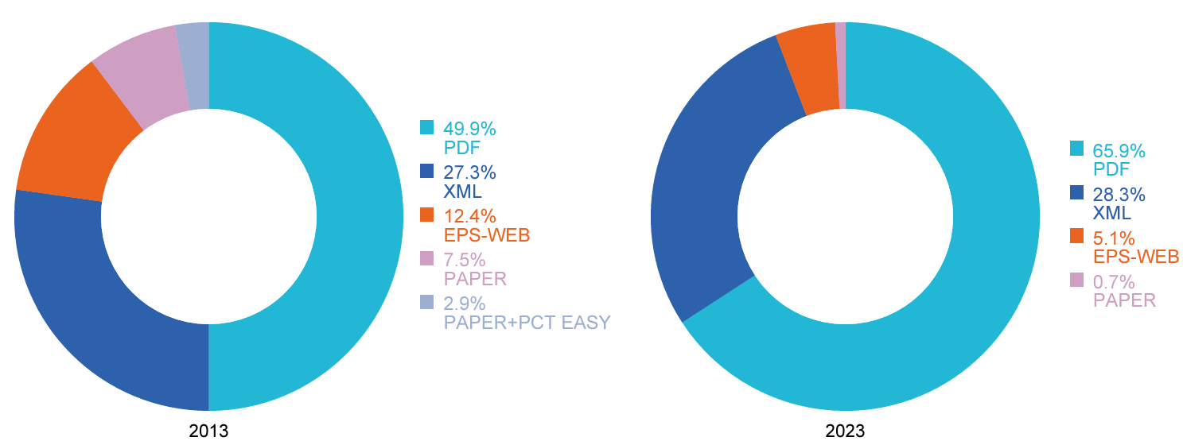
Medium of Filing
10 years
Source: WIPO statistics database. March 2024, PCT Yearly Review 2024

Slide 6
Medium of Filing : ePCT
Nearly 105,000 PCT applications were filed using ePCT in 2023 (+11.6 %). About a third (38.4 %) of all PCT applications filed globally in 2023 were filed using ePCT
Source: WIPO statistics database, March 2024, PCT Yearly Review 2024

Slide 7
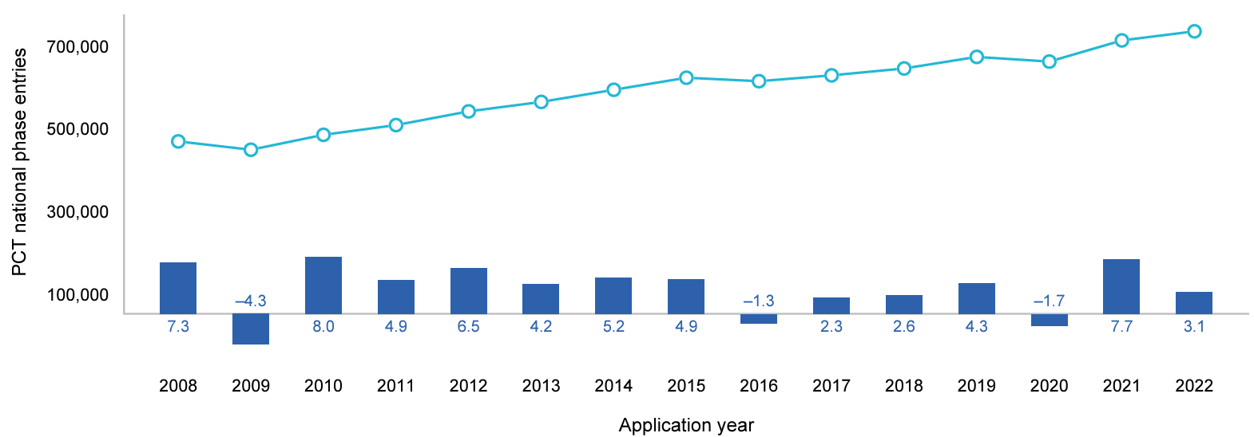
PCT National Phase Entries
737,000 total national phase entries in 2022 (+3.1%) 618,000 non-resident national phase entries in 2022 PCT system accounted for 59 % of all non-resident filings in 2021 and 2022
Source: WIPO statistics database. June 2024

Slide 8
International Authorities
International Search Reports
Distribution by International Authority
Timeliness of Transmission to International Bureau
A1 Publication Percentage
Supplementary International Search Reports
International Preliminary Examination Reports
Number of IPRPs per IPEA
Timeliness of Transmission to International Bureau

Slide 9
Distribution of ISRs established by ISA
84,061
70,241
Data based on international filing year of application
Source: WIPO statistics database. October 2024

Slide 10
Distribution of ISRs established by ISA (excluding IP5 Offices)
2,177
2,169
1,913
1,826
1,251
985
770
Data based on international filing year of application
Source: WIPO statistics database. October 2024

Slide 11
Timeliness in Transmitting ISRs to the IB measured from Date of Receipt of Search Copy by ISA for 2023
In 2023, 86.3% of all ISRs were transmitted within 3 months of date of receipt of search copy (up from 84.6% in 2022)
Source: WIPO statistics database. March 2024. Excludes cases where Rule 42 time limit of 9 months from priority date applies.

Slide 12
Timeliness in Transmitting ISRs to the IB measured from Priority Date by ISA for 2023
In 2023, 96.9% of all ISRs required to be transmitted to the International Bureau within 9 months of the priority date met this deadline (up from 89.6% in 2022)
Source: WIPO statistics database, March 2024. Excludes cases where Rule 42 time limit of 3 months from date of receipt of search copy applies.

Slide 13
PCT A1 Publication Percentage by ISA in 2023
The International Bureau published more than 96.3% of PCT applications together with an ISR (slightly down from 97.6 % in 2022)
Source: WIPO statistics database. March 2024

Slide 14
Supplementary International Search Requests
 | 2016 | 2017 | 2018 | 2019 | 2020 | 2021 | 2022 | 2023 | 2024 (partial)
Austria |  | 1 | 1 | 2 | 2 | 1 |  | 3 | 1
European Patent Office | 44 | 40 | 54 | 94 | 50 | 48 | 48 | 28 | 20
Nordic Patent Institute |  |  |  | 2 | 1 | 1 |  |  | 1
Russian Federation | 3 | 6 |  | 3 | 1 | 3
Singapore | 1 |  | 3 | 4 | 2 |  | 3
Sweden |  |  | 3 | 1 | 1 | 1 | 1 | 1
Turkey |  |  | 1 | 2 | 1
Ukraine |  | 2 | 1 | 4 | 1 |  | 1 |  | 1
Visegrad Patent Institute |  |  |  | 2 | 1
Total | 48 | 49 | 63 | 114 | 60 | 54 | 53 | 32 | 23
Source: WIPO statistics database. Last update : September 2024

Slide 15
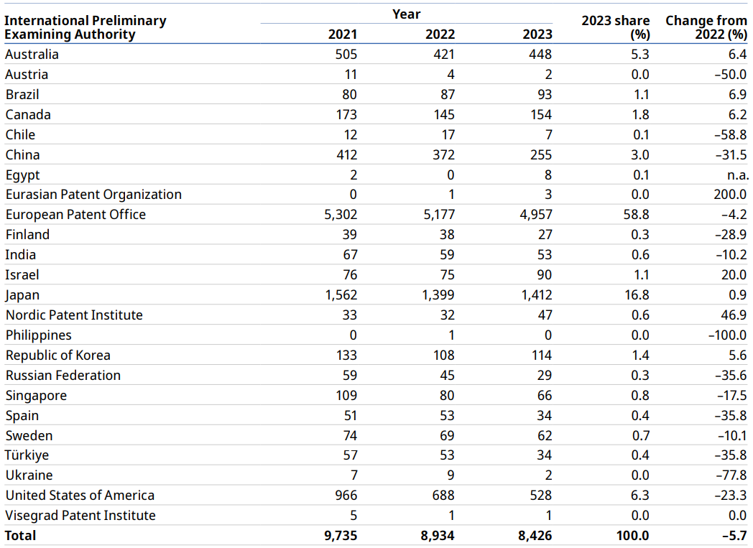
Number of IPRPs issued by IPEA
Steady decline over the last few years (dropped by further 5.7% in 2023)
EPO and Japan issued 75.6% of all Chapter II IPRPs
Source : PCT Yearly Review 2024 (data for 2023 may be incomplete)
Source: WIPO statistics database. October 2023

Slide 16
Timeliness in transmitting IPRPs by IPEA in 2023
In 2023, 89.8% of IPRPs were transmitted to the International Bureau within 28 months of the priority date (91.3% in 2022)
Timeliness calculated as time elapsed between priority date and date on which International Bureau received IPRP from IPEA
Source: WIPO statistics database. March 2024

Slide 17
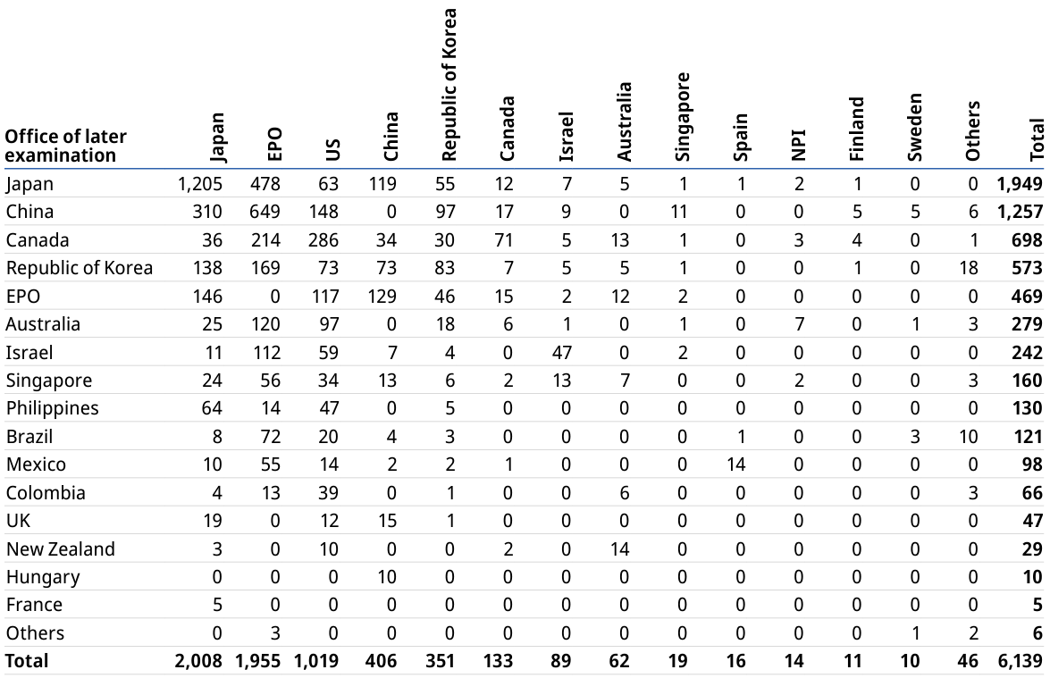
PCT-PPH pilot
Data for several offices of later examination (e.g. Germany, Indonesia, US) not available

Slide 18
Further information:
2024 PCT Yearly Review
The International Patent System
WIPO Publication No. 901EN/2024
WIPO IP Statistics Data Center
http://www.wipo.int/ipstats/en/

