Slide 1

PCT Statistics
PCT Working Group
Ninth Session
Geneva
May 17 to 20, 2016

Slide 2
Outline
PCT Application Filings
PCT National Phase Entries
Receiving Offices
International Authorities

Slide 3
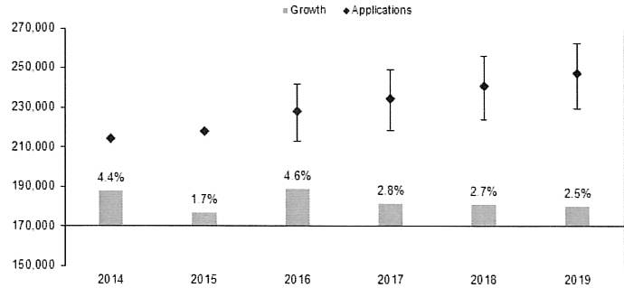
PCT Application Filings
247,100
241,000
234,600
228,100
218,000
214,318
Source: Economics and Statistics Division, WIPO

Slide 4
Filing Trends for Top 5 Origins
Source: WIPO Statistics Database, May 2016

Slide 5
Distribution of PCT Applicants in 2015
Top Applicants
Businesses: Huawei Technologies – 3,898 applications published
Universities: University of California – 361 applications published
Government and Research Institutions: Commissariat à l’Energie Atomique
et aux Energies Alternatives – 409 applications published

Slide 6
Main Fields of Technology in 2015
Main Fields of Technology by Percentage of Total
  Computer Technology 16,385 applications (8.2%)
  Digital Communication 16,047 applications (8.0%)
  Electrical Machinery 14,612 applications (7.3%)
Largest increases:
  Other consumer goods: +9.6%
  Textile and paper machines: +5.0%
  Other special machines: +4.2%
Largest decreases:
  Microstructural and nanotechnology: -13.3%
  Telecommunications:
  -10.8%
  Semiconductors: -10.6%
Source: WIPO Statistics Database, May 2016

Slide 7
PCT Applications by Medium of Filing
Source: WIPO Statistics Database, May 2016
Distribution in 2015: 5.6% paper, 0.8% PCT-EASY, 93.6% fully electronic (PDF 65.4%, XML 28.2%)

Slide 8
Trend in PCT applications in top 5 languages of publication
Source: WIPO Statistics Database, May 2016
English accounts for 51.8% of all applications published, followed by Japanese (18.7%) and Chinese (10.3%)
Top 5 languages of publication account for 95.4% of all PCT applications published.

Slide 9
PCT- National Phase Entries
Source: WIPO Statistics Database, May 2016
595,400 national phase entries estimated for 2014 (+5.2%)

Slide 10
Non-resident applications by filing route
Source: WIPO Statistics Database, May 2016
501,900 non-resident national phase entries (+5.5%), 378,700 non-resident Paris-route filings (-0.3%) in 2014
57% of all non-resident applications filed through PCT

Slide 11
Trends in PCT National Phase Entries for Top 5 Origins
Source: WIPO Statistics Database, May 2016
United States of America (170,928, +8.2%), Japan (123,787, +2.4%) and Germany (60,224, -4.7%) had highest number of NPEs
China (22,473, +24.1%) moved from 8th to 5th
place in number of NPEs from 2013 to 2014

Slide 12
Trends in PCT National Phase Entries for Next 5 Origins
Source: WIPO Statistics Database, May 2016
Switzerland (21,095, -3.7%) and Republic of Korea (21,090, +10.5%) have highest number of NPEs outside the top 5 origins

Slide 13
PCT NPEs for Top 10 Offices in 2014
Source: WIPO Statistics Database, May 2016
USPTO had most NPEs in 2014 (128,946 representing 21.7% of all NPEs)
Highest growth among top 10 Offices: SIPO (+9.3%), Japan (+7.7%) and USPTO (+7.5%)

Slide 14
PCT NPEs for Next 10 Offices in 2014
Source: WIPO Statistics Database, May 2016
Highest growth among next 10 Offices: New Zealand (+15.9%), Germany (+15.0%) and Viet Nam (+14.4%)

Slide 15
PCT Applications by Receiving Office
Source: WIPO Statistics Database, May 2016
The top 15 receiving Offices received 96% of all
PCT applications filed in 2015
Largest increases: China (+14.6%), Republic of Korea (+11.6%) and Israel (+10.1%)
Largest decreases: Sweden (-15.0%), Finland
(-9.0%) and Canada (-8.0%)

Slide 16
PCT applications for selected receiving Offices of middle-income countries in 2015
Source: WIPO Statistics Database, May 2016
Of the receiving Offices in middle-income countries that received the most applications in 2015, sharp rise for Turkey (+29.4%), declines for India (-15.0%) and Brazil (-5.5%)

Slide 17
Receiving Offices: Timeliness of Transmitting PCT Applications to the IB
Source: WIPO Statistics Database, May 2016
Average transmission time between international filing date and date the IB received the application decreased to 2.7 weeks in 2015 (shortest time since 2001)
93.4% of PCT applications transmitted to IB within 4 weeks in 2015 (83.5% in 2014).

Slide 18
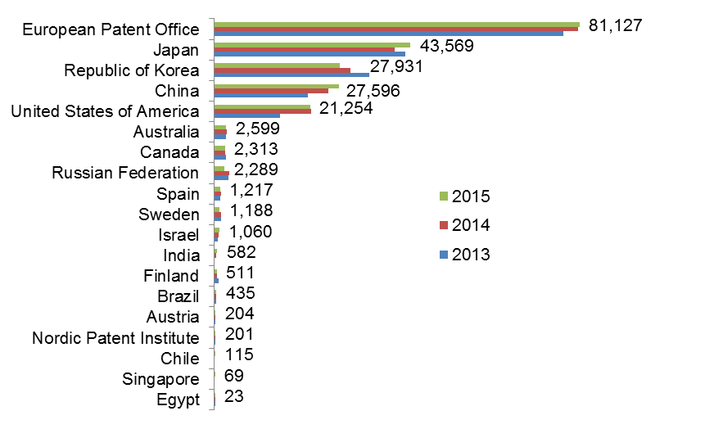
Search Reports established by International Searching Authority
Source: WIPO Statistics Database, April 2016
First full year of operations in 2015 for Chile

Slide 19
Average Timeliness in transmitting ISRs to the IB from Date of Receipt of Search Copy
Source: WIPO Statistics Database, May 2016
Average timeliness in transmitting ISRs to the IB was 3.3 months - shortest time since 2001
76.3% of PCT applications transmitted to IB within 3 months from date of receipt of search copy (67% in 2014)
79.8% of all ISRs issued within 16 months of priority
date (77.7% in 2014)

Slide 20
Distribution of Supplementary International Search Requests
Source: WIPO Statistics Database, May 2016
Supplementary International Search Requests fell by 41% to 64 in 2015 compared to 2014
The EPO and Rospatent accounted for 96.8% of requests for supplementary international search in 2015

Slide 21
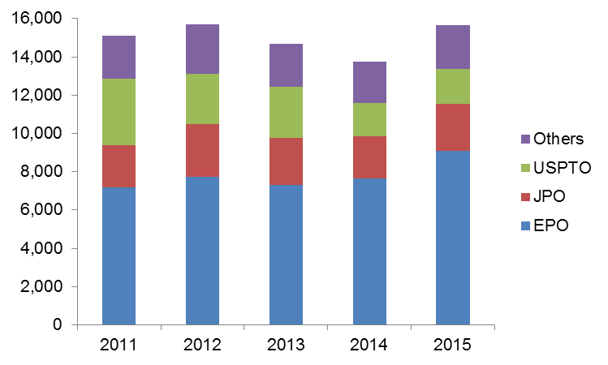
IPRPs (Chapter II) by International Preliminary Examination Authority
Source: WIPO Statistics Database, April 2016
Reports established by IPEA rose by 14.1% in 2015 to 15,662, after falls of 6.5% in both 2013 and 2014
85.4% of IPRPs (Chapter II) were produced by the
EPO, the JPO or the USPTO

Slide 22
Average Timeliness in transmitting IPRPs
Source: WIPO Statistics Database, May 2016
Average time in transmitting IPRPs fell to 27.9 months in 2015, similar to level observed in 2001
80.4% of all IPRPs were transmitted to the IB within 28 months of priority date (73.2% in 2014)

Slide 23
Further information:
2016 PCT Yearly Review
The International Patent System
WIPO Publication No. 901E/2016
WIPO IP Statistics Data Center
http://www.wipo.int/ipstats/en/
Patent Prosecution Highway Portal Site
http://www.jpo.go/jp/ppph-portal/index.htm

