Slide 1
Commercialising Intellectual Property Assets Case Study 5: – Topic 18 -
McLean Sibanda
Training of the Trainers Program on Effective Intellectual Property Asset Management by Small and Medium Sized Enterprises (SMEs)
Organised by the World Intellectual Property Organisation (WIPO) and the African Regional Intellectual Property Organization (ARIPO)
Harare, Zimbabwe, 28th November 2014

Slide 2
Overview
Introduction
Case Studies : Justick
: Jo’M
: Geratech
: Safe Eggs
: Photovoltaic Technology
: Joule
: Curtain hanger
: The Lightie
Concluding Remarks

Slide 3
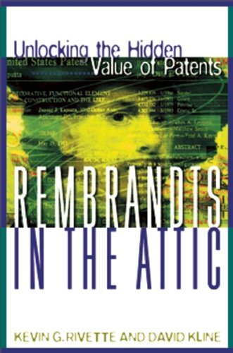
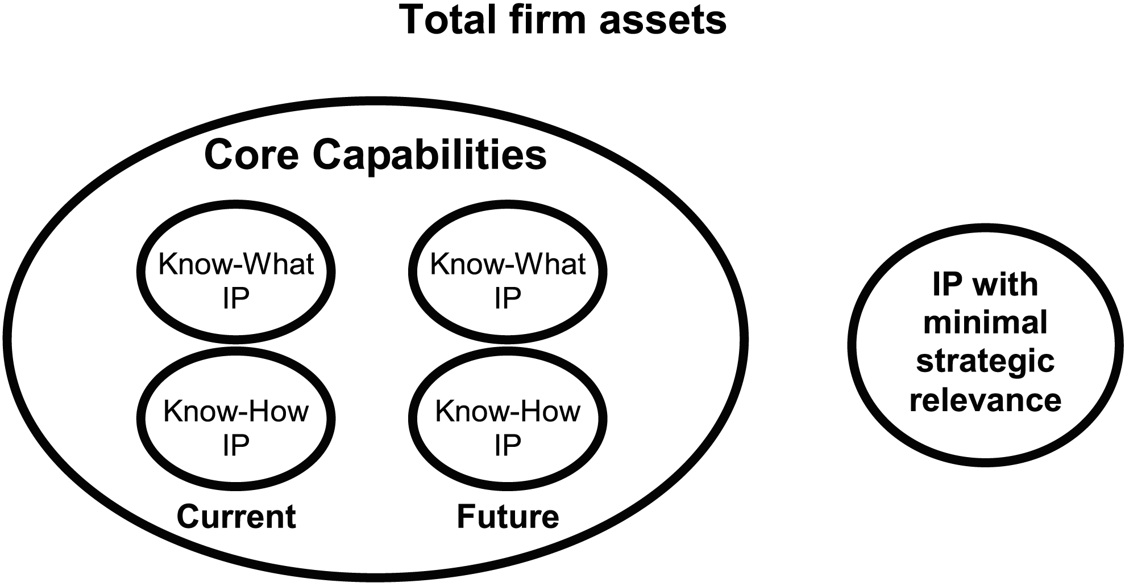
Introduction
Value adding IP identified
Ease of transaction / due diligence
Core / Non-core Assets

Slide 4
Introduction Commercialisation Considerations
Is there a market:
Market size and sophistication
Distribution channels
Competition
Investment required to bring the technology to market?
Technical Assistance and Know-how for effective commercialisation.
Is the technology the basis for a start-up or a spin-out company?
Holistic approach to intellectual property

Slide 5
Introduction
Critical Commercialisation Success Factors
TECHNOLOGY: Critical mass of ‘platform technology’ intellectual property
More likely more than just one form of intellectual property
MANAGEMENT: Highly capable management team with critical skills sets, which include entrepreneurial flair
INVESTMENT: Sufficient financing runway
PRODUCT: Sustainable, differentiated advantage; ideally should be a complete product not just a component
MARKET: A sense of reality of the size of the market and penetration; Understand the dynamics of the market including competition; Global market opportunity and perspective; and access to distribution channels

Slide 6
Introduction Commercialisation Considerations
The Fundamental Question:
What is the most appropriate commercial route for the intellectual property / technology?

Slide 7
Introduction Deciding on Most Appropriate Route
Potential licensing opportunities
Investment required to bring the technology to market?
Can transfer of invention to licensee be achieved solely by reference to a patent? Is there need for additional technical support (Know-how)?
Is the technology the basis for a start-up or a spin-out company?
Equity vs. Royalty
External funding for development and commercialisation
Market size and sophistication
Management of the spin-out / start-up

Slide 8
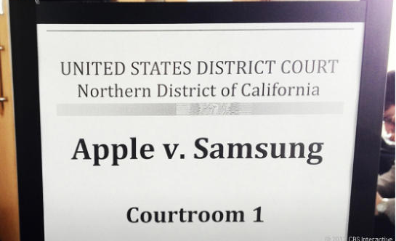
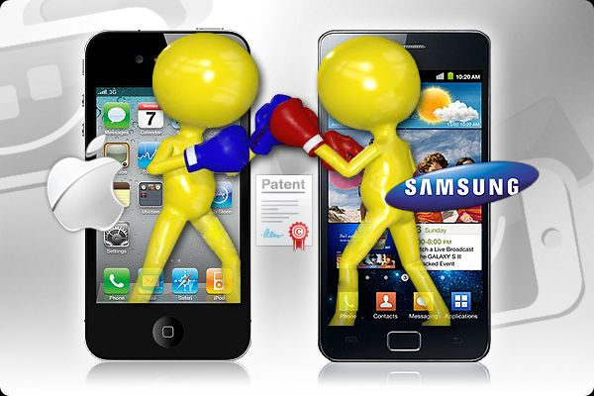
Introduction
Apple vs Samsung August 2012 Verdict
Apple iPad / iPhone
Design
Manufactured by Chinese company - Foxconn
Samsung manufactures:
memory chip and other components for Apple
Its own range - Galaxy
Apple alleges infringement of design patents and patents
Samsung counterclaim Apple infringes 3G patents

Slide 9
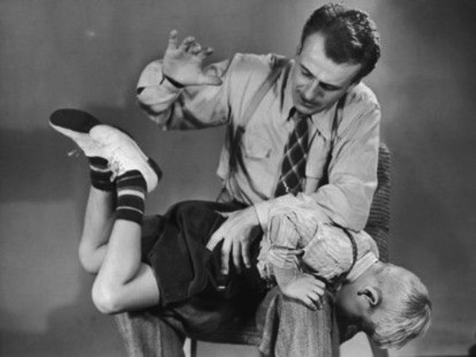
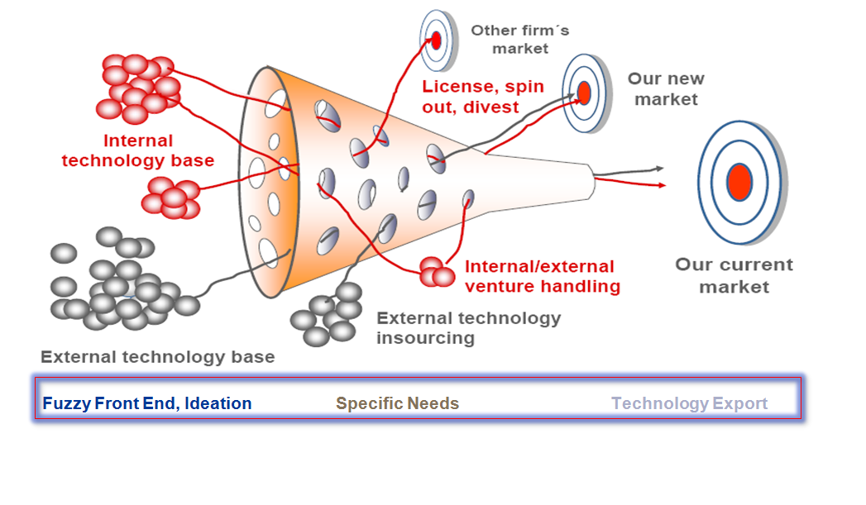
Introduction
Lessons from Apple vs Samsung
Know your business – should you diversity, be ware of risks
Territoriality of intellectual property (UK vs USA decisions)
IP an asset – puts you in the game
IP new currency in the knowledge economy
IP Bundle – right mix of IP rights
You don’t need to own everything

Slide 10
Introduction
Open Innovation and Intellectual Property
To:
From:
R&D

Slide 11
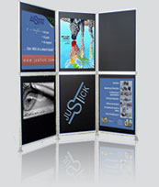
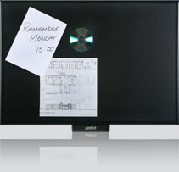
Case Studies Justick
Justick Light noticeboard, Justick Exhibition Board system
Electron-adhesion devices
“South African market was used as a base to pilot production, gauge market perceptions, and establish world-class quality products. Justick products have been extensively tested in the market and the success has led to an international expansion strategy with distributors across the globe.”
http://www.youtube.com/watch?v=zVeE1j5cdPw

Slide 12
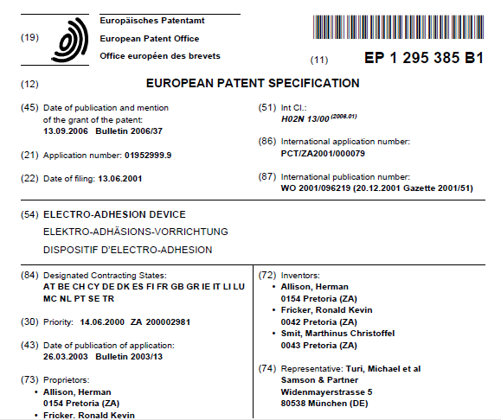
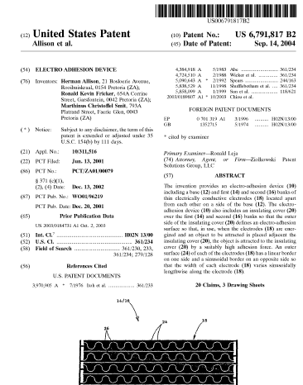
Case Studies Justick
Trademark – Justick
Patents
PCT application
US, EPO patents

Slide 13
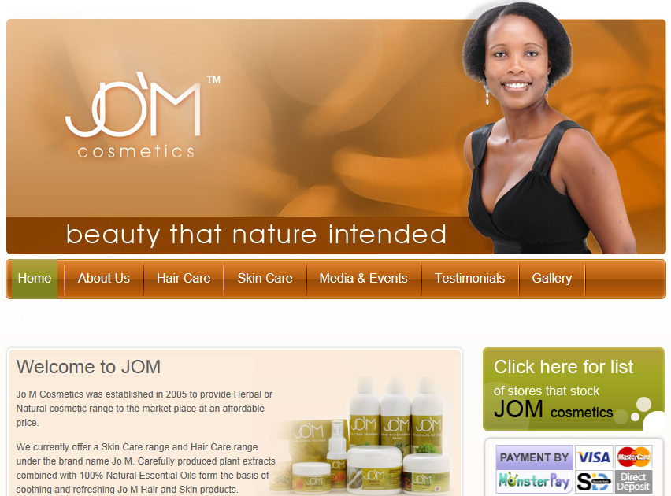
Case Studies Jo’M Cosmetics

Slide 14
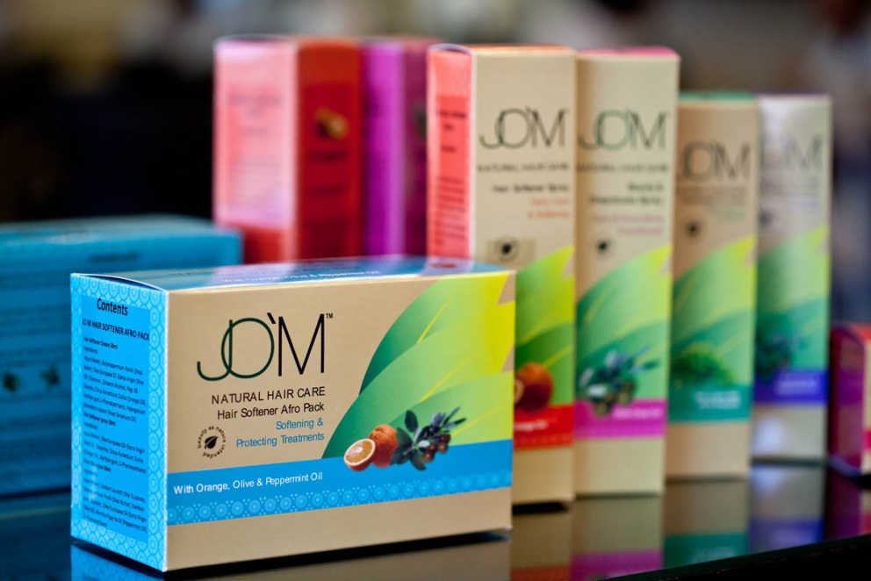
Case Studies Jo’M Cosmetics
Jo M Cosmetics: est. 2005
Herbal or natural cosmetic range
Trade marks
Jo’M
Jo’M Cosmetics
South African patent
Copyright – packaging / insert

Slide 15
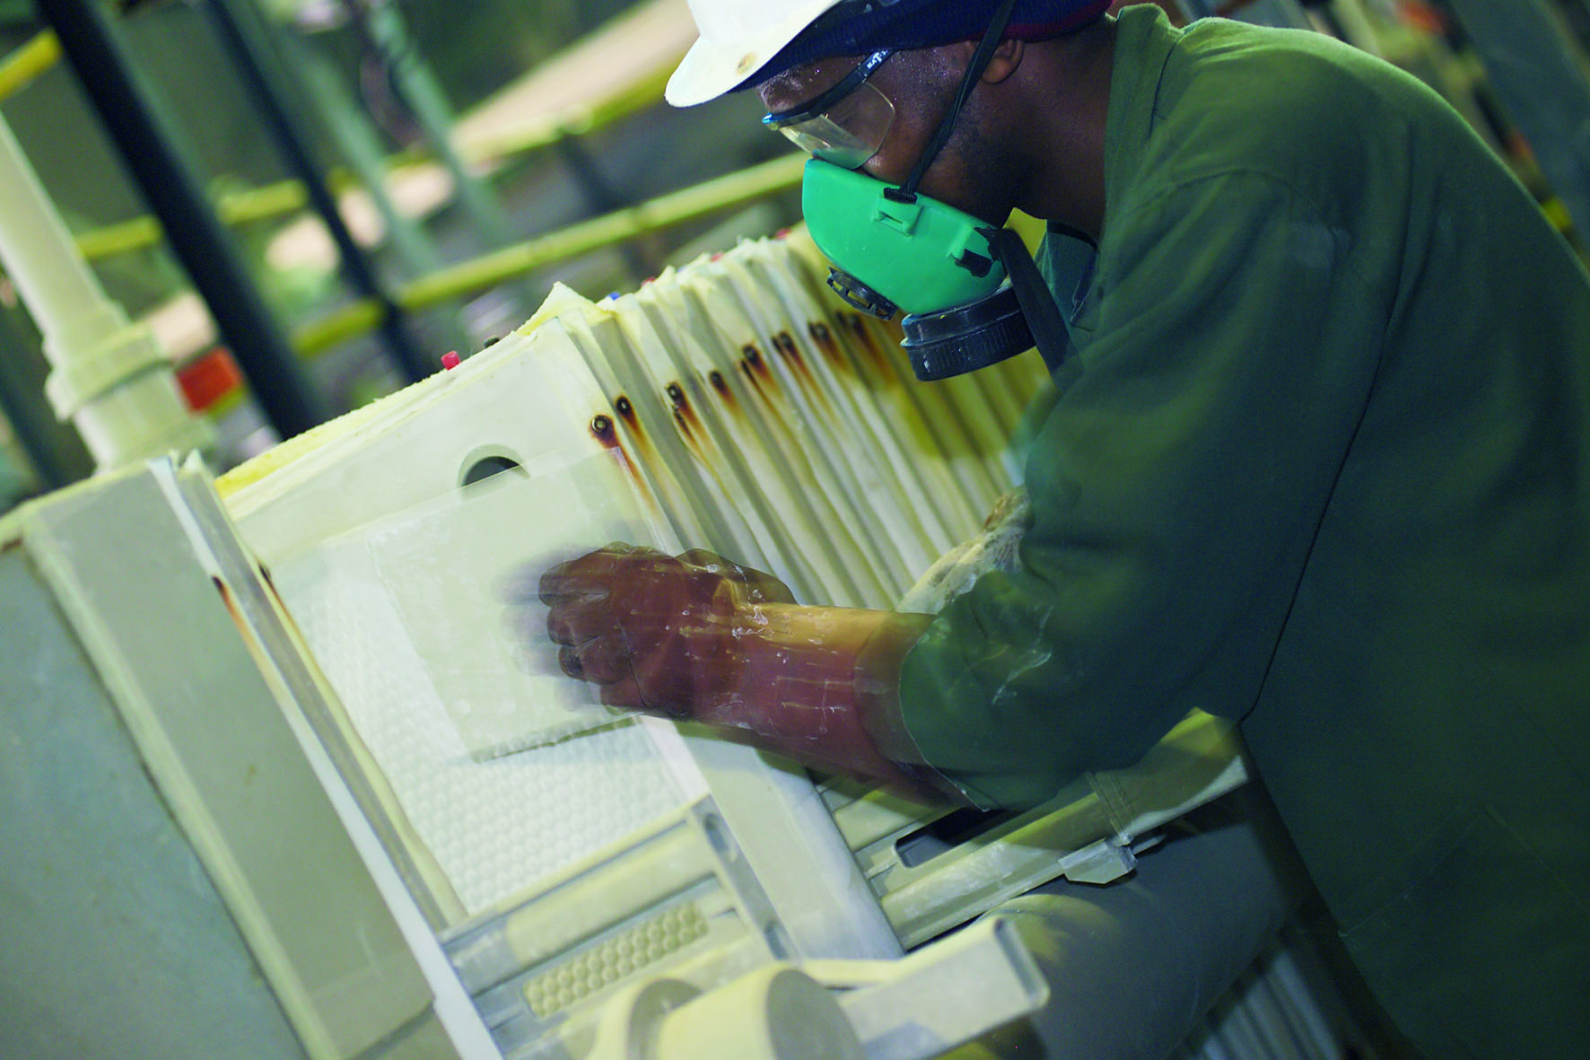
Case Studies Geratech
No patents – trade secrets and know-how
Produce wide range of high quality, cost effective, value added zirconium chemicals and zirconium oxides
Specialized zirconia products from dissociated zircon
Products marketed and sold to a diverse industry in more than 60 countries across the world
Only zircon chemical beneficiation plant in Africa

Slide 16
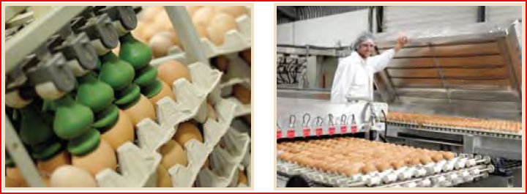
Case Studies Safe Eggs
Patents, know how and trademarks – Consortium licensed to Safe Eggs (Pty) Ltd
Eggs prone to contamination by Salmonella
Pasteurize shell eggs without cooking them - Reduced levels of pathogens
Extended shelf life of > six weeks at ambient temperature

Slide 17
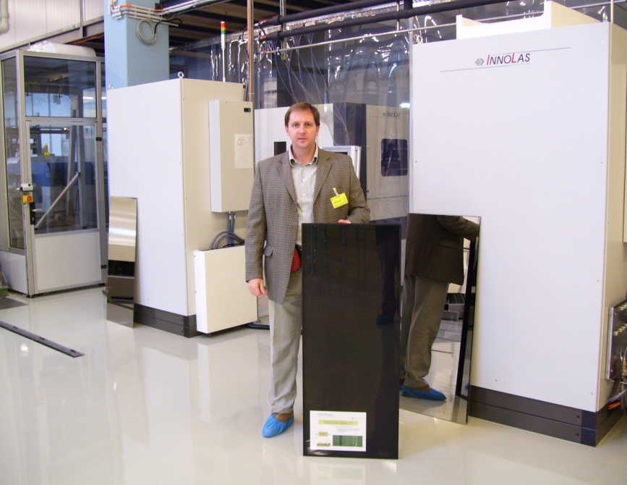
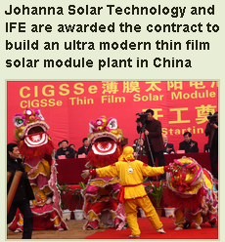
Case Studies PTIP - Photovoltaic Technology
Consortium of University of Johannesburg, University of Pretoria & University of Port Elizabeth
Patent Portfolio licensed to German, Chinese and RSA companies

Slide 18
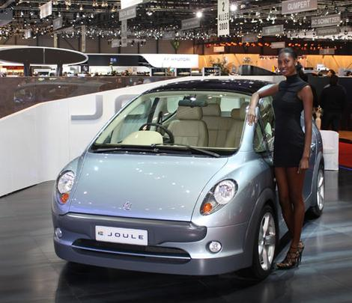
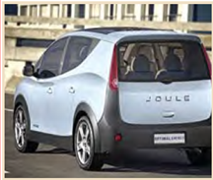
Case Studies Optimal Energy – the Joule
IP – battery management system; design registrations, trademarks
Six-seater urban vehicle
South Africa’s first electric motor vehicle
Advances in lithium ion battery technology
Practicality, performance and design
Optimal Energy
The Joule on display at Geneva Motor Show 2010

Slide 19
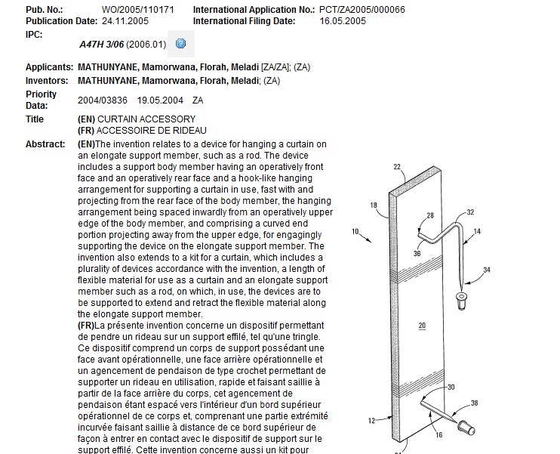
Case Studies Curtain Accessory

Slide 20
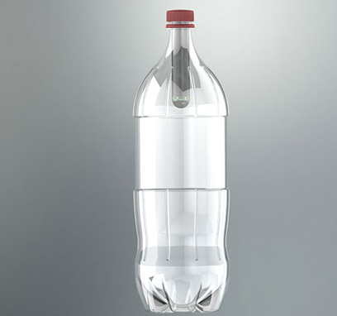
Case Studies The Lightie
South African inventor Michael Suttner developed “The Lightie”
Solar bottle light, offering a low cost, solar powered light
Built into a durable, ruggedized acrylic housing
Uses Lithium battery technology
Offers 40 hours of light when charged from 8 hours of sunlight.

Slide 21
Concluding Remarks
Intellectual property an important element
Other key factors for successful businesses:
team / management
sound business case that clearly identifies need and solution
market size
understanding of competition
competitive advantage

Slide 22
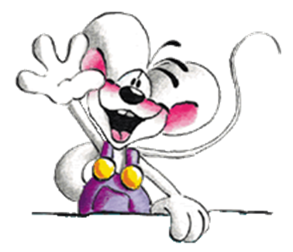
THANK YOU

