Slide 1
The Role and Importance of Effective IP Asset Management in Enhancing the Competitiveness and Productivity of Small and Medium Enterprises (SMEs) – The Zimbabwean Experience
Presentation by Moses Nkomo
IP attorney at Donsa-Nkomo & Mutangi IP Attorneys
IP lecturer at University of Zimbabwe
IP Consultant at IPIQ Business Solutions (Private) Limited
Harare, November 2014

Slide 2
Introduction
Definition of IP- results of intellectual activity in all fields of human endeavour, including literary, artistic, industrial and scientific fields
Examples include scientific discoveries, inventions, industrial designs, trademarks and service marks, commercial names and designations, trade secrets, confidential information etc

Slide 3
Knowledge is power
The leadership of the world in the 21st century will increasingly be in the hands of those who create and harness knowledge.
The 21st century has been called the century of knowledge or the century of the mind
Understanding the role of intellectual property rights in the process of innovation provides a basis for creating and sustaining enterprise competitiveness

Slide 4
The Role of IP Asset Management
In a knowledge-based economy, competitiveness of enterprises, including SMEs, is increasingly based on ability to provide high-value-added products at a competitive price
Globalization and trade liberalization has made it crucial for most enterprises, including SMEs, to become internationally competitive even when operating wholly in the domestic market
Knowledge is becoming the predominant element in differentiating enterprises from their competitors

Slide 5
Role of IP Asset Management (II)
To become and remain competitive, SMEs need a coherent business strategy to constantly improve their efficiency, reduce production costs and enhance the reputation of their products by:
Investing in research and development
Acquiring new technology
Improving management practices
Developing creative and appealing designs
Effectively marketing their products

Slide 6
Role of IP Asset Management (III)
For this, SMEs must make significant investments of time and resources
Without intellectual property protection there is a strong risk that investments in R&D, product differentiation and marketing may be stolen/copied
Intellectual property rights enable SMEs to have exclusivity over the exploitation of their innovative new or original products, their creative designs and their brands. The exclusivity creates an appropriate incentive for investing in improving their competitiveness

Slide 7
Importance of IP Asset Management I
IP adds value at every stage of the value chain from creative/innovative idea to putting a new, better, and cheaper, product/service on the market:
IP Strategy should be an integral part of the overall business strategy of an Enterprise
The IP strategy of an Enterprise is influenced by its creative/innovative capacity, financial resources, field of technology, competitive environment, etc.
Ignoring the IP system altogether is in itself an IP strategy, which may eventually prove very costly or even fatal

Slide 8
Importance of IP Asset Management II
IP protection prevents competitors from free-riding on the success and goodwill of the enterprise
Effective utilisation of IP assets can ensure quality in respect of products and services and can create and retain customers.
Effective IP asset management can result in increased revenue, increased operational efficiency, improvement of existing IP assets, opportunities for enterprise development , and higher quality workforce

Slide 9
Importance of IP Asset Management III
Effective IP asset Management helps increase efficiency in generation of inventive activity through:-
Encouraging the creative initiative of employees
Investment in research and development
Deliberate policies for the generation, protection, commercialisation, management and enforcement of IP assets

Slide 10
Mechanisms to unlock the value of IP
Own Use
Licensing (in, out, cross)
Franchising
Merchandising (Mickey Mouse, Hello Kitty)

Slide 11
Protection of IP
Value adding
Confidentiality or Nondisclosure
Agreements (Trade Secrets)
Ideas
Research
Collaborative Research
Agreement
Technologies
Patents
Products
Technology Licensing
Agreement

Slide 12
Types of IP Rights
Trademarks (Brands)
Geographical Indications
Industrial Designs
Patents and Utility Models
Copyright and Related Rights
Trade Secrets
New Varieties of Plants
Unfair Competition

Slide 13
Branding

Slide 14
Value of a brand value is affected by...
New inventions
Adaptability to change (Management, Employees – intellectual capital)
Changes in consumer tastes – consistently satisfying customer tastes ensures brand success
Situation and trends in the economy –in Zim this has been negative since 2000
Industry trends and brands trends
Impact of technological developments

Slide 15
Some Zimbabwean cases
Securico, Volsec fight turns nasty
DAGGERS have been drawn between indigenous private security firms, Securico and Volsec, with the companies accusing each other of plagiarising company information amid fierce competition in the security services sector, NewsDay has learnt.
The rivalry between the two firms intensified after it was established early this year that Volsec Security Services, had fraudulently acquired its ISO certification status last year using stolen documents from Securico Services (Private) Ltd.
Notes:
Reported in the Newsday of 23 May 2014

Slide 16
Employees and IP assets
Company “G” has a very experienced production manager “H”, has risen through the ranks during the 25 years that he has worked for the company, he knows vital production information in respect of the company’s flagship product. The company is struggling due to the economic hardships facing the nation; “H” is offered an irresistible package by company “Z”, provided he can launch a product that competes with Company “G”’s product. He accepts the offer and he takes with him the formulation of G’s leading product and launches a competing product, essentially pushing company “G” to the verge

Slide 17
Employees and IP
Employee “J” is the customer relations manager at company “K”, he has in his custody customer lists, customer needs assessment reports, customer contacts etc which company “K” has developed over the 50 years it has operated in Zimbabwe. He is disillusioned with the leadership of the company and he resigns and immediately set up a competing enterprise a few blocks away from company “K”

Slide 18
Dynamos Football Club
The club lost their right to use the name and device after failing to settle their debt.
The creditor attached their trademark and they ran around and raised the funds to liquidate the debt
Notes:
Reported in The Herald of 4 April 2013

Slide 19
Counterfeiting
Company X manufactures electrical components and has been in the business for 30 years and had established a significant market share and has registered trademarks, designs and utility models both locally and regionally.
Wholesaler Y, who has been a customer of X for a number of years, buys a batch and sends to China for reproduction and imports into Zimbabwe.
X is suing Y for IP rights infringement to defend his market share

Slide 20
Counterfeiting 2
Artist “A” makes metal sculptures at his home-industries workshop in Harare, Tourist “B” buys a handful of the art during one visit, sells them in his home country and realises that there is s huge demand for this type of art, he sets up a workshop in Harare, employs 50 people, give them “samples” purchased from “A”, provides them with raw materials and instructs them to copy the works of art. Meanwhile, he registers the artistic designs in the European Union such that Artist “A” can no longer sell his art in Europe

Slide 21
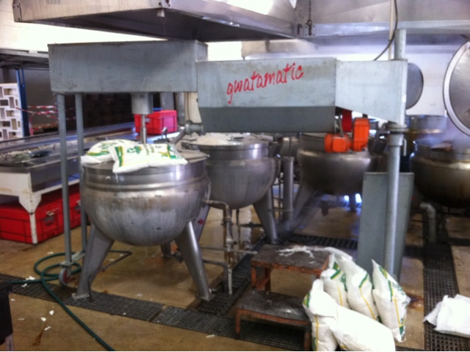
Success story - Gwatamatic
The inventor obtained IP rights for this and other subsidiary inventions growing but none of them is likely to grow as big as the Gwatamatic. They include the Kotomatic (an avocado harvesting implement), Steamatic(a steamer adapter), Kangamatic(a peanut roasting "tumble drier"), Gochamatic (a roasting apparatus for maize-on-the -cob and other foods with axial symmetry) and the Tsotsomatic (a camping stove). The Tsotsomatic only made its debut in formal retail channels on 1 December this year, three years after its invention.

Slide 22
The flying dream that never flew
Daniel Chingoma made a helicopter using scrap metal and a motor vehicle engine, he flew it but the authorities brought him crashing down. Instead of encouraging and supporting his creative genius, he was banned and his helicopter, which at one time was showcased at the Harare Agricultural Show, was condemned to oblivion. His engineering company never realised its full potential because it had no strategy for the protection of its IP assets. He remains poor to this day

Slide 23
Some observations
Most SMEs do not have a deliberate strategy for the creation, protection, commercialisation, management and enforcement of IP rights.
The general feeling (possibly justified), is that IP protection and enforcement is expensive.
IP is usually treated as a non-core aspect of the business.
The policy environment in which SMEs operate does not promote Intellectual Property as a tool for sustainable competitive advantage

Slide 24
Conclusion
IP assets are very important business assets which need to be harnessed, deployed and managed effectively to attain and sustain competitive advantage.
SMEs in developing countries need to embrace and leverage on creativity and innovation in order to gain and grow their market share.
The development of skills and competence to manage intellectual property assets and to leverage on their influence has become mandatory for sustainable competitiveness.

Slide 25
Thank you
Email: mnkomo@ipiqbusiness.co.zw/ nkomo@dnmattorneys.com
Twitter: @Ipiqbusiness/ @dnmlaw2011

