Slide 1
Why cooperatives for indigenous women?
An ILO Perspective
Simel Esim and Andrea Davila - ILOCOOP

Slide 2
Benefits of collective action

Slide 3
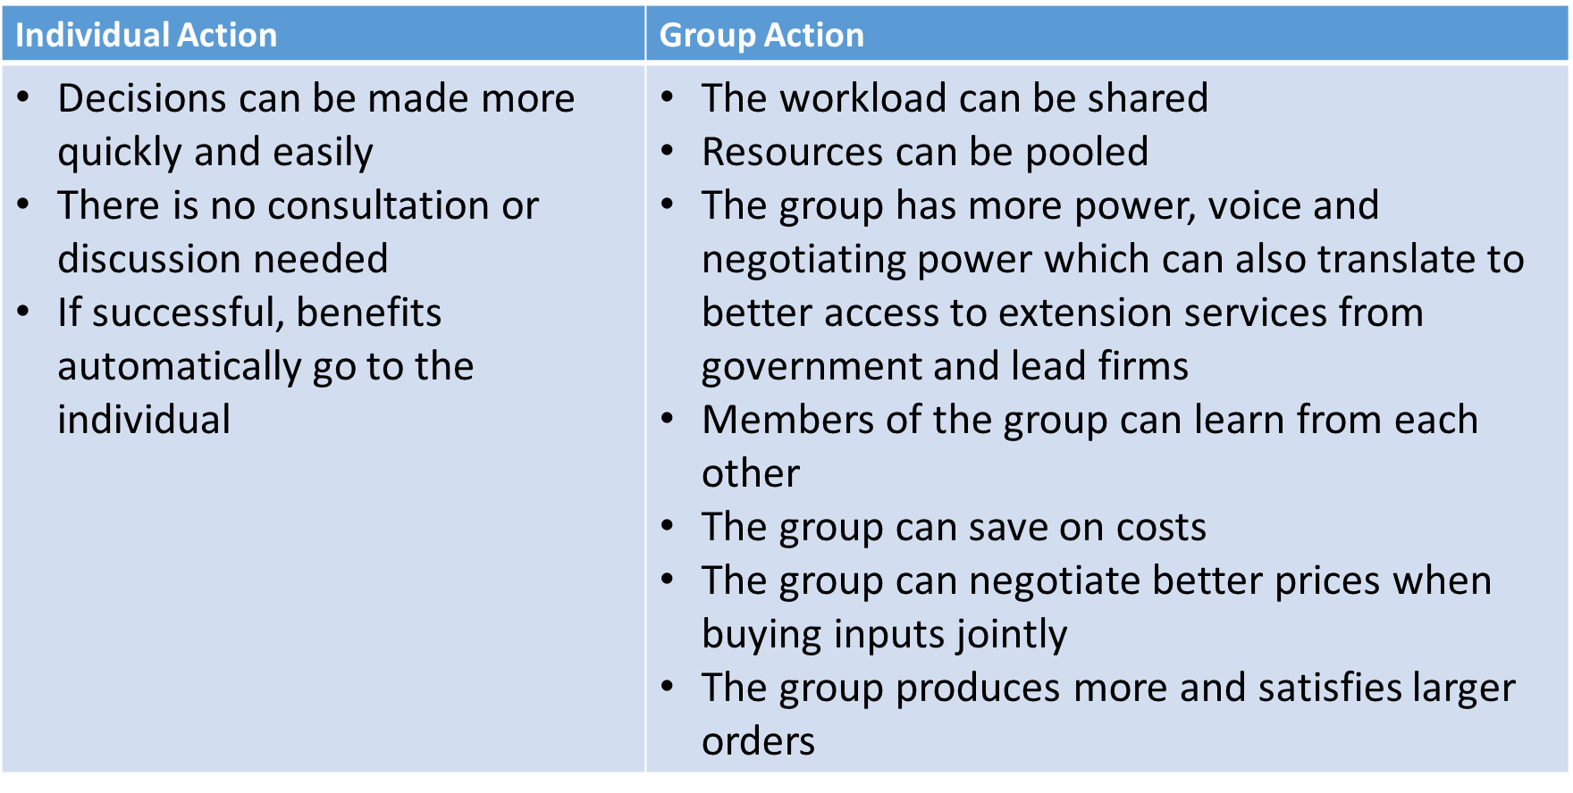
Benefits of collective action

Slide 4
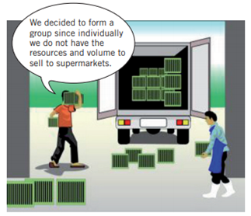
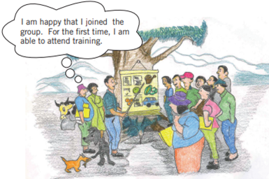
Benefits of collective action
Joint purchase & use of equipment
Joint purchase of inputs to get a discount
Access to a range of services (e.g. finance, care, housing)
Increased bargaining/selling power
Access to training opportunities

Slide 5
What is a cooperative?
A cooperative is defined as “an autonomous association of persons united voluntarily to meet their common economic, social and cultural needs and aspirations through a jointly owned and democratically controlled enterprise”
- ILO Promotion of Cooperatives Recommendation, 2002 (No. 193)
- International Cooperative Alliance (ICA) Statement on the Cooperative Identity

Slide 6
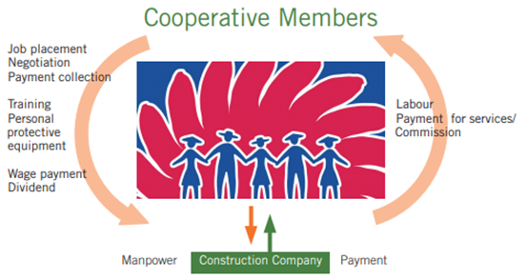
What is a cooperative?
Cooperatives are:
Businesses
To serve members
Democratically controlled by members
Cooperatives members:
Provide resources
Use & pay for its services
Participate in decision-making

Slide 7
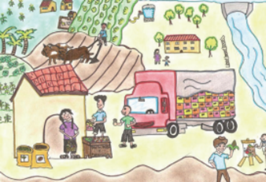
Cooperative values & principles
Voluntary and Open Membership
Democratic Member Control
Members’ Economic Participation
Autonomy and Independence
Education, Training, and Information
Cooperation among Cooperatives
Concern for Community
Values: Self-help, self-responsibility, democracy, equality, equity and solidarity

Slide 8
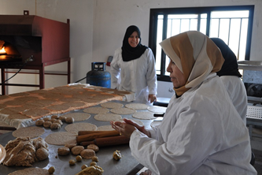
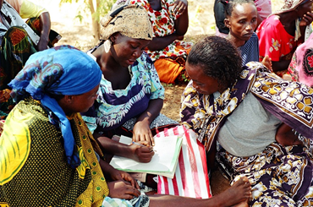
How cooperatives fare on women empowerment?
Creating employment and improving incomes
Providing affordable and accessible services (e.g. finance, care, housing)
Generating resource pools and collective bargaining power
Promoting education and training
Exercising economic democracy (decision making, ownership, use)

Slide 9
Plenary discussion
What kind of cooperatives exist in your country?
Who are the members?
What kind of services do they provide?

Slide 10
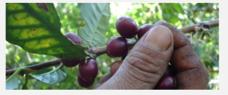
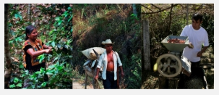
Examples of indigenous peoples cooperatives
Union of Indigenous Communities of the Isthmus Region (UCIRI)
Established in 1982
Members: coffee producers from 53 communities in Oaxaca (reaching 5000 families);
Sells at national and international level through Fair Trade;
Infrastructure and services to members: warehouses, transport, food supply systems and
health services;
Cooperative Solidarity Fund (purchase of goods and equipment and provision of credit);
Training to members and workers on organic production methods.

Slide 11
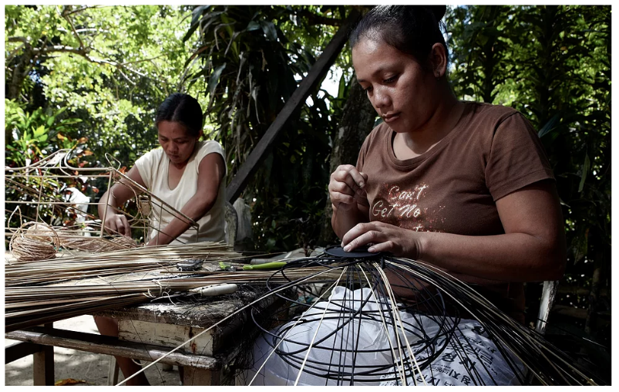
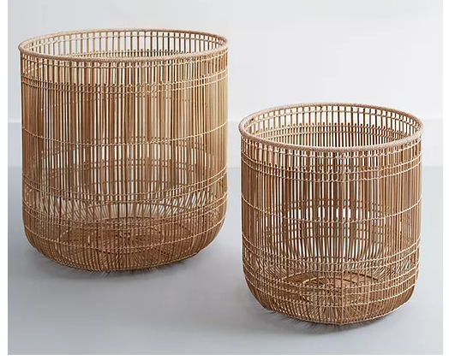
Examples of indigenous peoples cooperatives
Negros Islands Handicrafts
Established 25 years ago;
Members: Women weavers from Negros Island (reaching 500 families);
Products: baskets, mats, trays, coasters made of abaca, bamboo, buri and coconut (protection of environment as a priority);
Commercialized through Fair Trade;
Benefits for members and community: all members are paid a fair return for their products; their children can be sent to school and receive better nutrition;

Slide 12
Examples of indigenous peoples cooperatives
Toudarté Cooperative - Morocco
https://aroundtheworld.coop/portfolio/cooperative-story-2-toudarte/

Slide 13
When choosing a business structure consider:
Motivation for setting up the business
Ownership
Participation and control
Profit sharing
Resources
Liability

Slide 14
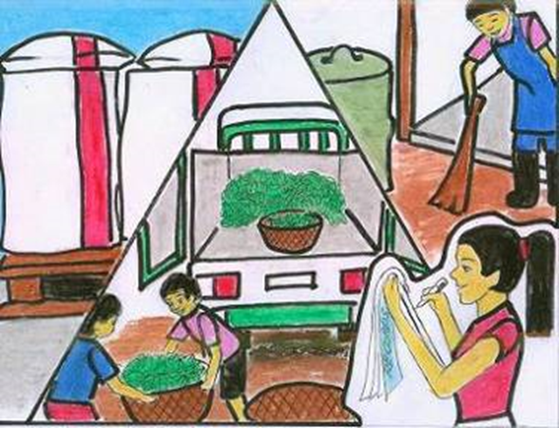
Learning tools
Our.Coop Package
Series of tools orienting the cooperative business model: conceive the idea of organizing, establishing and managing a cooperative
Training package includes training and facilitator’s guides of:
Think.Coop
Start.Coop
Manage.Coop
Uses activity learning methodology
Potential for quick and easy adaptation to different contexts

Slide 15
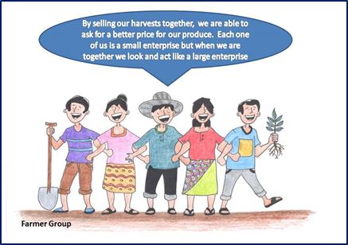
Think.Coop
One-day sensitization module on the importance of relationships, benefits of collective action, and cooperative business model
At the end of the training the participants should be able to have a better understanding on whether cooperative might be a suitable business model

Slide 16
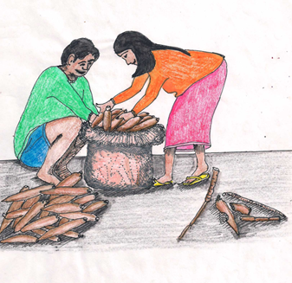
Start.Coop
Outlines the steps to be taken in order to start-up a cooperative
Four modules:
Identify the core members and the business idea
Research the feasibility of the business idea
Prepare a business plan
Organizational set-up
After the training, participants should be able to identify the steps required for setting-up a cooperative

Slide 17
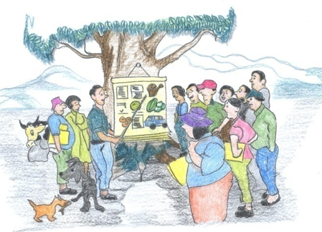
Manage.Coop (under development)
Focuses on the management of a cooperative
Six modules:
Governance and leadership
Effective and open communication
Conflict management
Business and market growth strategies
Human resources management
Financial management

Slide 18
Thank you!
Visit us: ilo.org/coop
E-mail: coop@ilo.org

